Slide 1
NLP Summarization using Genetic Algorithms
Daniel Zheng
Eduardo Pineda

Slide 2
Introduction
What is NLP (Natural Language Processing) summarization? (Relevant information extraction)
Abstraction vs. Extraction
Abstractive summarization - Information that is deemed most important is decided by a system.
Extractive summarization - Information is pre-processed and tagged (usually in whole sentences) without being modified.
Why is summarization important?
Leaving out irrelevant details
Understanding the big idea
Leave out supporting structures (pronouns, prepositions, etc)
Current research having to do with NLP summarization
Probabilistic Approach
Assign a string ‘s’ a probability, if ungrammatical P(s) should be low.
If pair of strings s and t are the same, then P(t | s) would be low to not account for repetition.
Decoder. When we observe a long string t, we search for the short string s that maximizes P(s | t). This is equivalent to searching for the s that maximizes P(s) · P(t | s).

Slide 3
Our Approach
We didn’t take the probabilistic approach, here is the approach we took:
Word frequency in given text (Monty Python and the Holy Grail, Pride and Prejudice)
Word pair frequency - The number of times two pairs of words existed.
‘The dog ate the ant, and the ant ate the worm.’
Word | Frequency
The | 4
Dog | 1
Ate | 2
Ant | 2
And | 1
Worm | 1
Word Pair | Frequency
The dog | 1
Dog ate | 1
Ate the | 3
The ant | 2
And the | 2
The worm | 1

Slide 4
Methodology
Worked with genetic algorithms implemented using DEAP
GA variables we decided to use for this presentation:
Num Generations: 150
Population Size: 200
Crossover Probability: 0.3
Uniform Crossover
Mutation Probability: 0.4
Uniform Mutation
Tournament Size: 3
Number of Sentences Generated: 10
Size of individuals (sentences): 16 words
Test Files Used: Chapter 5, 6, and 7 of Pride and Prejudice, and Monty Python and the Holy Grail script.
Fitness function based on the approach we took.
Word Frequencies and Word Pair Frequencies.
In this version of the results, I awarded negative fitness points for too much repetition.

Slide 5
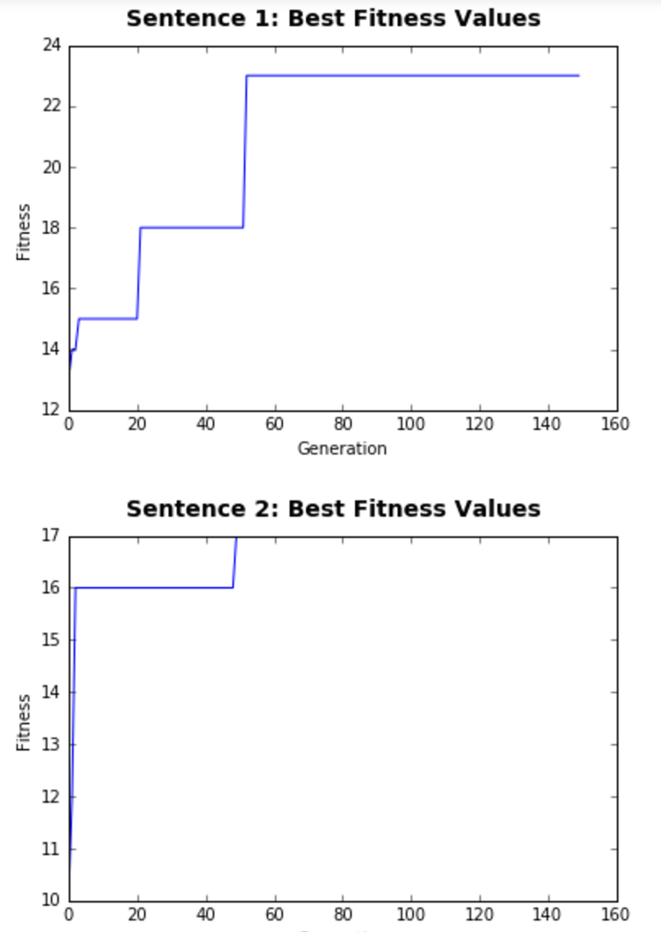
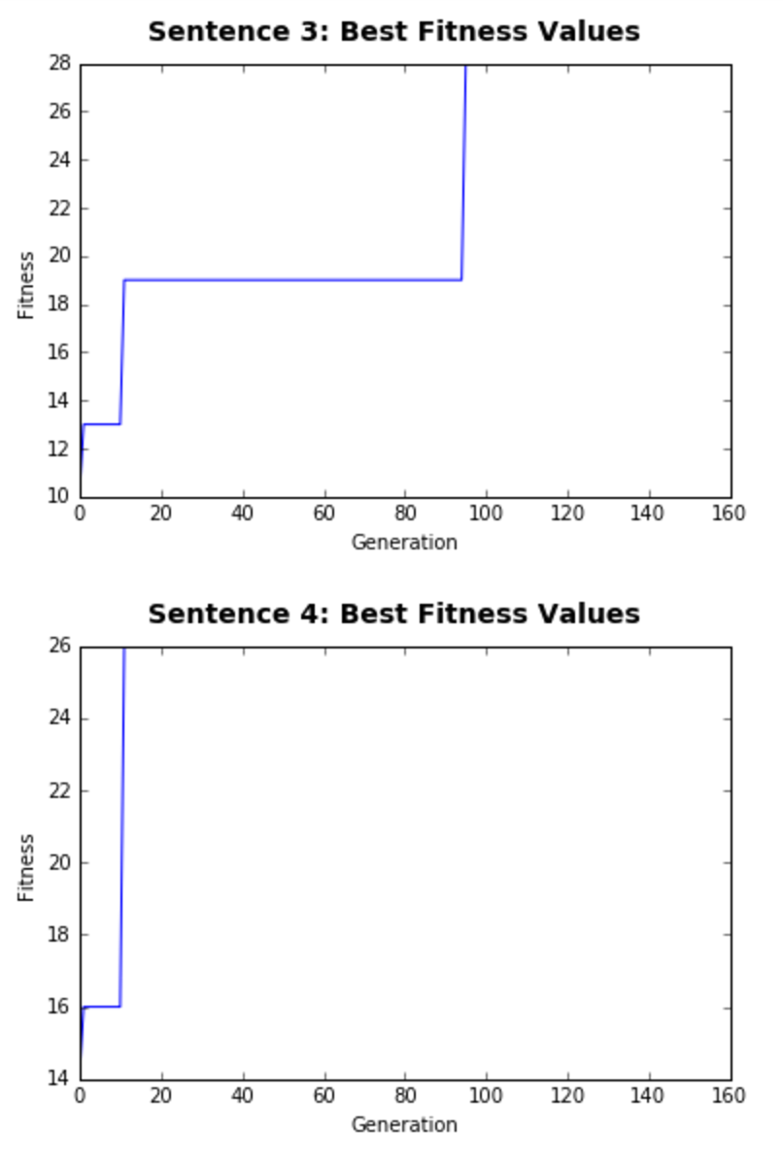
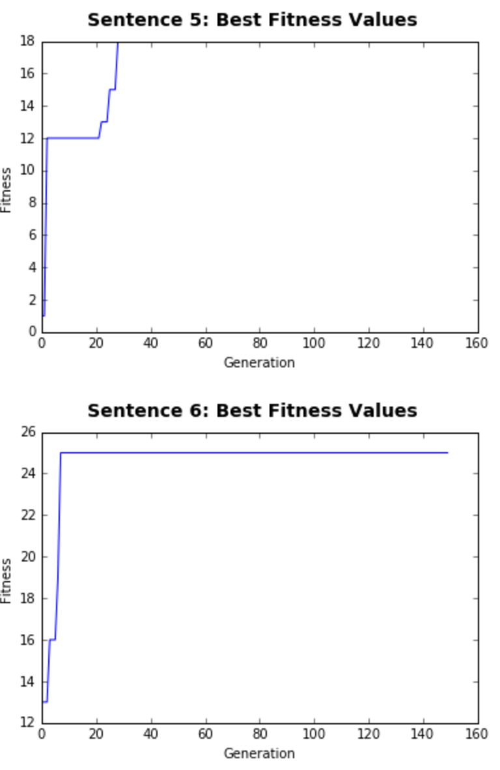
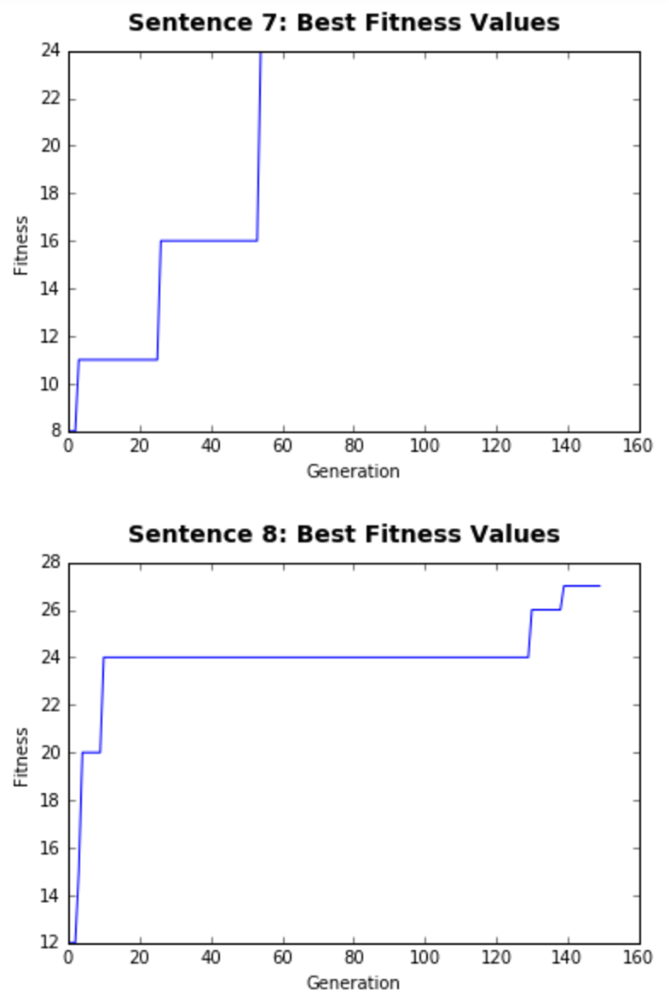
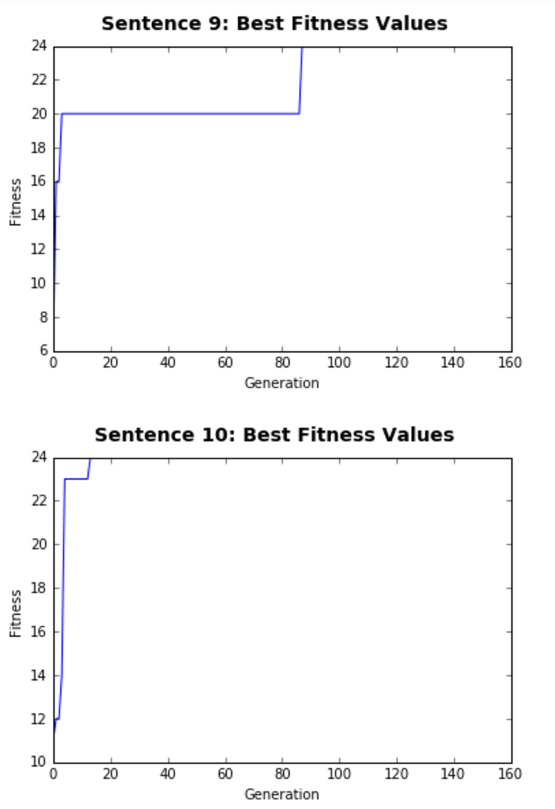
Results

Slide 6
Some Results...
Pride and Prejudice Chapter 5, 6, and 7
Sentence 1: "given higher dislikes such being woman my in disadvantage such unshackled word ached if their ought ", best fitness: 32 Sentence 2: "the gentlemen so it and believe which fortune my society Elizabeth spent the way are dying ", best fitness: 27 Sentence 3: "not ended eyes contrary great Meryton genius companion your best on hours the feverish husband equally ", best fitness: 32 Sentence 4: "saw is better with chaise if was us they she there she who of him ball ", best fitness: 29 Sentence 5: "so though DEAREST doing family dangerous by both readily I of some neighbourhood have Miss the ", best fitness: 24 Sentence 6: "out be entrance obliging clock as are safe friend Of own Miss my a early it ", best fitness: 30 Sentence 7: "occupy Darcy are been Not her intelligence as Longbourn my a amongst to being contrary he ", best fitness: 30 Sentence 8: "of friend Mr her examined not do man them defects but be of would them would ", best fitness: 29 Sentence 9: "hard friend be them out Meryton be was impatient energy Well him energetic without it contrary ", best fitness: 26 Sentence 10: "can the decided go to this to all equally oblige a he half-hour replied of it ", best fitness: 27

Slide 7
More Results…
Monty Python and the Holy Grail Whole Script
Sentence 1: "and staircase a LARGE big And to Looks fell need a Man from turns past Holy ", best fitness: 204
Sentence 2: "Keep The down For no stop looks must Beast the Court KNIGHT from JONES and FATHER ", best fitness: 207
Sentence 3: "beating gorge God base the 34 Arthur king find ( agree spoken ) Britons Leaving Are Lose ", best fitness: 217
Sentence 4: "the questions with sons him now eh tries nescess cave Good beginning Twinken ham KNIGHT Cast the ", best fitness: 202
Sentence 5: "atmosphere BEDEVERE He a here Oh Of men ribbons give farmland Lord the lute Tension hang ", best fitness: 212
Sentence 6: "Tell Their Do escape adventure peril shrubberies about our majority off a PRINCE call European of ", best fitness: 218
Sentence 7: "forest of ring a KING your not me window The left MONKS throat HEAD fires ROBIN ", best fitness: 209
Sentence 8: ") count it way uncomfortably the questions all ROBIN sex KING one of enchantingly amis of ", best fitness: 134
Sentence 9: "a the they reapproach Ni as for hut about corridor his got union modern BLACK already ", best fitness: 156
Sentence 10: "( and now BEDEVERE BROTHER the SOOTHSAYER and his HA You alarm Galahad ONLY the of ", best fitness: 233

Slide 8
Obstacles
Evaluation - Using a better fitness function
Due to time constraints, we could not find a tool to evaluate grammar and syntax in NLTK
A much harder problem due to complexity constraints
Parsing using NLTK was simple, and assumed sentences were grammatically correct to begin with.

Slide 9
Conclusion
Potential Improvements
Implement both extractive and abstractive summarization techniques.
Generate more understanding or cohesive sentences through extractive summarization.
Sentiment analysis

Slide 10
References
1. BIRD, SG; LOPER, E. NLTK: The Natural Language Toolkit. Proceedings of the 42nd Annual Meeting of the Association for Computational Linguistics. 2004.
2. Charniak, Eugene. Statistical Parsing with a Context-free Grammar and Word Statistics. Department of Computer Science, Brown University. 1997.
3. Kevin Knight, Daniel Marcu, Summarization beyond sentence extraction: A probabilistic approach to sentence compression, Artificial Intelligence, Volume 139, Issue 1, July 2002, Pages 91-107.
4. Griffiths, Thomas L., Mark Steyvers, David M. Blei, and Joshua B. Tenenbaum. "Integrating Topics and Syntax." In NIPS, vol. 4, pp. 537-544. 2004.

