Slide 1
Android WIFI Subsystem
ThunderSoft Confidential

Slide 2

Wifi subsystem
Framework
Hal
Wpa_supplicant
Driver
Hardware
Bug
ThunderSoft Confidential

Slide 3
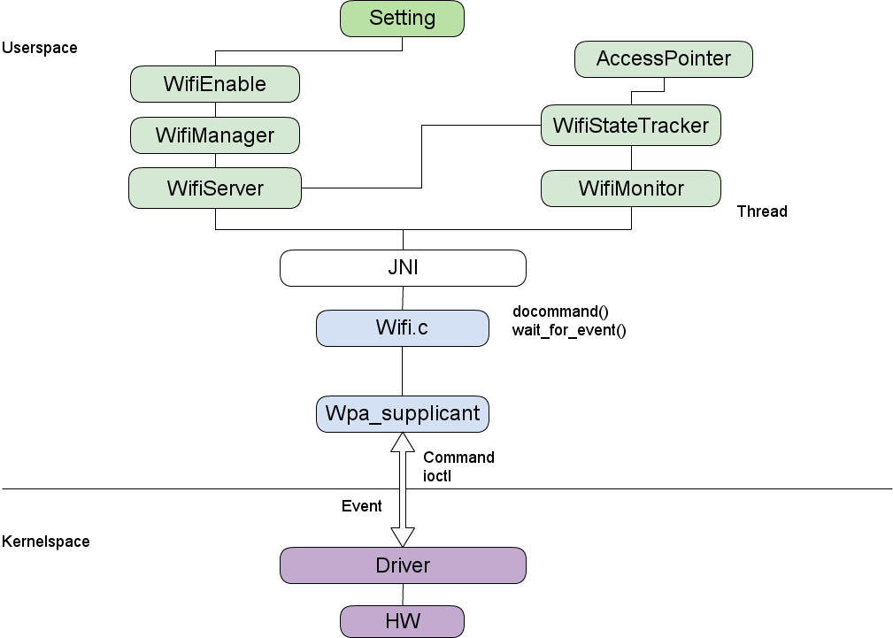

WIFI Subsystem框架
ThunderSoft Confidential

Slide 4

Framework
frameworks/base/wifi/java/android/net/wifi/
frameworks/base/services/java/com/android/server/WifiService.java
frameworks/base/core/jni/android_net_wifi_Wifi.cpp
StartWifi()
SetWifiEnabledBlocking()
->mWifiStateTracker.loadDriver()
->mWifiStateTracker.startSupplicant()
->registerForBroadcasts()
->mWifiStateTracker.startEventLoop()
SetWifiEnabledState()
ThunderSoft Confidential

Slide 5
Framework
StartScan()
ReadNetworkVariables()
StartMonitoring()
ConnectToSupplicant()
WifiNative.waitForEvent()
Mreceiver()
ThunderSoft Confidential

Slide 6
Hal
hardware/libhardware_legacy/wifi/wifi.c
int wifi_connect_to_supplicant()
{
…..
ctrl_conn = wpa_ctrl_open(ifname);
monitor_conn = wpa_ctrl_open(ifname);
…..
}
int wifi_send_command(struct wpa_ctrl *ctrl, const char *cmd, char *reply, size_t *reply_len)
{
…..
ret = wpa_ctrl_request(ctrl, cmd, strlen(cmd), reply, reply_len, NULL);
…..
ThunderSoft Confidential

Slide 7
Hal
int wifi_wait_for_event(char *buf, size_t buflen)
{
…...
result = wpa_ctrl_recv(monitor_conn, buf, &nread);
….....
}
ThunderSoft Confidential

Slide 8
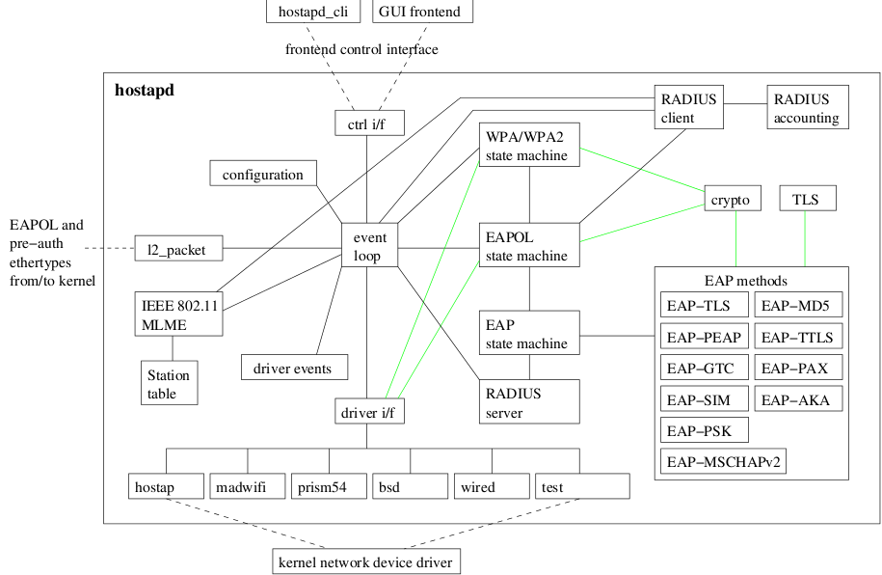
Wap_supplicant
ThunderSoft Confidential

Slide 9
Wap_supplicant
external/wpa_supplicant_6/wpa_supplicant/
external/wpa_supplicant_6/wpa_supplicant/wpa_supplicant.c
->wpa_supplicant_init()
->wpa_supplicant_add_iface()
->wpa_supplicant_run()
external/wpa_supplicant_6/wpa_supplicant/src/utils/eloop.c
->eloop_run()
external/wpa_supplicant_6/wpa_supplicant/src/drivers/driver.h
->struct wpa_scan_res
->struct wpa_driver_ops
ThunderSoft Confidential

Slide 10
Wap_supplicant
external/wpa_supplicant_6/wpa_supplicant/src/common/wpa_ctrl.c
->wpa_ctrl_open()
->wpa_ctrl_recv()
->wpa_ctrl_request()
…....
ThunderSoft Confidential

Slide 11
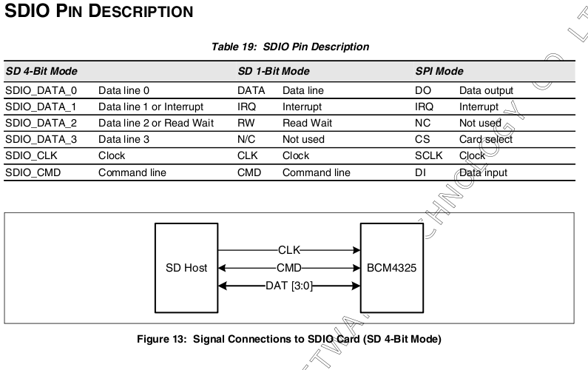
Driver
/kernel/driver/mmc
ThunderSoft Confidential

Slide 12
Driver
kernel/arch/arm/mach-msm/board-msm7x27.c
static void __init msm7x2x_init_mmc(void)
{
#ifdef CONFIG_MMC_MSM_SDC2_SUPPORT
msm_sdcc_setup_gpio(2, 1);
msm_add_sdcc(2, &msm7x2x_sdc2_data);
#endif
}
Mmc host device sdcc2注册到platfom bus上：
int __init msm_add_sdcc(unsigned int controller, struct mmc_platform_data *plat)
{
struct platform_device *pdev;
ThunderSoft Confidential

Slide 13
Driver
if (controller < 1 || controller > 4)
return -EINVAL;
pdev = msm_sdcc_devices[controller-1];
pdev->dev.platform_data = plat;
return platform_device_register(pdev);
}
ThunderSoft Confidential

Slide 14
Driver
Kernel/driver/mmc/host/msm_sdcc.c
static struct platform_driver msmsdcc_driver = {
.probe = msmsdcc_probe,
.remove = msmsdcc_remove,
.suspend = msmsdcc_suspend,
.resume = msmsdcc_resume,
.driver = {
.name = "msm_sdcc",
},
Mmc host controller driver注册到platform bus上：
static int __init msmsdcc_init(void)
{
return platform_driver_register(&msmsdcc_driver);
}
ThunderSoft Confidential

Slide 15
Driver
/sys/devices/platform/msm_sdcc.2/polling
void mmc_rescan(struct work_struct *work)
-> mmc_send_io_op_cond(host, 0, &ocr)
-> mmc_wait_for_cmd(host, &cmd, MMC_CMD_RETRIES);
-> mmc_wait_for_req(struct mmc_host *host, struct mmc_request *mrq)
-> mmc_start_request(host, mrq)
COMMAND:
Cmd52:复位
Cmd5:查询设置卡电压
Cmd3:获取卡地址
Cmd7:准备/命令状态
Cmd53:多字节读写
Cmd0:sdio/spi模式转换
Cmd15:不激活
Cmd55
ThunderSoft Confidential

Slide 16
Driver
Wifi driver:
Power on/off:
kernel/arch/arm/mach-msm/board-msm7x27-ktouch-5906.c
Recv command:
START
SCAN-ACTIVE
RSSI
LINKSPEED
MACADDR
COUNTRY
STOP........
Send event:
wireless_send_event(dev, cmd, &wrqu, extra);
ThunderSoft Confidential

Slide 17
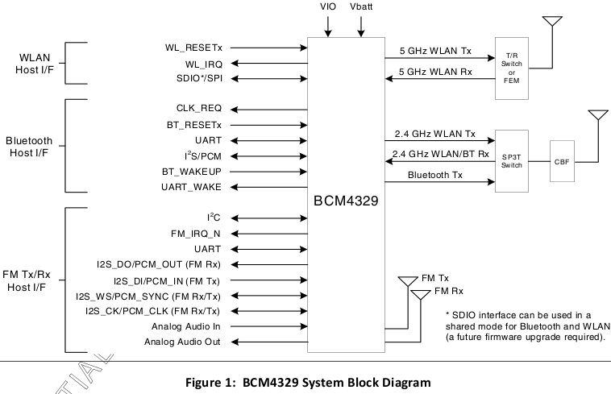

Hardware
ThunderSoft Confidential

Slide 18
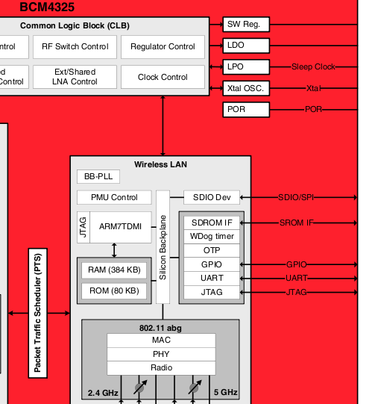
Hardware
ThunderSoft Confidential

Slide 19
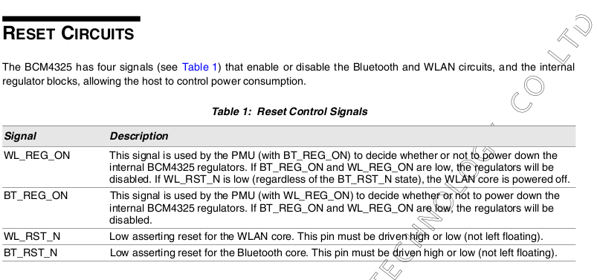
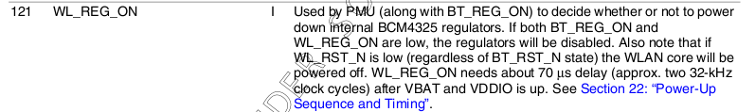
Hardware
ThunderSoft Confidential

Slide 20
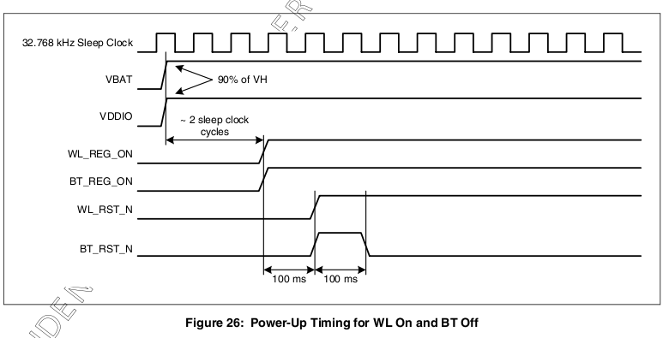
Hardware
ThunderSoft Confidential

Slide 21
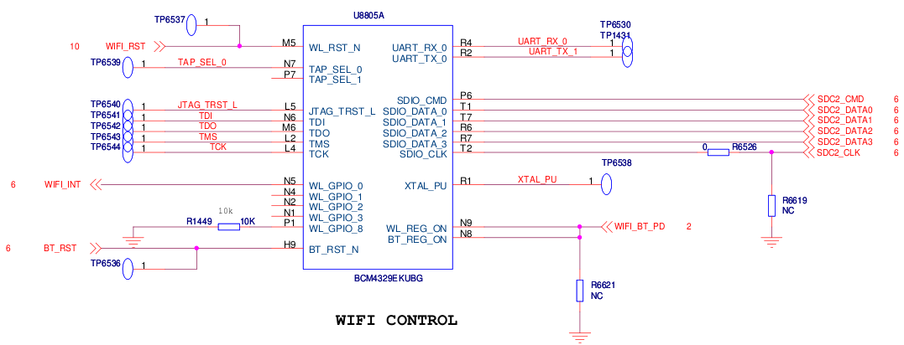
Hardware
ThunderSoft Confidential

Slide 22
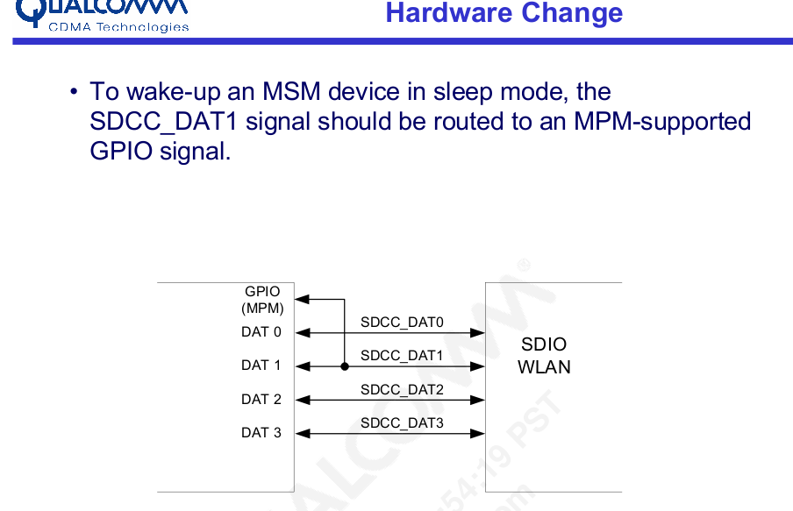
Hardware
ThunderSoft Confidential

Slide 23
Bug
Framework:
wifiserver->startwpa_supplicant->wpa_deamon->socket
wifiserver->wifistatetrcker->wifimoniter_thread->connect_to_wpa->socket
Qcom:c+w :(
wpa_supplicant_ctrl_iface_init()初始化控制接口
ThunderSoft Confidential

Slide 24
Bug
Framework:
Command:”STOP”->wpa_supplicant->ioctl()->wext-driver
Driver:clock,reset...->arm9 crush
System:wakeup,”START”->
wireless_send_event()
ThunderSoft Confidential

Slide 25
Bug
system suspend->bcm4325->sdio(data1)->irq->mmc
--->system crush.
request_irq(plat->sdiowakeup_irq.....
static irqreturn_t msmsdcc_platform_sdiowakeup_irq(int irq, void *dev_id) {
wake_lock(&host->sdio_wlock);
….......
Flag:
host->sdio_irq_disabled = 1
Suspend:
enable_irq_wake(host->plat->sdiowakeup_irq);
Resume:
disable_irq_nosync(host->plat->sdiowakeup_irq);
ThunderSoft Confidential

Slide 26
Android Bluetooth BSP
ThunderSoft Confidential

Slide 27
Hal
Hardware
Bug
ThunderSoft Confidential

Slide 28
Hal
frameworks/base/core/jni/android_server_BluetoothService.cpp
bt_enable()-->
system/bluetooth/bluedroid/bluetooth.c
bt_enable()
set_bluetooth_power(int on)
init_rfkill()-->
/kernel/driver/bluetooth/bluetooth-power.c
/sys/class/rfkill/rfkill0/type/state
→/kernel/arch/arm/mach-msm/board-msm7x27.c
system/bluetooth/brcm_patchram_plus/brcm_patchram_plus.c
init_uart()
proc_baudrate()
proc_bdaddr()
proc_enable_lpm()
brcm_set_pcm_parameter()
/system/bin/bluetoothd
external/bluetooth/bluez/src/main.c
ThunderSoft Confidential

Slide 29
Hardware
ThunderSoft Confidential

Slide 30
Hardware
ThunderSoft Confidential

Slide 31
Hardware
ThunderSoft Confidential

Slide 32
Bug
sleep->wakeup
/kernel/bluetooth/bluesleep.c
bt_wake pin
ThunderSoft Confidential

Slide 33
版本号 | 改版日期 | 改版人员 | 内容
1.0 | 2011.05.08 | 彭伦研 | Android wifi subsystem
2.0 | 2011.08.29 | 彭伦研 | Android bluetooth bsp
ThunderSoft Confidential

Slide 34
ThunderSoft Confidential

