Slide 1
The P Programming Language
Shaz Qadeer

Slide 2
The Heisenbug problem
System
Environment
Happen when interaction between system and environment is uncontrollable
Timing-dependent behavior
Failures
Interaction with physical world
Extremely difficult to reproduce, diagnose, and fix
Enormous impediment to programmer productivity and software quality

Slide 3
Extent Management in Azure Storage vNext
Extent Manager
Extent Manager
Extent Manager
Extent Manager
……
Extent metadata partitioned
Each ExtentManager in charge of a subset of extents
EN
EN
EN
EN
EN
EN
EN
EN
……
Extent Nodes

Slide 4
Replication Logic in Extent Manager
heartbeat from ENs (every 5 secs)
Extent Manager maintains 3 replicas for every extent
Discover node failures (heartbeat)
Identify missing replica
Sync report lists all extents on EN
Schedule extent repair task
extent repair task to ENs (on-demand)
Extent Manager
sync report from ENs (every 5 mins)

Slide 5
Difficulty in Testing vNext
Unit tests
Emulate heartbeat, sync report, EN expiration
Verify Extent Manager behavior
Integration tests
Launch real Extent Manager and Extent Nodes
Kill EN and launch new EN → verify extents repaired
Unit tests & integration tests always pass
Stress tests fail from time to time, when repair gets stuck as
Many extents are created
ENs are constantly killed and launched

Slide 6
Find and fix Heisenbugs during system
development and testing (not in production)!
.p
Code
Models
Specifications
Tests
P Compiler
Generated.c
HandWritten.c
P
Systematic
Concurrency
Testing
Tool
P runtime library
.dll
Unit
Interaction
Test
Operating system
Reproducible error trace

Slide 7
P: A language for writing asynchronous controllers
Devices Drones, HoloLens, …
Ubiquitous in
Microsoft
infrastructure
OS kernels USB, Bluetooth, …
Datacenters Batch, Node, Storage, …
Code
Models
Specification
Verification
Deep
Reasoning
P ↔ C
P ↔ C++
P ↔ C#
Notes:
It is worth pointing out that controllers are everywhere.
Programming technologies we are developing and refining for the SafeCPS expedition are being for solving reliability problems across the company, in Windows and Devices Group and in Azure.
All these applications rest atop the reasoning and programming techniques embodied in the P framework.
P code can interoperate with the most significant languages used in our infrastructure code.
More importantly, P provides first-class support for modeling, specification and scalable verification, which enables us to build reliable software.

Slide 8
Users
Windows
USB host
USB function
UART class extension
Hid class
USB Type C stack
Media Agnostic USB
Bluetooth
Azure
Node Service
Batch Service
Learning Service
AZSM
CAT (Connected Car)
Office
Client-server app

Slide 9
Outline
State machine programming model and language features
Hello
Safety and liveness specifications
PingPong
Unit interaction tests
PingPong, Failover
Failure modeling
Failover
Avoiding data races
CoarseGrainedLocking

Slide 10
Hello

Slide 11













Asynchronous system as a state-transition graph
$${ S}_{0}$$
$${ S}_{1}$$
$${ S}_{2}$$
$${ S}_{3}$$
$${ S}_{4}$$
$${ S}_{5}$$
$${ S}_{6}$$
$${ S}_{7}$$
$${ S}_{8}$$
$${ S}_{9}$$
$${ S}_{10}$$
$${ S}_{11}$$
$${ S}_{12}$$

Slide 12
Exceptions
Unhandled event exception
Event and queue cardinality constraints
Exceptions in the statement language
Cast exceptions
Null dereference exceptions
…

Slide 13
Safety specifications
Generalizes assertion in sequential programs
Violation is a finite execution
Bad never happens
Encode “Bad” using safety monitor

Slide 14
PingPong

Slide 15
Liveness specifications
Generalizes termination in sequential programs
Violation is an infinite execution
Good eventually happens
Encode “Good” using liveness monitor

Slide 16
PingPong

Slide 17
How do we test concurrent programs?
Unit tests are unable to find timing-related errors
Unit tests are usually followed by integration tests
Expensive
Difficult to debug
Unit interaction tests
Leverages that execution is replayable and controllable
Programmer writes a collection of small test cases
Let the test framework generate executions

Slide 18
PingPong
Failover

Slide 19
Data races in shared-memory programs
int x = 10
int x = 0, y = 0
Task A
x = x + 1
Task B
x = x + 1
Task A
x = 1
if (y == 0)
print A
Task B
y = 1
if (x == 0)
print B
x = 12, 11
Console = ., A, B, AB, BA
Violate desired atomicity
Cause behavior that is not sequentially consistent

Slide 20
Data races in message-passing programs
type H = { int f; int g; }
Task A
var x: H
send B, e, x
x.f = x.f + 1
Task B
on e do (y: H) {
y.f = y.f + 1
}

Slide 21
Avoiding data races
type H = { int f; int g; }
Task A
var x: H
x.f = x.f + 1
send B, e, x
Task B
on e do (y: H) {
y.f = y.f + 1
}
Ownership
transfer

Slide 22
CoarseGrainedLocking

Slide 23
Writing P# programs
Two approaches:
Using the high-level syntax of P# (based on P)
Using P# as a C# library (e.g. machines inherit a Machine C# abstract class)
Able to combine P# and C# syntax in the same project/file
Mix-and-match approach:
Using partial machines / actions
Write state-machine transition logic using the P# syntax
Write implementation of event handlers in C#

Slide 24
PingPong in P# (mixed-mode)
event Config (server: machine);
event Unit;
event Ping (client: machine);
partial machine Client
{
machine Server;
int Counter;
start state Init
{
entry
{
this.Server = (trigger as Config).server;
this.Counter = 0;
jump(Active);
}
}
state Active
{
entry
{
SendPing();
}
on Pong do SendPing;
}
partial void SendPing();
}
machine Environment
{
start state Init
{
entry
{
var server = create(Server);
create(Client, Config, server);
}
}
}
create machine
transition
create machine
event Pong;
machine Server
{
start state Active
{
on Ping do SendPong;
}
void SendPong()
{
var client = (trigger as Ping).client;
send(client, Pong);
}
}
send event
partial action
invoke action
partial class Client : Machine
{
partial void SendPing()
{
this.Counter++;
this.Send(this.Server, new Ping(this.Id));
if (this.Counter == 5)
{
this.Raise(new Halt());
}
}
}
send event

Slide 25
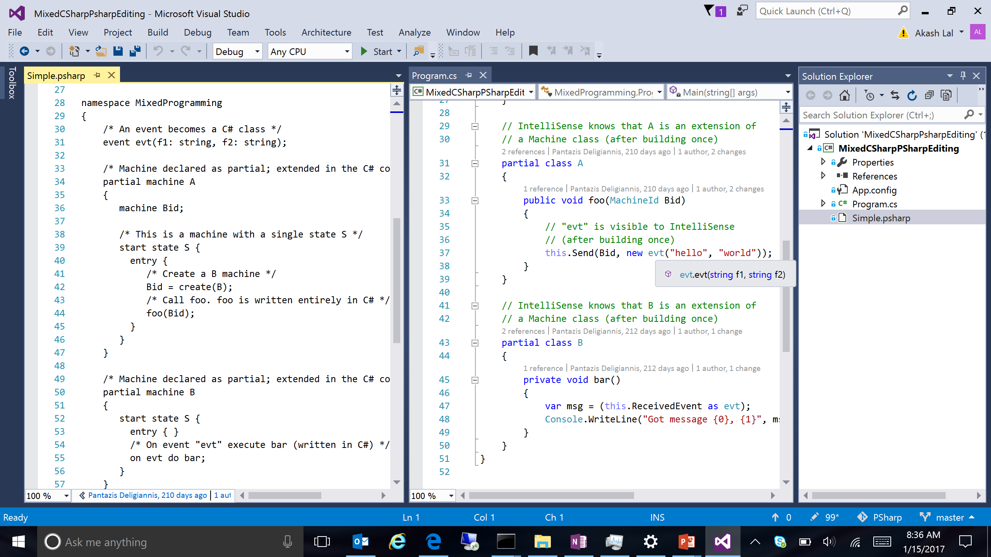
Screenshot: C# IntelliSense picks up P# types

Slide 26
Lowering P# to C#
Top-down recursive descent parsing
P# syntax nodes are rewritten to C#
C# statements and expressions are parsed verbatim (as a black box)
No need to re-invent the wheel (i.e. C# parser)
Rewritten syntax tree is compiled using the Roslyn compiler APIs
The C# code is made available to the compiler, which enables IntelliSense

Slide 27
Executing and testing a P# program
public class Program
{
public static void Main(string[] args)
{
// Creates a new P# runtime instance.
var runtime = PSharpRuntime.Create();
// Executes the P# program.
Program.Execute(runtime);
// The P# runtime executes asynchronously, so we wait
// to not terminate the process.
Console.WriteLine("Press Enter to terminate...");
Console.ReadLine();
}
[Microsoft.PSharp.Test]
public static void Execute(PSharpRuntime runtime)
{
runtime.CreateMachine(typeof(Environment));
}
}
C# Host
Entry point to a P# program
Responsible for instantiating the P# runtime
P# program runs unrestricted for production
P# Test
Entry point to a P# test
P# tester finds all methods in a specified binary that are marked with [Microsoft.Psharp.Test] attribute
P# tester invokes test method by passing the P# bug-finding runtime
Runs many iterations of the program using the P# bug-finding runtime

Slide 28
P# Tester
Executes a given P# test method using the P# bug-finding runtime:
Takes control of the machine scheduler
Serializes program execution
Runs the P# test from start to finish, for a user-specified number of iterations, each time executing a (potentially) different schedule
Iterations can be parallelized on the cloud!
If a bug is found, the tester dumps:
Reproducible trace
Human-readable log of all events that led to the bug
Various statistics (e.g. coverage)
Replayer tool can replay the buggy schedule
Allows to attach the visual studio debugger
User can insert breakpoints

Slide 29
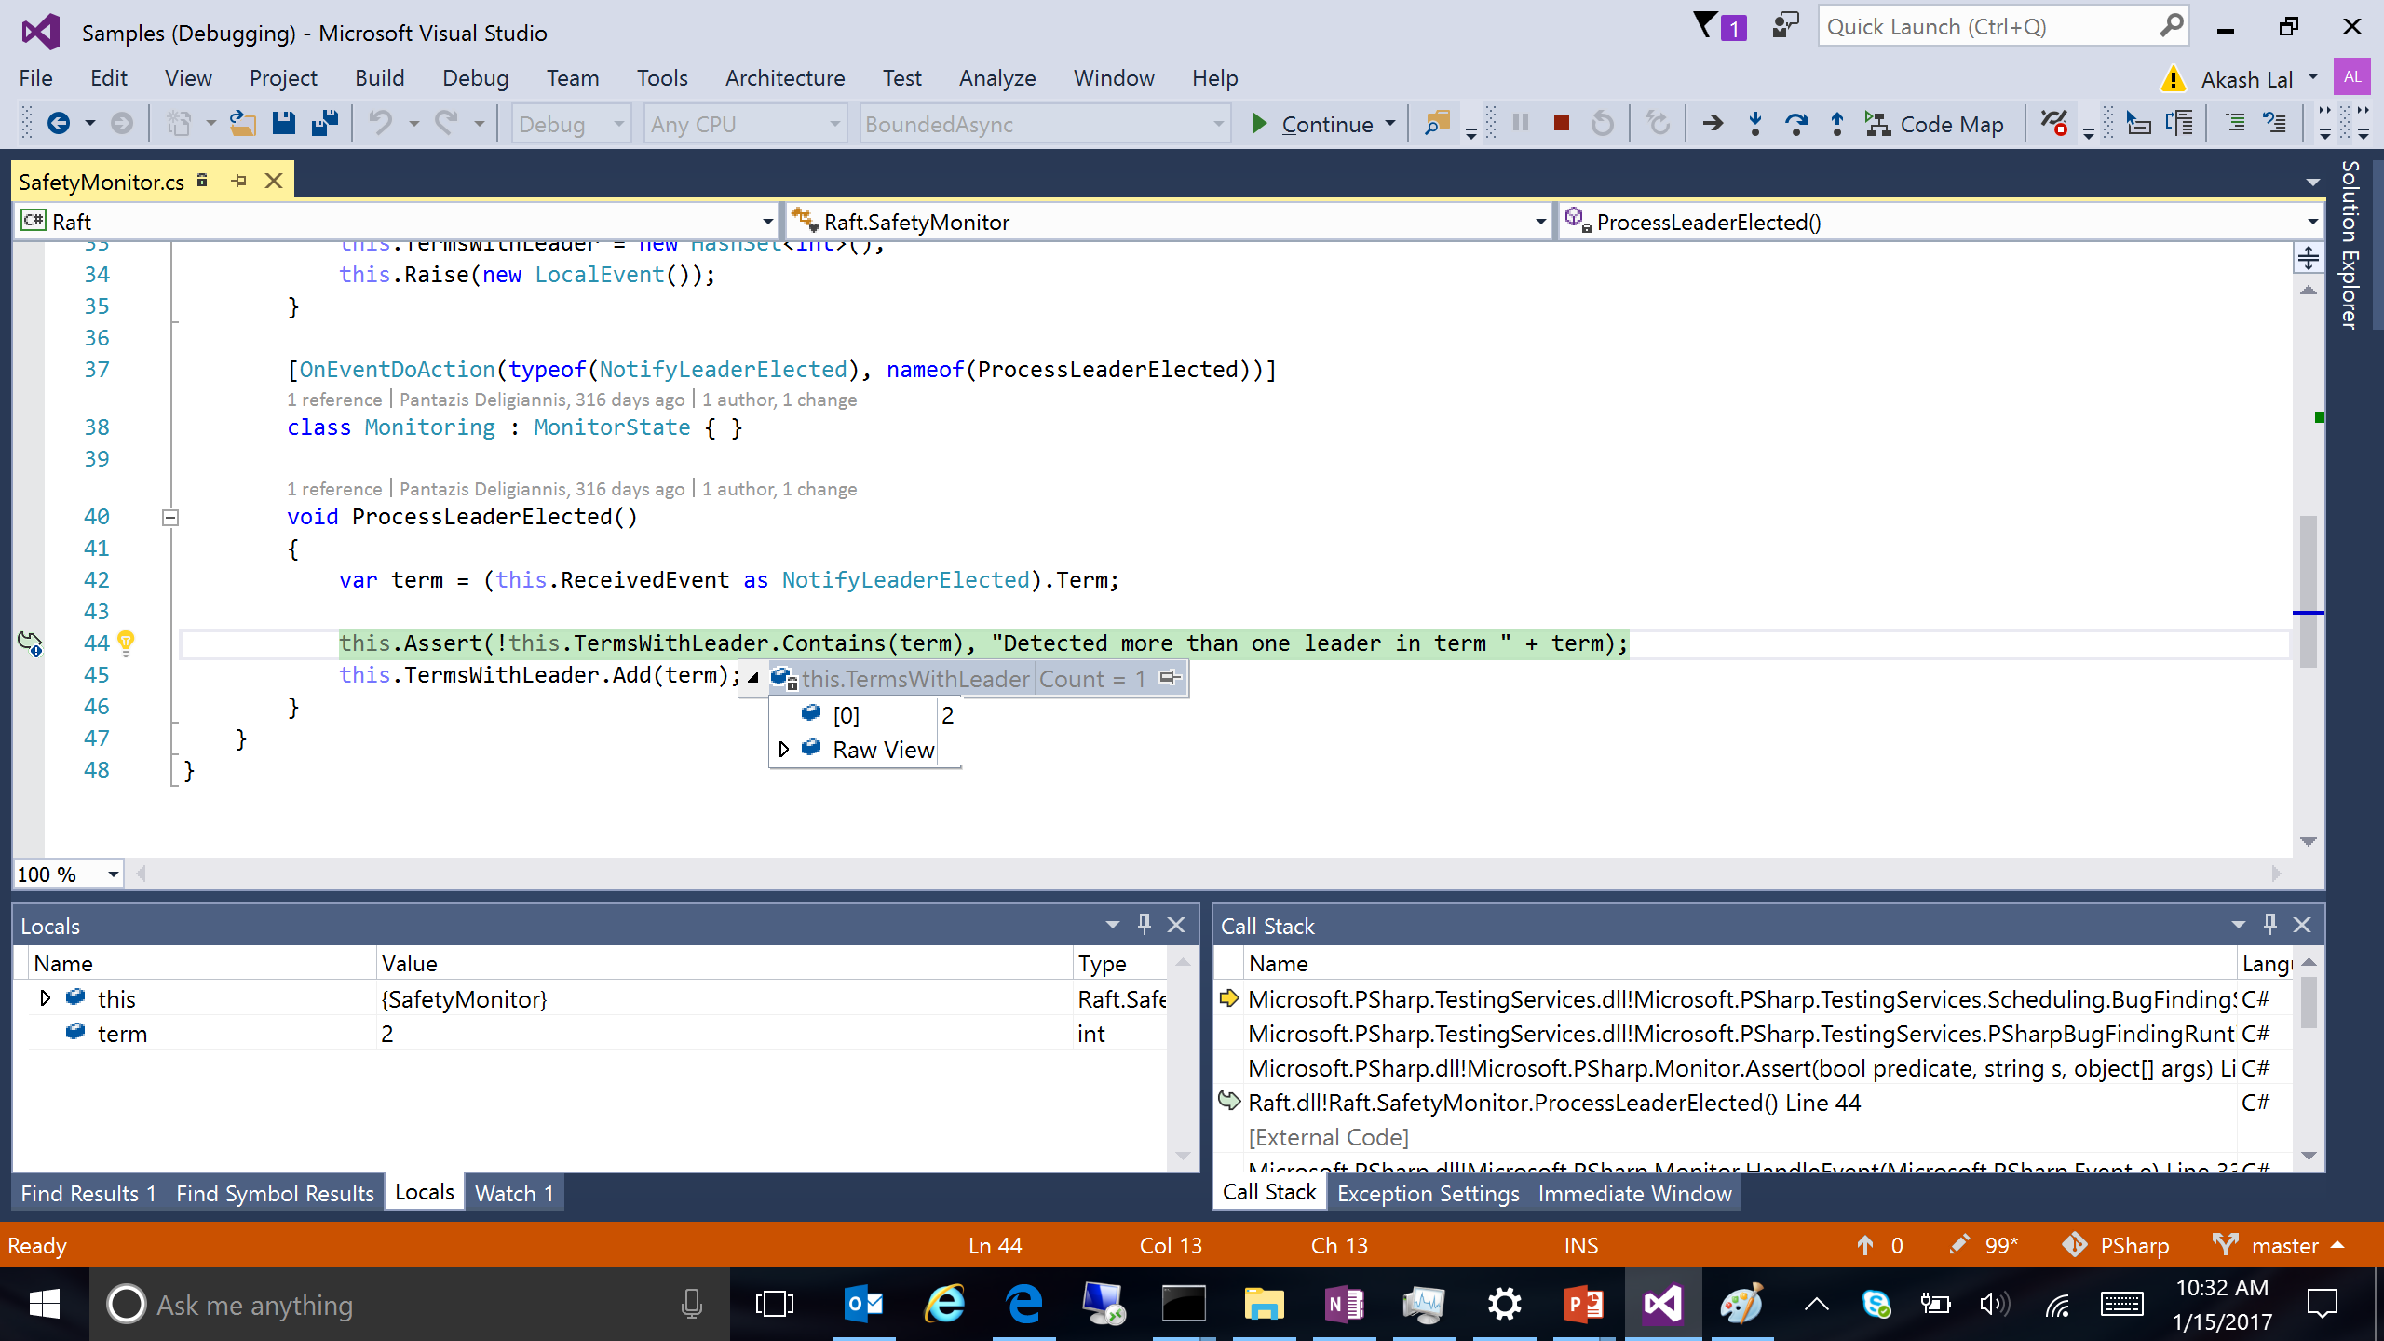
Screenshot: VS debugging

Slide 30
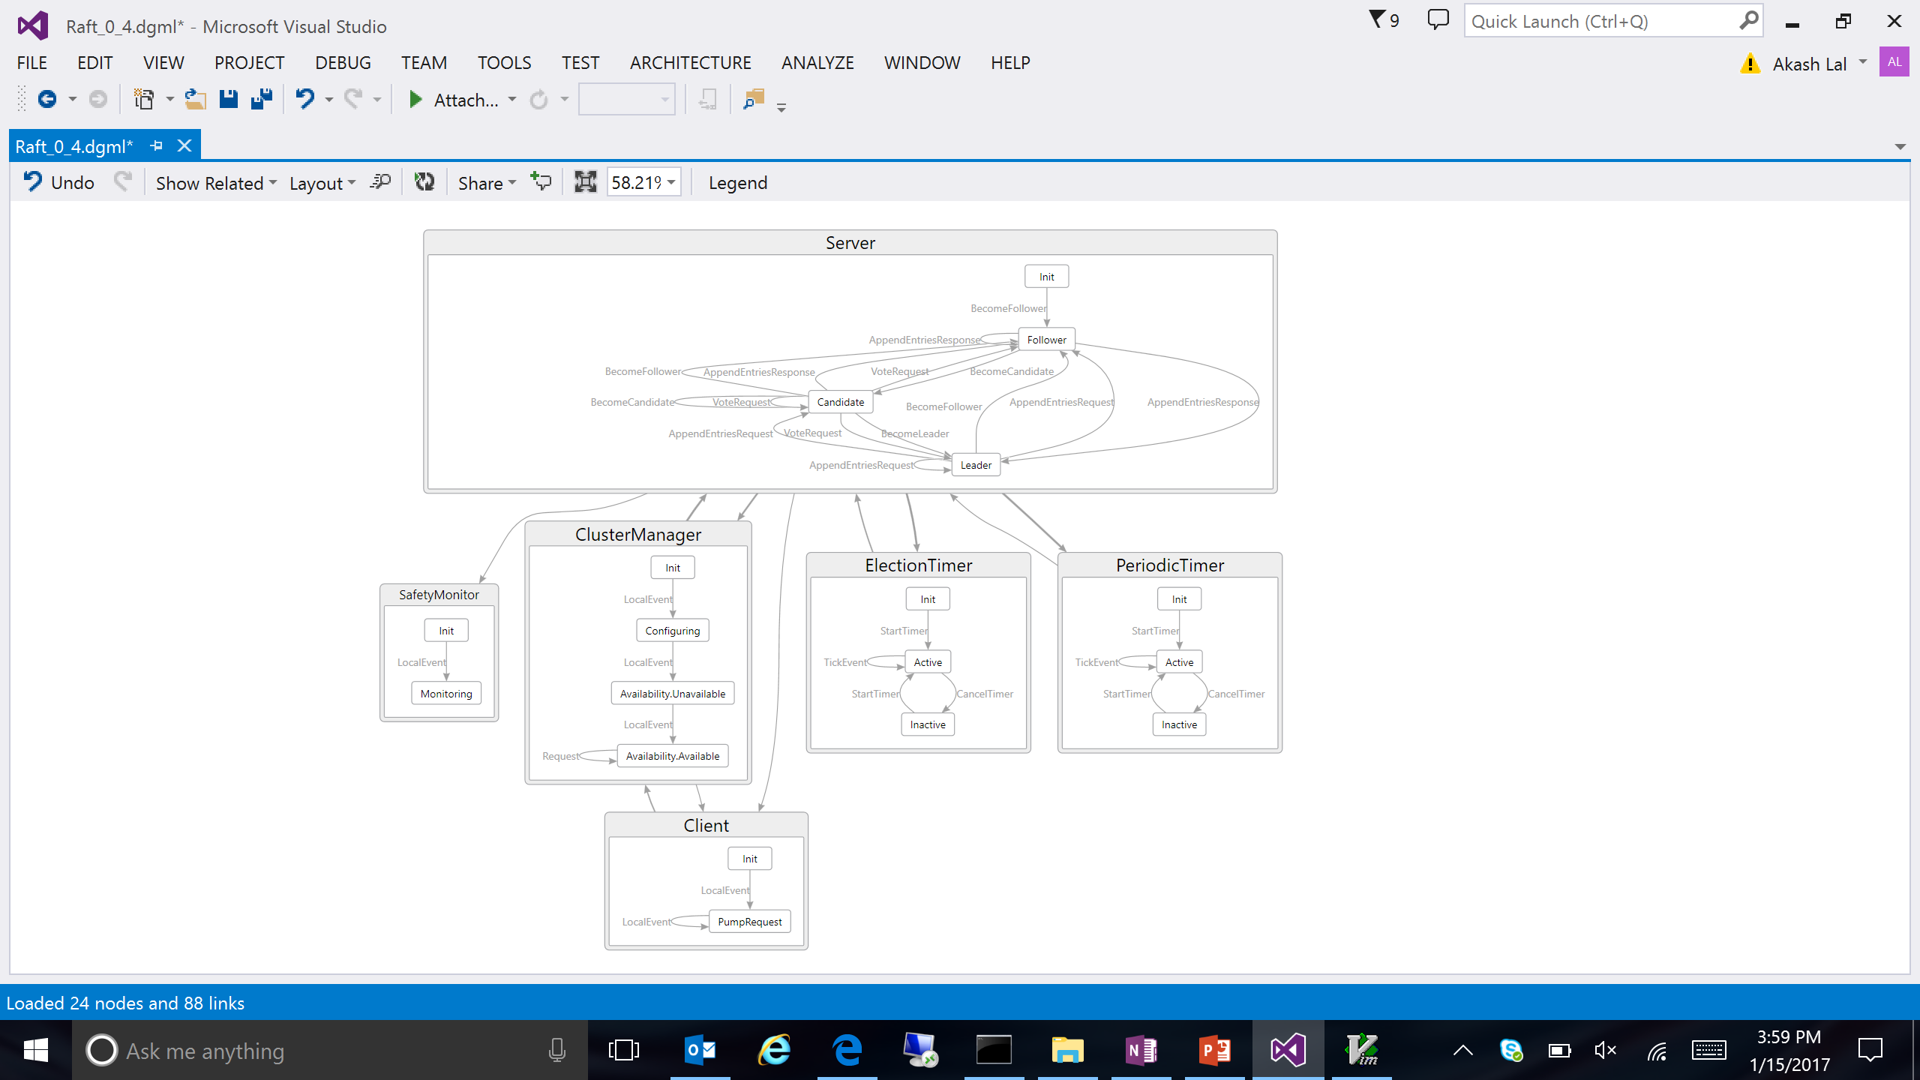
Screenshot: Coverage of a test run

