Slide 1
软 件 构 造
第一小组作业展示
小组成员：李爽、黄俊龙、陈飞、马强、谢贤杰、沈星

Slide 2
1
作业概述
Job overview
2
作业完成情况
CONTENTS
The code shown
3
代码展示与讲解
insufficient
4
缺点与不足
Experience and Summary

Slide 3
作业概述
Job overview

Slide 4
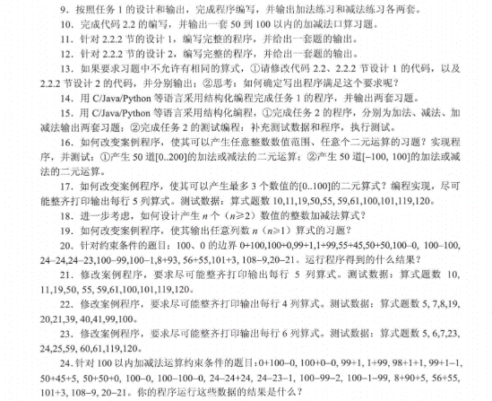
作业概述
作业题目：根据所给题目以及教材案例，完成代码编写
Job overview

Slide 5
作业概述
Job overview
编程语言
IDE
programming language
Integrated development environment
代码编写环境
Java
Code writing environment
IDEA 2021.2

Slide 6
作业完成情况
The code shown

Slide 7
作业完成情况
Job overview
2.小组讨论
4.编码
1.查看题目
3.确认基本解题思路
5.调试运行
PPT模板 http://www.1ppt.com/moban/

Slide 8
作业完成情况
print the presentation and make it into a film a wider field
30%
70%
编码时间
讨论时间
The user can demonstrate on a projector or computer, or presentation and make it film to be used in a wider field
The user can demonstrate on a projector or computer, or presentation and make it film to be used in a wider field

Slide 9
代码展示与讲解
The user can demonstrate on a projector or computer, or print the presentation and make it into a film to be used in a wider field The user can demonstrate

Slide 10
缺点与不足
The user can demonstrate on a projector or computer, or print the presentation and make it into a film to be used in a wider field The user can demonstrate

Slide 11
缺点与不足
print the presentation and make it into a film a wider field
1
知识点掌握
对于知识点的掌握情况一般
2
代码能力
代码能力有待提高，没有将算法的思维巧妙运用到解题当中
3
团队合作
初次合作，还不是很默契

Slide 12
感谢您的观看

