Slide 1

标签
蛋白-蛋白
0 1 0 0 1 0 1
1 0 1 1 0 1 0
0 1 0 1 1 0 1
1 1 1 0 1 0 0
...
0 0 0 1 1 1 1
蛋白质相互作用图
标签条件概率
词嵌入
x1 x2 x3 x4 x5 x6 x7
for class1
Conv1D
Pooling
LSTM
FC
Forward
for class2
Update
for class3
GIN
分类
...
...
for class7
...
MLP
预测
预定义特征
特征编码模块
解耦模块

Slide 2
蛋白质相互关系
构图
划分
数据集
标签条件概率矩阵
FC
解耦模块
LSTM
特征解耦
FC
解耦模块
预测
FC
解耦模块

Slide 3
Dataset | Partion Scheme | PIPR | GNN_PPI | OURS
SHS27K | Random | 83.31 | 87.91 | 88.61,87.50
 | BFS | 44.48 | 63.81 | 66.83, 75.82, 68.89, 76.98
 | DFS | 57.80 | 74.72 | 71.35, 77.34, 76.61, 77.22

Slide 4
蛋白质相互关系
构图
划分
数据集
标签条件概率矩阵
FC
解耦模块
LSTM
特征解耦
FC
解耦模块
预测
FC
解耦模块

Slide 5
GIN
BiGRU
pooling
Q
P
CONCAT
Decoupling module
pooling
MUL
GIN
Classifier
Prediction

Slide 6
BiGRU
CONCAT
Decoupling module
GIN
MUL
pooling
pooling
Classifier
pooling
Prediction
Q
P
pooling

Slide 7
CONCAT
MUL
Classifier
Prediction
BiGRU
Decoupling module
GIN
pooling
pooling
pooling
Q
P
pooling

Slide 8
PPI & Labels
Root node
Train
Test
Build
The Graph
Construct
Trainset / Testset
Supervise
Protein-Independent
Encoding
Classifier
BiGRU
Protein-Graph
Encoding
Decoupling module
Prediction
7
Q
P
GIN
7
Pooling

Slide 9
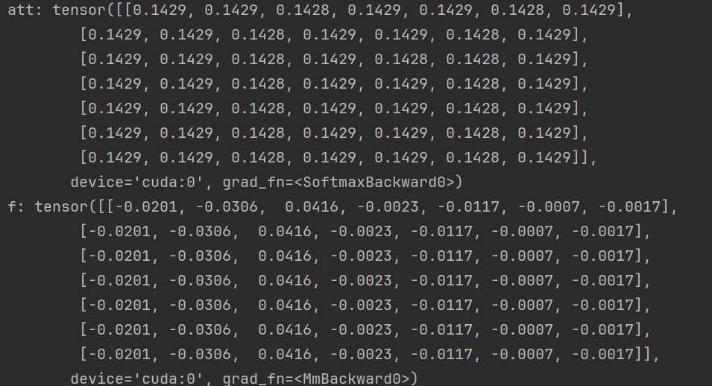

Slide 10
classifier
GIN
Correlation
coefficient calculation
MLP
pooling
classifier
Conditional
probability matrix
Conv1D
BN
BiGRU
MLP
GIN
pooling
Q
P
MLP
classifier
PPI Graph
GIN
pooling

Slide 11
classifier
GIN
Correlation
coefficient calculation
MLP
pooling
classifier
Conditional
probability matrix
Conv1D
BN
BiGRU
GIN
pooling
Q
P
classifier
PPI Graph
GIN
pooling

