Slide 1
Prof. Lovera Marco ICT FOR CONTROL SYSTEMS ENGINEERING Milano - 2014/2015
Model Identification: Comparison of Black-Box methods to identify the attitude dynamics of a quadrotor helicopter
Russo Alessio, Savaia Gianluca
School of Industrial and Information Engineering
Polytechnic of Milan
https://github.com/rssalessio/ictproject

Slide 2
PROJECT GOAL
GOAL
Identify the attitude dynamics of a quadrotor helicopter using classical PEM methods.
Compare the results obtained with those obtained using subspace identification.
DATA
Model identified with subspace methods.
Set of data measured during three experiments ${\left\{{\left(x,y\right)}_{i}, i=1,2,3\right\}}_{}^{}$
TOOLS
Matlab

Slide 3
IDENTIFICATION CYCLE
IDENTIFICATION CYCLE
Experiment
Data Processing
Already done
Should data be processed?
Is the model ok?
Validation
Model Identification

Slide 4
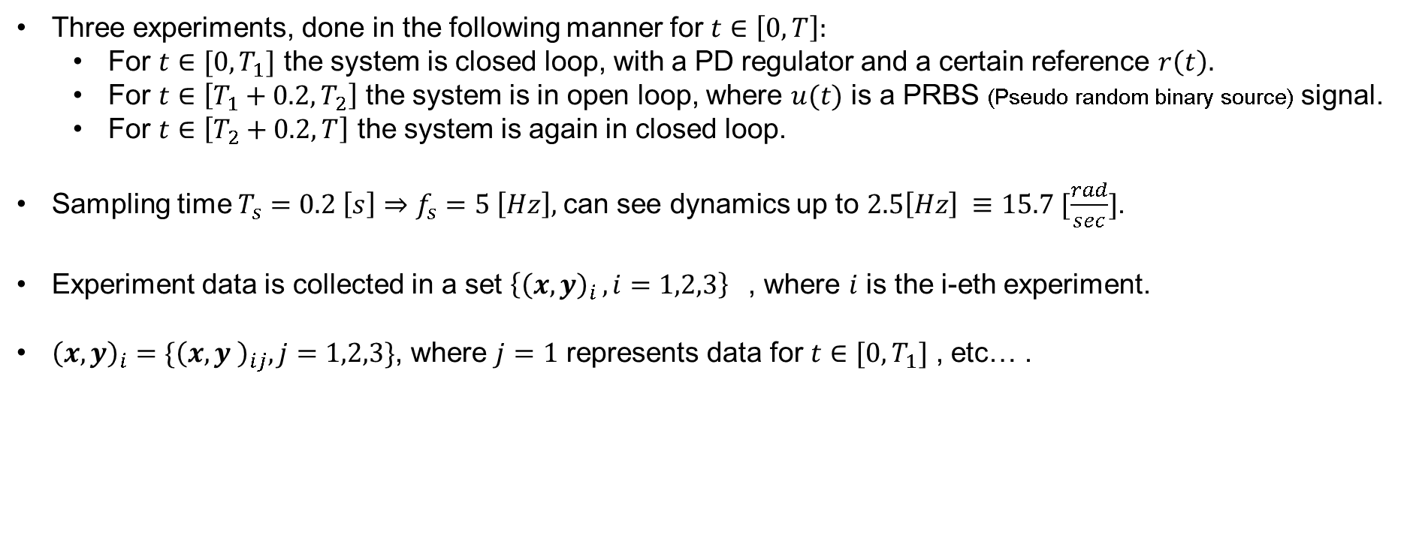
EXPERIMENT
EXPERIMENT
Three experiments, done in the following manner for $t∈\left[0, T\right]:$
For $t∈[0, T_{1}]$ the system is closed loop, with a PD regulator and a certain reference $r\left(t\right).$
For $t∈\left[T_{1}+0.2, T_{2}\right]$ the system is in open loop, where $u(t)$ is a PRBS (Pseudo random binary source) signal.
For $t∈\left[T_{2}+0.2, T\right]$ the system is again in closed loop.
Sampling time $T_{s}=0.2 \left[s\right]⇒f_{s}=5 \left[Hz\right],$can see dynamics up to $2.5\left[Hz\right] ≡15.7 [\frac{rad}{sec}]$.
Experiment data is collected in a set ${\left\{{\left(x,y\right)}_{i }, i=1,2,3\right\}}_{}^{}$, where $i$ is the i-eth experiment.
${\left(x,y\right)}_{i}=\{{\left(x,y \right)}_{ij}, j=1,2,3\}$, where $j=1$ represents data for $t∈[0, T_{1}]$ , etc… .
${\left(x,y\right)}_{i2}$is the open loop data

Slide 5
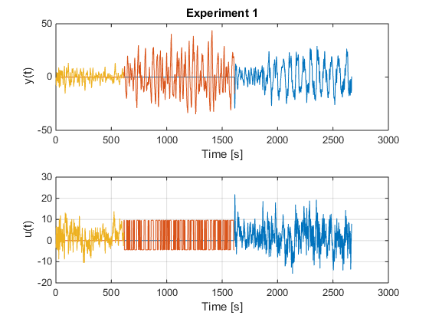
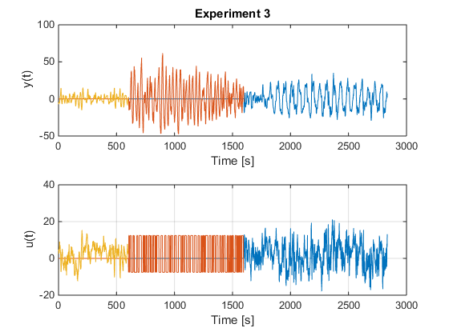
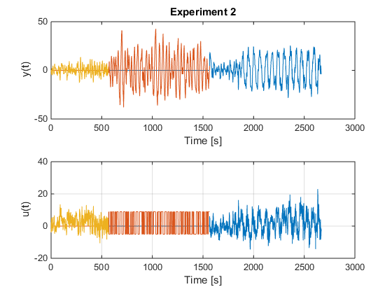
EXPERIMENT
EXPERIMENT DATA

Slide 6
DATA PROCESSING
DATA PROCESSING

Slide 7
MODEL IDENTIFICATION
MODEL IDENTIFICATION

Slide 8
MODEL VALIDATION
MODEL VALIDATION

Slide 9
CONCLUSION & REMARKS
CONCLUSION

