Slide 1
Prof. Lovera Marco ICT FOR CONTROL SYSTEMS ENGINEERING Milano - 2014/2015
Model Identification: Comparison of Black-Box methods to identify the attitude dynamics of a quadrotor helicopter
Russo Alessio, Savaia Gianluca
School of Industrial and Information Engineering
Polytechnic of Milan
https://github.com/rssalessio/ictproject

Slide 2
PROJECT GOAL
GOAL
Identify the attitude dynamics of a quadrotor helicopter using classical PEM methods.
Compare the results obtained with those obtained using subspace identification.
DATA
Model identified with subspace methods.
Set of data measured during three experiments ${\left\{{\left(x,y\right)}_{i}, i=1,2,3\right\}}_{}^{}$
TOOLS
Matlab
Github: https://github.com/rssalessio/ictproject (code available)

Slide 3
IDENTIFICATION CYCLE
IDENTIFICATION CYCLE
Experiment
Data Proc. & Analysis
Already done
Should data be processed?
Is the model ok?
Validation
Model Identification

Slide 4
EXPERIMENT

Slide 5
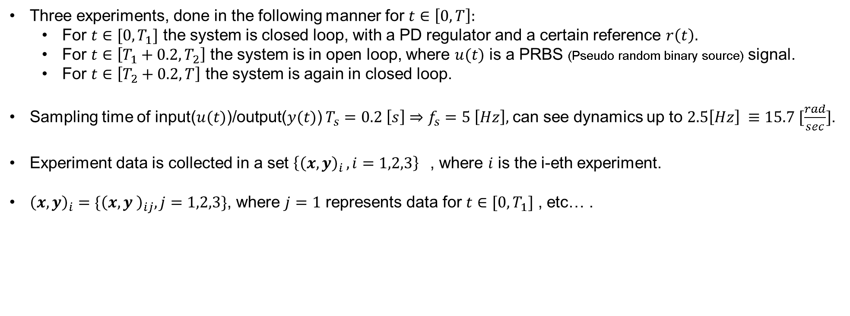
EXPERIMENT
EXPERIMENT
Three experiments, done in the following manner for $t∈\left[0, T\right]:$
For $t∈[0, T_{1}]$ the system is closed loop, with a PD regulator and a certain reference $r\left(t\right).$
For $t∈\left[T_{1}+0.2, T_{2}\right]$ the system is in open loop, where $u(t)$ is a PRBS (Pseudo random binary source) signal.
For $t∈\left[T_{2}+0.2, T\right]$ the system is again in closed loop.
Sampling time of input($u(t)$)/output($y(t)$) $T_{s}=0.2 \left[s\right]⇒f_{s}=5 \left[Hz\right],$can see dynamics up to $2.5\left[Hz\right] ≡15.7 [\frac{rad}{sec}]$.
Experiment data is collected in a set ${\left\{{\left(x,y\right)}_{i }, i=1,2,3\right\}}_{}^{}$, where $i$ is the i-eth experiment.
${\left(x,y\right)}_{i}=\{{\left(x,y \right)}_{ij}, j=1,2,3\}$, where $j=1$ represents data for $t∈[0, T_{1}]$ , etc… .
${\left(x,y\right)}_{i2}$is the open loop data

Slide 6
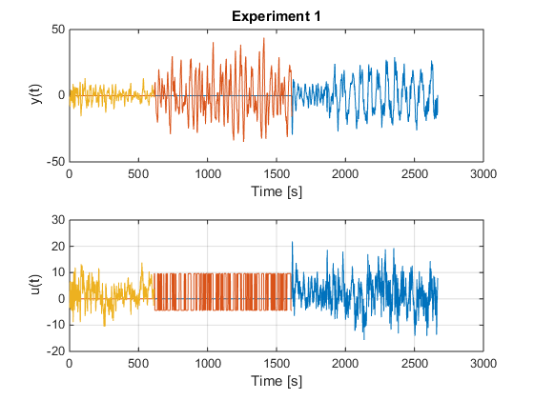
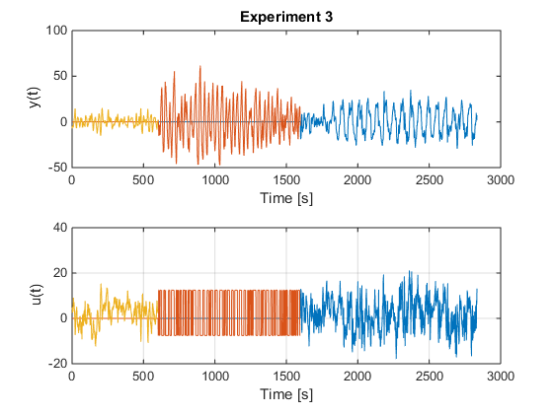
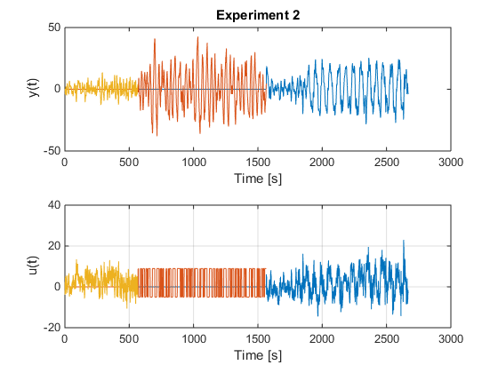
EXPERIMENT
EXPERIMENT DATA

Slide 7
DATA PROCESSING AND ANALYSIS

Slide 8
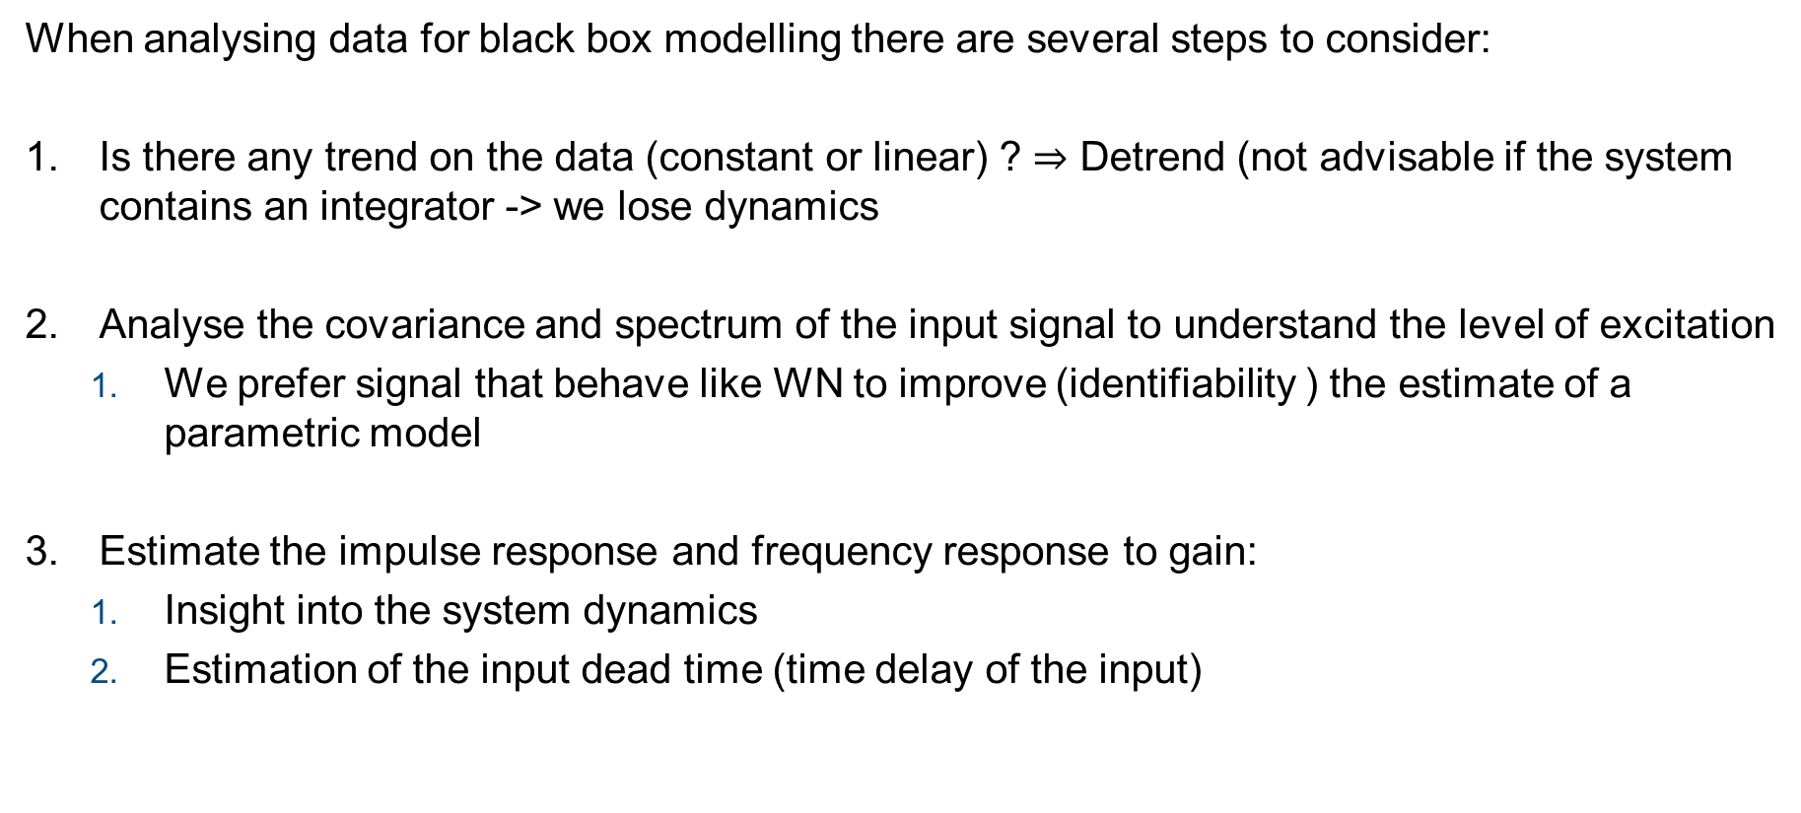
DATA PROCESSING
AND ANALYSIS
When analysing data for black box modelling there are several steps to consider:
Is there any trend on the data (constant or linear) ? $⇒$ Detrend (not advisable if the system contains an integrator -> we lose dynamics
Analyse the covariance and spectrum of the input signal to understand the level of excitation
We prefer signal that behave like WN to improve (identifiability ) the estimate of a parametric model
Estimate the impulse response and frequency response to gain:
Insight into the system dynamics
Estimation of the input dead time (time delay of the input)

Slide 9
DATA PROCESSING
AND ANALYSIS
Input Covariance – Spectrum Analysis 1/5
Analysis of the covariance gives insight on the level of excitation of the input signal: for example we can run the Anderson Whiteness Test to understand if the input signal behaves like a random white noise.
Also the rank of the correlation matrix can give some info, but most of the time has a persistence of excitation very high:
Matlab command pexcit always returned 50 (degree of persistence of excitation, its calculated based on min(n/3, 50) where n=rank(Ru) )

Slide 10
DATA PROCESSING
AND ANALYSIS
Input Covariance – Spectrum Analysis 2/5
The following table summarise the results of the Anderson Test, with confidence 90%, considering all samples of each set.
Ratio of violation | 1st Exp | 2nd Exp | 3rd Exp
Full data | 0.2245 | 0.2343 | 0.2231
1st portion | 0.3154 | 0.4293 | 0.4110
2nd portion | 0.1785 | 0.3049 | 0.2995
3rd portion | 0.4483 | 0.7414 | 0.9138

Slide 11
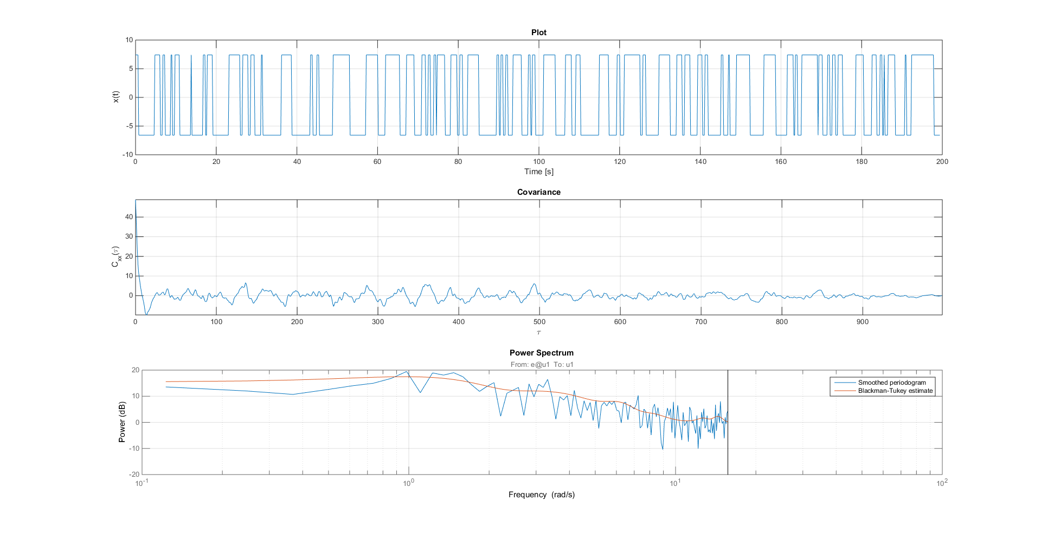
DATA PROCESSING
AND ANALYSIS
Input Covariance – Spectrum Analysis 3/5
1rd experiment, 2nd data set

Slide 12
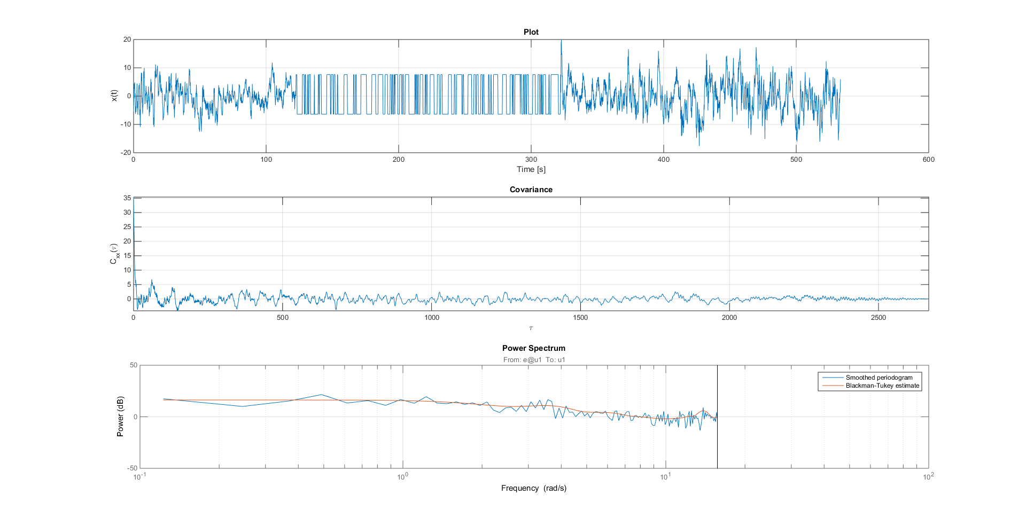
DATA PROCESSING
AND ANALYSIS
Input Covariance – Spectrum Analysis 4/5
1rd experiment, full data set

Slide 13
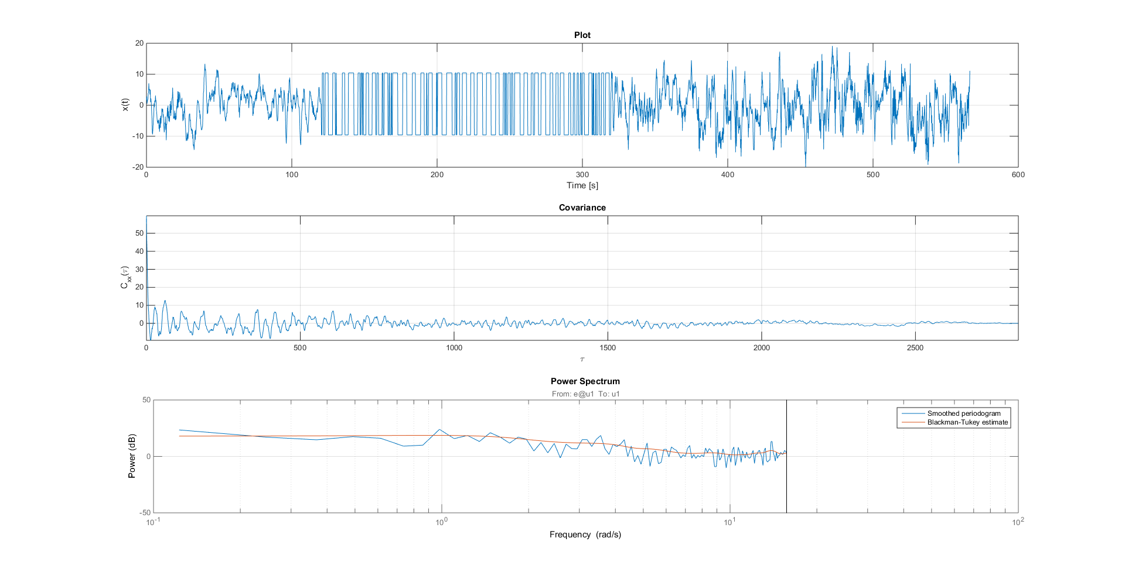
DATA PROCESSING
AND ANALYSIS
Input Covariance – Spectrum Analysis 5/5
3rd experiment, full data set

Slide 14
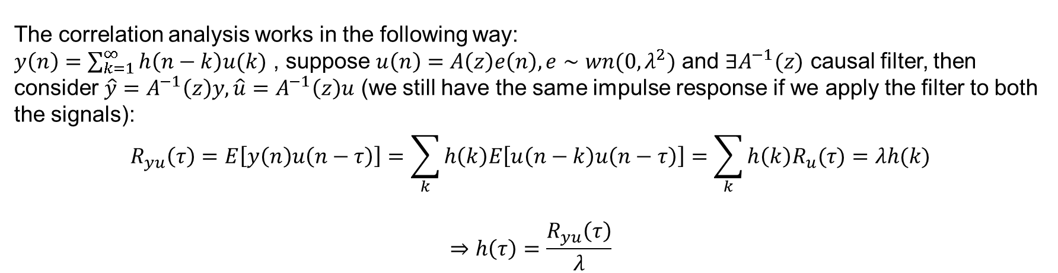
DATA PROCESSING
AND ANALYSIS
IMPULSE RESPONSE 1/3
Main two approaches to estimate the impulse response are:
Identify a FIR model
Make use of correlation analysis
From this we can make a rough estimation of the impulse response, and together with the measured data, try to estimate the input delay (dead time).
The correlation analysis works in the following way:
$y\left(n\right)=\sum_{k=1}^{∞}{h\left(n−k\right)u(k)}$ , suppose $u\left(n\right)=A\left(z\right)e\left(n\right), e∼wn(0,λ^{2})$ and $∃A^{−1}(z)$ causal filter, then consider $\hat{y}=A^{−1}\left(z\right)y, \hat{u}=A^{−1}\left(z\right)u$ (we still have the same impulse response if we apply the filter to both the signals):
$$R_{yu}\left(τ\right)=E\left[y\left(n\right)u\left(n−τ\right)\right]=\sum_{k}{h\left(k\right)E\left[u\left(n−k\right)u\left(n−τ\right)\right]=\sum_{k}{h\left(k\right)R_{u}(τ)}=λh(k)}$$
$$⇒h\left(τ\right)=\frac{R_{yu}\left(τ\right)}{λ}$$

Slide 15
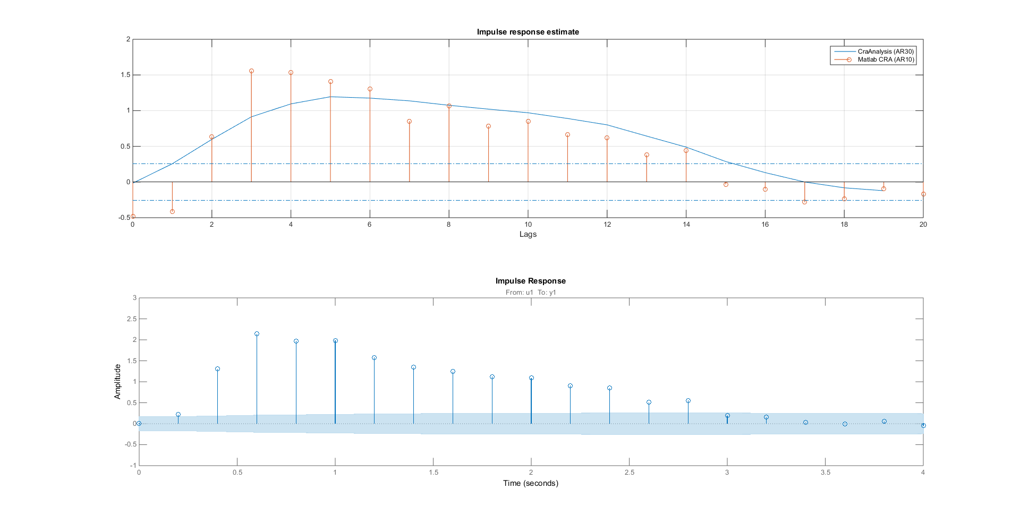
DATA PROCESSING
AND ANALYSIS
IMPULSE RESPONSE 2/3 – Estimation
First image is based on correlation analysis.
Second one is based on the identification of a fir model up to n=20.
Seems like that
A positive input
Is delayed of 2-3 lags (See confidence region)
Tested on all the datasets, quite similar behaviour.

Slide 16
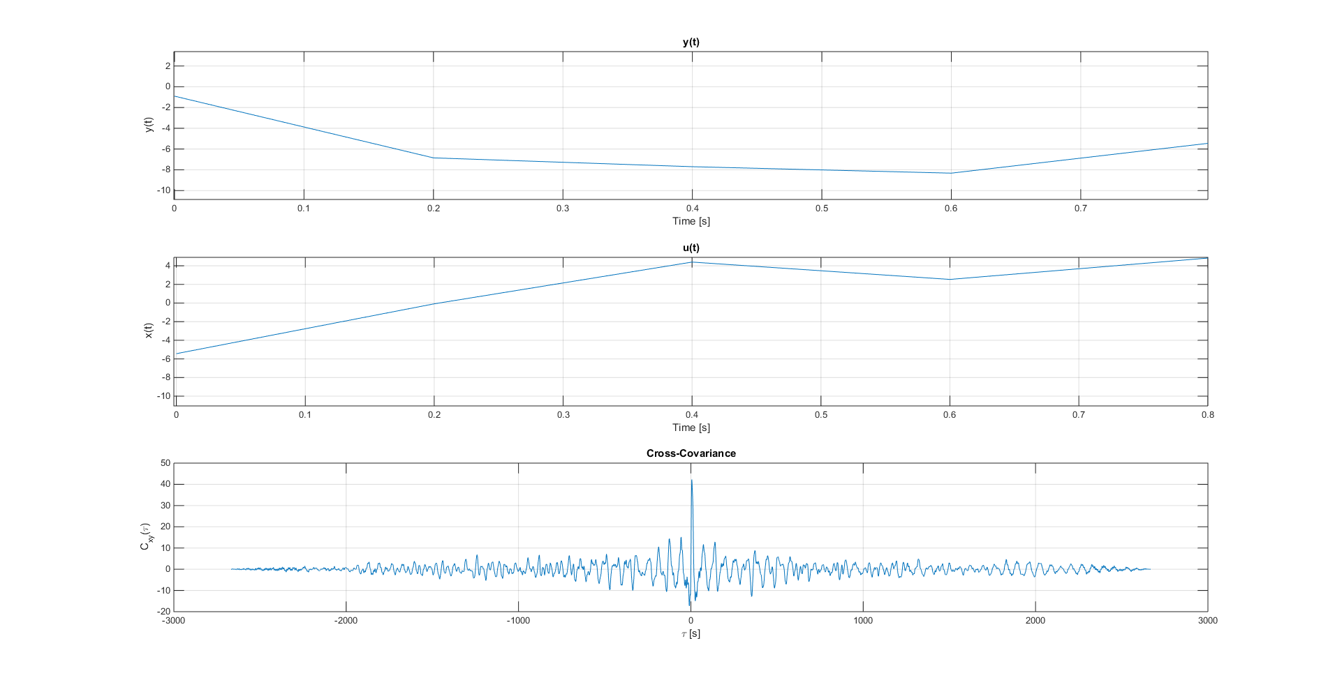
DATA PROCESSING
AND ANALYSIS
IMPULSE RESPONSE 3/3 – Data Analysis
Effect of u >0 after
2-3 Ts = 0.4-0.6 sec

Slide 17
Model identification

Slide 18
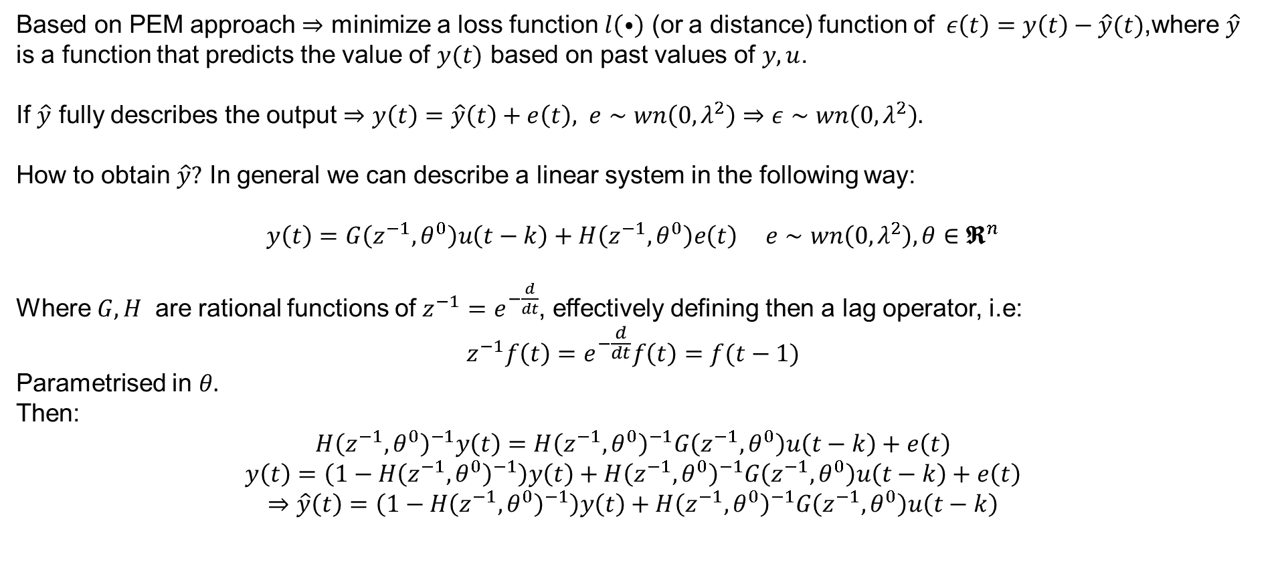
MODEL IDENTIFICATION
MODEL IDENTIFICATION - PEM
Based on PEM approach $⇒$ minimize a loss function $l\left(⦁\right)$ (or a distance) function of$ε\left(t\right)=y\left(t\right)−\hat{y}(t)$,where $\hat{y}$ is a function that predicts the value of $y(t)$ based on past values of $y,u$.
If $\hat{y}$ fully describes the output $⇒y\left(t\right)=\hat{y}\left(t\right)+e\left(t\right), e∼wn\left(0,λ^{2}\right)⇒ε∼wn\left(0,λ^{2}\right).$
How to obtain $\hat{y}?$ In general we can describe a linear system in the following way:
$y\left(t\right)=G\left(z^{−1},θ^{0}\right)u\left(t−k\right)+H\left(z^{−1},θ^{0}\right)e\left(t\right) e∼wn\left(0,λ^{2}\right), θ∈𝕽^{n}$
Where$G,H$ are rational functions of $z^{−1}=e^{−\frac{d}{dt}}$, effectively defining then a lag operator, i.e:
$$z^{−1}f\left(t\right)=e^{−\frac{d}{dt}}f\left(t\right)=f(t−1)$$
Parametrised in $θ.$
Then:
$$H{\left(z^{−1},θ^{0}\right)}^{−1}y\left(t\right)=H{\left(z^{−1},θ^{0}\right)}^{−1}G\left(z^{−1},θ^{0}\right)u\left(t−k\right)+e\left(t\right)$$
$$y\left(t\right)=\left(1−H{\left(z^{−1},θ^{0}\right)}^{−1}\right)y\left(t\right)+H{\left(z^{−1},θ^{0}\right)}^{−1}G\left(z^{−1},θ^{0}\right)u\left(t−k\right)+e\left(t\right)$$
$$⇒\hat{y}\left(t\right)=\left(1−H{\left(z^{−1},θ^{0}\right)}^{−1}\right)y\left(t\right)+H{\left(z^{−1},θ^{0}\right)}^{−1}G\left(z^{−1},θ^{0}\right)u\left(t−k\right)$$

Slide 19
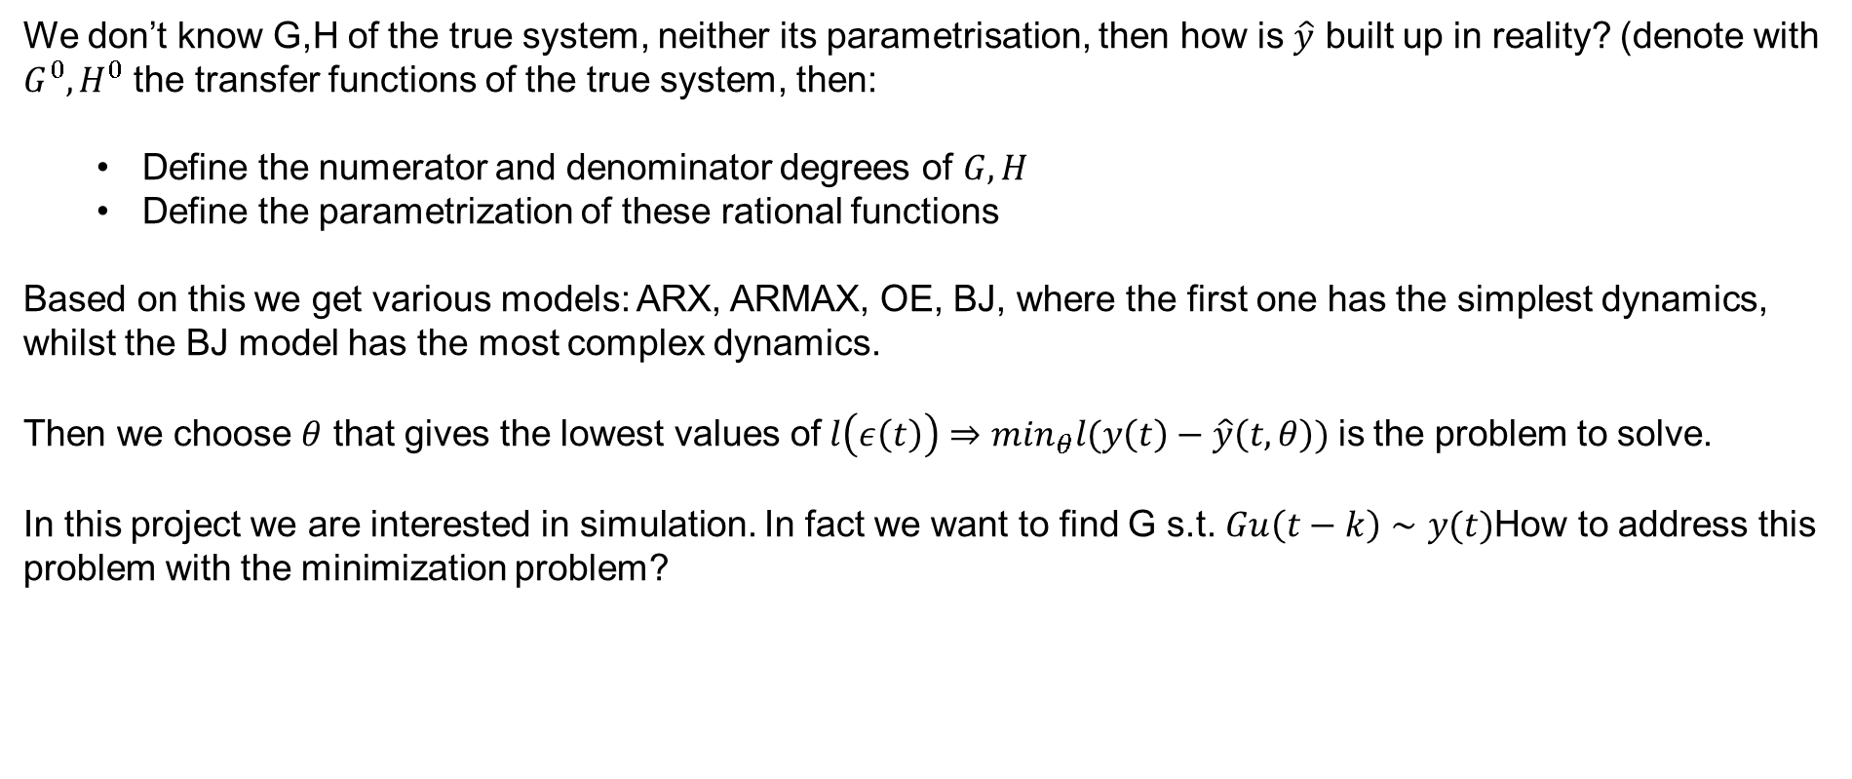
MODEL IDENTIFICATION
MODEL IDENTIFICATION – WHICH MODEL
We don’t know G,H of the true system, neither its parametrisation, then how is $\hat{y}$ built up in reality? (denote with $G^{0},H^{0}$ the transfer functions of the true system, then:
Define the numerator and denominator degrees of $G,H$
Define the parametrization of these rational functions
Based on this we get various models: ARX, ARMAX, OE, BJ, where the first one has the simplest dynamics, whilst the BJ model has the most complex dynamics.
Then we choose $θ$ that gives the lowest values of$l\left(ε\left(t\right)\right)⇒\min_{θ}l(y\left(t\right)−\hat{y}\left(t,θ\right))$is the problem to solve.
In this project we are interested in simulation. In fact we want to find G s.t. $Gu\left(t−k\right)∼y(t)$How to address this problem with the minimization problem?

Slide 20
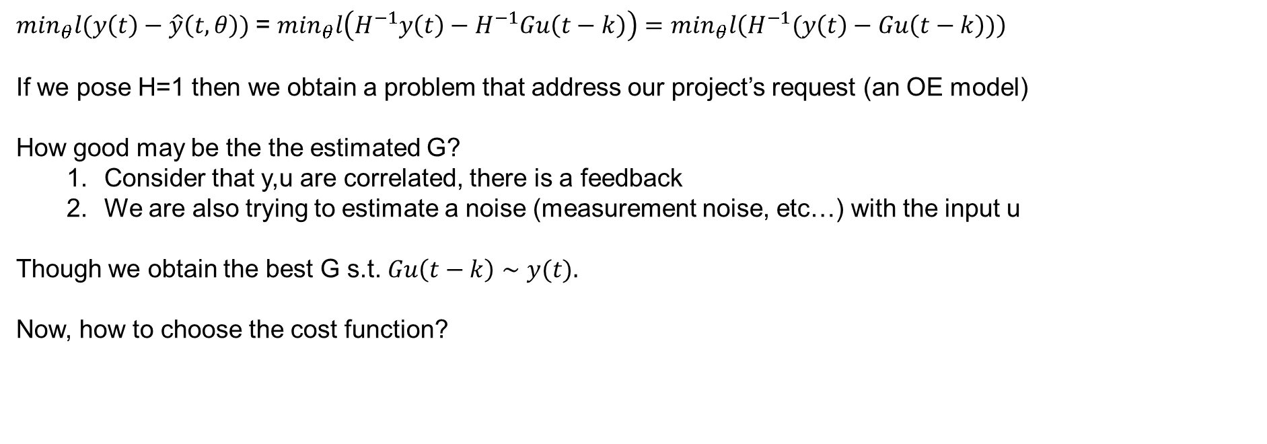
MODEL IDENTIFICATION
MODEL IDENTIFICATION – WHICH MODEL
$\min_{θ}l(y\left(t\right)−\hat{y}\left(t,θ\right))$= $\min_{θ}l\left(H^{−1}y\left(t\right)−H^{−1}Gu\left(t−k\right)\right)=\min_{θ}l\left(H^{−1}(y\left(t\right)−Gu\left(t−k\right))\right)$
If we pose H=1 then we obtain a problem that address our project’s request (an OE model)
How good may be the the estimated G?
Consider that y,u are correlated, there is a feedback
We are also trying to estimate a noise (measurement noise, etc…) with the input u
Though we obtain the best G s.t. $Gu\left(t−k\right)∼y(t).$
Now, how to choose the cost function?

Slide 21
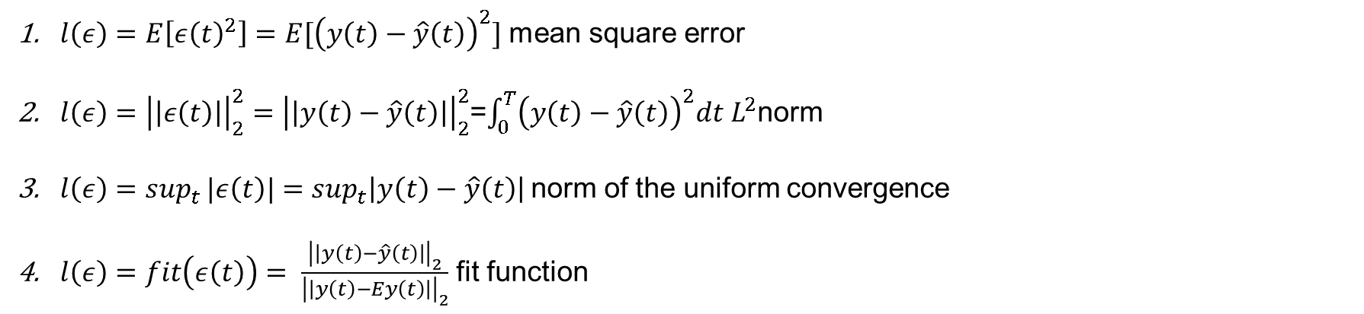
MODEL IDENTIFICATION
MODEL IDENTIFICATION – LOSS FUNCTION
$l\left(ε\right)=E\left[ε{\left(t\right)}^{2}\right]=E[{\left(y\left(t\right)−\hat{y}\left(t\right)\right)}^{2}]$ mean square error
$l\left(ε\right)={\left|\left|ε\left(t\right)\right|\right|}_{2}^{2}={\left|\left|y\left(t\right)−\hat{y}\left(t\right)\right|\right|}_{2}^{2}$=$\int_{0}^{T}{{\left(y\left(t\right)−\hat{y}\left(t\right)\right)}^{2}dt}$ $L^{2}$norm
$l\left(ε\right)=sup_{t}{|ε\left(t\right)|}=sup_{t}\left|y\left(t\right)−\hat{y}\left(t\right)\right|$norm of the uniform convergence
$l\left(ε\right)=fit\left(ε\left(t\right)\right)= \frac{{\left|\left|y\left(t\right)−\hat{y}\left(t\right)\right|\right|}_{2}}{{\left|\left|y\left(t\right)−Ey\left(t\right)\right|\right|}_{2}}$ fit function

Slide 22
MODEL VALIDATION
MODEL VALIDATION
but we are training a model based on $(y,u)$ data and then check the cost function on the same data -> we get a biased result.
To get unbiased results we need to test the cost function on a different data set.
Unfortunately in this project the data is quite similar, though the second data set covariance function is a little different $⇒$ We may test the cost function on a subset of this experiment.

Slide 23
CONCLUSION & REMARKS
CONCLUSION

Slide 24
WHAT WENT WRONG
AND WHY

Slide 25
CONCLUSION & REMARKS
Qui possiamo mettere tipo le ideee andate male o da provare
-interpolazione dati + training su essi
-experiment have the same kind of shape-> do an avg of the data and train
-use 2 experiments at time to do training and then validation on the other set

