Slide 1
Hospital Patient Pathway
Group 19
Xinran Zhang 23084415
Songjie Qiu 23084419
Cathleen Liu 23084383
Chenyu Yang 23084439

Slide 2
Project Background and Objectives
Hospital patient referral, treatment and administration pathway - BPM & EA / AISD
Background
A teaching hospital receives referrals from external referring organisations and must carry a
patient from referral receipt through consultation, consent, treatment, funding, payment and
follow-up administration.
The case study describes 17 interlocking business processes. Before this project they existed
only as prose: responsibilities were unclear, hand-offs to external parties were implicit, and
exception routes were undocumented.
External parties (referrer, patient, scheduling service, treatment/laboratory service, funder,
payment provider, correspondence, delay tracking) sit outside the hospital boundary and can
only be reached by message exchange.
Objectives
O1 Model all 17 processes as one executable Camunda 8 collaboration.
O2 Make participants, responsibilities and system boundaries explicit.
O3 Encode the business rules as measurable, testable conditions.
O4 Automate every automated step with external job workers.
O5 Give every human task a bound Camunda Form.
O6 Prove the result with a repeatable automated test suite and a
traceable acceptance test plan.
Non-goals: no real HIS/PAS integration, no real payment gateway, no
clinical urgency policy invented (left as a stakeholder decision).

Slide 3
CORE CLINICAL PATH
01
Referral
receipt
02
Referral
review
03
Initial
consultation
04
Diagnosis &
consent
05
Treatment &
services
06
Funding
verification
07
Payment
result
08
Continuation
review
P08 may repeat the treatment cycle, schedule a later review, or route a stopped case to refund handling.
09–11
12–14
15–17
Treatment changes, attendance exceptions, refunds
Patient inquiries, medical letters, follow-up booking
Monitoring, access and downtime, scheduling escalation
Notes:
This diagram shows 17 processes in the hospital patient pathway. We can understand them in three groups.
The first group is P01 to P07. It shows the main journey: the hospital receives a referral, checks it, contacts the patient, discusses treatment, plans the services, checks who will pay, and handles the payment.
The second group is P08 to P11. These processes deal with what may happen during treatment. The team checks if treatment should continue, handles changes or missed appointments, and deals with refunds or moving money to another appointment.
The third group is P12 to P17. These are support processes. They handle patient questions, clinic letters, follow-up visits, reports, staff access, system problems, and appointment changes. They start when needed, so they do not always happen in number order.
In short, the first group gets the patient ready for treatment. The second group manages treatment changes and payment issues. The third group helps the whole service run safely and smoothly.

Slide 4
Technical Solution and Architecture
Camunda 8.9 orchestration + Spring Boot job workers + deployment-bound forms
Runtime architecture
Camunda 8.9 (c8run, local self-managed cluster) - Zeebe engine, Operate, Tasklist.
Process_Hospital_Integrated: 1 executable pool, 11 lanes, 81 user tasks, 51 automated
steps (service + send tasks), 81 exclusive / 3 parallel / 6 event-based gateways.
8 non-executable black-box pools model the external parties; they interact only through
8 message flows and 49 message events (correlation key = referralId / patientId).
Spring Boot 4.0.5 worker application (java/): 13 worker classes covering 50 job types,
an embedded H2 system of record (20 tables), and a simulation layer that answers on
behalf of the external parties so the pathway can be walked end to end.
Design decisions
One executable process, not 17: keeps a single instance per referral and lets the
external-trigger router open any stage from one entry point.
Black-box pools for externals: BPMN lanes cannot reference another process, and a
message flow may not join elements of the same pool.
16 deployment-bound forms reused across 81 tasks; a shared form shows only the
section for the current task via hospitalFormTask.
Exceptions are modelled as timer/message catch plus exclusive gateways - Camunda 8
has no BPMN error escalation between pools.

Slide 5
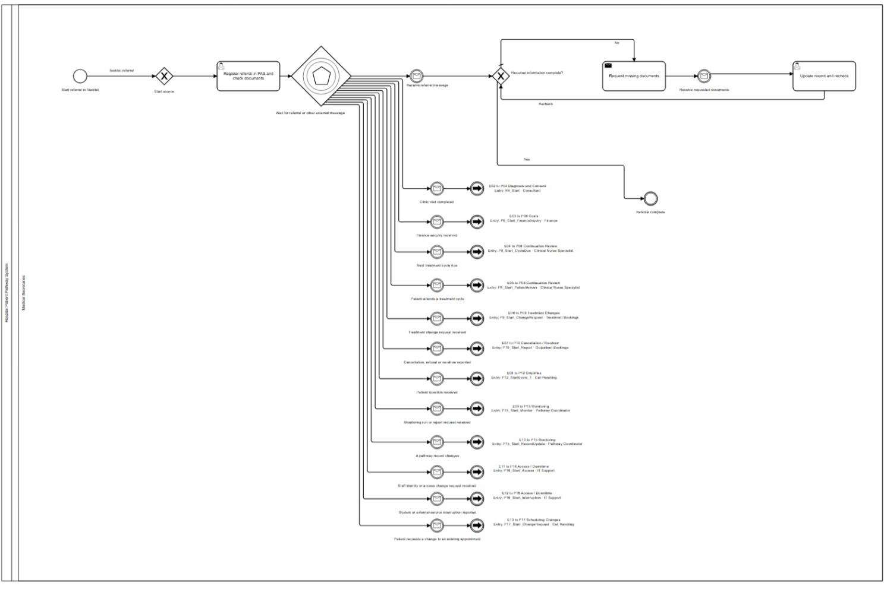
01 Referral Receipt & Handoffs
Notes:
1.When the hospital gets a referral, it opens a file for the patient. It writes down who the patient is and who sent the referral.
2.Staff check the list to see if all the referral papers are there.
3.If some papers are missing, staff tell the person who sent the referral what is missing and wait.
4.When the papers arrive, staff add them to the file and check everything again.
5.When all the papers are ready, staff send the case to a doctor. The doctor decides if the hospital can accept the patient.

Slide 6
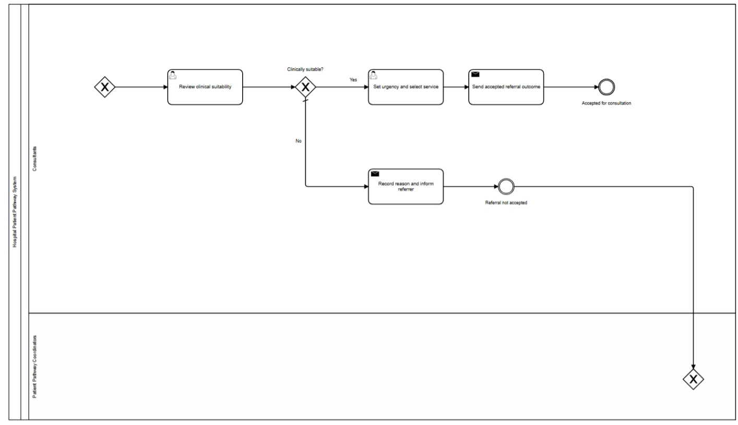
02 Referral Review
Notes:
The doctor checks the referral, the patient’s condition, and any test results. The doctor decides if this hospital can accept the patient.
· If the hospital cannot accept the patient, staff write down why and tell the person who sent the referral. The referral process then ends.
· If the hospital can accept the patient, the doctor or staff mark how urgent the case is and choose the team that will help next.
· The system tells the person who sent the referral that it has been accepted. Then the appointment team contacts the patient.

Slide 7
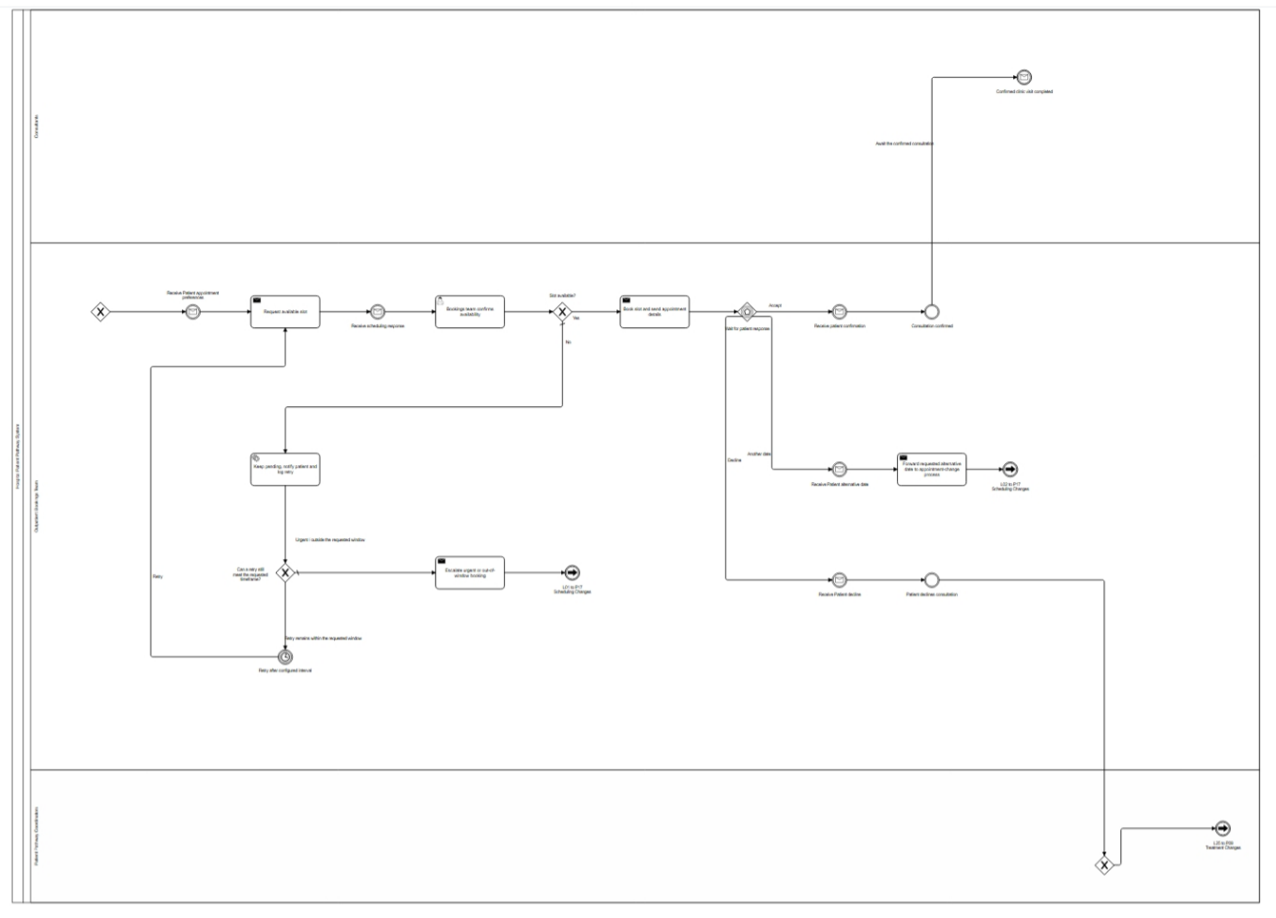
03 Initial Consultation & Patient Contact
Notes:
The booking staff ask the scheduling team for available times. Then they wait for a reply.
· When the times are available, the booking staff send them and the visit details to the patient.
· If the patient accepts a time, the team confirms the appointment and sends the details to the patient.
· If the patient wants a different date, the team sends the request to the rescheduling process.
· If there are no available times, the team tells the patient they are still looking and keeps the case open.
· The system checks for an available time again later. If waiting longer could make the patient miss the doctor’s time limit, the case is sent to the patient pathway team for help.

Slide 8
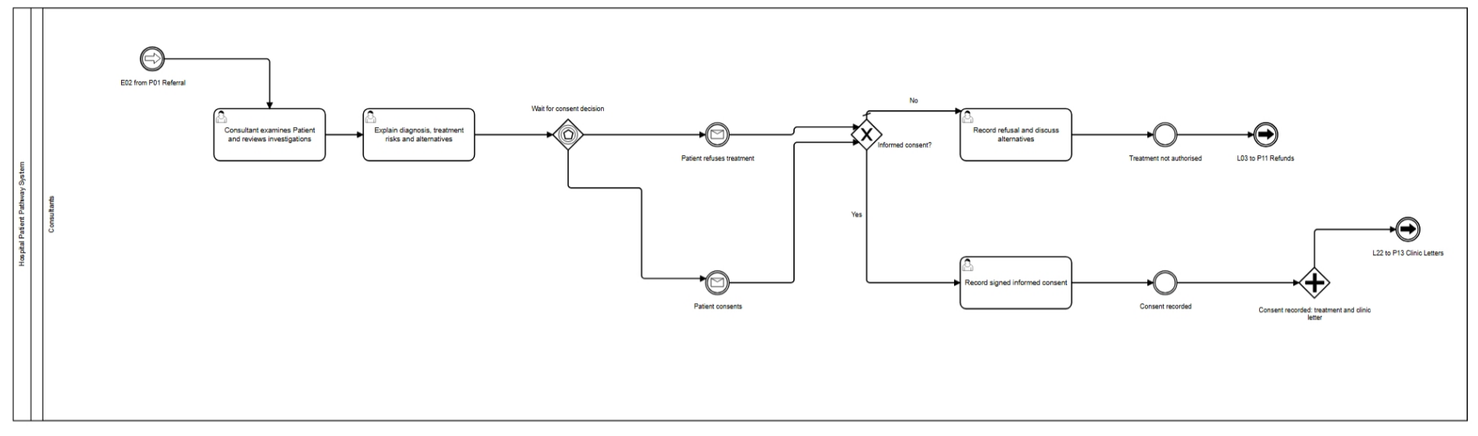
04 Diagnosis, Assessment & Informed Consent
Notes:
After the visit, the doctor checks the patient’s condition and test results.
· The doctor explains the diagnosis, the suggested treatment, its possible risks, and other choices.
· The patient may need time to think. The team waits for the patient’s answer and does not assume the patient has agreed.
· If the patient agrees, the team saves the signed form and tells the next team. If the patient says no, the team records the reason and the other choices they discussed. The case is sent to the Finance team if needed.

Slide 9
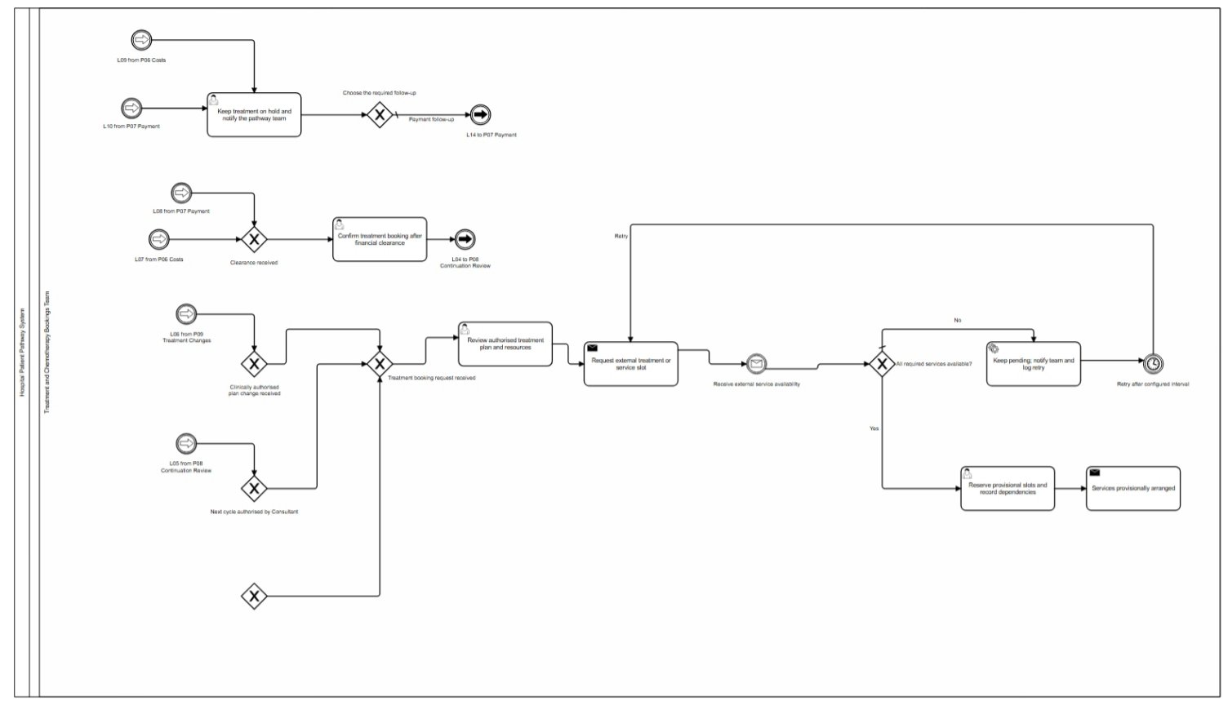
05 Treatment & External Services
Notes:
How it starts: We enter right after the consent decision in P04 — an internal flow. The page can also wake up again when the next treatment cycle is due, coming back from P08, or when a treatment plan change comes in from P09; all merge into the same review.
Trigger: The external services — scheduling, imaging, lab — reply with a "service availability" message; if something isn't available, a timer retries automatically.
Who does it: The Treatment and Chemotherapy Bookings Team. They review the authorised treatment plan, reserve the provisional slots, keep the treatment on hold and notify the pathway team if funding or payment is stuck, and confirm the final booking once clearance arrives.
How it ends: We publish a provisional booking and hand over to funding, P06. The booking only becomes final after the funding clearance or payment confirmation message comes back — then it moves to continuation, P08, and treatment is actually delivered. If clearance never comes, the case stays on hold and the issue goes back to funding or payment.

Slide 10
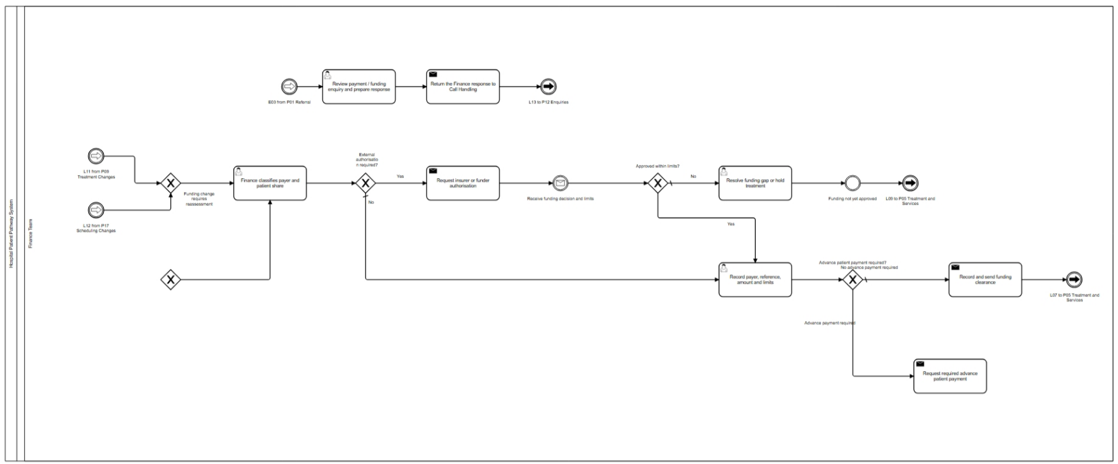
06 Funding Method Verification
Notes:
How it starts: We come in right after the provisional booking from P05. A plan change (from P09) or a funding arrangement change (from P17) can re-enter and reclassify the payer. A finance enquiry comes through the medical secretaries and is handed to the finance team.
Trigger: The insurer replies with a "funding authorisation decision" message.
Who does it: The Finance Team. They classify the payer and the patient's share, record the payer, reference, amount and limits, resolve a funding gap if authorisation is rejected, and answer finance enquiries.
How it ends: If no advance payment is needed, we send funding clearance back to P05 and the booking turns final. If an advance is needed, we move to payment processing, P07. If the gap can't be resolved, the treatment goes pending back to P05 and stays on hold. Enquiry replies go to the enquiries process, P12.

Slide 11
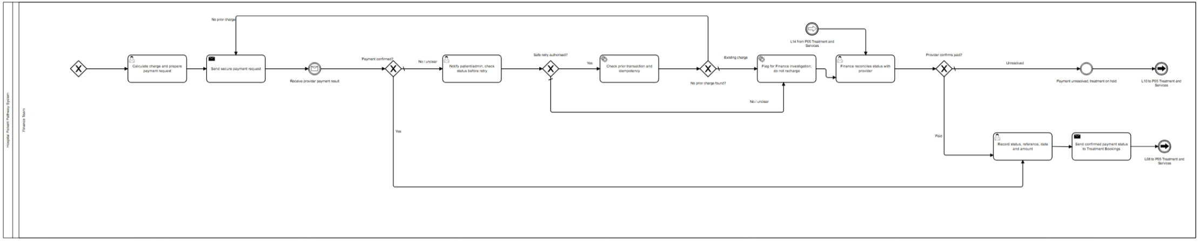
07 Payment Result Handling
Notes:
How it starts: We come in after P06 requests an advance payment. If the bookings team sends a payment follow-up, we go straight to reconciliation without opening a new payment cycle.
Trigger: The payment service provider replies with a "payment result" message.
Who does it: The Finance Team. They calculate the charge, record the payment outcome, notify the patient or admin to check the status when payment fails, and reconcile with the provider.
How it ends: If paid, we record it and send confirmation back to P05, which unlocks the final booking. If not, we run an idempotency check first — to make sure we never charge twice — then retry, or flag an investigation and reconcile if a charge already exists. If it stays unresolved, it goes pending back to P05.

Slide 12
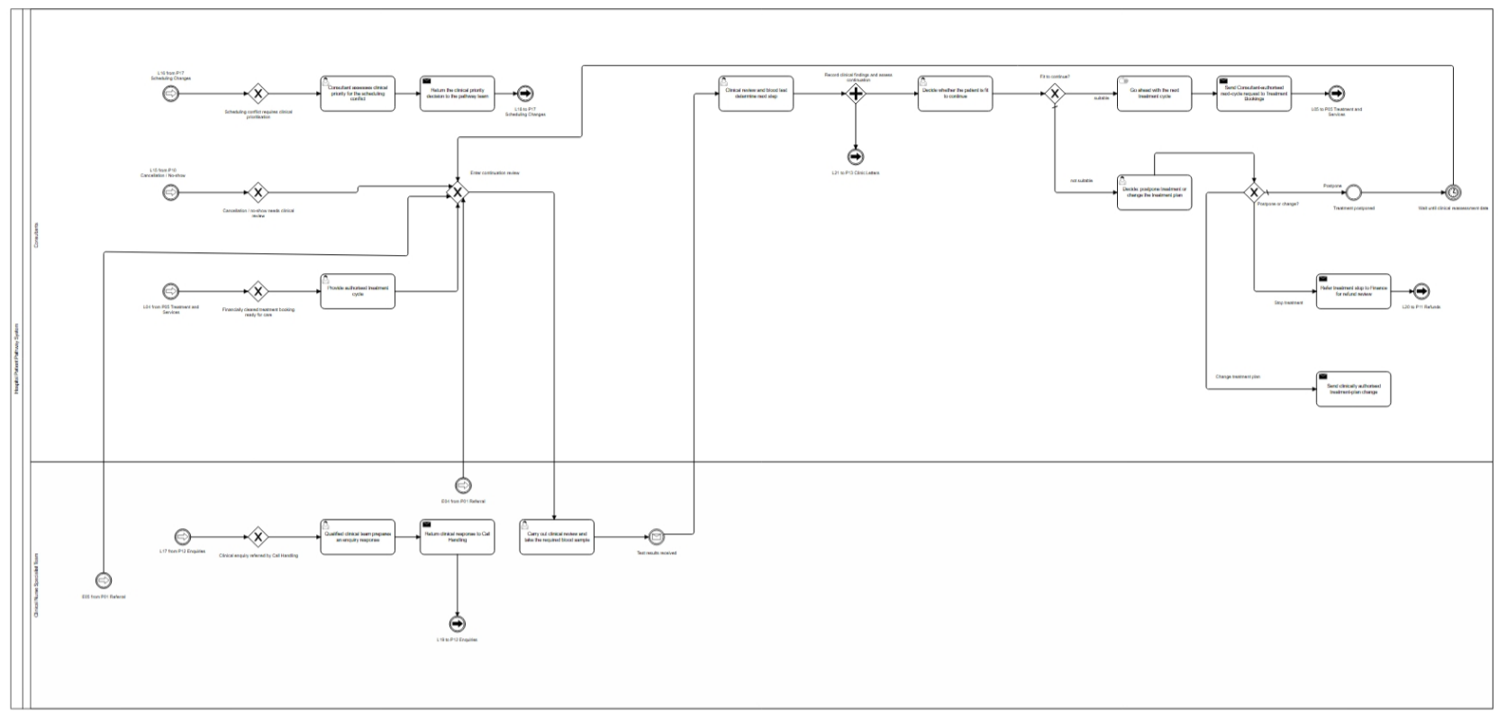
08 Treatment Continuation Review
Notes:
How it starts: Two ways. External messages — "next treatment cycle due" or "patient arrives for the cycle" — come in through the medical secretaries and are handed to the clinical team, so this page can start on its own. Or the confirmed booking from P05 comes in, and we deliver that treatment cycle first, then review. Smaller entries: a cancellation from P10, a scheduling conflict from P17, a clinical enquiry from P12.
Trigger: The lab sends a "test results" message.
Who does it: The Clinical Nurse Specialist Team does the clinical review and blood sample, and answers clinical enquiries. The Consultants do the clinical review, decide whether the patient is fit to continue, release the next cycle — that's a manual task done outside the system — decide to postpone or change the plan, and deliver the treatment itself.
How it ends: If fit, we release the next cycle and send it back to P05 to start the loop again. If not fit: postpone — a reassessment timer brings us back later; change the plan — goes to P09; or stop treatment — a refund case goes to P11. In parallel, the clinic letter goes to P13.

Slide 13
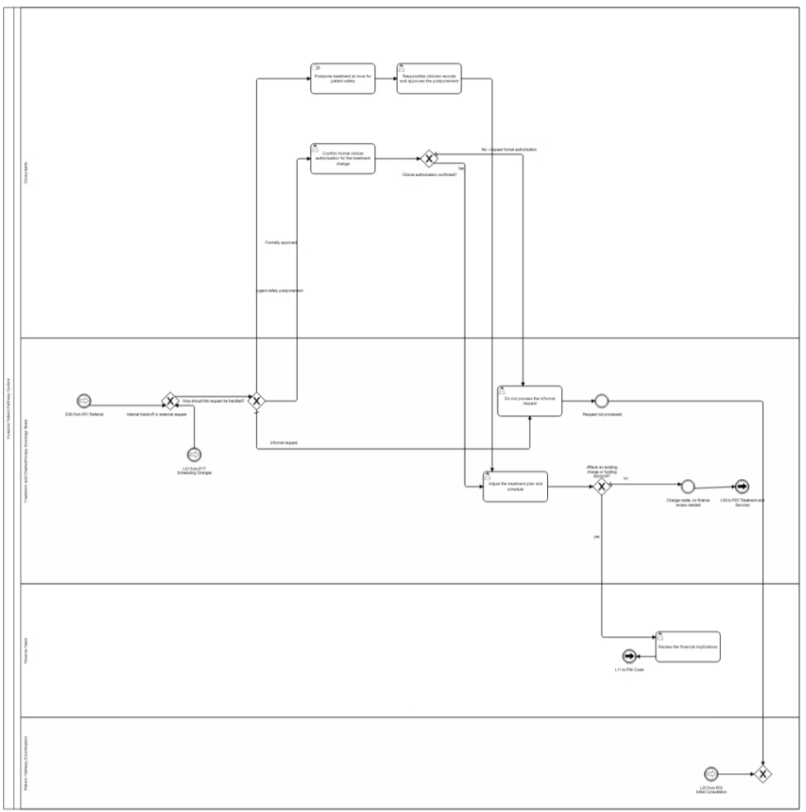
09 Treatment Plan Changes
Notes:
This process handles requests to change an existing treatment timetable.
When a change request arrives, the Bookings Team checks its type — there are three paths:
• Formally approved — the request has a signed change form in the system, so adjust the schedule directly.
• Informal — the request comes by email, phone, or casual chat. Do NOT act on it immediately.
• Urgent safety postponement — a consultant delays the appointment at once for patient safety, but the responsible doctor must formally record and approve it afterward.
After the schedule is adjusted, check whether the change affects any existing charge or funding. If it does, pass the case to the Finance Team; if not, the process ends.

Slide 14
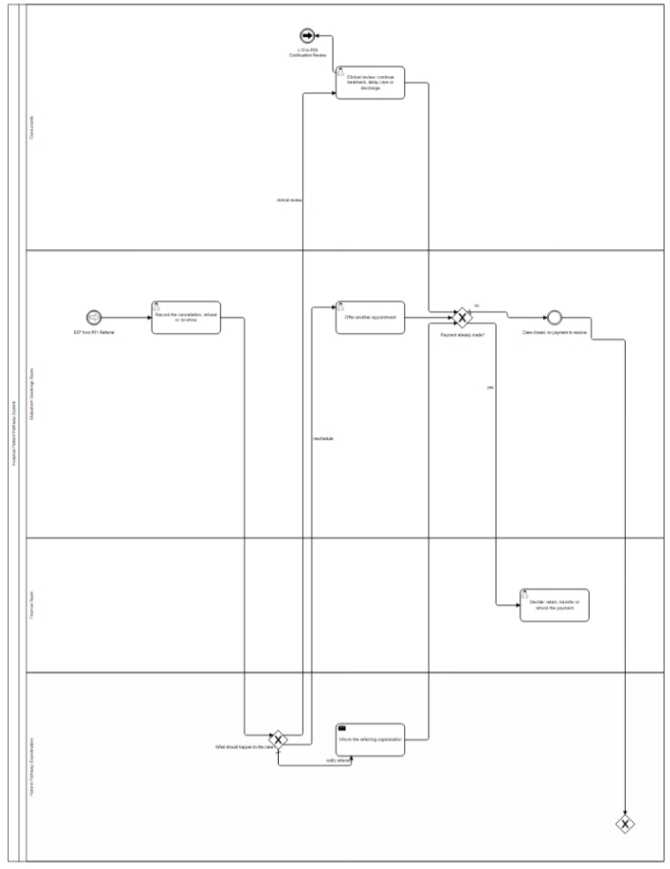
10 Cancellations, Rejections & No-Shows
Notes:
This process deals with cancelled appointments, refused visits, and patient no-shows.
First, the Outpatient Bookings Team records the event. Then a Patient Pathway Coordinator decides what to do:
• Re-book — offer the patient a new appointment.
• Clinical review — send the case back to medical staff for assessment.
• Notify referrer — inform the original GP or referring organisation.
Next, check whether the patient has already paid. If yes, the case goes to Finance — they decide to retain, transfer, or refund the payment. If no payment was made, the case is simply closed.
One key point: decisions about continuing treatment, delaying care, or discharging the patient can only be made by authorised clinical professionals

Slide 15
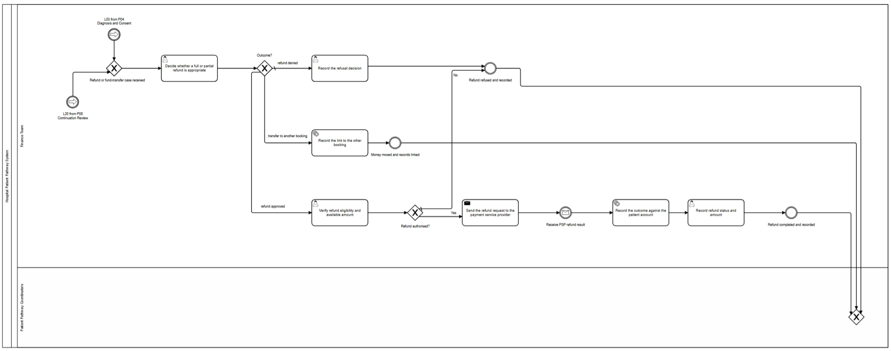
11 Refunds & Fund Transfers
Notes:
This process handles refunds and moving patient payments between bookings.
When a refund or transfer case arrives, an authorised Finance Team member decides the outcome. Important: only authorised finance staff can approve refunds — medical staff cannot unless they also hold finance authority.
Three possible outcomes:
• Refund approved — send the refund request to the external payment provider, then save the result on the patient account.
• Refund rejected — record the finance decision, and that ends the case.
• Transfer to another booking — link all related records together: patient data, referral form, treatment request, appointment record, funding choice, payment record, and refund record.

Slide 16
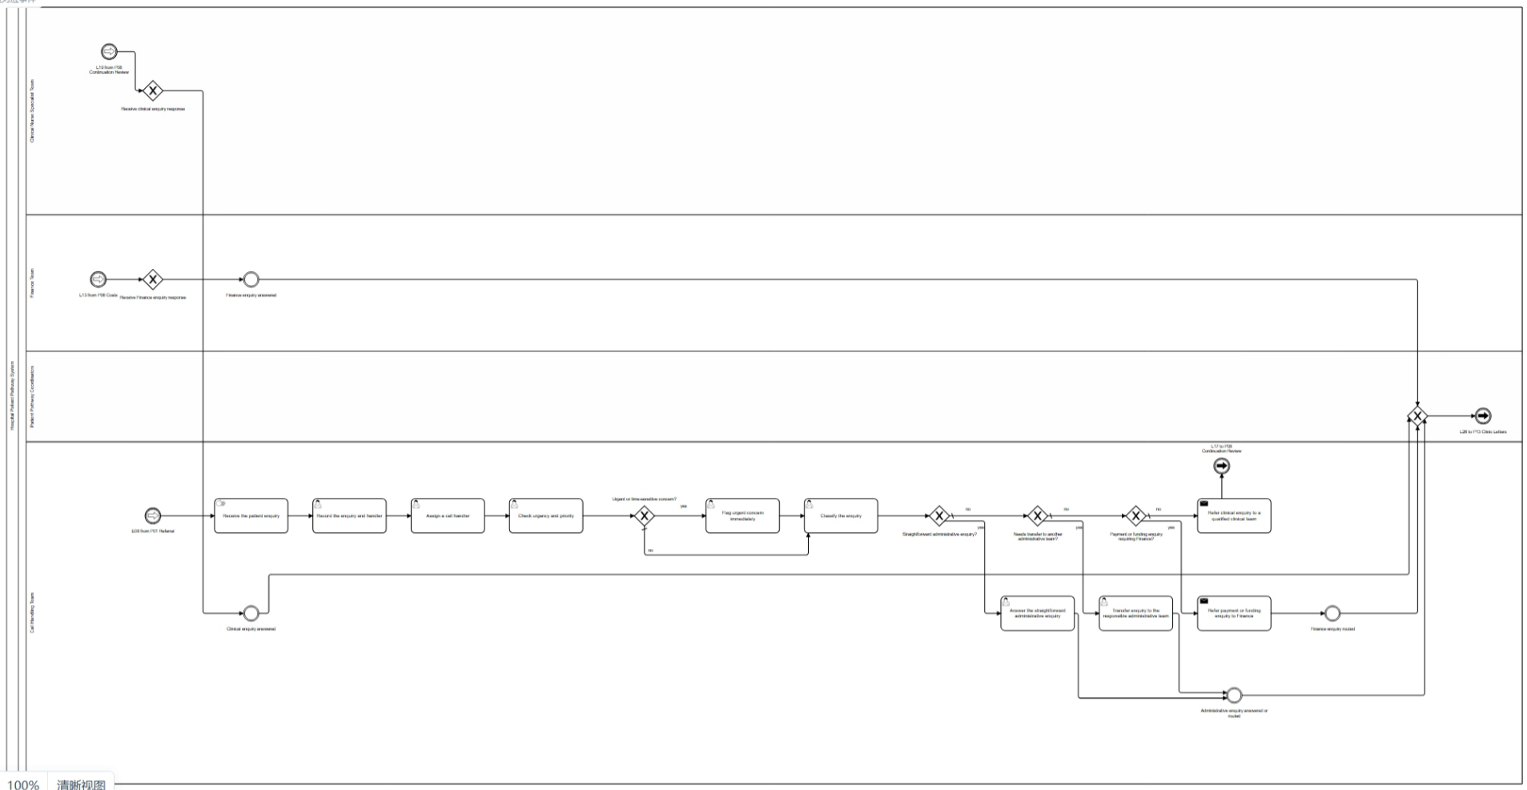
12 Patient Inquiries
Notes:
This process handles patient inquiries that come in by phone or message.
It starts when the Call Handling Team receives a patient question. They first take notes on the inquiry, then assign it to the right team and check whether it is urgent or imperative.
If the case is urgent, it is immediately flagged as high-priority and the process ends.
If it is not urgent, the inquiry is classified into one of four types:
• Simple office question — the Call Handling team answers the patient directly and closes the case.
• General office problem — the team sends out a reply and closes the case.
• Payment or funding question the team cannot answer — the case is passed to the Finance Team, who will handle it.
• Medical-related question — the case is sent to the medical staff, specifically the Clinical Nurse Specialist Team.
In short: urgent cases get flagged right away; everything else is classified and routed to the team that can actually answer it. That covers Process 12.

Slide 17
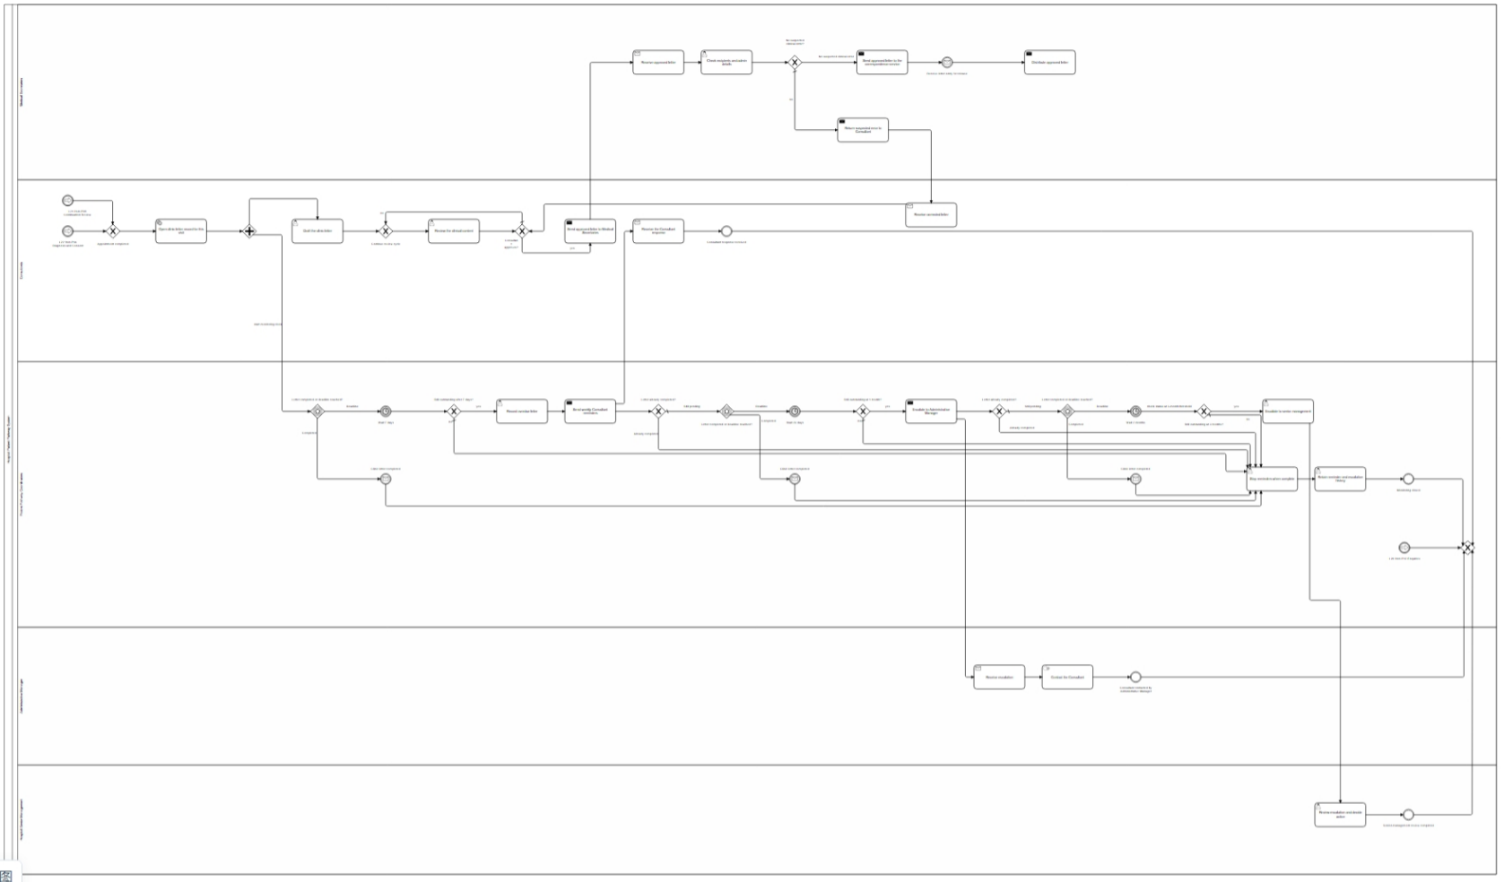
13 Medical Correspondence
Notes:
This process covers the full lifecycle of a clinic letter — from the doctor writing it up to final distribution.
It starts when a doctor writes a clinic letter after a patient visit. The senior doctor then reviews and approves it. If not approved, the doctor revises and resubmits.
Once approved, the letter goes to the Medical Secretaries for double-checking. If they spot possible medical errors, the letter is sent back to the senior doctor for re-checking. If no errors, it is sent out through approved channels to the correspondence service.
If the letter remains unfinished for more than seven days, the process tracks the delay and sends weekly reminders to the doctor. If no response after one month, the issue is reported to senior management, who talks to the responsible doctor. If it still is not done after three months, it is escalated to high-level hospital managers.
At every step, the full history of reminders and escalations is preserved. In short: write, review, check, send — with escalating reminders if the letter gets stuck.

Slide 18
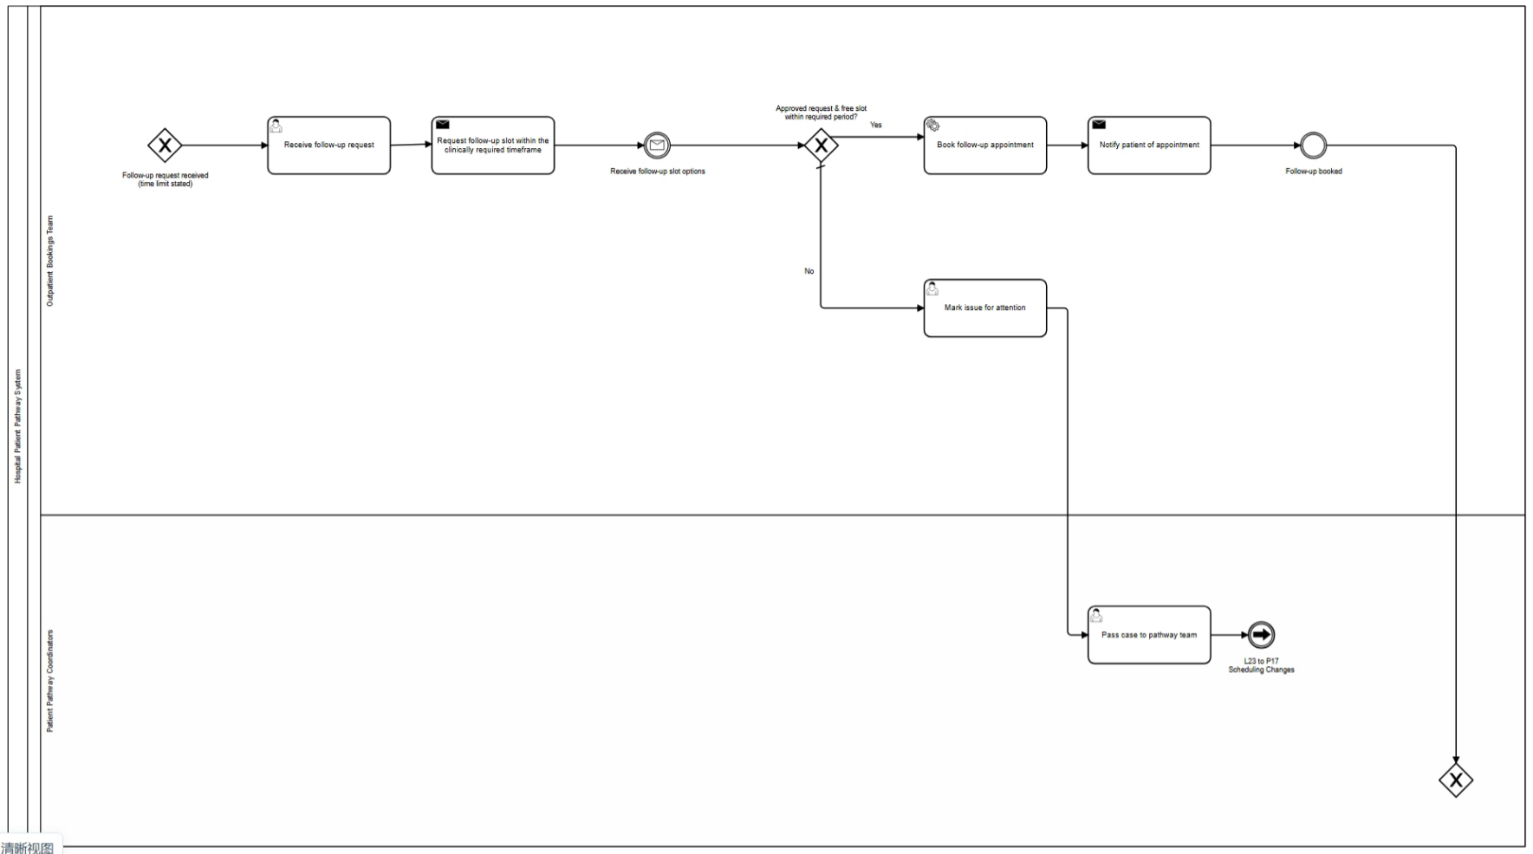
14 Follow-up Booking
Notes:
This process handles follow-up appointment requests submitted by consultants.
It starts when an approved follow-up request arrives — the consultant has stated the required timeframe for the next review.
The Outpatient Bookings Team then checks whether a suitable slot is available within that required period.
Two paths:
• If a slot is available — the bookings team books the follow-up appointment through the external scheduling service, then notifies the patient. The process ends here.
• If no slot can be booked within the required timeframe — the issue is flagged for attention and handed over to the Patient Pathway Coordinators. The bookings team must not book a later date on their own.
In short: book on time and notify the patient, or escalate to the pathway team — never book late without authorisation. That covers Process 14.

Slide 19
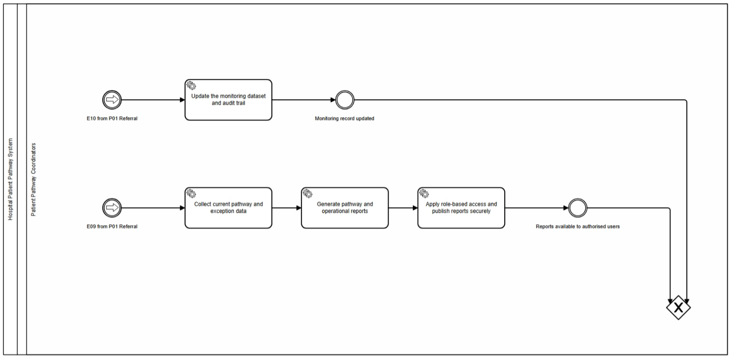
15 Process Monitoring & Reports
Notes:
This is a periodic monitoring process that checks the entire patient pathway and produces reports.
It starts with a monitoring cycle. The Administrative Management Team collects records across referrals, waiting times, letters, enquiries, bookings, funding, payments and refunds.The Administrative Manager then reviews the collected records. If no delays or open issues are found, a monitoring report is generated and sent to senior management for review.If issues are found, they are added to the work report and sent to the responsible operational team for action. The process waits for a resolution update. If the issue is not yet solved, monitoring continues. If it is solved, the status is updated with resolution notes, the report is generated, and senior management reviews it.In short: collect data, review it, fix issues, and report — either directly or through escalation.

Slide 20
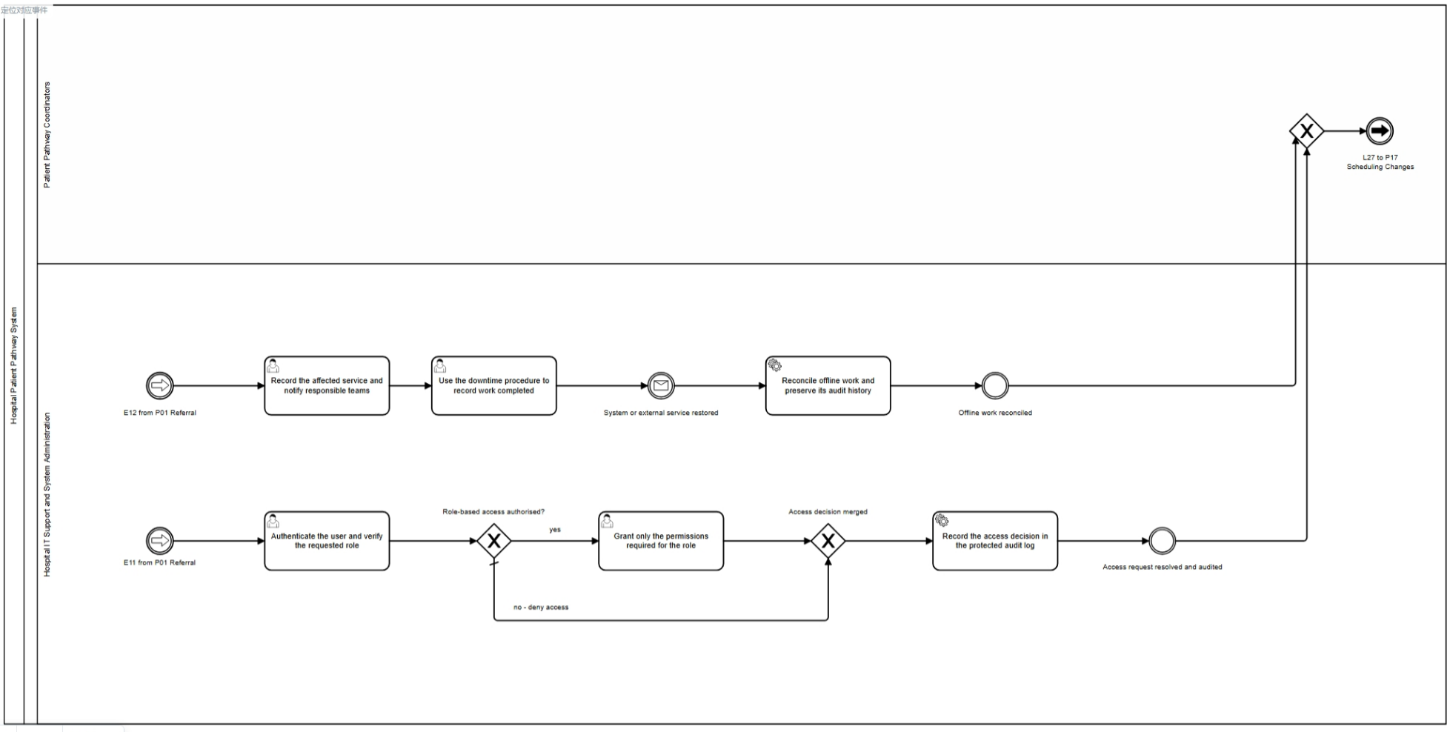
16 Identity, Access & System Downtime
Notes:
This process covers five separate identity, access and system-related scenarios.
First, an access request: the system verifies the user identity and role permissions. If valid, access is granted; if not, access is blocked.
Second, when patient data is received from a referring organisation, the system checks whether the identity matches. If the match is certain, the data is accepted. If not, a staff member manually confirms the patient identity.
Third, during a system failure, work is recorded under emergency rules. When systems are restored, missing inputs are completed and stored data is verified before recovery is marked complete.
Fourth, every important action is appended to a protected audit history that ordinary users cannot edit.
Fifth, when a role-access policy review is due, senior management reviews and approves the policy.In short: verify access, confirm identities, handle outages safely, audit everything, and let senior management own policy changes.

Slide 21
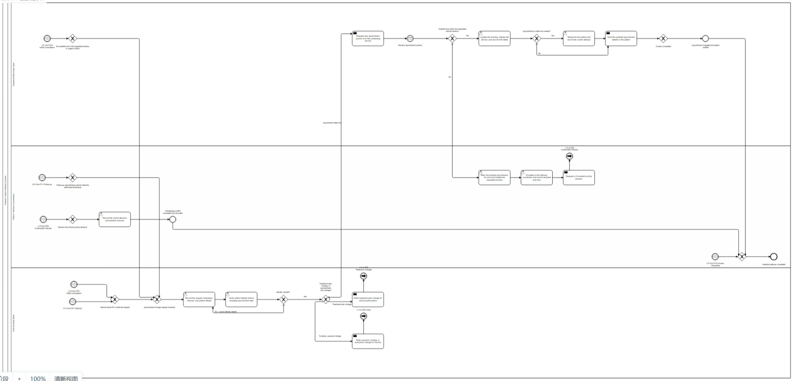
17 Appointment Changes & Conflicts
Notes:
When a patient asks to change an appointment, staff write down the patient’s name, the current appointment, how the request came in, and when it was made.
· Staff check the patient’s identity first. They do not change the appointment until they know who the patient is.
· If the request changes the treatment plan, staff ask the doctor to approve it. If it changes payment or funding, staff ask the Finance team to check it.
· If the patient only wants a different appointment time, staff ask the scheduling team for new times.
· When new times are available, staff check that they match the patient’s needs and the time limit set by the doctor.
· If a time is suitable, staff update the appointment, make the old time available for someone else, and tell the patient about the new time.
· If there is no suitable time, staff keep the current appointment, explain the problem to the patient, and ask the doctor or patient pathway coordinator to help.

Slide 22
Demo Flow
How to run the pathway end to end
1 Start the cluster: .\c8run.exe start (ports 26500 / 8080 / 9600)
2 Deploy model and forms in ONE request - the forms are deployment-bound:
  curl -X POST http://localhost:8080/v2/deployments -F resources=@1-17.bpmn -F resources=@01_receive_referral.form ... (all 16)
3 Start the workers: cd java && .\mvnw.cmd spring-boot:run
4 Open Tasklist and start the referral at the hospital start event (form 01).
5 Work the human tasks in order. Simulation switches in application.properties decide
  slot availability, patient consent, funding, payment and refund outcomes.
6 Automated external answers arrive from PatientAutoResponder every 10 s; the entry
  referral message and the clinic-visit message are the two gates that stay manual.
7 Verify in Operate: instance COMPLETED, hasIncident = false, no active task left.
Manual walkthrough with every message name and variable: MANUAL_TEST_GUIDE.md

Slide 23
Acceptance Test Overview
13 requirements / 11 business rules - 16 acceptance cases - 28 automated tests
Automated suites - 28 / 28 pass
BPMN model coverage 7 / 7
Hospital database (H2) 7 / 7
Worker persistence 6 / 6
Hospital pathway integration 6 / 6
Corridor message audit 2 / 2
Evidence: evidence/tests/*.txt and *.xml, plus the Maven logs.
Acceptance cases AT-01 to AT-16
Each case states requirement/rule, preconditions, test data, actions,
expected outcome, pass/fail condition and evidence state.
Executed: AT-01, AT-02, AT-03, AT-04, AT-10, AT-11 (part),
AT-12, AT-13, AT-14, AT-15 (part), AT-16.
Planned: the remaining negative and boundary token routes - they pass
design-time FEEL evaluation (53 / 53) but have no runtime trace yet.
Full plan: deliverables/Hospital_Patient_Pathway_Acceptance_Test_Plan.docx

Slide 24
Automated Test Evidence
Test suite | Coverage shown in the run | Passed
BPMN model coverage | Tasks, workers, messages, correlation keys, forms | 7 / 7
Hospital database | H2 database and repository persistence | 7 / 7
Worker persistence | Worker writes and persisted state | 6 / 6
Corridor message audit | Message publication and audit records | 2 / 2
Hospital pathway integration | Referral, documents, access, monitoring, denied access, unverified change | 6 / 6
Total: 28 / 28 tests pass on the current source

Slide 25
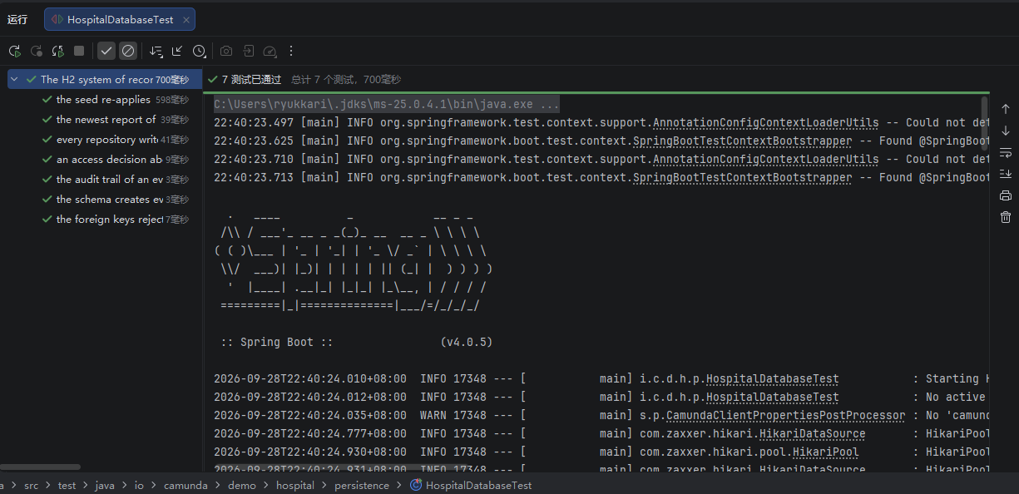
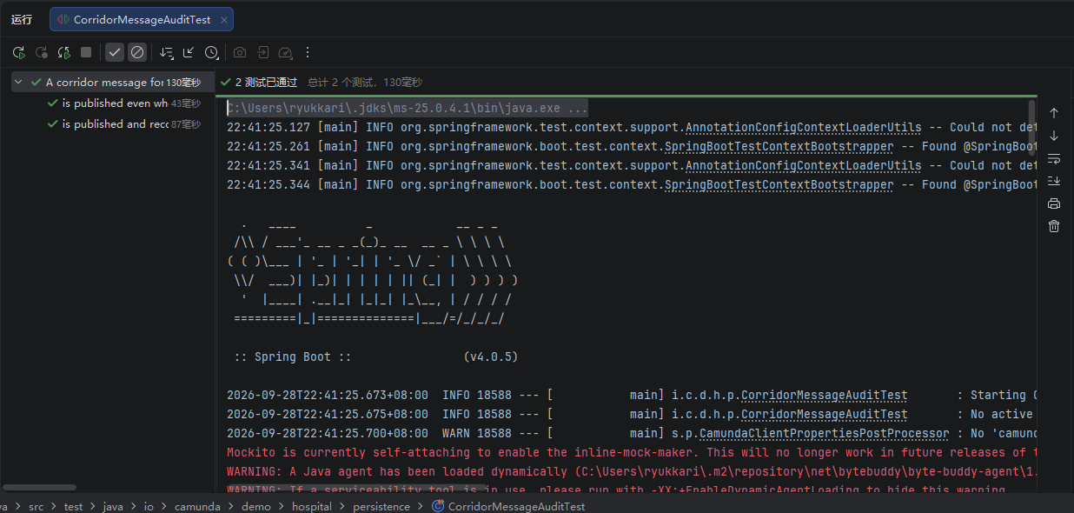
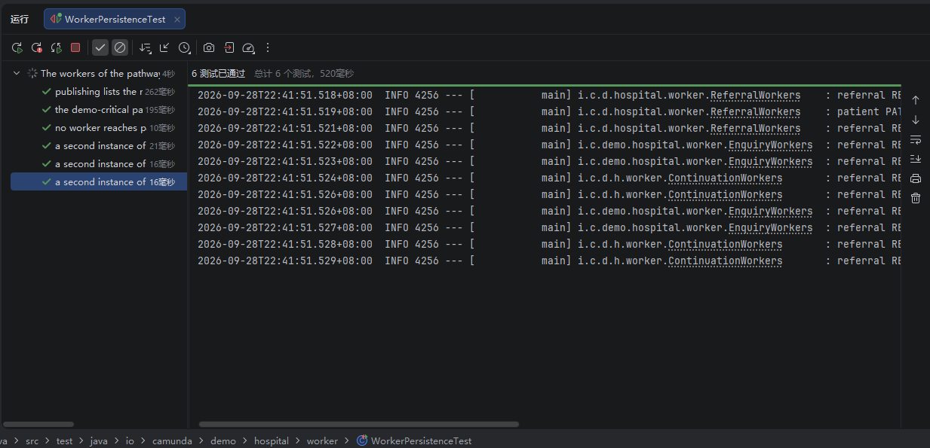
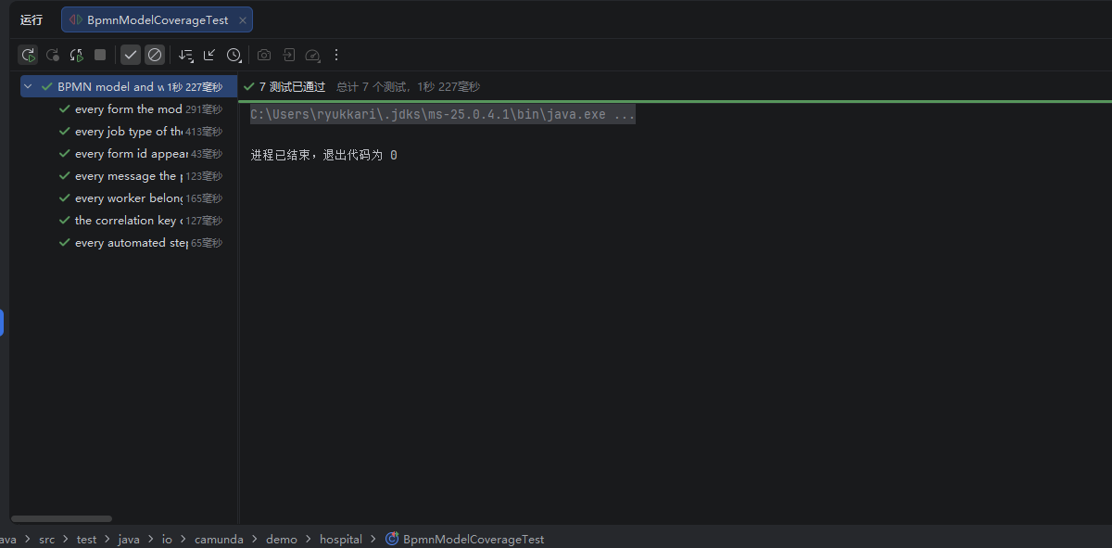
Hospital database 7 / 7
Corridor message audit 2 / 2
Worker persistence 6 / 6
BPMN model coverage 7 / 7

Slide 26
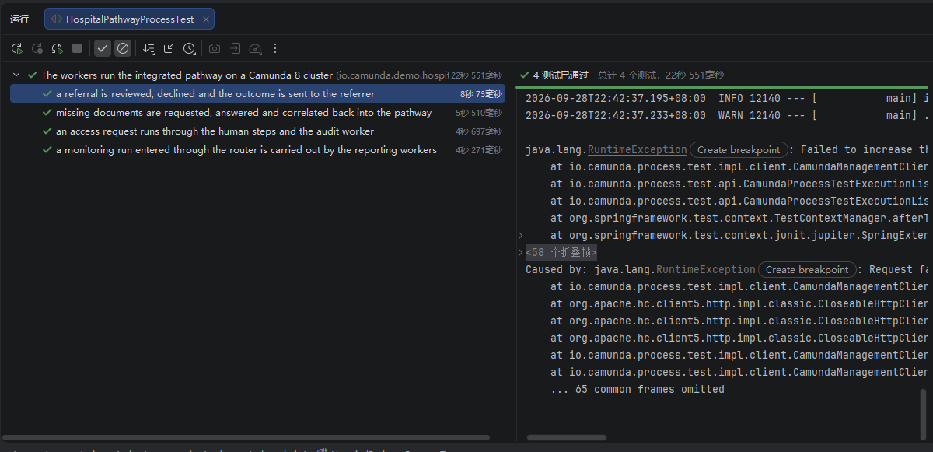
6 / 6
Hospital Pathway Integration Test
Scenarios marked passed in the IDE summary
1: Referral review outcome is sent
2: Missing documents return by referralId
3: Access request follows human and audit steps
4: Monitoring request reaches reporting workers
5: Denied access is audited without granting access
6: Unverified appointment change cannot update the booking

Slide 27
THANK YOU
Group 19
Xinran Zhang 23084415
Songjie Qiu 23084419
Cathleen Liu 23084383
Chenyu Yang 23084439

