Slide 1
Hospital Patient Pathway
BPMN 1–17 · Camunda 8
Process walkthrough and test evidence
30 September 2026
Notes:
Opening: this review walks through the 17-stage patient pathway, then presents the automated test evidence supplied with the project materials.

Slide 2
Hospital Patient Pathway
17 BPMN stages connect referral intake, clinical decisions, treatment, finance, and operational support.
CORE CLINICAL PATH · P01–P08
01
Referral
receipt
02
Referral
review
03
Initial
consultation
04
Diagnosis &
consent
05
Treatment &
services
06
Funding
verification
07
Payment
result
08
Continuation
review
P08 may repeat the treatment cycle, schedule a later review, or route a stopped case to refund handling.
OPERATIONAL SUPPORT · P09–P17
09–11
12–14
15–17
Treatment changes, attendance exceptions, refunds
Patient inquiries, medical letters, follow-up booking
Monitoring, access and downtime, scheduling escalation
Source: user-provided BPMN model and stage captures from the interactive review HTML.
2 / 22
Notes:
Orient the audience to the two parts of the model: P01–P08 cover the core clinical route, while P09–P17 handle operational support and exceptions. P08 sends ongoing treatment back into the treatment cycle, so the process is not a simple one-pass sequence.

Slide 3
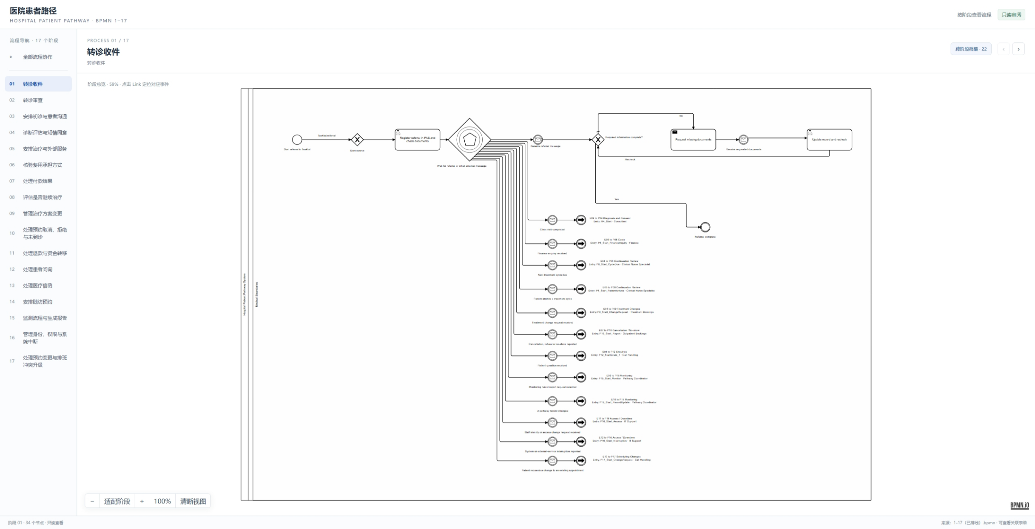
01 Referral Receipt & Handoffs
Referral intake launches the pathway and routes messages to downstream stages.
3 / 22
Notes:
Use the first screenshot to explain the pathway's referral entry point. The model waits for messages and routes each handoff to its corresponding process stage.
Source: user-supplied screenshot of Process 01 in Hospital_Patient_Pathway_Process_Review.html.

Slide 4
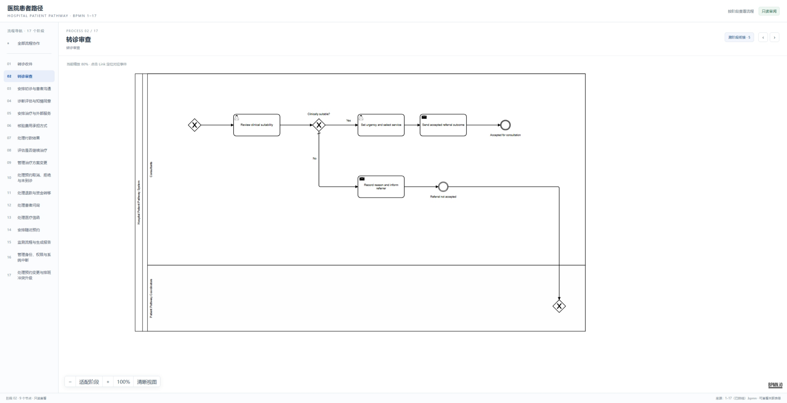
02 Referral Review
The clinical suitability decision routes accepted and declined referrals.
4 / 22
Notes:
Explain the clinical suitability gateway. Accepted referrals proceed to urgency and service selection; declined referrals are recorded and sent back to the referrer.
Source: user-supplied screenshot of Process 02 in Hospital_Patient_Pathway_Process_Review.html.

Slide 5
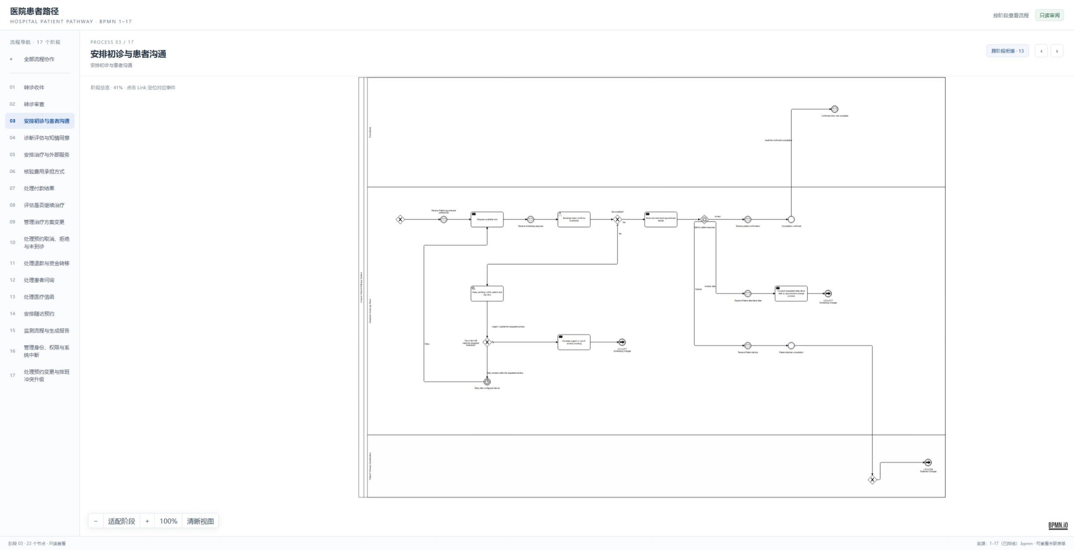
03 Initial Consultation & Patient Contact
Appointment options, patient response, and clinical suitability determine the next step.
5 / 22
Notes:
Walk through the appointment request and patient communication path. Availability, patient response, and suitability decisions can lead to confirmation, changes, or escalation.
Source: user-supplied screenshot of Process 03 in Hospital_Patient_Pathway_Process_Review.html.

Slide 6
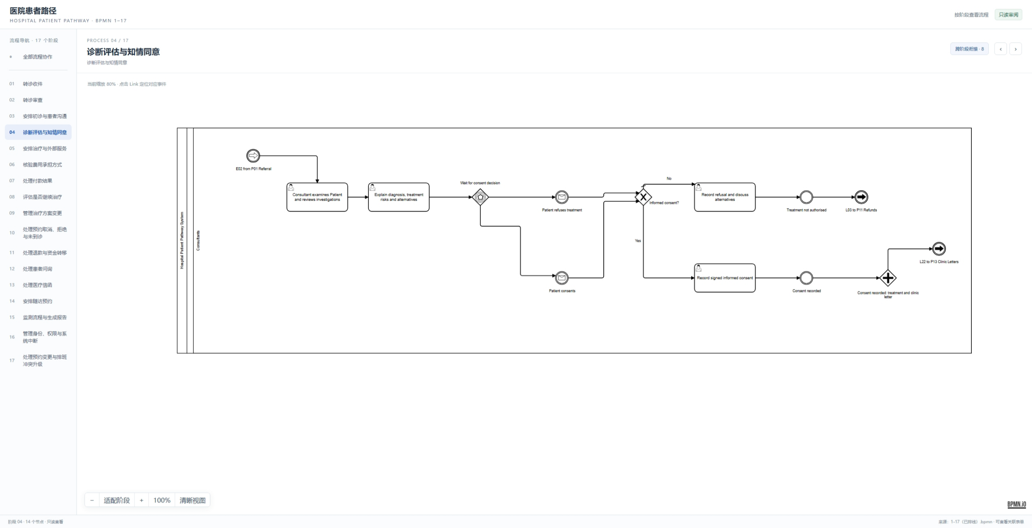
04 Diagnosis, Assessment & Informed Consent
The diagnosis and consent decision routes authorisation, refusal, or follow-up correspondence.
6 / 22
Notes:
The consultant reviews the patient and explains diagnosis, treatment risks, and alternatives. The consent outcome controls whether treatment can be authorised or alternatives are discussed.
Source: user-supplied screenshot of Process 04 in Hospital_Patient_Pathway_Process_Review.html.

Slide 7
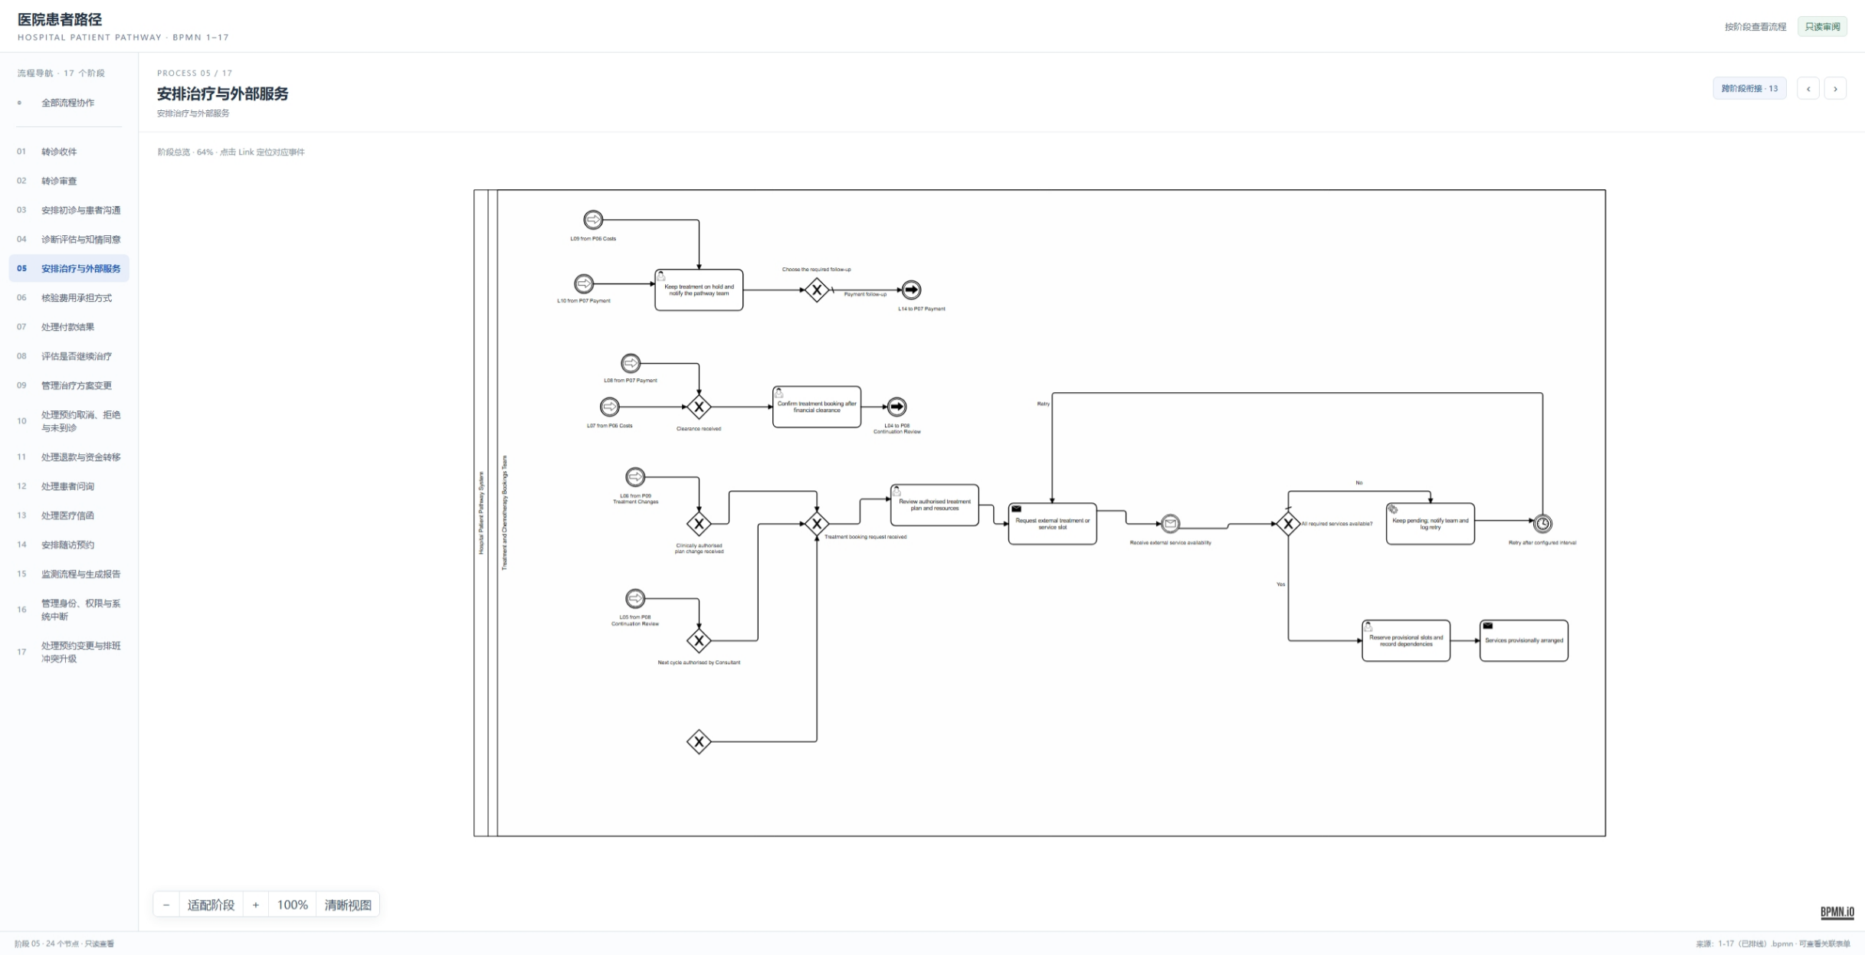
05 Treatment & External Services
Treatment booking depends on clinical approval, funding, and external service availability.
7 / 22
Notes:
Describe the treatment booking and external service checks. The process can hold pending funding or capacity, reserve a provisional slot, or retry after a configured interval.
Source: user-supplied screenshot of Process 05 in Hospital_Patient_Pathway_Process_Review.html.

Slide 8
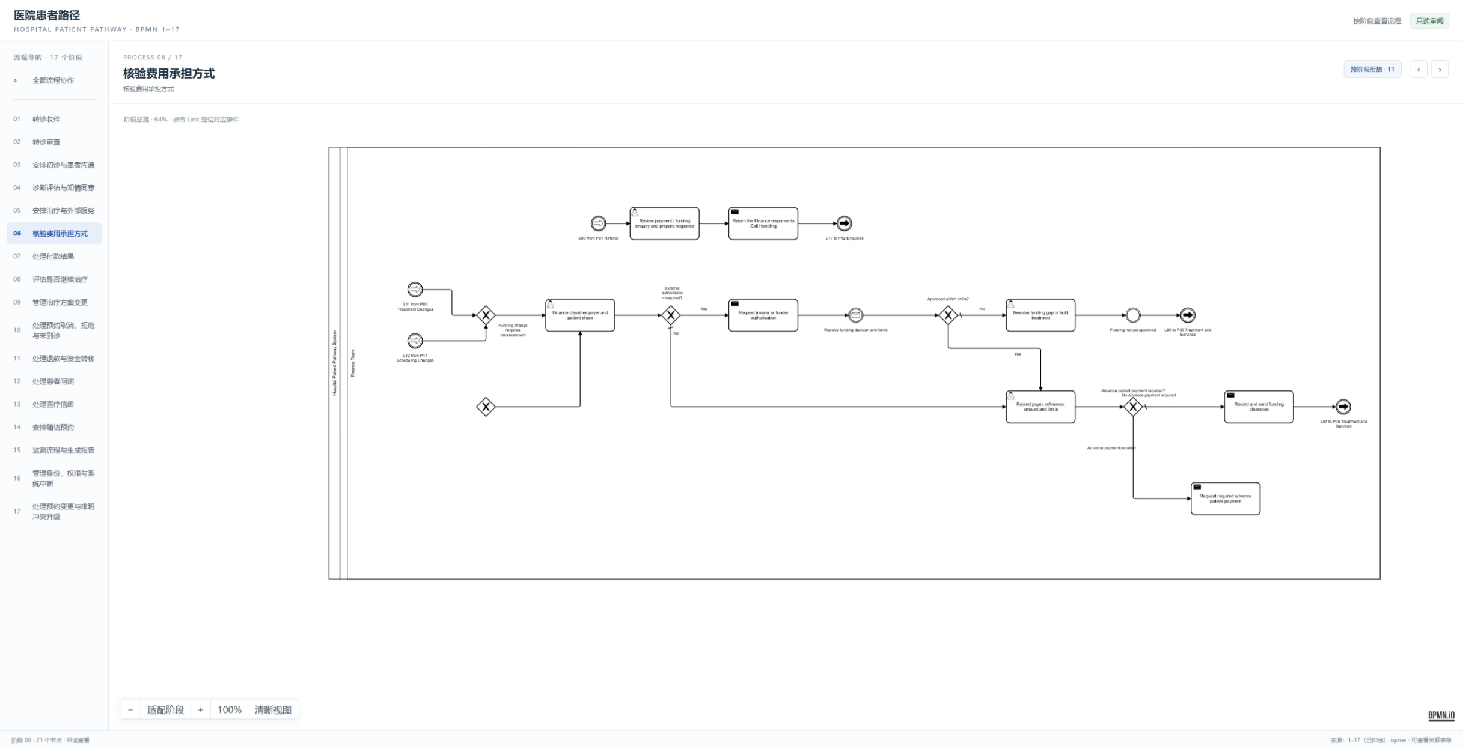
06 Funding Method Verification
The finance path classifies payer and funding source, requests authorisation, and records limits.
8 / 22
Notes:
Explain payer classification and any external authorisation requirement. The process records the decision, funding limits, and any required advance payment.
Source: user-supplied screenshot of Process 06 in Hospital_Patient_Pathway_Process_Review.html.

Slide 9
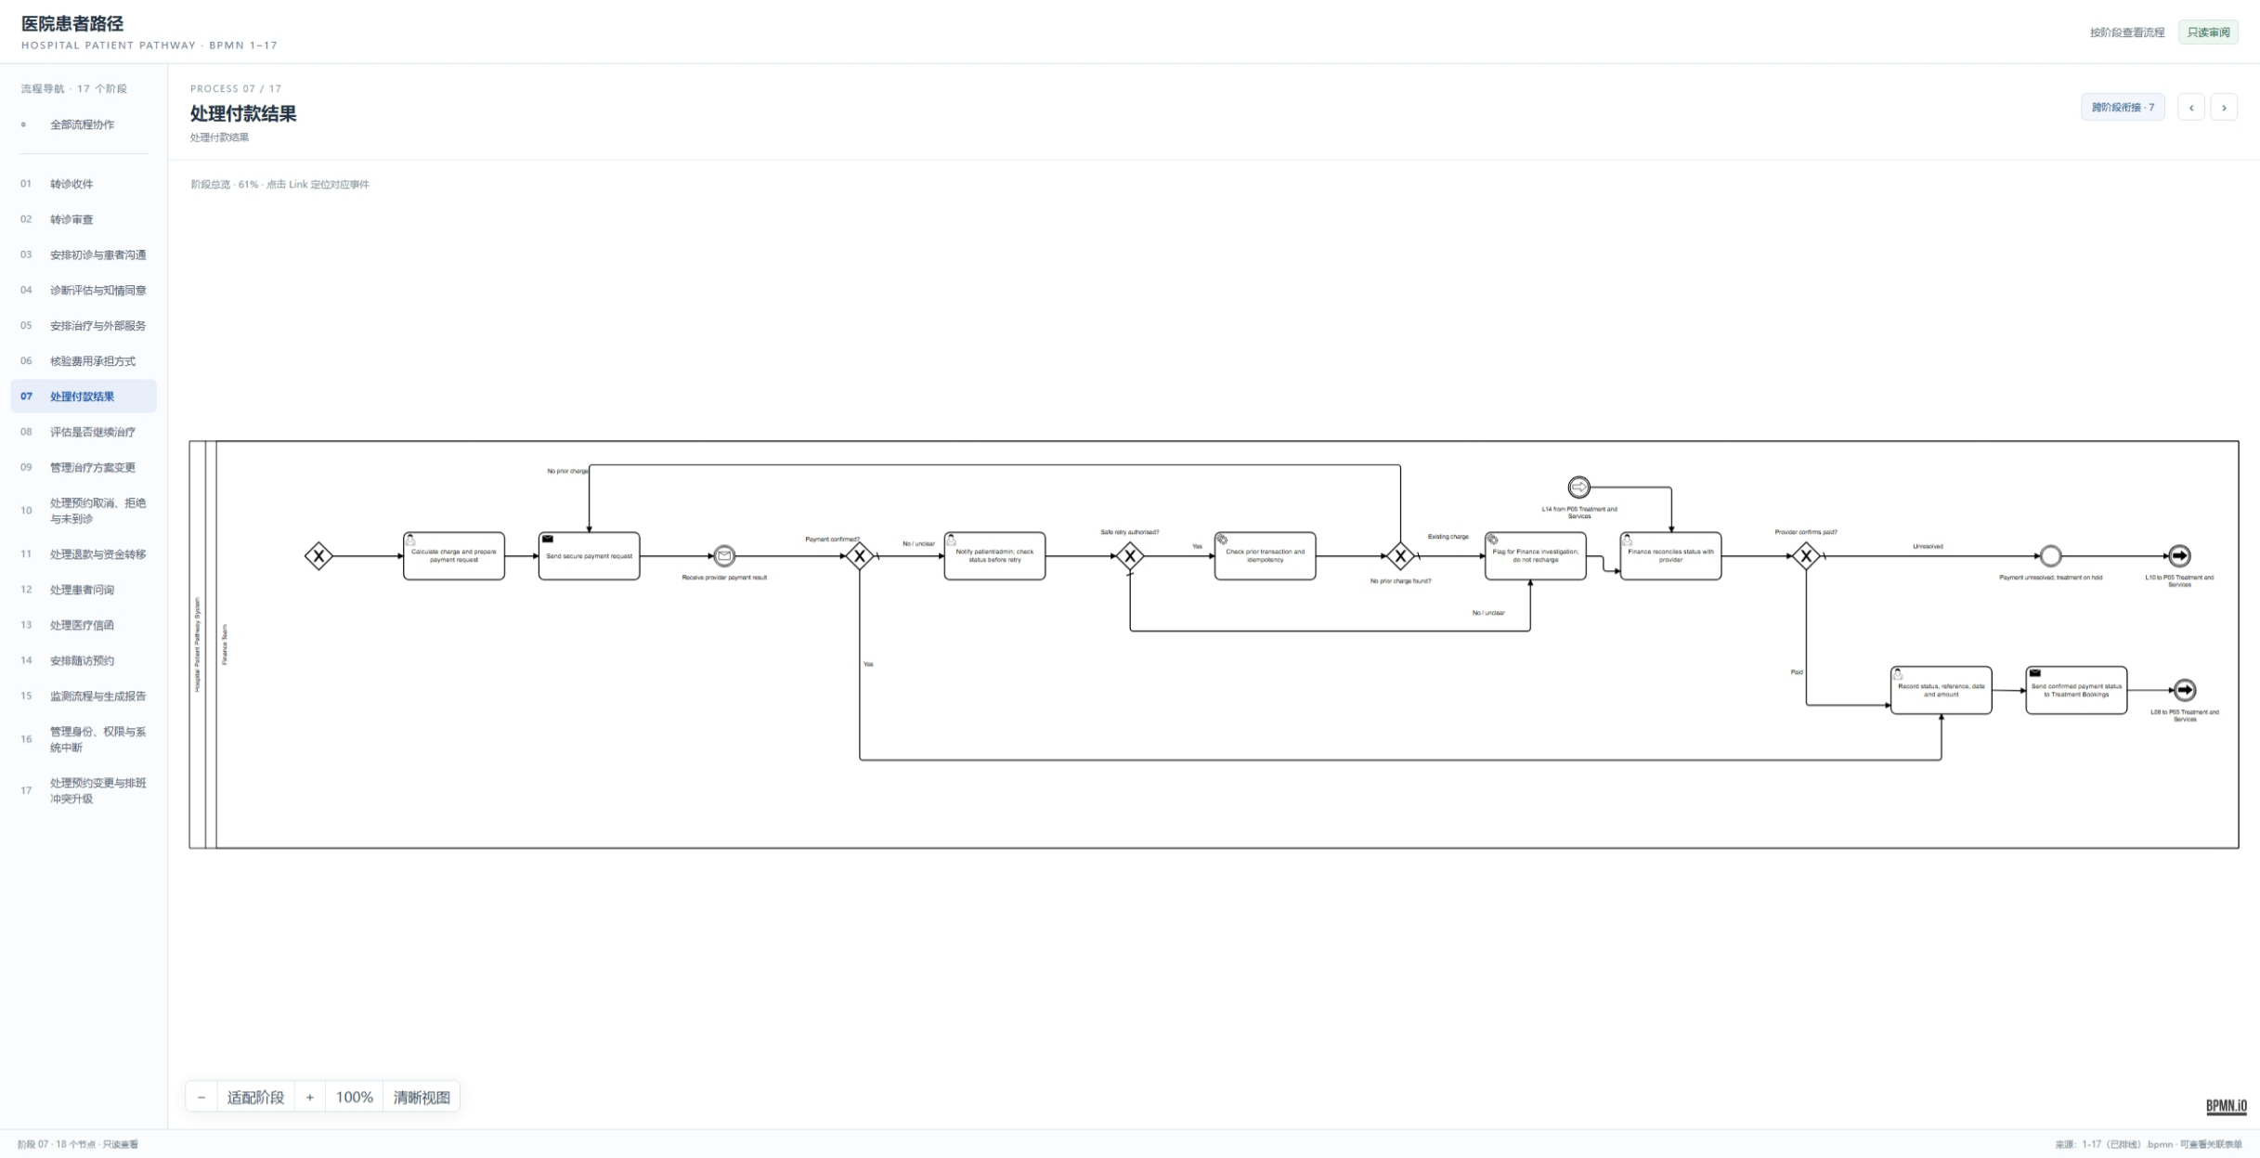
07 Payment Result Handling
Provider payment responses are checked, reconciled, and returned to the treatment booking path.
9 / 22
Notes:
Show how the workflow handles confirmed, declined, and unclear payment outcomes. Unresolved payments can put treatment on hold; confirmed outcomes update the booking path.
Source: user-supplied screenshot of Process 07 in Hospital_Patient_Pathway_Process_Review.html.

Slide 10
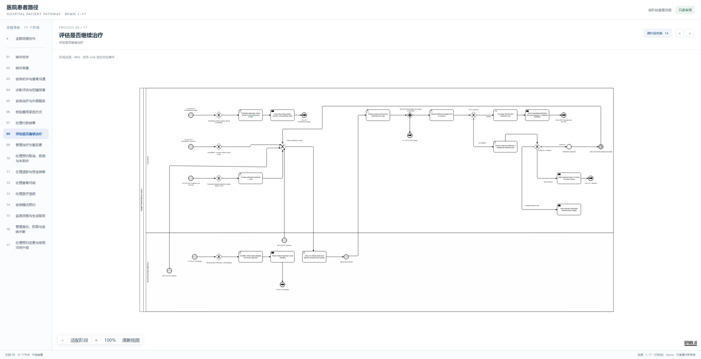
08 Treatment Continuation Review
The clinical decision continues treatment, changes the plan, delays review, or starts a refund path.
10 / 22
Notes:
Emphasise the continuation decision. Continued or changed treatment returns to treatment planning, delay creates a review cycle, and stopping treatment can lead to a refund.
Source: user-supplied screenshot of Process 08 in Hospital_Patient_Pathway_Process_Review.html.

Slide 11
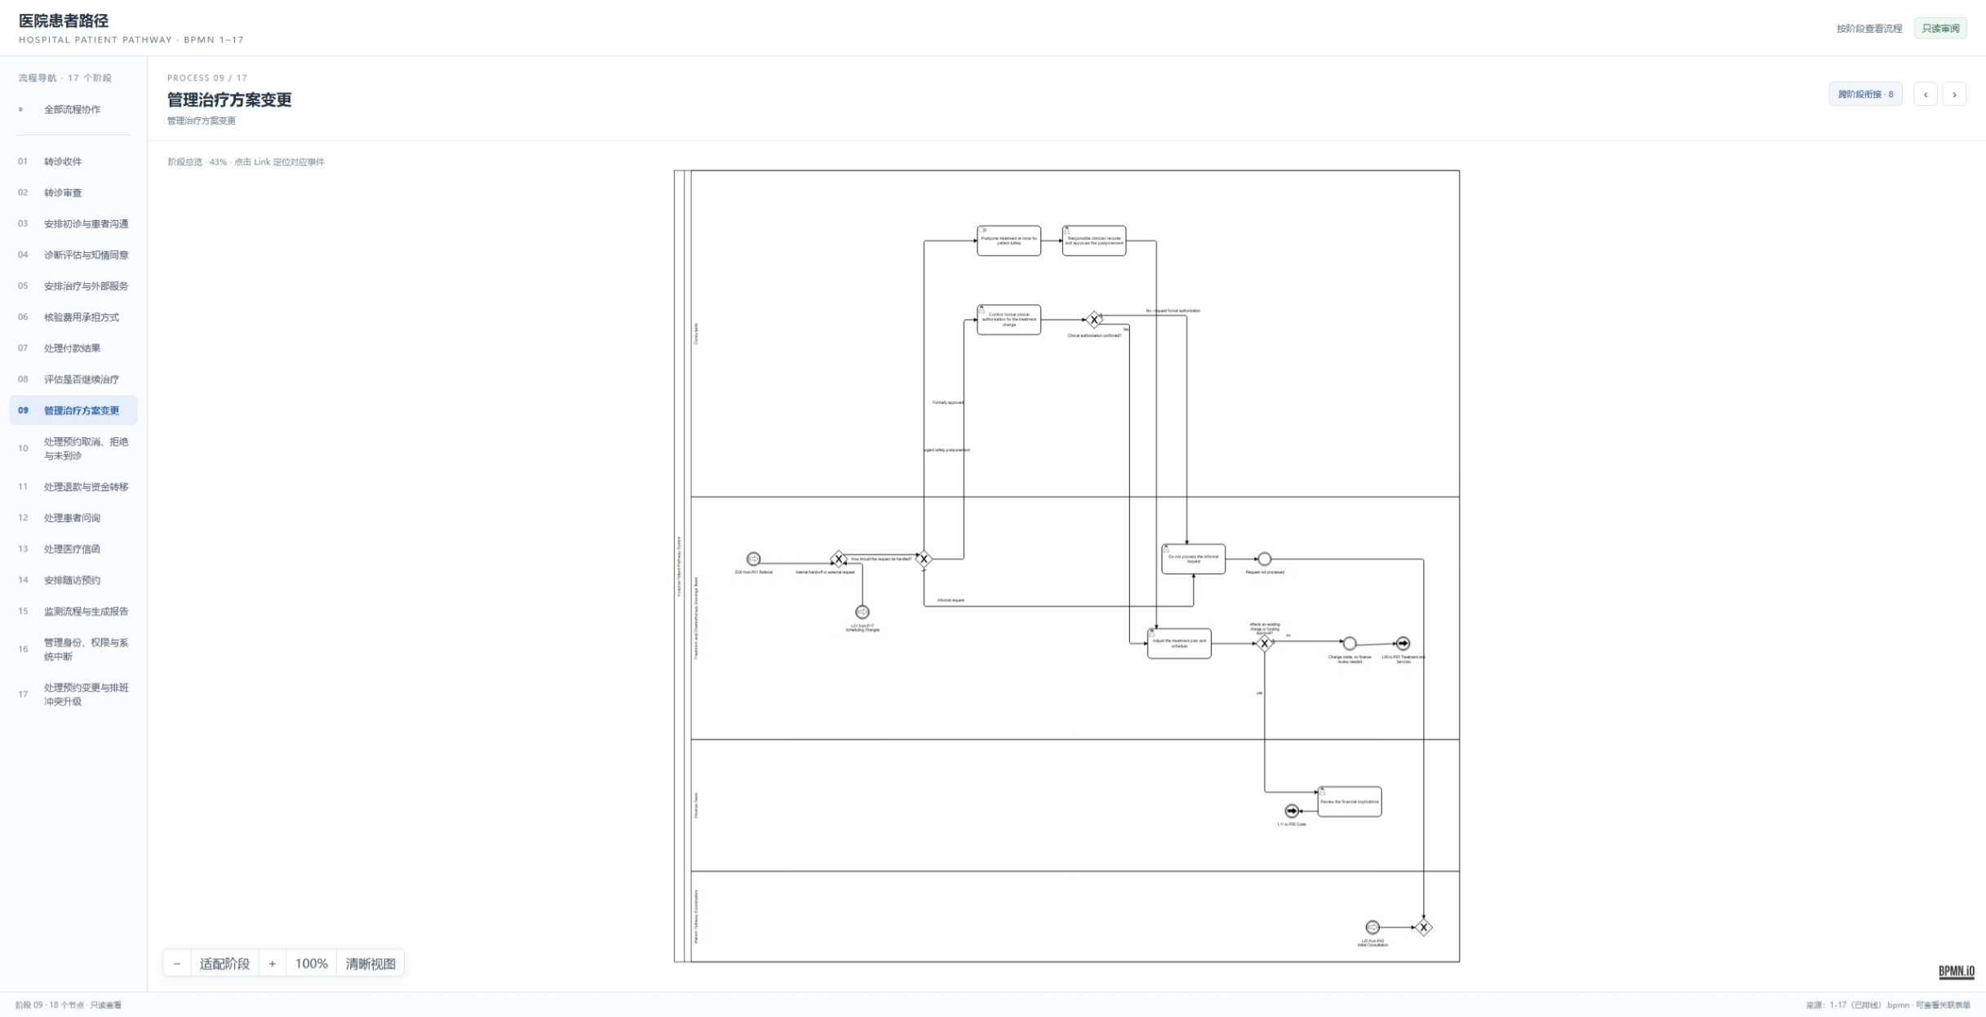
09 Treatment Plan Changes
Clinical approval and funding checks control changes to an existing treatment plan.
11 / 22
Notes:
Describe how a requested treatment change is checked with the clinician, communicated to the patient, and reconciled with funding and appointment details.
Source: user-supplied screenshot of Process 09 in Hospital_Patient_Pathway_Process_Review.html.

Slide 12
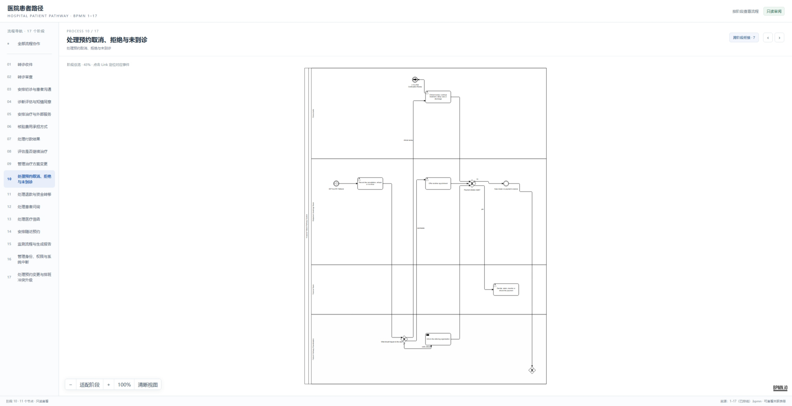
10 Cancellations, Rejections & No-Shows
Cancellation and attendance events update the booking and trigger any required follow-up.
12 / 22
Notes:
Explain how the model handles cancellation requests, declined appointments, and missed visits. The relevant teams are informed and the booking status is updated.
Source: user-supplied screenshot of Process 10 in Hospital_Patient_Pathway_Process_Review.html.

Slide 13
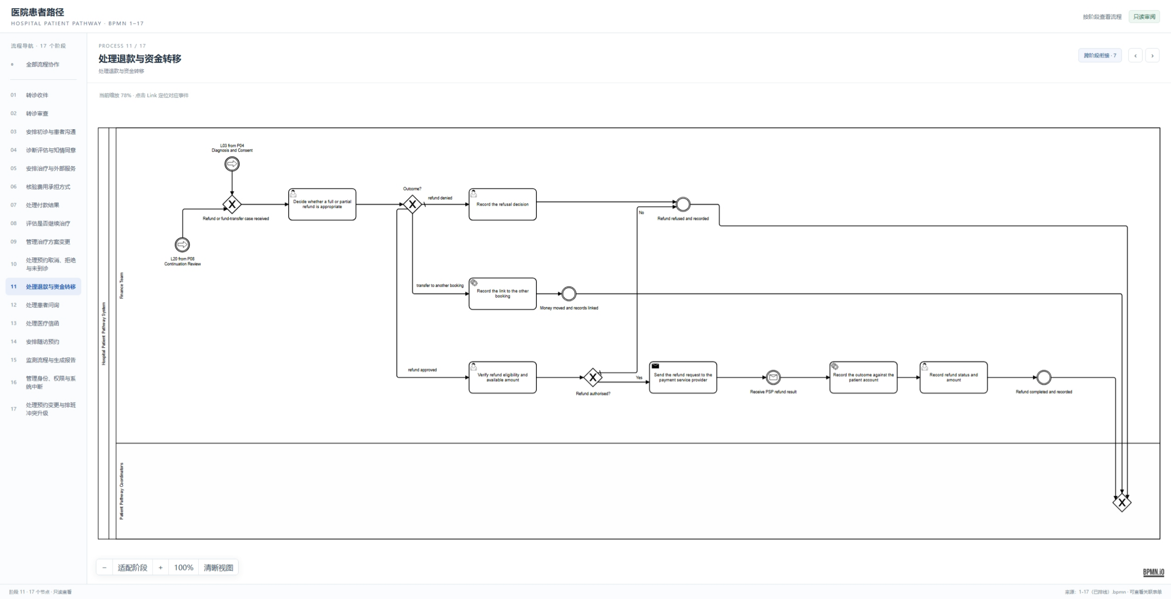
11 Refunds & Fund Transfers
Finance reviews refund eligibility, submits approved refunds, and records the final outcome.
13 / 22
Notes:
Show the refund or transfer decision, finance review, provider response, and final audit record. Refund denial and transfer to another booking are explicit outcomes.
Source: user-supplied screenshot of Process 11 in Hospital_Patient_Pathway_Process_Review.html.

Slide 14
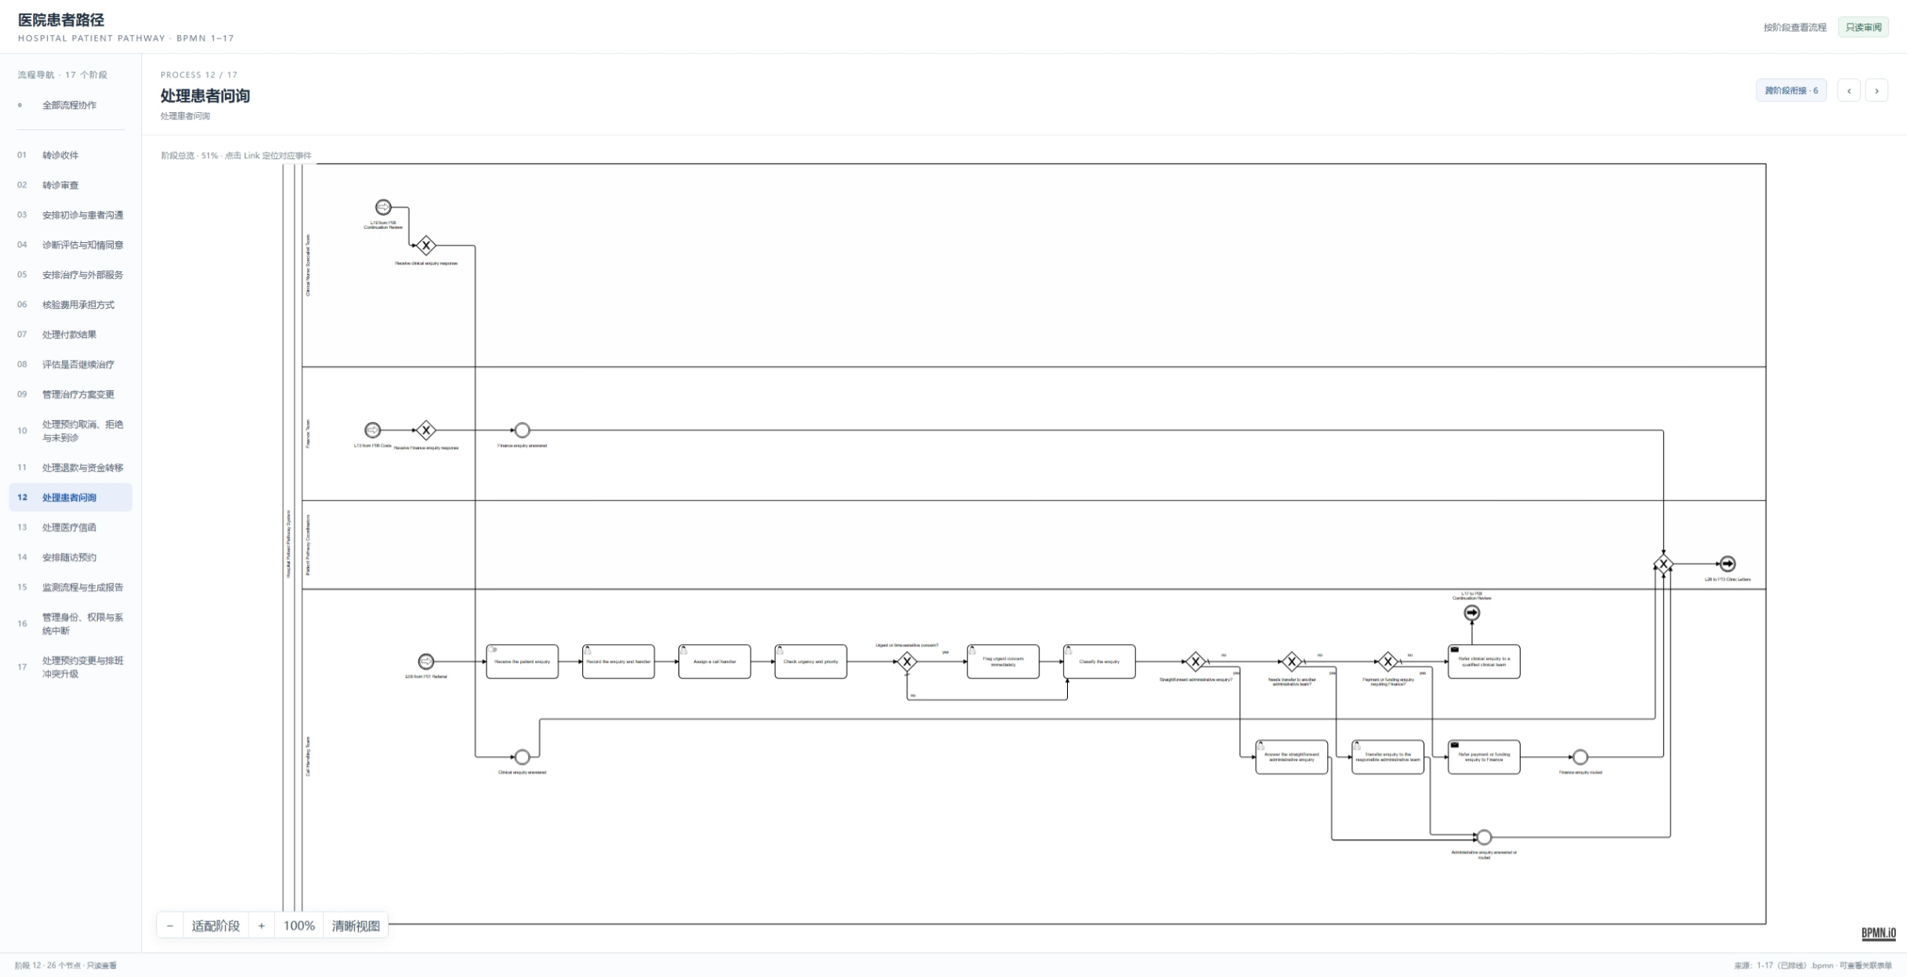
12 Patient Inquiries
Inquiry intake, classification, and routing connect clinical, administrative, and finance teams.
14 / 22
Notes:
Explain the patient inquiry path from receipt to classification and resolution. Specialist questions can be routed to the clinical, administrative, or finance teams.
Source: user-supplied screenshot of Process 12 in Hospital_Patient_Pathway_Process_Review.html.

Slide 15
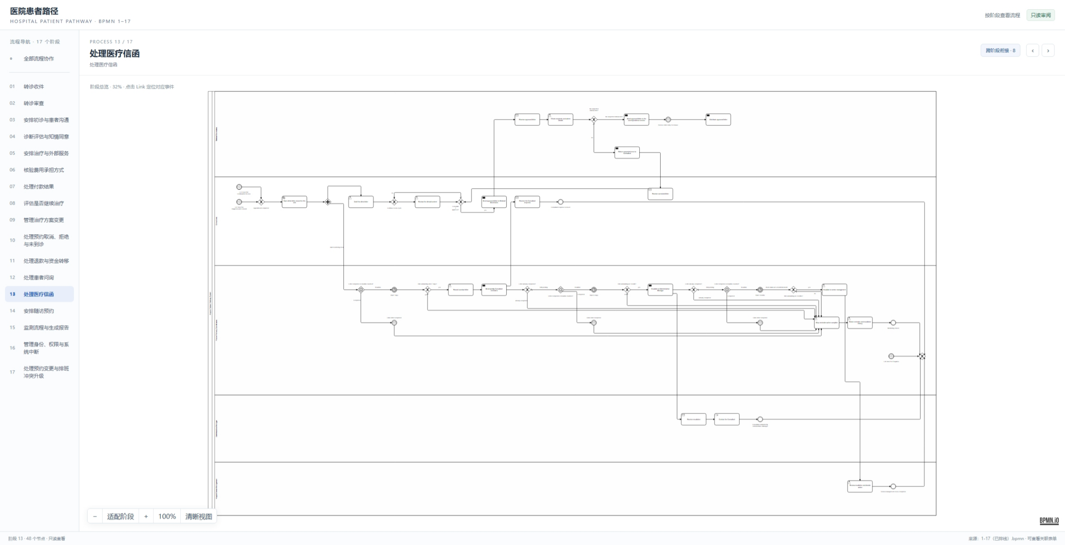
13 Medical Correspondence
Clinic letters are reviewed, issued, and tracked across the relevant pathway teams.
15 / 22
Notes:
Summarise correspondence review and issue steps, including the handoffs that return letters and decisions to the wider patient pathway.
Source: user-supplied screenshot of Process 13 in Hospital_Patient_Pathway_Process_Review.html.

Slide 16
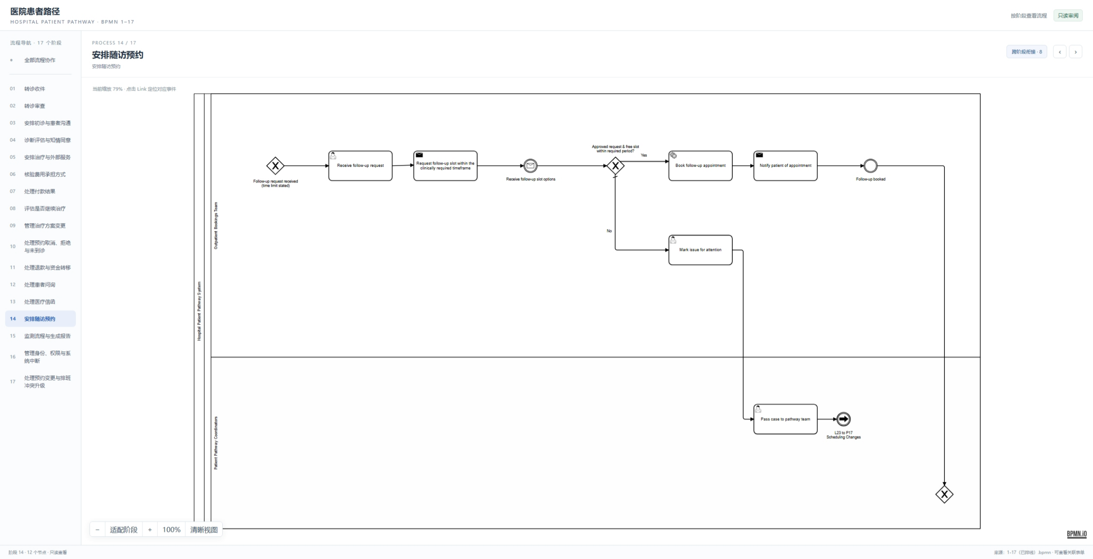
14 Follow-up Booking
The booking team requests an eligible slot, confirms the appointment, and notifies the patient.
16 / 22
Notes:
Show follow-up request, slot search, approval, booking, and patient notification. Requests outside the allowed period are marked for attention and passed back to the pathway team.
Source: user-supplied screenshot of Process 14 in Hospital_Patient_Pathway_Process_Review.html.

Slide 17
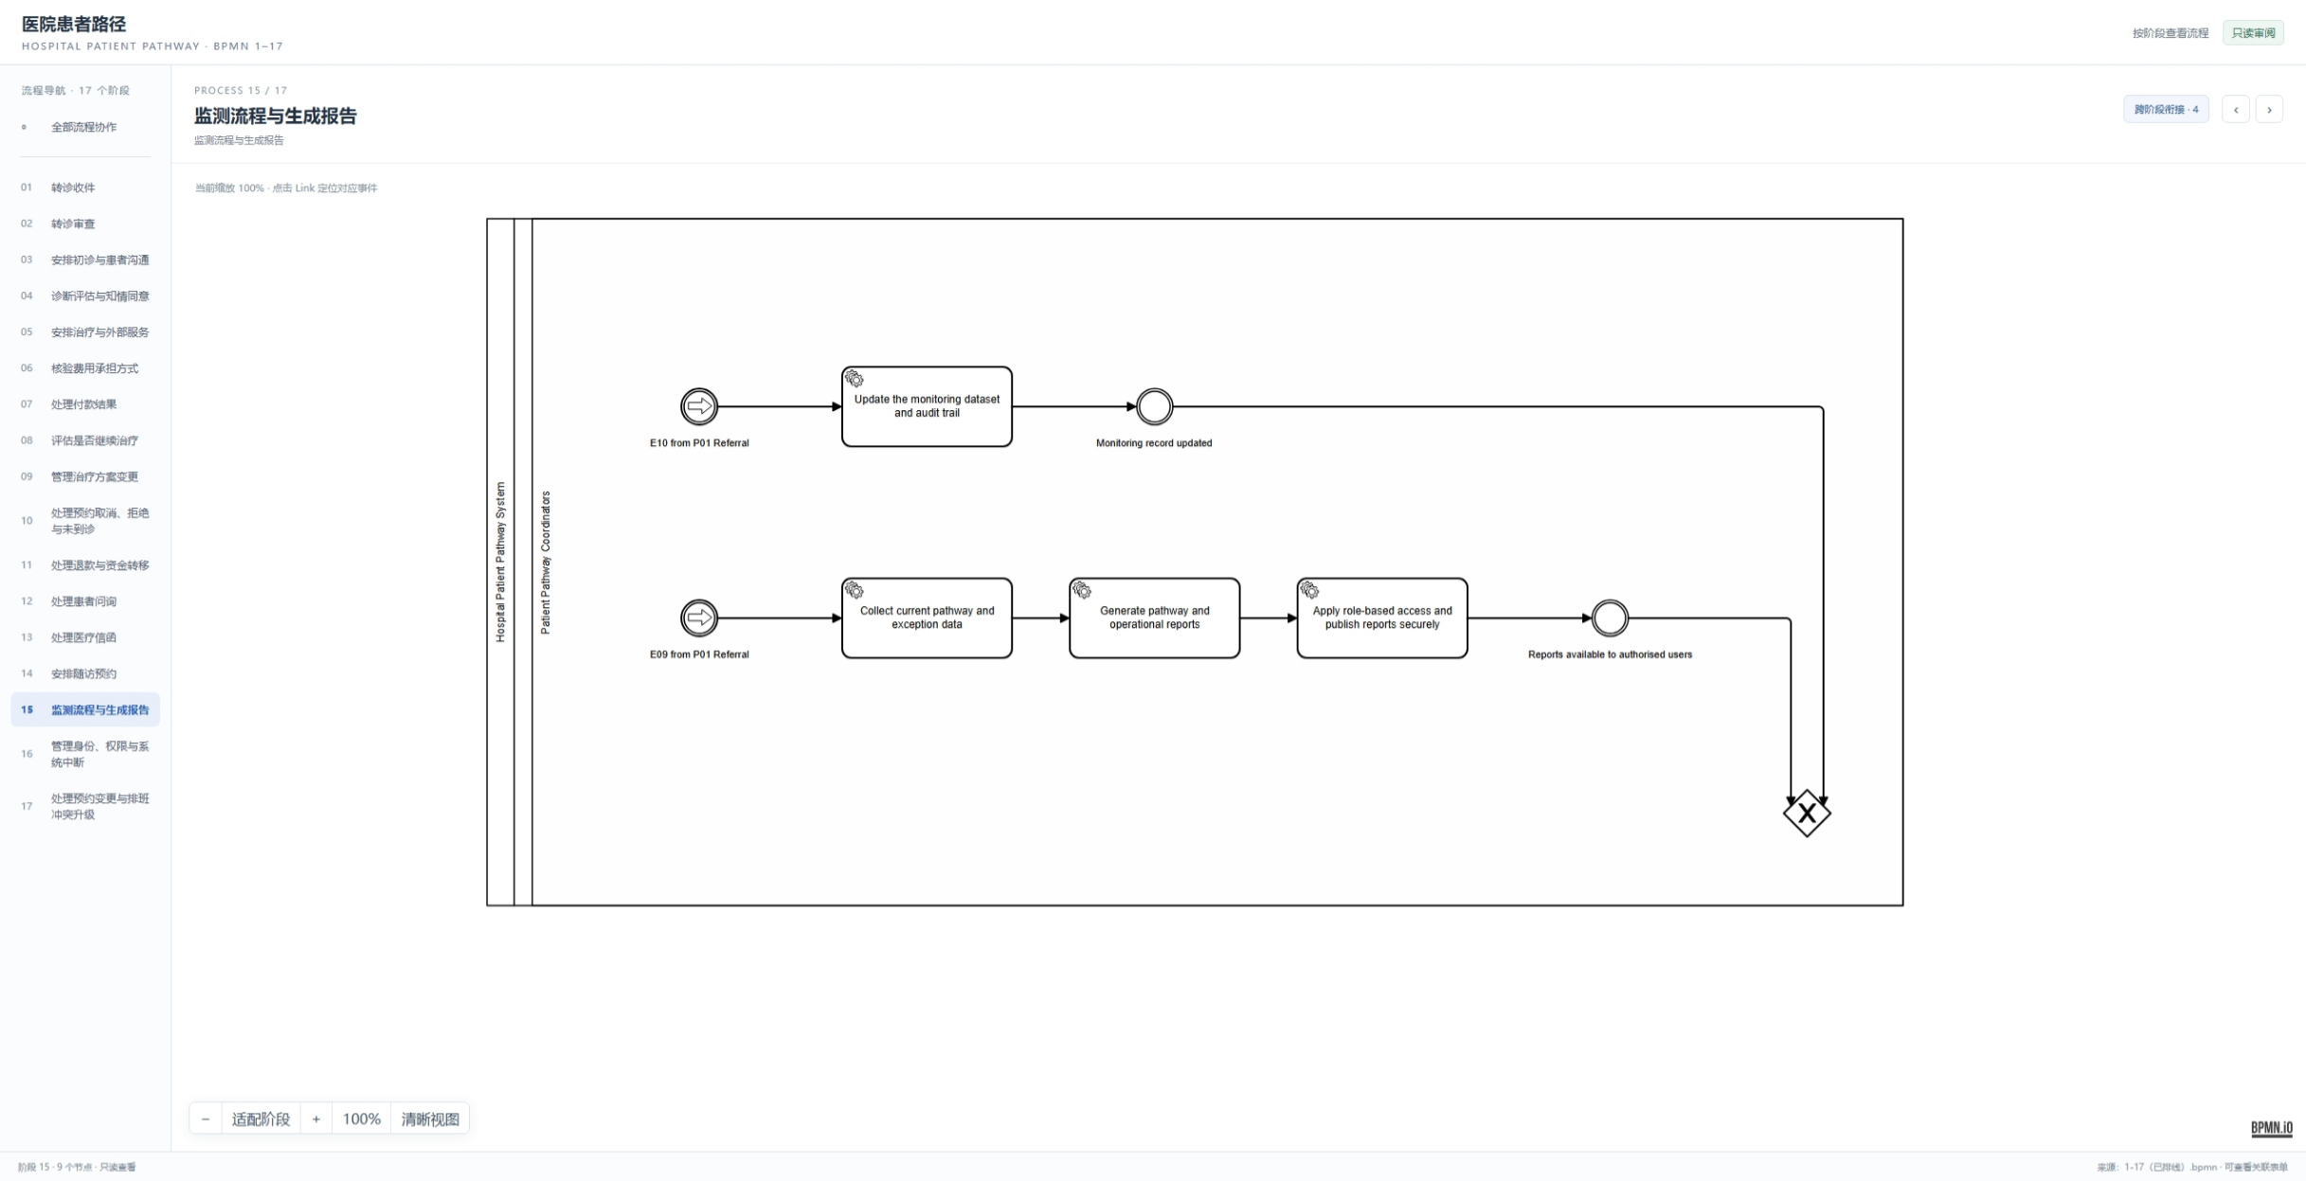
15 Process Monitoring & Reports
Operational workers update monitoring records and publish role-restricted reports.
17 / 22
Notes:
Explain the two reporting paths: update the monitoring dataset and audit trail, and collect pathway data to generate and securely publish operational reports.
Source: user-supplied screenshot of Process 15 in Hospital_Patient_Pathway_Process_Review.html.

Slide 18
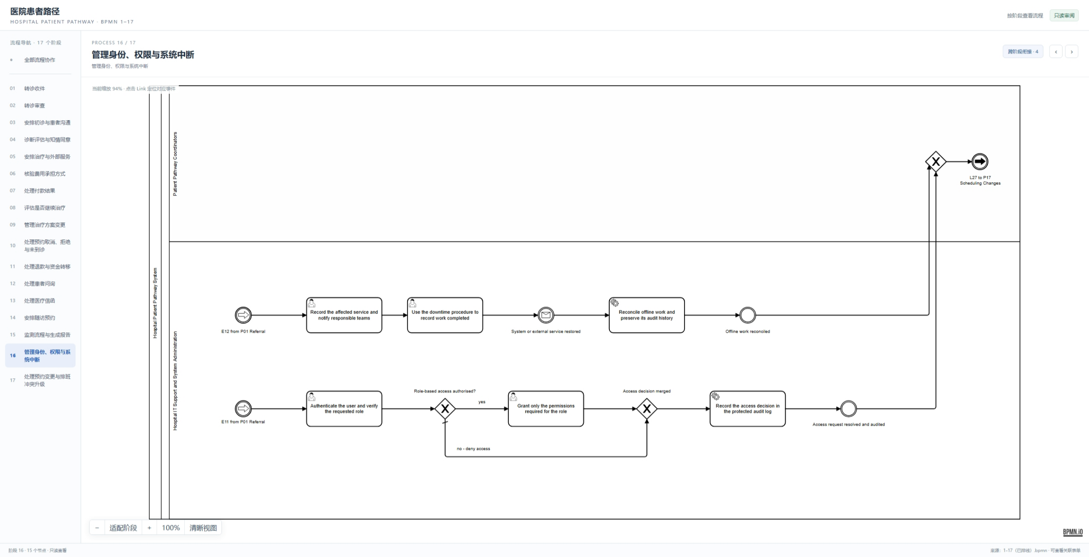
16 Identity, Access & System Downtime
Role-based access decisions and downtime recovery are recorded in the audit trail.
18 / 22
Notes:
The stage combines secure access checks with outage handling. Access is granted only for the required role, and offline work is reconciled after service restoration.
Source: user-supplied screenshot of Process 16 in Hospital_Patient_Pathway_Process_Review.html.

Slide 19
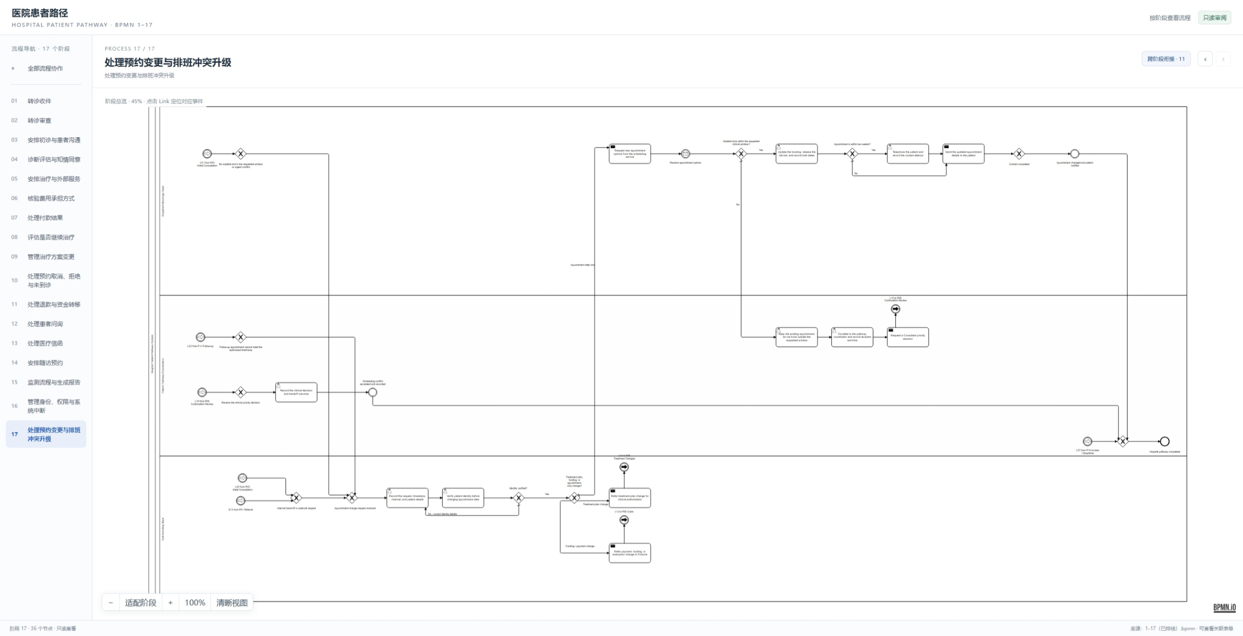
17 Appointment Changes & Conflicts
Clinical and operational constraints are checked; unresolved scheduling conflicts are escalated.
19 / 22
Notes:
Close the process section with appointment changes. The workflow checks clinical and operational constraints and escalates unresolved scheduling conflicts.
Source: user-supplied screenshot of Process 17 in Hospital_Patient_Pathway_Process_Review.html.

Slide 20
Automated Test Evidence
26 passing test cases across five supplied IDE run summaries
Test suite | Coverage shown in the run | Passed
BPMN model coverage | Tasks, workers, messages, correlation keys, forms | 7 / 7
Hospital database | H2 database and repository persistence | 7 / 7
Worker persistence | Worker writes and persisted state | 6 / 6
Corridor message audit | Message publication and audit records | 2 / 2
Hospital pathway integration | Referral, documents, access, and monitoring paths | 4 / 4
26 / 26
Counts are taken from the supplied screenshots and do not claim full project-suite coverage.
20 / 22
Notes:
The five supplied IDE summaries show 7 model coverage tests, 7 database tests, 6 worker persistence tests, 2 corridor message audit tests, and 4 pathway integration tests. The total shown here is the sum of those visible counts only.

Slide 21
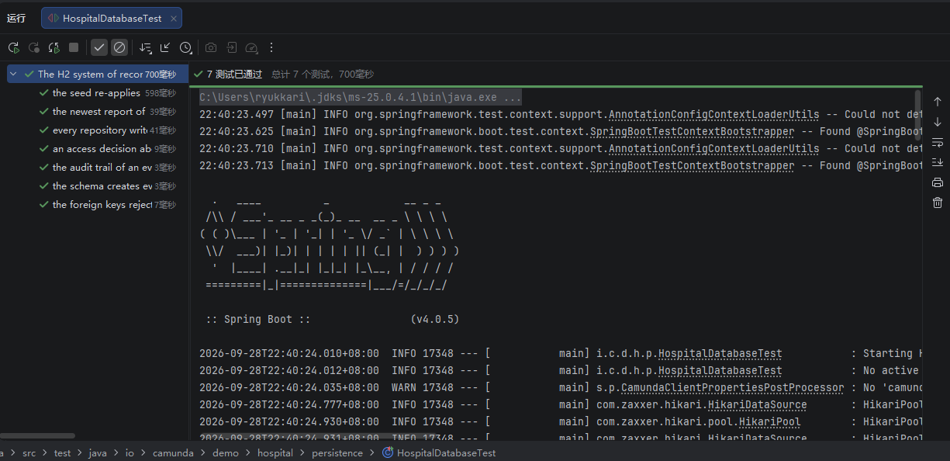
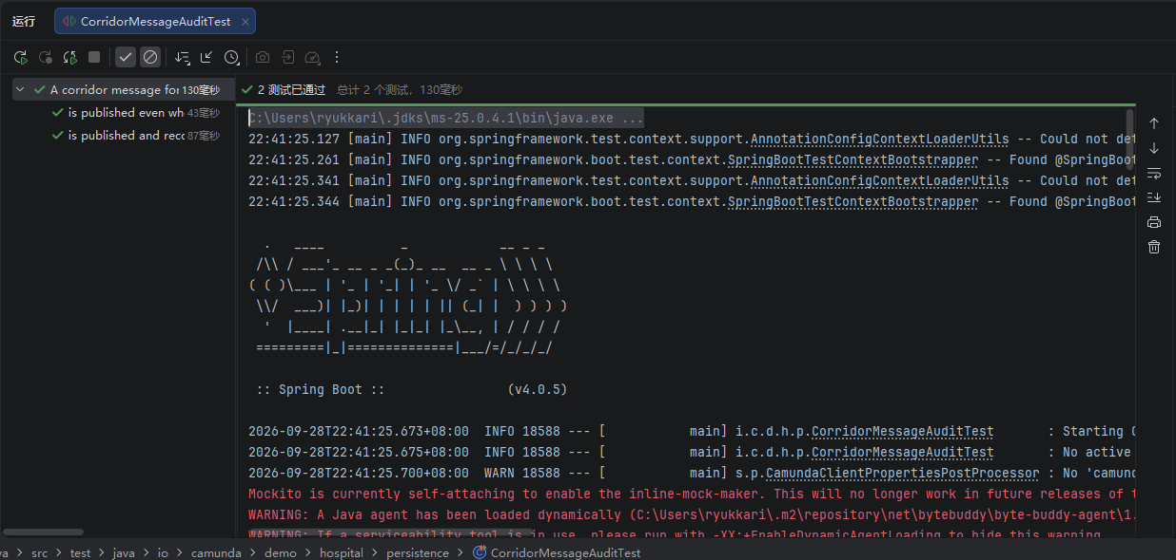
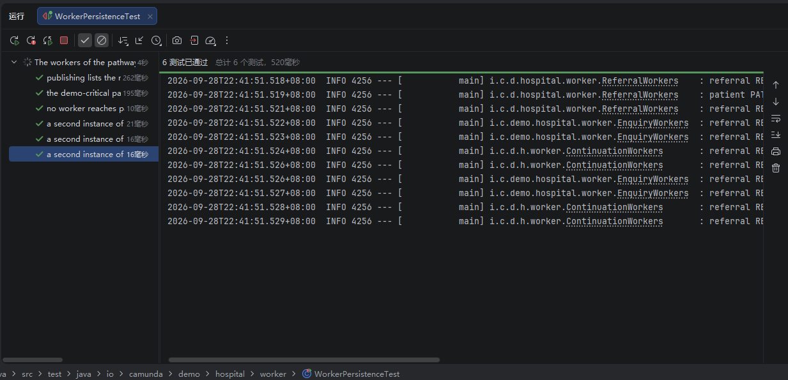
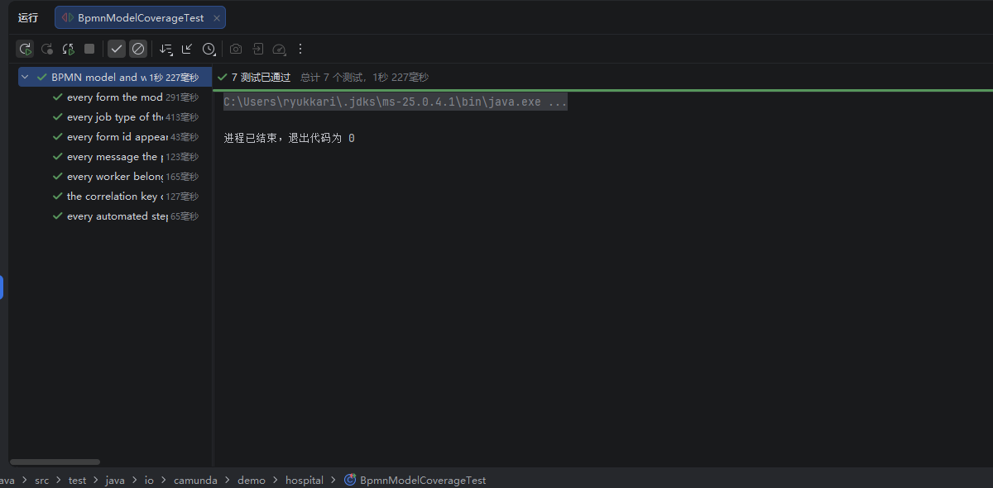
Evidence · Model, Data & Worker Tests
Hospital database · 7 / 7
Corridor message audit · 2 / 2
Worker persistence · 6 / 6
BPMN model coverage · 7 / 7
21 / 22
Notes:
The screenshots are the supplied IDE run results for database, message audit, worker persistence, and BPMN model coverage. The duplicate message audit capture was omitted.

Slide 22
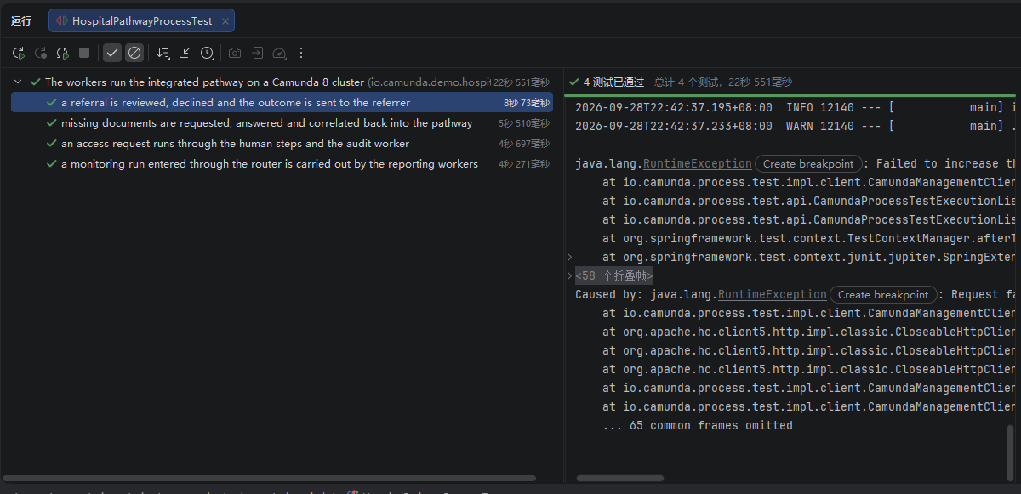
Hospital Pathway Integration Test
4 / 4
Scenarios marked passed in the IDE summary
01 Referral review outcome is sent
02 Missing documents return by referralId
03 Access request follows human and audit steps
04 Monitoring request reaches reporting workers
Review before presenting as a clean run: the console also shows “Failed to increase the time” and HTTP 403 “clock is immutable.”
22 / 22
Notes:
The supplied IDE summary reports four integration scenarios passed. The same screenshot also shows a RuntimeException related to advancing test time and an HTTP 403 response stating that the clock is immutable. Present this caveat plainly and confirm its impact before describing the run as fully clean.

