Slide 1
FacIAL ATTRIBUTES CLASSIFICATION
By Anna Gavrilova, Ruben Zink

Slide 2
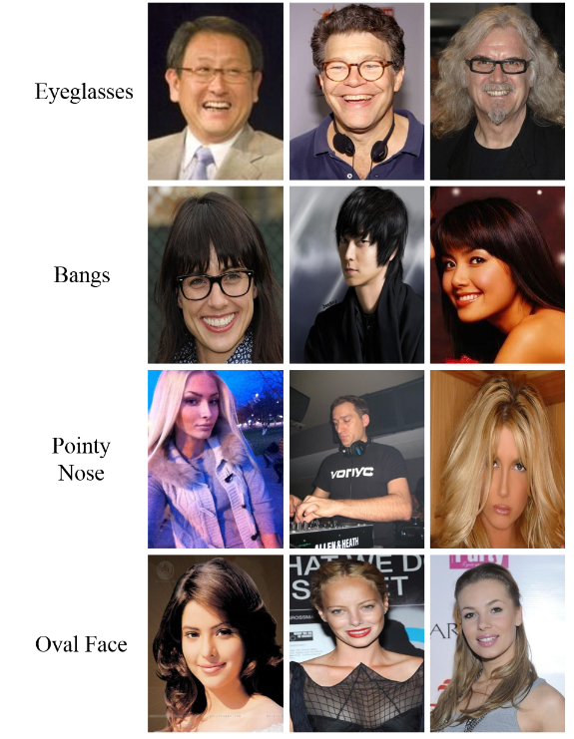
DATASET
Source:
Used from the CelebA (Celebrities Attributes) database
https://mmlab.ie.cuhk.edu.hk/projects/CelebA.html
Content:
over 200,000 images of celebrities
labels that identify various facial attributes (age, gender, facial hair, eyeglasses etc.)
Data Splitting:
Training Set: 80% of the data
Validation Set: 10% of the data
Testing Set: The remaining 10%

Slide 3
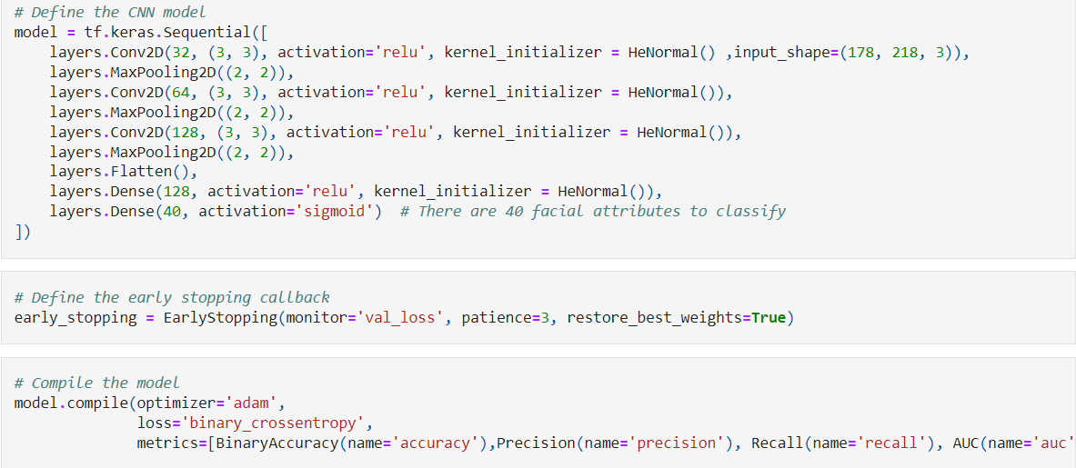
Proposed Method - Custom CNN Model
Approach:
Developed a custom Convolutional Neural Network (CNN) tailored for multi-label facial attribute classification.
Model Design:
Appropriate activations:
ReLU (Rectified Linear Unit): For non-linear transformations.
Sigmoid: For multi-label classification.
Optimizer used:
Adam: Adaptive learning rate optimization.
Training Process:
The model was trained several times to improve accuracy.
Complexity of images displaying multiple attributes simultaneously
Successfull results in multi-label classification

Slide 4
Proposed Method - Pretrained Inception V3 Model
Approach:
pretrained CNN, with modifications to suit our task
Inception V3:
image recognition, object detection model
shows greater than 78.1% accuracy on the ImageNet dataset
including convolutions, average pooling, max pooling, concatenations, dropouts, and fully connected layers
Results:
more accurate and efficient

Slide 5
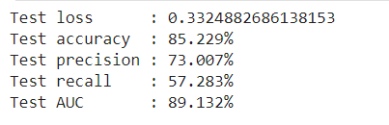
Evaluation
Multi-Label Classification Evaluation:
Each sample can belong to multiple classes simultaneously
Evaluate the model's performance on each attribute separately (correct and incorrect predictions for each feature)
Using Scikit-learn:
Weighted F1-Score
Recall
Precision

Slide 6
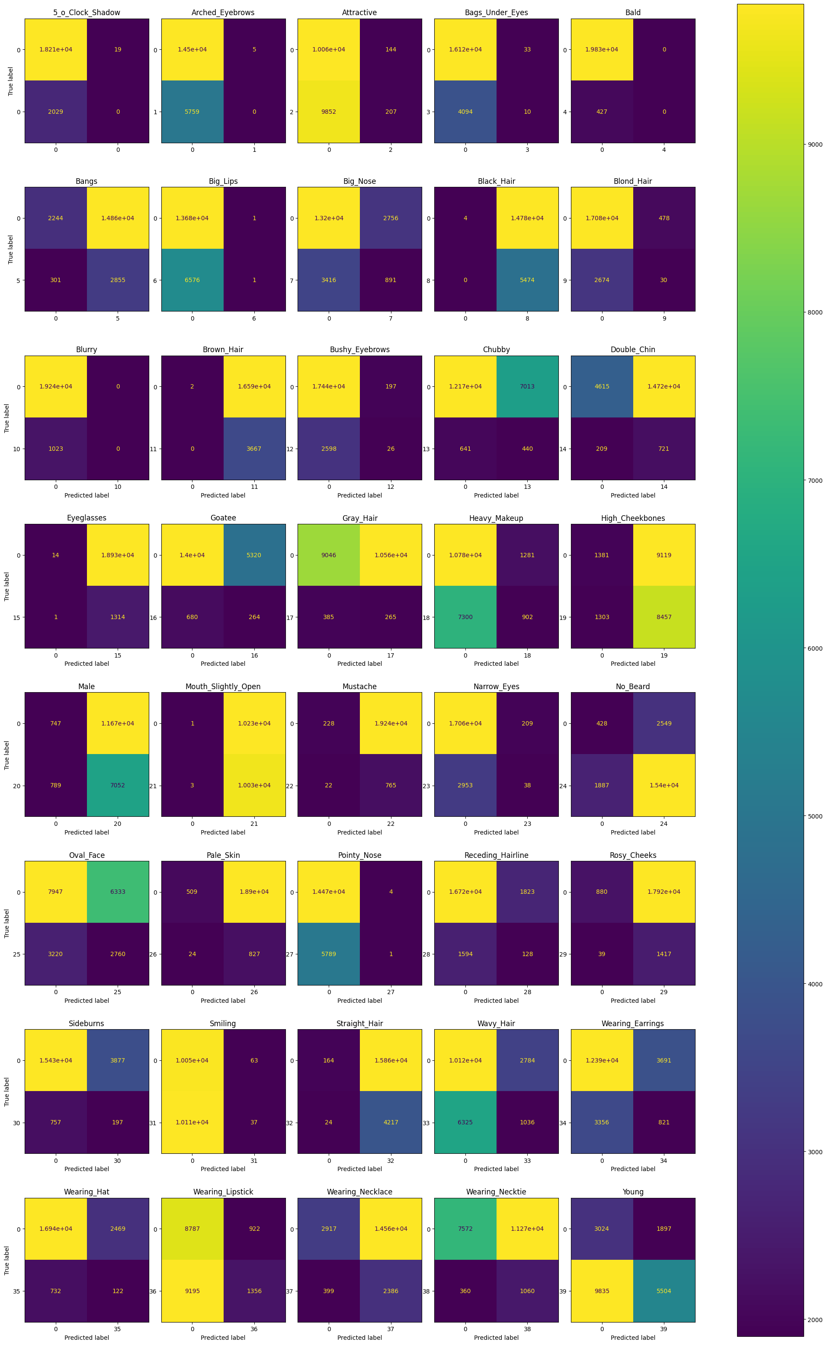
Summary
balanced accuracy with custom CNN model
images often contained several attributes simultaneously -> some errors may be caused by the dataset
pretrained model is to be more accurate

Slide 7
THANK YOU FOR YOUR ATTENTION!

