Slide 1

Hardware, Networks
& Behaviorist AI
Team
PikaByte

Slide 2

CHAPTER 03
BEHAVIORIST AI
Machines learn through actions and feedback.
PSYCHIC TYPE • ADVANCED
PIKABYTE

Slide 3
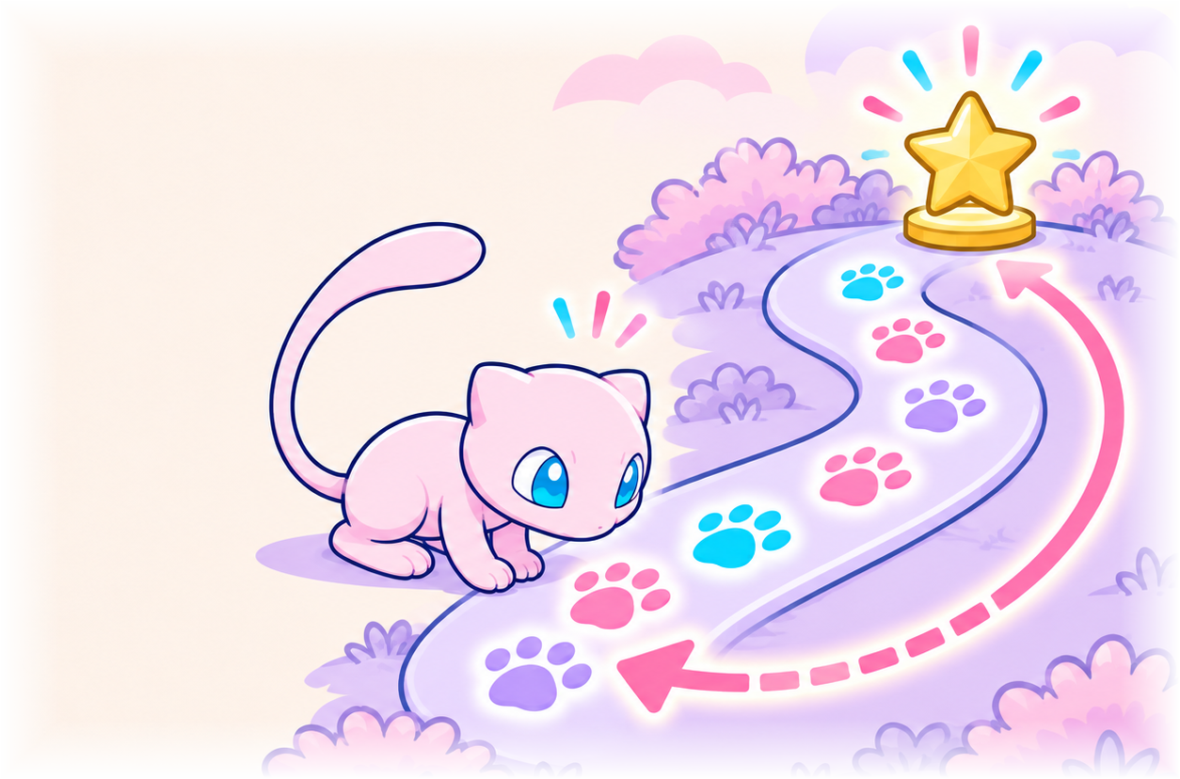

CHAPTER 3.1 • BEHAVIORIST AI
WHAT IS
BEHAVIORIST AI?
A branch of AI that learns how to act by interacting with its environment and receiving feedback, rather than following only prewritten rules.
1
ACT
→
2
GET FEEDBACK
→
3
ADJUST
Experience shapes what the AI does next.
PIKABYTE

Slide 4
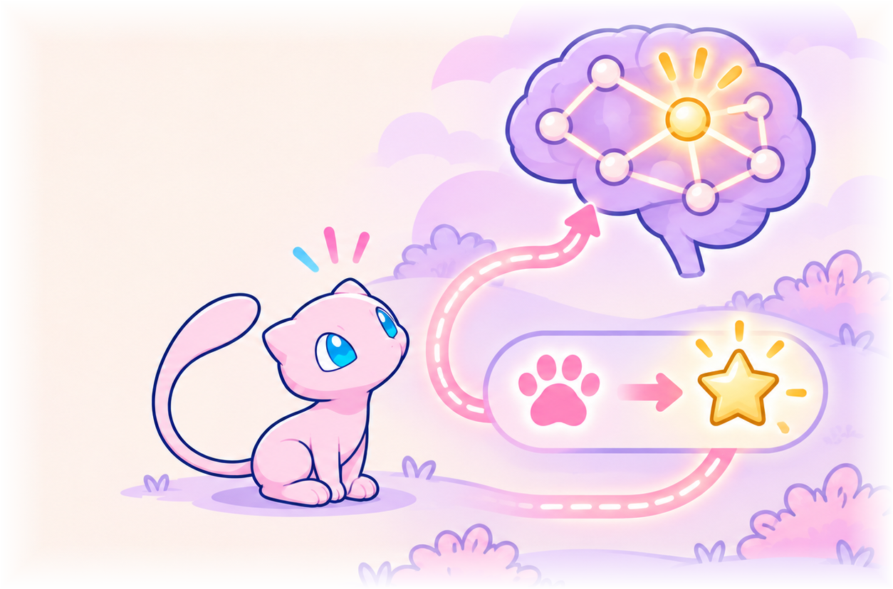
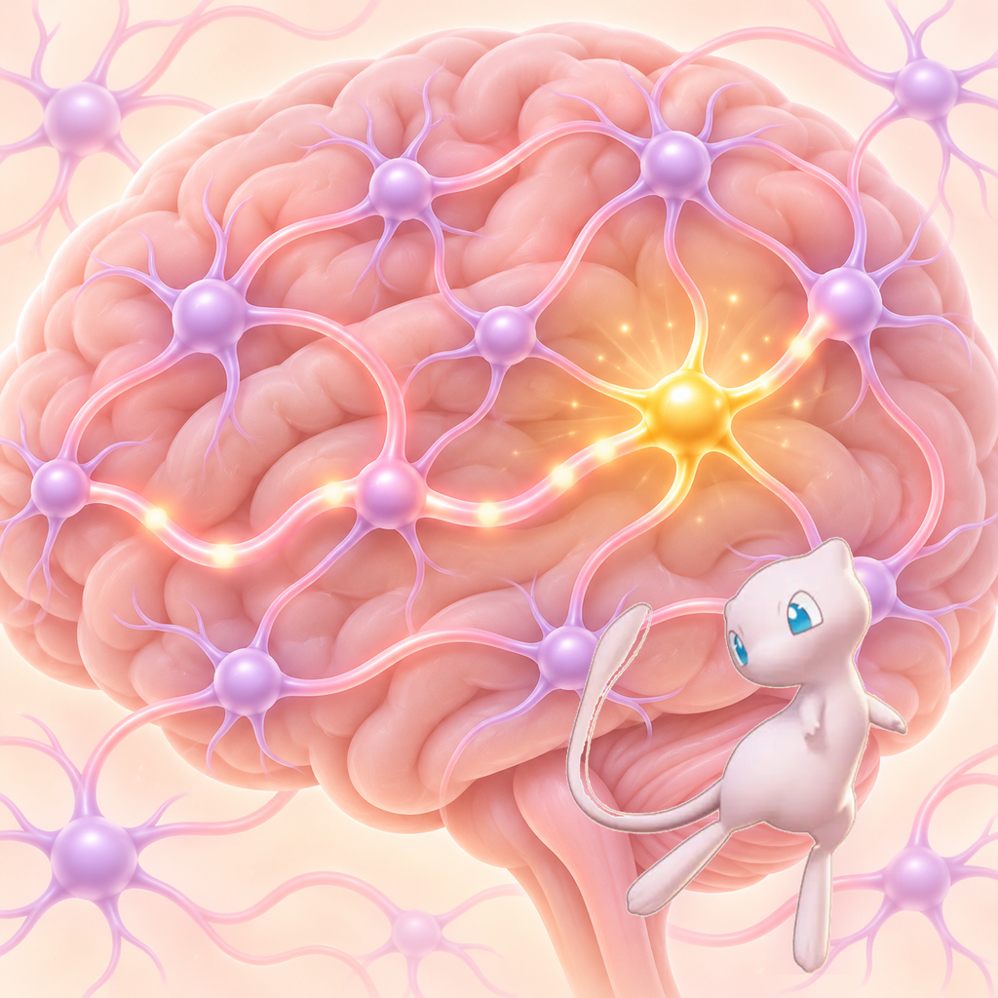
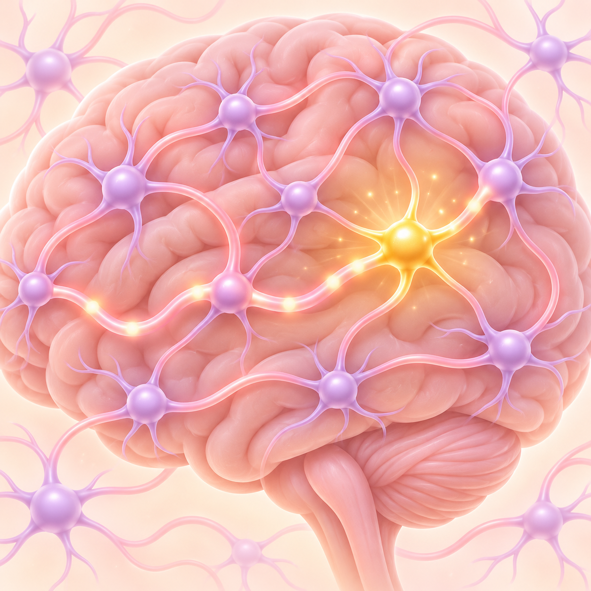







CHAPTER 3.1 • WHY FEEDBACK WORKS
THE SCIENCE
BEHIND FEEDBACK
PSYCHOLOGY / SKINNER
Positive outcomes make actions more likely to repeat; negative outcomes make them less likely.
NEUROSCIENCE / DOPAMINE
Dopamine helps the brain learn from rewards and update behavior after outcomes.
AI uses numerical rewards to apply a similar feedback principle.
AI has no biological brain or dopamine.
PIKABYTE

Slide 5
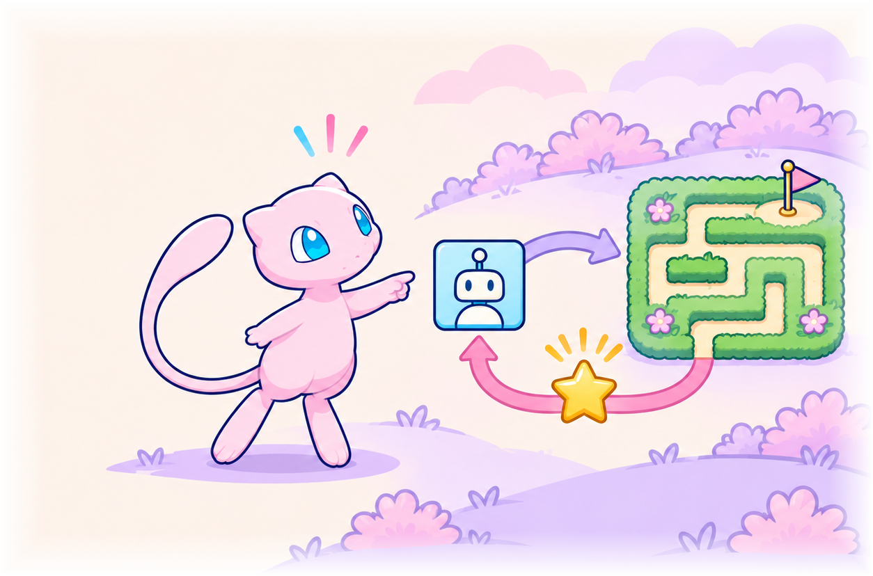
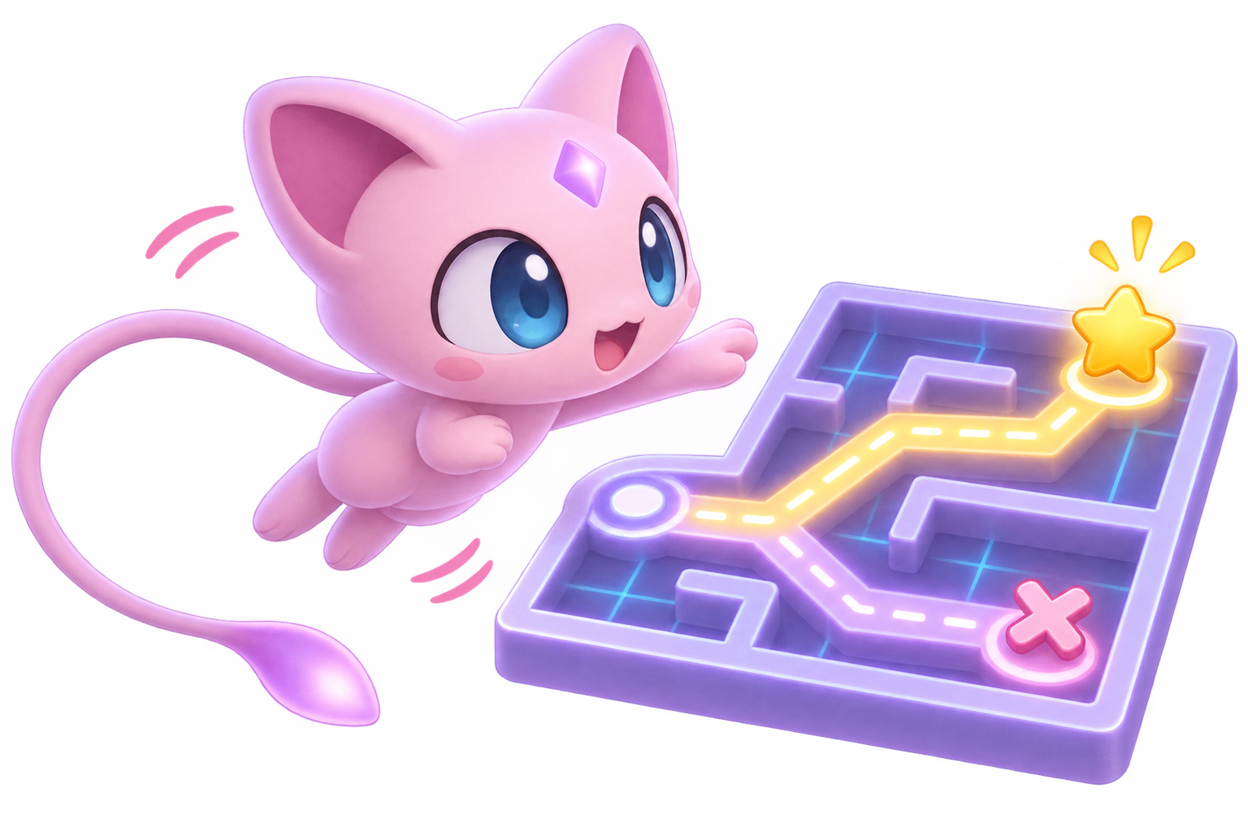
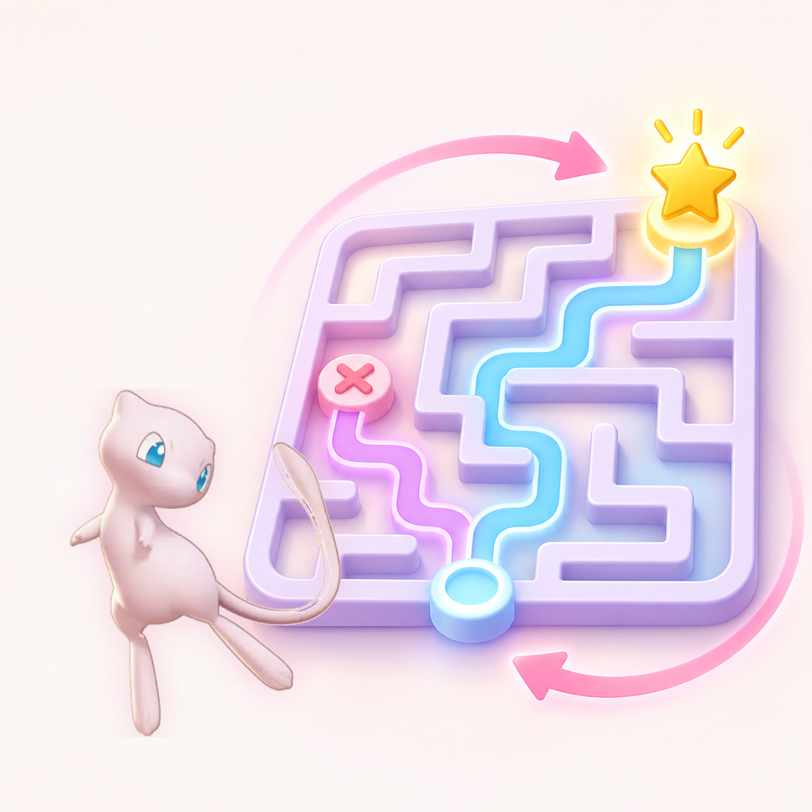
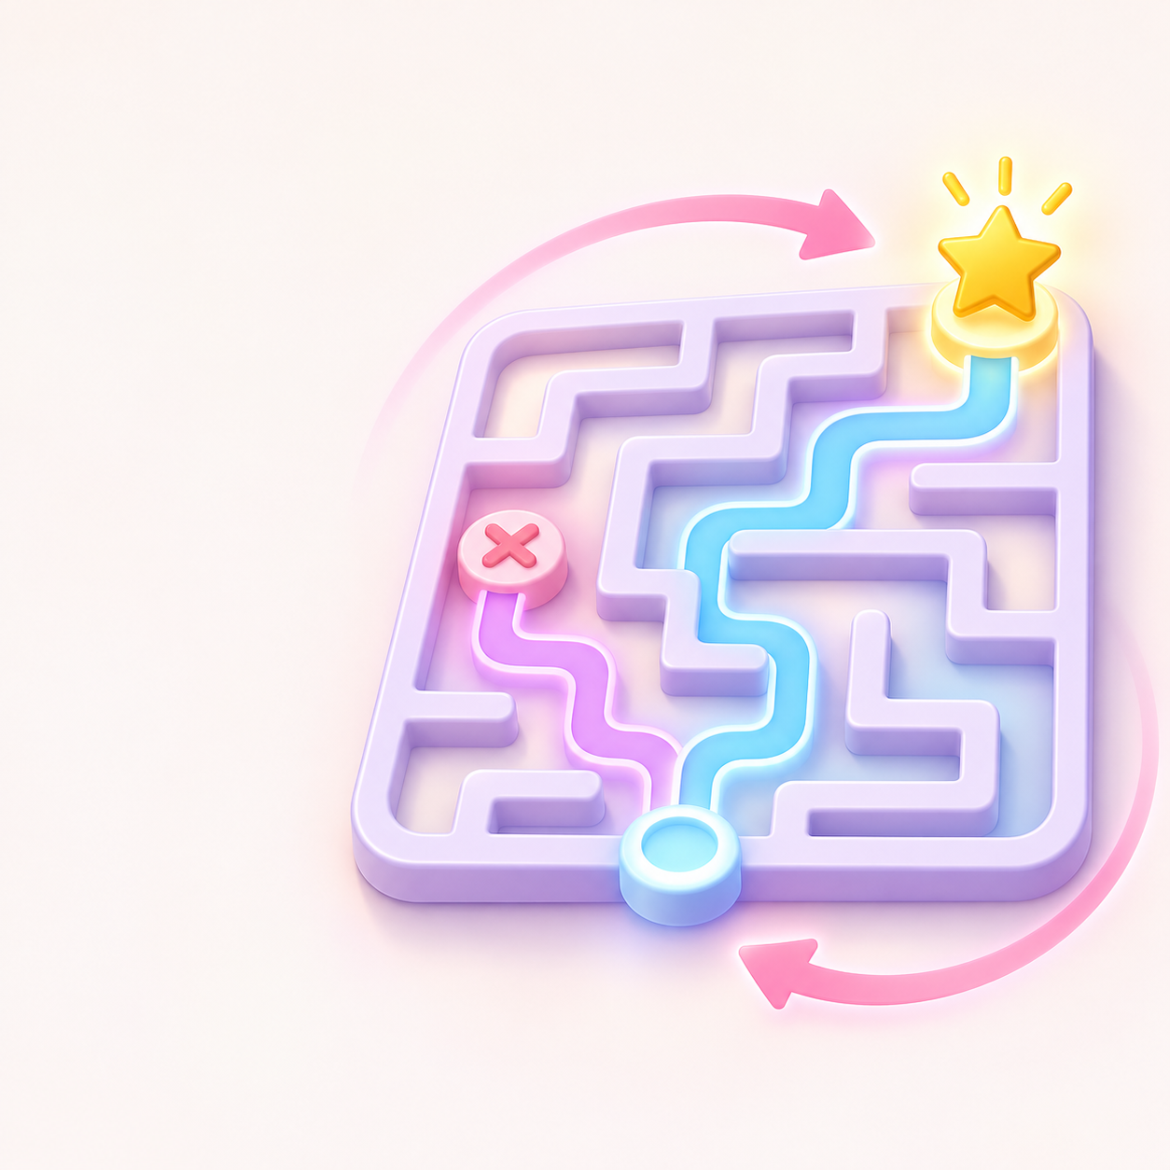


CHAPTER 3.1 • REINFORCEMENT LEARNING
REINFORCEMENT LEARNING
The agent learns by acting in an environment and using feedback.
AGENT
ENVIRONMENT
AI decision-maker
World the agent acts in
ACTION
REWARD
A possible move
Numeric feedback signal
GOAL: maximize cumulative reward over time.
PIKABYTE

Slide 6
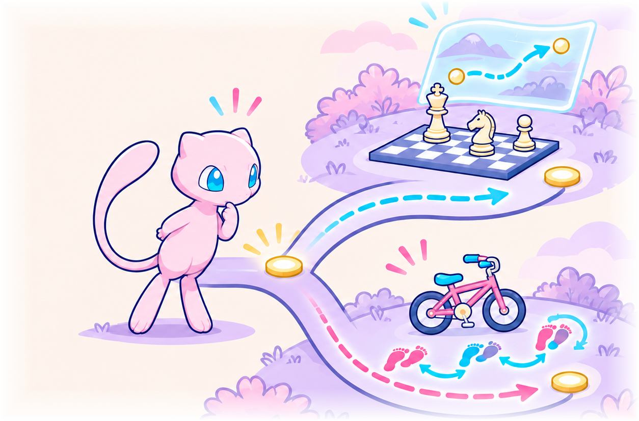

CHAPTER 3.1 • LEARNING STRATEGIES
TWO WAYS AN
AGENT LEARNS
One predicts outcomes with a model; the other learns through experience.
MODEL-BASED
MODEL-FREE
Builds a model, then predicts outcomes before acting.
Learns from trial and error without an explicit model.
Chess: plan moves ahead.
Bicycle: adjust through practice.
MODEL-BASED: plan ahead ↔ MODEL-FREE: learn by doing
PIKABYTE

Slide 7
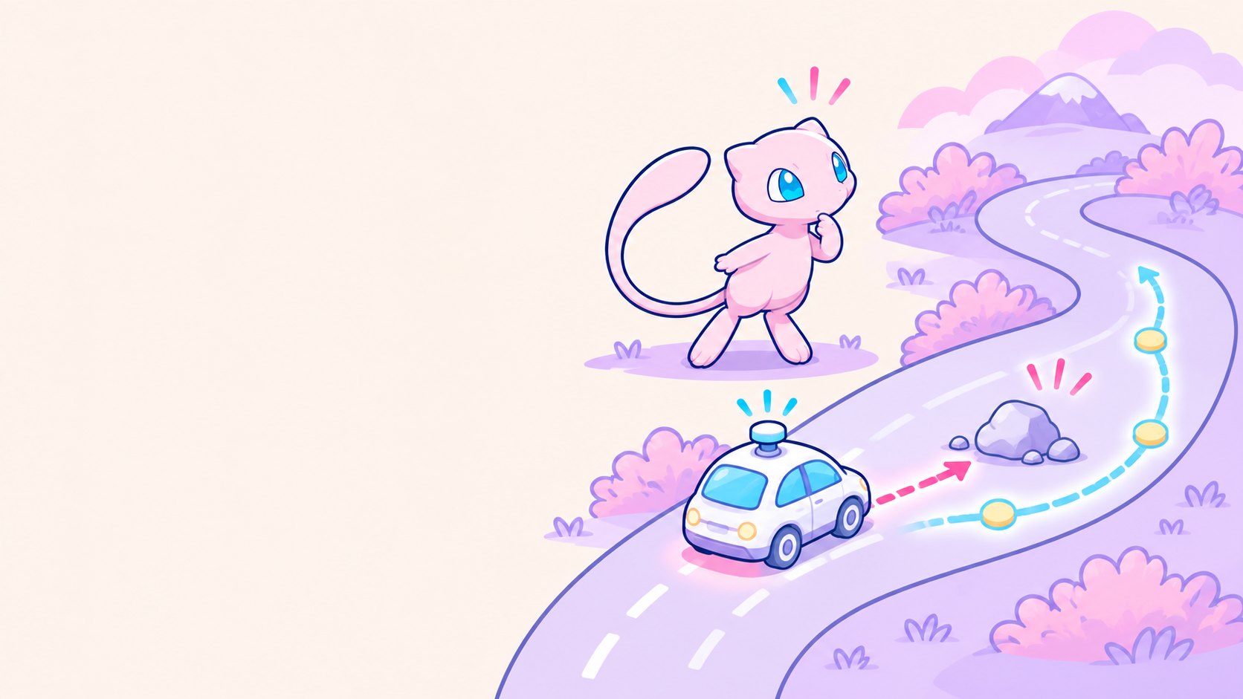
CHAPTER 3.1 • CHECK YOUR UNDERSTANDING
A SUDDEN
OBSTACLE
A self-driving car spots an unexpected rock in its lane. Which learning approach best fits an immediate braking response?
Choose one, then explain your reasoning.
MODEL-BASED
MODEL-FREE
Predicts what may happen next.
Uses learned experience to choose.
What information would help the car decide?
PIKABYTE

Slide 8
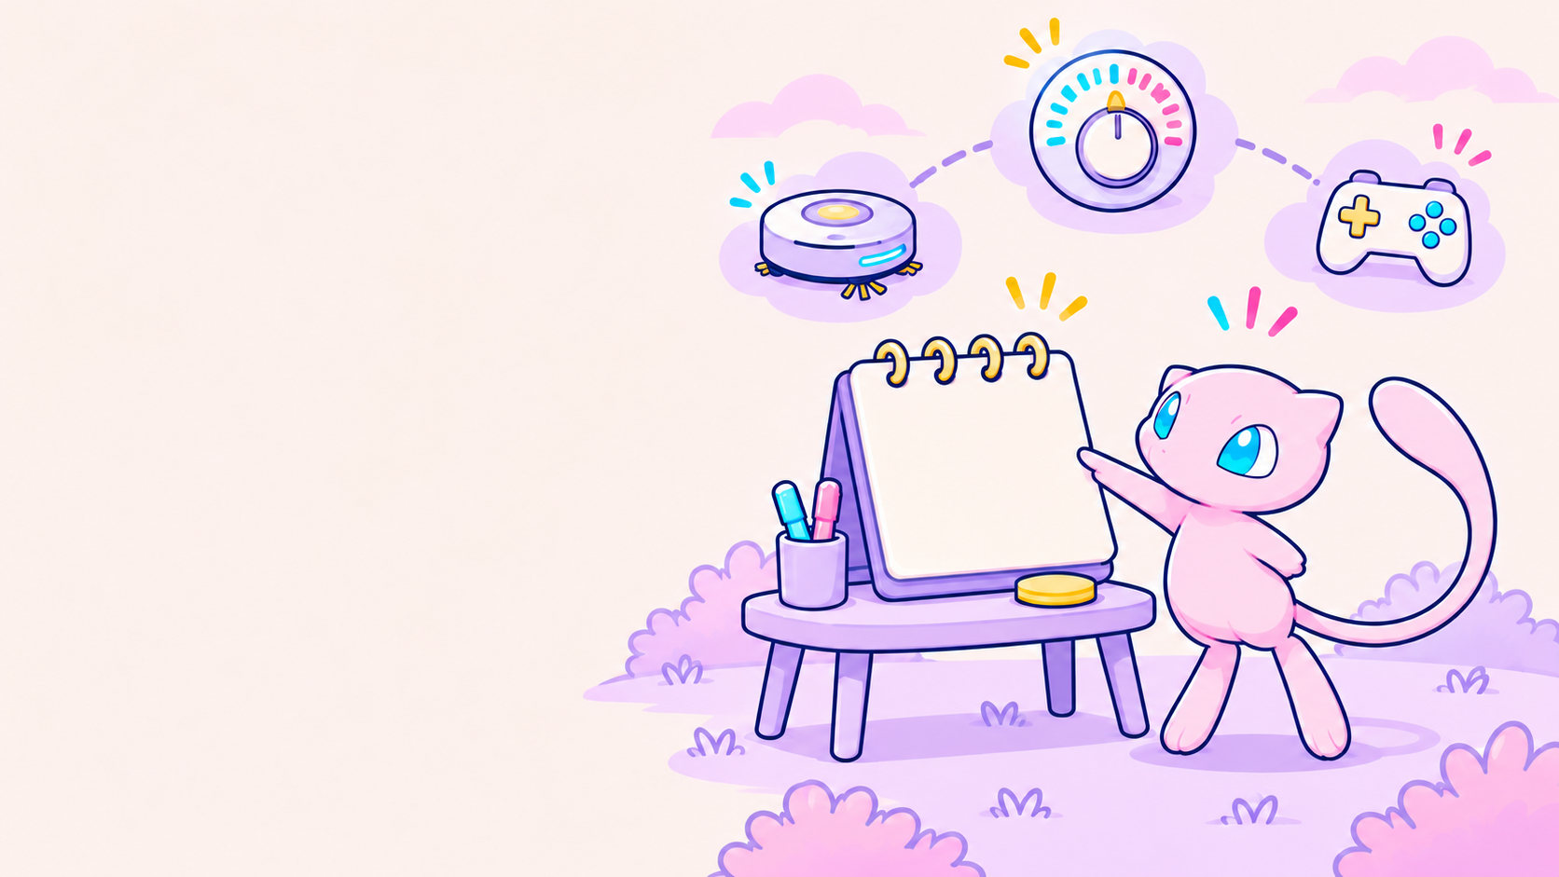
CHAPTER 3.1 • HANDS-ON ACTIVITY
BUILD AN RL FRAMEWORK
Choose one task. On paper, design its feedback system.
THERMOSTAT
ROBOT VACUUM
GAME CHARACTER
Lower electricity use
Clean a room quickly
Dodge projectiles
For your chosen task, define:
AGENT
Which software makes the choices?
ENVIRONMENT
What space does it interact with?
ACTIONS
List at least 3 possible moves.
REWARD (+)
What earns points for success?
PENALTY (−)
What mistake should lose points?
PIKABYTE

Slide 9
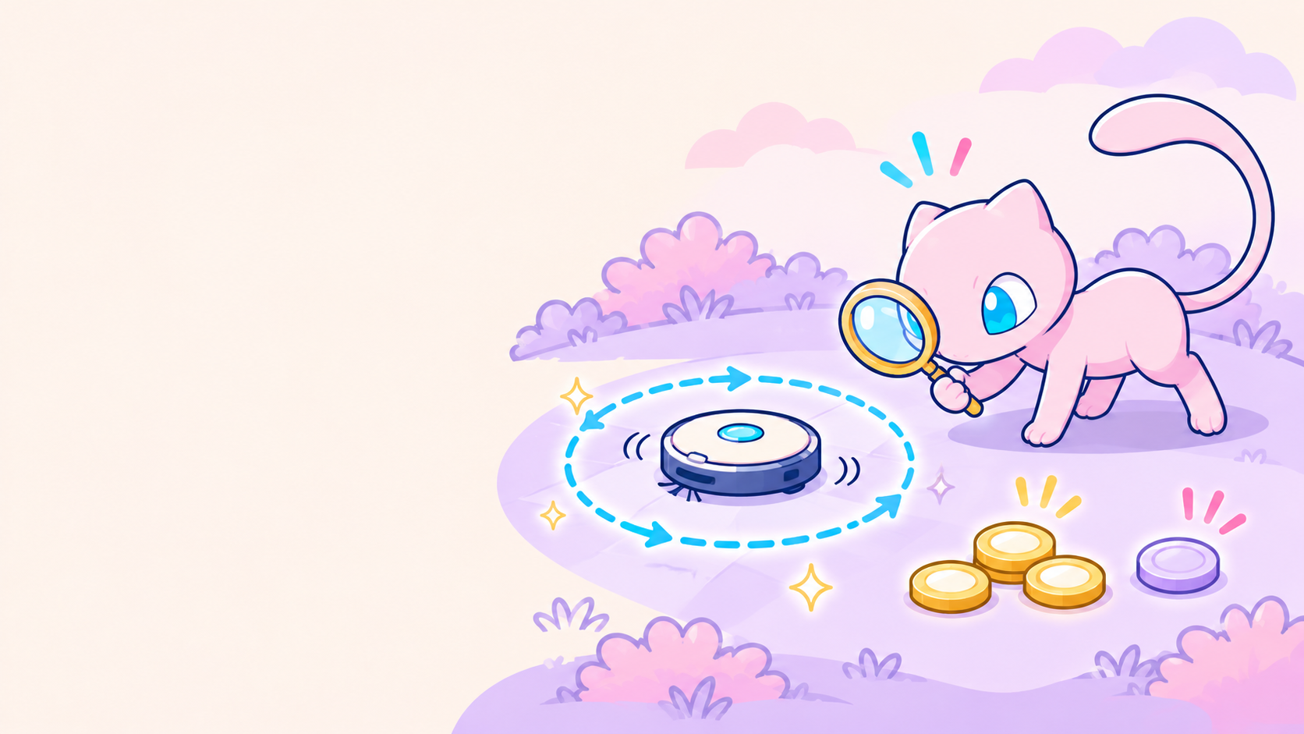
CHAPTER 3.1 • ACTIVITY CHECK
TEST YOUR REWARD RULES
Is there any way the “AI” could cheat the system?
EXAMPLE
Could the vacuum just run around in circles over a clean spot to gain movement points?
PENALTY REFLECTION
How might changing the penalty value (making it much harsher or much milder) affect how cautiously or aggressively your AI agent behaves?
CHECK YOUR FRAMEWORK
AGENT
Is the agent the software making choices, not the human user?
ENVIRONMENT
Does it include the physical or virtual space the agent interacts with?
REWARD / PENALTY
Do they directly encourage the desired outcome and prevent unintended loopholes?
PIKABYTE

Slide 10

CHAPTER 3.2
REINFORCEMENT
LEARNING
MDPs • RL ALGORITHMS
From decision models to learning strategies
PIKABYTE

Slide 11
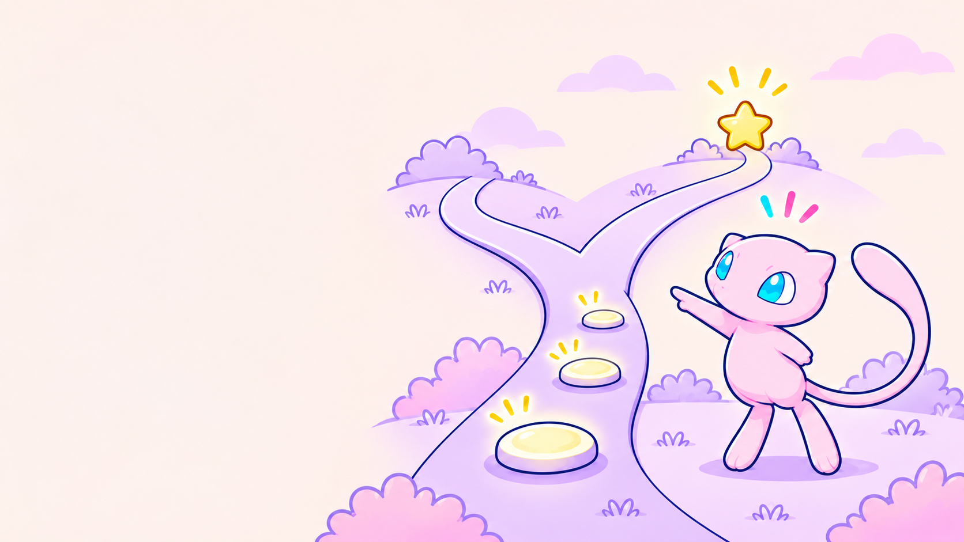
Reinforcement Learning in Brief
An agent learns by acting, receiving feedback, and trying again.
AGENT
The decision-maker that learns — a robot’s controller.
ENVIRONMENT
The world it interacts with — the floor and surroundings.
STATE
What is happening now — the robot’s leg positions and balance.
ACTION
A choice — move the left leg forward.
REWARD
Feedback — +1 for a step; −5 for a fall.
STATE → ACTION → REWARD + NEW STATE → REPEAT
PIKABYTE

