Slide 1

Hardware, Networks
& Behaviorist AI
Team
PikaByte

Slide 2

CHAPTER 02
NETWORKS
How devices connect and share data.
Connect the digital world.
PIKABYTE

Slide 3

CHAPTER 2.1
WHAT IS A
COMPUTER
NETWORK?
Connected devices share data and resources.
Start with the basics.
PIKABYTE

Slide 4
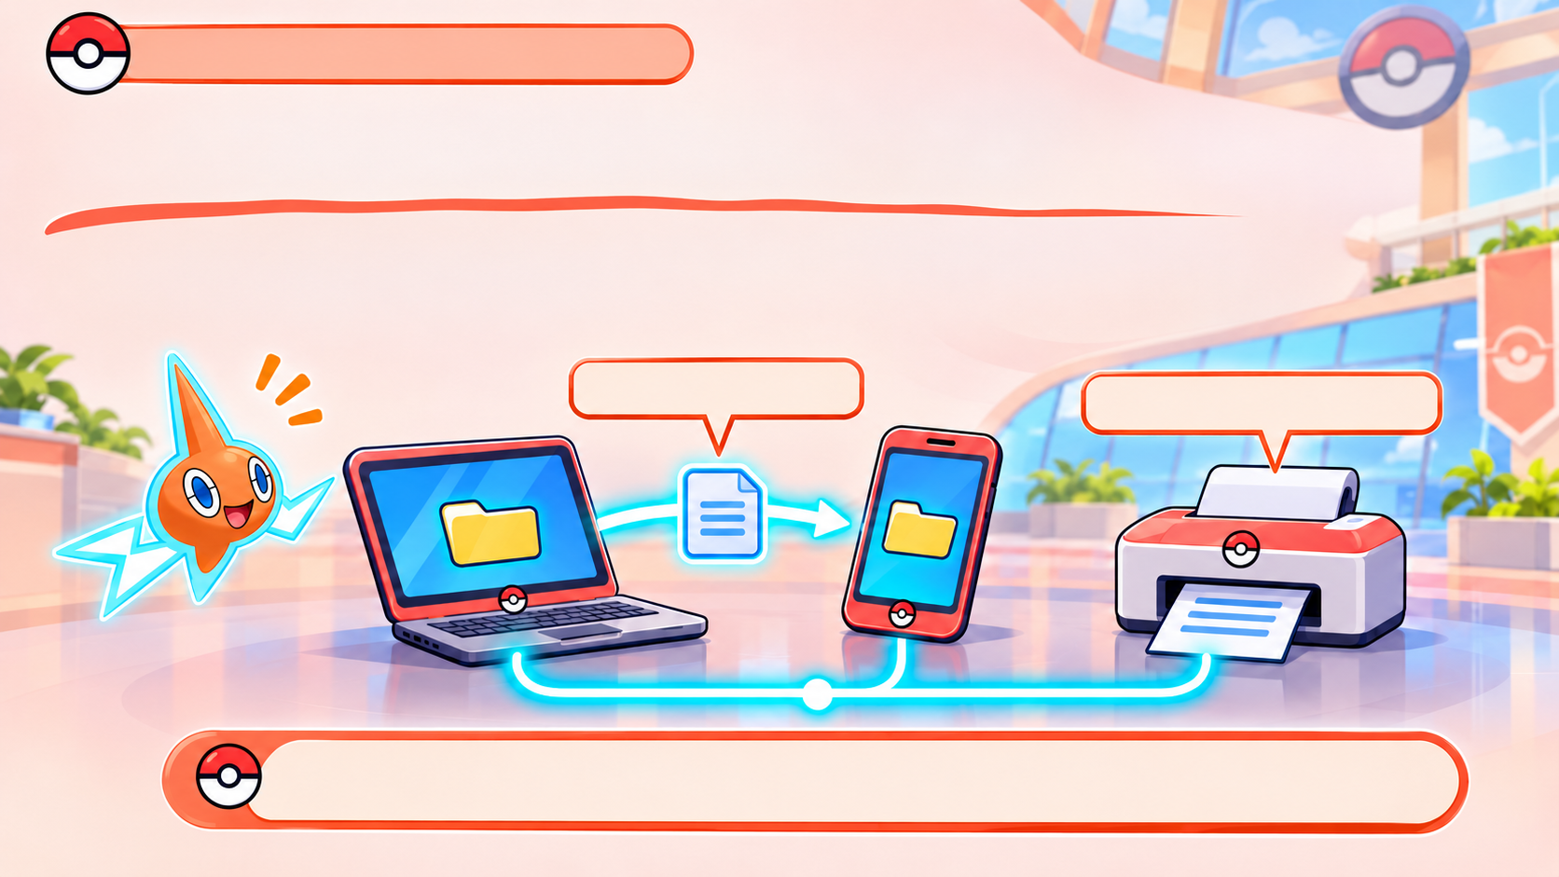
CHAPTER 2.1 NETWORK BASICS
A NETWORK CONNECTS DEVICES
A computer network is a group of connected devices that
share data and resources.
SHARED FILE
SHARED PRINTER
Connected devices can share information and tools.
PIKABYTE

Slide 5
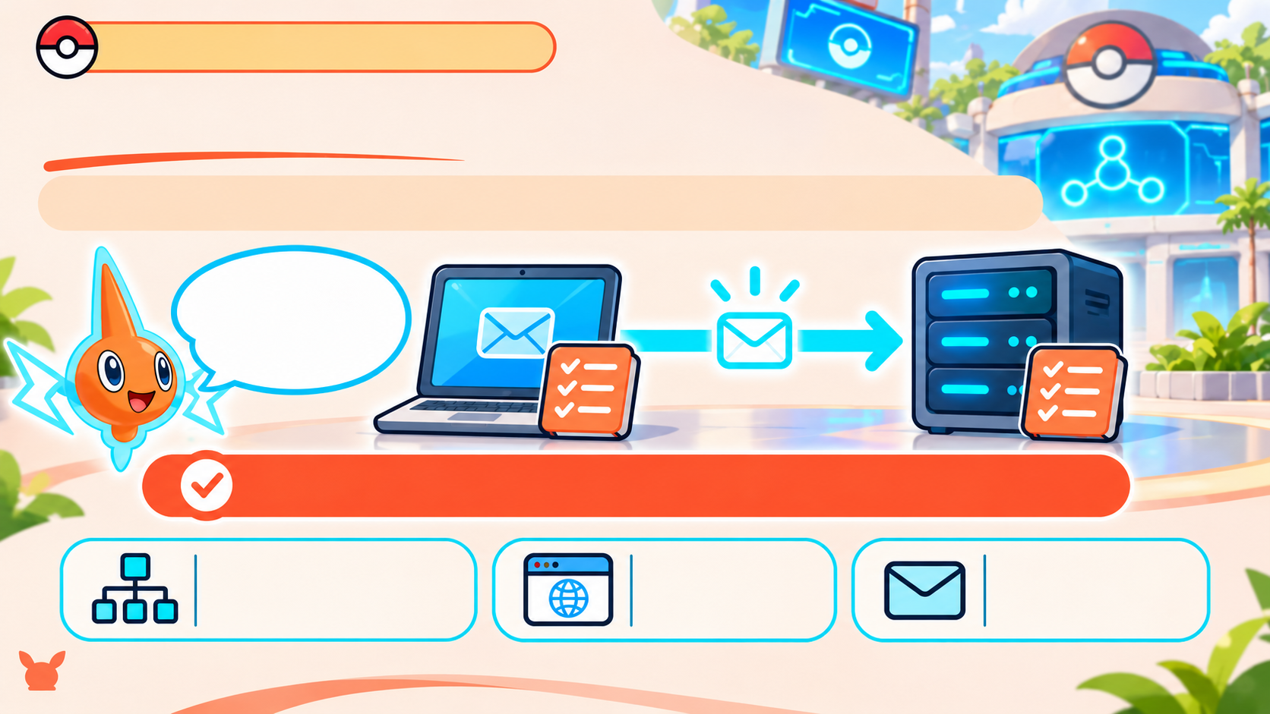
CHAPTER 2.1 NETWORK BASICS
PROTOCOLS ARE SHARED RULES
A protocol is a set of rules devices follow to exchange data.
Like speaking the same language
Shared rules help devices understand each other.
TCP/IP -
HTTP -
SMTP -
data across networks
web pages
sending email
PIKABYTE
Notes:
Devices need shared rules to exchange data. A protocol sets those rules, so the sender and receiver know how to format and understand a message. HTTP is used for web communication, and SMTP is used to send email.

Slide 6
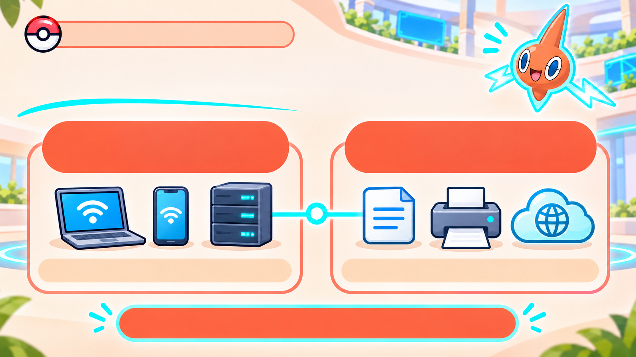
CHAPTER 2.1 NETWORK BASICS
NODES AND RESOURCES
NODES =
CONNECTED DEVICES
RESOURCES =
THINGS DEVICES SHARE
A node is a device on the network.
A resource is something devices share.
Devices connect; resources are shared.
PIKABYTE

Slide 7
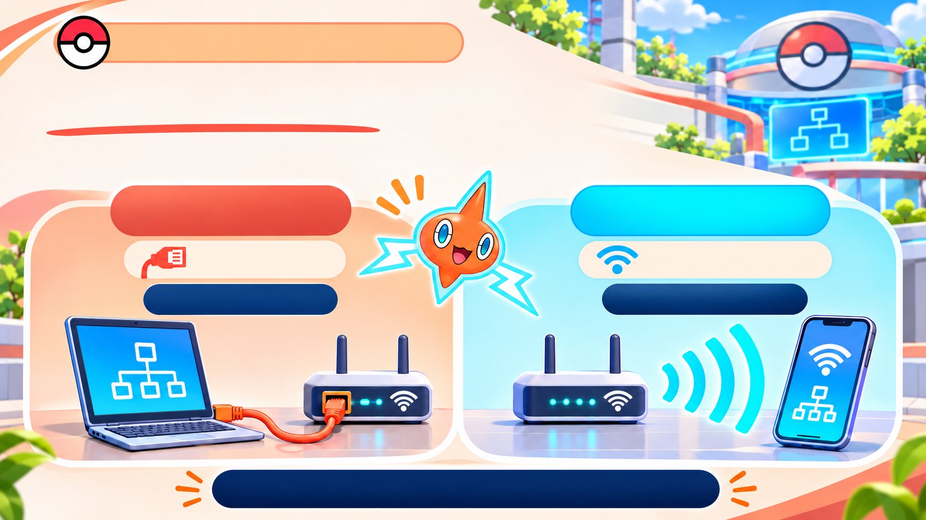
CHAPTER 2.1 NETWORK BASICS
TWO WAYS TO CONNECT
Devices join a network with a cable or through the air.
WIRED
WIRELESS
Uses a cable
Uses radio waves
Example: Ethernet
Example: Wi-Fi
Both methods connect devices to a network.
PIKABYTE

Slide 8
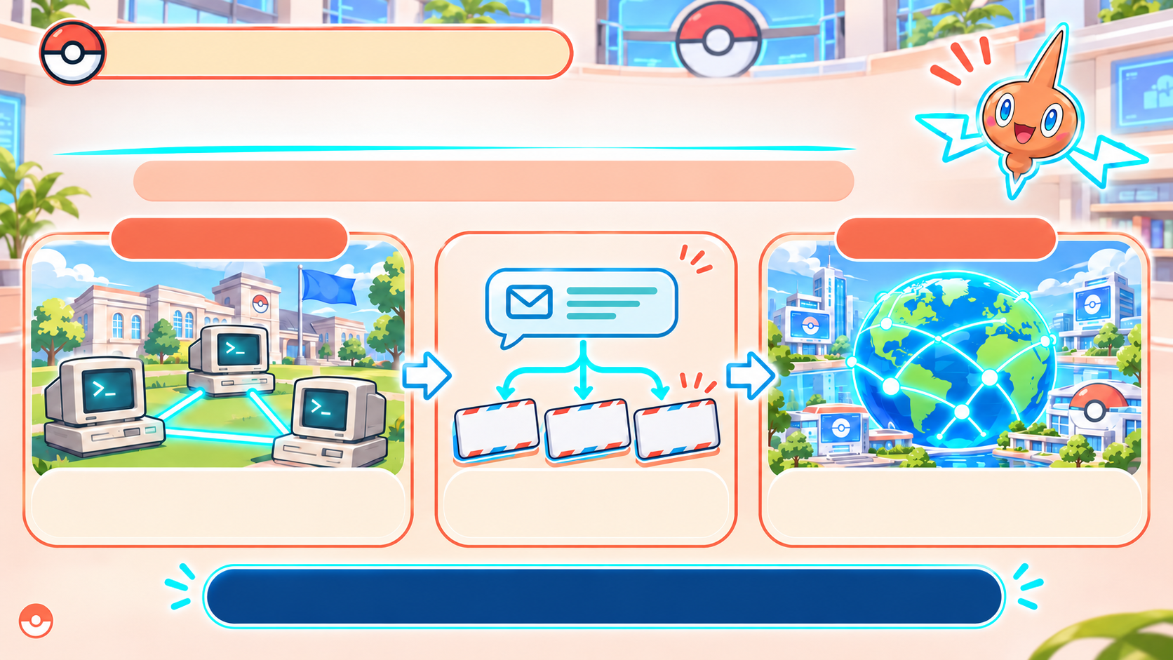
CHAPTER 2.1 NETWORK BASICS
FROM EARLY NETWORKS TO THE INTERNET
Networks grew from research links to a global system.
LATE 1960s
TODAY
HOW DATA TRAVELS
Packet 1
Packet 2
Packet 3
ARPANET: an early
packet-switched network
Packets small pieces of data
The Internet connects networks worldwide
Data can travel in small pieces across connected networks.
PIKABYTE
Notes:
The ARPANET began in the late 1960s and connected a small number of research computers. It used packet switching: data was split into small pieces that could travel across the network. Today, the Internet connects networks and devices around the world.

Slide 9
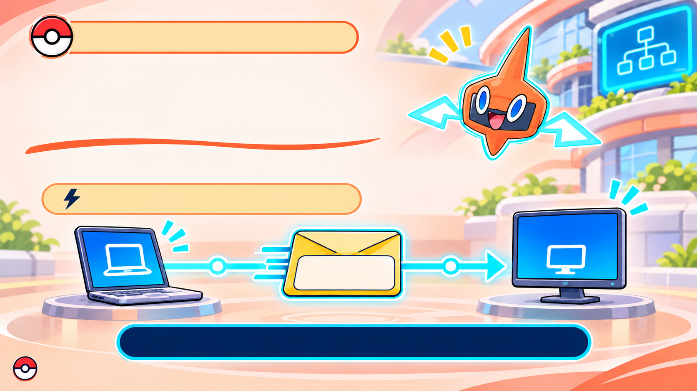
CHAPTER 2.1 NETWORK BASICS
HOW DOES DATA FIND
THE RIGHT DEVICE?
An IP address identifies a device on a network.
Like a delivery address for data.
192.168.1.25
Example IP:
192.168.1.25
The address helps data reach its destination.
PIKABYTE
Notes:
An IP address identifies a device on a network, much like an address helps a letter reach the right place. When data is sent, the network uses the destination IP address to help deliver it.

Slide 10
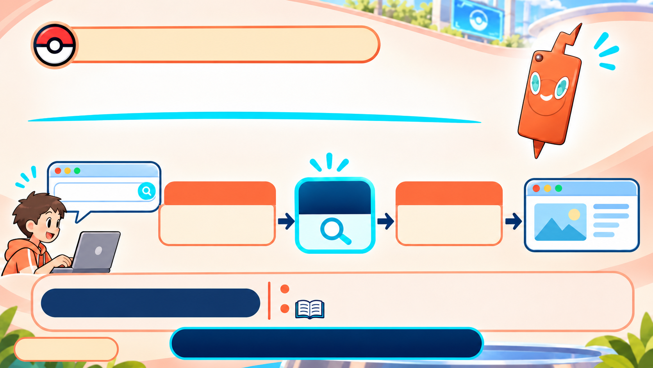
CHAPTER 2.1 NETWORK BASICS
DNS: NAMES TO IP ADDRESSES
People use names; devices use IP addresses.
www.example.com
HOSTNAME
DNS LOOKUP
IP ADDRESS
192.0.2.10
www.example.com
DNS finds the IP address linked to a website name.
DNS = Domain Name System
Like a phone book for website names.
Name in → IP address out.
PIKABYTE
Notes:
eople find websites easier by name than by number. DNS looks up a domain name, such as www.example.com, and finds the IP address connected to it. The browser can then use that address to contact the website.

Slide 11
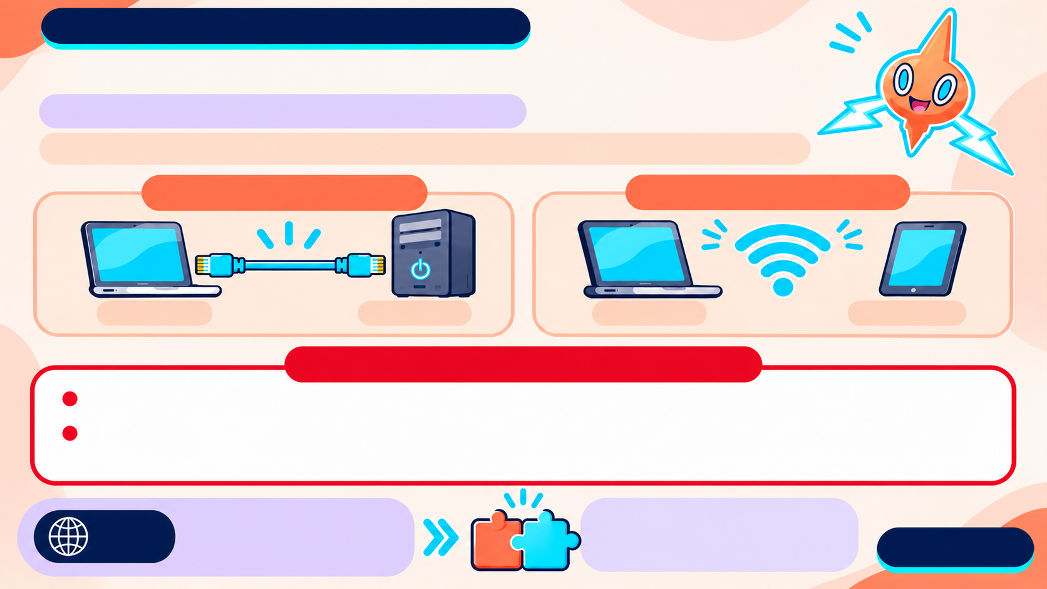
CHAPTER 2.1 NETWORK BASICS
STANDARDS HELP DEVICES WORK TOGETHER
A standard is an agreed technical rule.
Different makers' devices can connect when they follow the same standard.
Ethernet • wired
802.11 • Wi-Fi
Maker A
Maker B
Maker C
Maker D
REMEMBER THESE TERMS
Ethernet - a common standard for wired local networks.
IEEE -
Institute of Electrical and Electronics Engineers; an organization that develops standards such as Ethernet and 802.11.
IEEE
IEEE helps set network
standards.
Shared standards make devices compatible.
PIKABYTE

Slide 12
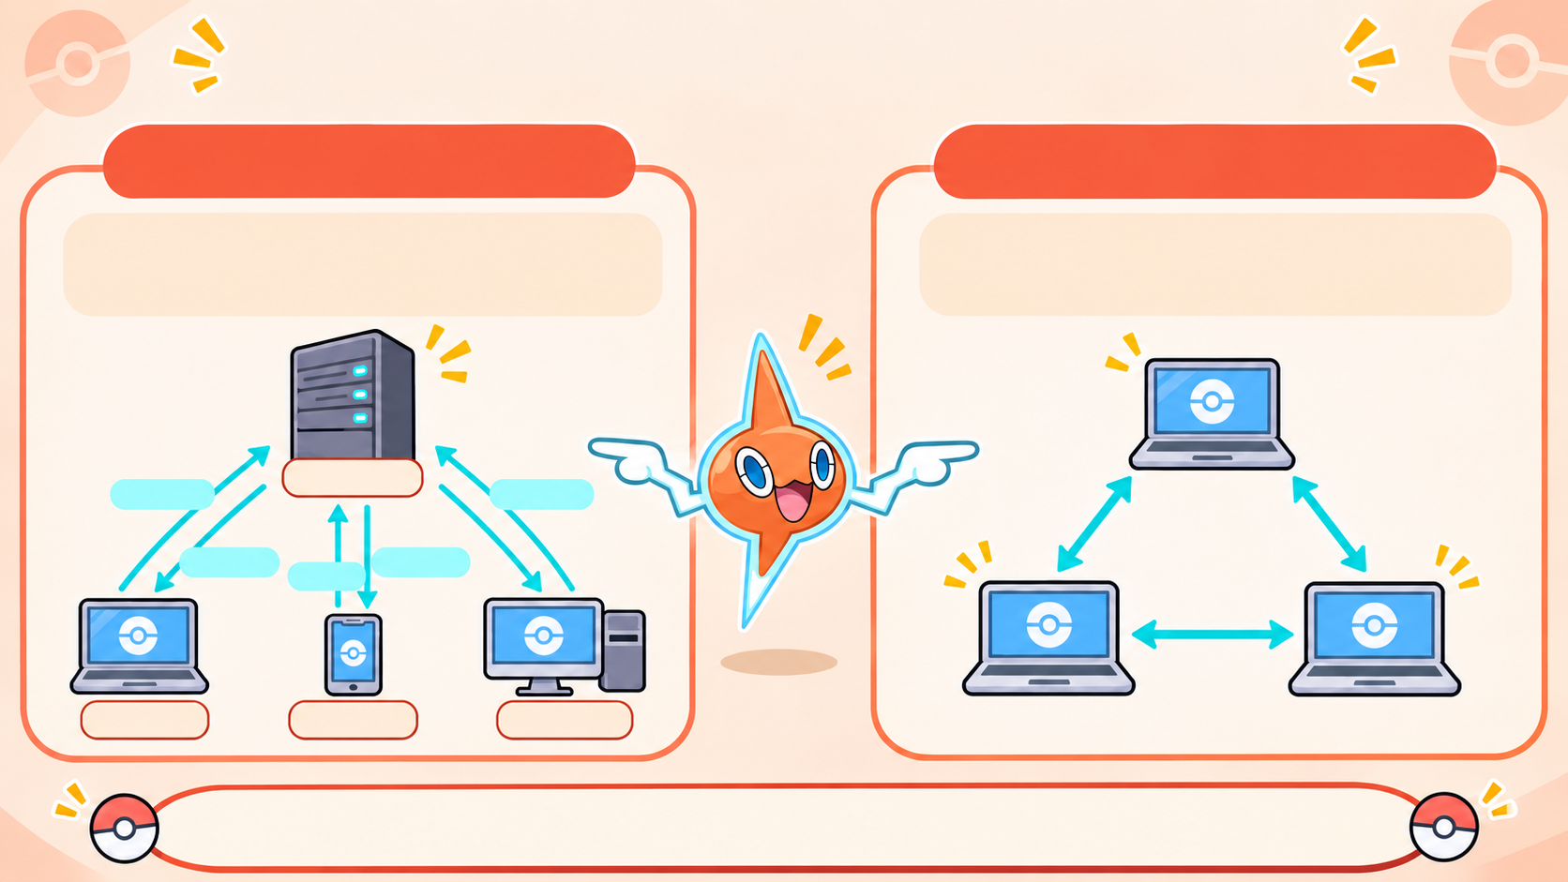
TWO WAYS DEVICES SHARE DATA
CLIENT-SERVER
PEER-TO-PEER (P2P)
A central server provides data or services to client devices.
Devices share directly; each can send and receive data.
Server
request
response
response
request
response
Client
Client
Client
Client-server: ask a server. P2P: share between devices.
Notes:
In a client-server network, a client asks a central server for a service or file. In peer-to-peer networking, devices share directly with one another. The difference is whether a central server provides the resource.

Slide 13
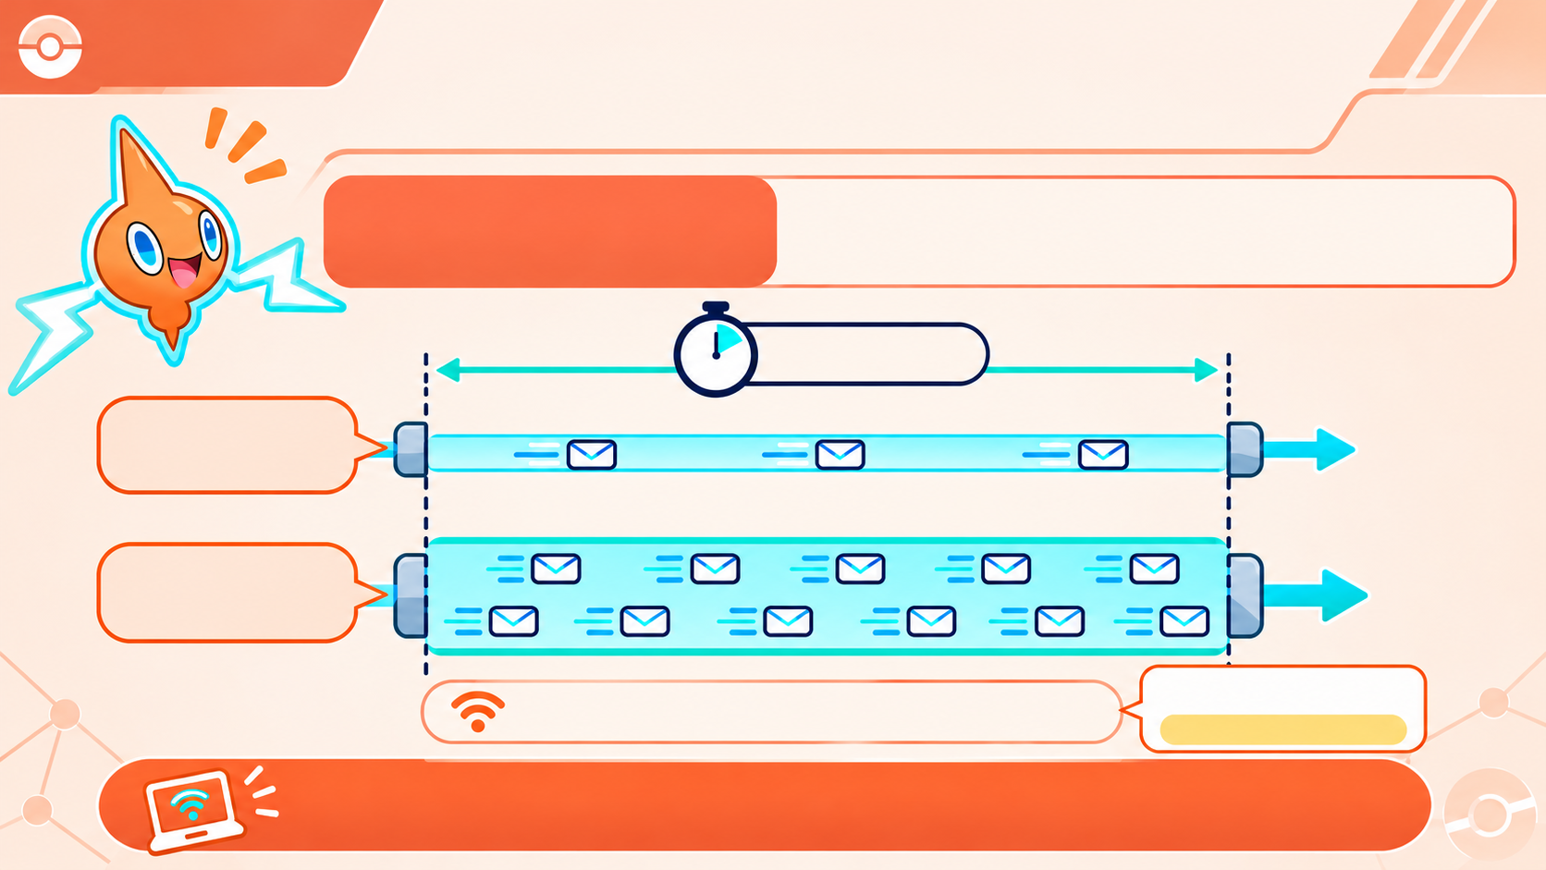
Chapter 2.1
Rotom Network
HOW MUCH DATA CAN A NETWORK CARRY?
BANDWIDTH
Bandwidth is the amount of data a connection can carry per second.
1 second
Lower bandwidth
Higher
bandwidth
Mbps = megabits per second Gbps = gigabits per second
Usually measured in Mbps or Gbps.
1 Gbps = 1,000 Mbps
More bandwidth = more data can travel at once.
Notes:
Bandwidth describes how much data a connection can carry per second. More bandwidth can carry more data at once. It does not necessarily mean that every response starts instantly; the delay before a response is latency.

Slide 14
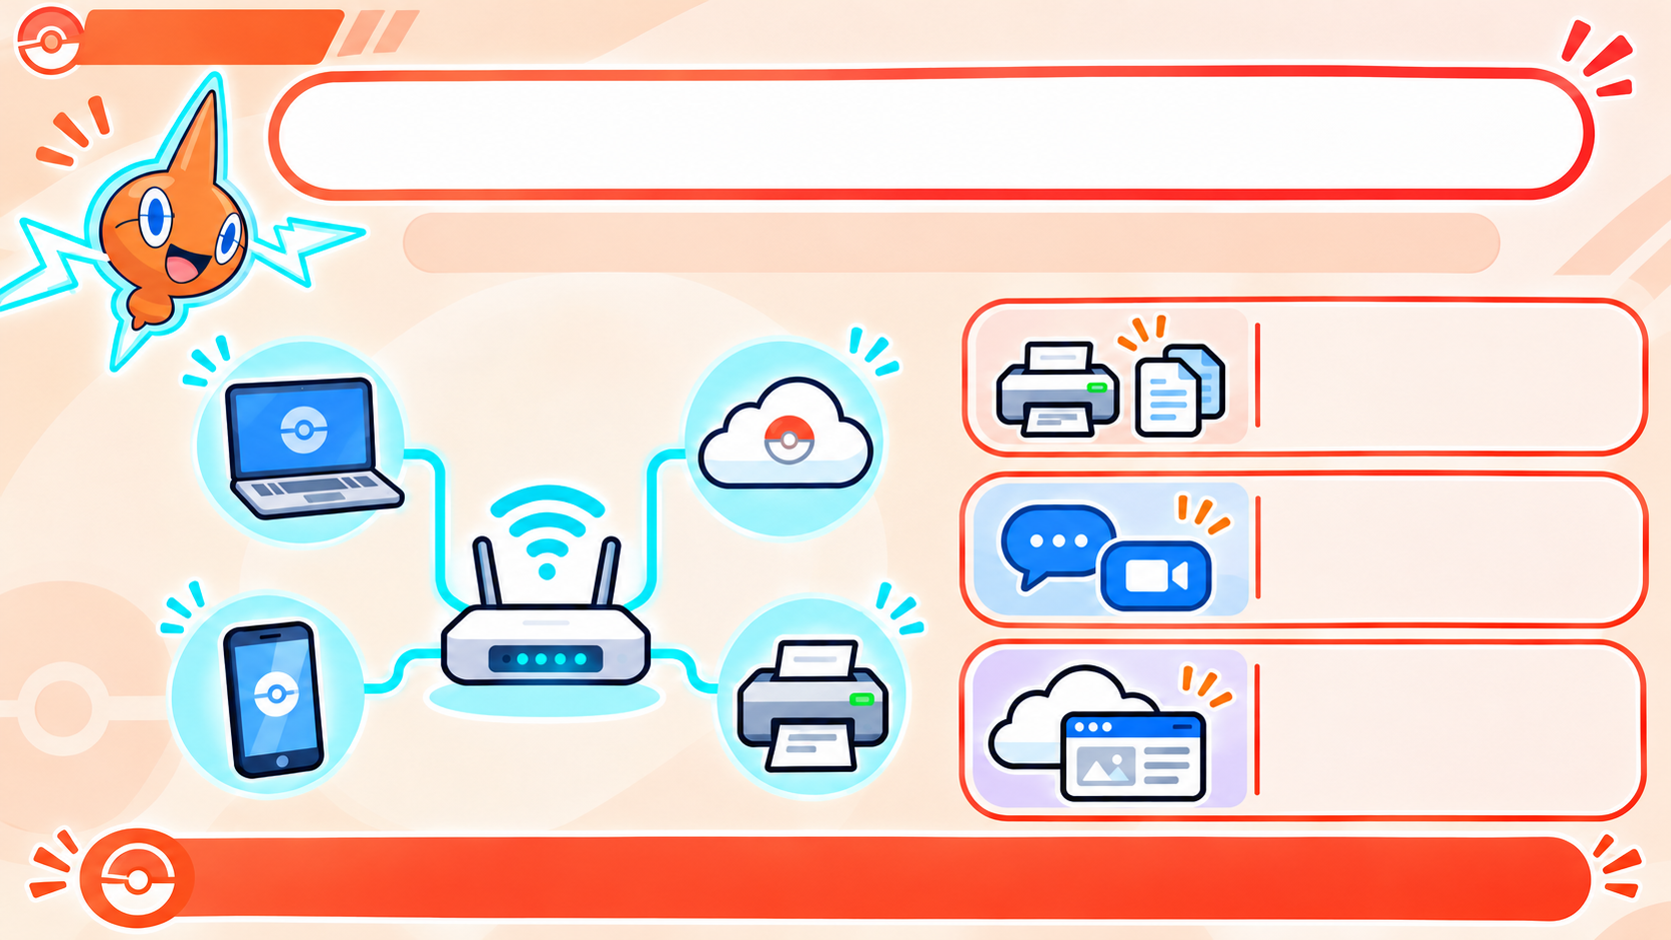
Chapter 2.1
WHY DO WE USE NETWORKS?
Networks let connected devices share and communicate.
Share resources
Use shared devices
and files.
Communicate
Send messages and make video calls.
Access online services
Use websites. Cloud
services are online
storage and tools.
A network connects devices so they can share data and services.

Slide 15
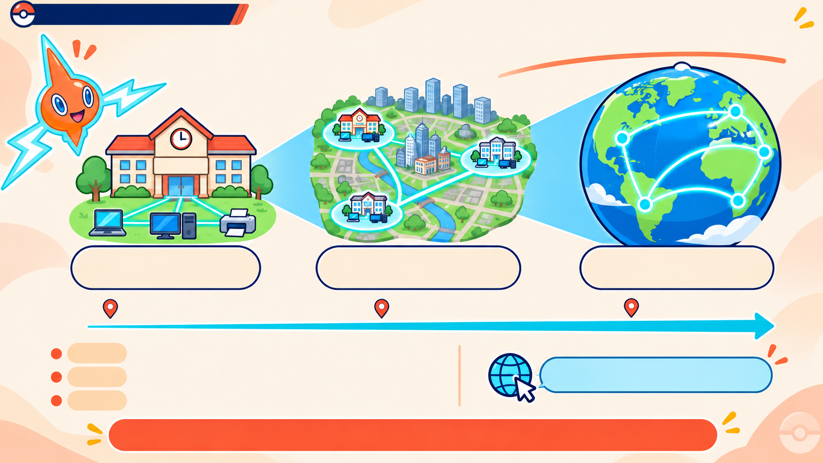
Chapter 2.1: Rotom Network
NETWORKS CAN COVER DIFFERENT AREAS
LAN –
MAN –
WAN –
Local Area Network
Metropolitan Area Network
Wide Area Network
City area
Across regions /
Small area
countries
LAN:
a small area, like a home, school, or office.
MAN:
a city or metropolitan area.
The Internet is a global WAN.
WAN:
a large area across regions or countries.
Bigger coverage connects networks over greater distances.
Notes:
A LAN covers a small area, such as a home, school, or office. A MAN connects networks across a city. A WAN covers a much larger area, such as several regions or countries. The Internet is a global WAN.

Slide 16
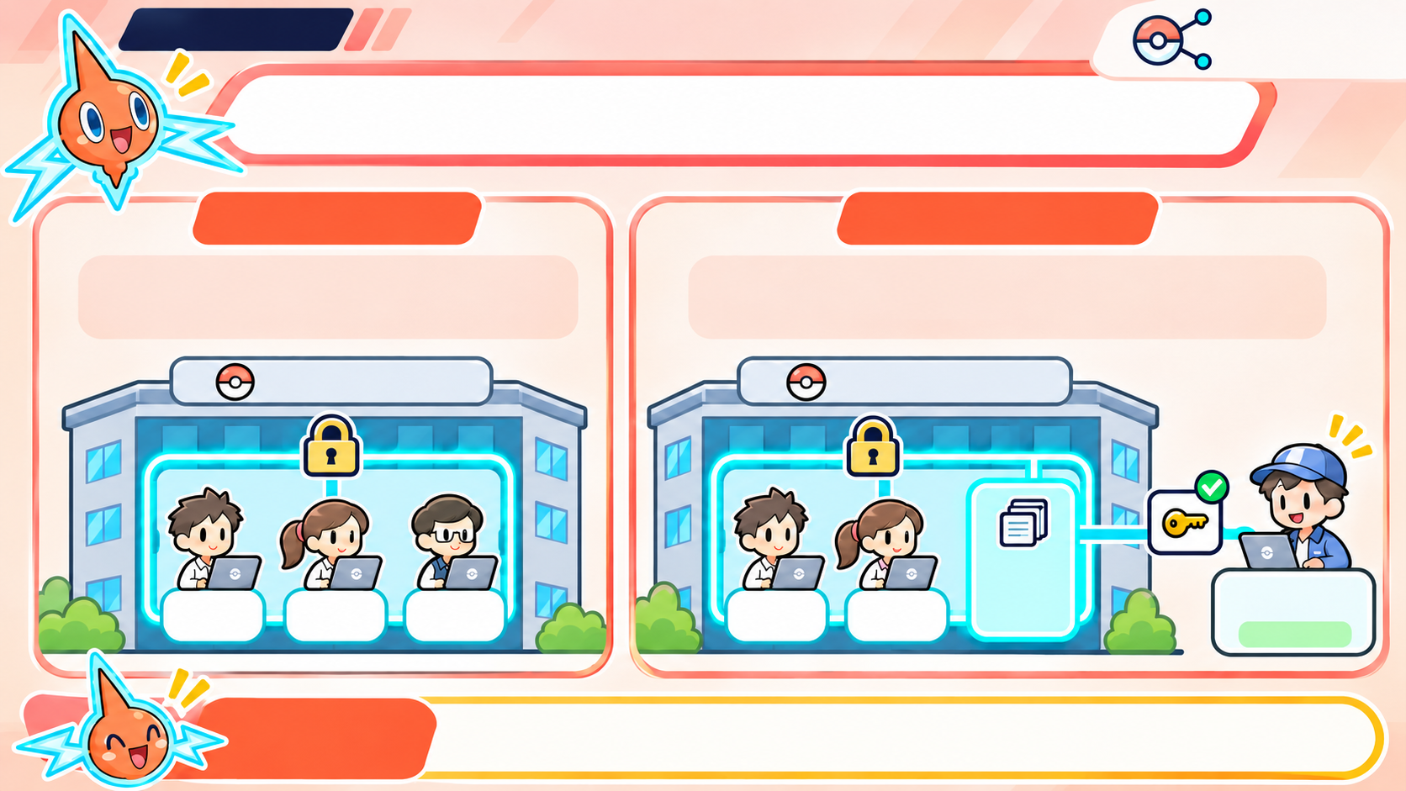
Chapter 2.1
Rotom
networks
WHO CAN ACCESS THIS NETWORK?
INTRANET
EXTRANET
A private network for an
organization’s employees.
A private network that gives
authorized outside partners limited access.
Private Company
Private Company
Limited
access
Approved
partner
Employees
(inside)
Employees
(inside)
Employees
(inside)
Employees
(inside)
Employees
(inside)
(outside)
KEY
TAKEAWAY:
Extranet gives approved outsiders limited access
to selected company resources.
Notes:
An intranet is a private network used inside an organization. Employees can use it to access internal information and services. It may use Internet technologies, but access is limited to authorized people.

Slide 17
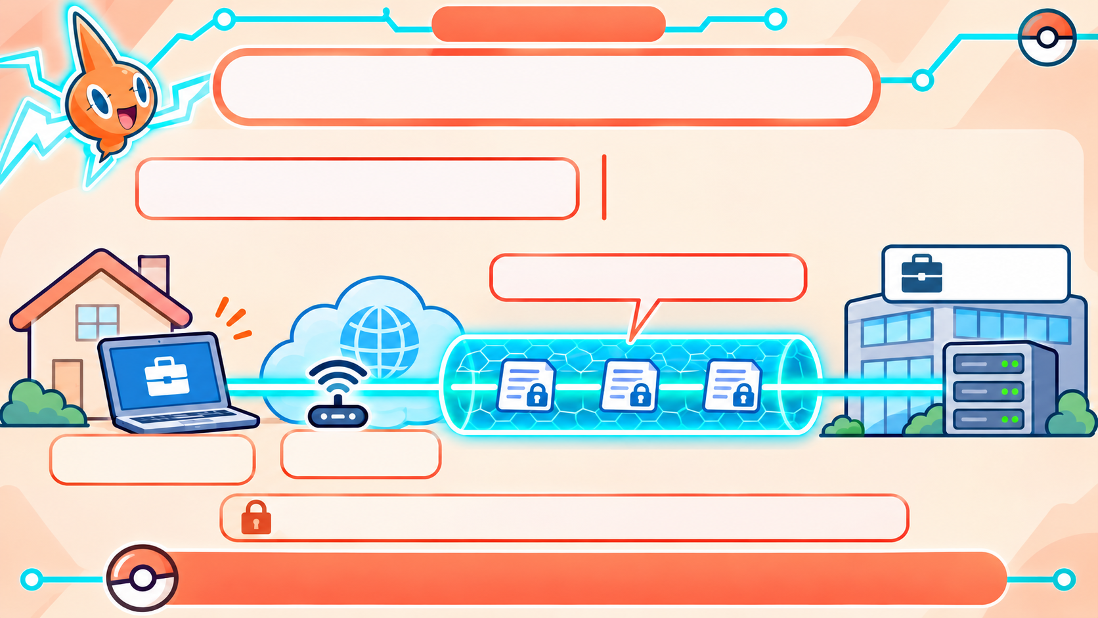
Chapter 2.1
WHAT DOES A VPN DO?
A VPN creates an encrypted
connection through the internet
to a private network.
VPN = Virtual Private Network.
Encrypted connection
Company
Network
Laptop at home
(remote connection)
Public Wi-Fi /
the Internet
Encryption scrambles data so others can’t easily read it.
A VPN helps protect data when connecting remotely.
Notes:
A VPN creates an encrypted connection between a device and a private network through the Internet. This can help protect data while someone connects remotely, for example from home or public Wi-Fi. A VPN does not make every website or file automatically safe.

Slide 18
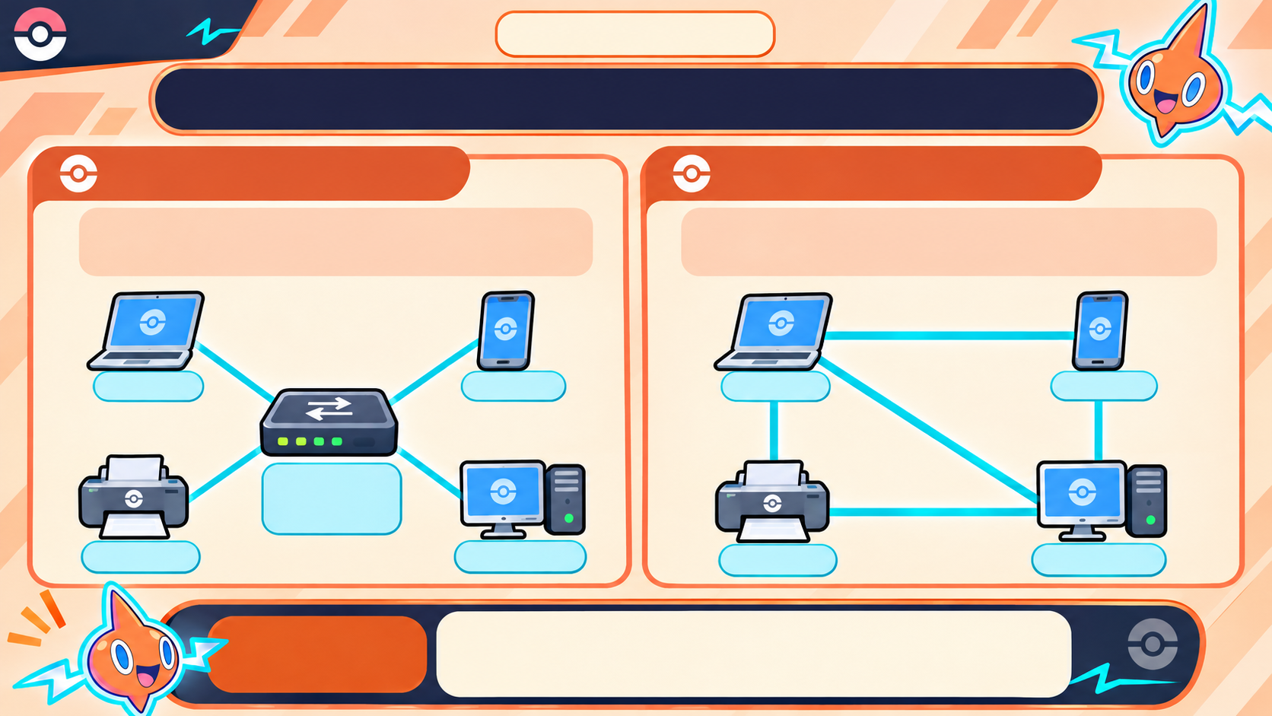
Rotom
Chapter 2.1
Network
HOW ARE NETWORK DEVICES CONNECTED?
STAR TOPOLOGY
MESH TOPOLOGY
Definition: Each device connects to a
central device.
Definition: Devices have multiple paths
between them.
Laptop
Phone
Laptop
Phone
Switch /
Router
(central device)
Printer
Desktop
Desktop
Printer
KEY
TAKEAWAY:
Star = one central connection point.
Mesh = multiple possible paths.
Notes:
In a star layout, each device connects to a central device. In a mesh layout, devices have multiple links and possible routes. The next slide compares what each layout gains and what it costs.

Slide 19
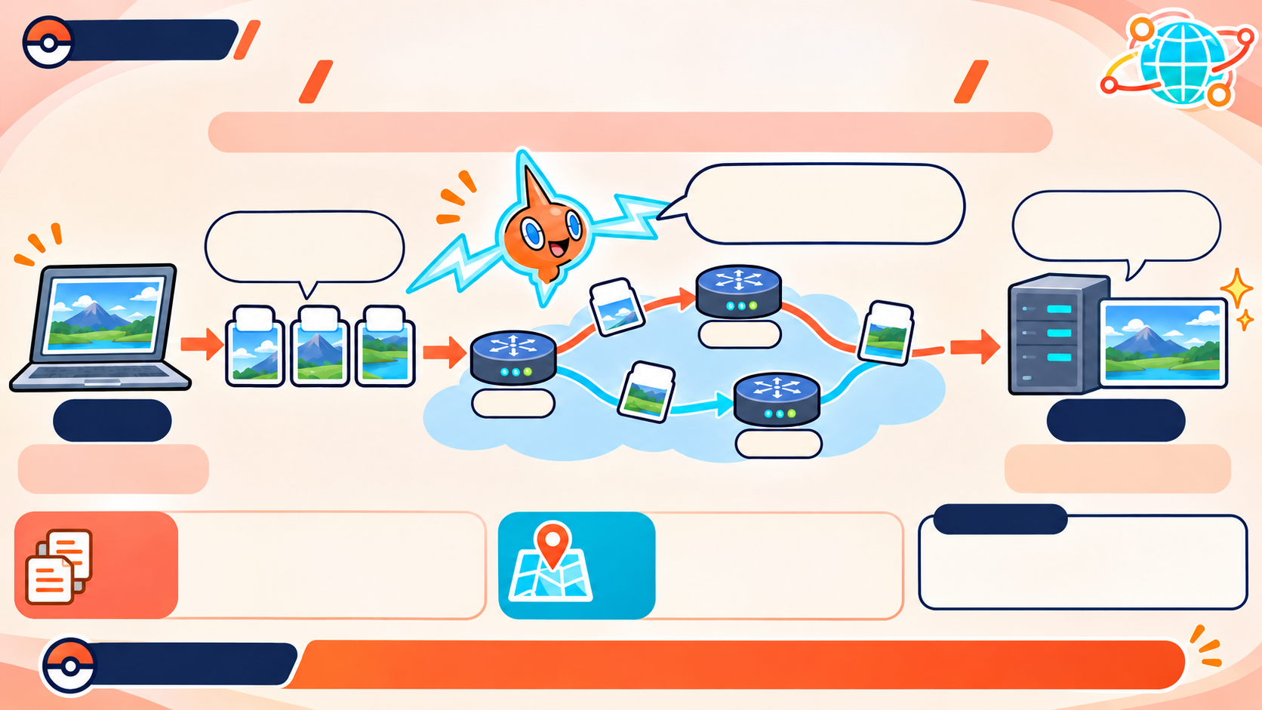
HOW DOES DATA TRAVEL
Chapter 2.1
ACROSS A NETWORK?
TCP/IP is a set of rules that helps data reach the right device.
I’m Rotom!
I’ll help the data packets
travel through the network!
Receive and
rebuild the photo
(by TCP)
Split into
small data packets
(by TCP)
Router
Sender
Router
Receiver
(Laptop)
(Server)
Send a photo
(e.g., a large file).
Router
Reorder the packets
and rebuild the photo.
IP adds destination
addresses and helps
route packets across
networks.
Glossary
TCP helps split data into
packets and checks/reorders
them at the destination.
TCP
IP
TCP = Transmission Control Protocol
IP = Internet Protocol
Key Takeaway
TCP helps manage delivery; IP helps packets find their destination.
Notes:
Large data can be split into smaller pieces called packets. TCP helps keep the pieces in order and checks that they arrive; IP helps address and route them to the destination. At the receiving end, the pieces are put back together.

Slide 20
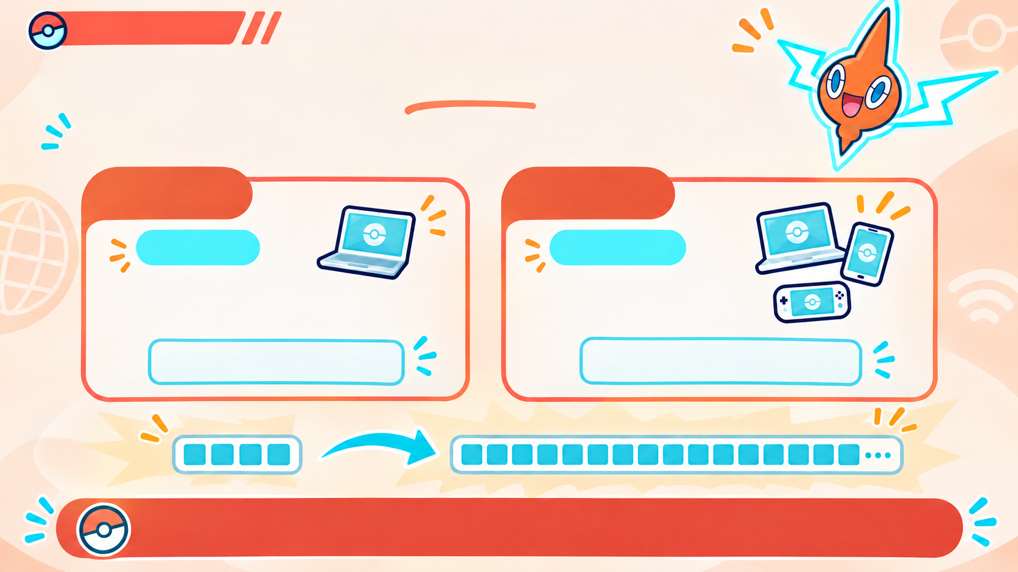
Chapter 2.1
WHY ARE THERE TWO IP VERSIONS?
More connected devices need more addresses.
IPv4
IPv6
32 bits
128 bits
About 4.3 billion
possible addresses
Allows many more
unique addresses
192.168.1.25
2001:db8::25
IPv6 was created because IPv4 addresses are limited.
Notes:
IPv4 uses 32-bit addresses, while IPv6 uses 128-bit addresses. IPv6 provides many more possible addresses. It was introduced because the number of devices that need addresses has grown beyond what IPv4 can comfortably support.

Slide 21
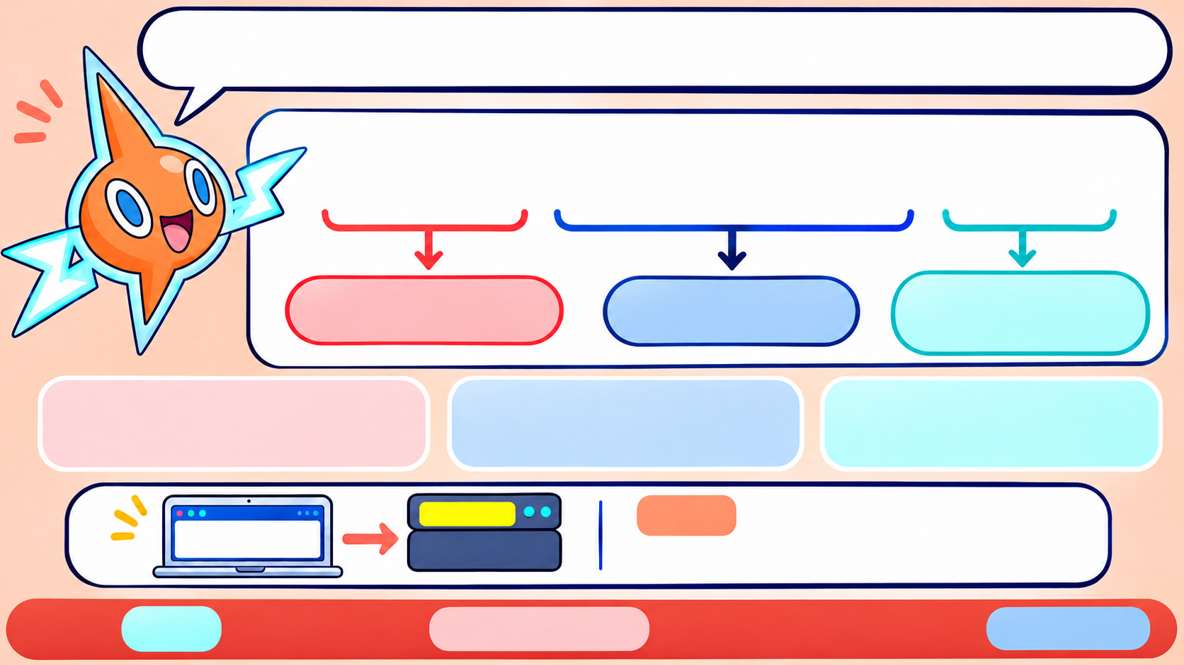
WHAT'S INSIDE A DOMAIN NAME?
blog.example.org
Subdomain
Domain
Top-Level Domain (TLD)
Subdomain: a section of the site.
Domain: the main site name.
TLD: the ending.
DNS links a domain name to an IP address
Example IP
blog.example.org
192.0.2.10
The TLD is last; the subdomain comes before the domain
Notes:
What’s Inside a Domain Name?In blog.example.org, blog is the subdomain, example is the main domain name, and .org is the top-level domain. DNS uses the full domain name to look up the IP address for the site.

Slide 22
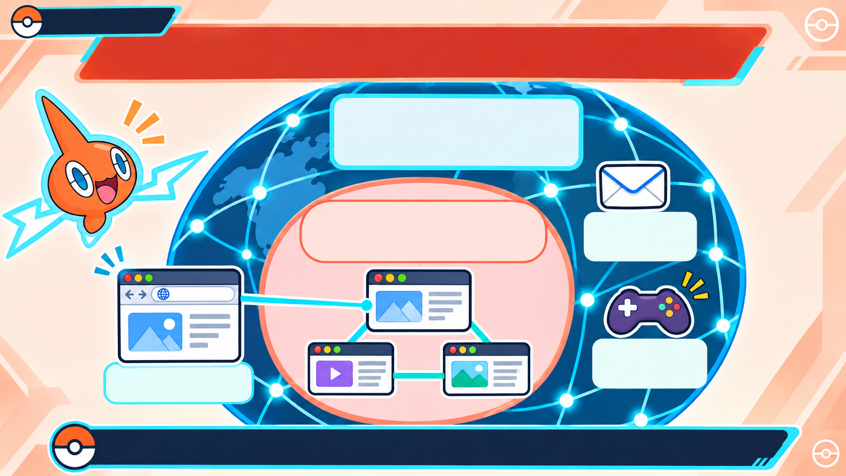
Chapter 2.1
THE WEB IS PART OF THE INTERNET
Internet — the global
network connecting
devices
World Wide Web (Web) –
linked pages opened
in a browser
Email
(send and
receive messages)
Online game
(play with
others online)
Browser
(opens web pages)
The Internet is the network; the Web is one service that uses it.
Notes:
The Internet is the global network that connects devices. The Web is one service that uses that network. Email and online games also use the Internet, but they are not the Web.

Slide 23
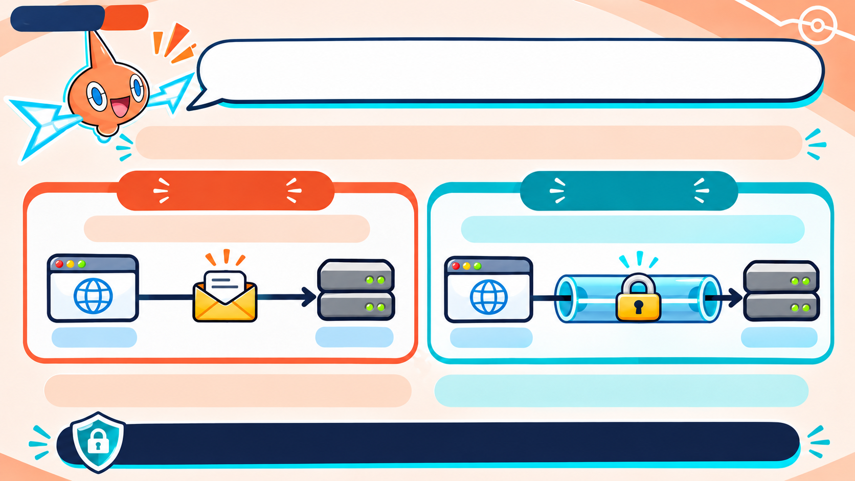
Chapter 2.1
HTTP OR HTTPS: WHAT’S THE DIFFERENCE?
They are rules for exchanging data between a browser and a website.
HTTP
HTTPS
Data is not encrypted in transit
Encryption helps protect data in transit
Browser
Server
Browser
Server
HTTP = Hypertext Transfer Protocol
HTTPS = HTTP with encryption
The S in HTTPS means a more secure, encrypted connection.
Notes:
HTTP is a set of rules browsers and websites use to exchange web data. HTTPS adds encryption to protect that data while it travels. Encryption helps protect information in transit, but HTTPS alone does not guarantee that a website is trustworthy.

Slide 24
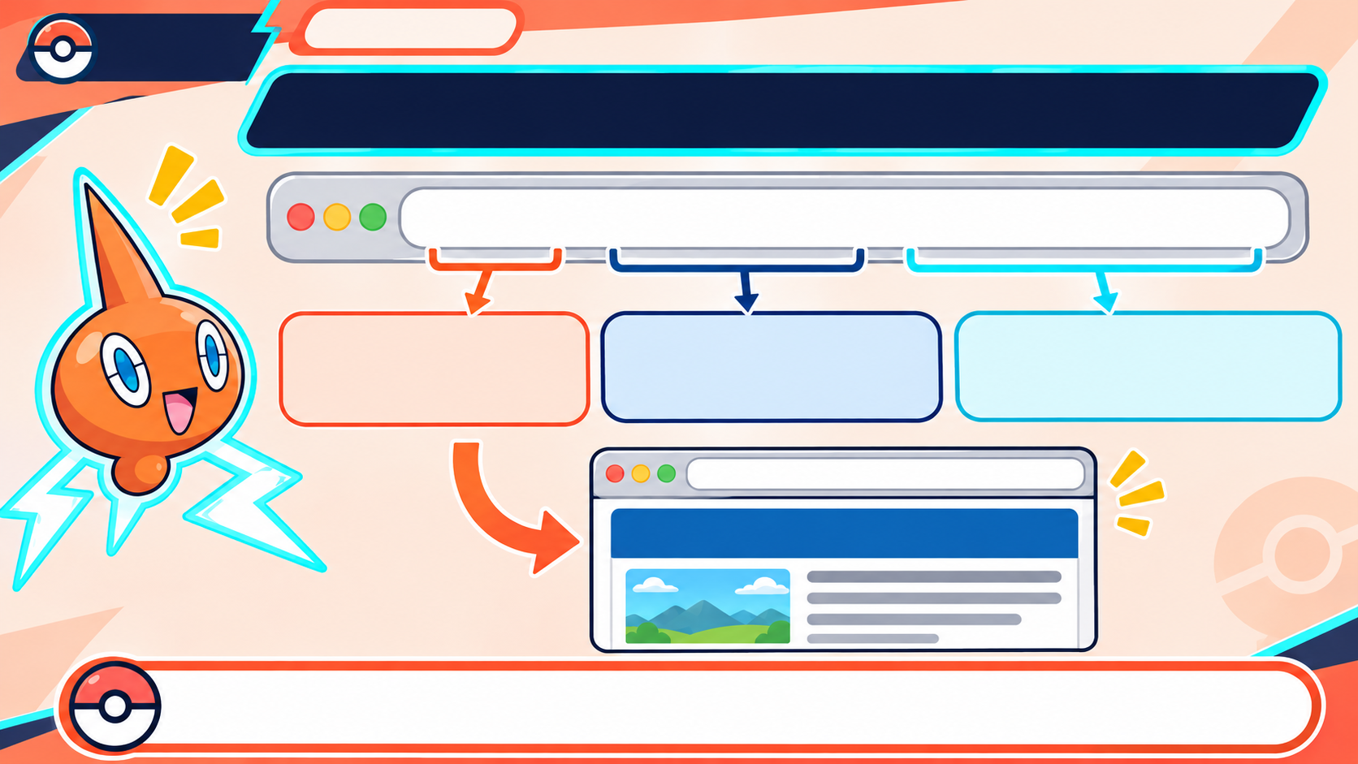
ROTOM
NETWORK
Chapter 2.1
WHAT DOES A URL TELL YOUR BROWSER?
https://example.org/news/today.html
Protocol: https:// –
how the browser
connects
Domain: example.org –
which website
Path: /news/today.html –
the exact page
https://example.org/news/today.html
News
A URL tells the browser how to connect and what page to open.
Notes:
A URL has parts that help the browser find a page. In https://example.org/news/today.html, https tells it how to connect, example.org names the site, and /news/today.html points to the page.

Slide 25
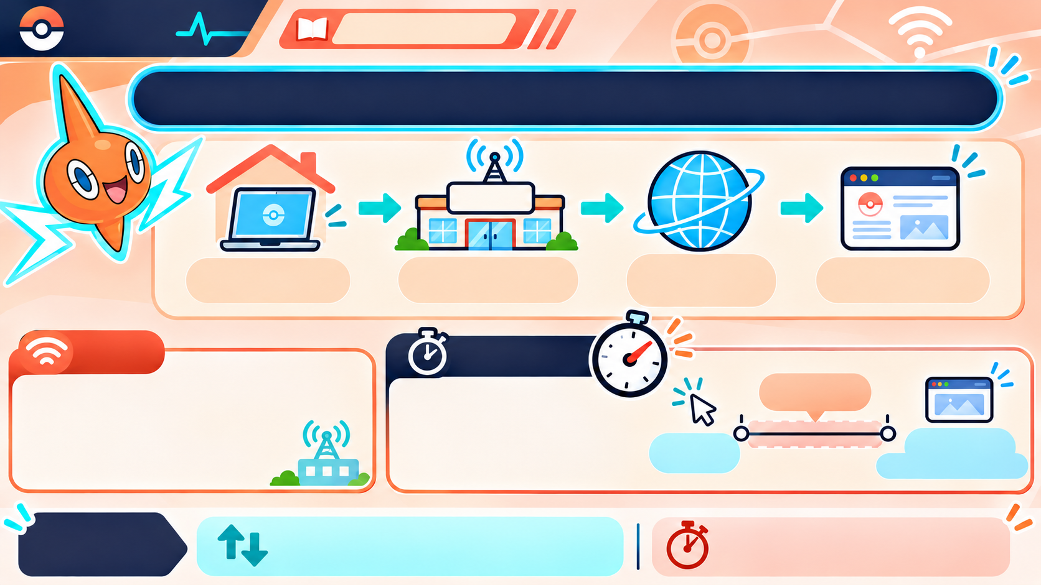
Rotom
Network
Chapter 2.1
WHO CONNECTS YOU TO THE INTERNET?
ISP
Your laptop
(at home)
ISP
(provider company)
Internet
(network of
networks)
Website
(e.g., Pokemon.com)
ISP
Latency
Latency
(waiting time)
ISP = Internet Service Provider.
A company that gives you
access to the Internet.
Latency is the delay
between a request
and the first response.
Click
(request)
First
response
(e.g., the page starts to load)
KEY
DIFFERENCE
Latency = how long you wait
for a response.
Bandwidth = how much data can move.
Notes:
Bandwidth is how much data can move per second. Latency is the wait between making a request and getting a response. A connection can have high bandwidth but still feel slow if its latency is high.

Slide 26
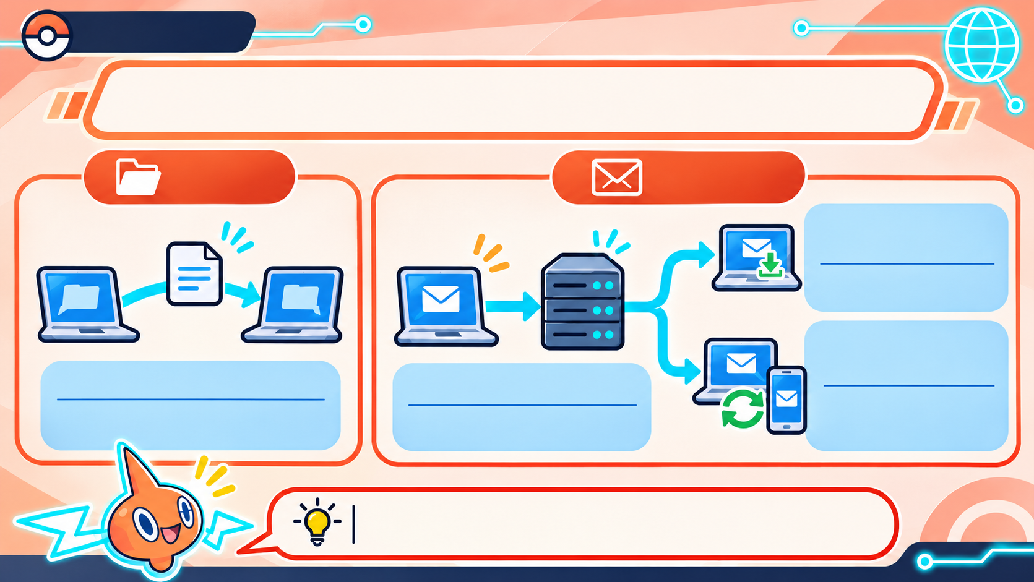
Chapter 2.1
PROTOCOLS HAVE DIFFERENT JOBS
FILES
EMAIL
POP3 — Post Office Protocol version 3
POP3 downloads
email to a device.
IMAP — Internet Message
Access Protocol
FTP — File Transfer Protocol
SMTP —
Simple Mail
Transfer Protocol
IMAP keeps email on
the mail server and
syncs it across devices.
FTP transfers files
between computers.
SMTP sends email.
The protocol depends on what you’re doing.
Notes:
Protocols are designed for different kinds of communication. FTP transfers files. SMTP sends email. POP3 downloads email to a device, while IMAP keeps email on the server and syncs it across devices.

Slide 27
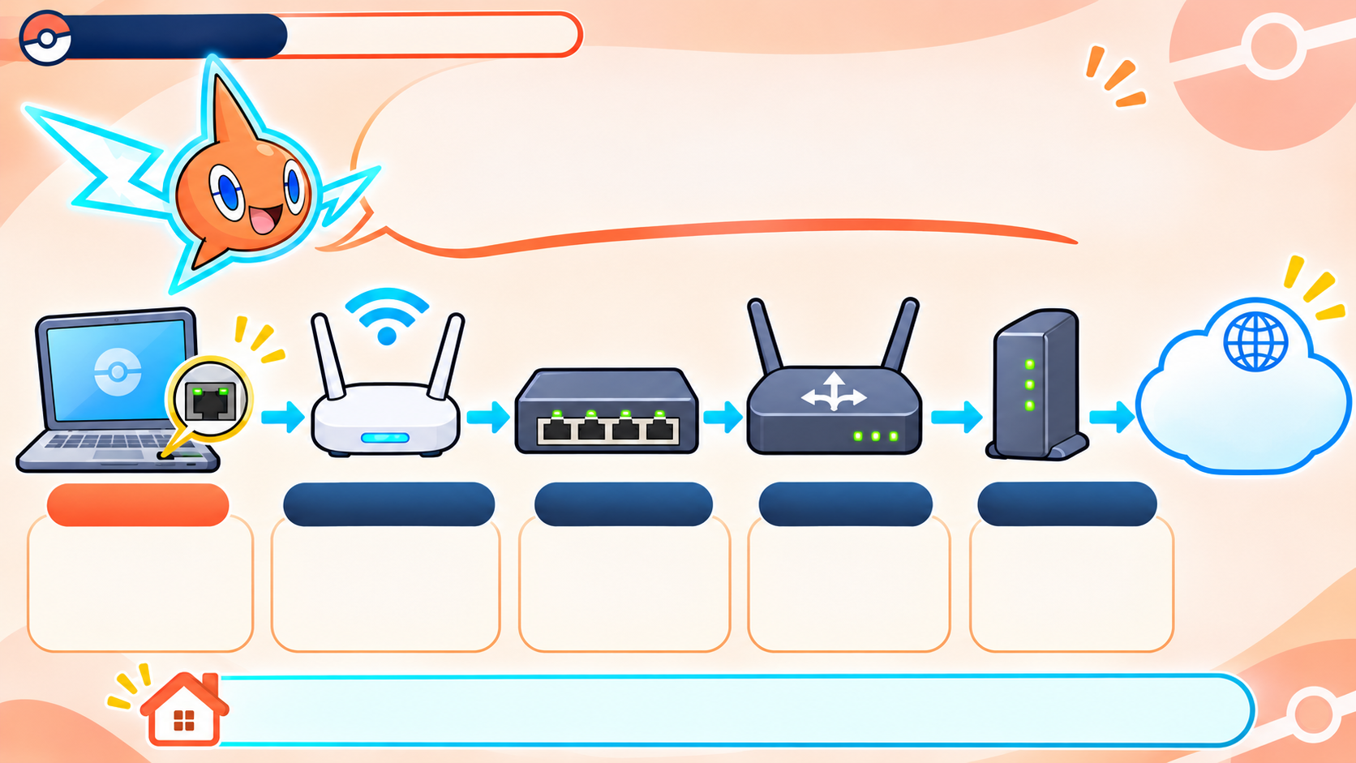
Chapter 2.1
Rotom Network
WHAT DOES EACH
NETWORK DEVICE DO?
ISP = Internet
provider
the company that
gives you Internet
access
NIC
Access Point
Switch
Router
Modem
NIC = Network
Interface Card.
It connects this
device to a network.
Connects
Wi-Fi devices
to the wired
network.
Connects
devices inside
one network.
Sends data
between
networks.
Converts
signals for
the Internet
line.
Many home boxes combine the access point, switch, router, and modem.
Notes:
A NIC connects a device to a network. A switch connects devices inside one local network. A router sends data between networks. An access point connects Wi-Fi devices to a wired network, and a modem connects the home network to the Internet line. Many home devices combine several of these jobs.

Slide 28
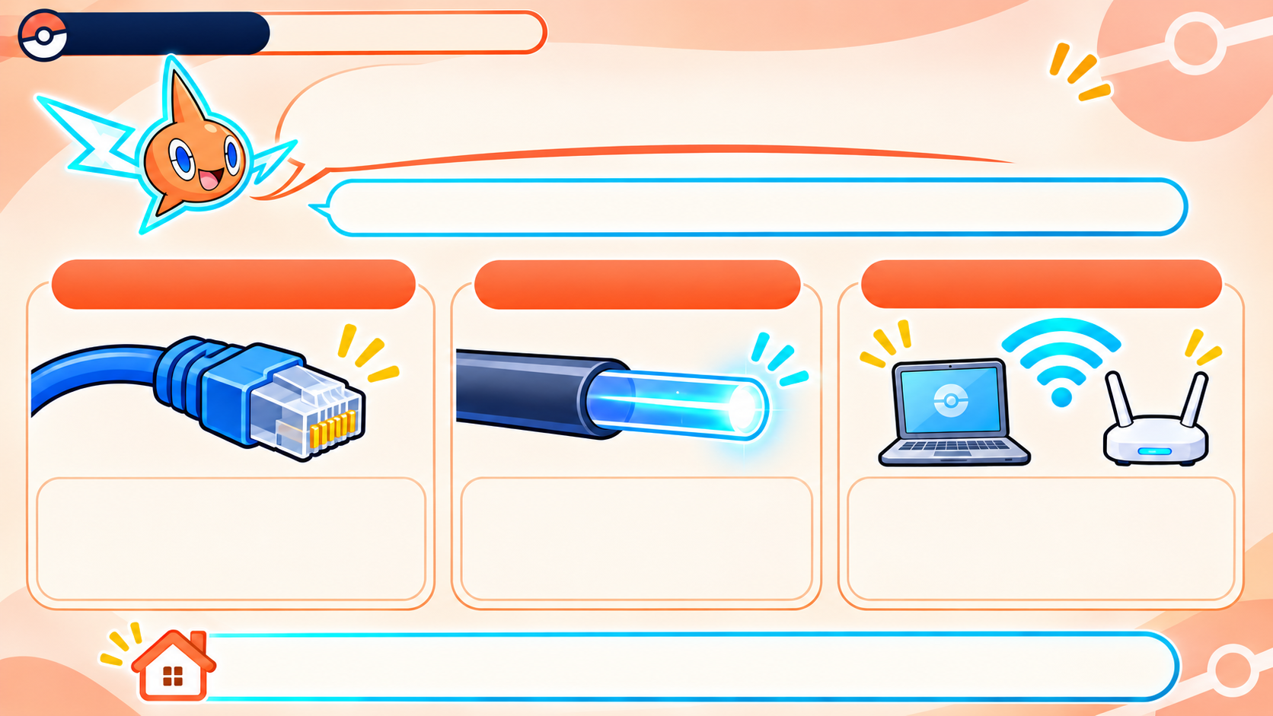
Chapter 2.1
Rotom Network
HOW DOES DATA TRAVEL?
Networks carry data through cables or through the air.
ETHERNET (COPPER)
FIBER-OPTIC
WI-FI
Light travels through
glass fibers.
Very fast over
long distances.
Radio waves carry data
through the air.
Walls and distance can
weaken the signal.
Electrical signals travel
through a copper cable.
Reliable, but needs a cable.
Ethernet and fiber use cables. Wi-Fi uses radio waves.
Notes:
Ethernet sends electrical signals through copper cable. Fiber-optic cable sends light through glass fibers and works well over long distances. Wi-Fi sends data using radio waves, so walls and distance can weaken the signal.

Slide 29
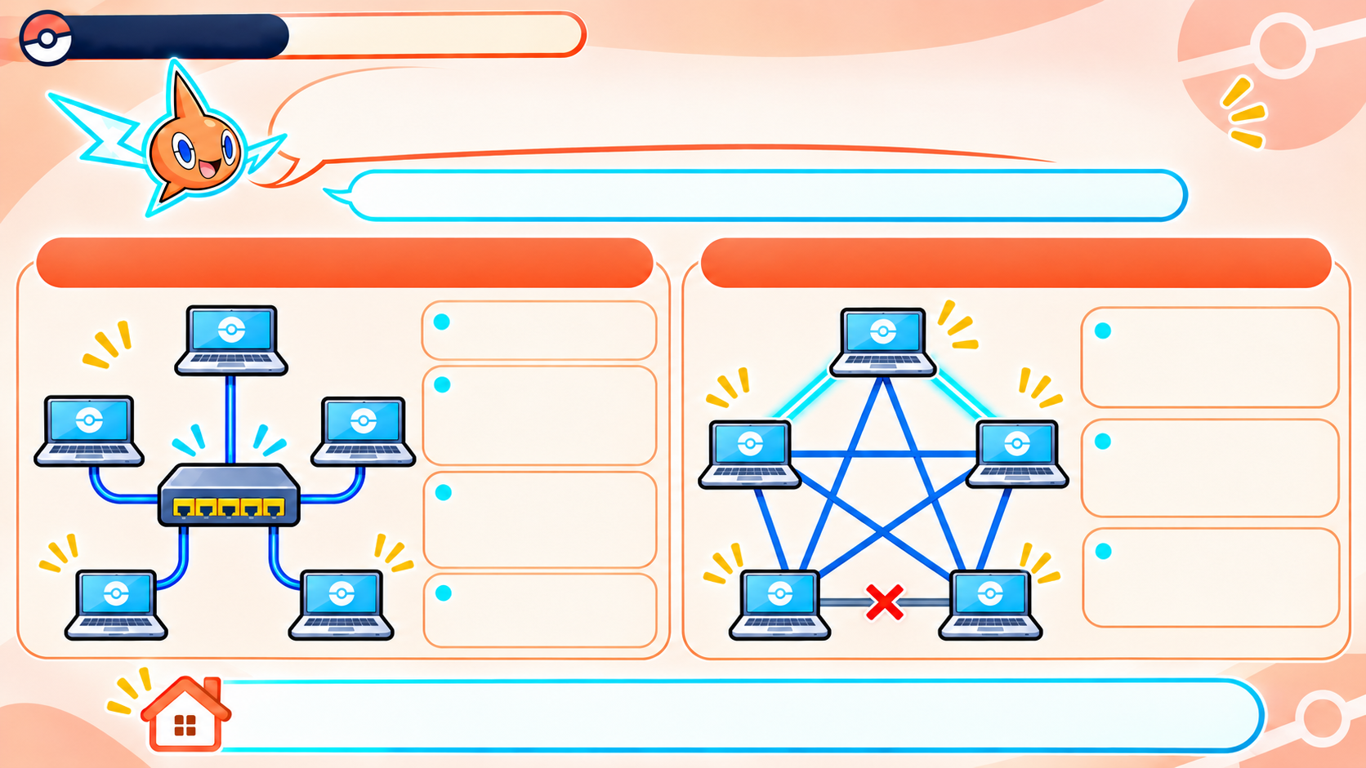
Chapter 2.1
Rotom Network
NETWORK LAYOUTS: STAR OR MESH?
Topology means how network devices are connected.
STAR
MESH
Easy to add devices.
If one link fails, data can take another route.
One broken
device cable affects
only that device.
More links cost
more and are harder
to manage
If the central switch fails, the whole
network stops.
Many possible paths make it reliable.
Needs cables
from each device to
the center.
Star is simpler. Mesh is more reliable, but more complex.
Notes:
In a star, each device connects to a central switch. If one device’s cable breaks, the other devices can still work, but if the switch fails, the whole network may stop. In a mesh, data can take another route when one link fails, but the extra links cost more and are harder to manage.

Slide 30
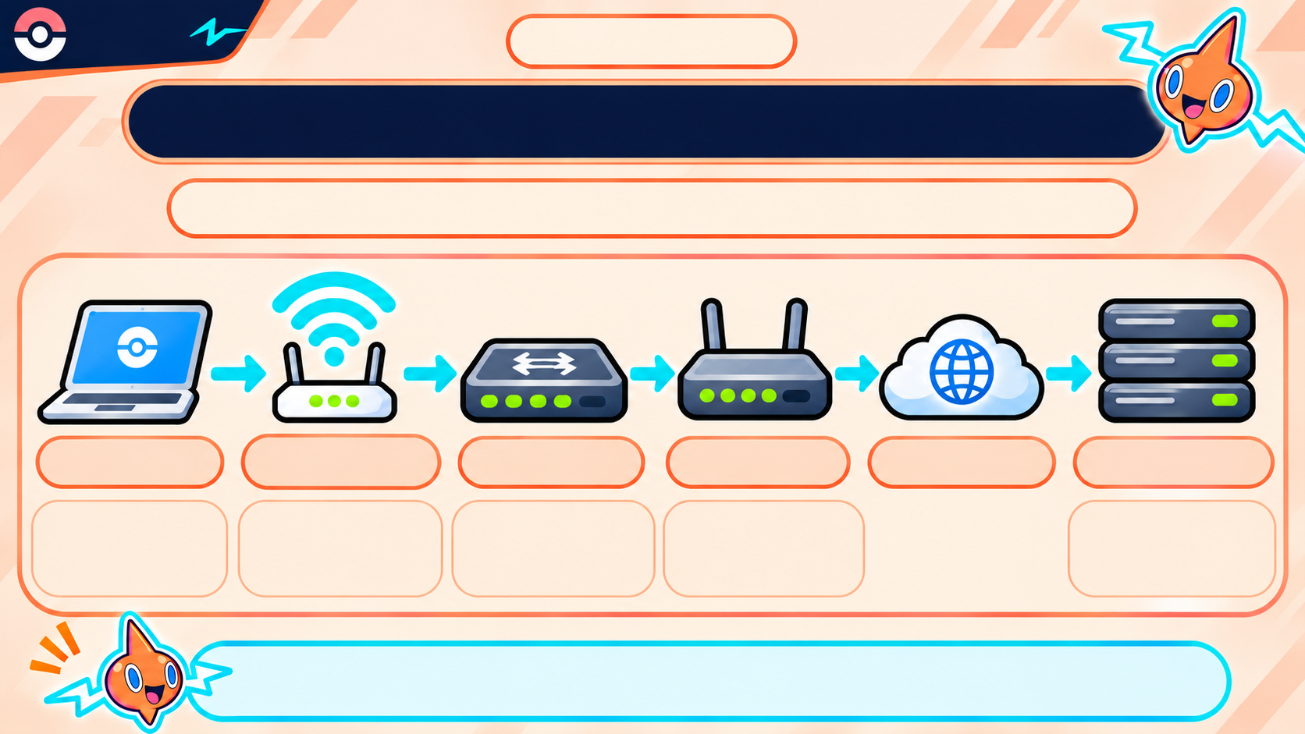
Rotom
Network
Chapter 2.1
HOW DATA MOVES THROUGH A NETWORK
Devices use links and shared rules to exchange data.
Laptop
Wi-Fi
Switch
Router
Internet
Web Server
Access Point
starts the request
connects Wi-Fi to the network
connects devices in one local network
sends data between networks
provides the requested page
TCP/IP rules help data reach the right destination.
Notes:
Follow the request from the laptop to the web server. The laptop sends it over Wi-Fi to the access point, then through the local network and router toward the Internet. The server sends the requested page back. The network devices and TCP/IP rules help the data reach the right destination.

Slide 31
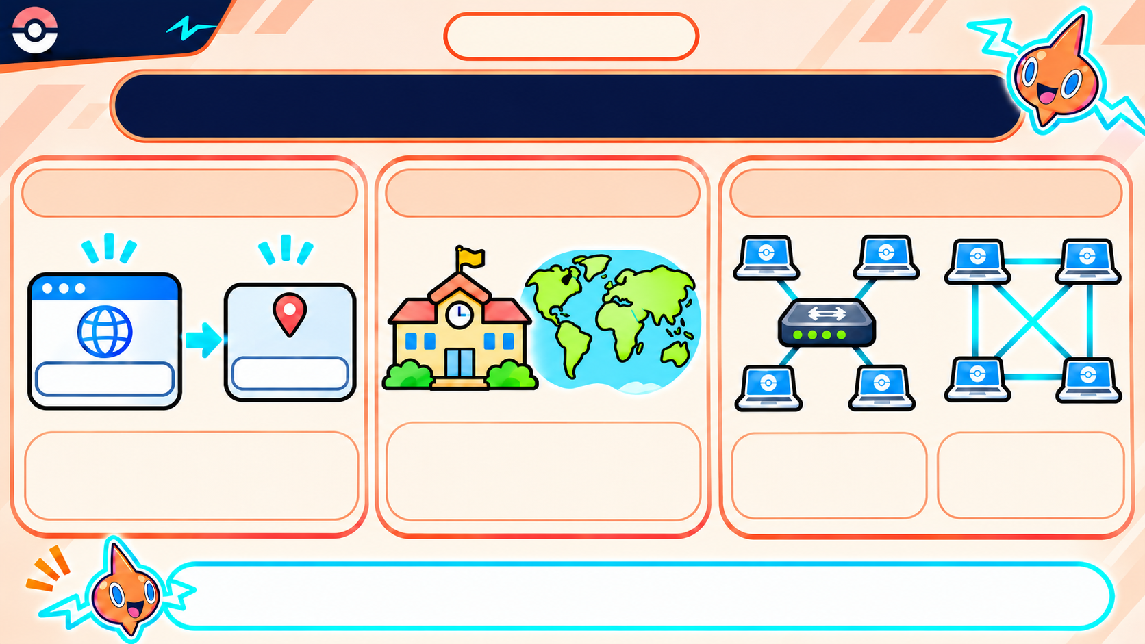
Rotom
Network
Chapter 2.1
NETWORKS: ADDRESSES, SIZE & LAYOUT
DNS FINDS A WEBSITE
NETWORK SIZE
NETWORK LAYOUT
DNS matches a website name to its IP address.
LAN = a small local area.
WAN = a large area, such as cities or countries.
Star = one central connection point.
Mesh = multiple possible paths.
DNS finds the address. LAN and WAN describe size. Topology describes connections.
Notes:
Network security protects data and helps us check who sent it. Privacy asks whether only the right people can read the data. Authentication checks who someone is. Integrity checks whether the data changed. Nonrepudiation gives evidence of who approved or sent something.

Slide 32

CHAPTER 2.2
NETWORK
SECURITY &
THE OSI MODEL
Protect data. Understand how it travels.
Notes:
Network Security and the OSI Model

Slide 33
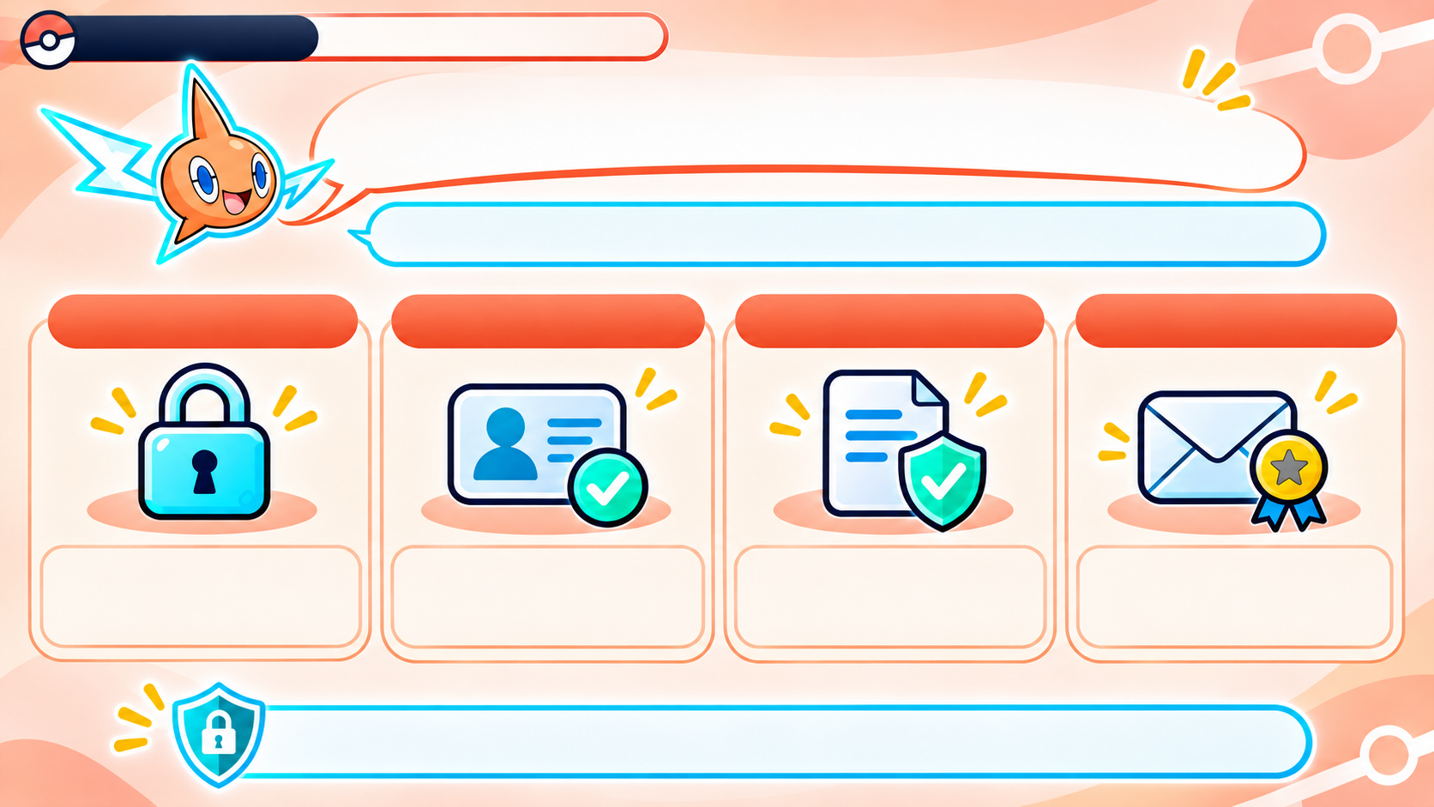
CHAPTER 2.2 •
ROTOM’S NETWORK LAB
WHAT DOES NETWORK SECURITY PROTECT?
It helps keep digital communication trustworthy.
PRIVACY
AUTHENTICATION
INTEGRITY
NONREPUDIATION
Can only the right
people read the data?
Is this user really
who they claim to be?
Has the data stayed
unchanged?
Can we prove who
sent the message?
Security protects data and helps verify who sent it.
Notes:
Network security protects data and helps us check who sent it. Privacy asks whether only the right people can read the data. Authentication checks who someone is. Integrity checks whether the data changed. Nonrepudiation gives evidence of who approved or sent something.

Slide 34
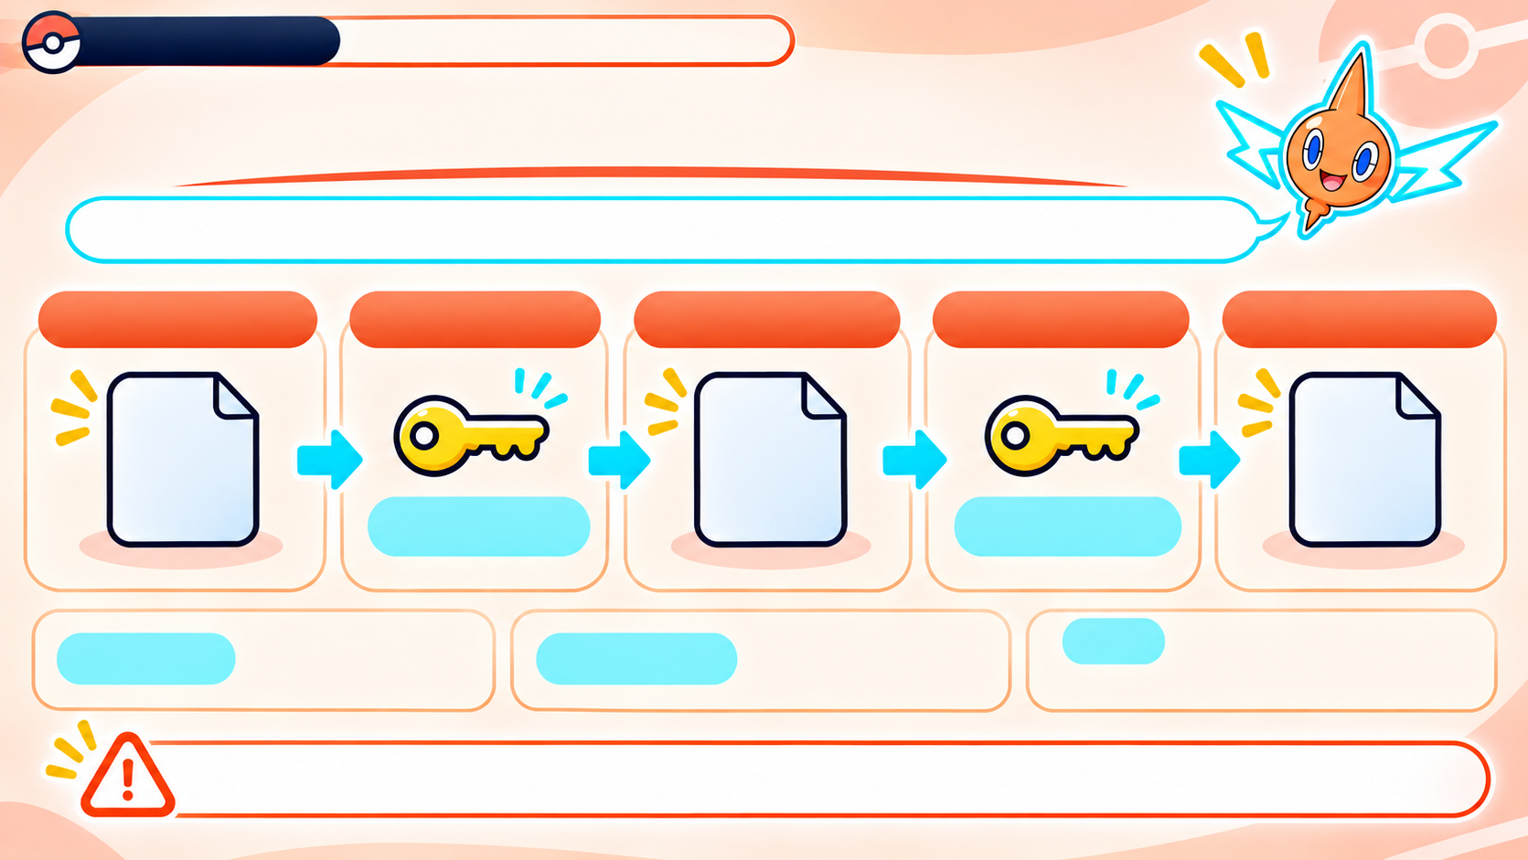
CHAPTER 2.2 •
ROTOM’S NETWORK LAB
PRIVACY: KEEP MESSAGES PRIVATE
Encryption scrambles data so only someone with the right key can read it.
PLAINTEXT
ENCRYPT
CIPHERTEXT
DECRYPT
READABLE AGAIN
CAT
CAT
CAT
key shift +1
key shift -1
Key = secret information
that locks or unlocks data.
Plaintext = readable data.
Ciphertext = scrambled data.
The Caesar cipher is only a simple demonstration, not secure real-world encryption.
Notes:
Encryption changes readable data, called plaintext, into scrambled data, called ciphertext. Someone with the right key can decrypt it and read it again. The Caesar cipher on this slide is only a simple demonstration; it is not secure enough for real communication.

Slide 35
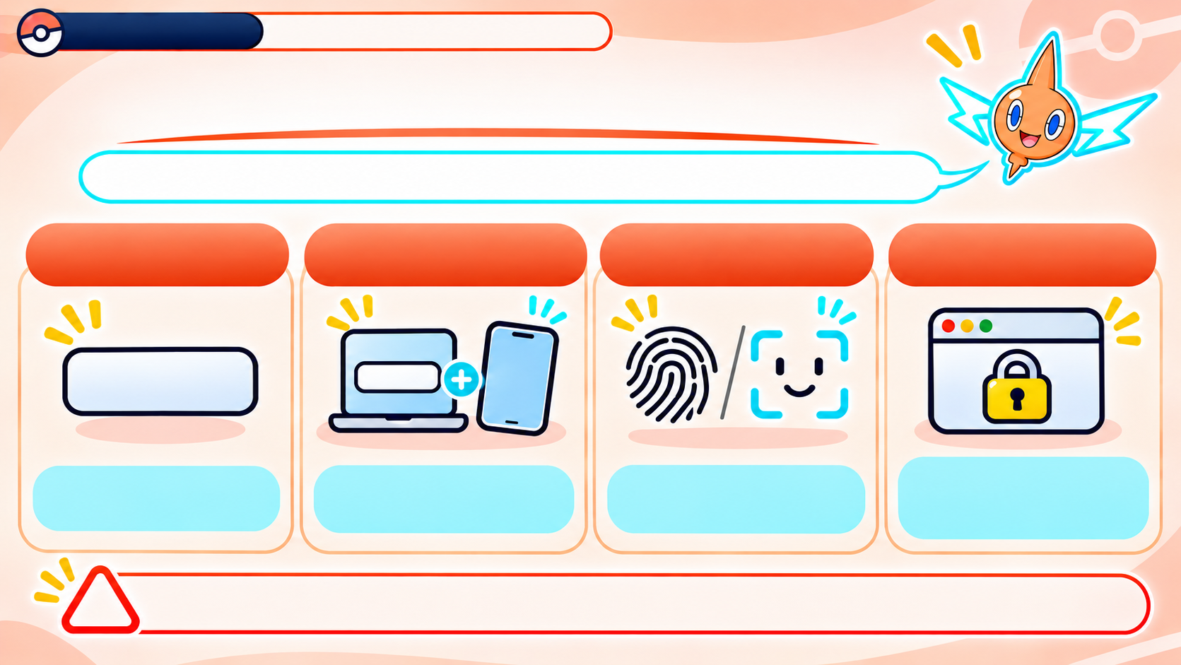



CHAPTER 2.2 •
ROTOM’S NETWORK LAB
AUTHENTICATION: PROVE WHO YOU ARE
It checks that a user or website is genuine.
PASSWORD
MFA
PKI
BIOMETRICS
(Multi-Factor Authentication)
(Public Key Infrastructure)
Digital certificates
act like ID cards
for websites.
Two proofs, like a
password + phone code.
A fingerprint or face
proves identity.
Something you know.
Authentication checks identity before access.
Notes:
Authentication checks that a user or website is who it claims to be. A password is something you know; a phone or security key is something you have; a fingerprint is something you are. Multi-factor authentication uses more than one kind of proof. A website certificate helps the browser check the site’s identity.

Slide 36
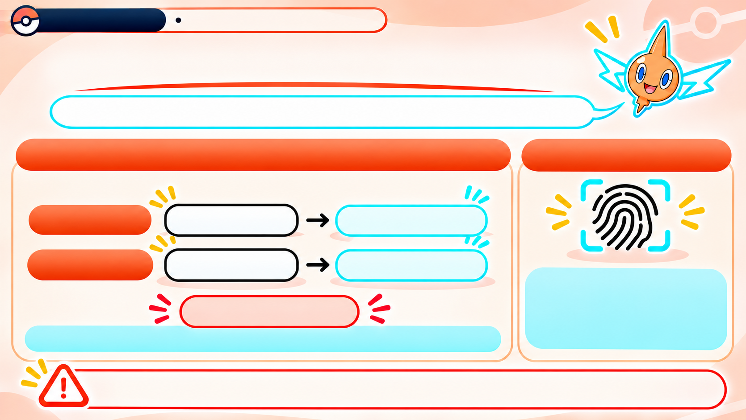


CHAPTER 2.2 •
ROTOM’S NETWORK LAB
INTEGRITY: DID THE DATA CHANGE?
Integrity means data stays the same while sent or stored.
CHECKSUM COMPARISON
HASH FUNCTION
SENT:
checksum 22
RECEIVED:
checksum 23
Hash function = makes a
fixed-size data fingerprint.
Even one changed
character changes the hash.
MISMATCH!
A different checksum warns that the data changed.
Matching checks help detect changes.
Notes:
Integrity means data stays the same while it is stored or sent. A checksum or hash gives us a value we can compare. If the sent and received values differ, something changed. This simple check can reveal a change, although a checksum by itself is not strong protection against someone deliberately altering data.

Slide 37
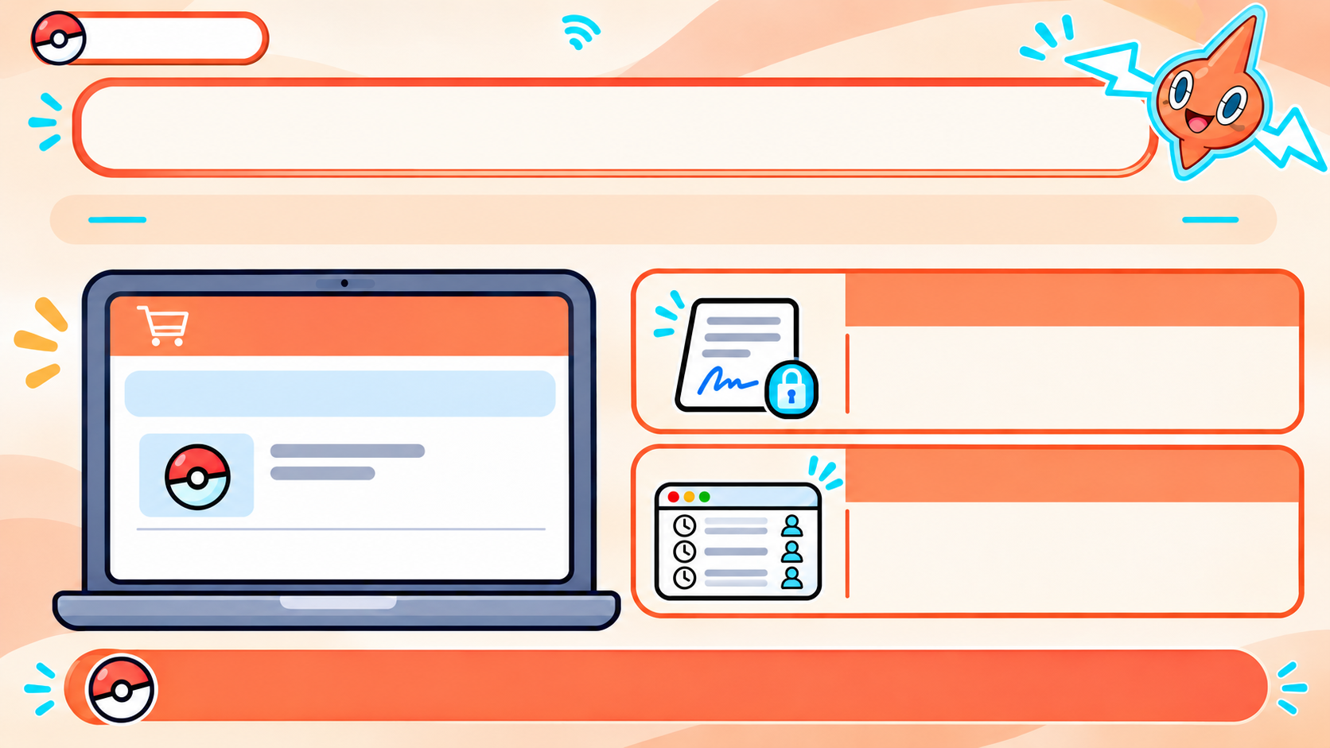
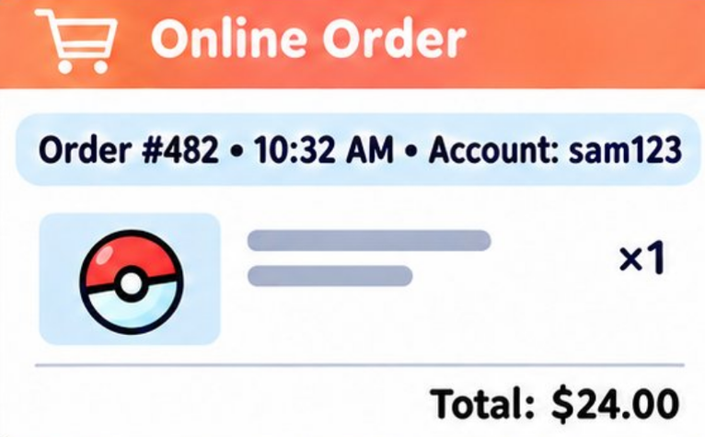
Chapter 2.2
ROTOM’S NETWORK LAB
NONREPUDIATION: PROOF OF WHO DID WHAT
Nonrepudiation means keeping evidence of who approved an action.
DIGITAL SIGNATURE
Shows which verified sender
approved the order and that
it was not changed.
LOG FILE
Records which account acted
and when.
Together, these records help show that Sam’s account placed the order.

Slide 38
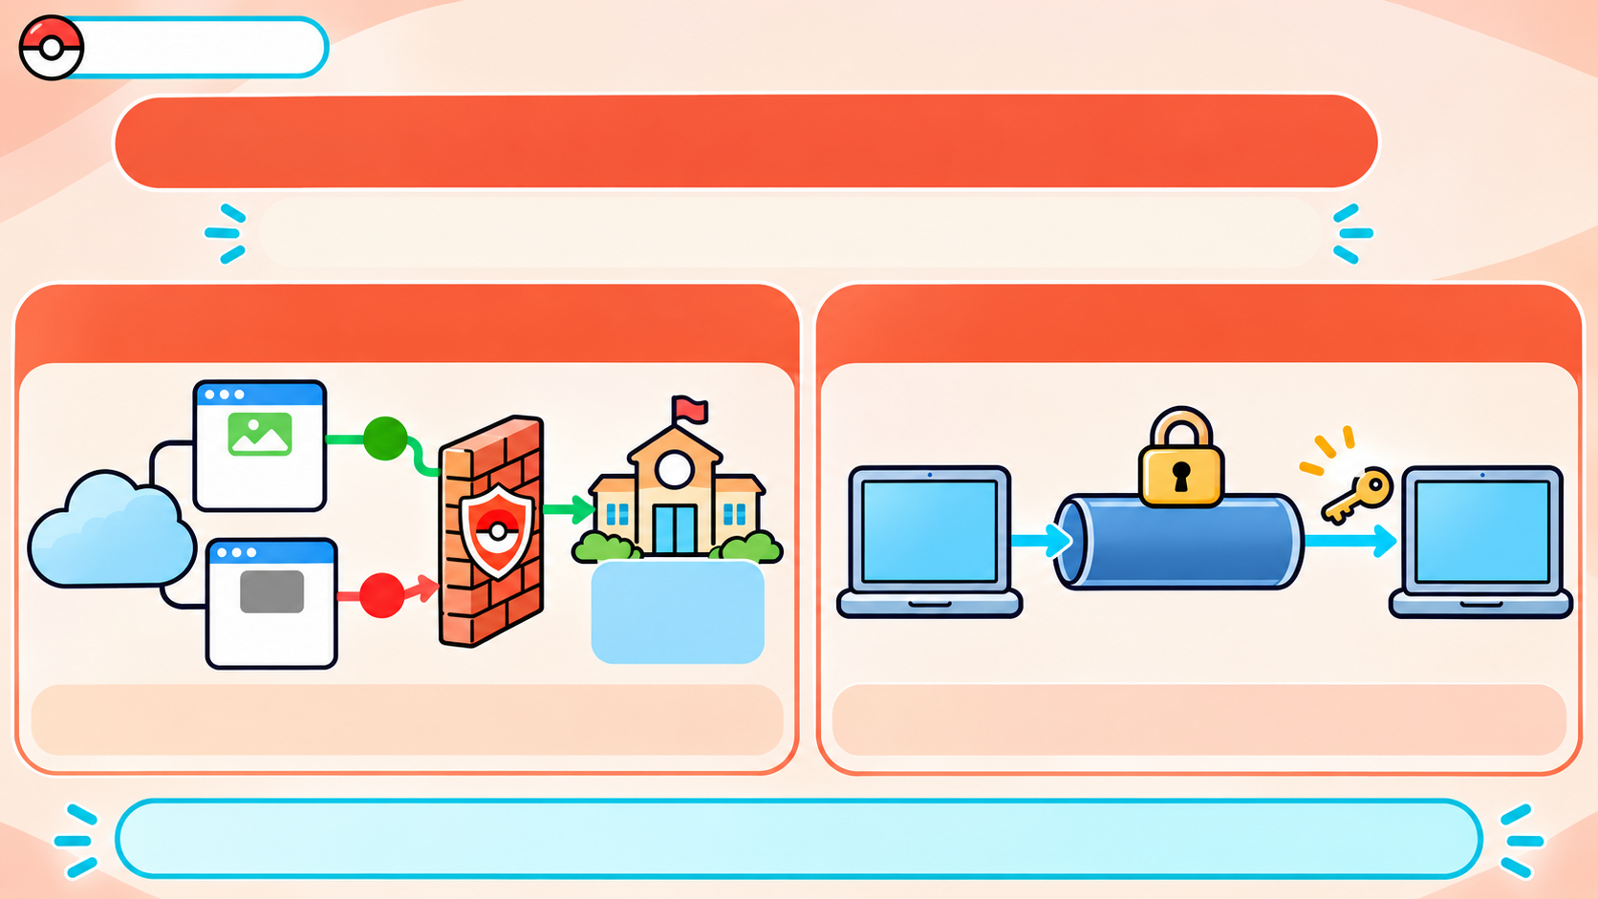






Chapter 2.2
TWO EVERYDAY NETWORK PROTECTIONS
A firewall filters traffic. Encryption hides the message.
FIREWALL
ENCRYPTION
Follows rules to allow or block network traffic.
Scrambles data so outsiders can’t read it.
Firewall controls what can pass. Encryption protects the message’s contents.
Notes:
Nonrepudiation means keeping evidence that links an action to an account or verified sender. A digital signature can show who approved a message and whether it changed. A log records which account acted and when. Together, they provide evidence of the action.

Slide 39
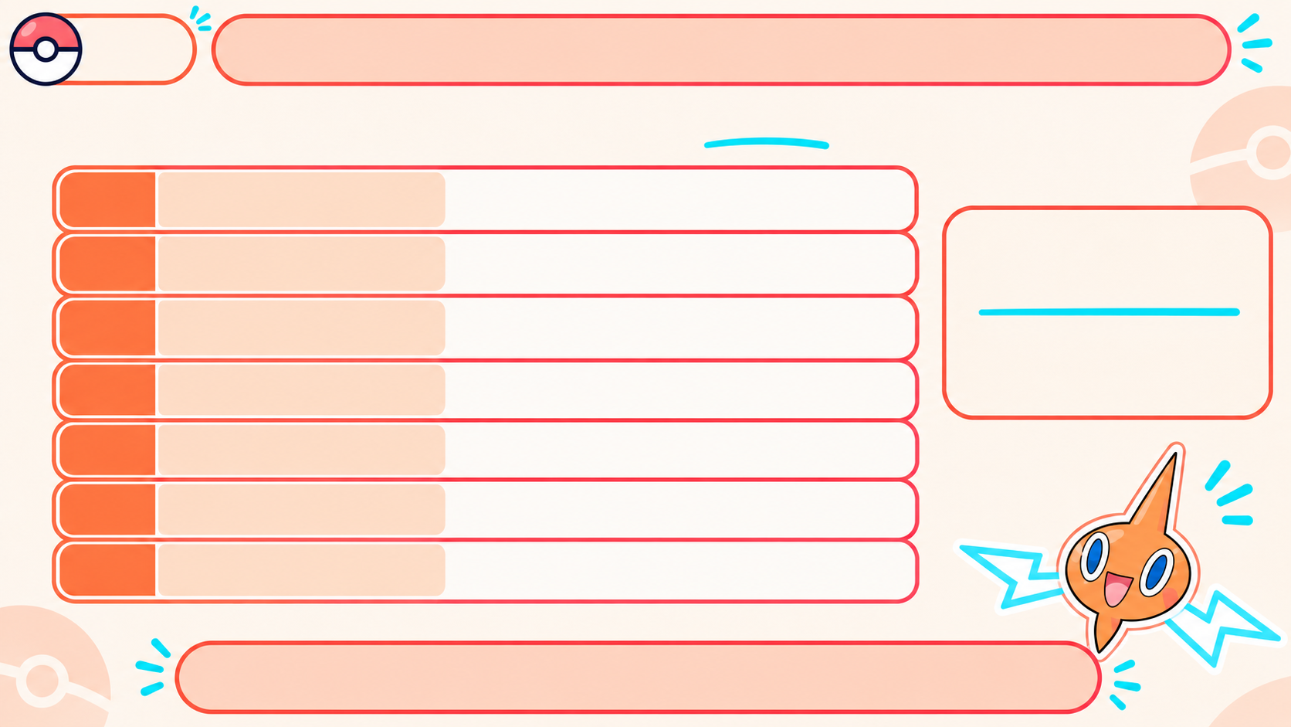
Chapter
2.2
THE OSI MODEL: A MAP FOR NETWORK DATA
It breaks network communication into 7 layers, each with its own job.
7
6
5
4
3
2
1
APPLICATION
Browsers and email apps start
communication
OSI = Open Systems
Interconnection
PRESENTATION
Formats and encrypts data
SESSION
Starts and maintains connections
A conceptual model,
not a physical device.
TRANSPORT
Splits data into parts and puts it
back together
NETWORK
Chooses a route (path) for data
DATA LINK
Moves data inside one network
PHYSICAL
Sends bits (0s and 1s) as signals
Each layer handles one part of communication.
Notes:
The OSI model divides network communication into seven layers, each with a different job. It is a teaching model, not a physical part inside a computer. We can use it to follow data from the application down to the signals sent across a network.

Slide 40
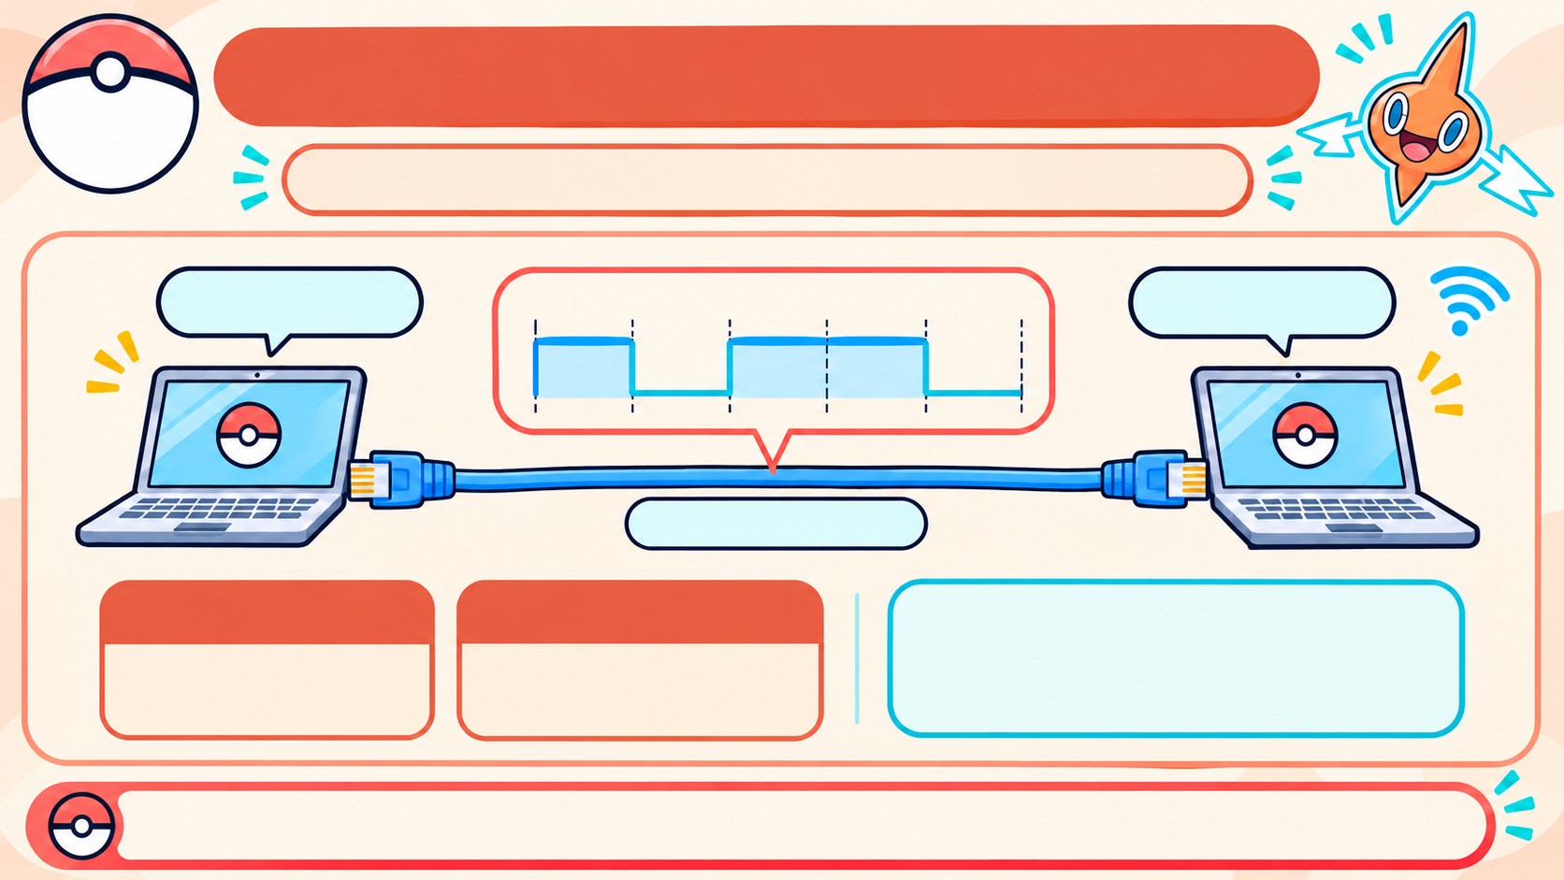
LAYER 1: THE PHYSICAL LAYER
It sends bits as signals through real hardware.
10110
1 0 1 1 0
10110
Ethernet Cable
BIT
BIT STREAM
Both devices use the same
signal rules to recognize
0s and 1s.
One 0 or 1.
A long sequence
of bits.
The physical layer carries raw bits as electrical, light, or radio signals.
Notes:
The physical layer carries bits as signals through real hardware. A bit is one 0 or 1. The layer sends those bits as electrical signals through copper, light through fiber, or radio signals through Wi-Fi.

Slide 41
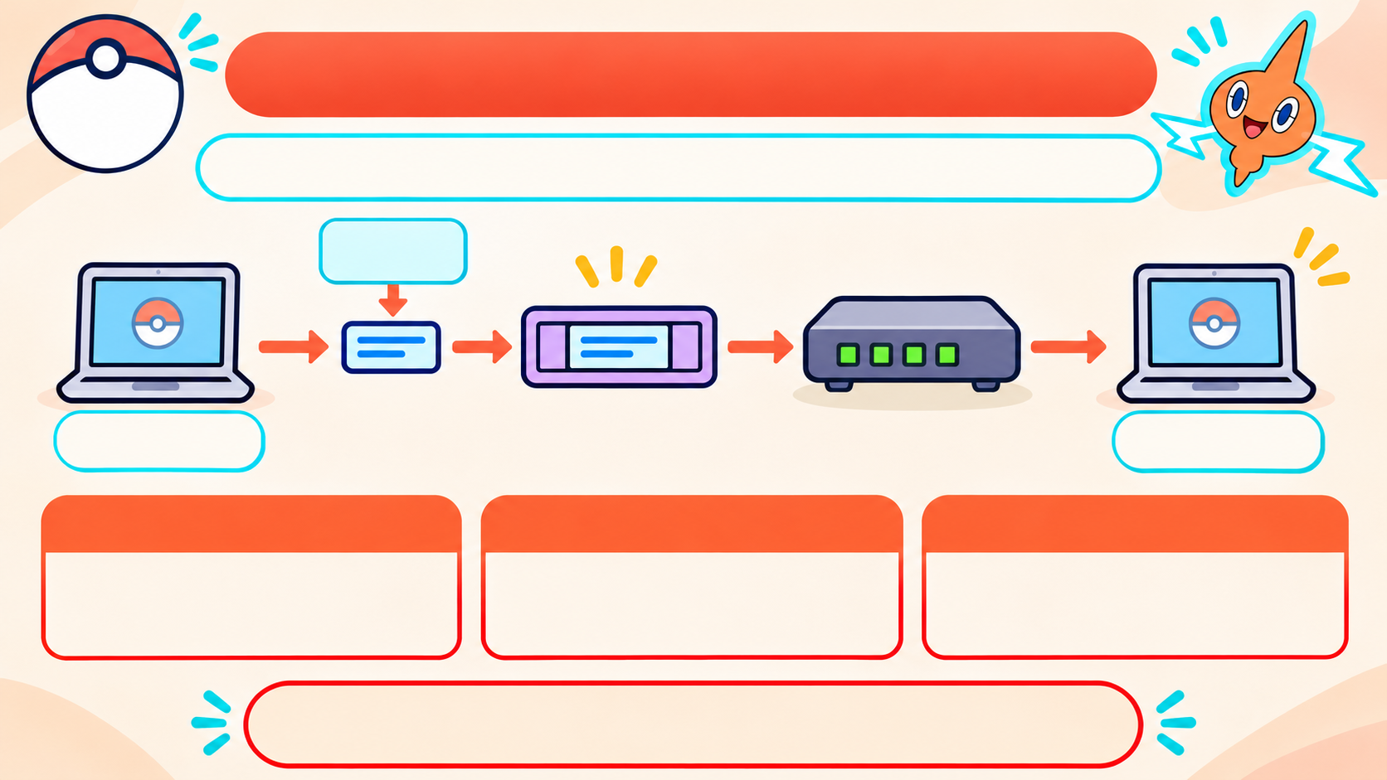



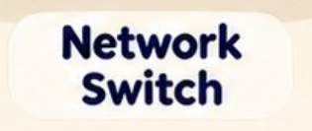

LAYER 2: THE DATA LINK LAYER
Chapter
2.2
It moves data between devices on the same network.
FRAME
FLOW CONTROL
ERROR CONTROL
A small unit that carries
a packet across the
local network.
Stops data from arriving
faster than the device
can handle.
Checks for
transmission mistakes.
Layer 2 handles local delivery.
Notes:
The data link layer moves data between devices on the same local network. It puts packets into frames for that local trip and checks for transmission errors. Flow control helps prevent a device from receiving data faster than it can handle.

Slide 42
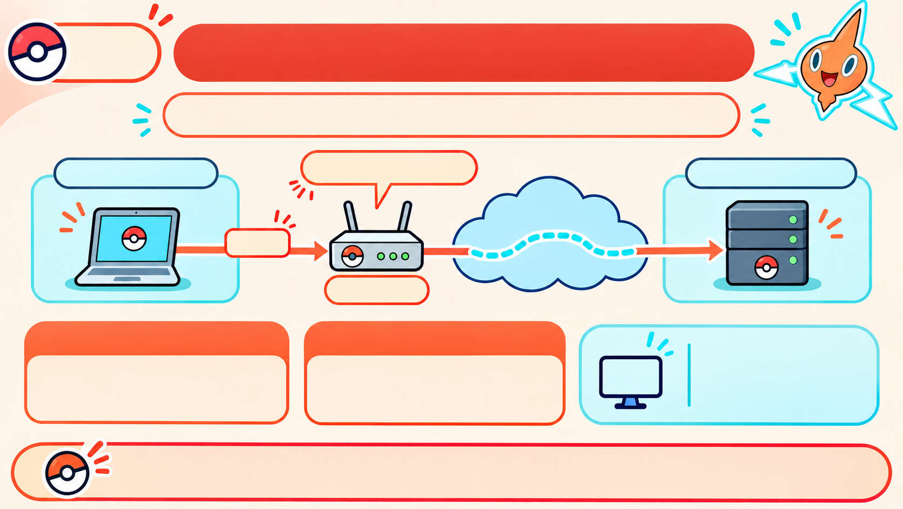






Chapter
2.2
LAYER 3: THE NETWORK LAYER
It moves packets between different networks.
PACKET
ROUTING
IP (Internet Protocol)
helps deliver
packets to the
right network.
A small chunk of data
sent across networks.
Choosing the path
packets take.
IP
Layer 3 connects networks; routers choose the route.
Notes:
The network layer moves packets between different networks. IP addresses help identify where packets should go, and routers choose a route toward the destination. Layer 2 handles a local link; layer 3 helps data travel across networks.

Slide 43
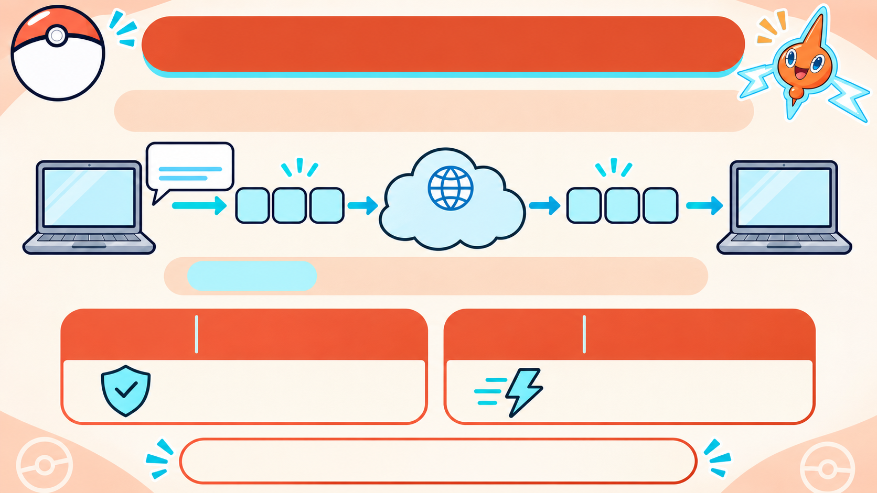
LAYER 4: THE TRANSPORT LAYER
Chapter
2.2
It manages end-to-end data delivery between devices.
Message
Sending
Device
Receiving
Device
1 2 3
1 2 3
Network
SEGMENT
— one piece of data sent separately.
TCP
Transmission Control
Protocol
UDP
User Datagram
Protocol
Checks delivery and
resends missing data.
Sends quickly; missing
data is not resent.
TCP checks more. UDP sends faster.
Notes:
The transport layer manages data delivery from the sending device to the receiving device. TCP checks delivery and resends missing data, which is useful when accuracy matters. UDP sends data with less checking, which can be faster when low delay matters.

Slide 44
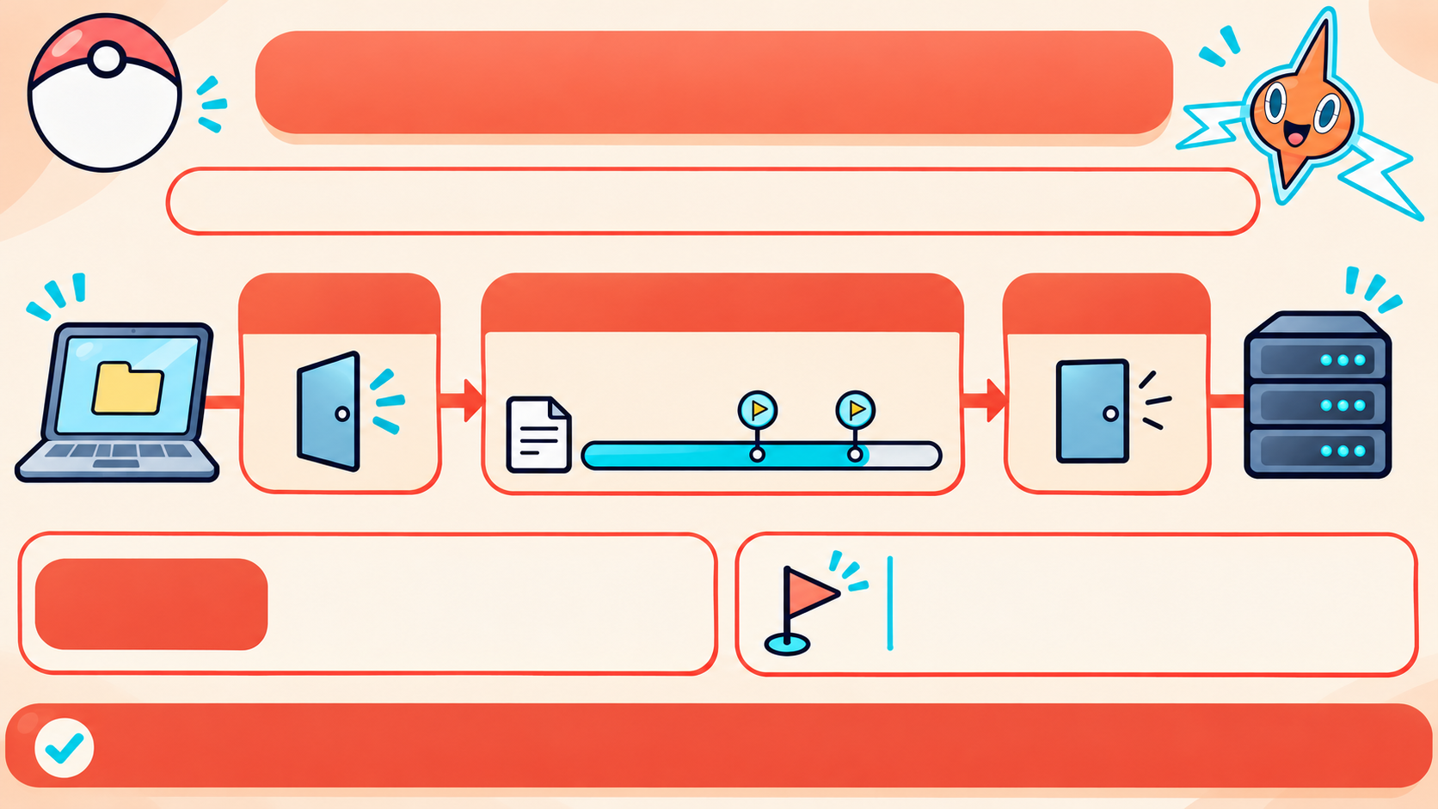



LAYER 5: THE SESSION LAYER
Chapter
2.2
It opens, maintains, and closes a communication session.
OPEN
KEEP ACTIVE
CLOSE
while devices communicate
File Transfer
SESSION
A checkpoint saves a progress point.
If a transfer is interrupted, it can
resume from the last checkpoint.
— the time two devices are
connected and communicating.
The session layer manages the start, continuation, and end of communication.
Notes:
The presentation layer prepares data so the receiving application can use it. It can translate between formats, compress data to make it smaller, or encrypt it for privacy. The receiving side reverses those changes when needed.

Slide 45
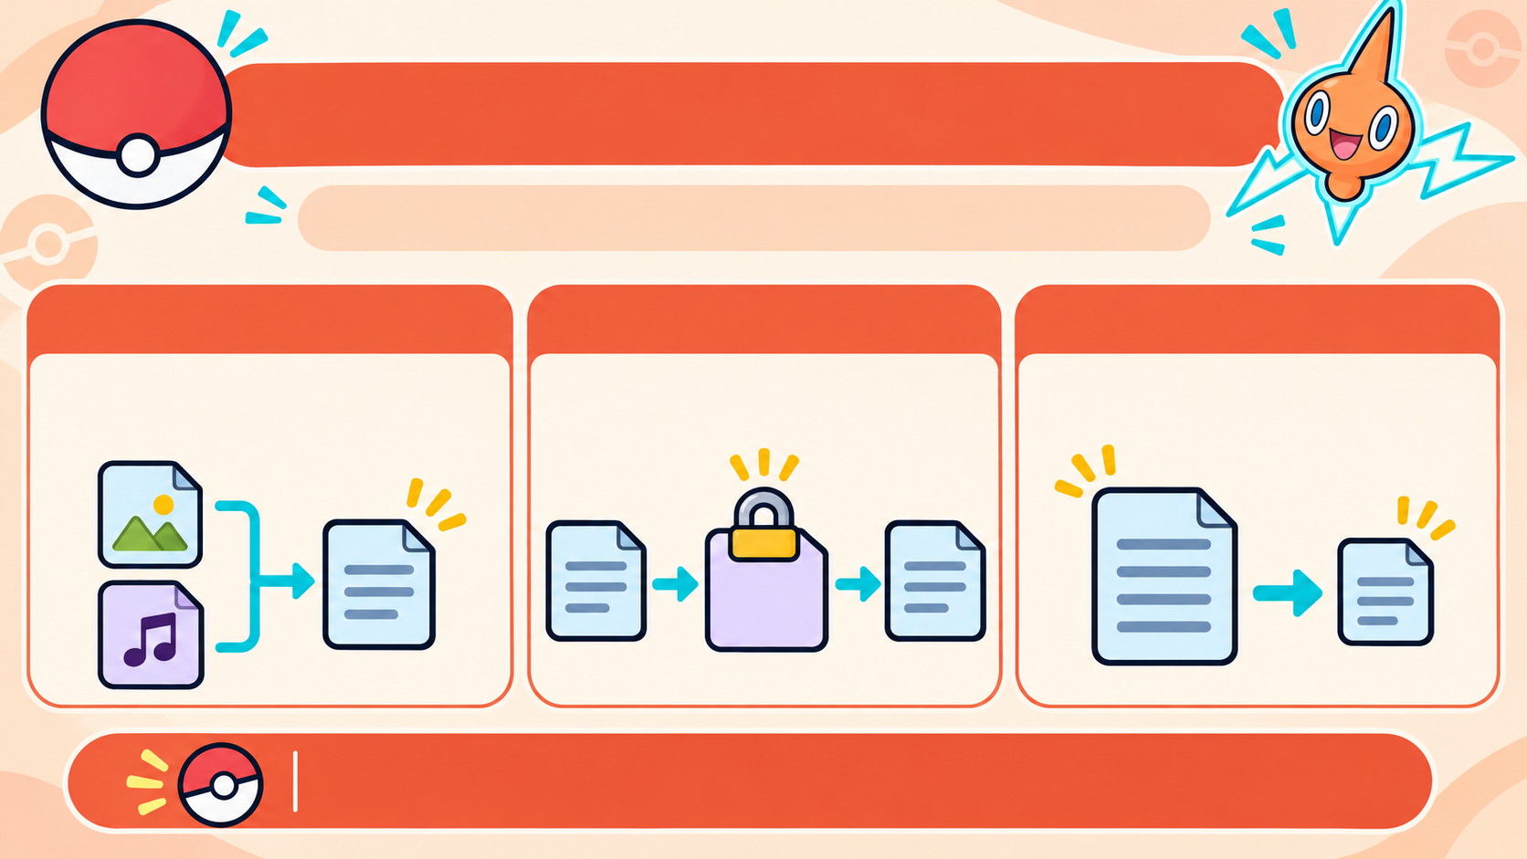
Chapter
2.2
LAYER 6: THE PRESENTATION LAYER
It prepares data so the receiving app can use it.
TRANSLATION
ENCRYPTION
COMPRESSION
Changes data into a format
the receiving device can read.
Scrambles data; the
receiver unscrambles it.
Makes data smaller so it
can travel faster.
*#@!
%&?
Layer 6 prepares data for the application.
Notes:
The presentation layer prepares data so the receiving application can use it. It can translate between formats, compress data to make it smaller, or encrypt it for privacy. The receiving side reverses those changes when needed.

Slide 46
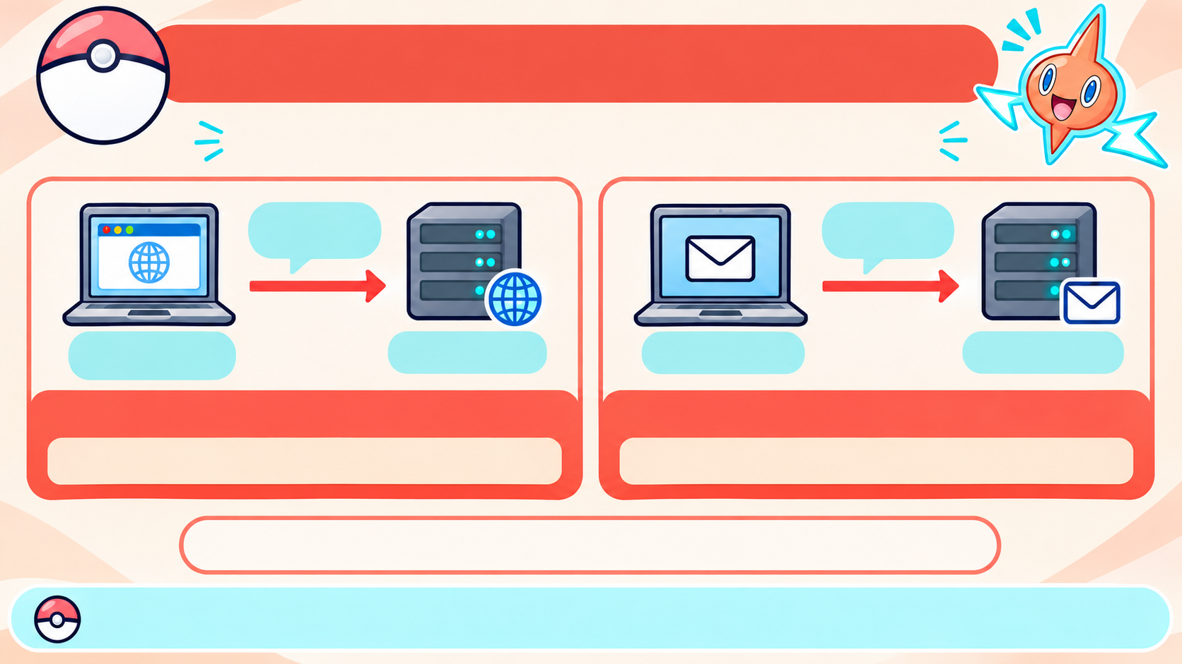
LAYER 7: THE APPLICATION LAYER
Chapter
2.2
Apps use network protocols to request services.
Request
web page
Send
email
Browser
(Web App)
Web Server
Email App
Mail Server
HTTP — Hypertext Transfer Protocol
SMTP — Simple Mail Transfer Protocol
Requests web pages.
Sends email.
A protocol is an agreed set of communication rules.
Browser and email are apps; HTTP and SMTP are the network rules they use.
Notes:
The application layer supports communication started by programs such as browsers and email apps. The apps themselves are not network protocols. A browser can use HTTP to request a web page, and an email app can use SMTP to send a message.

Slide 47
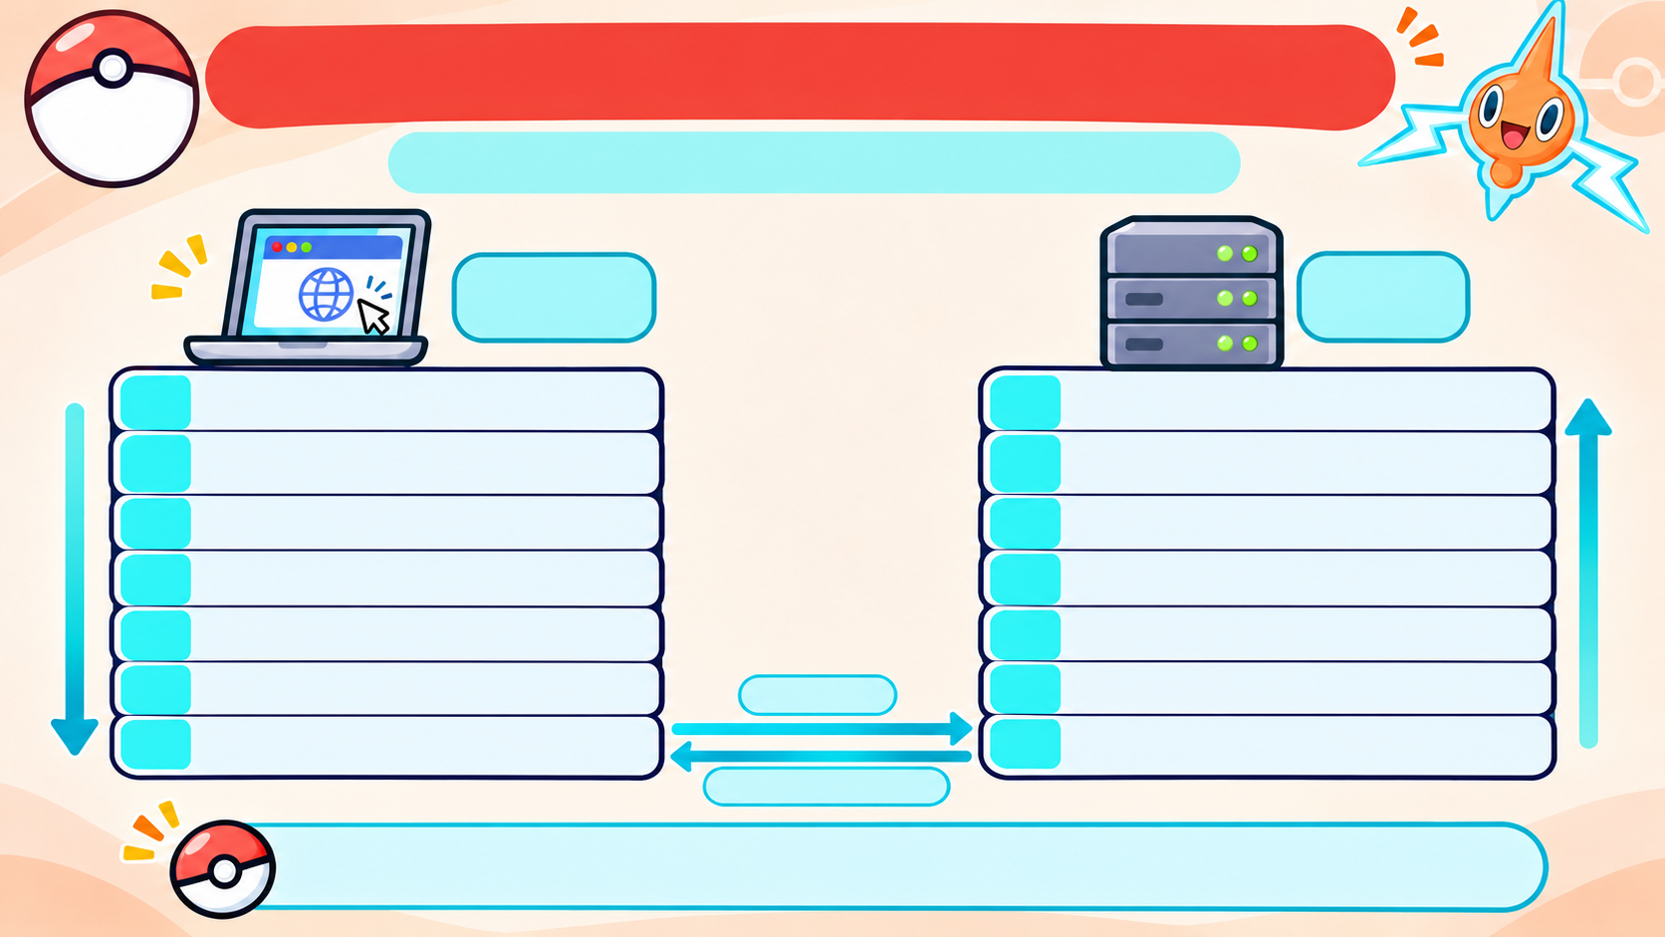
HOW A WEB PAGE REQUEST TRAVELS
Chapter
2.2
Your browser asks a server for a page.
Browser
(Client)
Web
Server
7
APPLICATION —
HTTP request
7
APPLICATION —
HTTP request
6
PRESENTATION —
data format /
6
PRESENTATION —
data format /
encryption
encryption
5
SESSION —
keeps the conversation
5
SESSION —
keeps the conversation
4
TRANSPORT —
TCP splits data into
4
TRANSPORT —
TCP splits data into
smaller pieces
smaller pieces
3
NETWORK —
IP addresses help
3
NETWORK —
IP addresses help
route packets
route packets
2
DATA LINK —
Prepares data for
request
2
DATA LINK —
Prepares data for
the next local link
the next local link
1
PHYSICAL —
bits as signals
1
PHYSICAL —
bits as signals
web page response
Each layer adds its part; together they deliver the request.
Notes:
When you open a page, the request moves down the layers on your device. Each layer adds information needed for its part of the trip. The physical layer sends the bits; the server’s layers then process the request. The page response travels back to the browser through the layers.

Slide 48
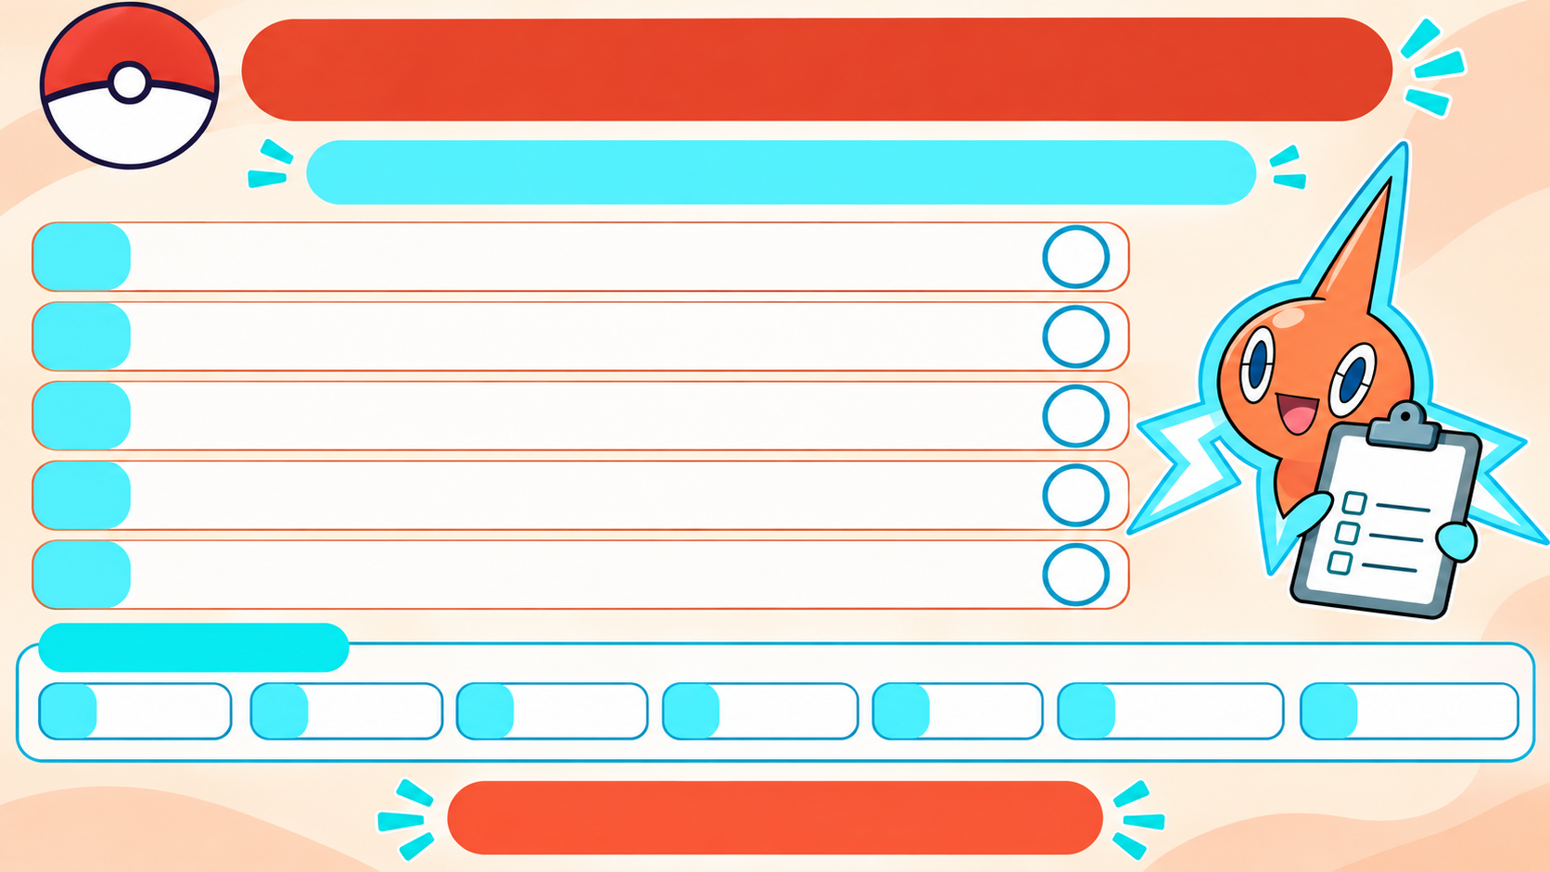
Chapter
OSI LAYER CHALLENGE
2.2
Match each job to the correct layer number.
A.
Chooses the route to another network.
B.
Sends bits as signals through a cable or Wi-Fi.
C.
Compresses and encrypts data.
QUIZ
D.
Keeps a session open and saves checkpoints.
E.
Splits data into TCP segments and checks delivery.
ANSWER BANK
1
Physical
2
Data Link
3
Network
4
Transport
5
Session
6
Presentation
7
Application
Can you match all five?

Slide 49
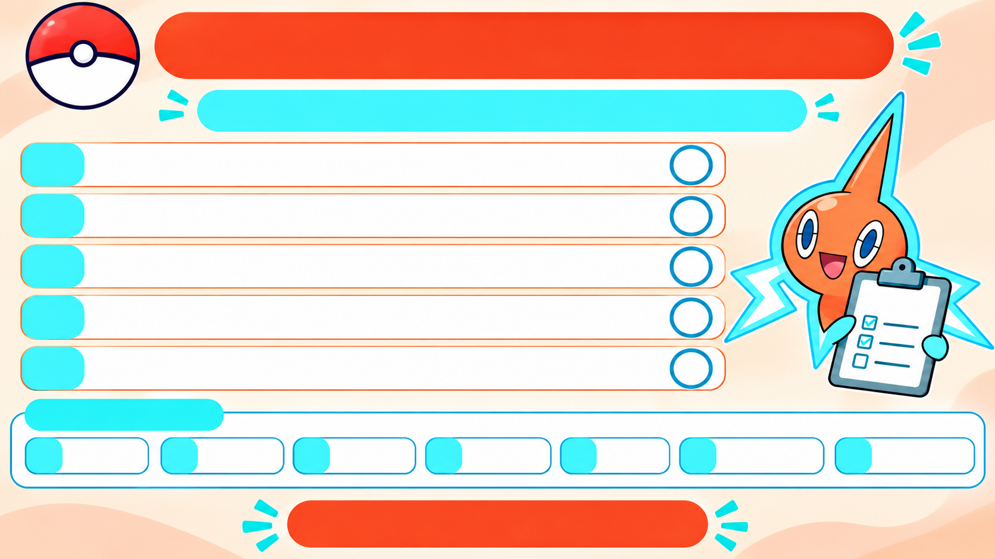
Chapter
OSI LAYER CHALLENGE
2.2
Match each job to the correct layer number.
A.
Chooses the route to another network.
3
B.
Sends bits as signals through a cable or Wi-Fi.
1
C.
Compresses and encrypts data.
6
QUIZ
D.
Keeps a session open and saves checkpoints.
5
E.
Splits data into segments and checks delivery.
4
ANSWER BANK
1
Physical
2
Data Link
3
Network
4
Transport
5
Session
6
Presentation
7
Application
ANSWER KEY

Slide 50
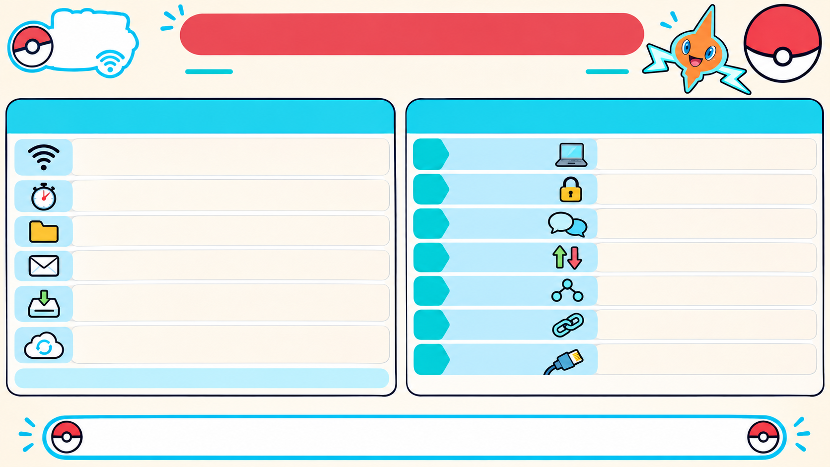
Rotom
Network
STAGE 1 RECAP: INTERNET & OSI
Chapter
2.2
Lab
How devices connect and move data.
INTERNET TERMS
OSI MODEL
ISP — Internet Service Provider:
7
6
5
4
3
2
1
Application
starts network communication
connects your home to the Internet.
Latency:
Presentation
formats, encrypts, compresses data
the delay before data starts arriving.
FTP — File Transfer Protocol:
Session
opens and manages a conversation
transfers files.
SMTP — Simple Mail Transfer Protocol:
Transport
sends data end to end
sends email.
POP3 — Post Office Protocol:
Network
routes data between networks
downloads email to a device.
Data Link
moves data on the local network
IMAP — Internet Message Access Protocol:
keeps email on the server and syncs it across devices.
Physical
sends bits as signals
A protocol is an agreed set of communication rules.
Protocols help devices communicate; OSI shows how data travels.
Notes:
The Internet terms describe services and delays we encounter: an ISP provides Internet access, latency is the wait before data starts arriving, FTP transfers files, and SMTP sends email. The OSI model gives us a way to describe the different jobs involved as data travels.

Slide 51
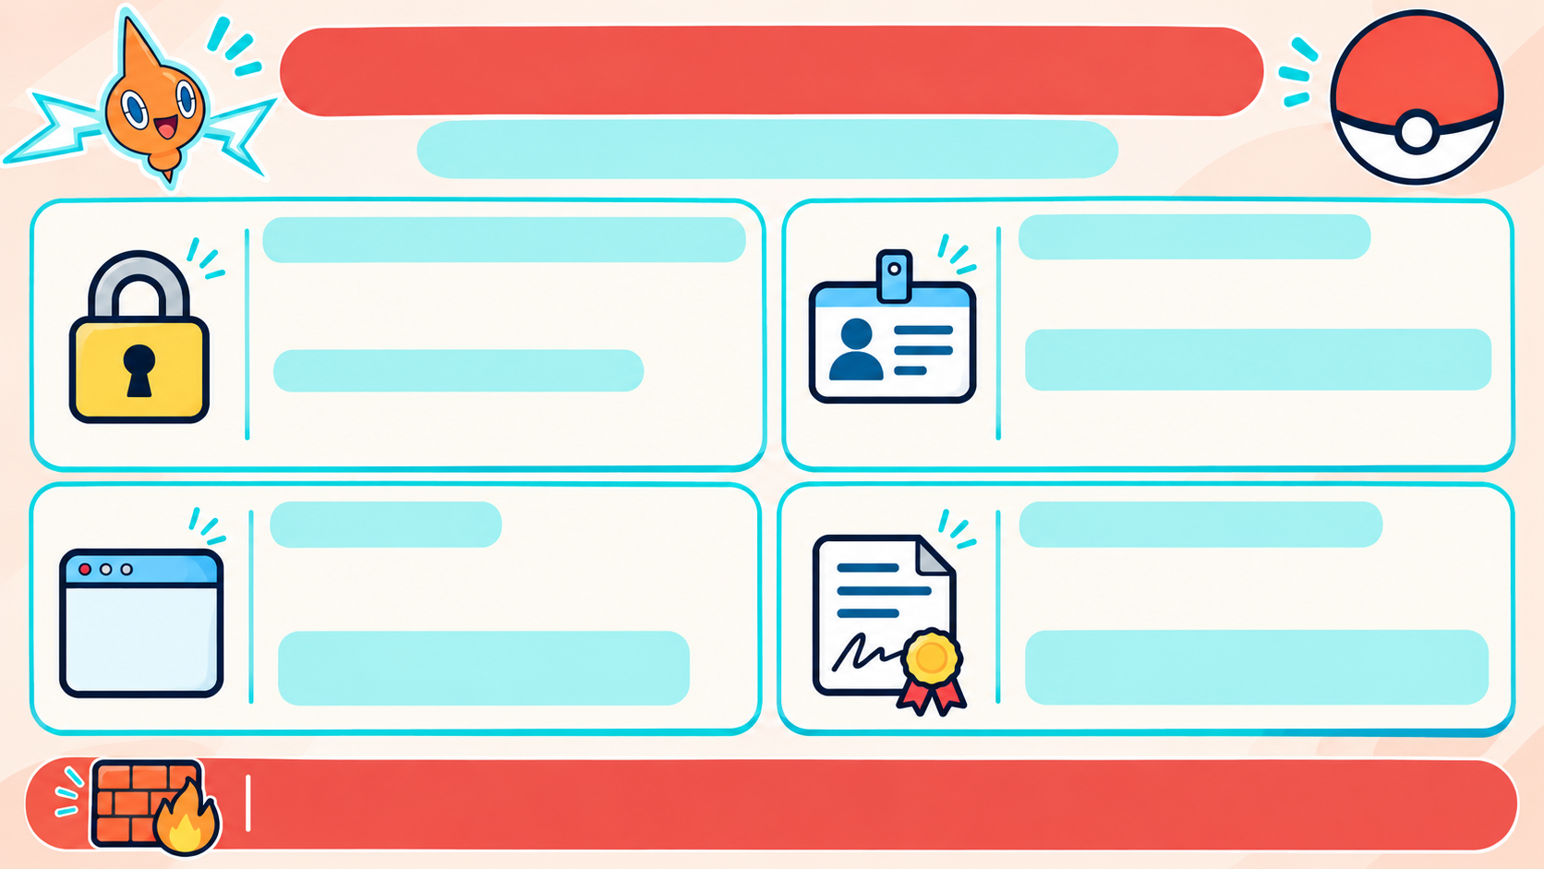
STAGE 1 RECAP: NETWORK SECURITY
Chapter
2.2
What security protects, and how.
PRIVACY (CONFIDENTIALITY)
AUTHENTICATION
Only authorized people can read
the data.
Checks that a person or device is
who it claims to be.
Methods: password, MFA, biometrics,
PKI certificates.
Encryption scrambles it.
AES uses one shared key;
RSA uses a key pair.
MFA = more than one proof of identity.
PKI = certificates that help verify a website.
INTEGRITY
NONREPUDIATION
Checks that data has not
changed.
Provides evidence of who sent or
approved something.
Hashes and checksums help
detect changes.
Digital signatures and log files
create evidence.
A firewall checks network traffic and blocks what breaks its rules.
Notes:
The four security goals answer different questions. Privacy controls who can read data. Authentication checks identity. Integrity detects changes. Nonrepudiation provides evidence of who approved or sent something. Encryption, certificates, hashes, digital signatures, and logs support these goals in different ways.

Slide 52

CHAPTER 02 • ROTOM NETWORK LAB
ELECTRIC/GHOST TYPE • INTERMEDIATE
CHAPTER 2 COMPLETE!
You connected the digital world!
Great job, Trainer!
Next up: Chapter 3 • Behaviorist Al

