Slide 1


Hardware, Networks & Behavorist Al
Team
PikaByte

Slide 2
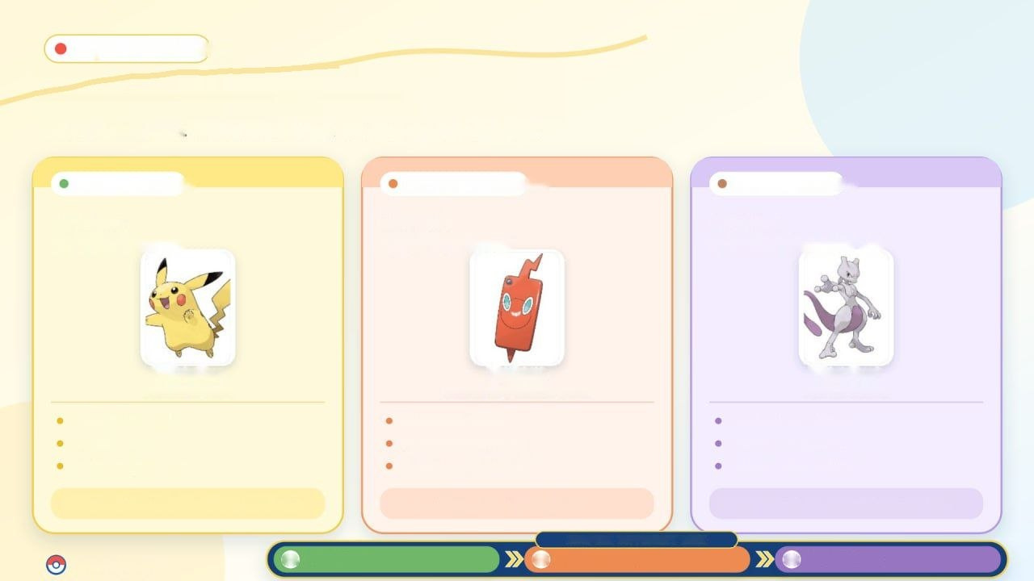




PikaByte Field Guide
Table of contents
Choose a chapter. Meet its Pokémon. Level up your knowledge
Level 01 • Beginner
Level 02 • Intermediate
Level 03 • Advanced
Chapter 1
Chapter 2
Chapter 3
Hardware
NETWORKS
BEHAVIORIST AI
Pikachu
Rotom
Mewtwo
ELECTRIC TYPE
ELECTRIC / GHOST TYPE
PSYCHIC TYPE
CPU & processing
Routers & switches
Environment & stimuli
Input /output devices
Topologies & protocols
Actions & responses
RAM & storage
Packets & data transfer
Rewards & reinforcement
Mission: Discover what's inside a computer
Mission: Connect the digital world.
Mission: Understand how machines leanr.
CHAPTER DIFFICULTY PATH
PIKABYTE
01
BEGINNER
02
INTERMEDIATE
03
ADVANCED

Slide 3
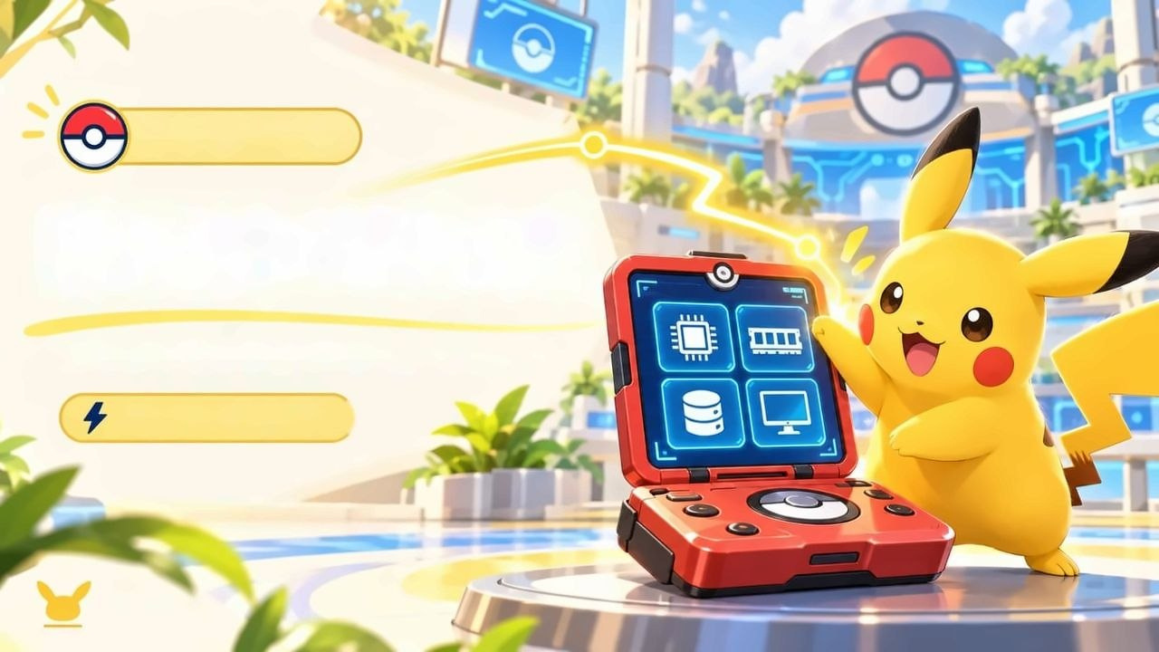
CHAPTER 01
HARDWARE
The physical parts that make a computer work
A Trainer’s Toolkit
PIKABYTE

Slide 4

CHAPTER 01 / PIKACHU'S HARDWARE LAB
ELECTRIC TYPE • BEGINNER
STAGE 01
COMPUTERS & DATA
Models • Components • Data • Algorithms • Workflow • Computer Types
01
02
03
MODELS & ALGORITHMS
HARDWARE & SOFTWARE
WORKFLOW & COMPUTER TYPES
Turing von • Neumann
Data • Binary • ASCII
Input • Processing • Output

Slide 5

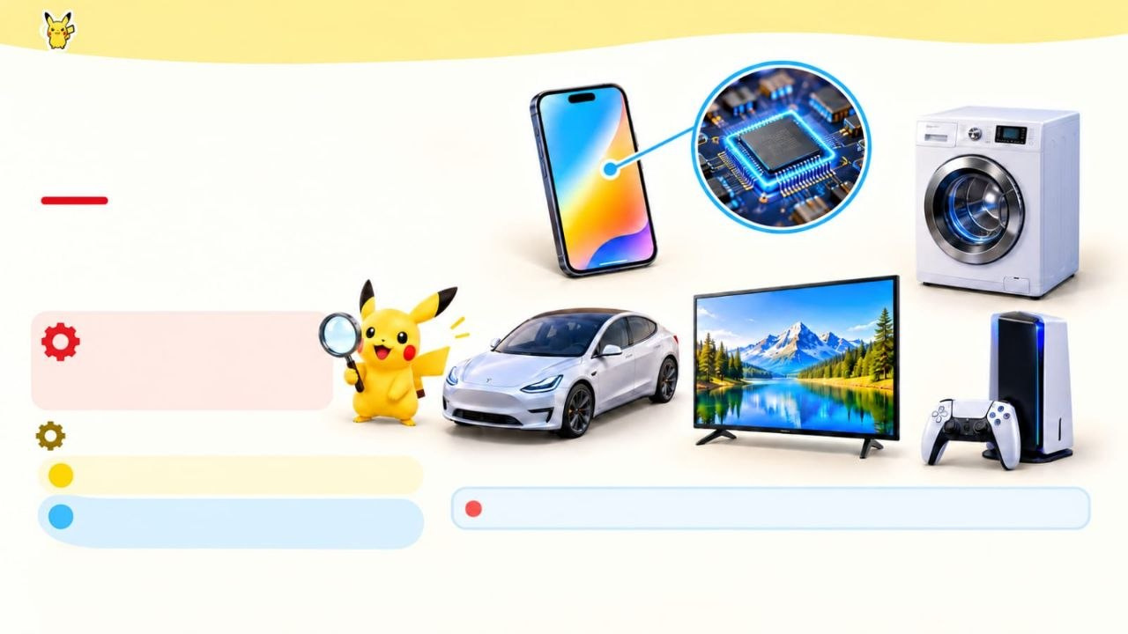
CHAPTER 01 / PIKACHU'S HARDWARE LAB
ELECTRIC TYPE • BEGINNER
COMPUTER HARDWARE
COMPUTERS ARE EVERYWHERE!
PROCESSOR
Phones, cars and appliances can
contain computer systems.
WHAT IS HARDWARE?
The physical parts of a computer system.
IN THIS CHAPTER
1
How computer components work
2
How programs and data work with hardware
Processors are part of the computer systems inside these devices.
NEXT: THE BASIC COMPUTER WORKFLOW

Slide 6

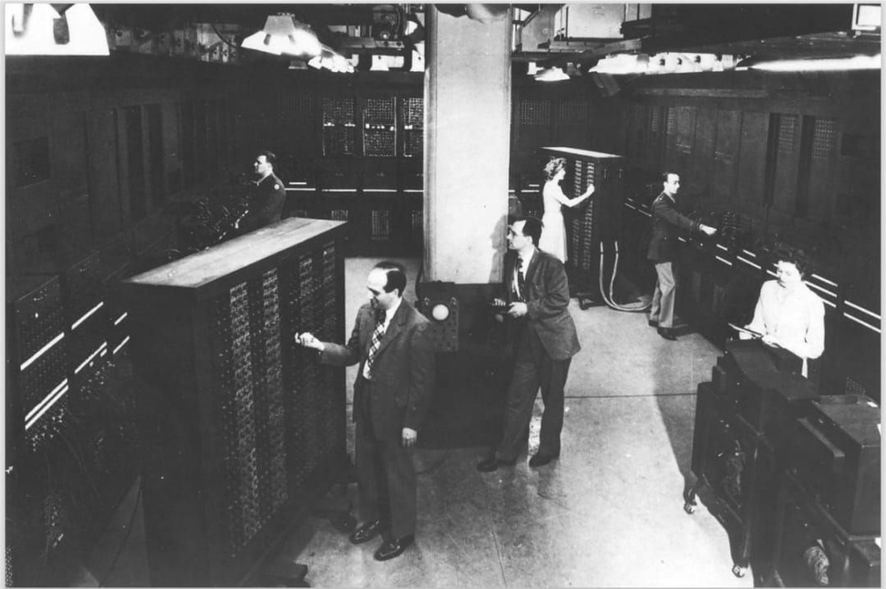
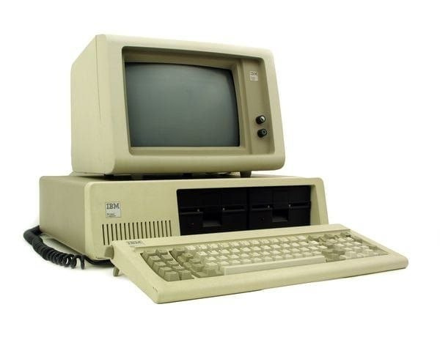
CHAPTER 01 / PIKACHU'S HARDWARE LAB
ELECTRIC TYPE • BEGINNER
THE EVOLUTION OF COMPUTERS
From early electronic computers to compact devices
1940s
1981
TODAY
Early electronic computers
IBM Personal Computer
Computers are everywhere
Built mainly as powerful automatic calculators.
Computing moved into
How computers process and store data
homes and workplaces.

Slide 7
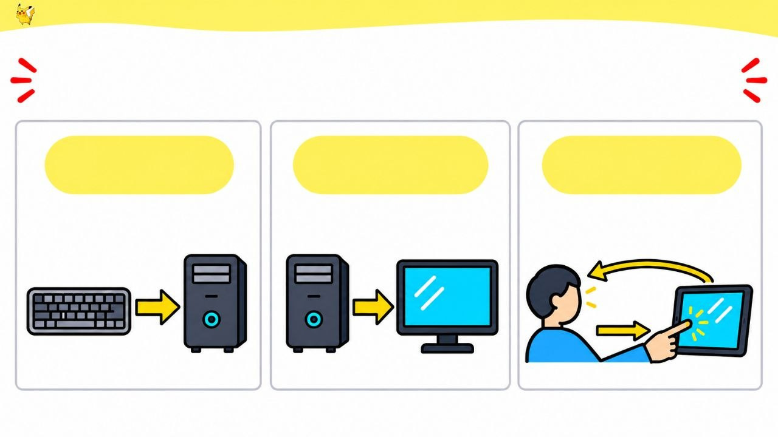
CHAPTER 01 / PIKACHU'S HARDWARE LAB
ELECTRIC TYPE • BEGINNER
THREE ROLES OF COMPUTER DEVICES
INPUT
OUTPUT
HYBRID
Data goes in
Results come out
input + output
visual output
touch input

Slide 8
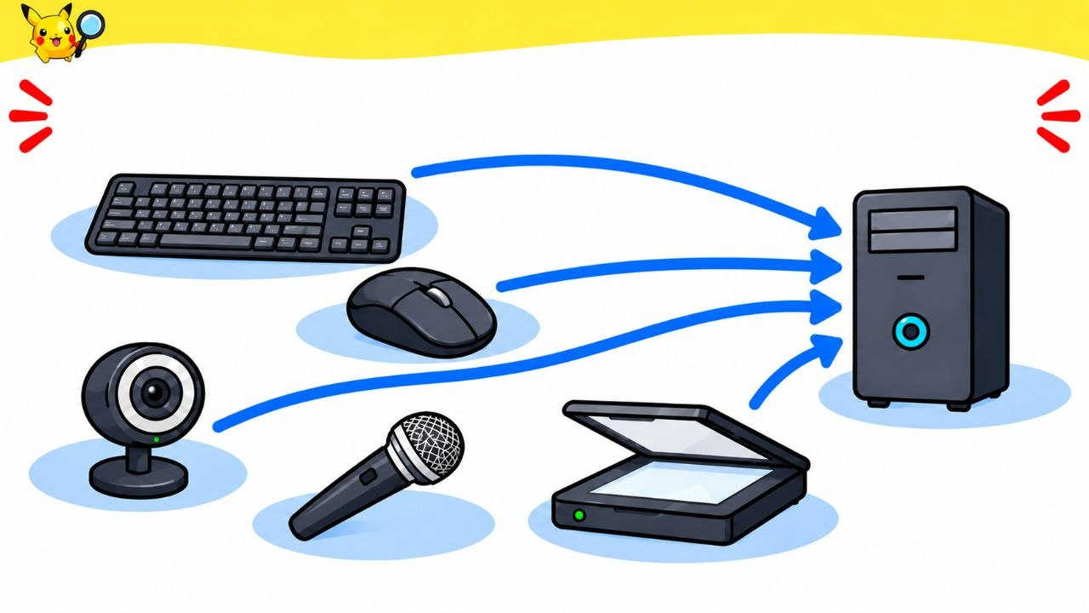
CHAPTER 01 / PIKACHU'S HARDWARE LAB
ELECTRIC TYPE • BEGINNER
INPUT DEVICES
They send data to a computer.
KEYBOARD
MOUSE
WEBCAM
MICROPHONE
SCANNER

Slide 9
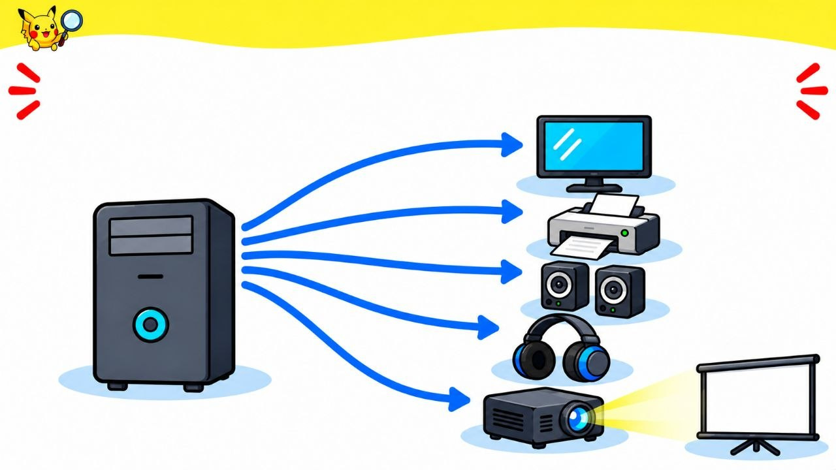
CHAPTER 01 / PIKACHU'S HARDWARE LAB
ELECTRIC TYPE • BEGINNER
OUTPUT DEVICES
They show or communicate a computer's results.
MONITOR
PRINTER
SPEAKERS
HEADPHONES
COMPUTER
PROJECTOR

Slide 10
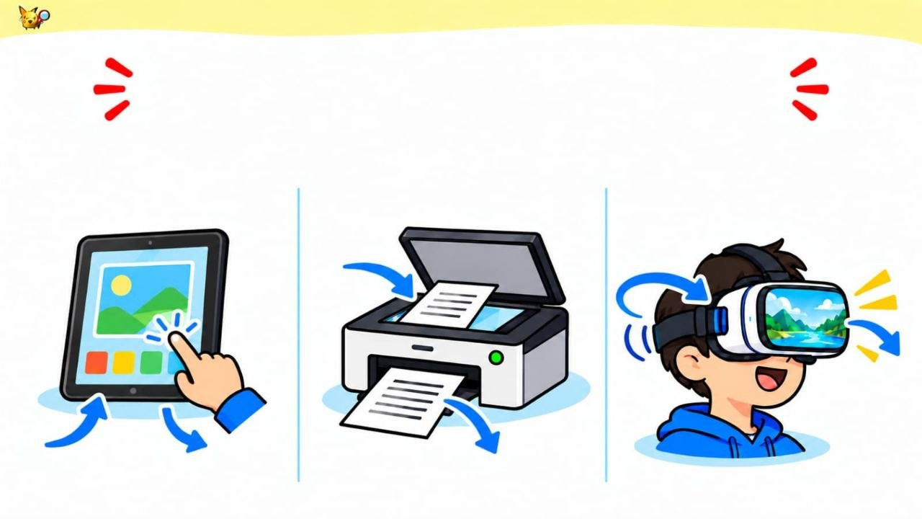
CHAPTER 01 / PIKACHU'S HARDWARE LAB
ELECTRIC TYPE • BEGINNER
HYBRID DEVICES
One device can take input and provide output.
TABLET
MULTIFUNCTION PRINTER
VR HEADSET
HEAD MOVEMENT (INPUT)
INPUT
OUTPUT
INPUT
OUTPUT
OUTPUT

Slide 11
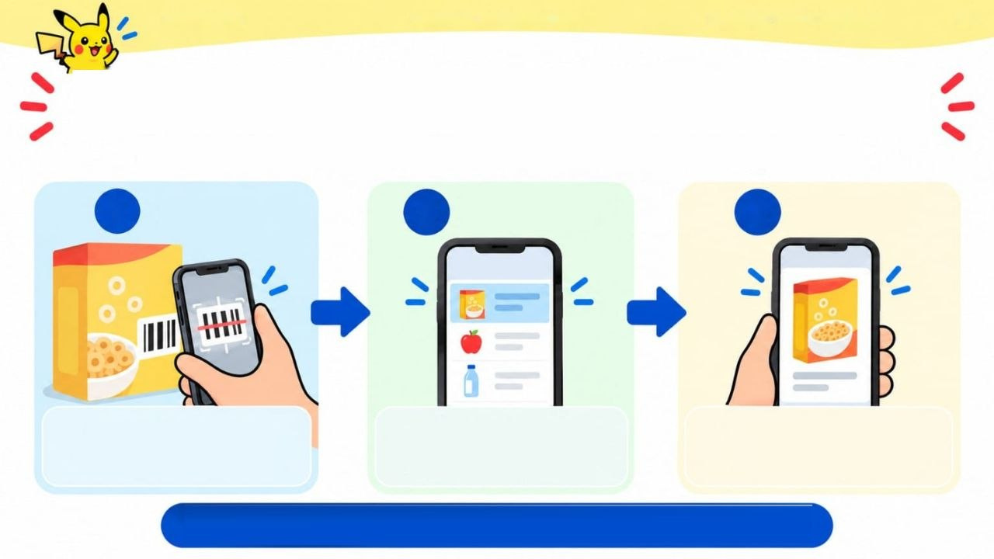
CHAPTER 01 / PIKACHU'S HARDWARE LAB
ELECTRIC TYPE • BEGINNER
HOW DOES INPUT BECOME OUTPUT?
A barcode scan can start a programmed sequence.
1
INPUT
2
PROCESS
3
OUTPUT
A smartphone camera scans a barcode on a cereal box.
A simple app matches
the scanned code to
a product entry in a list.
The phone screen
displays the product
name and picture.
The phone screen displays the product name and picture.
Notes:
A barcode scanner reads the code. The computer uses the program to find the matching product information. Then the screen shows the result. The scan is input, finding the information is processing, and showing it is output.

Slide 12
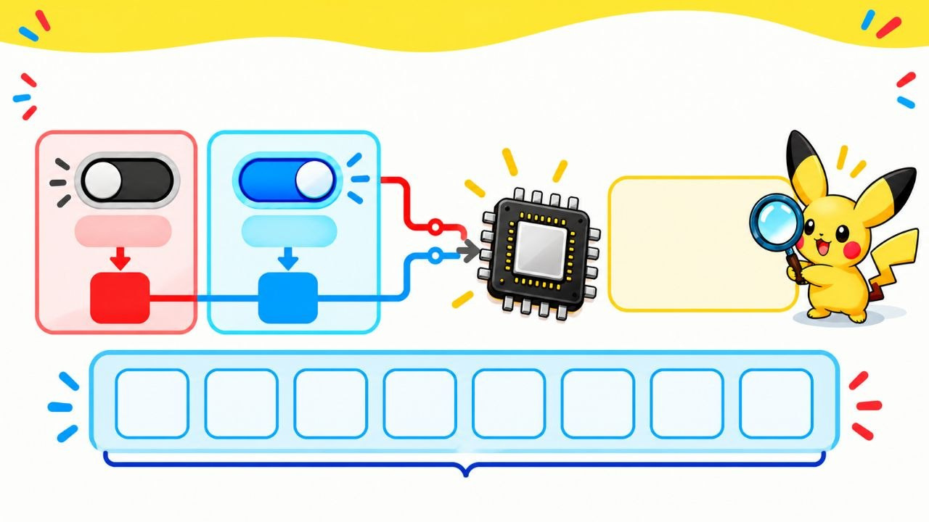
CHAPTER 01 / PIKACHU’S HARDWARE LAB
HOW DOES A COMPUTER READ INFORMATION?
Inside a computer, information is represented using two states.
BIT -
one binary digit: 0 or 1.
OFF
ON
0
1
0
1
0
1
1
0
0
1
1 byte = 8 bits
NEXT: HOW BITS REPRESENT NUMBERS

Slide 13
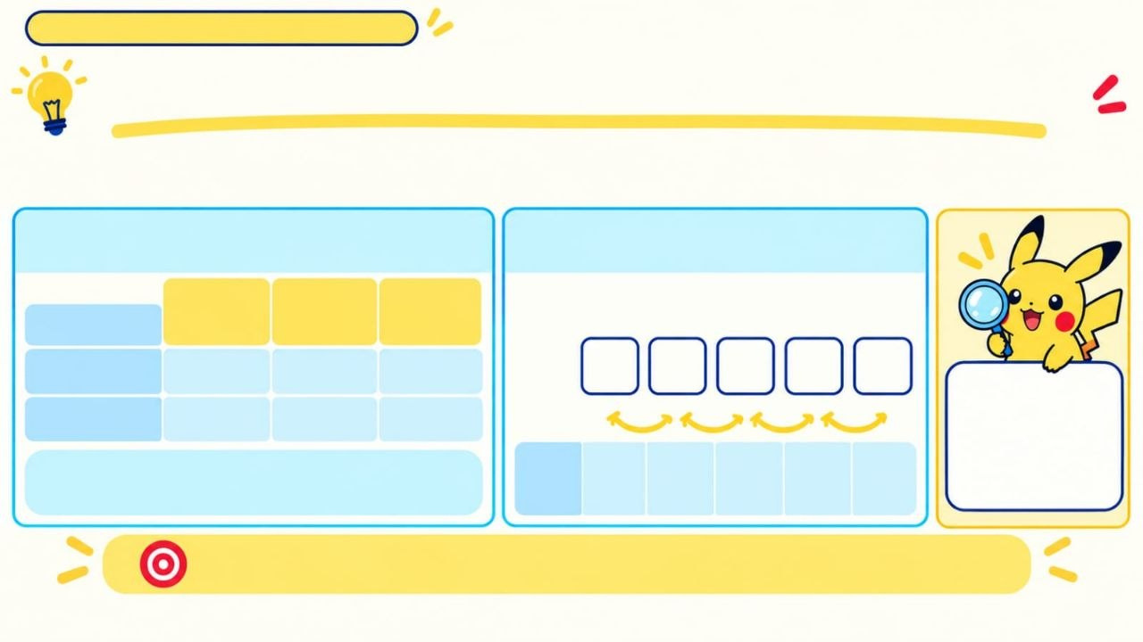
CHAPTER 01 PIKABYTE HARDWARE LAB
WHAT DOES „PLACE VALUE“ MEAN?
Bits are Os and 1s-but how do their positions form a number?
A digit's position tells us how much it is worth.
1
A FAMILIAR EXAMPLE: DECIMAL
2
BINARY POSITIONS
Start at the right with 1; double each
3
4
5
step to the left.
DIGIT:
PLACE VALUE:
100
10
1
PLACE VALUE - the amount a digit represents because of its position.
CONTRIBUTION:
300
40
5
×2
×2
×2
×2
PLACE VALUE:
2⁴
2³
2²
2¹
2⁰
345= 300+ 40+5
16
8
4
2
1
Place values let us turn a pattern of bits into a number.
NEXT: READ 10101₂ AS A NUMBER >>
Notes:
In binary, a digit’s position tells us its value. Starting from the right, the place values are 1, 2, 4, 8, 16, and so on. A 1 means we include that value. A 0 means we leave it out.

Slide 14
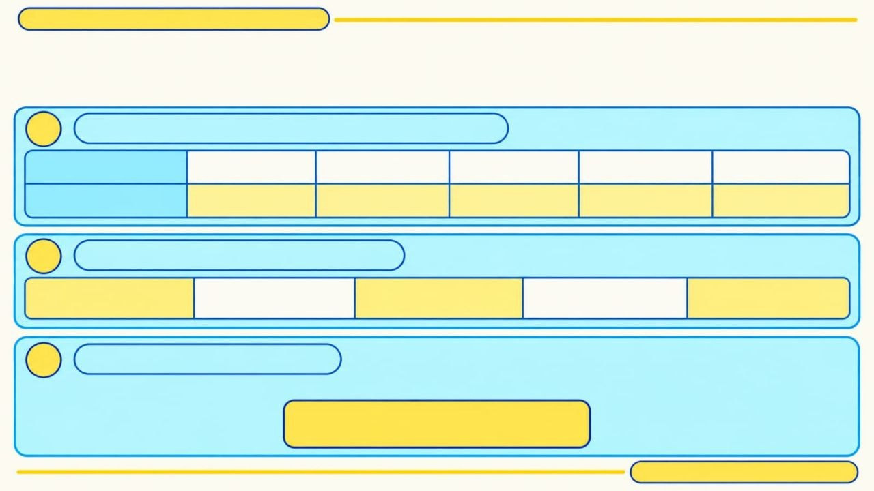
CHAPTER 01 / PIKACHU’S HARDWARE LAB
READ 10101 AS A NUMBER
2
Use the place values from the previous slide.
1
MATCH THE BITS TO THEIR PLACE VALUES
BIT:
1
0
1
0
1
PLACE VALUE:
16
8
4
2
1
2
FIND EACH BIT'S CONTRIBUTION
1 16 = 16
0 8 = 0
1 4 = 4
0 2 = 0
1 1 = 1
X
X
X
X
X
3
ADD THE CONTRIBUTIONS
16 + 0 + 4 + 0 + 1 = 21
10101₂ = 21₁₀
2 = base 2 (binary)
10 = base 10 (decimal)
NEXT: HOW BITS REPRESENT LETTERS
Notes:
The place values are 16, 8, 4, 2, and 1. In 10101, the 1s are in the 16, 4, and 1 places. So 10101₂ equals 16 + 4 + 1, which is 21 in decimal.

Slide 15
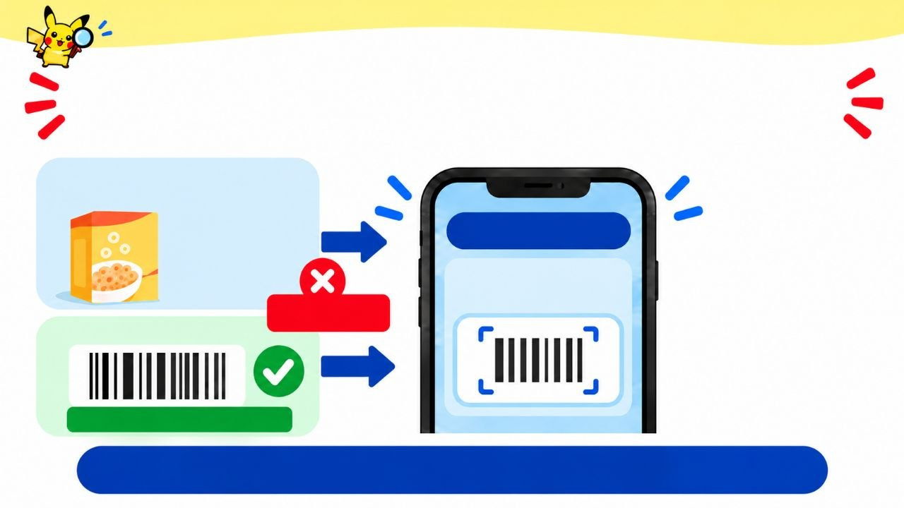
CHAPTER 01 / PIKACHU'S HARDWARE LAB
ELECTRIC TYPE • BEGINNER
WHY DOES DATA NEED A FORMAT?
A program expects information in a particular form.
PRODUCT NAME
AND PICTURE
FIND PRODUCT
Cereal
SCAN OR ENTER
A BARCODE
NOT THIS APP'S INPUT FORMAT
BARCODE
FORMAT THIS APP EXPECTS
Data is information in a defined format.

Slide 16
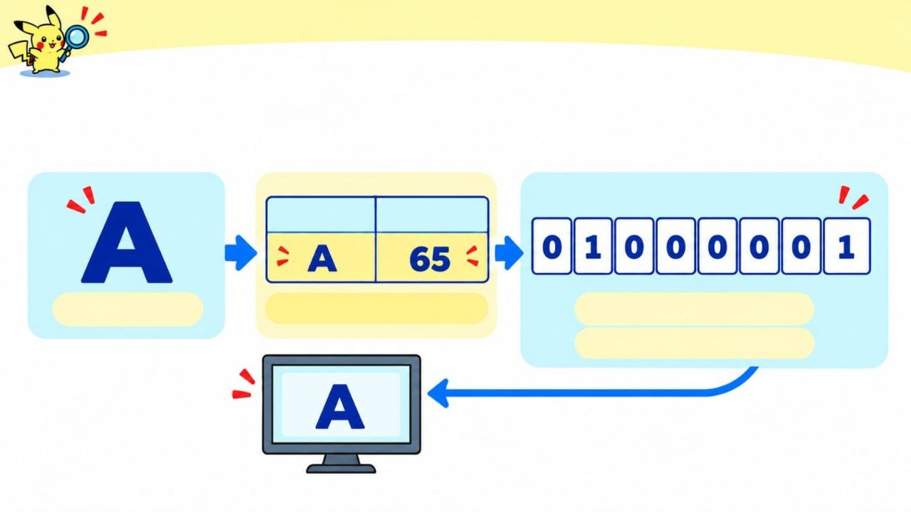
CHAPTER 01 / PIKACHU'S HARDWARE LAB
ELECTRIC TYPE • BEGINNER
HOW DO BITS REPRESENT LETTERS?
ASCII assigns each character a number.
CHARACTER
ASCII CODE
CHARACTER
LOOK UP IN ASCII TABLE
65 IN 8-BIT BINARY
7-BIT ASCII: 1000001
The computer uses the code
to store and display the letter.

Slide 17
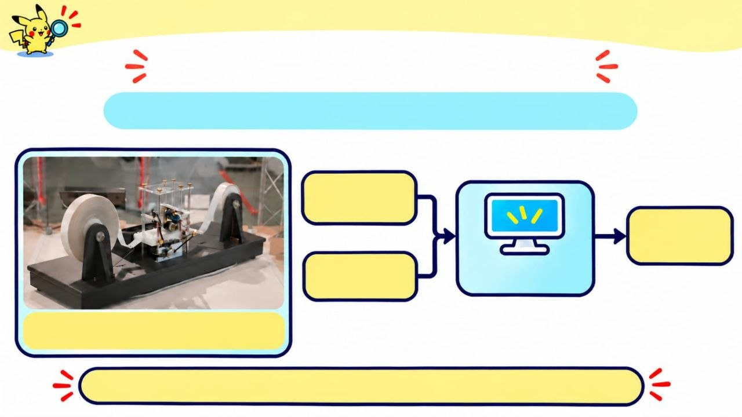
CHAPTER 01 / PIKACHU'S HARDWARE LAB
ELECTRIC TYPE • BEGINNER
THE TURING MODEL
A computer processes input by following a program.
INPUT
DATA
OUTPUT
DATA
PROGRAM
COMPUTER
TURING MACHINE
This photo shows a model of Turing’s theoretical idea.
Change the input or program, and the output can change.

Slide 18
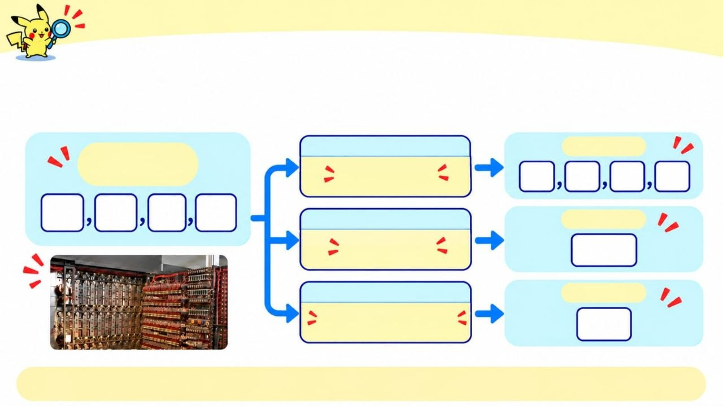
CHAPTER 01 / PIKACHU'S HARDWARE LAB
ELECTRIC TYPE • BEGINNER
SAME INPUT, DIFFERENT PROGRAMS
A program is a set of instructions that tells the computer what to do with the data.
INPUT
PROGRAM
OUTPUT
(SAME DATA)
SORT
3
12
8
22
3
12
8
22
PROGRAM
OUTPUT
ADD
45
PROGRAM
OUTPUT
FIND SMALLEST
3
Early computers followed instructions to process data.
The same input can produce different outputs when the program changes.

Slide 19
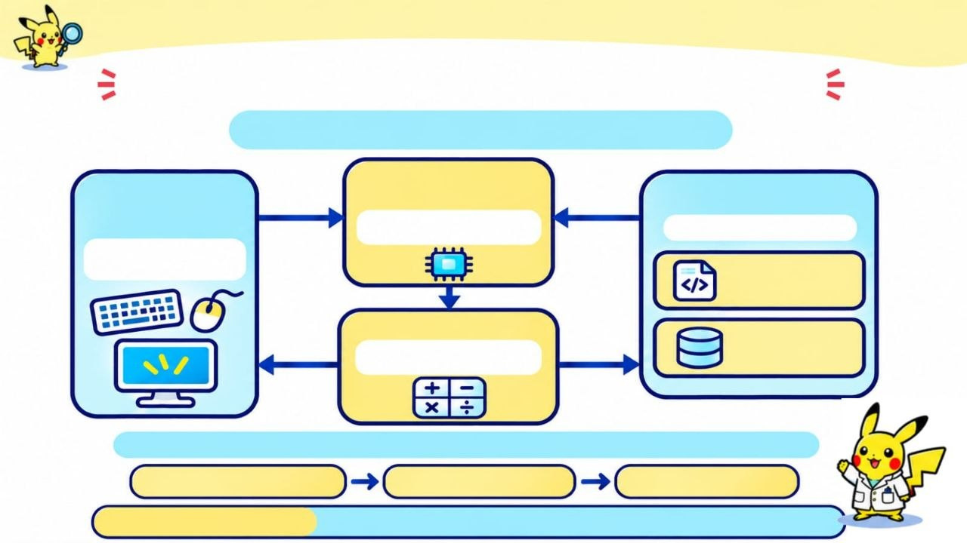
CHAPTER 01 / PIKACHU'S HARDWARE LAB
ELECTRIC TYPE • BEGINNER
THE VON NEUMANN MODEL
Programs and data share memory.
CONTROL
UNIT
INPUT/
OUTPUT
MEMORY
Gets instructions •
directs the work
Stores both
Keyboard in •
Screen out
PROGRAM
(instructions)
ALU
Does calcultions •
compares values
DATA
(numbers)
The control unit gets an instruction and tells other parts what to do.
GET INSTRUCTION
CARRY IT OUT
REPEAT
EXAMPLE: 2 + 3
Input: 2 and 3 → ALU calculates → Output: 5
Notes:
In this model, the computer stores both program instructions and data in memory. The control unit gets the instructions and directs the other parts. The ALU does calculations and comparisons. Together, these parts let the computer run a program.

Slide 20
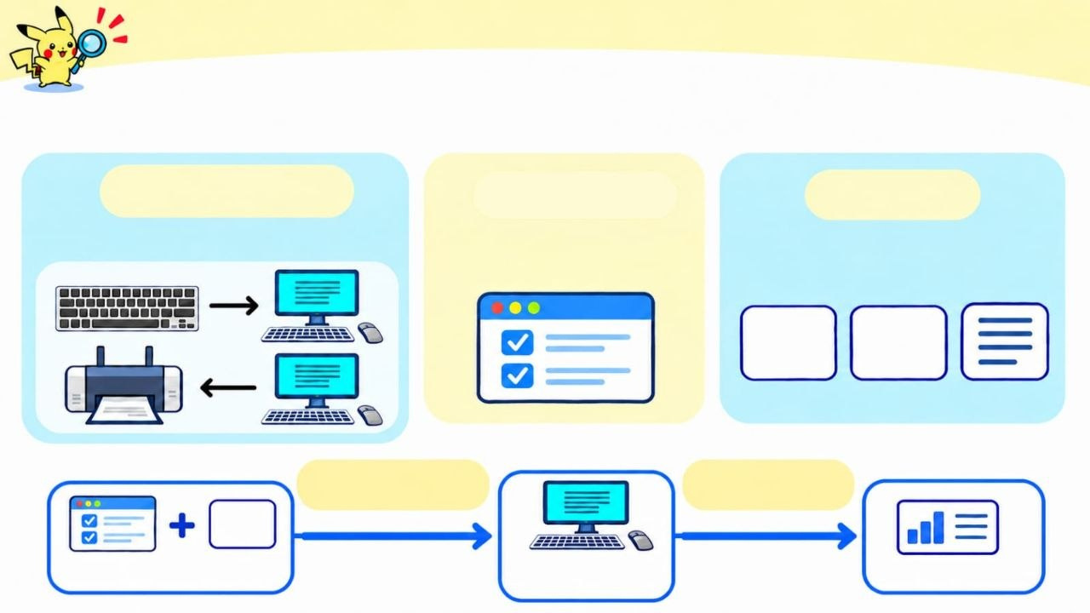
CHAPTER 01 / PIKACHU'S HARDWARE LAB
ELECTRIC TYPE • BEGINNER
HARDWARE, SOFTWARE & DATA
HARDWARE
SOFTWARE
DATA
Physical parts you can touch.
Programs and instructions.
Information a computer can use, change or save.
123
ABC
Software tells
hardware what to do
Hardware processes data.
123
SOFTWARE + DATA
COMPUTER (HARDWARE)
OUTPUT

Slide 21
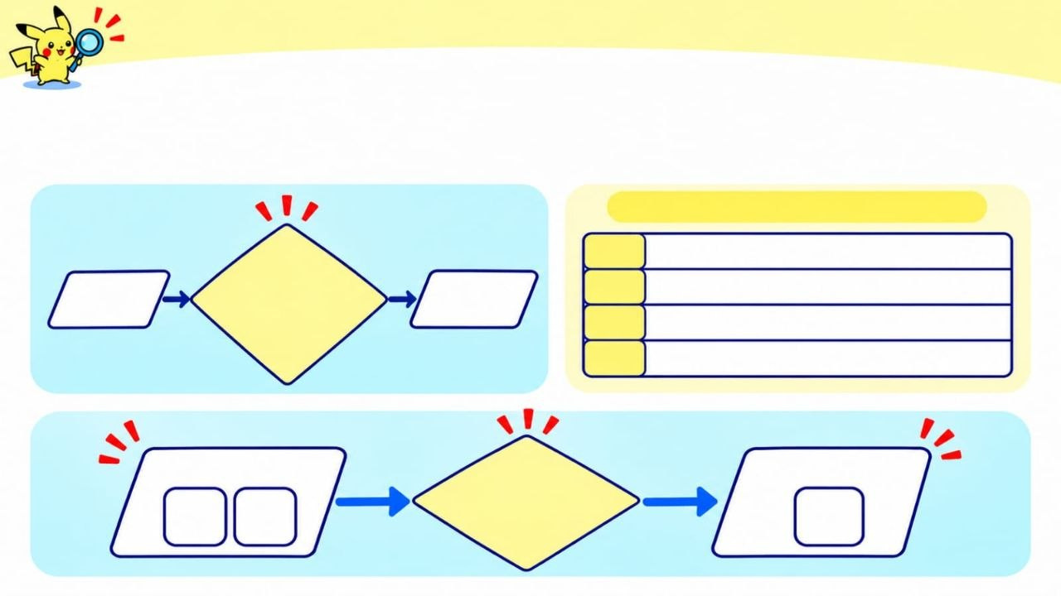
CHAPTER 01 / PIKACHU'S HARDWARE LAB
ALGORITHM • BEGINNER
WHAT IS AN ALGORITHM?
A step-by-step plan for solving a problem.
EXAMPLE: ADD TWO NUMBERS
1
Enter the first number.
ALGORITHM
A step-by-step plan to solve a problem.
2
INPUT
OUTPUT
Enter the second number.
3
Add them.
4
Show the result.
INPUT
OUTPUT
ALGORITHM add
2
3
5

Slide 22
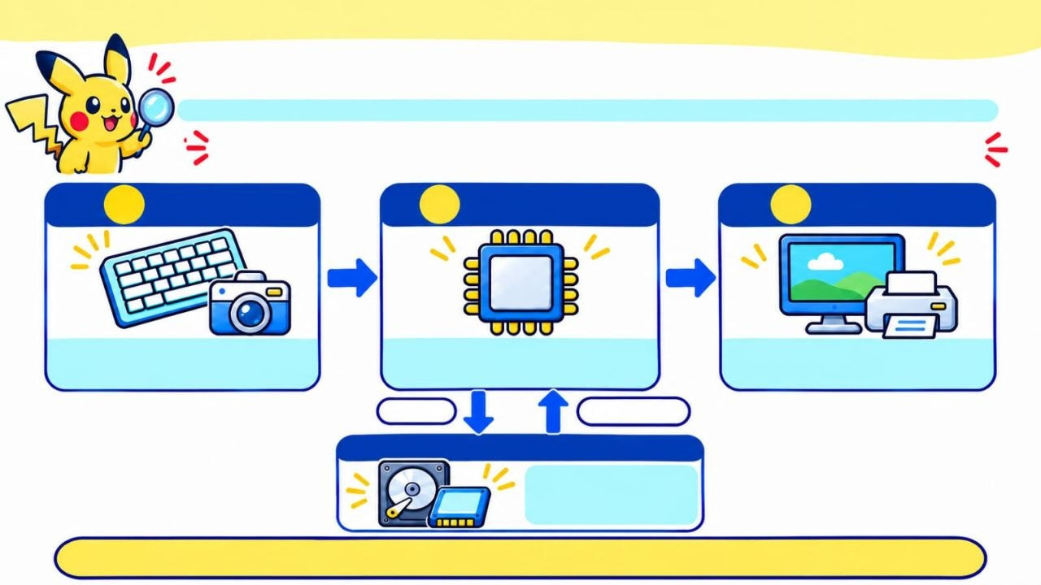
CHAPTER 01 / PIKACHU'S HARDWARE LAB
ELECTRIC TYPE • BEGINNER
THE BASIC WORKFLOW OF A COMPUTER
Data moves through three main stages; storage keeps data for later use.
1
INPUT
2
PROCESSING
3
OUTPUT
CPU
Receives data or commands.
Works on data using instructions.
Presents the result.
SAVE
RETRIEVE
Keeps data for later use.
Storage is connected to processing.
Notes:
A computer receives input, processes it by following instructions, and produces output. It can also store data so it is available later. For example, a computer can take a photo as input, process it, show it on screen, and save it.

Slide 23
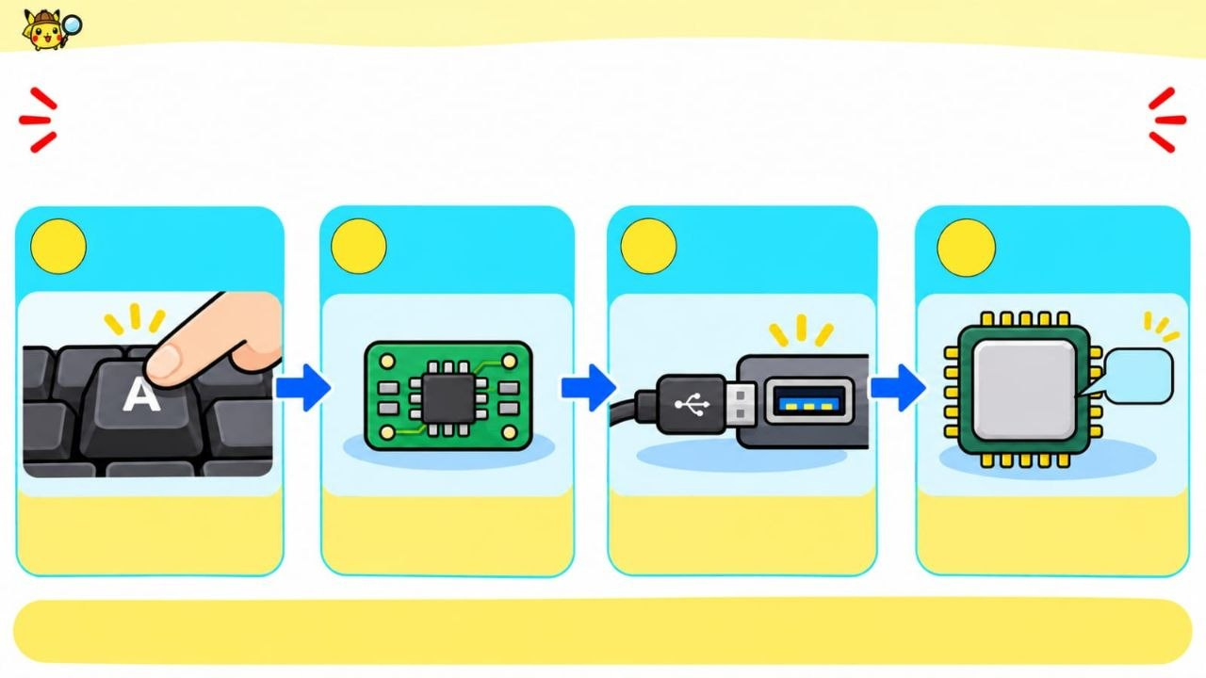
CHAPTER 01 / PIKACHU'S HARDWARE LAB
ELECTRIC TYPE • BEGINNER
HOW DOES A KEY PRESS REACH THE CPU?
Follow the letter A through the input system.
USB PORT/ INPUT INTERFACE
1
2
INPUT
CONTROLLER
3
4
KEYBOARD
CPU
A
CPU
Detects the key press.
Prepares the signal.
Type of the input
inferface
Receives the input data.
The input controller prepares the signal; the interface carries it to the CPU.
Notes:
When you press a key, the keyboard detects which key you pressed and sends that information to the computer. The computer treats it as input data, then the CPU can process it. The exact route depends on the device, but the basic idea is the same.

Slide 24
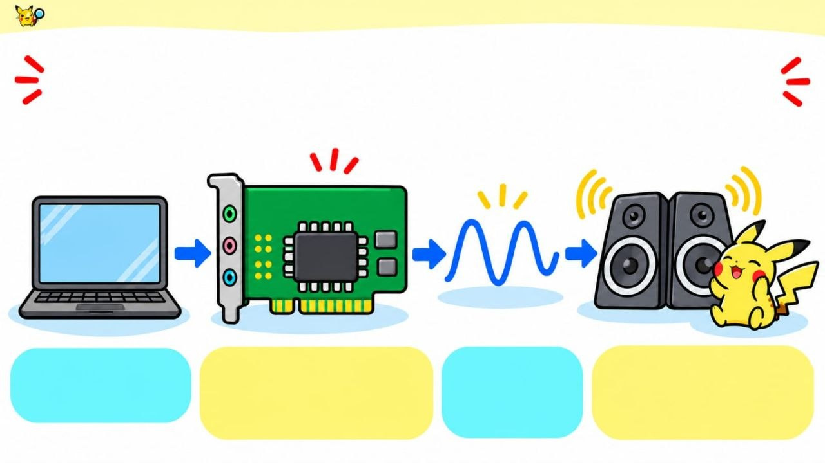
CHAPTER 01 / PIKACHU'S HARDWARE LAB
ELECTRIC TYPE • BEGINNER
HOW DOES A COMPUTER PLAY SOUND?
A DAC turns digital audio into a signal speakers can use.
SOUND CARD + DAC
01010110
DAC
ANALOG
SIGNAL.
SPEAKERS
Turn the signal into sound
DIGITAL AUDIO Os and 1s
Changes digital audio into an electrical signal,
A smooth electrical wave.
digital-to-analog converter
Notes:
A computer stores digital sound as numbers. The DAC, or digital-to-analog converter, changes those numbers into an electrical signal that varies over time. The speaker turns that signal into sound waves we can hear.

Slide 25
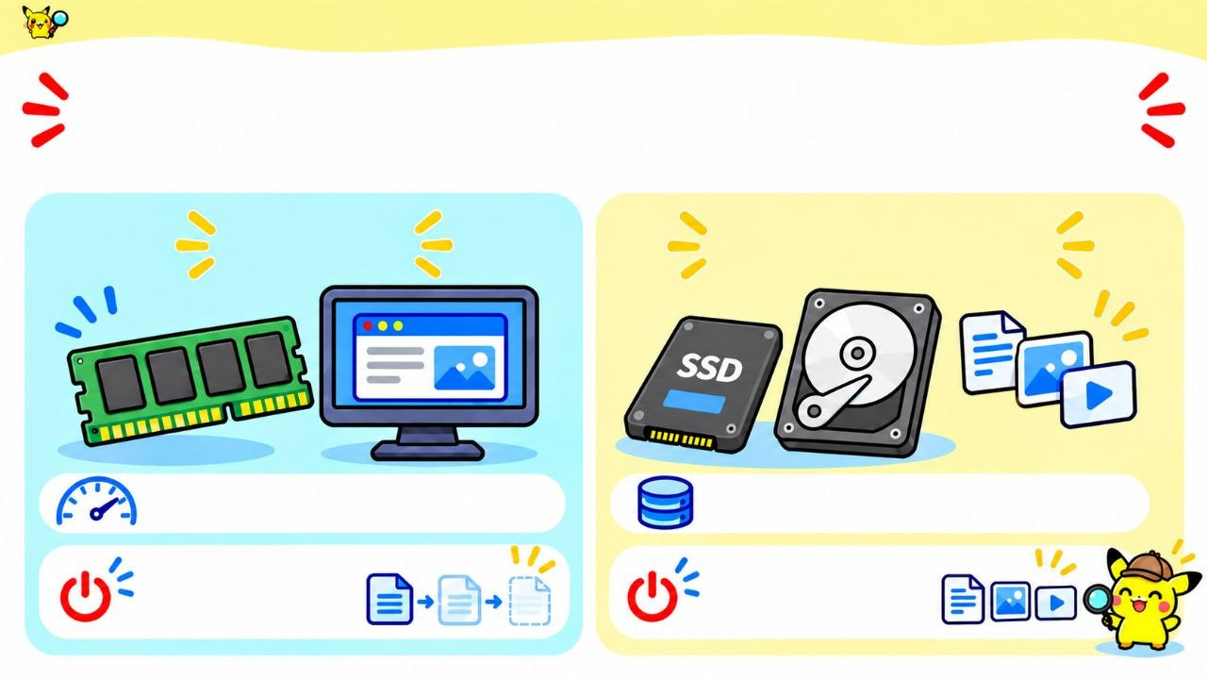
CHAPTER 01 / PIKACHU'S HARDWARE LAB
ELECTRIC TYPE • BEGINNER
RAM AND LONG-TERM STORAGE
One is temporary; the other keeps your files.
RAM
SSD / HDD
Fast memory for current work
Long-term storage
Clears when power is off
Keeps files when power is off
Notes:
RAM holds the data and programs the computer is using right now. It is temporary, so its contents usually disappear when the power is off. An SSD or HDD keeps saved files after shutdown. An unsaved document is in RAM while you work on it; its saved copy is on the drive.

Slide 26
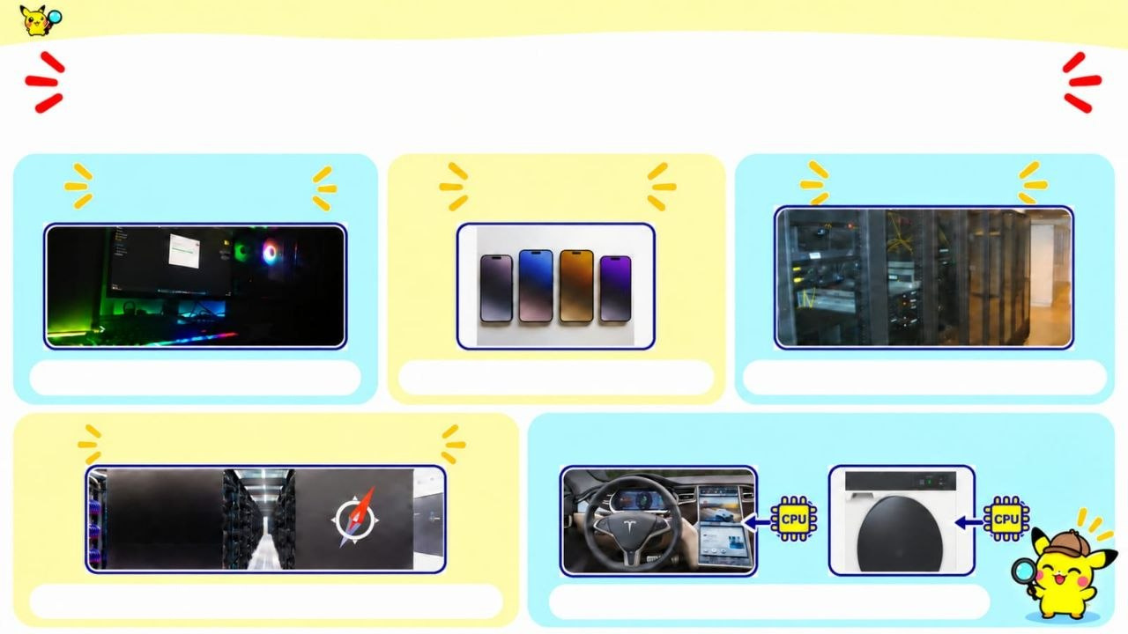
CHAPTER 01 / PIKACHU'S HARDWARE LAB
ELECTRIC TYPE • BEGINNER
COMPUTERS COME IN MANY FORMS
Different types are built for different jobs.
PERSONAL COMPUTER
MOBILE DEVICE
SERVER
For one person
A computer you can carry
Provides data to other computers
SUPERCOMPUTER
EMBEDDED COMPUTER
Solves huge scientific problems
Built into a car or appliance

Slide 27

YOUR TURN, TRAINERS!
Ready to test your computer skills?

Slide 28
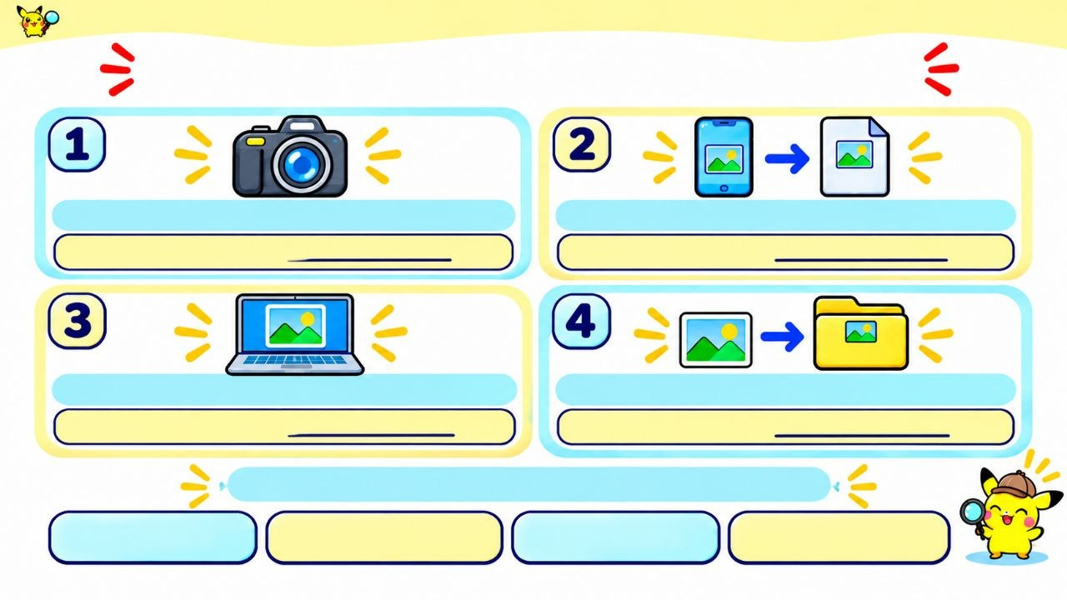
CHAPTER 01 / PIKACHU'S HARDWARE LAB
ELECTRIC TYPE • BEGINNER
PIKACHU'S PHOTO MISSION
Match each step to a computer function.
.JPG
The camera captures a picture.
The phone turns it into a file.
FUNCTION:
FUNCTION:
Gallery
The picture appears on the screen.
The photo is saved to Gallery.
FUNCTION:
FUNCTION:
Choose one function for each step.
INPUT
PROCESSING
OUTPUT
STORAGE
Notes:
Give the class about one minute to match each step to a computer function. Then review the sequence: capturing the photo is input, changing or preparing the image is processing, showing it on the screen is output, and saving it is storage.

Slide 29
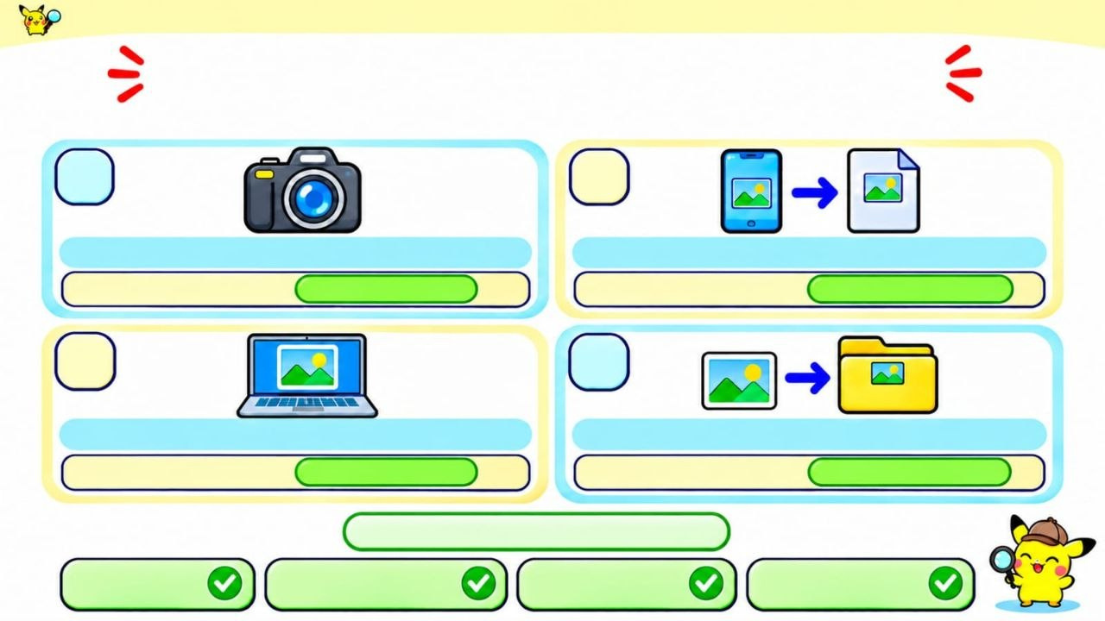
CHAPTER 01 / PIKACHU'S HARDWARE LAB
ELECTRIC TYPE • BEGINNER
PIKACHU'S PHOTO MISSION
Match each step to a computer function.
1
2
2
The camera captures a picture.
The phone turns it into a file.
FUNCTION:
INPUT
FUNCTION:
PROCESSING
3
4
FUNCTION:
OUTPUT
FUNCTION:
STORAGE
CHECK YOUR ANSWERS
INPUT
PROCESSING
OUTPUT
STORAGE

Slide 30
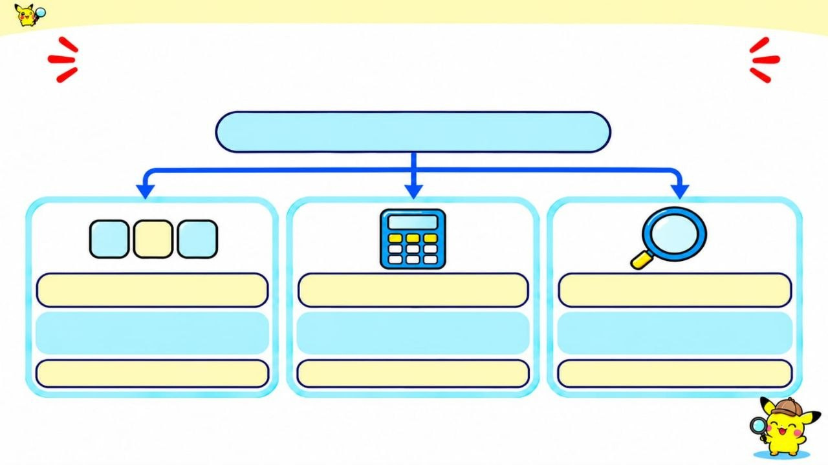
CHAPTER 01 / PIKACHU'S HARDWARE LAB
ELECTRIC TYPE • BEGINNER
SAME INPUT, THREE PROGRAMS
What output does each program produce?
INPUT DATA: 5,2,9
5
2
9
2
SORT
ADD
FIND SMALLEST
Put the numbers in order, smallest first.
Find the total.
Choose the smallest number.
OUTPUT:
OUTPUT:
OUTPUT:
Same input. Different programs. What changes?
Notes:
Give the class 30–45 seconds to work out the outputs for 5, 2, 9. Then review: sorting gives 2, 5, 9; adding gives 16; finding the smallest gives 2. The input stayed the same, but the instructions changed, so the outputs changed.

Slide 31
CHAPTER 01 / PIKACHU'S HARDWARE LAB
ELECTRIC TYPE • BEGINNER
SAME INPUT, THREE PROGRAMS
What output does each program produce?
INPUT DATA: 5,2,9
5
2
9
2
SORT
ADD
FIND SMALLEST
Put the numbers in order, smallest first.
Find the total.
Choose the smallest number.
OUTPUT:
2, 5, 9
OUTPUT:
16
OUTPUT:
2
The program changes the output

Slide 32
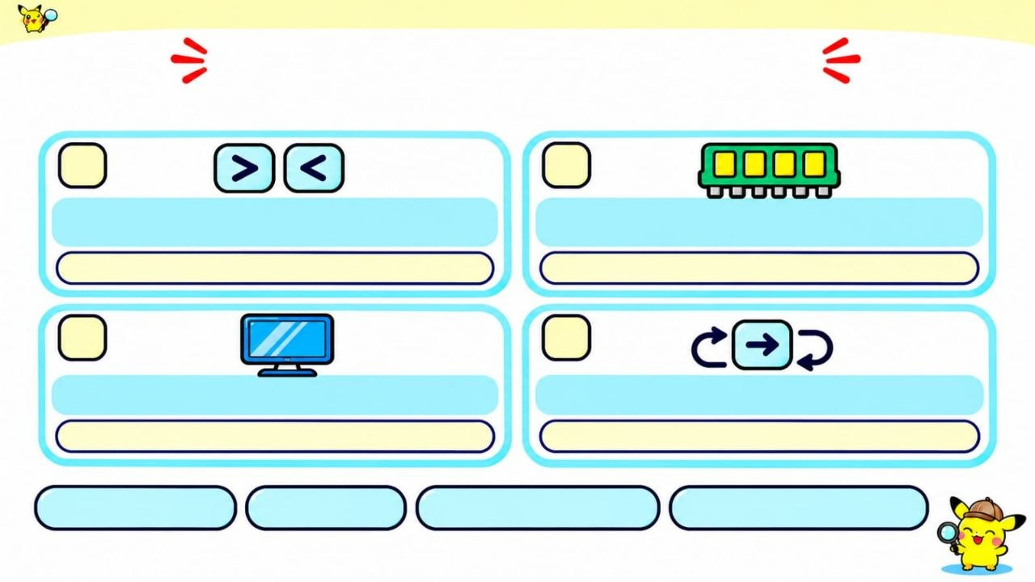
CHAPTER 01 / PIKACHU'S HARDWARE LAB
ELECTRIC TYPE • BEGINNER
WHO DOES THIS JOB?
Match each task to a von Neumann subsystem.
1
2
Checks whether 15 is greater than 12.
Holds a program while it runs.
SUBSYSTEM:
SUBSYSTEM:
3
4
Shows a result on the monitor.
Chooses which instruction runs next.
SUBSYSTEM:
SUBSYSTEM:
MEMORY
ALU
CONTROL UNIT
INPUT/OUTPUT
Use each subsystem once.
Notes:
Give the class about 45 seconds to match each task to a computer part. The ALU compares numbers, memory holds programs and data while they are being used, and the control unit directs the instructions. Have learners explain how the job gives them a clue.

Slide 33
CHAPTER 01 / PIKACHU'S HARDWARE LAB
ELECTRIC TYPE • BEGINNER
WHO DOES THIS JOB?
Match each task to a von Neumann subsystem.
1
2
Checks whether 15 is greater than 12.
Holds a program while it runs.
SUBSYSTEM:
ALU
SUBSYSTEM:
MEMORY
3
4
Shows a result on the monitor.
Chooses which instruction runs next.
SUBSYSTEM:
INPUT/OUTPUT
SUBSYSTEM:
CONTROL UNIT
MEMORY
ALU
CONTROL UNIT
INPUT/OUTPUT
CHECK YOUR ANSWER

Slide 34
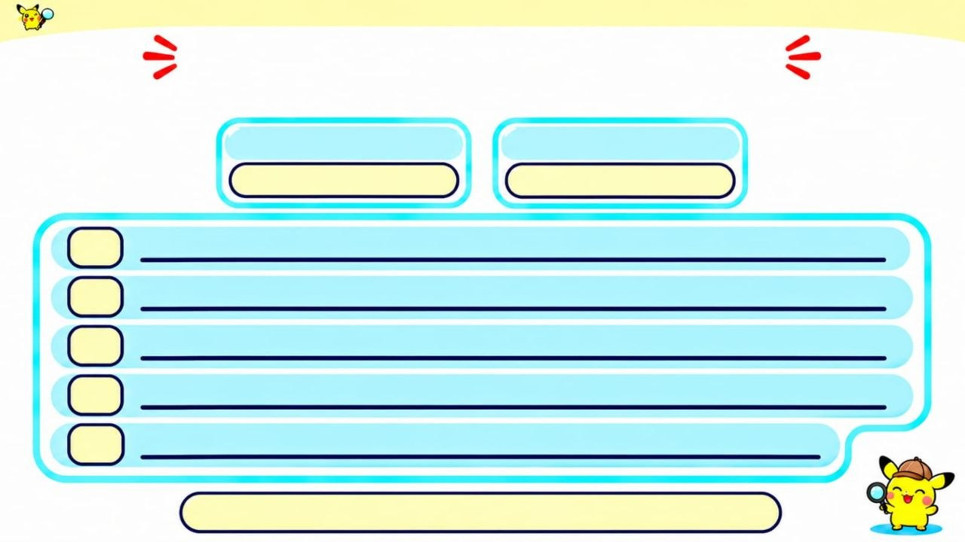
CHAPTER 01 / PIKACHU'S HARDWARE LAB
ELECTRIC TYPE • BEGINNER
ALGORITHM CHALLENGE
Write an algorithm to find the average of two numbers.
NUMBER 1
NUMBER 2
1
2
3
4
5
Use 3-5 clear steps, in the correct order.
Notes:
Give the class about one minute to write steps for finding the average of two numbers. A complete algorithm gets both numbers, adds them, divides the total by 2, and gives the result. For example: input 6 and 10, calculate 6 + 10 = 16, then 16 ÷ 2 = 8.

Slide 35
CHAPTER 01 PIKASYTE'S HARDWARE LAB
ELECTRIC TYPE • BEGINNER
ALGORITHM CHALLENGE
Write an algorithm to find the average of two numbers.
NUMBER 1
NUMBER 2
a
b
1
Input the first number (a).
Input the second number (b).
2
3
Add the numbers: sum = a + b.
4
Divide the sum by 2: average = sum / 2.
5
Output the average.
CHECK YOUR ANSWER

Slide 36
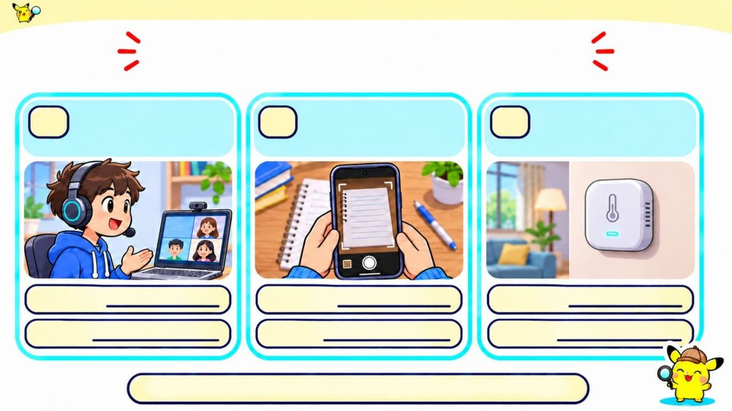
CHAPTER 01 / PIKACHU'S HARDWARE LAB
ELECTRIC TYPE • BEGINNER
INPUT DETECTIVE
Name the input device and the data it captures.
You speak into a headset during a video call.
You photograph a page of notes with a phone.
A smart-home chip reads the room temperature.
A.
B.
C.
DEVICE:
DEVICE:
DEVICE:
DATA:
DATA:
DATA:
For each situation, identify both answers.

Slide 37
CHAPTER 01 / PIKACHU'S HARDWARE LAB
ELECTRIC TYPE • BEGINNER
INPUT DETECTIVE
Name the input device and the data it captures.
You speak into a headset during a video call.
You photograph a page of notes with a phone.
A smart-home chip reads the room temperature.
A.
B.
C.
DEVICE:
MICROPHONE
DEVICE:
CAMERA
DEVICE:
TEMPERATURE SENSOR
DATA:
SOUND/VOICE
DATA:
IMAGE/ PHOTO
DATA:
ROOM TEMPERATURE
CHECK YOUR ANSWER

Slide 38
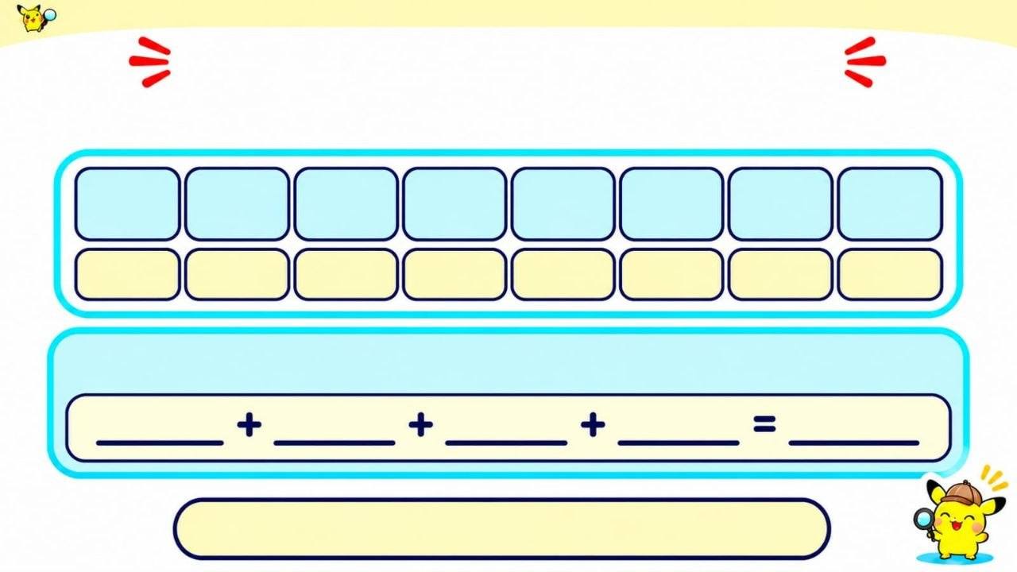
CHAPTER 01 / PIKACHU'S HARDWARE LAB
ELECTRIC TYPE • BEGINNER
BINARY CODE BREAKER
Convert this binary number to decimal
0
0
1
0
1
1
0
1₂
128
64
32
16
8
4
2
1
Add the place values under the 1s:
What is 00101101₂ in decimal?
Notes:
Give the class about 45 seconds to convert the binary number. For 00101101₂, the place values under the 1s are 32, 8, 4, and 1. Add them: 32 + 8 + 4 + 1 = 45.

Slide 39
CHAPTER 01 / PIKACHU'S HARDWARE LAB
ELECTRIC TYPE • BEGINNER
BINARY CODE BREAKER
Convert this binary number to decimal
0
0
1
0
1
1
0
1₂
128
64
32
16
8
4
2
1
Add the place values under the 1s:
32
8
4
1
45
CHECK YOUR ANSWER

Slide 40
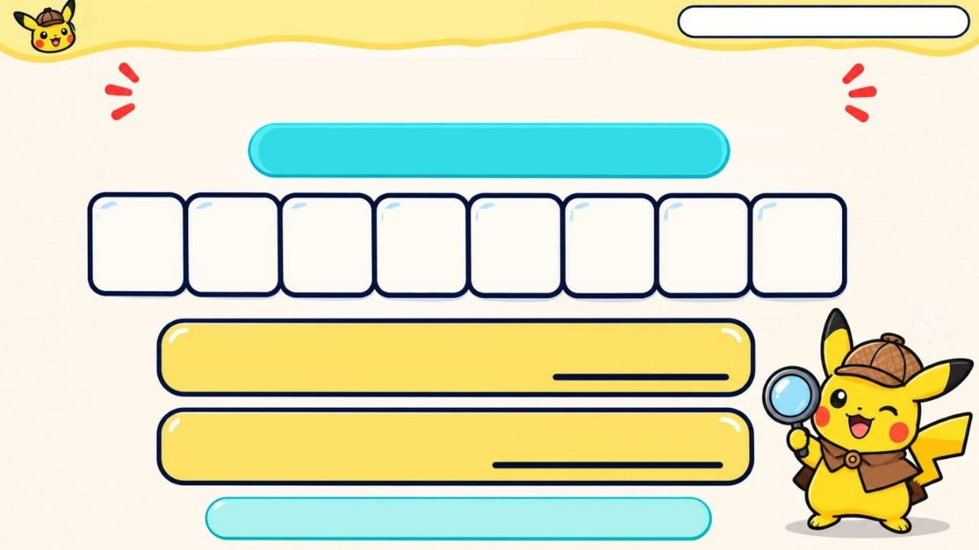
CHAPTER 01 / PIKACHU'S HARDWARE LAB
ELECTRIC TYPE • BEGINNER
ASCII CODE BREAKER
Decode the 8-bit code
0
1
0
0
0
0
0
1
2
DECIMAL VALUE:
CHARACTER:
Use place values and the ASCII table.
Notes:
Give the class about one minute to decode the 8-bit code. First use binary place values to find its decimal number. Then use the ASCII table to find the character for that number. The binary code represents a number; the table connects that number to a character.

Slide 41
CHAPTER 01 PIKASYTE'S HARDWARE LAB
ELECTRIC TYPE • BEGINNER
ASCII CODE BREAKER
Decode the 8-bit code
0
1
0
0
0
0
0
1
2
DECIMAL VALUE:
65
CHARACTER:
A
CHECK YOUR ANSWER

Slide 42
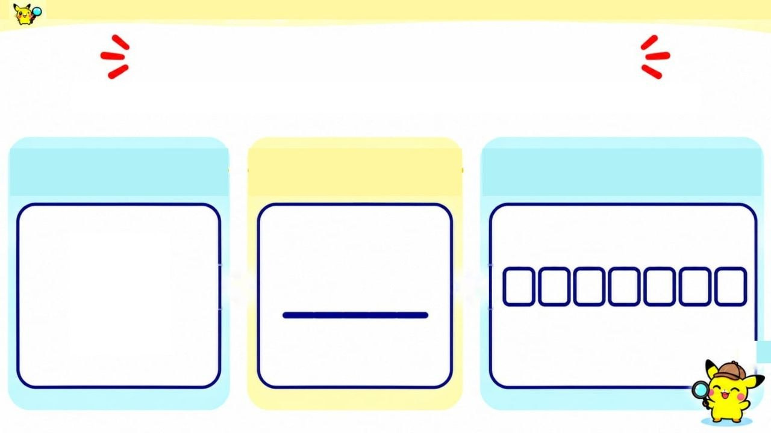
CHAPTER 01 / PIKACHU'S HARDWARE LAB
ELECTRIC TYPE • BEGINNER
ASCII CODE QUEST
Use the ASCII table to decode the character.
CHARACTER
DECIMAL CODE
7-BIT BINARY
B
Notes:
Give the class about one minute to look up B in the ASCII table. B has decimal code 66. In 8-bit binary, 66 is 01000010.

Slide 43
CHAPTER 01 / PIKACHU'S HARDWARE LAB
ELECTRIC TYPE • BEGINNER
ASCII CODE QUEST
Use the ASCII table to decode the character.
CHARACTER
DECIMAL CODE
7-BIT BINARY
B
66
1
0
0
0
0
1
0

Slide 44
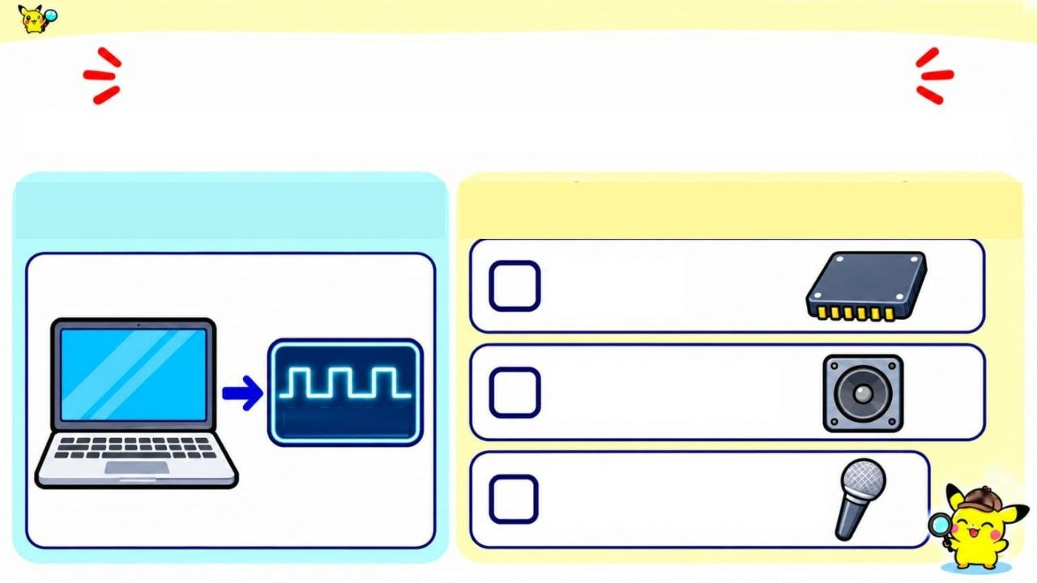
CHAPTER 01 / PIKACHU'S HARDWARE LAB
ELECTRIC TYPE • BEGINNER
SOUND OUTPUT CHECK
Which component converts digital audio into an analog signal?
DIGITAL AUDIO
CHOOSE ONE
DAC
SPEAKER
01001011
MICROPHONE

Slide 45
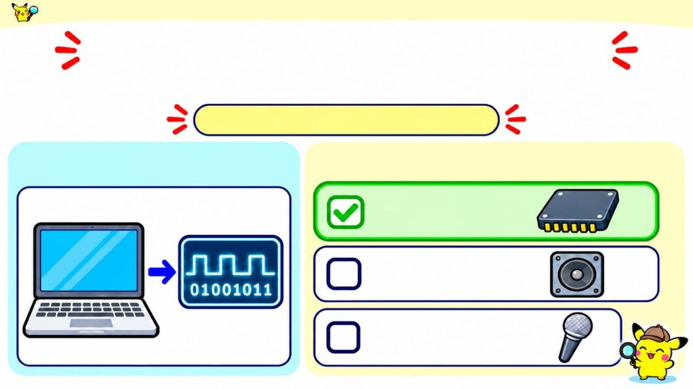
CHAPTER 01 / PIKACHU'S HARDWARE LAB
ELECTRIC TYPE • BEGINNER
SOUND OUTPUT CHECK
Which component converts digital audio into an analog signal?
CHECK YOUR ANSWER
DIGITAL AUDIO
CHOOSE ONE
DAC
SPEAKER
MICROPHONE

Slide 46
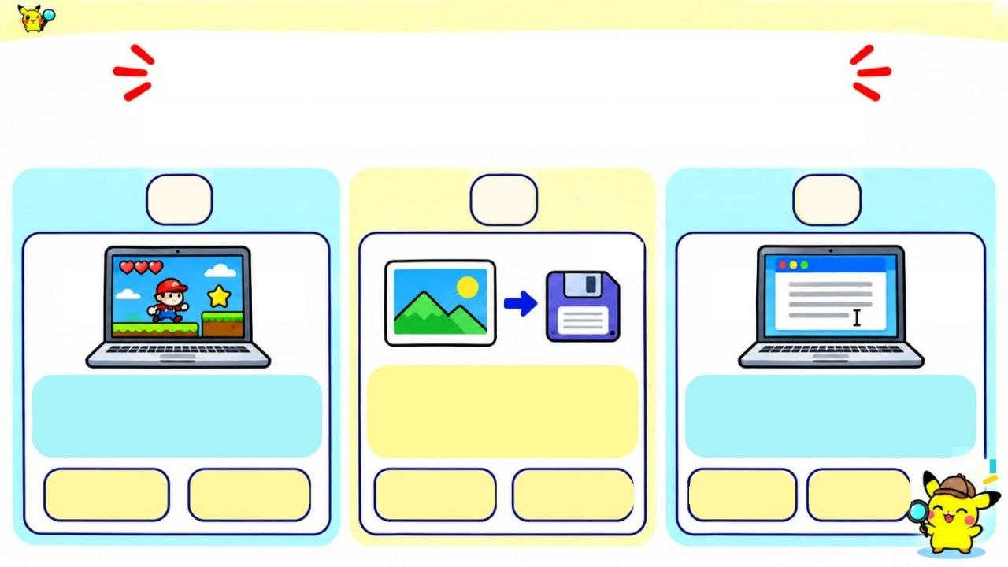
CHAPTER 01 / PIKACHU'S HARDWARE LAB
ELECTRIC TYPE • BEGINNER
MEMORY DETECTIVE
For each situation, choose RAM or SSD.
1
2
3
A game is open
and running.
A photo is saved
to keep after
shutdown
A document is open while you edit it.
RAM
SSD
RAM
SSD
RAM
SSD
Notes:
Give the class about 45 seconds to choose RAM or SSD for each situation. RAM is for data the computer is using now. An SSD keeps saved data even when the computer is off. The key question is whether the data needs to stay after shutdown.

Slide 47
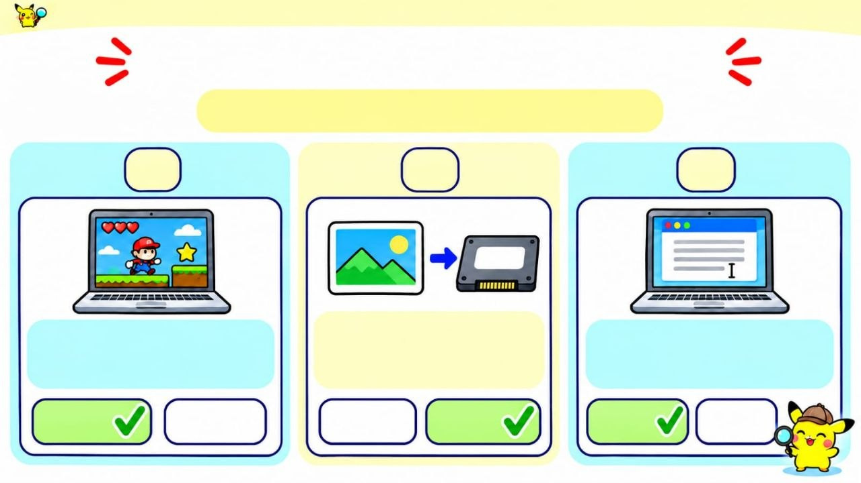
CHAPTER 01 / PIKACHU'S HARDWARE LAB
ELECTRIC TYPE • BEGINNER
MEMORY DETECTIVE
ANSWERS: RAM or SSD
1
2
3
A photo is saved
to keep after
shutdown
A game is open
and running.
A document is open while you edit it.
RAM
SSD
RAM
SSD
RAM
SSD

Slide 48
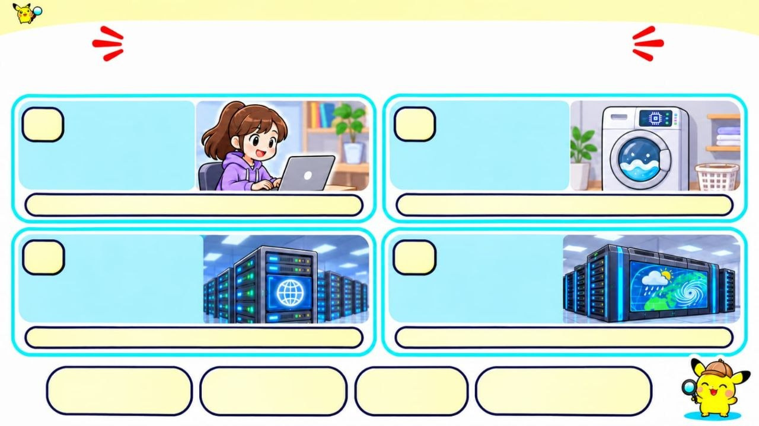
CHAPTER 01 / PIKACHU'S HARDWARE LAB
ELECTRIC TYPE • BEGINNER
COMPUTER TYPE DETECTIVE
Read each situation. Choose the computer type.
A.
A student uses a laptop to write
B.
A computer
inside a washing machine controls its wash cycle.
an essay.
C.
A data-center
D.
A research
computer
sends a website to thousands of users.
center uses a
powerful
computer to
model the weather.
PERSONAL COMPUTER
EMBEDDED
COMPUTER
SERVER
SUPERCOMPUTER
Notes:
Give the class about 45 seconds to classify the examples. A personal computer is for an individual user. An embedded computer is built into a device, such as a washing machine. A server provides services to other computers. A supercomputer handles extremely large calculations.

Slide 49
CHAPTER 01 / PIKACHU'S HARDWARE LAB
ELECTRIC TYPE • BEGINNER
COMPUTER TYPE DETECTIVE
Read each situation. Choose the computer type.
A.
A student uses a laptop to write
B.
A computer
inside a washing machine controls its wash cycle.
an essay.
A. PERSONAL COMPUTER
B. EMBEDDED COMPUTER
C.
A data-center
D.
A research
computer
sends a website to thousands of users.
center uses a
powerful
computer to
model the weather.
C. SERVER
D. SUPERCOMPUTER
PERSONAL COMPUTER
EMBEDDED
COMPUTER
SERVER
SUPERCOMPUTER

Slide 50

CHAPTER 01 / PIKACHU'S HARDWARE LAB
ELECTRIC TYPE • BEGINNER
STAGE 02
NUMBER SYSTEMS
Binary • Decimal • Hexadecimal • Octal • overview
01
02
03
BINARY
DECIMAL
HEXADECIMAL
Base 2 • 0 and 1
Base 10 • 0-9
Base 16 • 0-9, A-F
Notes:
Number Systems and Data Storage

Slide 51

CHAPTER 01 / PIKACHU'S HARDWARE LAB
ELECTRIC TYPE • BEGINNER
FOUR NUMBER SYSTEMS
A base tells us which digits a number system uses
HEXADECIMAL
DECIMAL
OCTAL
BASE 16
BINARY
BASE 10
BASE 8
DIGITS 0-9
DIGITS 0-9
BASE 2
DIGITS 0-7
6A₁₆
106₁₀
6A
DIGITS 0, 1
106
157₈
1101₂
571
01
Each system uses its own set of digits.

Slide 52
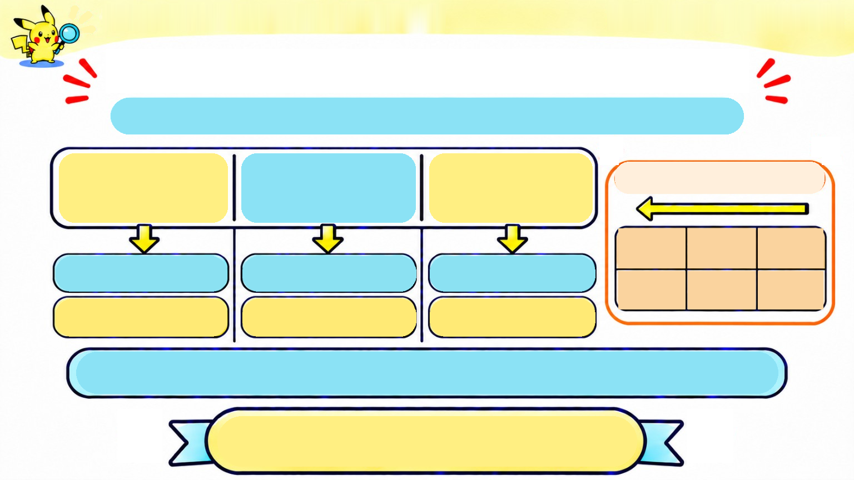
CHAPTER 01 / PIKACHU'S HARDWARE LAB
ELECTRIC TYPE • BEGINNER
WHAT DOES 157 IN OCTAL MEAN?
In octal, each step to the left is worth 8 times more.
1
5
7
Read from right to left
2
1
0
8
8
8
8
2
=
64
8
1
=
8
8
0
=
1
64
8
1
1 x 64 = 64
5 x 8 = 40
7 x 1 = 7
64 + 40 + 7 = 111
157 = 111
8
10
Notes:
Octal is base 8, so each place is a power of 8. The number 157₈ means 1 × 8² + 5 × 8¹ + 7 × 8⁰. That is 64 + 40 + 7, or 111 in decimal.

Slide 53
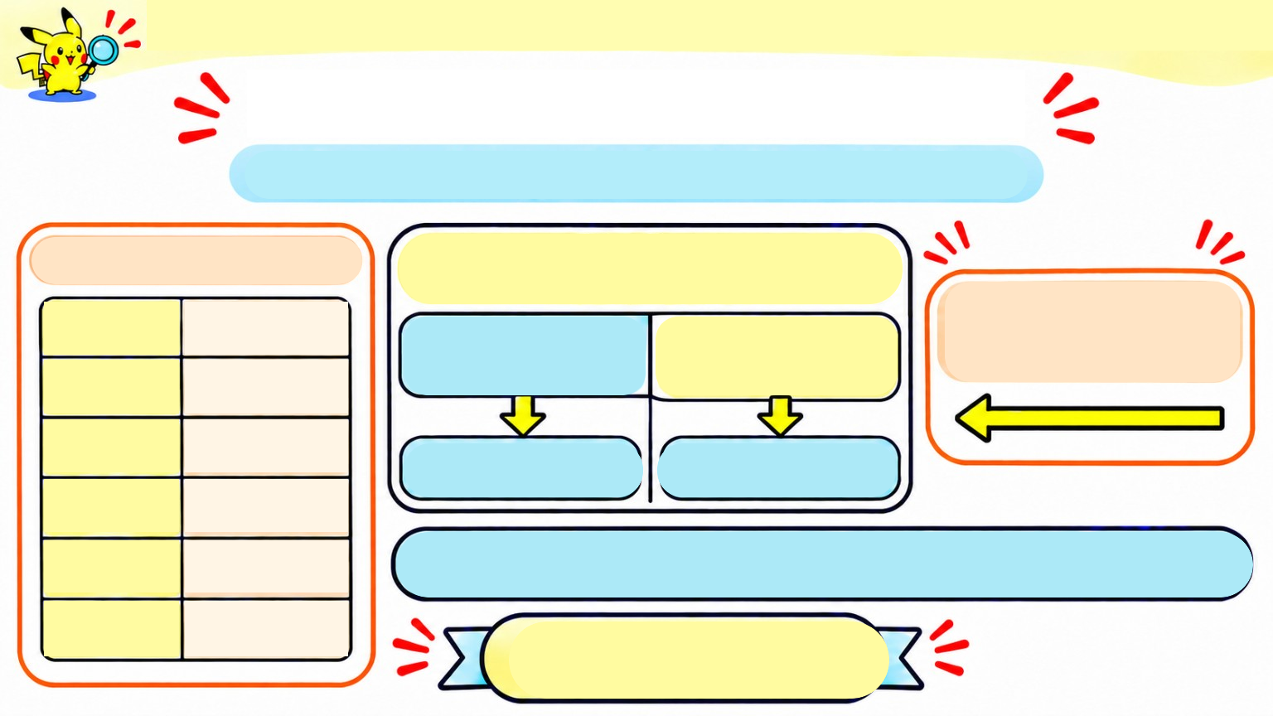
CHAPTER 01 / PIKACHU'S HARDWARE LAB
ELECTRIC TYPE • BEGINNER
HEXADECIMAL: BASE 16
It uses 16 symbols: 0-9 and A-F.
2A
THE SIX EXTRA DIGITS
16
A
= 10
A
Start at the right: 16 , then 16 .
2
0
1
B
= 11
=10
C
= 12
1
0
0
16
=
16
16 = 1
D
= 13
E
= 14
2 x 16 + 10 x 1 = 42
F
= 15
2A
=
42
16
10
Notes:
Hexadecimal uses the digits 0 to 9 and the letters A to F. The letters stand for values 10 to 15. For example, 2A₁₆ means 2 × 16 + 10, which equals 42 in decimal. A is one digit with the value ten.

Slide 54
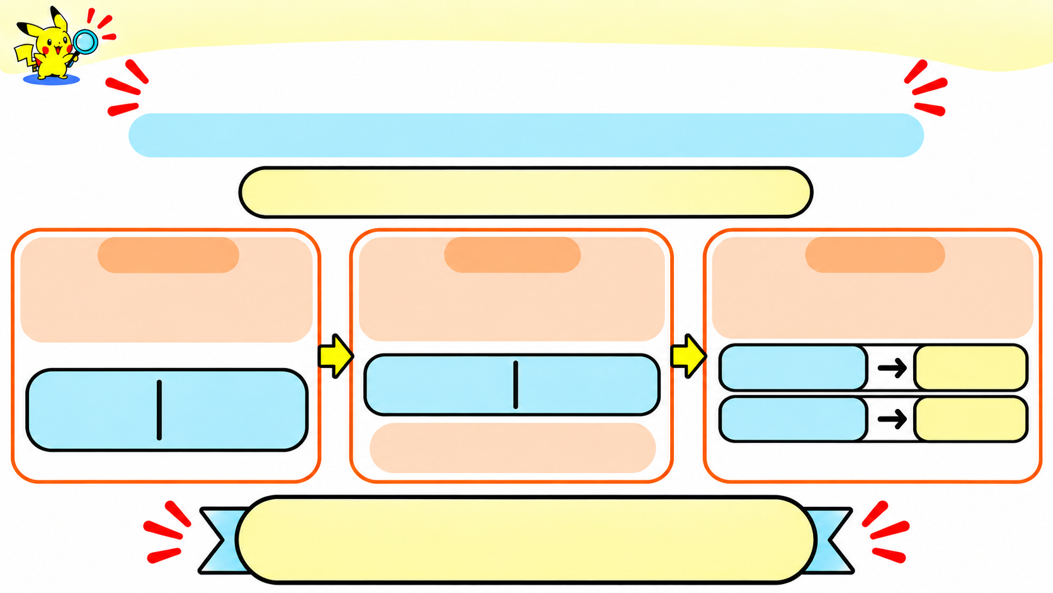
CHAPTER 01 / PIKACHU'S HARDWARE LAB
ELECTRIC TYPE • BEGINNER
BINARY TO HEX: GROUP IN FOURS
Each group of 4 bits becomes one hexadecimal digit.
Convert 1101010 to hexadecimal.
2
Step 1:
Step 2:
Step 3:
Start from the right
and group 4 bits.
Add a leading zero to complete the left group.
Map each 4-bit group
to one hexadecimal digit.
0110
6
0110
1010
2
16
110
1010
1010
A
A leading zero does not change the value.
2
16
1010 = 10 = A
2
10
16
1101010 = 6A
2
16
Notes:
To change binary to hexadecimal, group the bits in fours, starting from the right. If the first group has fewer than four bits, add zeros to its left. Each group of four bits matches one hexadecimal digit because four binary bits can represent values from 0 to 15.

Slide 55
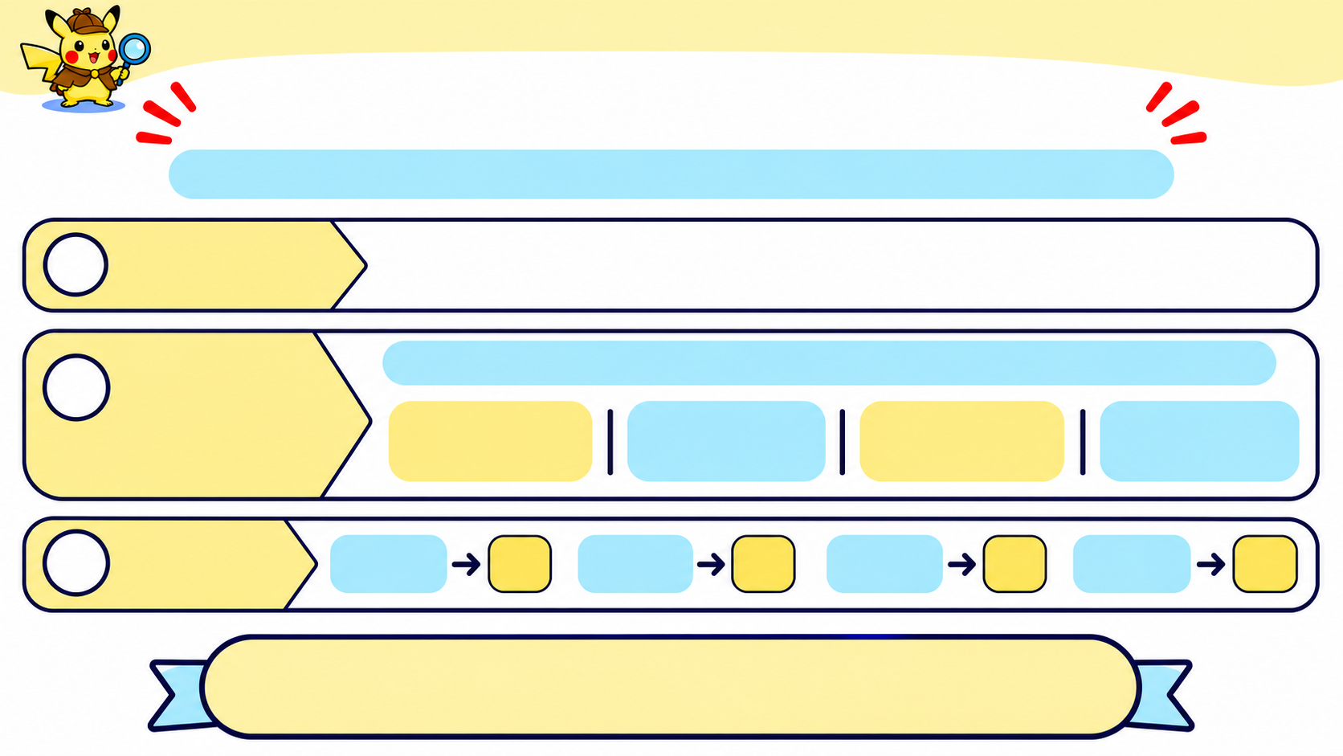
CHAPTER 01 / PIKACHU'S HARDWARE LAB
ELECTRIC TYPE • BEGINNER
BINARY TO HEXADECIMAL
Group binary digits in fours. Each group matches one hex digit.
Start with:
1010101101001
1
2
Add three
zeros at the front, then group the digits from the right:
The zeros only complete the first group; they do not change the number.
2
0001
0101
0110
1001
3
Match 3 each group:
0001
1
0101
5
0110
6
1001
9
1010101101001
=
1569
2
16
Notes:
Start by grouping the bits in fours from the right. For 1010101101001₂, add zeros on the left to make complete groups: 0001 0101 0110 1001. Those groups represent 1, 5, 6, and 9, so the answer is 1569₁₆. The added zeros do not change the number’s value.

Slide 56
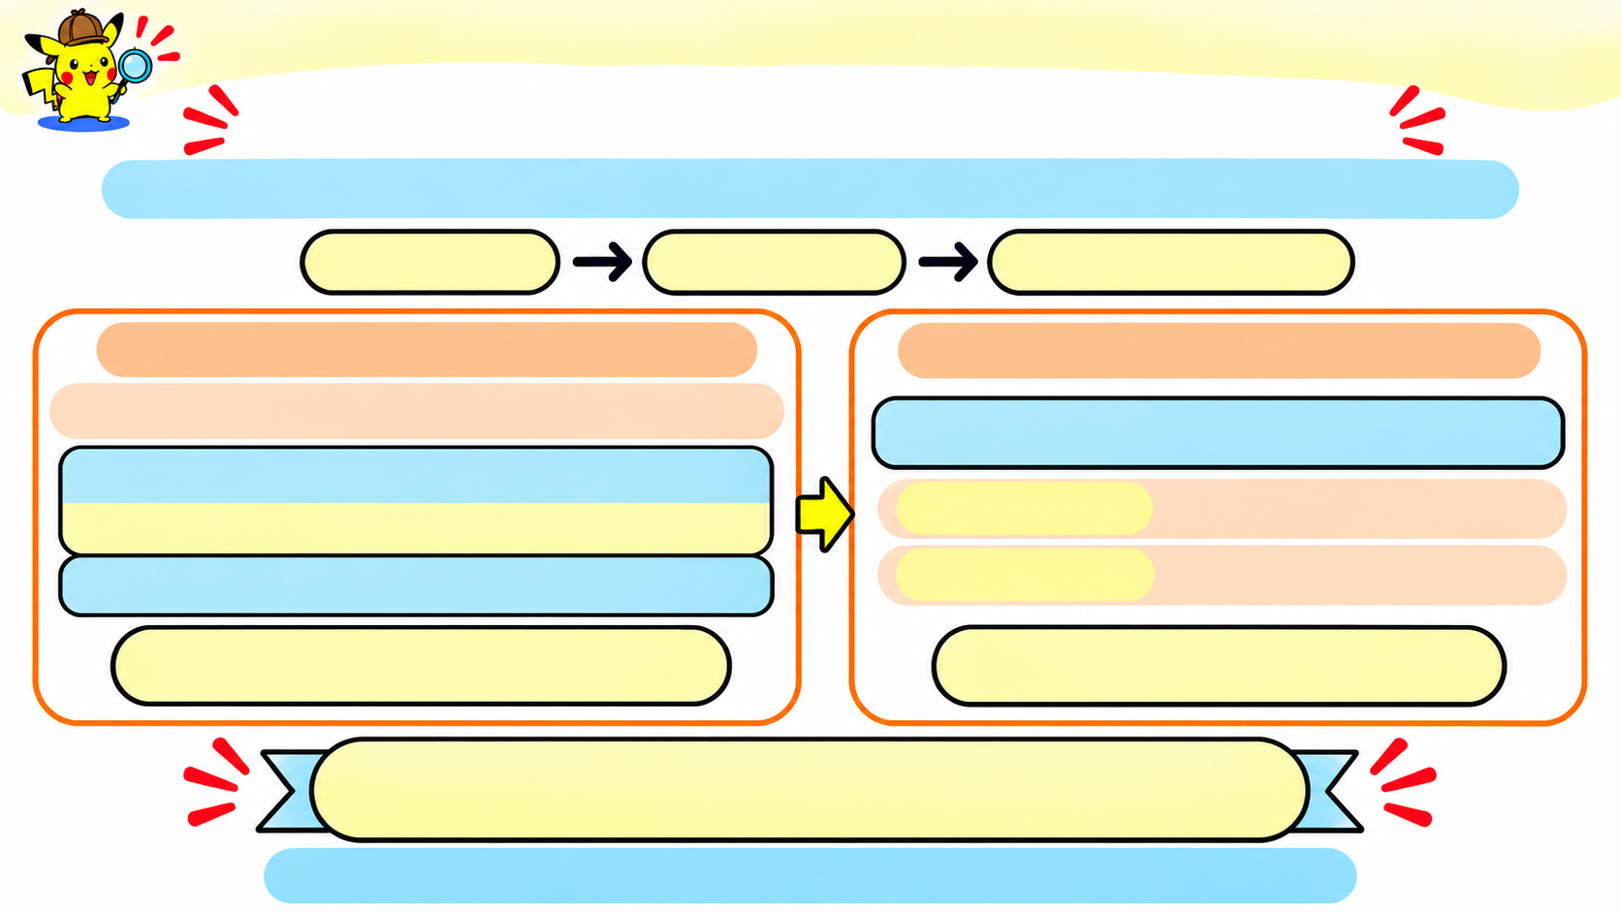
CHAPTER 01 / PIKACHU'S HARDWARE LAB
ELECTRIC TYPE • BEGINNER
ANOTHER WAY: GO THROUGH DECIMAL
Convert the binary number to decimal first, then write that value in hexadecimal.
BINARY
DECIMAL
HEXADECIMAL
STEP 1-BINARY TO DECIMAL
STEP 2 - DECIMAL TO HEX
Start with 1101010 .
2
106÷16=6 remainder 10
1 1 0 1 0 1 0
Quotient 6 → first hex digit 6
2⁶
2⁵
2⁴
2³
2²
2¹
2⁰
64 + 32 + 0 + 8 + 0 + 2 + 0 = 106
Remainder 10
→ last hex digit A
1101010 = 106
106 = 6A
2
10
10
16
1101010 = 106 = 6A
2
10
16
Direct grouping and the decimal route give the same answer.
Notes:
There is another way to convert binary to hexadecimal: convert the binary number to decimal first, then convert the decimal number to hexadecimal. For example, 1101010₂ is 106₁₀, and 106₁₀ is 6A₁₆. Grouping binary digits in fours is usually quicker, but both methods give the same answer.

Slide 57
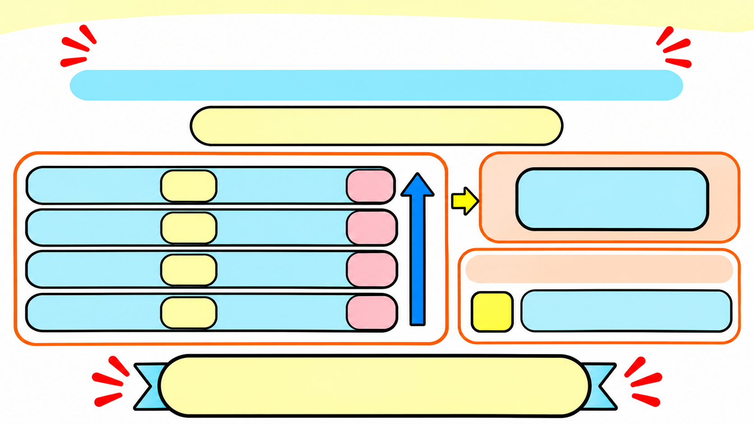
CHAPTER 01 / PIKACHU'S HARDWARE LAB
ELECTRIC TYPE • BEGINNER
DECIMAL TO BINARY: DIVIDE BY 2
Keep the remainders, then read them from bottom to top.
Convert 13₁₀ to binary
13 ÷ 2 =
6
remainder
1
1101₂
6 ÷ 2 =
3
remainder
0
3 ÷ 2 =
1
remainder
1
Verification:
1 ÷ 2 =
0
remainder
1
8 + 4 + 1 = 13
13₁₀ = 1101₂
Notes:
To convert 13 to binary, divide by 2 and write down each remainder. Keep dividing the quotient until it reaches zero. Then read the remainders from bottom to top. They give 1101₂. We can check it because 8 + 4 + 1 = 13.

Slide 58
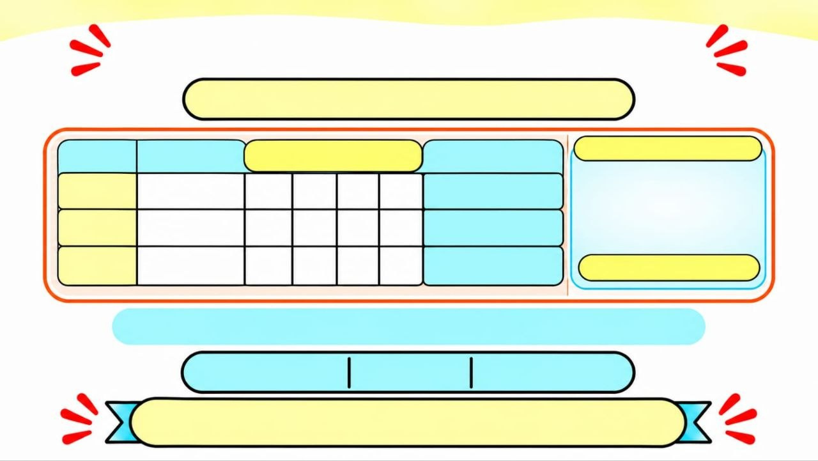
CHAPTER 01 / PIKACHU'S HARDWARE LAB
ELECTRIC TYPE • BEGINNER
HEX TO BINARY: 4 BITS PER DIGIT
Convert 3F2₁₆ to binary
Hex
Decimal
8
4
2
1
4-bit Group
General Rule:
3
3
0011
Choose place values
that add up to the decimal value: write 1
for a chosen value and
O for the rest.
0
0
1
1
F
15
1
1
1
1
1111
2
2
0
0
1
0
0010
3 = 2 + 1 0011
F₁₆ = 15₁₀ = 8 + 4 + 2 + 1, so its bits are 1111.
0011
1111
0010
3F2₁₆ = 001111110010₂
Notes:
Convert each hexadecimal digit into four bits. In 3F2₁₆, 3 becomes 0011, F becomes 1111, and 2 becomes 0010. Put the groups together in the same order: 0011 1111 0010₂. Keep all four bits for every digit, including zeros at the start of a group.

Slide 59
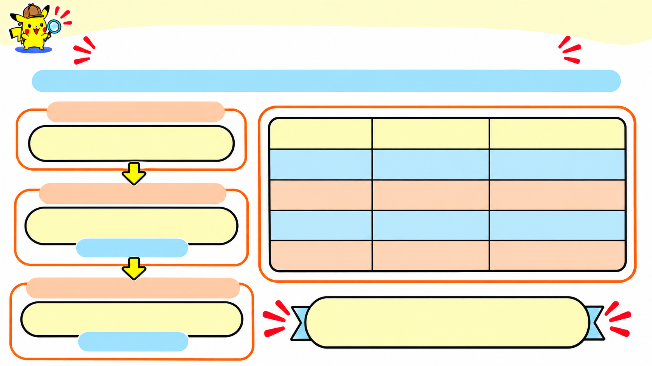
CHAPTER 01 / PIKACHU'S HARDWARE LAB
ELECTRIC TYPE • BEGINNER
HOW DOES A COMPUTER STORE TEXT?
ASCII gives each character a number; the computer stores that number in binary.
CHARACTER (TEXT)
A
Character
Decimal code
8-bit binary
A
65
01000001
ASCII DECIMAL CODE
a
97
01100001
65
0
48
00110000
decimal code
SPACE
32
00100000
8-BIT BINARY REPRESENTATION
01000001
ASCII uses 7-bit codes; the leading 0 shows the 8-bit byte.
Uppercase A and lowercase a have different codes.
binary byte

Slide 60
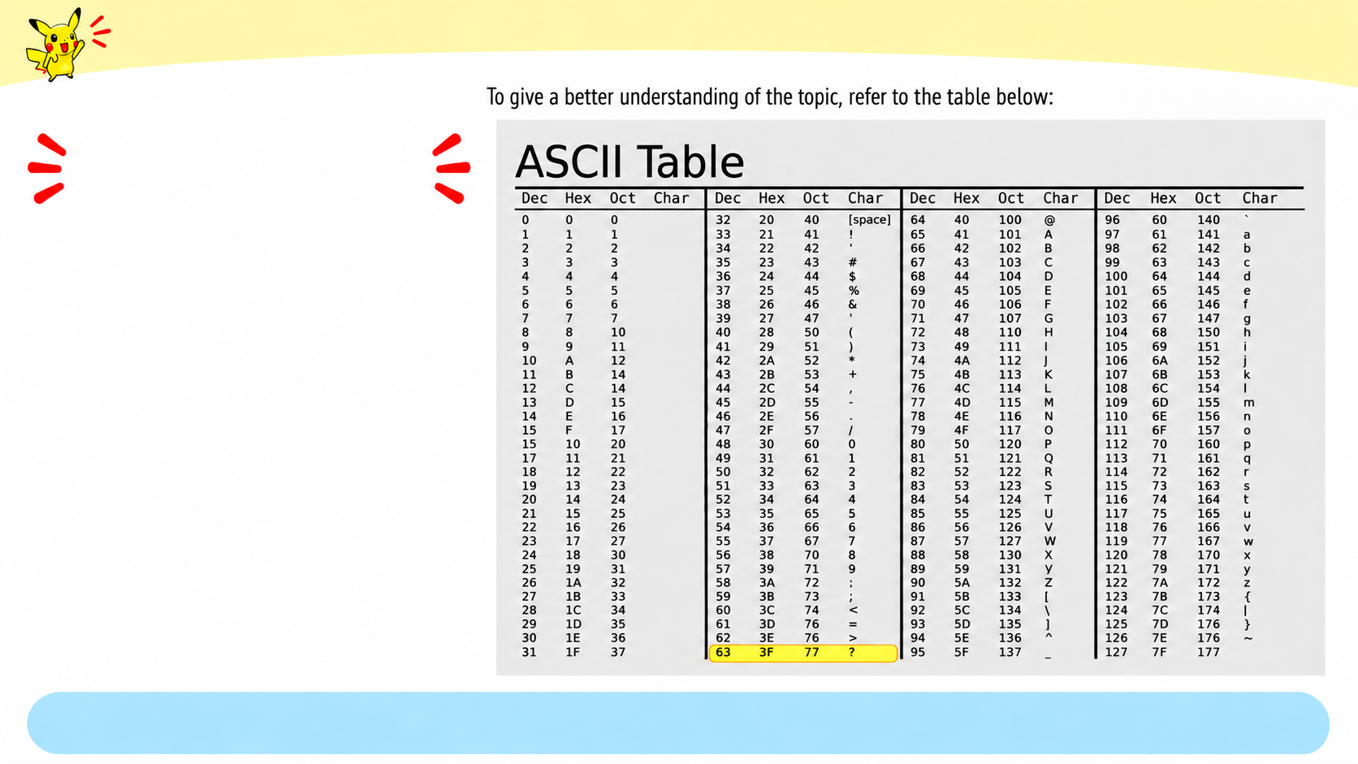
CHAPTER 01 / PIKACHU'S HARDWARE LAB
ELECTRIC TYPE • BEGINNER
USING THE ASCII TABLE
•
Find a character in the Char column.
•
Read across to find its code.
? → 63 (decimal)
Convert 63 to 8-bit binary:
00111111
Look up the decimal code first, then convert it to binary.
Notes:
To find a character’s binary code, first look up the character in the ASCII table. The table gives its decimal code. Then convert that decimal number to binary. If the result needs eight bits, add a zero at the front.

Slide 61
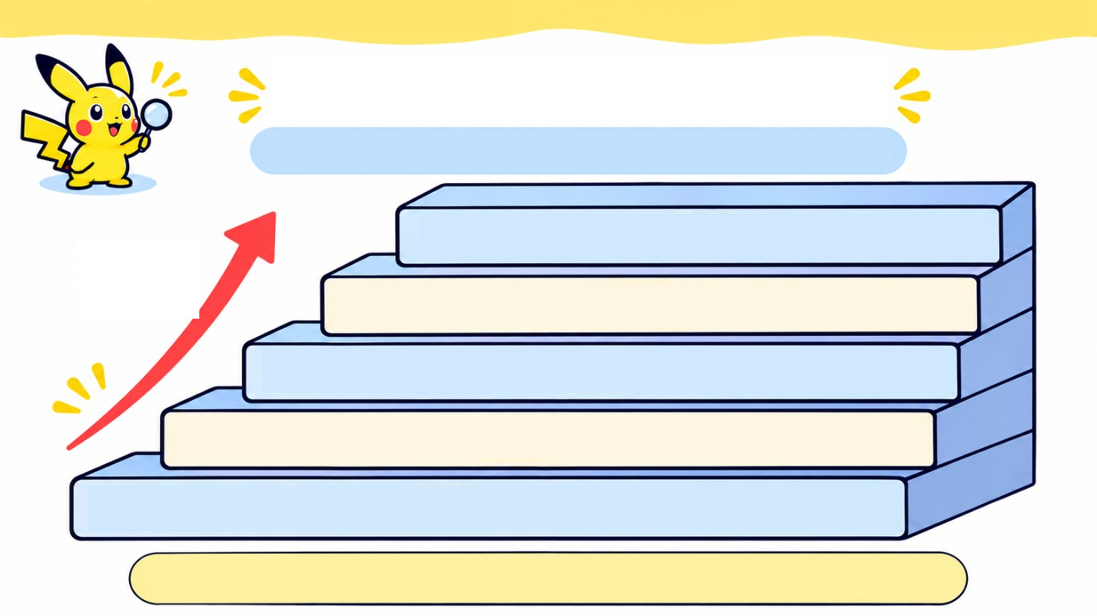
CHAPTER 01 / PIKACHU'S HARDWARE LAB
ELECTRIC TYPE • BEGINNER
HOW BIG IS A FILE?
File size tells us how much data is stored.
1 terabyte (TB) = 1,000 GB
larger units
1 gigabyte (GB) = 1,000 MB
1 megabyte (MB) = 1,000 KB
1 kilobyte (KB) = 1,000 bytes
1 byte (B) = 8 bits
For this lesson, use 1,000. Some systems use 1,024.

Slide 62
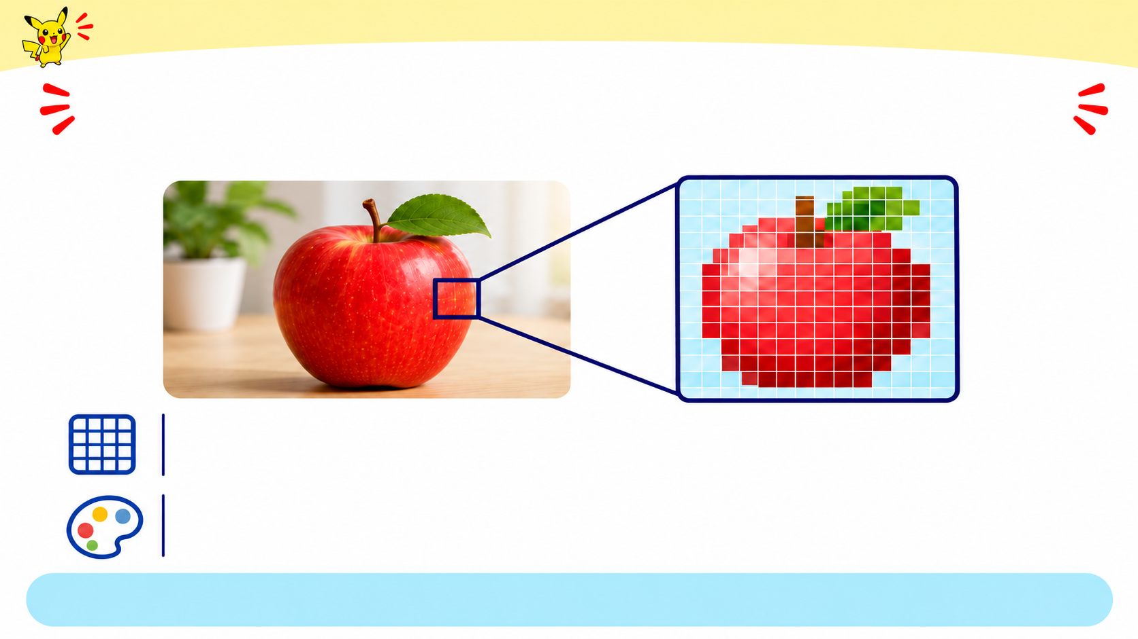
CHAPTER 01 / PIKACHU'S HARDWARE LAB
ELECTRIC TYPE • BEGINNER
HOW DOES A COMPUTER STORE A PHOTO?
A digital image is a grid of tiny squares called pixels.
RESOLUTION: pixels across × pixels down
Example: 4 x 4 = 16 pixels
COLOUR DEPTH: bits used to store each pixel's colour
1 bit = 2 colours • 8 bit = 256 colours • 24 bit = 16.7 million solours
More pixels show finer detail. More bits give each pixel more colour choices
Notes:
A digital photo is a grid of tiny squares called pixels. Resolution tells us how many pixels go across and down. Colour depth tells us how many bits represent each pixel. More pixels or more bits per pixel usually means more data to store.

Slide 63

CHAPTER 01 / PIKACHU'S HARDWARE LAB
ELECTRIC TYPE • BEGINNER
HOW DOES A COMPUTER STORE SOUND?
It measures a sound wave in tiny steps and stores each measurement as binary
Each sample is stored as a binary number.
0101 0011 1010
SOUND WAVE
SAMPLES
STORED AS BINARY DIGITS: 0 AND 1
SAMPLE RATE
BIT DEPTH
How many measurements are taken each second (Hz).
How many bits record each measurement.
Fewer samples (lower sample rate)
More samples (higher sample rate)
Fewer bits (lower bit depth)
More bits
(higher bit depth)
More detail = better sound quality + a larger file.
1 s uncompressed mono: 44,100 samples x 16 bits = 88 KB
Notes:
A computer measures a sound wave at regular intervals and stores each measurement as a number. The sample rate tells us how many measurements it takes each second. Bit depth tells us how much detail each measurement can hold. More samples or a higher bit depth usually means a larger uncompressed file.

Slide 64

CHAPTER 01 / PIKACHU'S HARDWARE LAB
ELECTRIC TYPE • BEGINNER
HOW DOES A COMPUTER STORE VIDEO?
A video is many still images played quickly, usually with sound.
FRAMES
Frames + audio → video
10 fps = 10 frames every second
fps = frames per second
UNCOMPRESSED FRAME DATA ≈ frame size x fps × time
1 MB per frame × 10 fps × 3 s = 30 MB
3 seconds • frame data only
More frames per second or bigger frames = more data.
Audio adds data; compression makes real video files smaller.
Notes:
A video is made of still images, called frames, shown quickly one after another. To estimate the uncompressed frame data, multiply the size of one frame by the frames per second and by the video’s duration. The actual video file may be smaller because compression reduces its size.

Slide 65

CHAPTER 01 PIKACHU'S HARDWARE LAB
ELECTRIC TYPE BEGINNER
WHICH STORAGE DEVICE SHOULD YOU USE?
These storage options keep files after the computer is turned off.
HDD
SSD
USB FLASH DRIVE
OPTICAL DISC
Magnetic spinning disks
Flash memory,
no moving parts
Small and portable
An optical drive uses a laser to read the disc
Large, affordable
Easy file transfer between computers
Used for media and backups
file archives.
Fast access to files
Choose by need: speed • capacity • portability • media

Slide 66

CHAPTER 01 / PIKACHU'S HARDWARE LAB
ELECTRIC TYPE • BEGINNER
USB FLASH DRIVE: SMALL BUT USEFUL
A simple way to carry or transfer files.
ADVANTAGES
LIMITS TO REMEMBER
Flash drives have a limited number of
write cycles.
Portable: small and light.
Plug-and-play:
Small size makes them easy to lose or damage
connect it and use it.
For most people, write-cycle limits are not a concern with normal use.
Keep another copy of important files.

Slide 67

CHAPTER 01 / PIKACHU'S HARDWARE LAB
ELECTRIC TYPE • BEGINNER
WHICH STORAGE FITS THE JOB?
Choose the device that best matches each need.
Start a laptop and open apps as fast as possible.
Keep 4 TB of old videos at home for a low cost.
Distribute a film to customers on a disc
Move a school presentation between two computers.
USB FLASH DRIVE
SSD
HDD
CHOOSE FROM
OPTICAL DISC
USE each
shoice once.
Notes:
Give the class about one minute to choose a device for each task. For fast startup and opening apps, an SSD is a good fit because it gives fast access to data. For carrying a presentation between computers, a USB flash drive is a practical choice. The best device depends on what it needs to do.

Slide 68
CHAPTER 01 / PIKACHU'S HARDWARE LAB
ELECTRIC TYPE • BEGINNER
WHICH STORAGE FITS THE JOB?
Choose the device that best matches each need.
Start a laptop and open apps as fast as possible.
Keep 4 TB of old videos at home for a low cost.
SSD
HDD
Distribute a film to customers on a disc.
Move a school presentation between two computers.
OPTICAL DISC
USB FLASH DRIVE
USB FLASH DRIVE
SSD
HDD
CHOOSE FROM
OPTICAL DISC
USE each
shoice once.

Slide 69


CHAPTER 01 / PIKACHU'S HARDWARE LAB
ELECTRIC TYPE • BEGINNER
WHAT HAPPENS WHEN YOU OPEN A FILE?
The computer copies it into RAM so the CPU can use it.
1
FILE ON THE DRIVE
2
COPIED INTO RAM
3
CPU WORKS ON THE DATA
Long-term storage
Fast temporary workspace
Reads it from RAM
SSD
CPU
SAVE: updated data is written back to the drive
Unsaved changes can be lost if the power goes off.

Slide 70

CHAPTER 01 / PIKACHU'S HARDWARE LAB
ELECTRIC TYPE • BEGINNER
RAM, ROM & CACHE: DIFFERENT JOBS
Primary memory is close to the CPU, but each type has a different role.
ROM
CACHE
RAM
ROM
CACHE
Holds open programs and
Stores start-up instructions
Keeps frequently used data
data.
(firmware).
near the CPU.
Fast, temporary memory.
Keeps them without power.
Very small and very fast.
VOLATILE
NON-VOLATILE
VOLATILE
VOLATILE = data is lost when power is off
NON-VOLATILE = data stays when power is off
HDD, SSD, USB drives and discs are secondary storage for files you keep long-term.

Slide 71

CHAPTER 01 / PIKACHU'S HARDWARE LAB
ELECTRIC TYPE • BEGINNER
WHICH STORAGE DEVICE SHOULD
THE PHOTOGRAPHER CHOOSE?
A photographer needs to carry 20 GB of photos to a friend's house.
USB FLASH DRIVE
64 GB
Portable • Plug-and-play • Enough space
20 GB photos
HDD
HDD
Less convenient to carry; moving parts can be damaged by knocks.
ON AN EMPTY 64 GB DRIVE:
If each photo is 4 MB:
64,000 MB ÷ 4 MB = 16,000 photos
Notes:
The photographer needs a portable device for 20 GB of photos. If each photo is about 4 MB, then 20 GB is about 20,000 MB, which holds about 5,000 photos. A 64 GB drive could hold about 16,000 photos at 4 MB each. These are estimates; other files and formatting use some space too.

Slide 72

CHAPTER 01 / PIKACHU'S HARDWARE LAB
ELECTRIC TYPE • BEGINNER
DATA & STORAGE: QUICK RECAP
Computers store information as patterns of Os and 1s.
HOW DIFFERENT DATA IS REPRESENTED
WHERE DATA IS KEPT
Numbers - place values
RAM
Fast, temporary working memory
Text- character codes (ASCII)
Images - pixels
SECONDARY STORAGE
Keeps files when power is off
Audio - samples
Video - frames
8 bits = 1 byte
Binary is how data is represented; storage keeps it for later use.

Slide 73

CHAPTER 01 / PIKACHU'S HARDWARE LAB
ELECTRIC TYPE • BEGINNER
CHAPTER 1.1 • FINAL REVIEW
How a computer represents, processes and stores data.
REPRESENT DATA
MEMORY NEAR THE CPU
LONG-TERM STORAGE
RAM
Secondary storage keeps files without power.
1 byte = 8 bits
fast, temporary, volatile
Numbers → binary place values
Cache
very fast, temporary, volatile
SSD fast, no moving parts
Text→character codes (ASCII)
ROM
keeps startup instructions without power
HDD - large capacity, spinning disks
Images→ pixels
USB portable file transfer
Audio samples
Audio samples
Video frames
Save changes back to storage.
Optical disc - CD, DVD, Blu-ray
CHECK YOURSELF: convert a small binary number calculate a simple image or sound size choose the right storage device
Notes:
A computer takes in data, processes it by following instructions, and produces an output. It can also store data for later. For example, when we take a photo, the camera captures input, the computer processes the image, the screen shows it, and storage keeps the saved photo.

Slide 74
YOUR TURN, TRAINERS!
Ready to test your computer skills?

Slide 75

CHAPTER 01 / PIKACHU'S HARDWARE LAB
ELECTRIC TYPE • BEGINNER
DOES THE DATA STAY?
V = volatile • N = non-volatile
An unsaved web page is open.
A photo is
saved on a
USB flash drive.
A game is
installed on the
computer's drive.
A calculator is using numbers right now.
V loses data without power • N keeps data without power
Notes:
Give the class about one minute to decide which data remains after the power is off. An unsaved web page and numbers currently being used by a calculator are temporary. A photo saved on a USB drive remains there without power. The key difference is whether the data was saved to non-volatile storage.

Slide 76
CHAPTER 01 / PIKACHU'S HARDWARE LAB
ELECTRIC TYPE • BEGINNER
DOES THE DATA STAY? • ANSWERS
V = volatile • N = non-volatile
An unsaved web page is open.
A photo is
saved on a
USB flash drive.
V
Unsaved data is temporary; it can be lost when power is off
N
A USB drive keeps saved data without power.
A calculator is using numbers right now.
N
An installed game stays on the drive when power is off.
V
Numbers in use are held in temporary working memory.
V loses data without power. • N keeps data without power

Slide 77

CHAPTER 01 / PIKACHU'S HARDWARE LAB
ELECTRIC TYPE • BEGINNER
FOLLOW THE FILE
Put the steps in the order they happen.
A
The CPU processes the data in RAM.
B
The file is saved back to the drive.
CPU
RAW
C
You open a file stored on the drive
D
The file's data is copied into RAM
RAW
Notes:
Give the class about 45 seconds to put the steps in order. First, the computer reads the file from the drive. Then it copies the data into RAM. After that, the CPU can process the data in RAM.

Slide 78

CHAPTER 01 / PIKACHU'S HARDWARE LAB
ELECTRIC TYPE • BEGINNER
FOLLOW THE FILE ANSWER
Correct order: C→D→A→B
1
2
3
CPU
RAM
RAM
C - Open a file stored on the drive
D - Copy the file's data into RAM.
A - The CPU processes the data in RAM.
B - Save the file back to the drive.
Open → load into RAM →process → save back

Slide 79

CHAPTER 01 / PIKACHU'S HARDWARE LAB
ELECTRIC TYPE • BEGINNER
Data representation • practice
Try each question, then check the next slide.
1
2
3
C
C
A
T
Character C has
ASCII code 67.
Write its 8-bit
binary code.
How many bytes
does the word
CAT use in
basic ASCII?
Write decimal
ten in binary.
8 bits = 1 byte • Each basic ASCII character uses 1 byte
Notes:
Give the class about one minute to solve the three questions. The answers are: 10₁₀ = 1010₂, because 8 + 2 = 10; ASCII C is 67, or 01000011 in 8-bit binary; CAT uses 3 bytes if each character takes one byte, as assumed in this exercise.

Slide 80

CHAPTER 01 / PIKACHU'S HARDWARE LAB
ELECTRIC TYPE • BEGINNER
How to solve these questions
Follow the place values, then count the bytes.
1
2
3
DECIMAL 10 → BINARY
ASCII C → 8 BITS
CAT → BYTES
C
C
A
T
Use place values: 8 | 4 | 2 | 1
C has decimal code 67.
CAT has 3 characters:
C, A and T.
10 = 8 + 2
67 = 64 + 2 + 1
Values: 128 | 64 | 32 | 16 | 8 | 4 | 2 | 1
Each basic ASCII
character = 1 byte.
Values
8
4
2
1
Values
128
64
32
16
8
4
2
1
Bits
1 0 1 0
Bits
0 1 0 0 0 0 1 1
3 × 1 byte = 3 bytes.
Answer: 1010
Answer: 01000011
Answer: 3 bytes
Notes:
For decimal 10, find the binary place values that add to 10: 8 + 2, so the answer is 1010₂. For C, the ASCII table gives 67, which is 01000011 in 8-bit binary. CAT has three characters, so it uses 3 bytes under the one-byte-per-character assumption in this question.

Slide 81

CHAPTER 01 / PIKACHU'S HARDWARE LAB
ELECTRIC TYPE • BEGINNER
RAM, ROM or cache?
Match each description to the correct memory.
RAM • ROM • CACHE
1
2
3
Keeps start-up
firmware even
when the power
is off.
Holds the programs
and data you are
using right now.
Very fast memory
near the CPU for
frequently used
data.
Each description matches one choice.
Notes:
Give the class about 45 seconds to match each description to RAM, ROM, or cache. RAM holds programs and data in use. ROM or firmware storage keeps startup instructions. Cache keeps frequently used data close to the CPU for quick access.

Slide 82

CHAPTER 01 / PIKACHU'S HARDWARE LAB
ELECTRIC TYPE • BEGINNER
RAM, ROM or cache?
Match each description to the correct memory.
RAM • ROM • CACHE
1
2
3
ROM
RAM
CACHE
Keeps start-up
firmware without
power.
Holds programs
and data in use
right now.
Very fast memory
near the CPU for
frequently used
data.

Slide 83

CHAPTER 01 / PIKACHU'S HARDWARE LAB
ELECTRIC TYPE • BEGINNER
File size • practice
Work out each answer.
1
2
3
Image: 8 × 8 pixels,
1 bit per pixel.
How many bytes?
Audio: 8,000
samples/s, 8 bits/
sample, 10 s.
How many KB?
Video: 2 MB/frame,
5 frames/s, 4 s.
How many MB?
bits ÷ 8 = bytes • 1 KB = 1,000 bytes
Notes:
Give the class about one minute to calculate each size and keep the units visible. The image has 8 × 8 = 64 bits, or 8 bytes. The audio has 8,000 × 8 × 10 = 640,000 bits, or 80 KB using decimal units. The video has 2 MB × 5 × 4 = 40 MB of uncompressed frame data.

Slide 84
CHAPTER 01 / PIKACHU'S HARDWARE LAB
ELECTRIC TYPE • BEGINNER
File size • answers
Here is the calculation for each.
1
2
3
8 × 8 = 64 pixels.
64 bits ÷ 8 =
8 bytes.
8,000 × 8 × 10 =
640,000 bits.
÷ 8 = 80,000 bytes
= 80 KB.
2 MB × 5 frames/s
× 4 s = 40 MB.
1 KB = 1,000 bytes • Video answer is uncompressed size

Slide 85

CHAPTER 01 / PIKACHU'S HARDWARE LAB
ELECTRIC TYPE • BEGINNER
What counts as hardware?
Hardware is the physical parts of a computer — parts you can see and touch.
INTERNAL HARDWARE
EXTERNAL HARDWARE
CPU
RAM
PERIPHERALS
Inside the computer case
Outside the case — connected to the computer
Programs are software. The physical devices are hardware.

Slide 86

CHAPTER 01 / PIKACHU'S HARDWARE LAB
ELECTRIC TYPE • BEGINNER
HOW DO COMPUTER PARTS CONNECT?
Connected parts can send data to one another.
RAM modules plug into these slots.
1
MOTHERBOARD
RAM SLOTS
The motherboard links components so they can communicate.
CPU
CHIPSET
2
A group of chips that helps coordinate communication between components.
CHIPSET
3
BUS + BUS SPEED
SSD
A bus is a data pathway. Bus speed tells how quickly data can travel along it.
MOTHERBOARD
The main board that connects computer parts.

Slide 87

CHAPTER 01 / PIKACHU'S HARDWARE LAB
ELECTRIC TYPE • BEGINNER
The motherboard connects the parts
It is the main circuit board inside a computer.
CPU SOCKET
PORTS
where the CPU fits
connect devices
MEMORY SLOTS
where RAM fits
EXPANSION SLOT
for cards such as a
graphics card
The motherboard lets the computer’s parts communicate.

Slide 88

CHAPTER 01 / PIKACHU'S HARDWARE LAB
ELECTRIC TYPE • BEGINNER
How do computer parts share data?
A data bus carries information between components.
DATA BUS
RAM
CPU
DATA BUS
processes data
temporarily
holds data
A set of wires
that moves
data.
STORAGE
permanently
keeps data
DATA BUS
Bus width = how many
bits can move at once.
Narrow bus (e.g., 4 bits)
Wider bus (e.g., 8 bits)
A wider bus carries more data per transfer.
Notes:
A data bus carries bits between computer parts. Its width tells us how many bits it can carry in one transfer in this example. An 8-bit bus needs eight transfers to carry 64 bits.

Slide 89

CHAPTER 01 / PIKACHU'S HARDWARE LAB
ELECTRIC TYPE • BEGINNER
What does the chipset do?
It helps computer parts work together.
TRADITIONAL CHIPSET LAYOUT
RAM
NORTHBRIDGE
GRAPHICS CARD
CPU
STORAGE
SOUTHBRIDGE
USB PORTS
Northbridge:
fast connections
Southbridge:
lower-speed devices
In many modern computers, the CPU handles the northbridge’s job.
Notes:
The chipset helps computer parts communicate with one another. This diagram shows a traditional layout with a northbridge and southbridge. Modern computers often combine some of these jobs into other components, so the important idea is the chipset’s role in communication.

Slide 90

CHAPTER 01 / PIKACHU'S HARDWARE LAB
ELECTRIC TYPE • BEGINNER
How many transfers does it take?
Compare how much a bus carries in one transfer.
WORKED EXAMPLE: SENDING 64 BITS
8 bits
per transfer
8-bit bus
64 ÷ 8 = 8
8 transfers
32-bit bus
32 bits
per transfer
64 ÷ 32 = 2
2 transfers
64 bits
per transfer
64-bit bus
64 ÷ 64 = 1
1 transfer
A wider bus moves the same data in fewer transfers.
Notes:
For 64 bits of data, an 8-bit bus needs 8 transfers. A 32-bit bus needs 2, and a 64-bit bus needs 1. This example assumes each transfer carries the full width of the bus. Real transfer speed also depends on other factors, such as the bus’s operating rate.

Slide 91

CHAPTER 01 / PIKACHU'S HARDWARE LAB
ELECTRIC TYPE • BEGINNER
What does the CPU do?
It processes data and carries out instructions.
CPU
the computer’s
processing unit
CPU SOCKET
where the CPU
is installed
CPU = Central Processing Unit

Slide 92

CHAPTER 01 / PIKACHU'S HARDWARE LAB
ELECTRIC TYPE • BEGINNER
How does a computer start?
The CPU begins the boot sequence.
1
PRESS THE POWER BUTTON
2
THE CPU STARTS THE BOOT SEQUENCE
3
HARDWARE PARTS ARE INITIALIZED
4
THE OPERATING SYSTEM LOADS
FROM STORAGE INTO MEMORY
5
THE COMPUTER IS READY TO USE
Boot means to start up.
Notes:
When the computer turns on, the CPU begins the boot sequence. The firmware, called BIOS or UEFI, checks and prepares the hardware. Then the computer finds and loads the operating system. The operating system starts after this initial process.

Slide 93

CHAPTER 01 / PIKACHU'S HARDWARE LAB
ELECTRIC TYPE • BEGINNER
RAM and ROM: what’s the difference?
Both are memory, but they do different jobs.
RAM
ROM
Fast, temporary working memory
Stores firmware
Holds data and programs in use
Keeps start-up instructions, such as BIOS
Clears when power is off
Retains data when power is off
RAM holds current work. ROM keeps start-up instructions.

Slide 94

CHAPTER 01 / PIKACHU'S HARDWARE LAB
ELECTRIC TYPE • BEGINNER
Which hardware helps with 4K video?
A designer uses several computer parts while editing.
GRAPHICS CARD
RAM
GPU inside the card
Holds the video
data being edited
Draws images
and video quickly
CPU
Runs the
editing
program
The GPU handles the visuals. RAM and CPU support the work.
Notes:
Give the class a moment to match each job to a component. The GPU draws and processes images. RAM holds the video and project data being used. Storage keeps the original files. Editing video relies on several parts working together.

Slide 95

CHAPTER 01 / PIKACHU'S HARDWARE LAB
ELECTRIC TYPE • BEGINNER
What does a graphics card do?
Its GPU processes images and video.
GPU
Graphics Processing Unit
the graphics
processor on the card
PCIe SLOT
where the card
connects to the
motherboard
The graphics card sends the picture to the monitor.

Slide 96

CHAPTER 01 / PIKACHU'S HARDWARE LAB
ELECTRIC TYPE • BEGINNER
Sound card and network card
Two expansion cards with different jobs.
SOUND CARD
NETWORK CARD
Improves audio
Connects the computer
to a network
Both cards communicate with the CPU through the motherboard.

Slide 97

CHAPTER 01 / PIKACHU'S HARDWARE LAB
ELECTRIC TYPE • BEGINNER
Expansion card check
Answer all three questions.
What does GPU
1.
stand for?
GPU
Which slot is a graphics
2.
card plugged into?
Name another type of
3.
expansion card.
Notes:
Give the class about 45 seconds to answer. GPU means Graphics Processing Unit. A graphics card usually fits into a PCIe expansion slot. A sound card or a network card is another example of an expansion card.

Slide 98

CHAPTER 01 / PIKACHU'S HARDWARE LAB
ELECTRIC TYPE • BEGINNER
Expansion card check: ANSWERS
Compare your answers.
1.
Graphics Processing Unit
GPU
2.
PCIe expansion slot
Sound card or
network card
3.

Slide 99

CHAPTER 01 / PIKACHU'S HARDWARE LAB
ELECTRIC TYPE • BEGINNER
WHAT DOES THE POWER SUPPLY DO?
It converts wall power into electricity computer parts can use.
AC
Alternating
Current
LOW-VOLTAGE
DC
Direct Current
PSU
Power Supply Unit
Power cables
The PSU supplies power to the computer's parts.
Notes:
The wall supplies alternating current, or AC. Computer parts need lower-voltage direct current, or DC. The PSU converts the electricity and sends it to the components through power cables.

Slide 100


CHAPTER 01 / PIKACHU'S HARDWARE LAB
ELECTRIC TYPE • BEGINNER
Which PSU can power this computer?
Its parts need about 350 W in total.
350 W needed
100 W short
150 W spare
250 W
500 W
Suitable
350 W needed
350 W needed
350 − 250 = 100 W short
500 − 350 = 150 W spare
Choose a PSU rated above the computer’s power needs.
Notes:
The example computer needs 350 W. A 250 W PSU cannot provide enough; it is 100 W short. A 500 W PSU has 150 W of extra capacity. The rating tells us how much power the PSU can provide, not how much it constantly sends to the computer.

Slide 101

CHAPTER 01 / PIKACHU'S HARDWARE LAB
ELECTRIC TYPE • BEGINNER
Power supply check
1.
What does a power supply unit
convert?
2.
If you add a powerful graphics
card, why might you need a
bigger PSU?
Think about power coming in and power each part needs.
Notes:
Give the class about 30 seconds to answer. The PSU changes AC from the wall into lower-voltage DC for computer parts. A more powerful graphics card may use more electricity, so the PSU needs enough capacity for the whole computer.

Slide 102

CHAPTER 01 / PIKACHU'S HARDWARE LAB
ELECTRIC TYPE • BEGINNER
Power supply check: answers
1.
The PSU converts AC
(alternating current) from
the wall into low-voltage
DC (direct current).
2.
A powerful graphics card
uses more electricity, so
the PSU must supply
more watts.
More power-hungry parts need a PSU that can supply more watts.

Slide 103

CHAPTER 01 / PIKACHU'S HARDWARE LAB
ELECTRIC TYPE • BEGINNER
What does USB connect?
USB means Universal Serial Bus.
USB Port
Keyboard
Scanner
Mouse
External Hard Drive
USB Cable
Printer
USB Flash Drive
USB ports come in different shapes and versions.
USB connects many external devices.

Slide 104

CHAPTER 01 / PIKACHU'S HARDWARE LAB
ELECTRIC TYPE • BEGINNER
Internal and external ports
Physical connectors link the motherboard to devices.
EXTERNAL PORTS
INTERNAL
PORTS
Connect the motherboard to devices outside
the case
CD drive
Connect the motherboard to devices inside the case
Examples:
Mouse • Printer • USB drive
Hard disk
Mouse
Examples:
Hard disk • CD drive
Printer
USB drive
physical connectors
Ports let devices connect to the computer.

Slide 105

CHAPTER 01 / PIKACHU'S HARDWARE LAB
ELECTRIC TYPE • BEGINNER
USB versions have different speeds
Maximum transfer speed depends on the version.
USB 1.1
USB 2.0
USB 3.0
5,000 Mbps
12 Mbps
480 Mbps
5 Gbps
Mbps = megabits per second. 1 megabit = 1 million bits.
Real speeds are usually lower than the maximum.
Notes:
The slide compares 12 Mbps, 480 Mbps, and 5 Gbps. Since 1 Gbps is 1,000 Mbps, 5 Gbps equals 5,000 Mbps. These rates are in megabits per second. They show maximum speeds, so real file transfers can take longer.

Slide 106

CHAPTER 01 / PIKACHU'S HARDWARE LAB
ELECTRIC TYPE • BEGINNER
Portable external storage
Storage not built permanently inside the computer.
External
USB Flash Drive
Hard Drive
SD / microSD Card
Carry files between devices or keep a backup.
For more examples, see the Study Guide.

Slide 107

CHAPTER 01 / PIKACHU'S HARDWARE LAB
ELECTRIC TYPE • BEGINNER
How long to transfer a 600 MB file?
Faster USB versions move the same file in less time.
600 MB = 4,800 megabits
USB 1.1 • 12 Mbps
4,800 ÷ 12 = 400 seconds
about 6 min 40 sec
USB 2.0 • 480 Mbps
4,800 ÷ 480 = 10 seconds
USB 1.1
600
MB
USB 2.0
Real transfer times are usually longer. More detail in the Study Guide.
Notes:
The file is 600 megabytes. Since one byte has eight bits, that is 4,800 megabits. At 12 Mbps, the ideal time is 4,800 ÷ 12 = 400 seconds, or 6 minutes 40 seconds. At 480 Mbps, it is 10 seconds. Real transfers can take longer.

Slide 108

CHAPTER 01 / PIKACHU'S HARDWARE LAB
ELECTRIC TYPE • BEGINNER
Portable storage check
Answer all three questions.
Which device can read an SD card
1.
if a computer has no card slot?
How long does a 60 MB file
2.
take at 480 Mbps?
Name two types of portable
3.
external storage.
Think about the device, the data, and the speed.
Notes:
Give the class about one minute to answer. A card reader lets a computer read an SD card if it has no card slot. At 480 Mbps, a 60 MB file is 480 megabits, so the ideal transfer time is 480 ÷ 480 = 1 second. USB flash drives and SD or microSD cards are portable storage.

Slide 109
CHAPTER 01 / PIKACHU'S HARDWARE LAB
ELECTRIC TYPE • BEGINNER
Portable storage check: answers
Compare your answers.
A USB card reader.
1.
60 MB = 480 megabits;
2.
480 ÷ 480 Mbps = 1 second.
USB flash drive, external
3.
hard drive, or memory card.
A card reader connects a memory card through USB.

Slide 110

CHAPTER 01 / PIKACHU'S HARDWARE LAB
ELECTRIC TYPE • BEGINNER
The motherboard has two more important jobs
It shares power and helps the computer start.
SHARES POWER
STARTS THE COMPUTER
CPU
BIOS / UEFI
checks
hardware
Looks for the
operating
system
Power on
RAM
BOOT ORDER
PSU
You can change
boot order in
BIOS / UEFI.
MOTHERBOARD
PERIPHERAL
USB drive
Voltage regulators help each part
get steady power.
SSD
BIOS / UEFI starts hardware before the operating system loads.
Notes:
The motherboard distributes power to the computer’s parts. Voltage regulators help provide the steady voltage each part needs. BIOS or UEFI runs before the operating system, checks the hardware, and looks for a device to start from.

Slide 111

CHAPTER 01 / PIKACHU'S HARDWARE LAB
ELECTRIC TYPE • BEGINNER
The CPU fetch-decode-execute cycle
One instruction, step by step: ADD 4 + 3.
FETCH
DECODE
EXECUTE
MEMORY
ADD
4 + 3
CPU
ALU
Control
Unit
4 + 3 =
7
ADD 4 + 3
The control unit
works out what it
means.
Get the instruction
from memory.
The ALU calculates
4 + 3 = 7.
Fetch → Decode → Execute → repeat for each instruction.
Notes:
The CPU repeats three steps for each instruction. It fetches the instruction from memory, decodes what it means, and executes it. In this example, the ALU adds 4 and 3, giving 7.

Slide 112

CHAPTER 01 / PIKACHU'S HARDWARE LAB
ELECTRIC TYPE • BEGINNER
MARIE: add and store
The program adds 7 + 5 and saves the result.
LOAD 104
ADD 105
STORE 106
HALT
AC = accumulator, a CPU
register that holds the
current result.
AC
M[105]
AC
M[106]
HALT
M[104]
12
5
12
12
7
7
Add 5, so AC
becomes 12.
Write 12 to
memory address
106.
Stop the
program.
Load 7 into
the AC.
Address 104 105 106
Value
104 is a memory location.
It stores the value 7.
MEMORY
5
7
12
After the program runs, address 106 holds 12.
Notes:
The program first loads the value at address 104 into the accumulator. Then it adds the value at address 105. The STORE instruction writes the result to address 106, and HALT stops the program. Here, the values are 7 and 5, so the program stores 12 at address 106. The address tells us where to look; it is not the value itself.

Slide 113

CHAPTER 01 / PIKACHU'S HARDWARE LAB
ELECTRIC TYPE • BEGINNER
GPU AND VRAM: BUILT FOR VISUALS
A GPU handles many visual tasks at the same time.
GPU CORES
Work on many small
tasks in parallel.
Integrated GPU
Shares system RAM, saves power.
VRAM
Dedicated GPU
Stores textures
and image data
for the GPU.
Has its own VRAM, usually
more powerful.
VRAM keeps graphics data close to the GPU.
Notes:
The GPU works on graphics calculations, and its cores can handle many tasks in parallel. VRAM holds graphics data, such as textures, close to the GPU. An integrated GPU shares the computer’s RAM; a separate graphics card usually has its own VRAM.

Slide 114

CHAPTER 01 / PIKACHU'S HARDWARE LAB
ELECTRIC TYPE • BEGINNER
Memory cards and external storage
Two common ways to store and move files.
SD / microSD
CARDS
USB
FLASH DRIVES
Store files in
phones and
cameras.
Plug into
USB ports.
Can be read
with a card
slot or
reader.
Carry files
between
computers.
Store files in phones and
cameras, and can be read
with a card slot or reader
Plug into USB ports
and carry files between
computers.
MEMORY CARDS
(SD / microSD)
USB
FLASH DRIVES
External storage keeps files when the computer is off.

Slide 115

CHAPTER 01 / PIKACHU'S HARDWARE LAB
ELECTRIC TYPE • BEGINNER
Hardware final check
Answer all four questions.
1.
Name two examples of external ports.
How long to copy 60 MB at 480 Mbps?
2.
Hint:
60 MB × 8 = 480 megabits.
3.
What can read an SD card if a computer has no card slot?
Give two examples of external storage.
4.
Think about connections, speed, and saved files.
Notes:
Give the class about one minute to answer before showing the next slide. USB and HDMI are examples of external ports. A 60 MB file is 480 megabits, so at 480 Mbps the ideal transfer time is 1 second. A card reader can read an SD card without a built-in slot; USB flash drives and SD or microSD cards are portable storage.

Slide 116

CHAPTER 01 / PIKACHU'S HARDWARE LAB
ELECTRIC TYPE • BEGINNER
Hardware final check
Compare your answers.
1.
USB port and HDMI port (an audio jack also counts).
2.
1 second: 480 megabits ÷ 480 Mbps = 1 second.
3.
A USB card reader.
A USB flash drive and a memory card
4.
(an external hard drive also counts).
Ports connect devices. External storage keeps files without power.

Slide 117


