Slide 1
MACHINE LEARNING • FINANCIAL RISK ANALYTICS
Bankruptcy Prevention
A machine-learning system to assess company bankruptcy risk using six business risk indicators.
ExcelR Data Science Project
Mentor: Dilavar | Co-Mentor: Nagesh
Team Members: Mohammed Shazin T V • Ruttala Uday Bhargav • Shivansh • Manav Mule
Soujanya Sidaray Savukar • Ketha Madhan • Abhinash Bishoi

Slide 2
1. Business Objective
What the project is designed to solve
PROJECT OBJECTIVE
Objective
Predict whether a company is heading towards Bankruptcy or Non-Bankruptcy from six qualitative risk indicators, so that early warning signs can be acted on.
Acceptance Criterion
Deploy the end-to-end bankruptcy prediction solution using a framework such as Streamlit.
Business Value
Give lenders and managers an early, data-driven view of a company’s solvency risk.
Automation
Replace manual, judgement-based risk screening with an instant model prediction.
Bankruptcy Prevention | ExcelR Data Science Project
2

Slide 3
2. Dataset Overview
Actual dataset used in the project
250
Company records
7
Original columns
0
Missing values
147
Duplicate rows
6
Risk features
Original fields
• industrial_risk — risk linked to the company’s industry
• management_risk — quality of management
• financial_flexibility — ability to raise funds
• credibility — trust of lenders and market
• competitiveness — position in the market
• operating_risk — day-to-day operations
• class — target: bankruptcy / non-bankruptcy
Prepared dataset
Semicolon-separated CSV loaded with sep=“;” and column names cleaned. Target encoded as bankruptcy = 0, non-bankruptcy = 1. All 250 rows were kept, since removing duplicates would leave only 103. Classes: 143 non-bankruptcy (57%) vs 107 bankruptcy (43%).
Bankruptcy Prevention | ExcelR Data Science Project
3

Slide 4
3. Exploratory Data Analysis
Class balance and the strongest risk signal
Class distribution (250 records)
Bankrupt companies by Competitiveness score
Score 0
103
Non-Bankrupt
143
Score 0.5
4
Bankrupt
107
Score 1
0
Key observations
Non-bankruptcy is the larger class (143 vs 107), so the data is fairly balanced. Competitiveness is decisive: all 103 companies scoring 0 went bankrupt, while none of the 91 scoring 1 did.
Bankruptcy Prevention | ExcelR Data Science Project
4

Slide 5
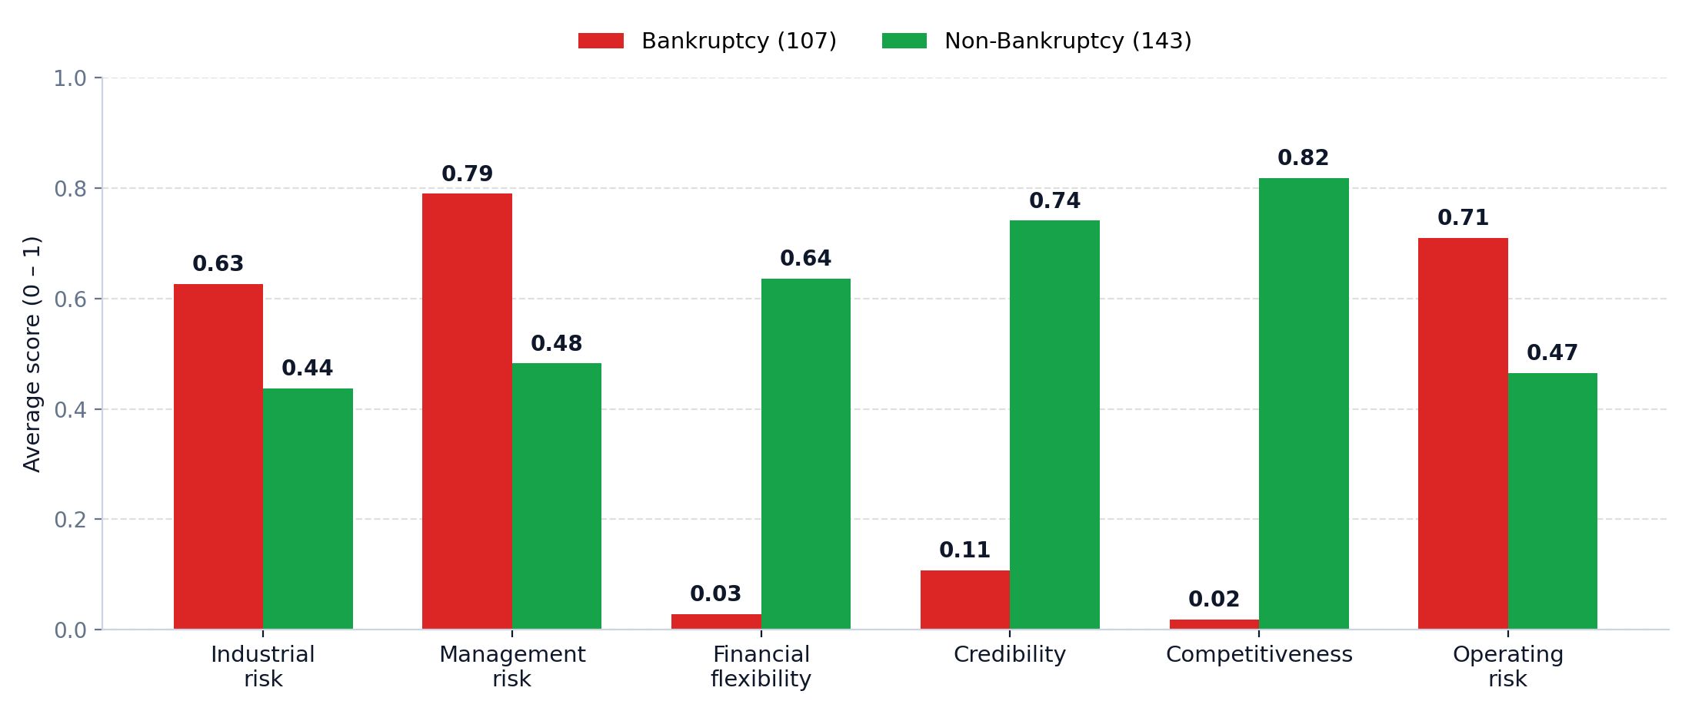
EDA: Average Risk Score by Class
Mean value of each risk indicator for bankrupt vs non-bankrupt companies
Inference
Surviving companies score far higher on competitiveness (0.82 vs 0.02), credibility (0.74 vs 0.11) and financial flexibility (0.64 vs 0.03). Industrial, management and operating risk differ far less between the two groups.
Bankruptcy Prevention | ExcelR Data Science Project
5

Slide 6
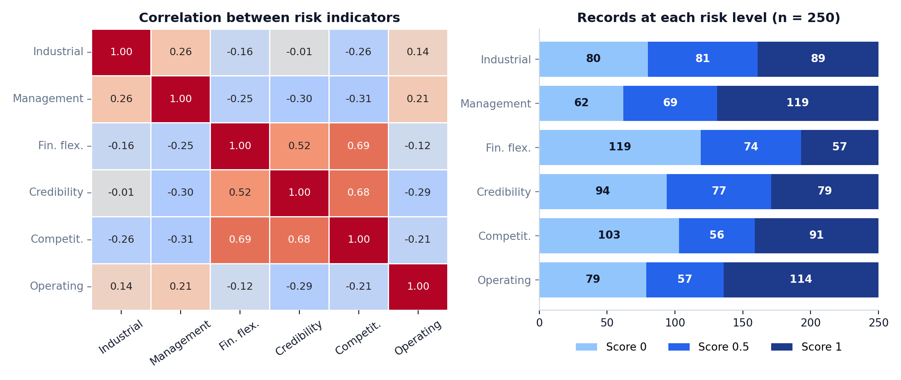
EDA: Correlation and Risk-Level Distribution
How the indicators relate to each other and how often each score occurs
Inference
Financial flexibility, credibility and competitiveness are positively correlated (0.52 to 0.69); no pair exceeds 0.85, so multicollinearity is not a concern. Management and operating risk most often sit at level 1 (119 and 114 companies).
Bankruptcy Prevention | ExcelR Data Science Project
6

Slide 7
4. Data Preparation & Feature Insights
Preparing the risk-indicator data for machine learning
1
Load
semicolon-separated CSV
2
Clean
strip column-name spaces
3
Inspect
nulls • duplicates • outliers
4
Encode
target → 0 / 1
5
Explore
crosstabs • correlation
6
Select
6 risk features as X
Data quality
No missing values and no outliers: every feature holds only 0, 0.5 or 1. The 147 duplicate rows were kept because dropping them would leave only 103 records.
Target encoding
LabelEncoder maps bankruptcy to 0 and non-bankruptcy to 1 (107 and 143 records). The classes are close to balanced, so no resampling was needed.
Key feature insights
Competitiveness, financial flexibility and credibility separate the classes most clearly. Industrial, management and operating risk overlap heavily.
Bankruptcy Prevention | ExcelR Data Science Project
7

Slide 8
5. Machine Learning Approach
Train, compare, evaluate and select the deployment model
Raw data
250 × 7
Encoding
target → 0 / 1
Train/Test split
80 / 20
stratified
ML models
LR • DT • RF • KNN
Evaluation
Accuracy • Precision
Recall • F1
Models trained
• Logistic Regression
• Decision Tree (entropy, max depth 3)
• Random Forest (100 trees, entropy)
• K-Nearest Neighbors (k = 5)
Evaluation setup in the project notebook
The split gives 200 training and 50 test records (random_state = 42). Each model was checked with a confusion matrix and classification report; ROC–AUC was computed for Logistic Regression and KNN.
Bankruptcy Prevention | ExcelR Data Science Project
8

Slide 9
6. Model Comparison
Actual test-set performance from the project notebook
Model | Accuracy | Precision | Recall | F1-score
Decision Tree | 100.00% | 100.00% | 100.00% | 100.00%
K-Nearest Neighbors | 100.00% | 100.00% | 100.00% | 100.00%
Logistic Regression (selected) | 100.00% | 100.00% | 100.00% | 100.00%
Random Forest | 100.00% | 100.00% | 100.00% | 100.00%
Result
All four models reached 100% accuracy on the 50-record test set, with no false positives and no false negatives.
Important caveat
The dataset is small and repeats many risk patterns (147 duplicate rows), so perfect scores should be confirmed with cross-validation or more data.
Bankruptcy Prevention | ExcelR Data Science Project
9

Slide 10
7. Final Model Evaluation
Logistic Regression on the 20% stratified test set (50 records)
100%
Accuracy
100%
Weighted precision
100%
Weighted recall
1.00
ROC–AUC
Confusion Matrix — Actual vs Predicted
Bankrupt
Non-Bankrupt
Class-level performance
Bankrupt (0): precision 1.00, recall 1.00, F1 1.00 (21 records)
Non-Bankrupt (1): precision 1.00, recall 1.00, F1 1.00 (29 records)
Both classes: 0 false positives and 0 false negatives.
Bankrupt
21
0
Non-Bankrupt
0
29
Interpretation
Logistic Regression classified all 50 test companies correctly (ROC–AUC = 1.00). Treat the perfect score with care given the small test set.
Bankruptcy Prevention | ExcelR Data Science Project
10

Slide 11
8. Final Model Selection
Why Logistic Regression was chosen for deployment
Logistic Regression coefficients
Selection decision
All four models scored 100% on the test set, so Logistic Regression was chosen for interpretability, probability output and speed rather than accuracy.
Competitiveness
+3.81
Fin. flexibility
+2.36
Deployment rationale
Its coefficients show how each risk factor moves the outcome, it gives class probabilities, and the saved model is tiny and predicts instantly — ideal for a web app.
Credibility
+2.22
Industrial risk
−0.63
Management risk
−0.63
Final deployed stack
Logistic Regression saved with joblib (bankruptcy_model.pkl) + Streamlit interface.
Operating risk
−0.59
Green: pushes towards Non-Bankruptcy • Red: pushes towards Bankruptcy
Bankruptcy Prevention | ExcelR Data Science Project
11

Slide 12
9. Deployment — Streamlit Application
End-to-end inference flow used by the application
Risk indicators
Select 0 / 0.5 / 1
Input table
6-column DataFrame
Logistic Regression
Predict class
Class label
0 or 1 output
Result
Bankruptcy / Non-Bankruptcy
Application features
• Dropdowns for the six risk indicators
• “Analyze Company Risk” button
• Colour-coded prediction banner
• Table of submitted risk indicators
• Academic-project disclaimer
Saved artifacts
The trained Logistic Regression model is saved with joblib as bankruptcy_model.pkl and loaded by the app, so it never needs retraining.
Deployment output
The app shows Bankruptcy (red) or Non-Bankruptcy (green) together with the submitted risk values.
Bankruptcy Prevention | ExcelR Data Science Project
12

Slide 13
10. Results & Business Impact
What the final solution delivers
250
Companies analysed
6
Risk indicators
100%
Test accuracy
1.00
ROC–AUC
What the solution achieves
• Classifies a company as Bankruptcy or Non-Bankruptcy
• Shows competitiveness, financial flexibility and credibility as key drivers
• Provides a deployable Streamlit web interface
• Enables fast, consistent early-warning screening
Practical interpretation
Low scores on competitiveness, financial flexibility and credibility strongly signal bankruptcy, while higher scores on them point to survival. The data is a small academic dataset, so predictions should support, not replace, expert financial judgement.
Bankruptcy Prevention | ExcelR Data Science Project
13

Slide 14
11. Conclusion & Future Scope
Closing summary
Conclusion
The project built an end-to-end bankruptcy prediction pipeline: data cleaning, EDA, model training and comparison, and Streamlit deployment. All four models reached 100% test accuracy, and Logistic Regression was selected for its interpretability.
Future scope
1. Collect a larger and more diverse company dataset
2. Validate with k-fold cross-validation and unseen data
3. Add prediction probability and confidence to the app
4. Explain predictions with feature contributions (e.g. SHAP)
5. Combine the indicators with real financial ratios
6. Add batch prediction from uploaded CSV files
Key learning
• Competitiveness, financial flexibility and credibility drive bankruptcy risk
• Simple, interpretable models suit small structured datasets
• Perfect scores on a small test set need careful validation
• Deployment turns the model into a usable tool
Bankruptcy Prevention | ExcelR Data Science Project
14

Slide 15
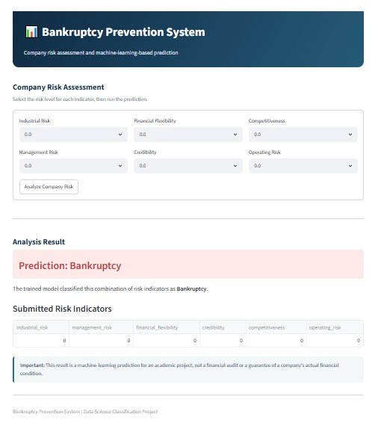
12. Deployment Demo — Streamlit Application
Live deployed project interface
Input
All six risk indicators are set to 0.0 with the dropdown selectors: industrial, management, financial flexibility, credibility, competitiveness and operating risk.
Prediction
The model returns Bankruptcy, shown in a red result banner under Analysis Result.
Reading the output
The Submitted Risk Indicators table repeats the inputs (all 0). A note states that the result is an academic-project prediction, not a financial audit.
Bankruptcy Prevention | ExcelR Data Science Project
15

Slide 16
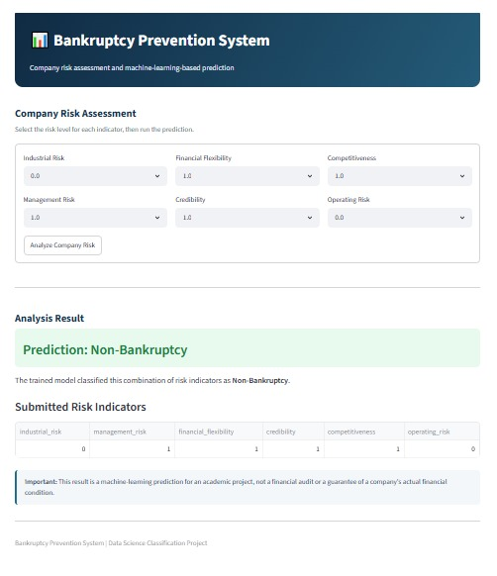
13. Deployment Demo — Prediction Result
Prediction for a different combination of risk indicators
Input
Industrial risk and operating risk are 0.0, while management risk, financial flexibility, credibility and competitiveness are set to 1.0.
Prediction
The model returns Non-Bankruptcy, shown in a green result banner.
Reading the output
Changing the indicator levels and pressing Analyze Company Risk updates the prediction. This combination (0, 1, 1, 1, 1, 0) is classified as Non-Bankruptcy.
Bankruptcy Prevention | ExcelR Data Science Project
16

Slide 17
Thank You
Bankruptcy Prevention System
Group-3
Questions & Discussion
Bankruptcy Prevention | ExcelR Data Science Project
17

