Slide 1
Schooner Memcached Java Client
Presenter: Schooner R&D group
Date: 2009/12/2
Notes:
1
1
Bill Hunt

Slide 2
Agenda
Overview
Features
Usage
API difference
Schooner Optimization
Upgrade to Schooner Java Client
Benchmark
2

Slide 3
Overview
Existing 2 types of java memcached clients
Whalin (http://whalin.com/memcached/ ) | asfmemcached (http://code.google.com/p/memcache-client-forjava)
Support synchronized set operation
Spy (http://code.google.com/p/spymemcached/ ) | xmemcached (http://code.google.com/p/xmemcached/)
Support asynchronized set operation
Schooner memcached client
Low latency / High-throughput / Low CPU time per trans. 270% performance increased compared to whalin.
Support text/binary and udp(text) memcached protocols.
Add append/prepend/cas commands.
Support customized serialization and deserialization.
Fully compatible with Whalin client, simply replace whalin client with schooner one without any modification and even no re-compile of your application.
Memcached Client | Sync/Async | Supported Protocols
Whalin | asfmemcached | sync | ASCII
Spy | xmemcached | Async for set Sync for get | ASCII, binary
Schooner | sync | ASCII, binary, UDP

Slide 4
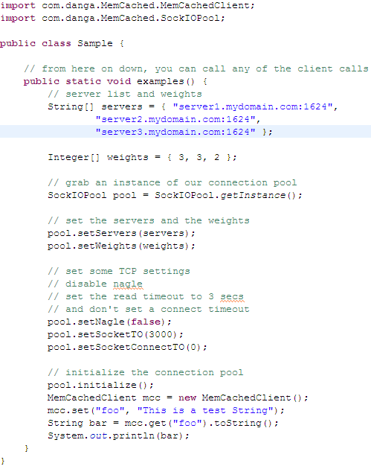
Overview
Schooner java client Usage
Specify servers
Create and initialize connection pool
Create memcached client
Use the client

Slide 5
Schooner Optimization
Deserialize while receiving the response
Whalin does the deserialization after complete receiving the response from server side.
Java.nio.* packages
Actually, all java memcached clients are using these packages.
Java direct buffer
Reduce the unnecessary objects creation in transaction.
More convenient and efficient in storing none-serializable java objects
Re-implement connection pool
Simplify the connection pool maintain strategy, use a smart way to process the over-loaded requests.
Add memcached binary and UDP protocol support
Source code refinement and tuning
We refined nearly all the source code of Whalin to help increase the performance.

Slide 6
Schooner Optimization
Fake API
Fake API means those public APIs exist in old whalin client but not real implemented in our new client. The purpose of creating these fake APIs is to make our customers’ application successfully compiled without any modification.
For performance reasons, the following API are fake in Whalin 2.5.0:
setCompressEnable(boolean) / setCompressThreshold(long)
Compression in LAN is not a good idea, it consumes a lot of CPU resources but benefit little. In our new client, compress is fake APIs, we don't compress anything in our client, but we will decompress the data from the server side for those key/value pairs set with old whalin client.
And from another point of view, compression is transparent to end users, they don’t care how we store the values.
getAliveCheck() / getMaintSleep() / getMaxBusy() / setAliveCheck(boolean) / getMaxIdle() / setMaintSleep(long) / setMaxBusyTime(long) / setMaxIdle(long)
In our new client, we choose a negative strategy and keep only one pool to do such things. Which means we do the alive check and the status only when user get connection from our pool and get rid of those dead and busy connections since memcached is running in LAN. By doing this, the performance increased about 10%.
And from another point of view, all these APIs are not popular in the whalin client, I believe only 1% of the users will invoke these APIs. And actually, these APIs will not cause any direct impact for those memcached keys and values.

Slide 7
Upgrade to Schooner Java Client
We call Schooner Java client as Whalin client 2.5.0
API difference to Whalin
Common API | Whalin Only | Schooner Only
addOrDecr / addOrIncr | setCompressEnable (fake API in schooner) | Cas
decr / incr/storeCounter | setCompressThreshold (fake API in schooner) | append/prepend
delete / flushAll |  | gets
get / set / add |  | sync/syncAll
getMulti / getMultiArray |  | setTransCoder
keyExists |  | isUseBinaryProtocol
replace |  | ……
stats / statsSlabs / statsItems

Slide 8
Upgrade to Schooner Java Client
How to upgrade to our client
Our client is 100% compatible with the old version.
The legacy systems can smoothly upgrade to Whalin 2.5.0 without any modification.
All the original data stored in memcached server with Whalin 2.0.1 can be retrieved with our new client.
Just replace the old jar package with “java_memcached-release_2.5.0.jar”, and then the upgrade is successfully finished.

Slide 9
Memcached client Benchmark (1/5)
Benchmark
Different threads and data sizes.
The data’s type covered both String and customized java object.
With Serialization and Deserialization.
No get miss
The following thing were considered in our test.
Throughput
Latency
Hardware
CPU: Intel Xeon 2.83G 8 core 64 bits.
MEM: 32G 667M
NET: 10 Gbps
Software
Centos 5.1 (both server and client)
Memcached 1.4.3 (server side)
Java 1.5-16 x86_64 from SUN (client side)

Slide 10
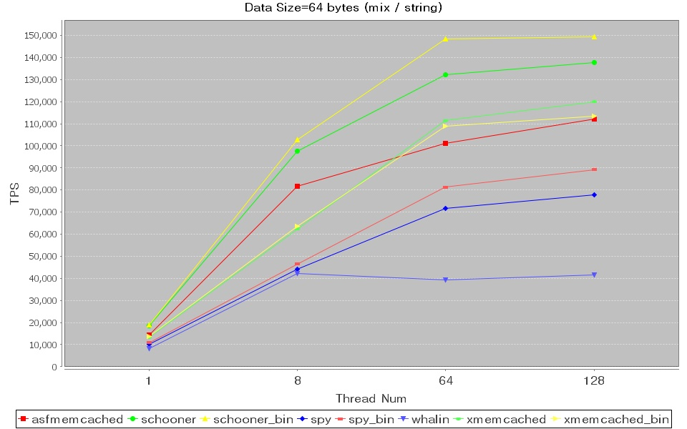
Memcached client Benchmark (2/5)

Slide 11
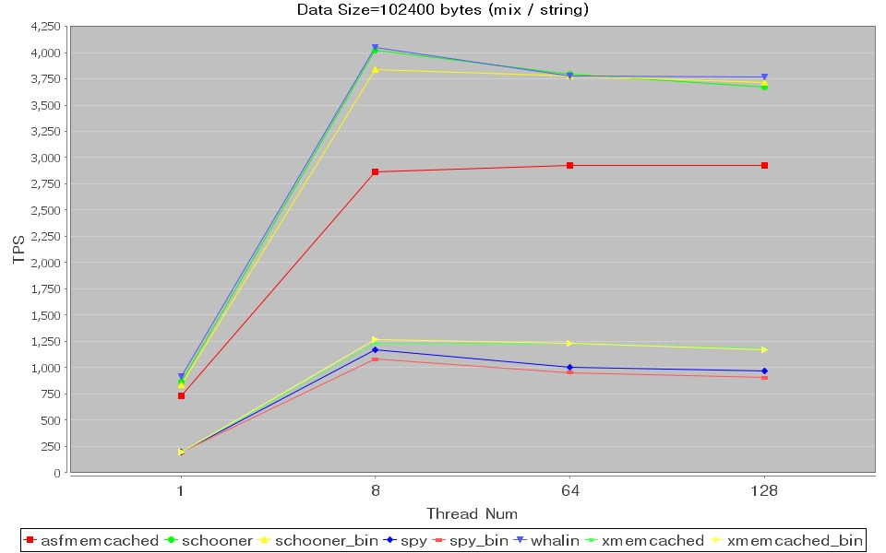
Memcached client Benchmark (3/5)

Slide 12
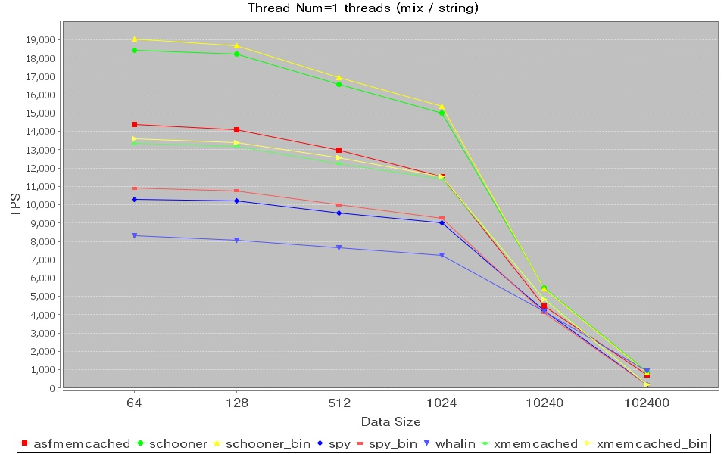
Memcached client Benchmark (4/5)

Slide 13

Memcached client Benchmark (5/5)

Slide 14
The End
Thanks
14
Notes:
14
14

