Slide 2
This is newly added

Slide 3




Git History
▪
▪
▪
▪

Slide 4







SCM Terminologies

Slide 5

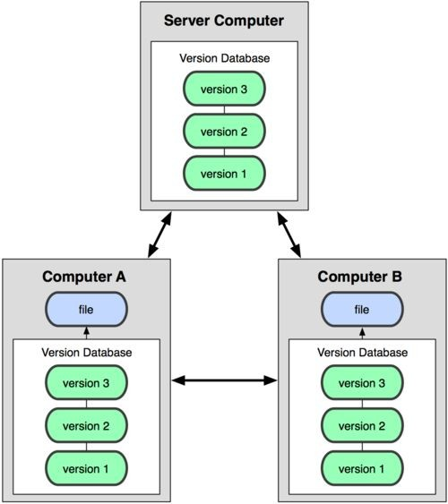
Distributed version control system
Centralized Model
Distributed Model
(CVS, Subversion, Perforce)
(Git, Mercurial)
Result: Many operations are local

Slide 6
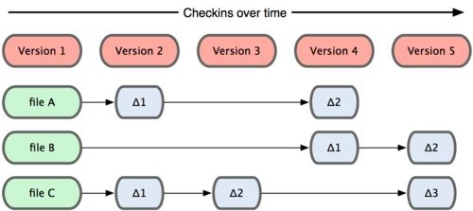
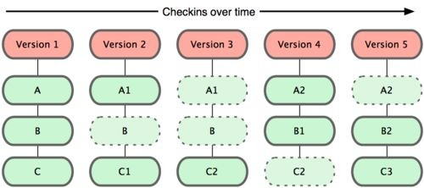
Git takes snapshots
Subversion
Git

Slide 7
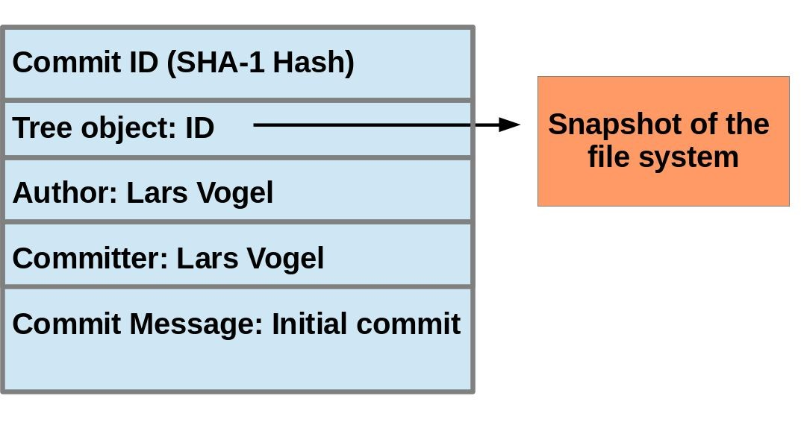
Git uses checksums

Slide 8

A L ocal Git project has three areas
Unmodified/modifie Stage
d d
Files Files
Committe d
Files
Note: working directory sometimes called the “working tree”, staging area sometimes called the “index”.

Slide 9
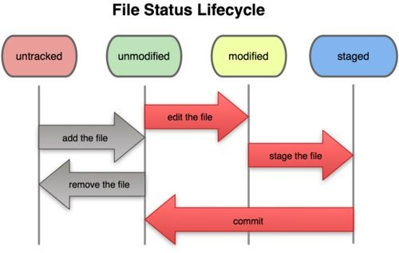
Git file lifecycle

Slide 10





Aside: So what is github?

Slide 11
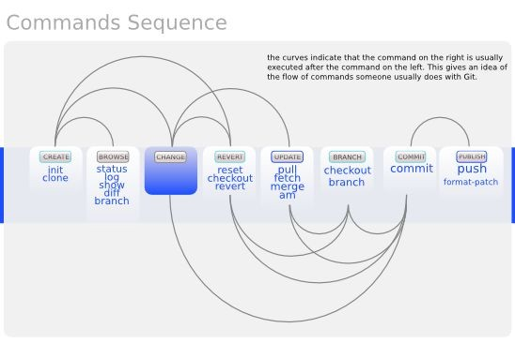
Basic Workflow

Slide 12





Get ready to use Git!
1.
$ git config --global user.name “Bugs Bunny”
$ git config --global user.email
$ git config --global push.default simple
git config –list
--global

Slide 13





Repositories
▪
▪
▪

Slide 14







Git commands
git clone url [dir]
git add files
git commit
git status
git diff
git help [command]
git pull
git push
init, reset, branch, checkout, merge, log, tag

Slide 15


Add, Status and Diff
$ git add <file>
$ git status
$ git status –s (-s
$ git diff

Slide 16



Pulling and Pushing
1.
2.
3.
$ git pull origin master
$ git push origin master
origin master

Slide 17





Ignoring files & Viewing logs

Slide 18
Branching
•$ git branch experimental
•$ git branch
•$ git checkout experimental
•$ git diff master <your_branch>
Merge branches :
•$ git merge <source_branch> <destnation_branch>

Slide 19
Stashing commited changes
•$ git stash
•$ git stash list
•$ git stash pop
•$ git stash apply stash@{num}
Remove stash from repo
•$ git stash clear

Slide 20

Reverting changes
•$ git reset <file>
•$ git reset --soft
•$ git reset --mixed
•$ git reset --hard

Slide 21

Reverting changes …
•$ git revert <commit>
•$ git checkout <commit_id>
•$ git rm <file>
•$ git clean -n (-n is for dry run)
•$ git clean -f (force delete)
Discard changes in working directory
•$ git checkout -- <file>

Slide 22




Tags
•$ git tag –a <pattern> -m ‘comment’ <commitid>
•$ git show <pattern>
•$ git tag

Slide 23
SVN vs. Git
▪
▪
▪
▪
▪

Slide 24
Do This:
1. $ git config --global user.name “Your Name”
2.
3.
$ git config --global user.email
$ git clone https://github.com/rea2000/santalist.git
Then try:
$ git log, $ git log --oneline
Create a file named userID.txt (e.g. rea.txt)
$ git status, $ git status –s
Add the file: $ git add userID.txt
$ git status, $ git status –s
Commit the file to your local repo:
$ git commit –m “added rea.txt file”
$ git status, $ git status –s, $ git log --oneline
*WAIT, DO NOT GO ON TO THE NEXT STEPS UNTIL YOU ARE TOLD TO!!
Pull from remote repo: $git pull origin master
Push to remote repo: $git push origin master

