Slide 1



Horrible death of
easter bunnies

Slide 2
chocolate
Let’s scale

Slide 3
Y-axis
Scale by splitting different things
Functional decomposition
Z-axis
Scale by splitting similar things
X-axis
Scale by cloning
Horizontal duplication
Data Partitioning
http://microservices.io/articles/scalecube.html

Slide 4
Order Microservice
Shipping Microservice
Frontend (Stateless)
Broker
Backend (Stateful)
Broker
Backend (Stateful)
Dark
ChocolateOrder
33000
Shipping
ChocolateOrder ProcessManager
ChocolateOrder.Front
Brown
ChocolateOrder
66000
Shipping
White
ChocolateOrder
99000
Shipping
Sender Side Distribution
Sender and Receiver Side Distribution
Receiver Side Distribution

Slide 5
Demo
Notes:
Let’s see what the team came up with.

Slide 6
It is always more difficult than Microsoft tells you ;)
Stateful computation with low latency requires smart routing
Service Fabric with stateless and stateful services combined with messaging gives you best of two worlds
Recap

Slide 7
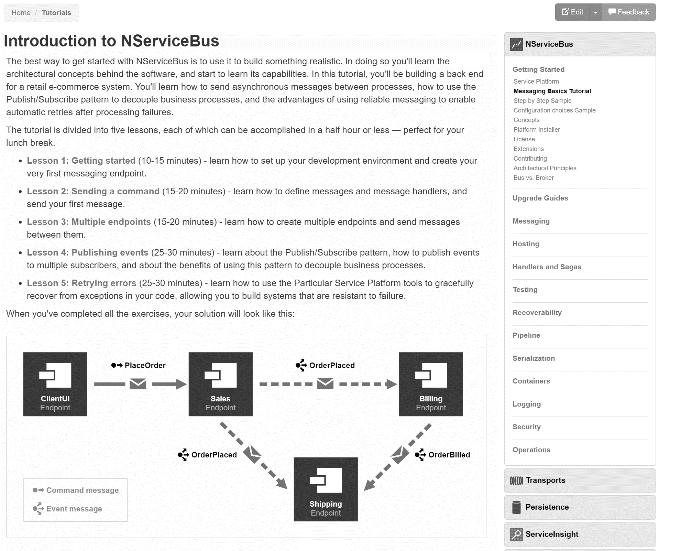
docs.particular.net/ tutorials/intro-to-nservicebus

Slide 8
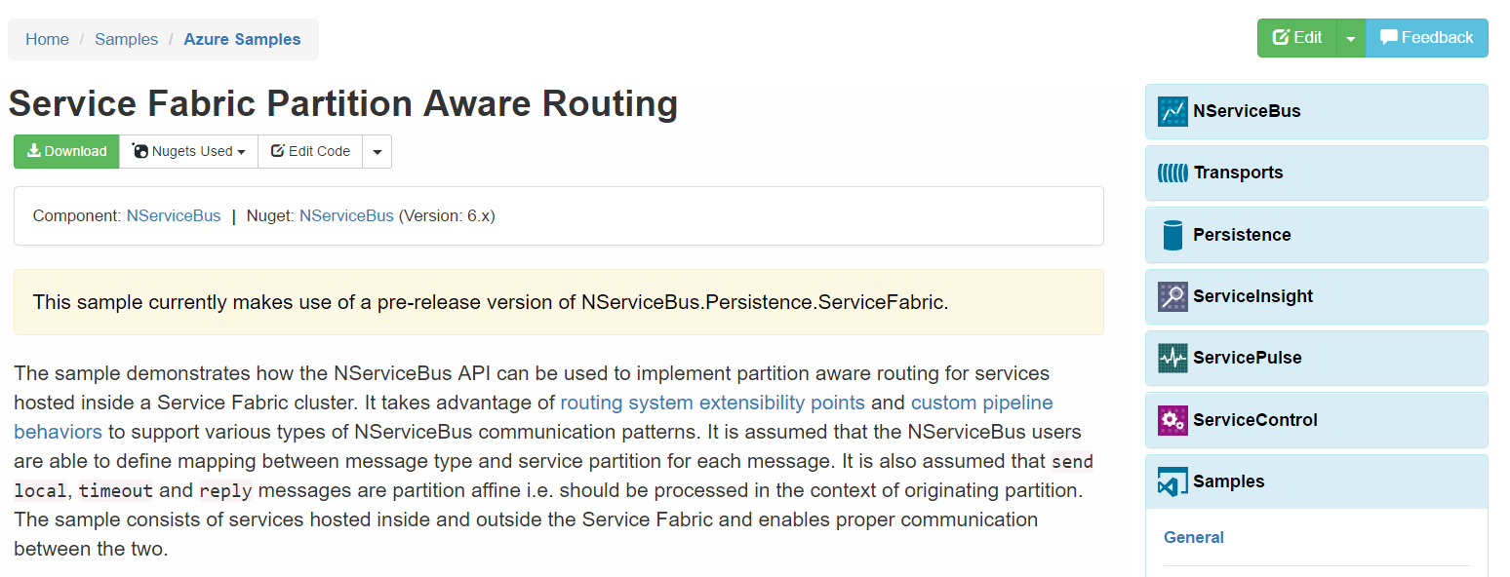
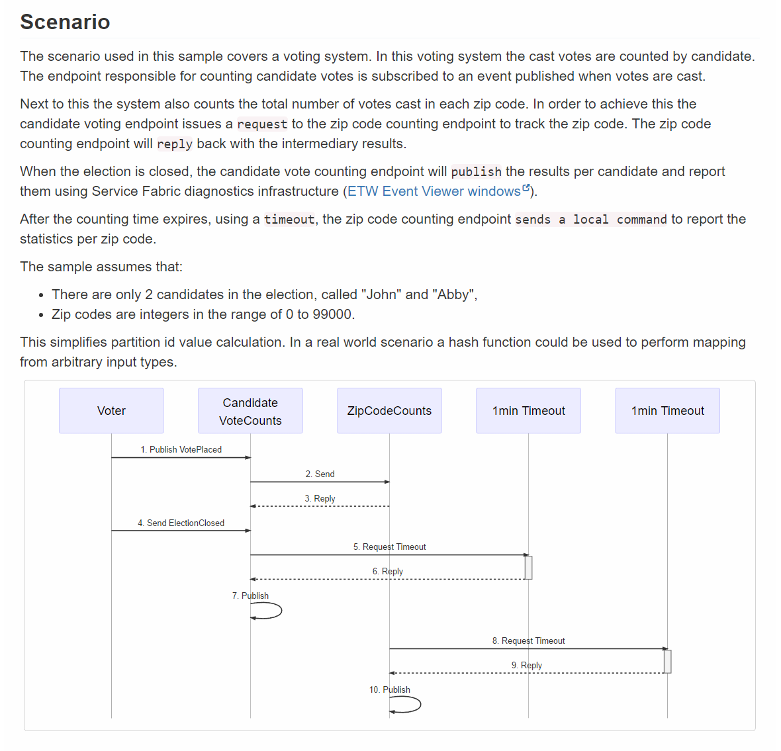
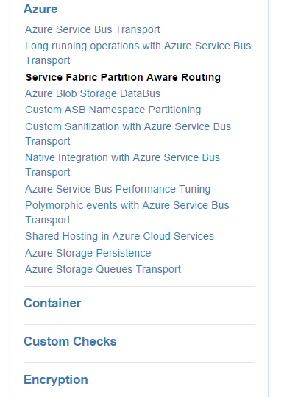
docs.particular.net/ samples/azure/azure-service-fabric-routing/

Slide 9
Slides, Links…
github.com/danielmarbach/Microservices.ServiceFabric
Notes:
Questions that can be answered in blog posts

