Slide 1

Microservices with Service Fabric
Easy... or is it?
Notes:
You are doing it wrong, If you are building applications and services today and you are not considering Platform as a Service!
The days of shipping data from tier to tier through countless stateless instances to the client and back are over.
Modern concurrent computation models for distributed systems like Actors bring data closer to the compute nodes and thus significantly reduce latency.
Today I’m taking you on a journey to move away from the data shipping paradigm and stateless middle tiers to a stateful middle tier architecture. By leveraging smart routing I’ll show how

Slide 2
Goals
Stateless and Stateful Services
Partitioning of Business Data
Message Patterns and Partitioning
Notes:
we can route request that are coming from other Platform as a Service Offerings like Azure ServiceBus into the stateful service components running inside Service Fabric that are responsible of handling business requests.
At the end of this talk you’ll know the benefits of stateful services for data intense workloads and how message patterns need to be tweaked to ensure proper routing.

Slide 3
Premise
Notes:
In this talk I’ll assume some basic knowledge around Service Fabric and messaging in general.
Every time I feel I need something to cheer me up I’ll take a piece of Swiss Chocolate. You might wonder what Chocolate has to do with this presentation I’m giving. Well, let me tell you a sweet but totally fictional story.

Slide 4
A Tale of
chocolate
Notes:
Switzerland is well known for its excellent chocolate bars, don’t believe me? Here is a sample
International demand is raising
Chocolate manufacturers in Switzerland realized need for Highly reliable chocolate order management system
The team responsible for the new order management wanted to go for Platform as a Service
but unfortunately they have a few legacy infrastructure pieces that can’t be moved to PaaS just yet
In the architecture meeting of the team, Karl, the team architect starts the discussion with a horror story
(attention the next slide is not for the faint of heart)

Slide 5



Horrible death of
easter bunnies
Notes:
Many easter bunnies have died last easter. Our chocolate is so good that people around the globe can’t resist.
Last easter the demand was so high that our internal legacy application became slower and slower and eventually started timing out.
The ripple effects were severe and a few of the orders never came through.
Losing orders is a no go since one of our mission is to make people around the globe happy.
By not being able to ship our delicious chocolate world wide, even under spiky demands, we are failing on that mission.
If we continue to do so we’ll be soon wiped out by our competitors

Slide 6
Karl’s, Sales Pitch
Notes:
But recently I stumbled over service fabric and started diving into it I think it is the perfect fit for our new order management system

Slide 7
Our Chocolate Microservices
High Availability
Automatic Rollback
Stateless Services
Load balancing
Hyper Scale
Data Partitioning
Stateful Services
Replication & Failover
Self-healing
Rolling Upgrades
Health Monitoring
Container orchestration & lifecycle management
On-premises or in the cloud
https://channel9.msdn.com/Blogs/Azure/Azure-Service-Fabric https://docs.microsoft.com/en-us/azure/service-fabric/service-fabric-overview
Notes:
Azure Service Fabric is a distributed systems platform that makes it easy to package, deploy, and manage scalable and reliable microservices.
Service Fabric also addresses the significant challenges in developing and managing cloud applications.
Developers and administrators can avoid complex infrastructure problems and focus on implementing mission-critical, demanding workloads that are scalable, reliable, and manageable.
It is hyper scale, highly available, supports different programming models
Replication & Failover as well as upgrade domains and rolling upgrade
Load balancing and…
Of course Karl’s sales pitch went on and on and on, after all isn’t that what all architects do, talk, talk, talk and get nothing done?
Of you want to known what Karl explained I suggest you just read the documentation links provided below, after all Karl copy pasted his slides from this page anyway ;)

Slide 8
Demo
Cluster
Stateless1
Stateless1
Connector
Stateless1
Stateless1
Stateless1
Remoting
Chaos

Slide 9
Demo
Notes:
This is what Karl showed to his team
After the demo the team was absolutely hooked,

Slide 10
chocolate
Let’s scale
Notes:
they decided they want to benefit from the scalability of Service Fabric. The team wanted to immediately jump in front of their computers and get started hacking away their new ideas with service fabric. But Karl stopped them and I said
Hold on. Before we proceed we first need to understand the fundamentals of scaling. There is a thing called the scale cube

Slide 11
Y-axis
Scale by splitting different things
Functional decomposition
X-axis
Scale by cloning
Horizontal duplication
http://microservices.io/articles/scalecube.html
Notes:
Functional decomposition:
Or also known as Y-axis scaling,
We scale by splitting into different things
we do that by applying Microservices
Order Management Service, Manufacturing Service, Shipping service
(click)
X-axis scaling can then be used by cloning these microservices and having multiple instances of them running
Also known as horizontal duplication
We make them smaller and then spread them out
Thereby I, the great Karl, architect of the universe came up with the following architecture blue print

Slide 12
Loadbalancer
Stateless Web
FrontEnd1
FrontEnd2
FrontEnd3
Stateless Middletier
Stateless1
Stateless2
Stateless3
Storage Tier
Notes:
First, let’s start with the load balancer, every good architecture has to have one, check
Requests are then routed randomly to the stateless web tier. The stateless web tier will contain our latest AngularReactKnockoutJsKillMyselfFramework UI
From there every request will be routed to a stateless middletier that is responsible to do the necessary compute
Service Fabric has the concept of Reliable Services, namely Stateless Services
The orders will be managed in the storage tier and storage for the duration of the request
Since this architecture is stateless the loadbalancer can assign requests to any stateless entry point and the data will be shipped through the tiers to the currently assigned stateless slice
If hell breaks loose and our storage tier can’t keep up we’ll just throw in some of the hipster caching technology like Redis and we’ll be good
The paradigm used her is also known as Data Shipping just in case you want to impress your homies

Slide 13
and then
Mandy spoke up
Notes:
I’m sorry Karl Nobody builds that type of architecture anymore,
We’ve tried that in-house in the past before you joined the company and we realized that Building interactive services that are scalable and reliable is hard. Interactivity imposes strict constraints on availability and latency, as that directly impacts enduser experience. To support a large number of concurrent user sessions, high throughput is essential
The traditional three-tier architecture with stateless front-ends, stateless middle tier and a storage layer has limited scalability due to latency and throughput limits of the storage layer that has to be consulted for every request.
(click)

Slide 14
and then
Mandy spoke up
Notes:
We added a caching between the middle tier and storage to improve performance.
However, a cache loses most of the concurrency and semantic guarantees of the underlying storage layer.
To prevent inconsistencies caused by concurrent updates to a cached item, the application or cache manager has to implement a concurrency control protocol.
With or without cache, a stateless middle tier does not provide data locality since it uses the data shipping paradigm
next

Slide 15
and then
Mandy spoke up
Notes:
For every request, data is sent from storage or cache to the middle tier server that is processing the request. The advent of social graphs where a single request may touch many entities connected dynamically with multi-hop relationships makes it even more challenging to satisfy required application-level semantics and consistency on a cache with fast response for interactive access In the world of IoT, cloud services and mainly actor models to approach distributed computing we want to reduce latency and therefore move data as close to compute as possible.
This is me successor architecture blueprint to your proposal

Slide 16
Loadbalancer
Stateless Web
FrontEnd1
FrontEnd2
FrontEnd3
Stateful Tier (Hot)
Stateful1
Stateful2
Stateful3
Storage Tier (Cold)
Notes:
Concept of stateful services, Stateful Services allow to consistently and reliably store state right inside the service by leveraging the power of reliable collections. They have a similar API to C# collections but are offer transactional semantics as well as replication inside the cluster. With that we can achieve:
Application hot state lives in the compute tier
Low latency reads and writes
Fewer moving parts
External stores are only used for exhaust and offline analytics
Capacity in cluster is limited compared to the storage tier (tradeoff)
Mention orders in memory
Add state symbol to this diagram

Slide 17
Y-axis
Scale by splitting different things
Functional decomposition
Z-axis
Scale by splitting similar things
X-axis
Scale by cloning
Horizontal duplication
Data Partitioning
http://microservices.io/articles/scalecube.html
Notes:
And furthermore, she continued Karl has completely forgotten to mention, probably has been watching too many Channel 9 videos until late night, that the scale cube as a third axis called Z-axis, and the diagram should actually look like this
(Amazing how she is she scribbles a new diagram, click)
So in order to achieve the hyperscale that Karl talked about we need to split similar things into multiple pieces. It is not enough to split into things like OrderManagement, Shipping etc. for example OrderManagement itself should be partitioned into multiple data partitions.
(click)
(Let me show you an example. She gracefully walks back to the architecture drawing) Now I’m totally pulling this out of thin air but we could for example split our orders into different chocolate types that customers are ordering. For the sake of the example let’s consider a customer could only order a chocolate type per order.

Slide 18
Loadbalancer
FrontEnd1
FrontEnd2
FrontEnd3
Dark
Brown
White
Notes:
We have customer ordering dark, brown or white chocolate. I know silly but bear with me.
Service Fabric makes it easy to develop scalable stateful services by offering a first-class way to partition state (data).
Conceptually, you can think about a partition of a stateful service as a scale unit that is highly reliable through replicas that are distributed and balanced across the nodes in a cluster.
Partitioning in the context of Service Fabric stateful services refers to the process of determining that a particular service partition is responsible for a portion of the complete state of the service.
A great thing about Service Fabric is that it places the partitions on different nodes.
This allows them to grow to a node's resource limit. As the data needs grow, partitions grow, and Service Fabric rebalances partitions across nodes. This ensures the continued efficient use of hardware resources.
next

Slide 19
Loadbalancer
FrontEnd1
FrontEnd2
FrontEnd3
Dark
Brown
White
Notes:
Ranged partitioning (otherwise known as UniformInt64Partition).
Named partitioning. Applications using this model usually have data that can be bucketed, within a bounded set. Some common examples of data fields used as named partition keys would be regions, postal codes, customer groups, or other business boundaries. Or for us the chocolate type
Singleton partitioning. For example, stateless services use this partitioning scheme by default.
Things to consider:
Try to partition the state so that it is evenly distributed across all partitions.
Another aspect of partition planning is to choose the correct number of partitions to begin with.

Slide 20
However
Joe couldn’t understand it
Notes:
But Joe had troubles to keep up with the technical gibberish that Mandy was talking about and asked for a concrete example.

Slide 21
Loadbalancer
White
Dark
Order
Order
FrontEnd1
FrontEnd2
FrontEnd3
Dark
Brown
White
Notes:
Ok Joe, Imagine a customer comes in and gets randomly assigned a stateless webnode. He orders White chocolate (click). The stateless front-end will use the chocolate type as the partition key for the named partition and use the Service Fabric built in ServicePartitionResolver to resolve the partition that is responsible for Service the Partition for white chocolate. Imagine Service Fabric has internally a thing that acts like a NameService or DNS (like Consul.io or DNS in the internet) that can tie together service names and partition keys to the location in the cluster transparently. This is done via RPC calls. When the right statefull instance is determined the front-end issues an HTTP call (actually yet another RPC style call) to the API of the Service. Inter-service communication can only be done over endpoint communication listeners (RPC, HTTP, Remoting, WCF). So we can say the routing is done based on the chocolate type.
Click, so my orders would all end up on the partition responsible for handling dark chocolate orders she explains.

Slide 22
And then
Sophia threw a grenade
Notes:
Thanks Mandy for carefully explaining this to Joe, says Sophia. But I’m getting shivers when I hear you talking about all this RPC style communication. This reminds of a project I’ve been doing for my previous employer.

Slide 23
Loadbalancer
WcfOrderSvc1
WcfOrderSvc2
WcfOrderSvcN+1
…
FAT DB
(Slow)ThirdParty
Notes:
We built this huge intertangled and interconnected RPC legacy mess. At that time the term Microservices wasn’t coined yet but I believe it was something similar but done horribly wrong.
We had this WCF Order Services connected to a Slow and unreliable third party as well es a FAT and slow database we had to transactionally call into. The temporal and special coupling we introduced was horrible. Everytime the Third Party was unresponsive or slow our customer-facing latency went through the rooftop. We couldn’t fulfill our SLA. Orders got lost. We couldn’t throttle the requests. We kept transactions open or to long which caused the database transactions to rollback. People got fired… Nono it wasn’t me who got fired I actually had the idea which saves the project…
next

Slide 24
Loadbalancer
WcfOrderSvc1
WcfOrderSvc2
WcfOrderSvcN+1
…
Queue
FAT DB
(Slow)ThirdParty
Gateway
Notes:
We first introduced async programming into the game which drastically reduced the memory footprint of the application and allowed us the better satisfy the ressources we had available. But that didn’t solve the problem of transactions being created too early and things timing out into the user face.
We decided to decouple the slow thirdparty behind a message queue. At that time we used the rusty MSMQ service available on Windows. But nowadays you’d probably be using something more hipster like Rabbit Or ASB. This allowed us to throttle requests, have a consistent and predictable load on the system as well as retry mechanism when something went boom on the third party. We applied that pattern successfully in various areas of the system. The fire & forgot nature of messaging made our system scale much more.
So here is my proposal. It is only a slight modification to the architecture that mandy proposed.

Slide 25
FrontEnd1
FrontEnd2
FrontEnd3
Broker Middleware
Queue
Stateful1
Stateful2
Stateful3
Notes:
The stateless frontend tier and the stateful middle tier with the compute remains the same. But between the stateless and the stateful tier we should introduce some kind of broker middleware like Azure Service Bus, Azure Storage Queues or RabbitMQ for on-premises. The broker middleware will contain a queue for our chocolate orders. Of course not everything has to go through the queue. Only things like orders that need to be processed in order and potentially throttled. After all it is better to process orders a bit later than loosing them right? With that we get
Competing consumers
Awesome scaling
Throttling
Retries and business transactions to stateful middletier
Reactive

Slide 26
Peter snatches
the whiteboard markers
Notes:
But then

Slide 27
and furiously
screams
Notes:
THIS DOESN’T SOLVE ANYTHING
After taking some moments to breath and team colleguages reminding him that this is only a design discussion and nothing has been set in stone he starts:
Really sorry about my outburst. My youngest son slept in our bed tonight and him pushing his legs and arms into my face and back didn’t really solve my sleep abbreviation.
We completely forget the data partitioning part that we discussed before.

Slide 28
FrontEnd1
FrontEnd2
FrontEnd3
Broker Middleware
Queue
Dark
Brown
White
Notes:
With competing consumers messages in the queue belonging to Dark chocolate could also be picked up by other partitions. Then the data ends up on the wrong partition and we are completely screwed.
Imagine a customer calls us and then we find out that we have inconsistent business data. That is money lost and I can assure heads will start rolling.
So we are back on square one even with queuing and we need some kind of smart routing and/or queue partitioning to achieve hyperscale.

Slide 29
FrontEnd1
FrontEnd2
FrontEnd3
Broker
Dark
Brown
White
Dark
Brown
White
Notes:
So we would need to have a dedicated queue per chocolate type.
When an order is created on the stateless frontend its chocolate type is used to determine via smart routing where the message has to be routed. In our a bit silly example with chocolate types we can map the chocolate type 1:1 to the queue name or to a queue name convention containing the chocolate type. Each partition will have its own dedicated queue receiver that is receiving messages on the uniquely addressable queue. With that we have a clear separation and messages that are destined for a given chocolate type are guaranteed to land on the right partition responsible for that chocolate type.

Slide 30
Commands
Notes:
What we talked about here so far is the command pattern.

Slide 31
Logical Receiver
Same bounded context
Dark
OrderProcessor1
OrderChocolate
Cmd
Brown
OrderSender
OrderProcessor2
White
OrderProcessor3
Sender Side Distribution
Notes:
The UI composite for issuing orders in the order management microservice will issue a command to the order backend part.
Since they belong to the same bounded context it is OK to use commands.
When sending a commend the sender knows the receiver or at least the logical destination (here the queue). With that we can decouple the order sending temporarily from the order receiving.
In that case it is OK for the sender to know the data partition function the maps the input data to the partition key.
Integration scenarios, a command sender is not part of the cluster but still belongs to the same bounded context
For simplicity reasons let’s call this Sender Side Distribution.

Slide 32
The PhD dude
acts like a smart ass
Notes:
Peter talking about commands triggered the PhD dude and he started acting like a smart ass (nothing new for the team).
But in the messaging world we do not only have commands. We also have pub & sub semantics. Namely

Slide 33
Events
Notes:
Events

Slide 34
Logical Subscriber “Shipping”
Different bounded context
Shipping1
Shipping1
ChocolateOrdered
Evnt
Shipping2
Shipping
Publisher
Shipping2
Shipping3
Shipping3
Notes:
For example for the chocolate ordered event the publisher cannot defined how the data needs to be partitioned by the subscribers.
That would enforce the same partitioning schema down to all subscribers.
Subscribers use the events to trigger their own business workflows and store their own business process data.
Only the subscribers know how that business data has to be partitioned.
A publisher cannot define how data needs to be partitioned since subscribers define how they interpret the event that they are subscribed to.
Only the subscriber can know the partitioning schema of its own data.
next

Slide 35
Logical Subscriber “Shipping”
Different bounded context
Shipping1
Shipping1
ChocolateOrdered
Evnt
Shipping2
Shipping
Publisher
Shipping2
Shipping3
Shipping3
Receiver Side Distribution
Notes:
For PubSub the subscriber is abstracted behind a logical thing like a logical queue or a topic or exchange.
The fact that a subscriber is scaled out is not visible to the publisher.
For non-data replication scenarios usually a single physical subscriber of a logical group gets the event.
Since they act as competing consumers a message can be picked up by any subscriber. The subscriber then recalculates the data partition key by using its internal data partitioning function.
If the key matches the current partition everything is good. If not the event is internally rerouted with a single hop.
(click)
To keep it aligned with Peters lingo let’s call this receiver side distribution although I know this is not an official term!

Slide 36
Request / Reply
Notes:
But this is not all. There is more.

Slide 37
Logical Sender
Logical Receiver
Sender1
Dark
OrderSender1
OrderProcessor1
Cmd
Sender2
Brown
OrderSender2
OrderProcessor2
Rpl
Sender3
White
OrderSender3
OrderProcessor3
Notes:
Sometimes we want to asynchronously confirm back to the user that an order was process.
Since the user is currently on the node of the logical sender we need to be able to reply in a sticky or partition affine way back to the sender.
The sender could have a callback registers or have state that is associated with the command sending for tracking purposes.
Return address pattern (not shared queue, individual queue)
Receiver doesn’t need to compute anything

Slide 38
Process Manager

Slide 39
ChocolateOrdered
Evnt
ChocolateOrder ProcessManager
MakePayment
Cmd
OrderChocolate
Cmd
OrderPayed
Evnt
ShipOrder
OrderShipped
Cmd
Evnt
Notes:
In a complex system that you have modeled using aggregates and bounded contexts, there may be some business processes that involve multiple aggregates, or multiple aggregates in multiple bounded contexts. In these business processes multiple messages of different types are exchanged by the participating aggregates. For example, in our order management system, the business process of purchasing ordering chocolate might involve the payment gateway, the shipping service interaction and more. They must all cooperate to enable a customer to complete a purchase.
A combination of different messaging patterns like command, pub/sub and request/reply. The state and partitioning schema belongs to the bounded context that owns the process manager unless the process manager is here for integration purposes over multiple bounded processes.

Slide 40
Order Microservice
Shipping Microservice
Frontend (Stateless)
Broker
Backend (Stateful)
Broker
Backend (Stateful)
Dark
ChocolateOrder
33000
Shipping
ChocolateOrder ProcessManager
ChocolateOrder.Front
Brown
ChocolateOrder
66000
Shipping
White
ChocolateOrder
99000
Shipping
Sender Side Distribution
Sender and Receiver Side Distribution
Receiver Side Distribution
Notes:
The team decided to do a PoC with NServiceBus running on top of Service Fabric. They’ve chosen NServiceBus because it provides a robust queue abstraction so that they didn’t need to focus on writing much plumbing code to fetch messages from the queues.

Slide 41
Demo
Notes:
Let’s see what the team came up with.

Slide 42
It is always more difficult than Microsoft tells you ;)
Stateful computation with low latency requires smart routing
Service Fabric with stateless and stateful services combined with messaging gives you best of two worlds
Recap

Slide 43
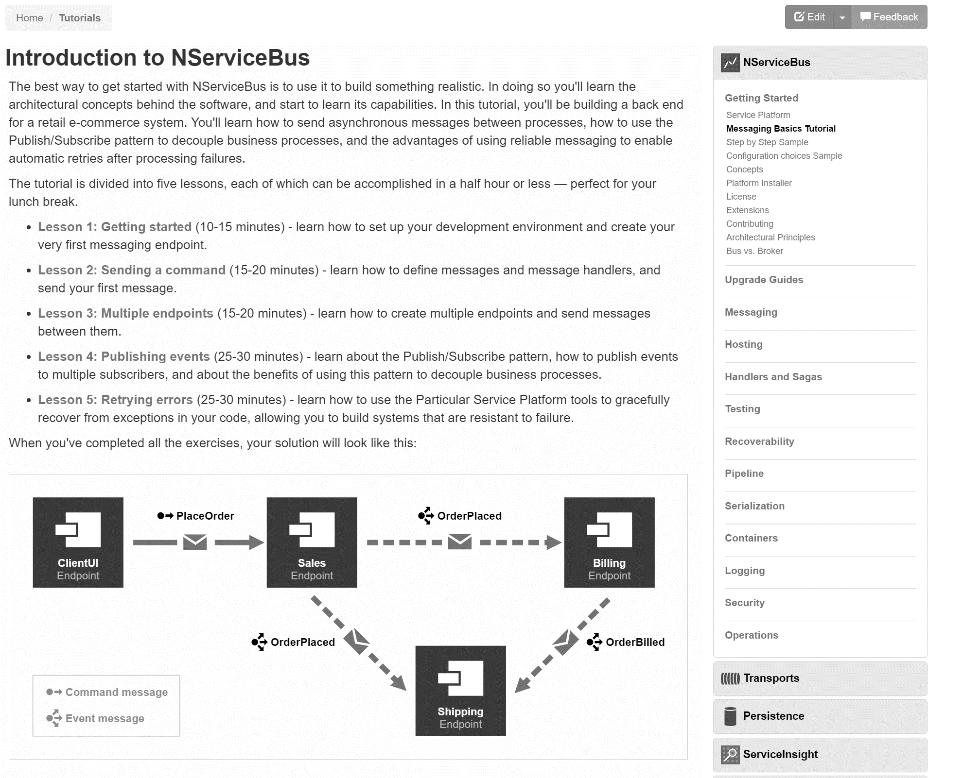
docs.particular.net/ tutorials/intro-to-nservicebus

Slide 44
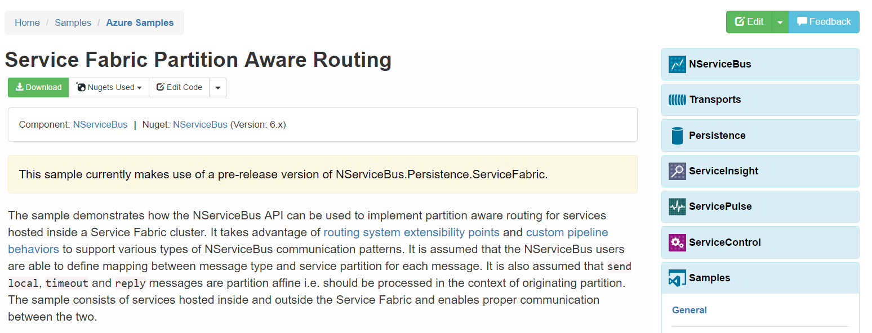
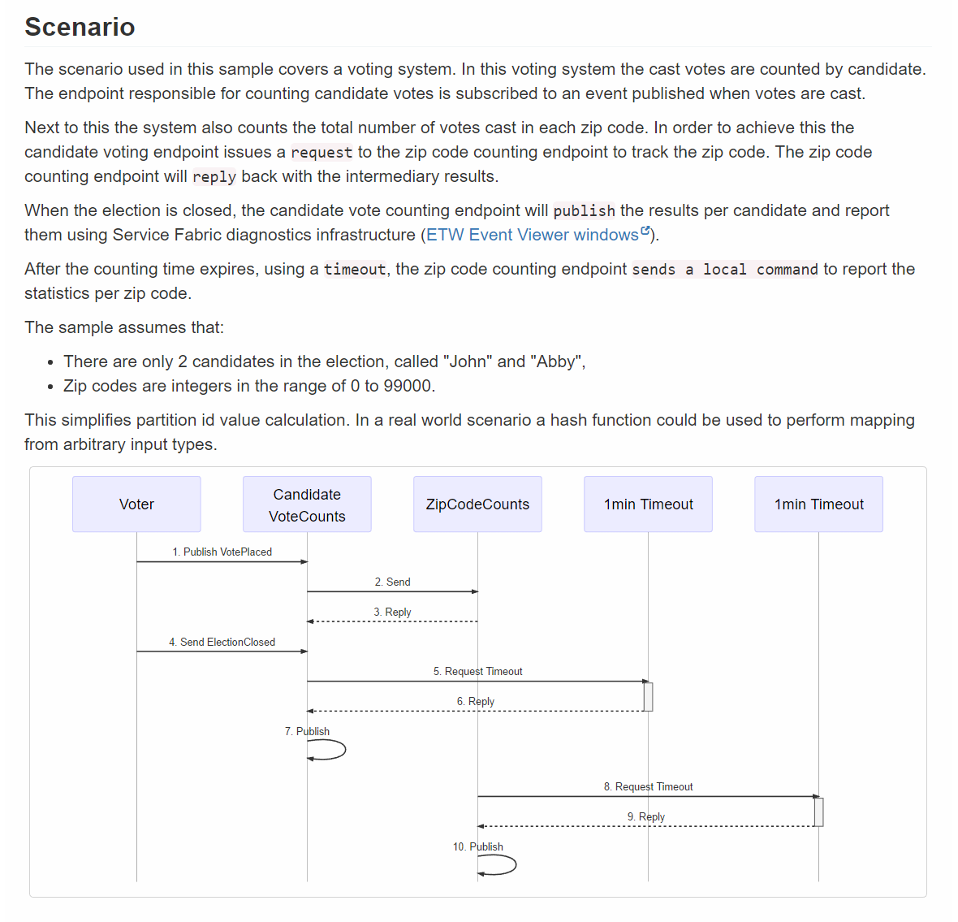
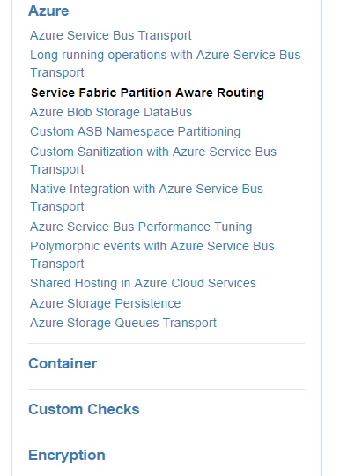
docs.particular.net/ samples/azure/azure-service-fabric-routing/

Slide 45
Slides, Links…
github.com/danielmarbach/Microservices.ServiceFabric
Notes:
Questions that can be answered in blog posts

Slide 46
Q & A

Slide 47

Software Engineer
Enthusiastic Software Engineer
Microsoft MVP
@danielmarbach
particular.net/blog
planetgeek.ch
Notes:
I’m Daniel, Solution Engineer…
I live in central Switzerland. If you want to know more about me listen to episode 77 of developer on fire
You can reach me on twitter under @danielmarbach
I blog on the particular blog and on my personal blog
I’m the lead behind the asyncification of NServiceBus and the ecosystem around it
I regularly contribute back ideas and code changes to asyncify the .NET OSS libraries and frameworks out there. So far I contributed to Entity Framework, RabbitMQ, Marten, MassTransit, Quartz.NET and many more

Slide 48
Thanks
Notes:
Thank you very much for listening and see you next time

