Slide 1
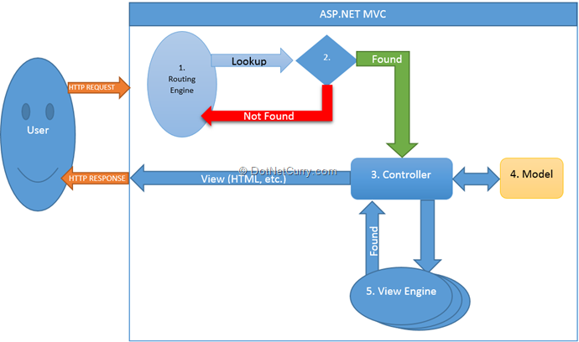
Asp.net MVC

Slide 2
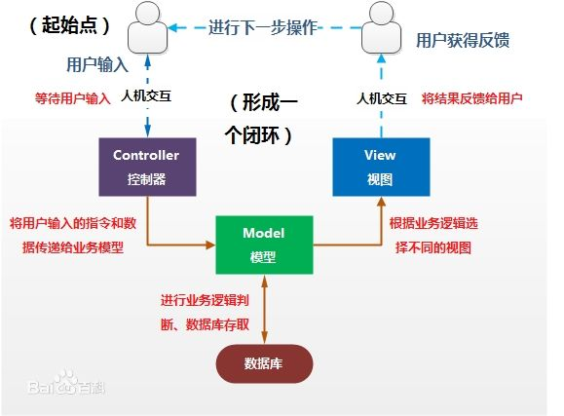
MVC
SOA

Slide 3
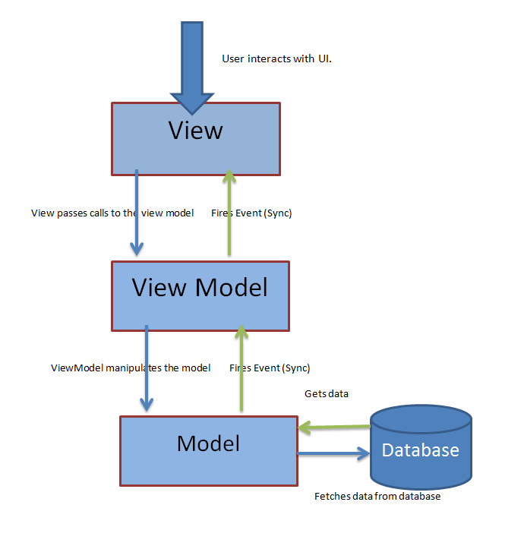
SOA

Slide 4
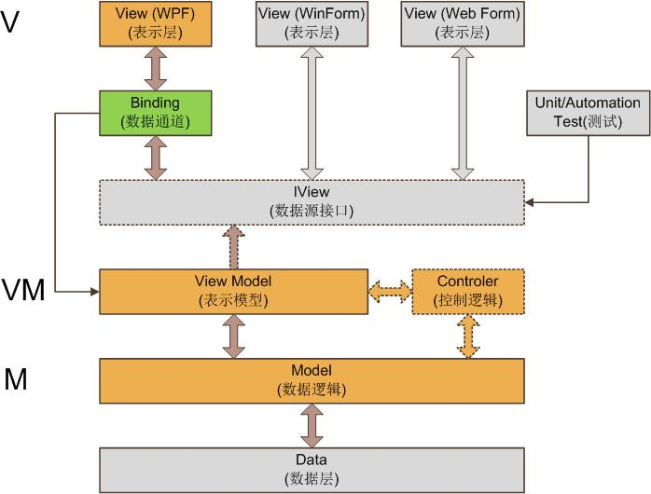
angularjs
MVP MVVM
emberjs
avalon
knockoutjs
http://architasblog.blogspot.com/2013/01/what-is-mvvm-mvvm-is-ui-design-pattern.html

Slide 5
Object.defineProperty(obj, "aaa", { get : function(){ return aValue; }, set : function(newValue){ obj.bbb += newValue aValue = newValue; }, enumerable : true, configurable : true })

Slide 6
