Slide 1
开发期
部署期(冷/热)
RuleTemplate(zip)
Event
Source
Rule
RuleInstance
Json1
Json2
Rule
Event
Source
EPS
Listener
CEP Engine
EPS
Listener
Extension
Action
Web
Console
输入
Param
Action
Extension
Jar1
Jar2
Jar3
OSGI
Web上传
加载
File System

Slide 2
RuleTemplate
Event
Source
Rule
EPS Listener
Acton
Extension
XXX.rt
EPS1
EPSn
Studio

Slide 3
MapEvent
name:String
properties:Map<String,Class>
JSON
Event
Source
EPS
name:String
isPattern:boolean
text:String
paramMap:Map<Integer,Class>
EPS1
Reg
epses:Map<Integer,EPS>
...
EPSn
EPS

Slide 4
Rule
Template Manager
Rule
Template1
Event Source1
Rule1
Action1
Listener1
Extension1
Rule
Template2
Event Source2
Rule2
Action2
Listener2
Extension2
Rule
Template3
Event Source3
Rule3
Action3
Listener3
Extension3
Event Source Manager
Rule Manager
Action Manager
Listener Manager
Extension Manager

Slide 5
Rule
Template Manager
Rule
Template1
Rule Instance1-1
Rule Instance1-M
Rule Instance Manager
FS
RT1
Param1
...
RT1
ParamM
zookeeper
Rule
Template2
Rule Instance2-1
Rule Instance2-M
RT2
Param1
...
RT2
ParamM
Rule
TemplateN
Rule InstanceN-1
Rule InstanceN-M
RTN
Param1
...
RTN
ParamM

Slide 6
Engine Container(Master)
CEP Engine Manager
zookeeper
CEP Engine1
CEP Engine2
Rule Instance Manager
Rule
Instance1
Rule
Instance2
Rule
Instance3
Engine Container(Slaver)
CEP Engine1
CEP Engine2

Slide 7
Event1
Event2
Event3
Master
Slaver
Event Buffer
Event Buffer
CEP Engine1
CEP Engine2
CEP Engine1-1
CEP Engine2-1
CEP Engine Manager

Slide 8
Engine
Engine
Engine
Engine
注册/监听
event buffer
event buffer
通知新的主进程运行
Engine Manager
主备策略(优先级 是否抢占)
监听
Zookeeper
通知
决定新的主进程

Slide 9
面向开发人员
面向业务人员
Action Manager
Event Source Manager
Rule Manager
Listener Manager
Extension Manager
Rule
Template Manager
Rule Instance Manager
Engine Manager
Framework
Web Server(JVM)

Slide 10
Engine Cluster
Engine1
Engine2
Engine1
Engine2
Engine1
Engine2
Engine Container
Engine Container
Engine Container
JVM1
JVM2
JVM3

Slide 11
Zookeeper Tree
root
RuleTemplate
(EventSource Action Rule Listener Extension )
Rule Inst1 ID(Parameters1)
Rule Inst2 ID(Parameters2)
Rule Inst3 ID(Parameters3)
Rule Inst4 ID(Parameters4)

Slide 12
MapEvent
序列化
JSON
写入
XXX.event

Slide 13
EPS1
EPS2
Rule
…
EPSn

Slide 14
EPS1
XXX.rule
读取
JSON
反序列化
Rule
EPS2
EPS3
EPS1
Rule
序列化
JSON
写入
XXX.rule
EPS2
EPS3

Slide 15
业务规则部署
是否包含自定义扩展
是
新建Engine进行部署
否
选择需要部署的Engine
持久化到文件系统
是否部署在新的Engine上
是
保存业务规则实例到内存中
否
可选择是否暂停当前Engine进行部署
Engine注册Listener监听zk上业务规则的变化
部署完成

Slide 16
业务规则参数热更新
保存到zk上
持久化更新后的业务规则实例
Engine监听到zk上业务规则节点的变化
暂停运行该规则的Engine
更新内存中的业务规则实例
删除该规则相关的原EPL实例
新建EPL实例加载更新后的规则
更新完成

Slide 17
在规则库中查找规则的持久化文件
持久化文件是否存在
解压规则.zip文件，将事件源等分散到各自的目录中，同时得到规则的持久化文件
不存在
存在
根据规则的持久化文件将事件源等注册到各自的Manager中
Engine容器根据节点的值，即事件源名称等，让Engine实例去各自的目录加载事件源等
将规则模板中的Reg生成表单到webconsole
将用户提交的参数以及事件源等名称注册到zookeeper中
Engine容器监听到增加了规则实例节点

Slide 18
保存修改后的参数到zk上
Engine监听到实例节点的变化，并得到修改后的参数值
暂停Engine，即停止接收事件
将原EPS实例停止并销毁
新建EPS实例
恢复Engine，即开始接收事件

Slide 19
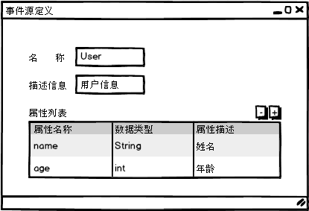

Slide 20
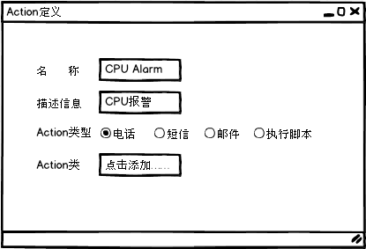

Slide 21
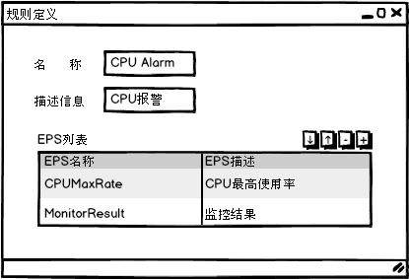

Slide 22
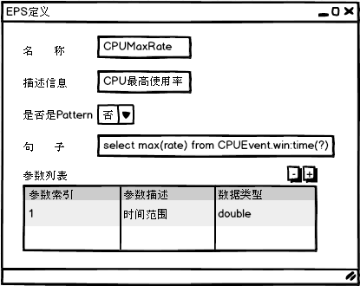

Slide 23
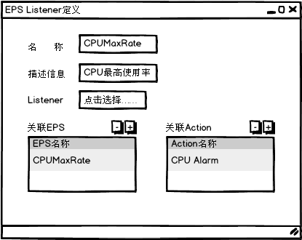

Slide 24
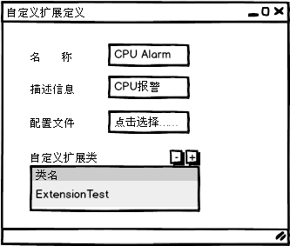

Slide 25
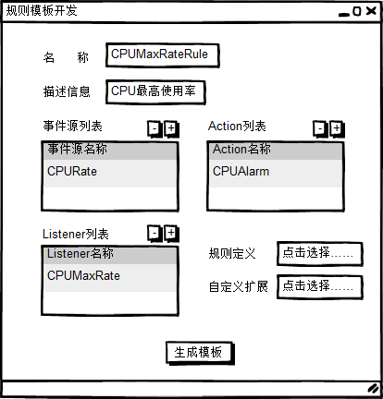

Slide 26
xxx.zip
xxx.event
xxx.rule
xxxAction.jar
xxxListener.jar
xxxExt.jar
xxx.rt

