Slide 1
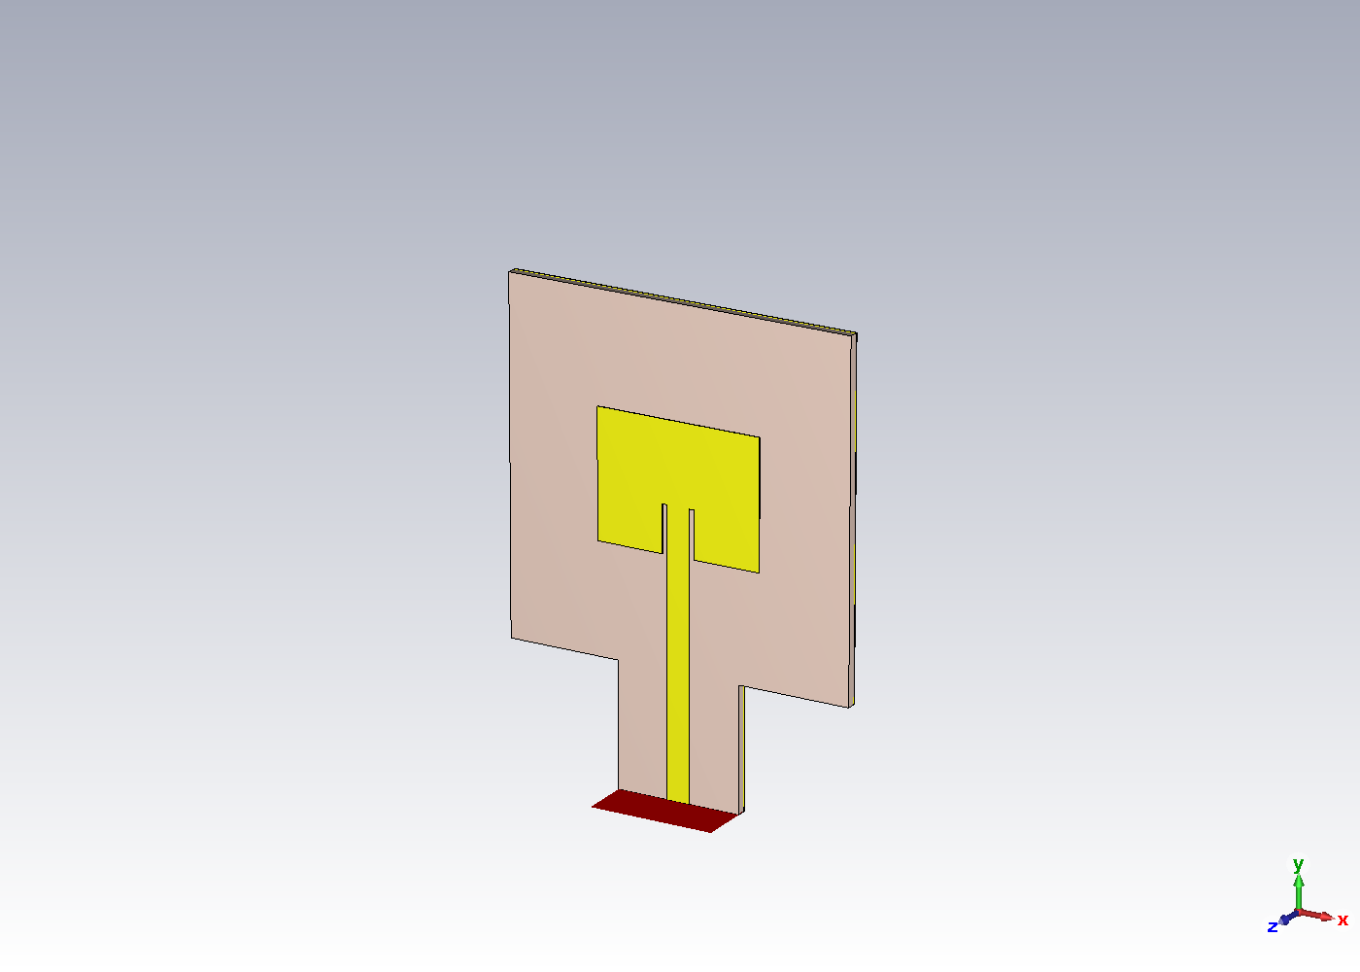
Design and Simulation of a D-Band
Microstrip Patch Antenna
TELE9782
Hanqing Zhao • Ning Mao
CST Studio Suite 2024
17 November 2026
Hanqing Zhao / TELE9782
01
Notes:
Good morning. We are Hanqing Zhao and Ning Mao. For TELE9782, we designed an inset-fed microstrip patch using CST Studio Suite. The aim was to exceed 6.5 dBi of directivity in the specified D-band range. We will explain how the starting dimensions were calculated, how the model was tuned, and how we checked the final result.
First, here are the requirements that defined the design.
Sources: Assignment brief supplied with project; final CST model.

Slide 2
Project requirements
130–170 GHz
150 GHz
>6.5 dBi
Specified design and sweep range
Nominal design point
Maximum directivity criterion
Compare the analytical estimate and simulated match frequency
Plot S₁₁ and find its −10 dB bandwidth
Plot directivity, realized gain and radiation efficiency versus frequency
Obtain the E-plane and H-plane radiation patterns
Hanqing Zhao / TELE9782
02
Notes:
The specified frequency range is 130 to 170 gigahertz. We chose 150 gigahertz, near the middle of that range, as the nominal design point. The main target is maximum directivity greater than 6.5 dBi. The brief also asks us to compare the analytical resonance with simulation, plot S eleven and extract its minus-ten-decibel bandwidth, report directivity and realized gain versus frequency, show radiation efficiency, and obtain the E-plane and H-plane patterns. We use the full sweep to see where the antenna responds. The impedance bandwidth is a separate quantity defined by the two minus-ten-decibel crossings.
The rectangular patch model gives us a starting size for that frequency.
Sources: Assignment brief; Engineering_Design_Notes.md.

Slide 3
Rectangular patch theory
TM₁₀ • half guided wavelength along L
Radiating edge
Leff ≈ λ₀ / (2√εeff)
Half-wave variation along L
L = Leff − 2ΔL
Dmax = 4πUmax / Prad
Radiating edge
Feed
Plan view • schematic
Hanqing Zhao / TELE9782
03
Notes:
In the fundamental T M one zero mode, one half-wave variation fits along the resonant length. The fringing fields at the two radiating edges act like two slots. Their broadside fields add, giving a main lobe normal to the patch. The wave travels through fields in both the substrate and the air, so we use an effective relative permittivity. This makes the guided wavelength shorter than the free-space wavelength. Fringing makes the effective patch length longer than the metal length, so we subtract the edge extension twice to get the physical length. Directivity describes how much radiation is concentrated in one direction. It compares the peak radiation intensity with the average over the sphere. The patch equations give a starting geometry, and the full-wave farfield gives the actual directivity of the model.
Here are the dimensions that come out of those equations.
Sources: Analytical_Starting_Design.json; supplied transmission-line equations; Balanis 4th ed., Ch. 14.

Slide 4
Analytical design and final parameters
Parameter
Analytical start
Final geometry
Patch width W
0.666 mm
0.667 mm
Patch length L
0.520 mm
0.513 mm
Substrate h
0.040 mm
0.040 mm
Frequency
150 GHz target
152.000 GHz analytical estimate
148.840 GHz simulated match minimum • 2.08% below the final-size estimate
Polyimide εr = 3.5, tanδ = 0.0027 • Gold 0.002 mm, σ = 4.561 × 10⁷ S/m
Hanqing Zhao / TELE9782
04
Notes:
At 150 gigahertz, the free-space wavelength is almost two millimetres. For a forty-micrometre polyimide substrate with relative permittivity 3.5, the starting width is 0.666 millimetres. The effective permittivity is about 3.203. The half guided wavelength is 0.558 millimetres, and the fringing correction is 0.019 millimetres at each edge. That gives a starting length of 0.520 millimetres. After tuning, we kept the width at 0.667 millimetres and shortened the length to 0.513. Length primarily sets resonance. Width influences the radiating aperture and input impedance. Substrate thickness changes the field distribution and the match. Feed position controls how the line couples to the patch. Applying the same formula to the final dimensions gives 152.00 gigahertz. The simulated S eleven minimum is at 148.84, about 2.08 percent lower. The finite ground and feed affect the input response.
We then modelled those features explicitly in CST.
Sources: parameters.json; Analytical_Starting_Design.json; Final_Performance.json.

Slide 5
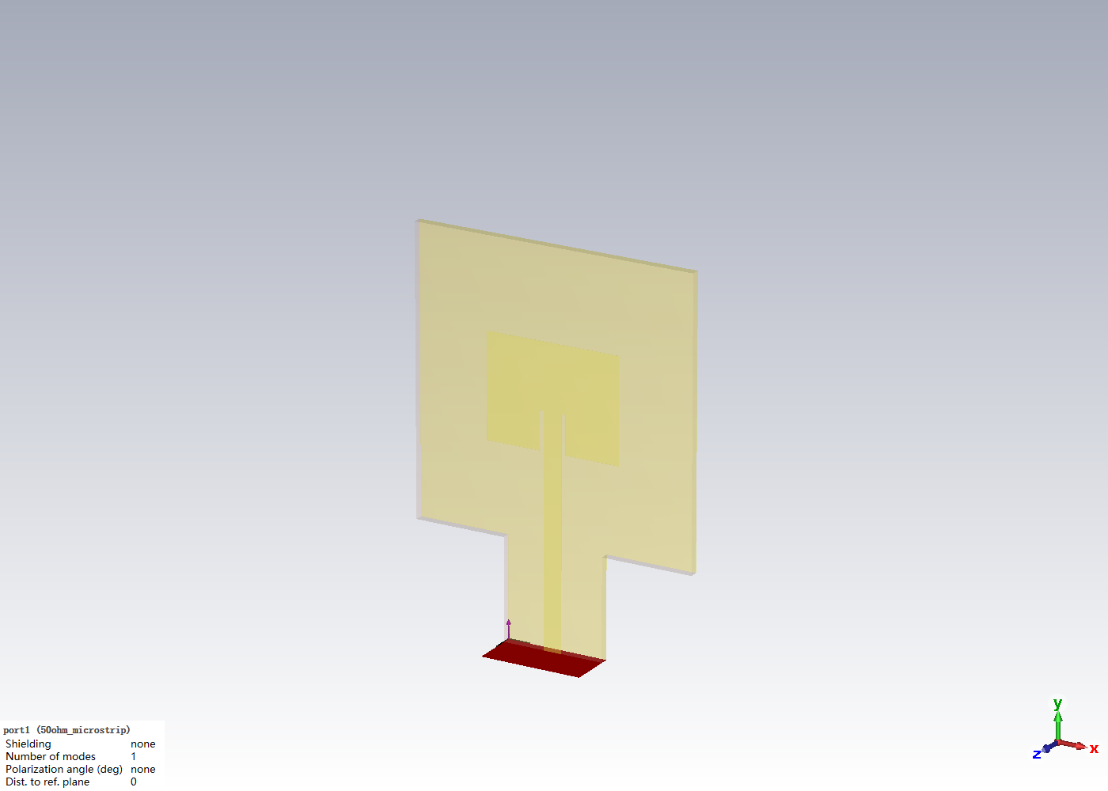
CST model and simulation setup
0.090 mm microstrip • 50 Ω reference
Uniform launch • +y quasi-TEM mode
Open boundaries • lossy materials
Hex/PBA time domain • 130–170 GHz
262,197 cells • 13 farfield monitors
Global enclosing surface • −60 dB decay
Hanqing Zhao / TELE9782
05
Notes:
This is the final CST model. The gold patch and feed sit on polyimide, above a finite gold ground. A uniform launch extends from the board to the port. The waveguide port excites one quasi-TEM microstrip mode towards the patch, with a 50-ohm reference for the S parameters. The time-domain solver sweeps 130 to 170 gigahertz. Open boundaries approximate free space, and the model includes dielectric loss and finite gold conductivity. The mesh resolves the thin substrate, the feed gaps and the port region. Thirteen farfield monitors sample the band, including points around the matched region and at exactly 150 gigahertz. We also compare two meshes and check the power balance and the full-sphere directivity normalization. Those checks matter because a completed solver run can still produce an unreliable farfield.
Ning will explain how the model was corrected and how the final results were verified.
Sources: Port_Configuration.png; 04_Automation/engineering.py; saved CST project.

Slide 6
Troubleshooting and optimisation
01 Diagnose invalid −20.92 dBi output and backward excitation
02 Rebuild a uniform launch and parameterise the finite ground
03 Baseline S₁₁ min −10.18 dB at 148.56 GHz
04 Inset sweep • 0.17 mm → −14.18 dB • 0.19 mm → −26.82 dB
05 Shorten L from 0.521 to 0.513 mm to move the matched band up
06 Reject near-model farfield inconsistency; verify global-surface result
Ning Mao / TELE9782
06
Notes:
Thanks, Hanqing. The original run displayed a maximum directivity near minus 20.92 dBi. That was physically inconsistent for a normalized full-sphere maximum. The port faced away from the patch, and changing its orientation exposed an insufficient uniform feed length. We rebuilt the launch and parameterised the ground. The reconstructed model ran, with a baseline S eleven minimum near minus 10.18 dB. The inset sweep improved the match. The 0.17 millimetre trial reached minus 14.18 dB, and the 0.19 trial reached minus 26.82. We shortened the patch to move the matched region upwards. A later farfield check also exposed an error with the near-model integration surface. The final configuration uses a global enclosing surface and a stricter decay criterion. The port and farfield changes made the calculation credible. Inset tuning primarily improved the match.
Here is the final S eleven response after those changes.
Sources: Project_Diagnosis.md; Iteration_Log.csv; Simulation_Validation.md.

Slide 7
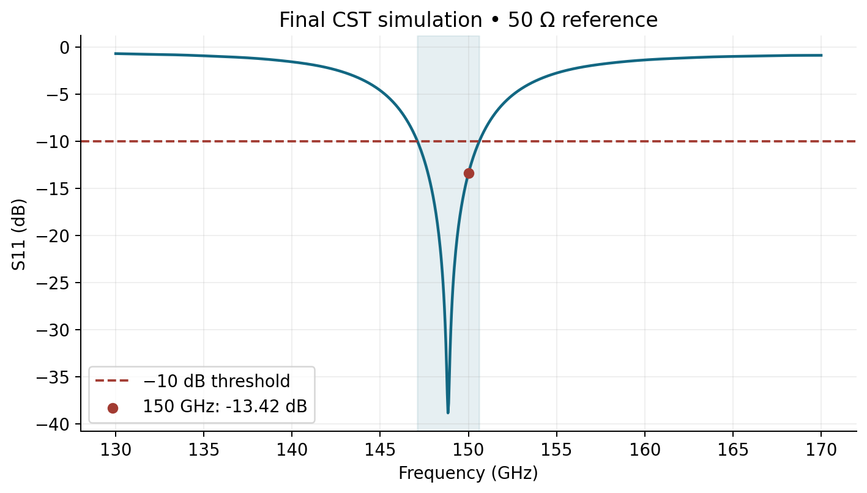
Resonance and S₁₁
150 GHz • −13.424 dB
Match dip • 148.840 GHz
Minimum • −38.859 dB
−10 dB • 147.106–150.619 GHz
Bandwidth • 3.513 GHz / 2.36%
Ning Mao / TELE9782
07
Notes:
The orange marker shows 150 gigahertz. S eleven there is minus 13.424 dB, so about 4.55 percent of incident power is reflected. The deepest sampled dip is minus 38.859 dB at 148.840 gigahertz. We call it the match minimum because the input reflection also depends on the feed and impedance reference. The minus-ten-decibel crossings are 147.106 and 150.619 gigahertz. Subtracting the two gives a bandwidth of 3.513 gigahertz. Dividing by their midpoint gives 2.36 percent. The selected 150 gigahertz point is within that interval and has a dedicated farfield monitor. This lets us compare input matching and radiation at exactly the same frequency.
The next slide shows what the antenna does with the power it accepts.
Sources: S11.csv; Impedance_Bandwidth.csv; S11.png.

Slide 8
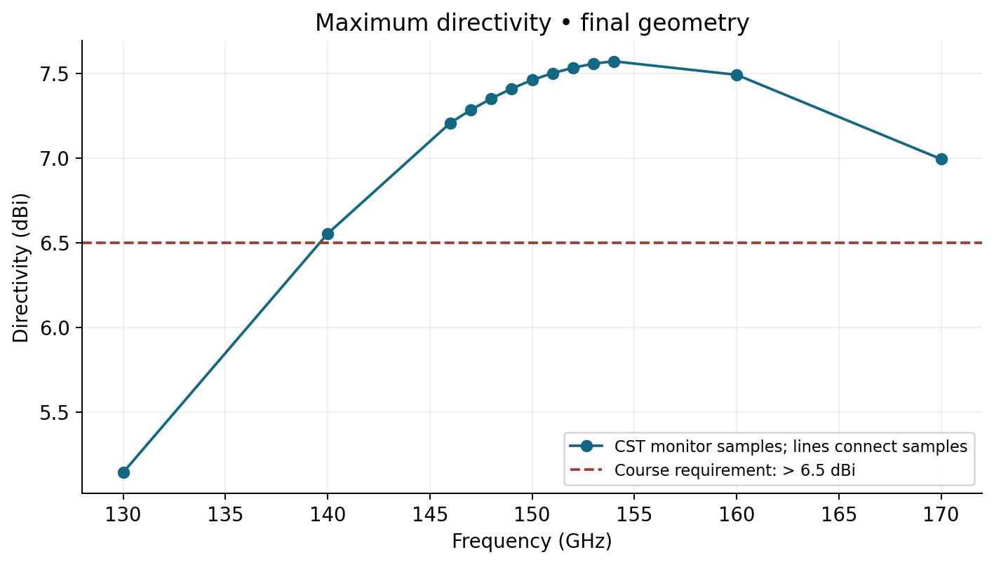
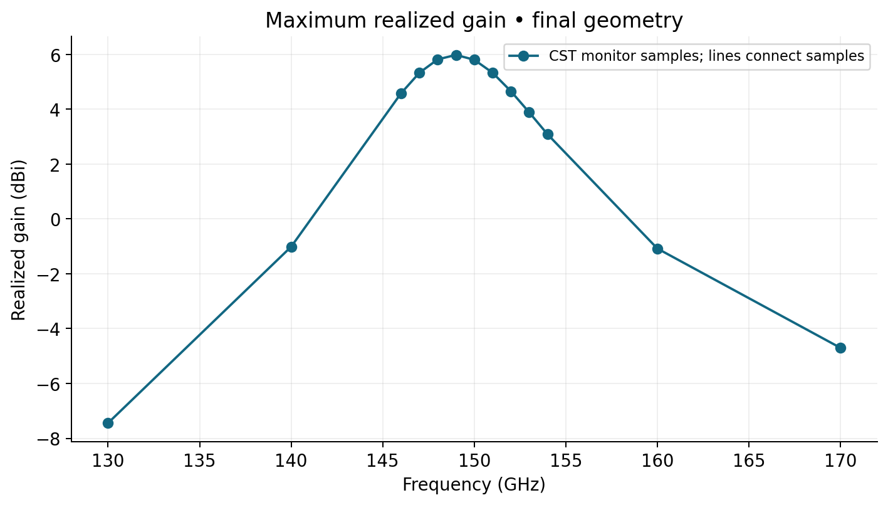
Directivity and realized gain
7.460 dBi
+0.960 dB
5.804 dBi
Directivity at 150 GHz
Above the 6.5 dBi criterion
Realized gain at 150 GHz
Discrete CST monitor points • realized gain includes dissipation and mismatch
Ning Mao / TELE9782
08
Notes:
The left plot shows maximum directivity and the right plot shows maximum realized gain at the monitor frequencies. At 150 gigahertz, directivity is 7.460 dBi. The requirement is greater than 6.5 dBi, so the margin is 0.960 dB at a matched frequency. Directivity tells us where the radiated power goes. Realized gain also accounts for losses in the antenna and reflection at the input. The realized gain at the same point is 5.804 dBi. We can reproduce it by adding ten times the logarithm of total efficiency to the directivity in dBi. The largest sampled directivity is at 154 gigahertz, where the input match is poor. We report the result at 150 because it demonstrates useful matching and directivity together.
The efficiency and the principal-plane cuts explain the radiation in more detail.
Sources: Directivity.csv; Realized_Gain.csv; Validation_Summary.csv.

Slide 9
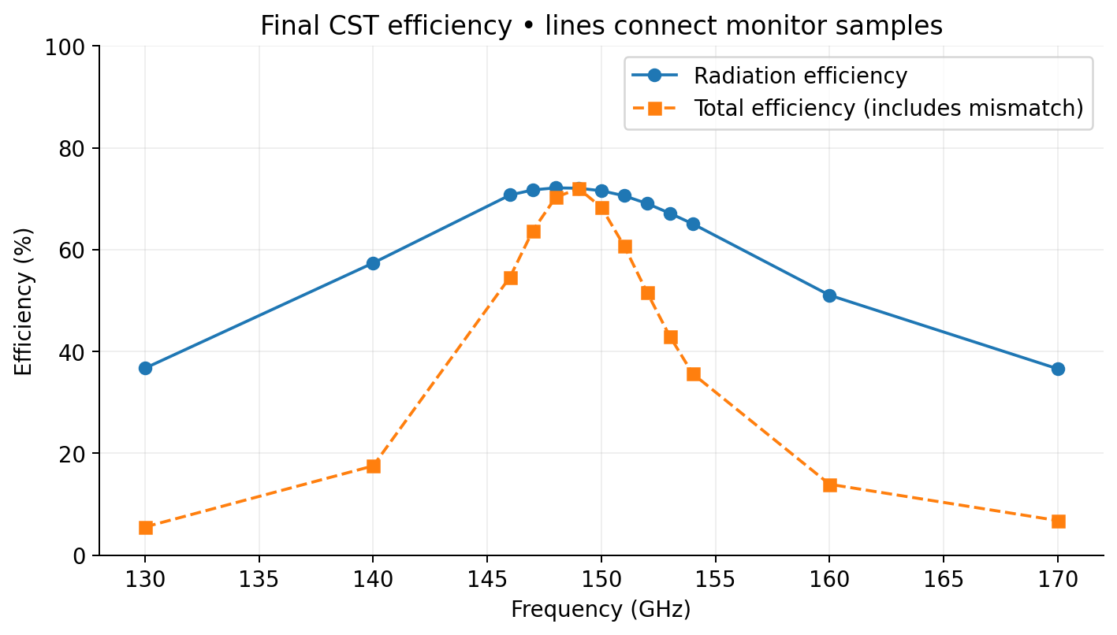
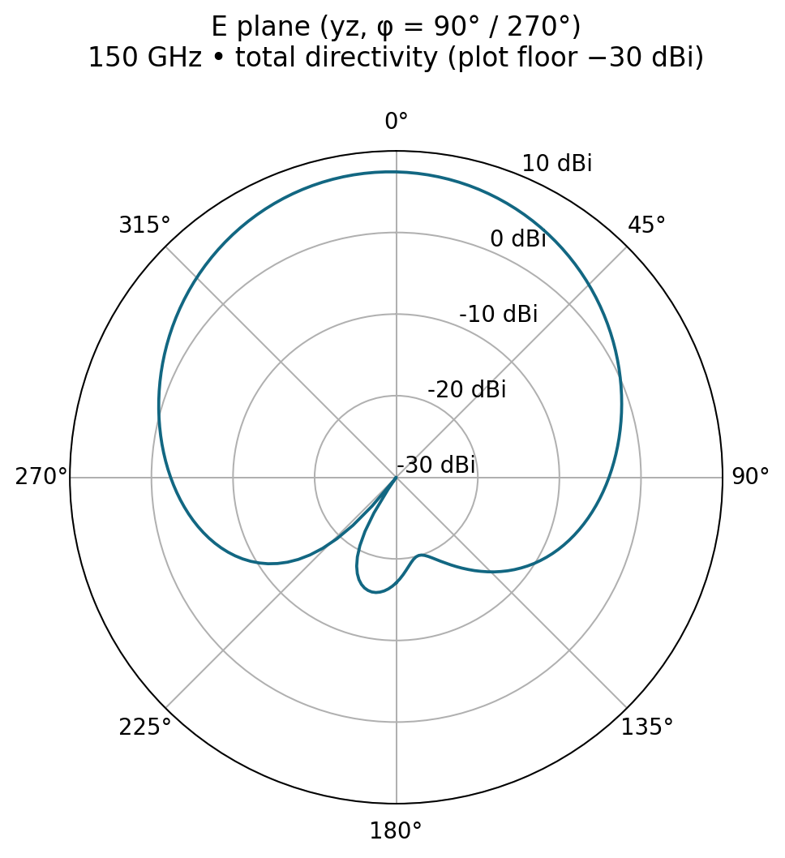
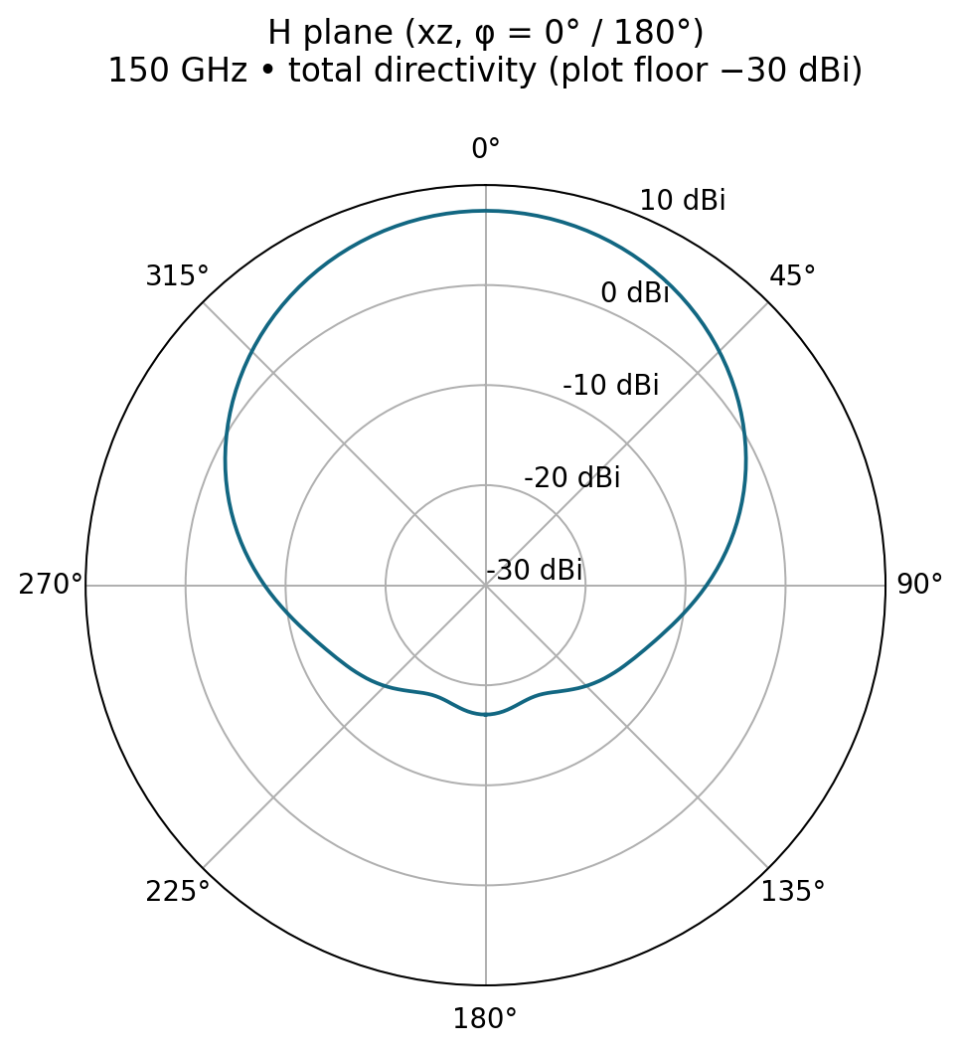
Efficiency and radiation patterns
71.55% radiation efficiency at 150 GHz
E-plane / yz
H-plane / xz
E-plane yz; H-plane xz • y-polarized broadside field • peak near +z (θ ≈ 4°)
Ning Mao / TELE9782
09
Notes:
The first graph shows radiation efficiency over frequency. At 150 gigahertz, 71.55 percent of the accepted power is radiated. If we also include the reflected power, total efficiency is 68.30 percent. The two cuts show the directional pattern at 150 gigahertz. The broadside electric field is mainly y-polarized. This makes the y z cut the E-plane and the x z cut the H-plane. Both show a forward lobe. In the full three-dimensional pattern the maximum is close to positive z, about four degrees from broadside on a two-degree sampling grid. The cuts give the shape of the beam in two perpendicular planes, while the full sphere supplies the maximum directivity.
We close with the checks that support the reported performance.
Sources: Radiation_Efficiency.csv; E_Plane.csv; H_Plane.csv; Sphere_Normalization_Check.json.

Slide 10
Validation and conclusion
7.460 dBi
−13.424 dB
150 GHz maximum directivity
S₁₁ at the same operating point
Two meshes • ΔDmax = 0.037 dB • match dip shift 0.56%
Full sphere • mean linear D = 0.9991
Power balance • 0.754% residual of accepted power
Final CST project reopened and reran successfully
Ning Mao / TELE9782
10
Notes:
Between the two meshes, directivity changed by only 0.037 dB at 150 gigahertz. The spherical mean was 0.9991, and the power-balance residual was 0.754 percent. The saved project reopened and reran successfully. At 150 gigahertz, this single patch delivers 7.460 dBi of simulated directivity with S eleven below minus 10 dB.
Thank you. We are happy to take questions.
Sources: Mesh_Convergence.csv; Power_Consistency.csv; Sphere_Normalization_Check.json; Verification.json.

Slide 11
Transmission-line calculation
Start with λ₀ = 299.792458 / 150 = 1.9986 mm.
W = λ₀/2 × √[2/(3.5 + 1)] = 0.6662 mm
εeff = (εr + 1)/2 + (εr − 1)/(2√(1 + 12h/W)) = 3.203
ΔL/h = 0.412[(εeff + 0.3)(W/h + 0.264)] / [(εeff − 0.258)(W/h + 0.8)]
Leff ≈ 0.5584 mm; ΔL ≈ 0.0190 mm; L ≈ 0.5204 mm
Final-size estimate: c / [2(L + 2ΔL)√εeff] = 152.000 GHz
APPENDIX A / TELE9782
11
Notes:
Q&A only. Start with λ₀ = 299.792458 / 150 = 1.9986 mm. W = λ₀/2 × √[2/(3.5 + 1)] = 0.6662 mm εeff = (εr + 1)/2 + (εr − 1)/(2√(1 + 12h/W)) = 3.203 ΔL/h = 0.412[(εeff + 0.3)(W/h + 0.264)] / [(εeff − 0.258)(W/h + 0.8)] Leff ≈ 0.5584 mm; ΔL ≈ 0.0190 mm; L ≈ 0.5204 mm Final-size estimate: c / [2(L + 2ΔL)√εeff] = 152.000 GHz
Sources: Analytical_Starting_Design.json; Balanis 4th ed., Ch. 14.

Slide 12
Final geometry and materials
Patch W × L | 0.667 × 0.513 mm
Main ground / launch | 1.4 × 1.4 / 0.5 × 0.5 mm
Substrate | 0.040 mm polyimide; εr 3.5; tanδ 0.0027
Gold | 0.002 mm; conductivity 4.561 × 10⁷ S/m
Feed / inset / each gap | 0.090 / 0.190 / 0.020 mm
Material parameters are nominal D-band model assumptions.
APPENDIX B / TELE9782
12
Notes:
Q&A only. Patch W × L | 0.667 × 0.513 mm Main ground / launch | 1.4 × 1.4 / 0.5 × 0.5 mm Substrate | 0.040 mm polyimide; εr 3.5; tanδ 0.0027 Gold | 0.002 mm; conductivity 4.561 × 10⁷ S/m Feed / inset / each gap | 0.090 / 0.190 / 0.020 mm Material parameters are nominal D-band model assumptions.
Sources: parameters.json; Engineering_Design_Notes.md; Reference_ModelHistory.json.

Slide 13
Waveguide port and inset matching
Uniform launch: 0.5 mm long, feeding +y
Port plane: y = −1.2 mm; x = ±0.25 mm
z = −0.002 to 0.24 mm; one quasi-TEM mode
Final line impedance: 49.47 Ω at 150 GHz
S-parameter reference: 50 Ω
Rin(y) ≈ Redge cos²(πy/L)
APPENDIX C / TELE9782
13
Notes:
Q&A only. Uniform launch: 0.5 mm long, feeding +y Port plane: y = −1.2 mm; x = ±0.25 mm z = −0.002 to 0.24 mm; one quasi-TEM mode Final line impedance: 49.47 Ω at 150 GHz S-parameter reference: 50 Ω Rin(y) ≈ Redge cos²(πy/L)
Sources: CST_Raw/1D Results_Port Information_Line Impedance_1(1).csv; engineering.py; Port_Configuration.png.

Slide 14
Mesh, power and rerun checks
Coarse: 76,860 cells; 7.497 dBi; dip 149.680 GHz
Fine: 262,197 cells; 7.460 dBi; dip 148.840 GHz
Accepted 0.47727 W; radiated 0.34150 W
Metal 0.08954 W; dielectric 0.04264 W
Residual 0.00360 W = 0.754% of accepted power
Spherical mean 0.9991; saved project rerun SUCCESS
APPENDIX D / TELE9782
14
Notes:
Q&A only. Coarse: 76,860 cells; 7.497 dBi; dip 149.680 GHz Fine: 262,197 cells; 7.460 dBi; dip 148.840 GHz Accepted 0.47727 W; radiated 0.34150 W Metal 0.08954 W; dielectric 0.04264 W Residual 0.00360 W = 0.754% of accepted power Spherical mean 0.9991; saved project rerun SUCCESS
Sources: Mesh_Convergence.csv; Power_Consistency.csv; Verification.json.

Slide 15
Frequency results at all 13 monitors
GHz
S₁₁ (dB)
Dmax (dBi)
Grealized (dBi)
ηrad (%)
ηtotal (%)
130
-0.71
5.14
-7.44
36.70
5.51
140
-1.58
6.55
-1.01
57.36
17.51
146
-6.43
7.21
4.58
70.72
54.62
147
-9.54
7.28
5.33
71.71
63.75
148
-15.91
7.35
5.82
72.12
70.27
149
-30.15
7.41
5.98
72.05
71.98
150
-13.42
7.46
5.80
71.55
68.30
151
-8.54
7.50
5.33
70.57
60.69
152
-5.97
7.53
4.66
69.04
51.59
153
-4.43
7.56
3.89
67.13
42.95
154
-3.44
7.57
3.09
65.06
35.62
160
-1.38
7.49
-1.08
51.03
13.90
170
-0.89
6.99
-4.70
36.57
6.77
13 actual farfield samples • 1001-point S₁₁ trace on slide 7
APPENDIX E / TELE9782
15
Notes:
Q&A only. S₁₁ at the monitor frequencies uses the same 50 Ω reference. D, realized gain and efficiency are evaluated at these discrete points.
Sources: Validation_Summary.csv.

Slide 16
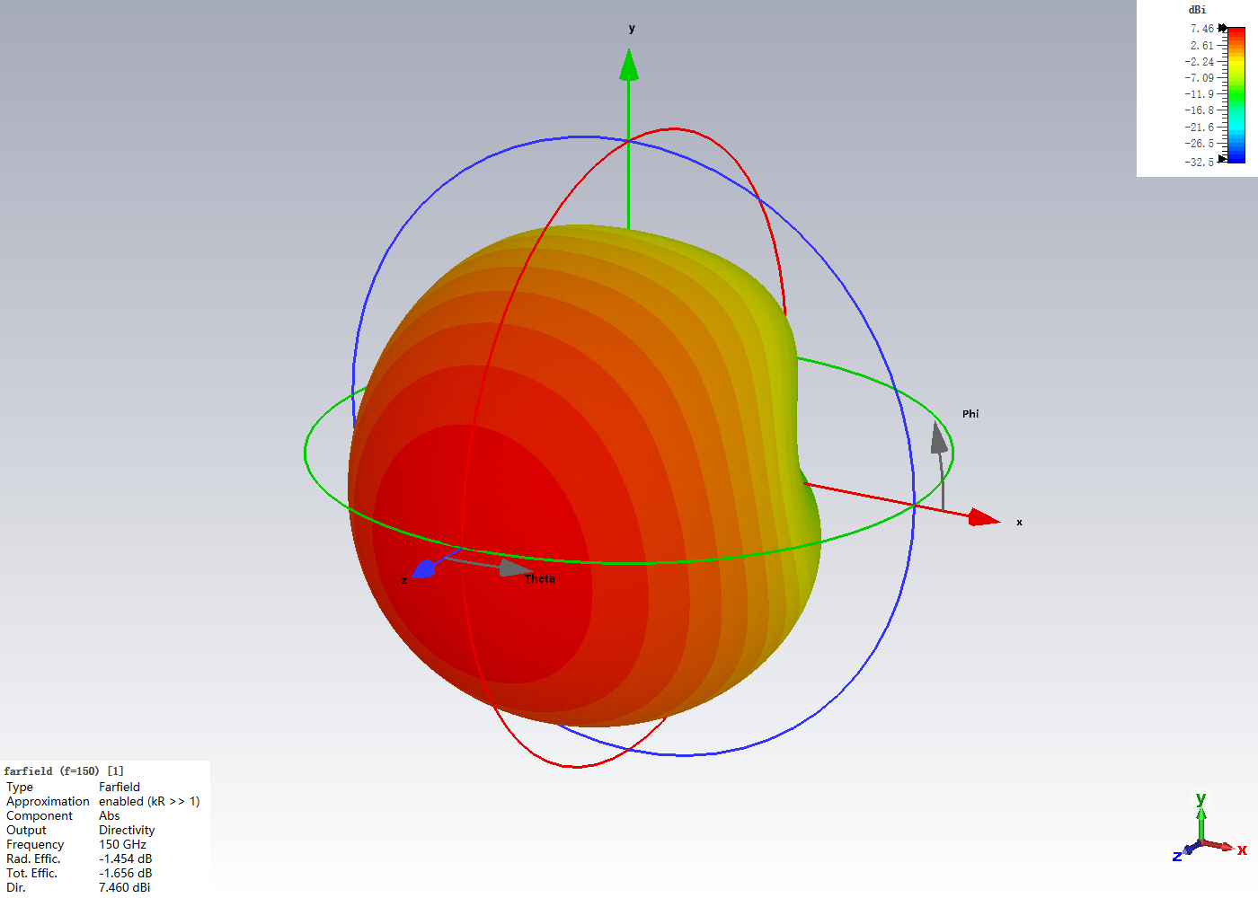
Polarisation and 3D farfield
Peak at θ ≈ 4°, φ ≈ 264° on the 2° export grid
Broadside field predominantly y-polarized
E-plane yz: φ = 90° / 270°
H-plane xz: φ = 0° / 180°
Cuts on slide 9 show total directivity.
APPENDIX F / TELE9782
16
Notes:
Q&A only. Peak at θ ≈ 4°, φ ≈ 264° on the 2° export grid Broadside field predominantly y-polarized E-plane yz: φ = 90° / 270° H-plane xz: φ = 0° / 180° Cuts on slide 9 show total directivity.
Sources: Farfield_150_Sphere.txt; Farfield_3D.png; Engineering_Design_Notes.md.

Slide 17
Diagnostic history and references
Invalid historical maximum: ≈ −20.92 dBi. Corrected port and uniform launch.
Near-model diagnostic: 8.54 dBi rejected; full-sphere mean 1.291.
Accepted: enclosing surface, −60 dB decay, mean 0.9991.
Theory: TELE9782 supplied project equations; C. A. Balanis, Antenna Theory, 4th ed., Wiley, Chapter 14.
Evidence: saved CST project, Iteration_Log.csv and Simulation_Validation.md.
APPENDIX G / TELE9782
17
Notes:
Q&A only. Invalid historical maximum: ≈ −20.92 dBi. Corrected port and uniform launch. Near-model diagnostic: 8.54 dBi rejected; full-sphere mean 1.291. Accepted: enclosing surface, −60 dB decay, mean 0.9991. Theory: TELE9782 supplied project equations; C. A. Balanis, Antenna Theory, 4th ed., Wiley, Chapter 14. Evidence: saved CST project, Iteration_Log.csv and Simulation_Validation.md.
Sources: Project_Diagnosis.md; Simulation_Validation.md; supplied project equations; https://www.wiley.com/en-us/-p-9781119178996

