Slide 1
Gravity Toss
SEUNGHYUN KIM

Slide 2
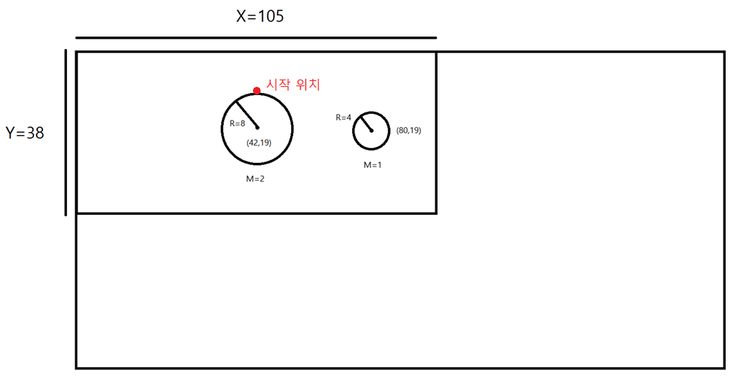
1. Outline
you begin here

Slide 3
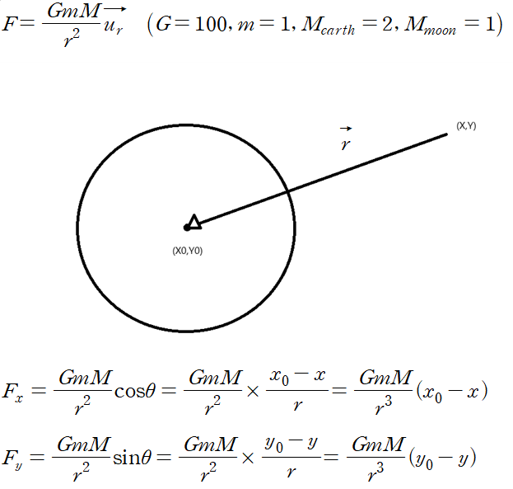

Slide 4
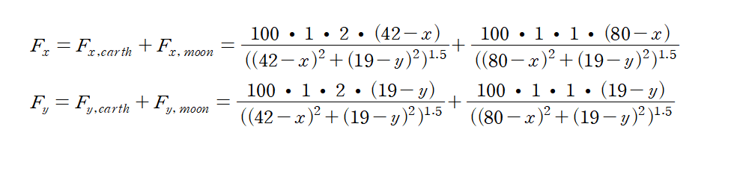

Slide 5
2. Pros and Cons
<Pros>
-Implemented the use of the Beep function to play a specific sound when the ball hits the wall or when the game ends.
-The total number of attempts to hit the target is displayed.
<Cons>
-The difficulty of the game varies greatly depending on the position of the target.
-Both Earth and the Moon are not perfect spheres.

Slide 6
3. Source Code Illustration

Slide 7
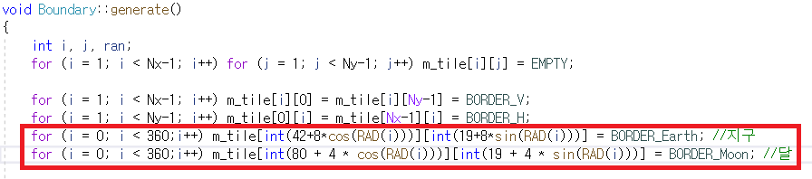
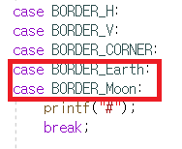
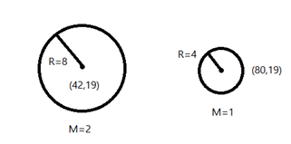
Generation of Earth and Moon
Print of Boundary Point

Slide 8
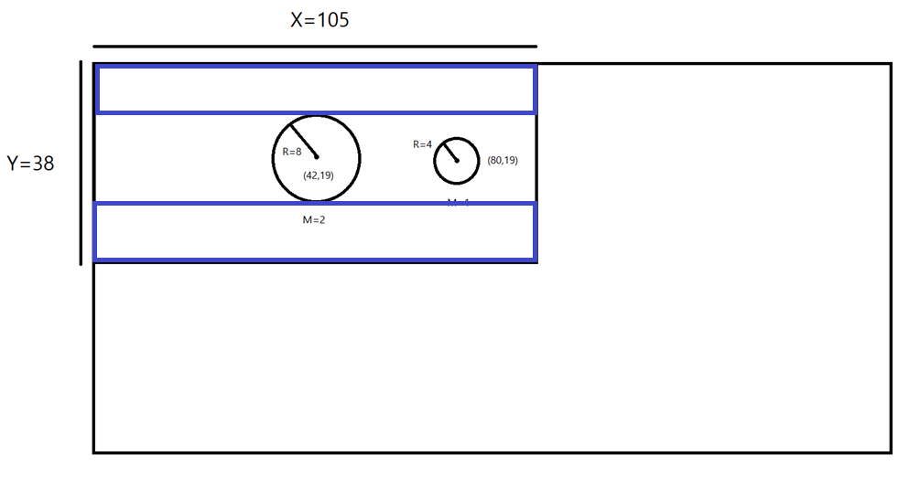
How to locate the target at a random location
The target is generated randomly in the rectangle shaped section in blue colour

Slide 9
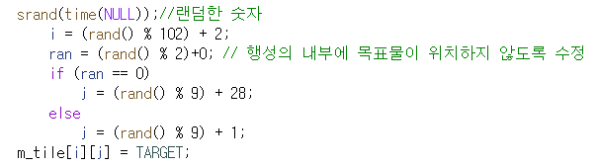
How to locate the target at a random location
//Random number
//An adjustment was made so that the target will not be located inside the planet

Slide 10
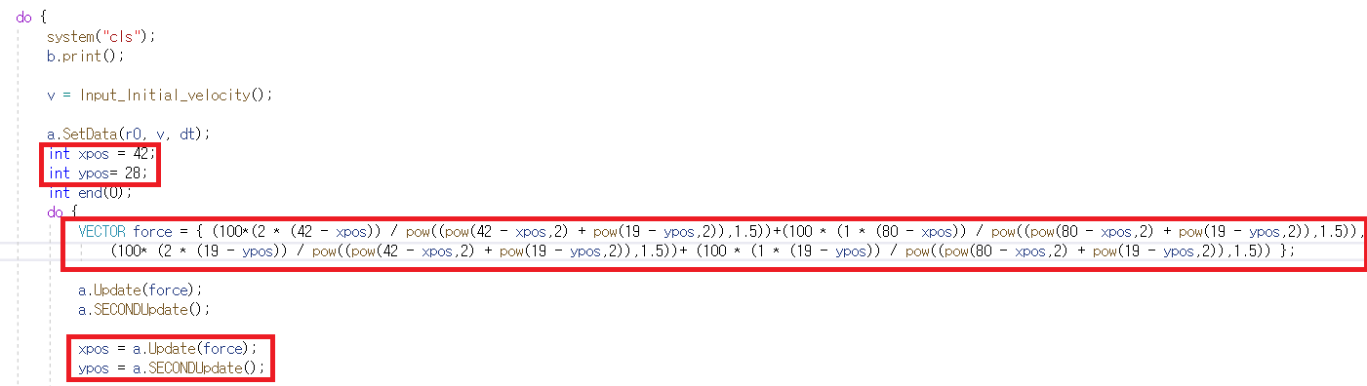

How to set the gravity force, and update it

Slide 11
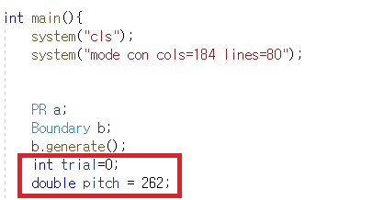
The number of attempts are represented by the variable trial, and a double-type variable pitch represents the sound frequency.

Slide 12
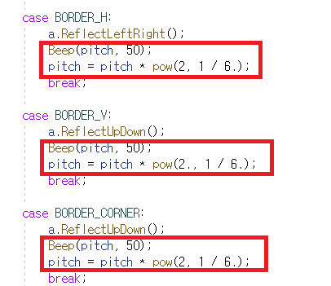
When the ball hits the wall

Slide 13
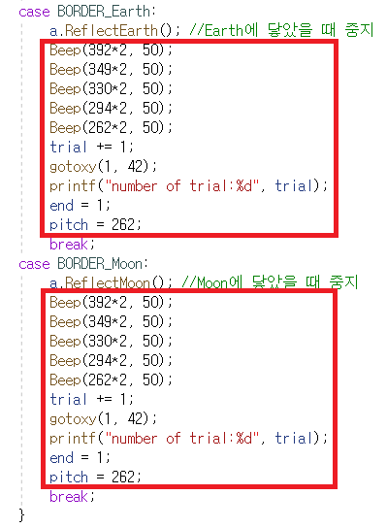
When the ball lands on either Moon or Earth

Slide 14
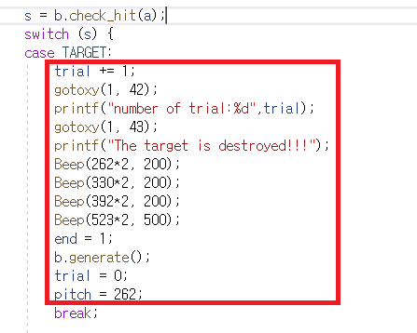
When the ball reaches the target

