Slide 1
UK Road Accident Analysis & Risk Assessment
Project Overview:-
This project analyzes UK road accident data to identify patterns, high-risk conditions, and contributing factors affecting accident frequency and severity. The analysis combines Python, SQL, and Power BI to deliver data-driven insights for road safety and decision-making.
Objectives:-
Identify accident trends over time (date, month, quarter).
Analyze risk severity under different conditions (speed, weather, light, road surface).
Detect high-risk locations, road types, and time periods.
Provide actionable insights through interactive dashboards.
Tools & Technologies:-
Python: Data cleaning, transformation, EDA, feature engineering, statistical analysis.
SQL: Aggregations, CTEs, group-by, ordering for deeper analysis.
Power BI: Power Query, DAX (MTD, QTD), date/time tables, filters, interactive visuals.

Slide 2
Data Source and Analytical Approach
Dataset Description:-
UK road accident dataset containing:
Accident date & time.
Location & police force.
Road type, junction details, pedestrian crossings.
Weather, light, speed limits.
Accident severity, casualties, and vehicles involved.
Data Preparation & Modeling:-
Cleaned and standardized raw data using Python.
Performed EDA , created derived features (time bands, seasons, risk rates) using feature engineering, statistically tested patterns.
Built SQL queries for grouped and aggregated insights.
Transformed data in Power Query & designed date and time dimension tables in Power BI.
Developed DAX measures including MTD, QTD, totals, and risk rates.

Slide 3
Data Source and Analytical Approach
Dashboard Design Philosophy:-
KPIs for quick summary metrics.
Trends & distributions for pattern detection.
Filters & slicers for interactive exploration.
Focus on clarity, insights, and decision support.

Slide 4
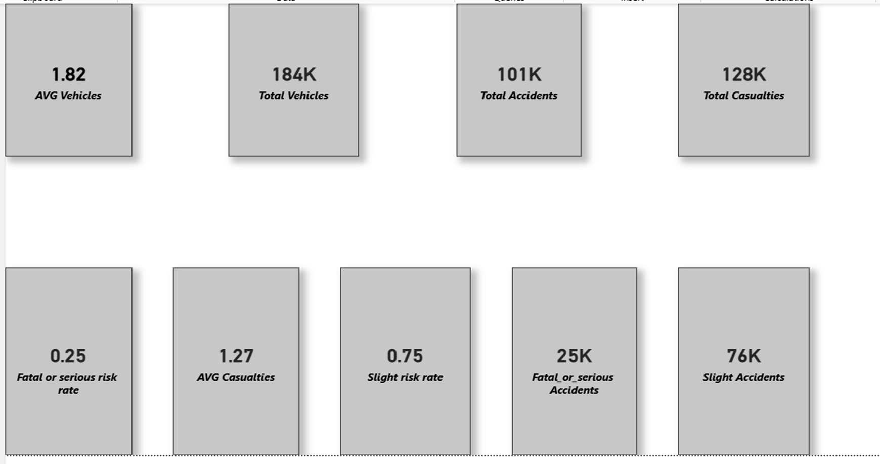
Key Accident Summary Metrics

Slide 5
Key Insights:-
•Majority of accidents are slight in severity, but severe accidents still form a critical risk segment.
•Fatal and serious accidents, though fewer, drive a high share of total casualties.
•Multi-Vehicle involvement contributes to higher casualty counts per accident.

Slide 6
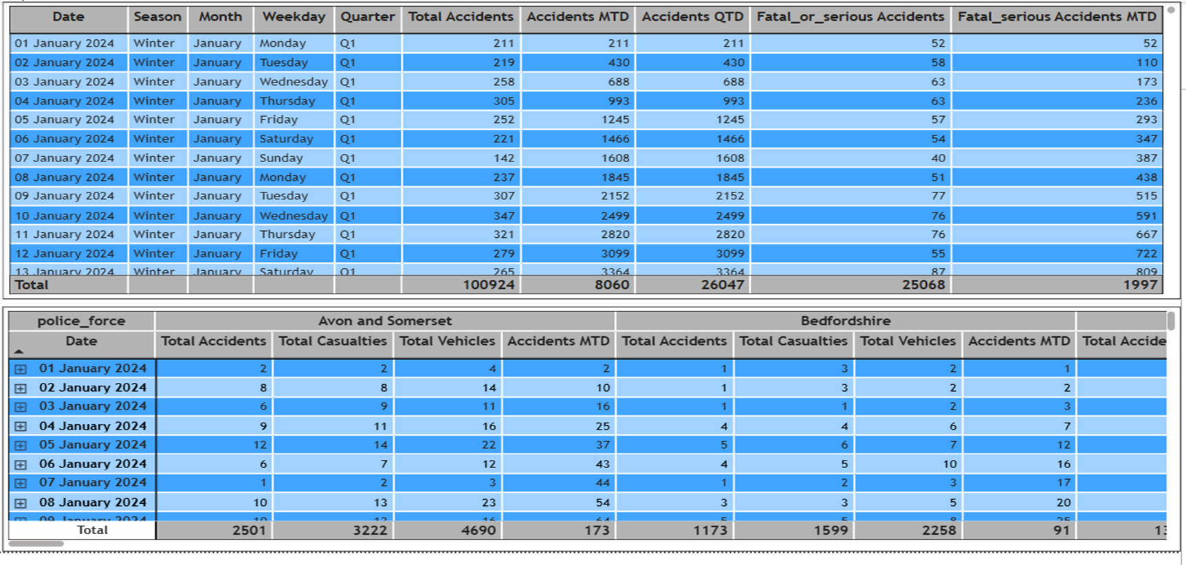
1. Road Accident Trends by Date, Month and Quarter(Table Visual)
2. Daily Road Accident Metrics Across Time and Police Force(Metrix Visual)

Slide 7
Key Insights:-
•Road accidents peak during the fourth quarter, with October recording the highest total accident count.
•August records the highest number of fatal or serious road accidents, indicating increased accident severity during this period.
• Accident frequency is highest during afternoon hours.
• The Metropolitan Police area consistently records the highest number of accidents across all times of the day compared to other police forces.

Slide 8
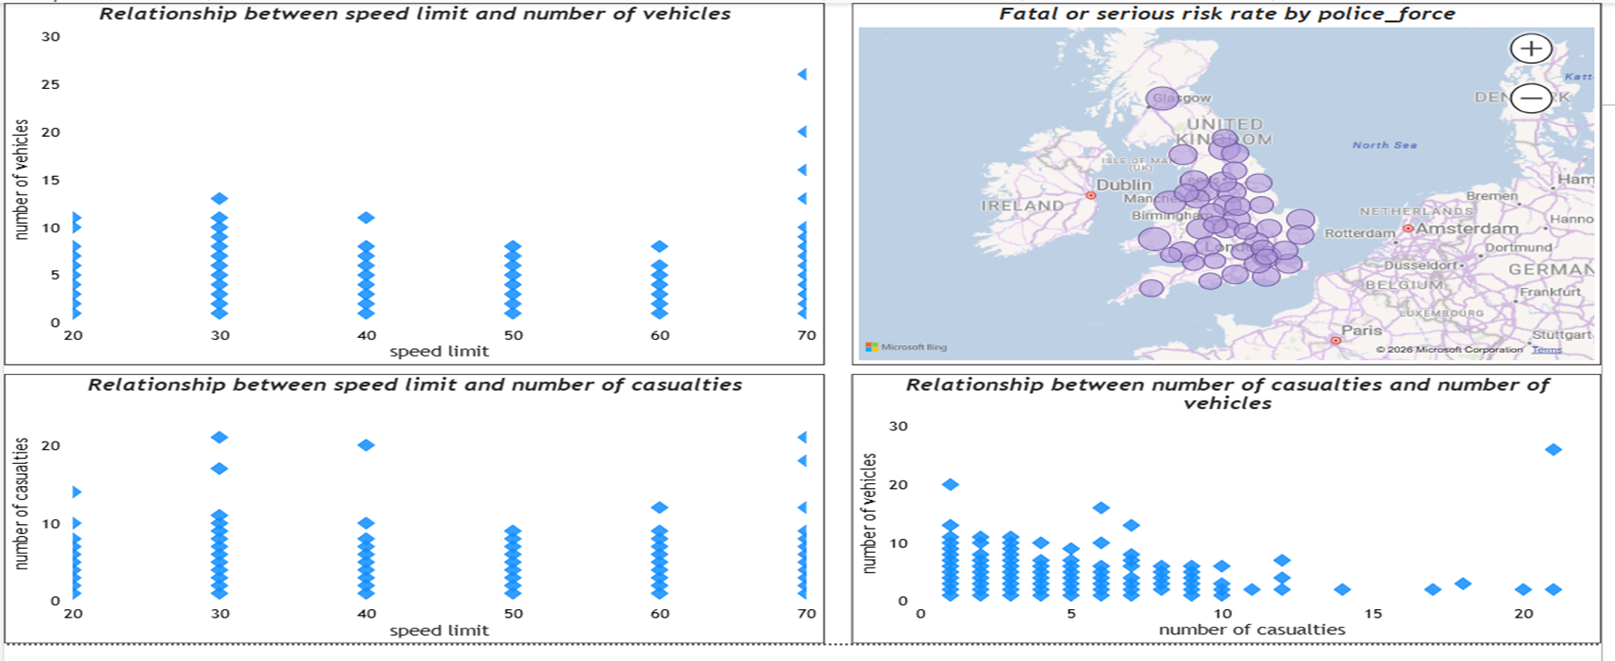
Scatter plot(Correlation Analysis) & Map visual

Slide 9
Key Insights:-
•Accident casualties increase as the number of vehicles involved rises, indicating a strong relationship between collision complexity and impact.
•Speed limit alone does not strongly determine casualty count, as severe outcomes occur across both low and high speed limits.
•Fatal or serious accident risk is geographically concentrated within specific police force areas.

Slide 10
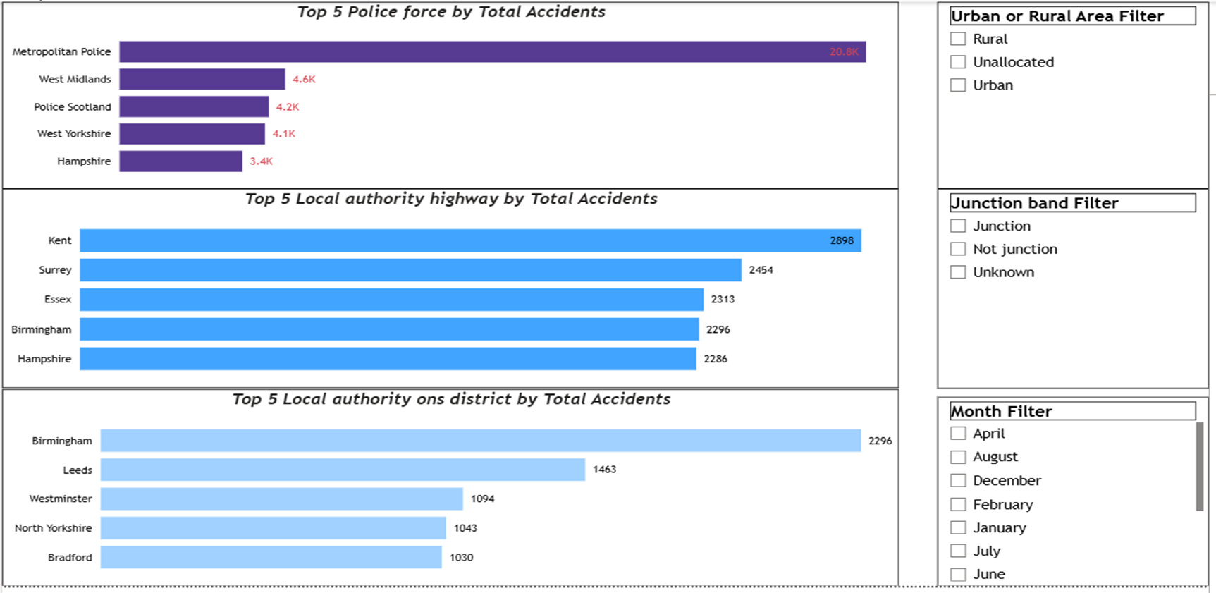
Top 5 Accident-Prone Locations Across Authorities
Subtitle:- Dynamic ranking of accident-prone locations based on selected time, junction, and area filters

Slide 11
Key Insights:-
Across all months, the Metropolitan Police area consistently records the highest number of accidents, particularly in urban regions, indicating sustained high-risk exposure in metropolitan areas.
Within police force areas, local authority districts & local authority highways , urban locations account for the majority of accidents, highlighting traffic density as a key contributor.
Among local authority districts, Birmingham records the highest number of accidents across all months, especially in urban area, reinforcing its status as a high-risk district.
For local authority highways, Kent records the highest number of accidents across all months(especially in rural area) except in September where Surrey records the highest number of accidents.
Rural areas generally record fewer accidents compared to urban areas, though specific rural police forces (e.g., Devon & Cornwall) still show relatively higher accident counts within their category.

Slide 12
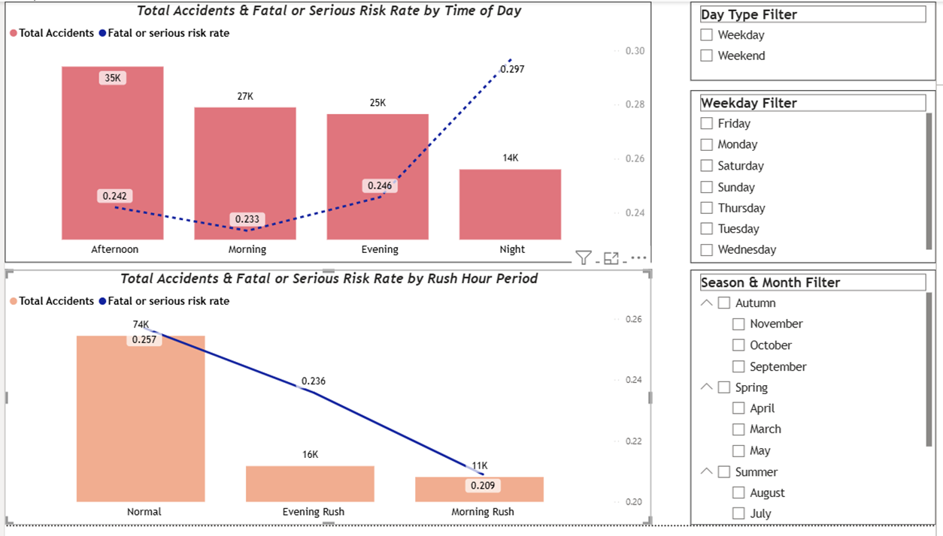
Accident and Risk Rate Trends Over Time
Subtitle:- Time-of-day and rush-hour accident patterns under selected season and weekday filters

Slide 13
Key Insights:-
Across all seasons, accident frequency consistently peaks during afternoon hours, while night-time records the lowest accident volume.
Within the afternoon time period, accident volumes are highest during May and the summer season compared to afternoons in other seasons.
Weekend mornings record the fewest accidents, while weekday night-time consistently shows minimal accident counts, indicating lower traffic exposure during these periods.
Normal hours account for the highest accident volume, followed by evening rush hours, with morning rush hours across all seasons contributing the least to total accidents.
During evening rush hours, Winter season consistently record higher accident volumes compared to evening rush hour of other seasons, while during morning rush hour& normal hours , Autumn season had most accidents as compared to morning rush hour & normal hour of other seasons.
Weekday accident patterns show distinct time-of-day peaks, with Wednesday evening rush hours recording higher accident volumes compared to other evening rush hours, while Tuesday morning rush hours exhibit the highest accident frequency among morning rush hours.
During normal daytime hours, Fridays consistently record higher accident volumes compared to normal hours on other weekdays.

Slide 14
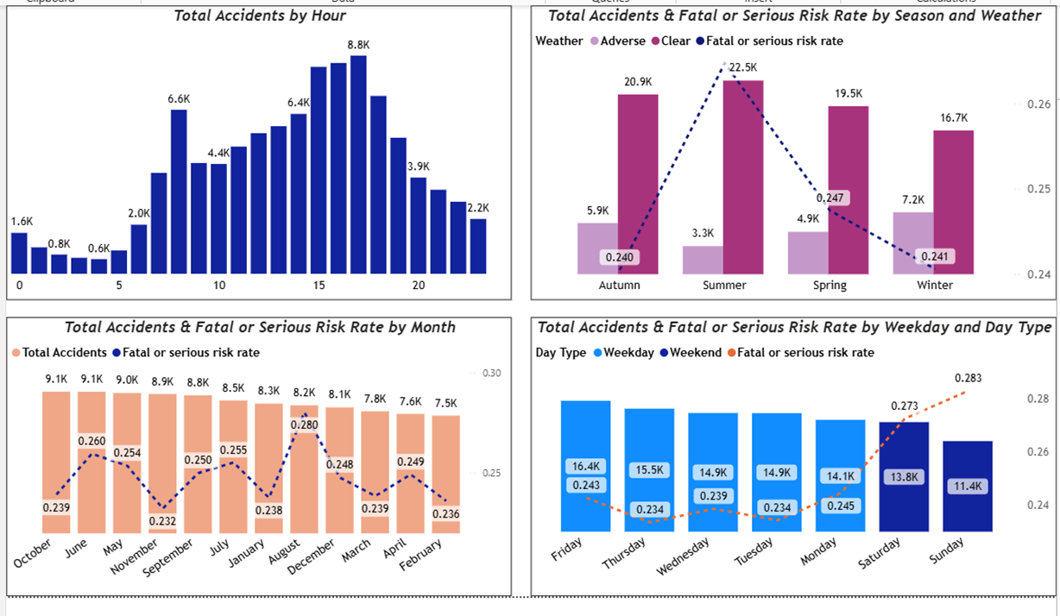
Accident and Risk Rate Patterns Across Time

Slide 15
Key Insights:-
Accident frequency peaks during the 17th hour (late afternoon), making it the highest-risk hour in terms of total accident volume.
Seasonal patterns show contrasting trends:
1.Autumn records the highest total number of accidents.
2.Winter records fewer accidents but shows relatively higher fatal or serious risk rates.
3.Summer exhibits the highest fatal or serious risk rate, despite not having the highest accident volume.
Weather conditions significantly influence accident occurrence:
1.Clear weather consistently records more accidents than adverse weather.
2.However, adverse weather is associated with comparatively higher fatal or serious risk rates.
Weekday patterns dominate accident trends:
1.Fridays record the highest number of accidents among weekdays.
2.Sundays show the lowest accident counts, though they exhibit a relatively higher fatal or serious risk rate.
Monthly variation highlights differing volume vs severity patterns:
1.October records the highest total number of accidents.
2.August shows the highest fatal or serious risk rate, indicating increased accident severity during this period.

Slide 16
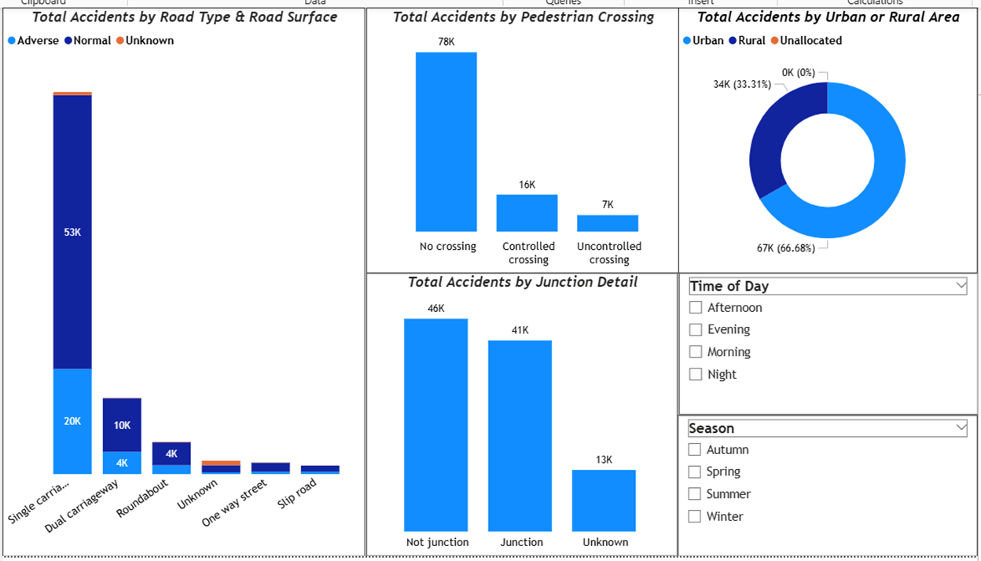
Road Infrastructure and Condition Impact on Accidents
Subtitle:-Patterns analyzed across pedestrian crossing, time of day and season.

Slide 17
Key Insights:-
General Patterns:-
Urban areas consistently record more accidents than rural areas, with locations without junctions contributing more accidents than junction-controlled locations.
Single carriageways combined with normal road surface conditions account for the highest number of accidents, significantly exceeding other road types and surface combinations.
Impact of pedestrian crossing:-
Locations without pedestrian crossings record the highest number of accidents, particularly at non-junction locations.
Controlled crossings are associated with fewer accidents, especially in urban areas, indicating their effectiveness in reducing collision frequency.
In urban areas, uncontrolled pedestrian crossings contribute a lower share of accidents compared to controlled crossings, while rural areas show a lower overall impact from pedestrian crossing types.

Slide 18
Key Insights:-
Impact of time:-
1.In rural area, Morning time & Summer season show higher accidents as compared to other seasons, While in urban area, evening time & winter season show higher accidents as compared to other seasons.
2.During afternoon time & autumn season, junction & not junction locations record highest accidents. While during night & winter season consistently show lower accident counts.
3.Generally in winter season accidents are lowest, but for controlled & uncontrolled crossing, during summer season accidents are lowest.
4.For "one way street"(road type), during summer and autumn season, accidents were maximum, while for other road types, accidents were highest in autumn season only.

Slide 19
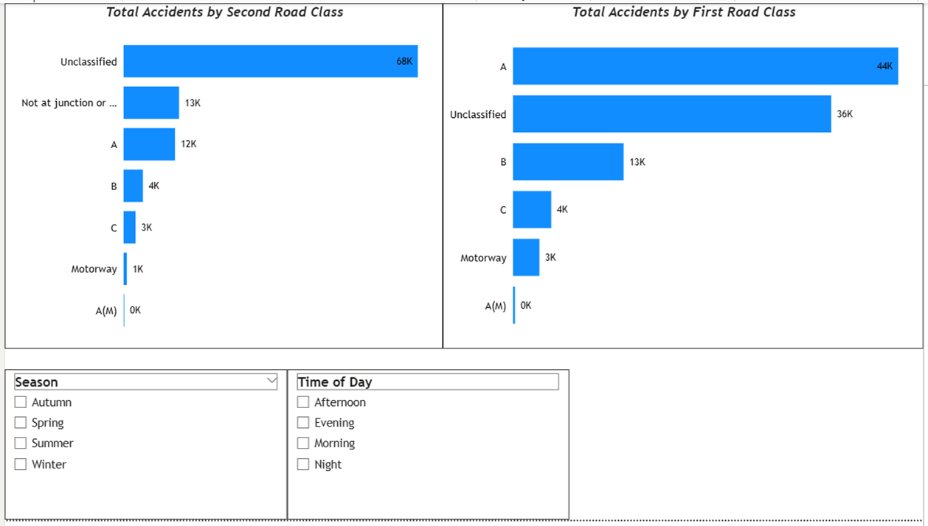
Accident Distribution by Road Classification
Subtitle:-Patterns analyzed across time of day and season.

Slide 20
Key Insights:-
First roadclass:-
In first road class, "A" -class roads has maximum accidents of all other first road class.
In general, Accidents for all first road class peak during afternoon hours and autumn season, while minimum accidents were observed during night and winter season.
Motorways & A(M) roads record higher accidents during morning hours.
Motorways record min accidents during spring season, while A(M) roads record higher accidents during spring season.
Second road class:-
In second road class, locations away from junctions ("not at junction or within 20m" ) consistently record highest number of accidents as compared to all other second road class.
Locations away from junction record higher accidents in summer instead of autumn.
On B-class roads & Motorways, accidents were more frequent during morning hours rather than afternoon.

Slide 21
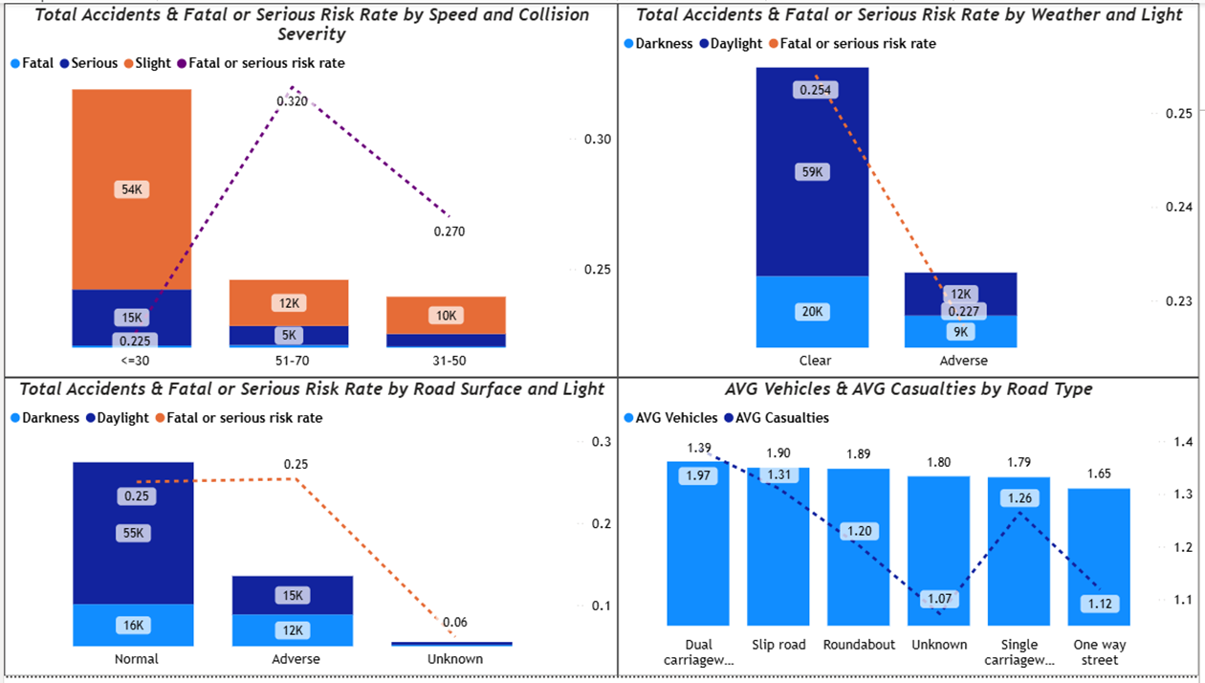
Accident severity and Risk Patterns by Road Surface Conditions, Speed and Environmental Conditions

Slide 22
Key Insights:-
Speed Band & Severity:-
≤30 mph roads record the highest number of accidents, followed by 51–70 mph and 31–50 mph.
Fatal/serious risk rate peaks on high-speed roads (51–70 mph), while it is lowest on ≤30 mph roads.
Road Surface & Lighting:-
Normal road surfaces account for most accidents.
Daylight conditions consistently record more accidents than darkness.
Under adverse surfaces, accident counts are similar in daylight and darkness.
Fatal/serious risk rate remains roughly constant (~0.25) across normal and adverse road surfaces.

Slide 23
Key Insights:-
Weather & Light Conditions:-
Clear weather contributes more accidents than adverse weather.
Clear + daylight has the highest accident count, followed by clear + darkness.
Adverse + daylight and adverse + darkness show similar accident levels.
Average Vehicles & Casualties by Road Type:-
Dual carriageways have the highest average vehicles involved per accident (~1.37).
They also record the highest average casualties (~1.39) among road types.

Slide 24
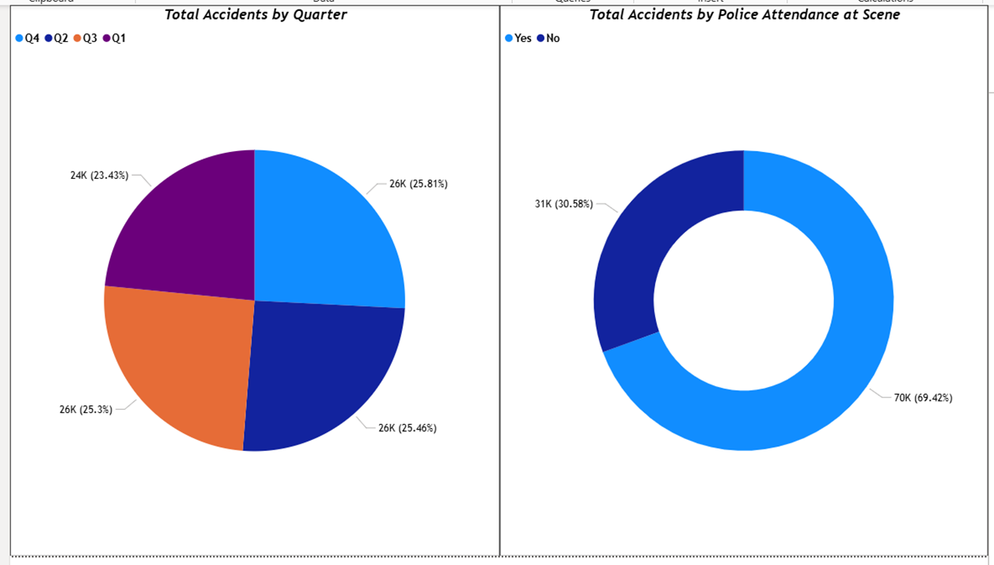
Accident Distribution by Quarter and Police Attendance

Slide 25
Key Insights:-
Police Attendance:-
Police attended (~69%) of accident scenes, while (~31%) had no police presence.
Quarter Accident Pattern:-
Q1( First Quarter) records lowest percentage of total accidents(~23.43%) , while Q2, Q3 and Q4 show a nearly even distribution, each contributing around (~25%) of total accidents.

Slide 26
Overall Conclusions& Key Takeaways:-
Road accidents show clear patterns across time, location, road type, and environmental conditions rather than being randomly distributed.
Afternoon hours and peak traffic periods consistently record the highest number of accidents, while night-time accidents are fewer but relatively riskier.
Urban areas, not-junction locations, single carriageways, no pedestrian crossing and normal road surfaces account for the majority of accidents.
Higher speed bands (51–70 mph) are associated with higher fatal or serious risk rates, despite fewer total accidents.
Seasonal and quarterly analysis indicates that accidents are fairly evenly distributed across the year, with Q1 showing relatively lower accident share.
These insights can support targeted road safety measures, such as speed management, junction design improvements, and time-specific traffic enforcement.

