Slide 1

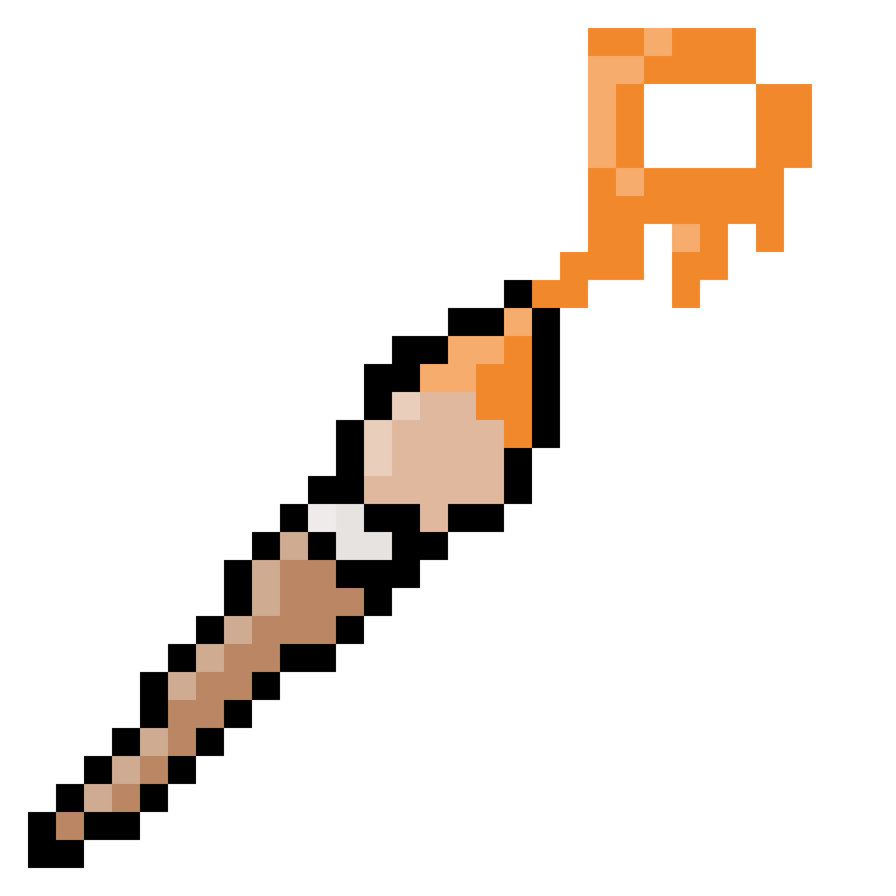
Pix Paint April 9, 2024
Blair O’Brien (Product Owner)
Daniel Phelps (S1 Scrum Master)
Likha Pulido (S2 Scrum Master)
Christy Miao (S3 Scrum Master)
Jennifer Chen (S4 Scrum Master)

Slide 2
Pix Paint
Free Open Source Pixel Art Program
Most art programs (Autodesk Sketchbook and Clip Studio Paint, etc) are not geared toward making pixel art
There are online options, but that requires the internet
User base:
Artists: Of any skill level and motivation looking to make pixel art
Game developers: Also of any skill level and motivation looking to make/modify assets
Notes:
speaker: Blair

Slide 3
Project Scope
Users should be able to…
Use Pix Paint as an offline/online application.
Create/Open/Save/Export a canvas that can have its dimensions set before or after creation.
Use layers so that different parts of the artwork can be edited independently.
Use pen and eraser tools that can have their sizes/opacities adjusted.
Zoom in/out to better see parts of canvas as needed.
Undo/Redo strokes tracked by a stroke history.
Choose colors from a color wheel.
Notes:
speaker: Blair

Slide 4
Sprint 1
List Sprint 1
As a program-user I want to…
have the program on my computer for offline use (a)
have a familiar, intuitive GUI (a)
draw on the canvas based on where I clicked my mouse (d)
erase based on where I clicked my mouse (d)
create a new transparent canvas (g)
open a previously-existing canvas (g)
Spikes
Research GUI implementation
Research transparent backgrounds
Infrastructure tasks
setup GitHub repo
setup Godot
Notes:
Daniel

Slide 5
Sprint 2
List Sprint 2
As a program-user I want to…
be able to resize the canvas (e)
have an adjustable pen: size and opacity (d)
have an adjustable eraser: size and opacity (d)
Spikes
research how to modify drawing tools and canvas
Notes:
Likha

Slide 6
Sprint 3
List Sprint 3
As a program-user I want to…
access colors from a color wheel to change the pen color (g)
zoom in/out of the canvas (f)
undo/redo a stroke (e)
export the drawing to different resolutions (b)
Spikes
research libraries to implement a color wheel, enabling zooming functionalities and undo/redo functionality
research process of exporting drawings
Notes:
Christy

Slide 7
Sprint 4
List Sprint 4
As a program-user I want to…
add layers to the canvas (c)
delete layers on the canvas (c)
use a stylus to draw (a)
be able to draw online (a)
be able to draw on mobile (a)
Spikes
Research mobile app development
Research Pen compatibilities/integrations
Notes:
Jen

Slide 8
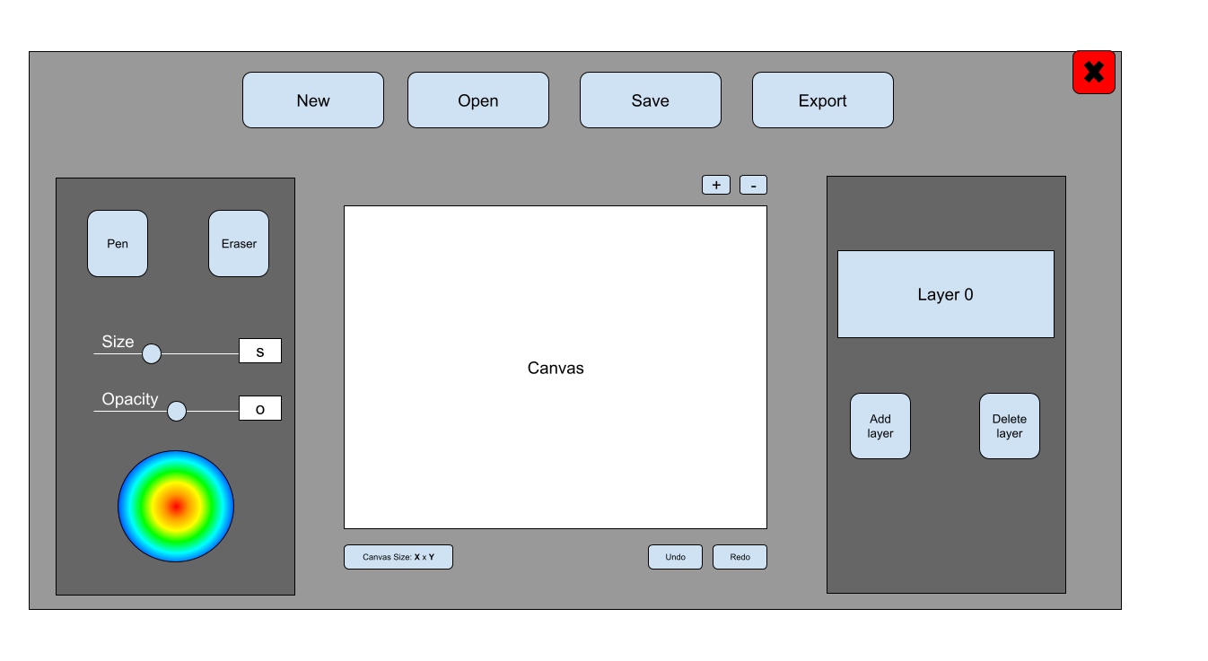
Architecture
Notes:
Blair

Slide 9
Technologies
Engine: Godot
Languages: GDscript and/or C#
Version Control: GitHub
Communication: Discord
Documentation/Management: Google Suite
Notes:
Daniel

Slide 10
Challenges/Risks
Godot:
Need to learn how to use engine and language
Any bugs within Godot will be inherited
Might need to go under the hood
Not as much documentation as other technologies
Experience:
It is the first time creating something of this scale for many of us
Notes:
Likha

Slide 11
Minimum Viable Product (MVP)
Offline program that can be run on the computer
File open/saving/export functionality
Adjustable transparent canvas to draw on
Pen tool with adjustable size and opacity
Eraser tool with adjustable size and opacity
Color selection
Zoom functionality
Undo/redo functionality
Notes:
Jen

