Slide 1
CROSS-PLATFORM
APPLICATION
DEVELOPMENT
TEAM - 6
G. Aishwarya -2021SP93074
Sharadhi-2021SP93034
Pragti Singh-2021SP93061
Pratyush Sinha-2021SP93070
Mohit M-2021SP93069

Slide 2
PROBLEM STATEMENT
Do any of the following seem familiar?
Feeling bored of studying alone or working too much?
Confused between learning & playing?
Want to learn while you play?
Don’t think you’re unusual because there are thousands
of students or in general say people who wants this!

Slide 3

SOLUTION
TRIVIA is the go-to app that helps one to play quizzes alone and in group as well.
It helps in passing your time in a fun and productive way.

Slide 4
FEATURES
Sign-in/Sign-up Using Google
Playing Quizzes based on different categories
Playing alone and/or with friends
Learning new things

Slide 5


FRONT END
FLUTTER: Flutter is an open-source mobile UI framework created by Google which allows us to develop cross platform applications
DART : Dart is a programming language designed for client development, such as for the web and mobile apps. It is developed by Google and can also be used to build server and desktop applications.

Slide 6

BACKEND
FIREBASE: Firebase is a set of hosting services for any type of application (Android, iOS, JavaScript, Node.js, Java, Unity, PHP, C++..). It is a platform developed by Google for creating mobile and web applications

Slide 7

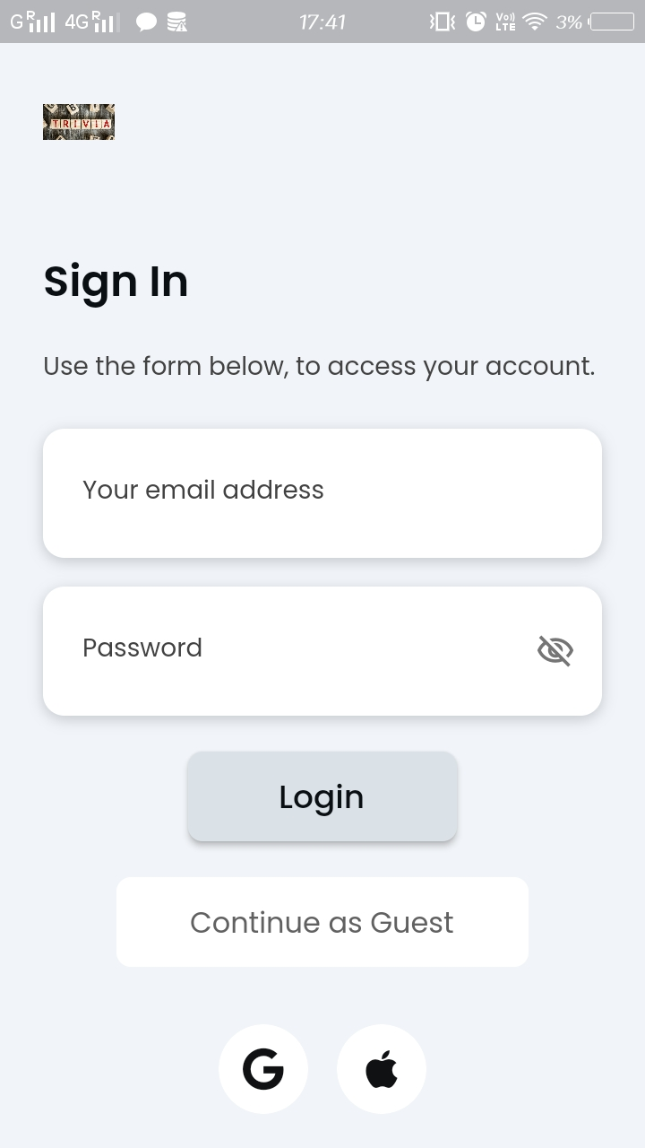
MOCK UI
(1) Landing Page
(2) Login Page

Slide 8
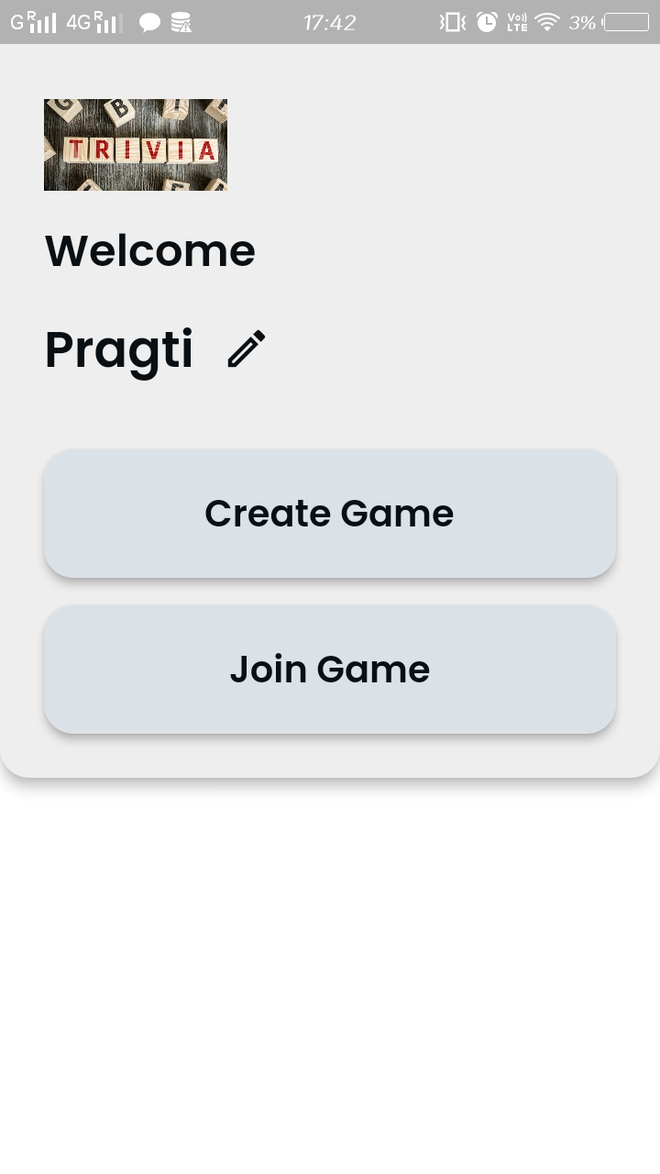
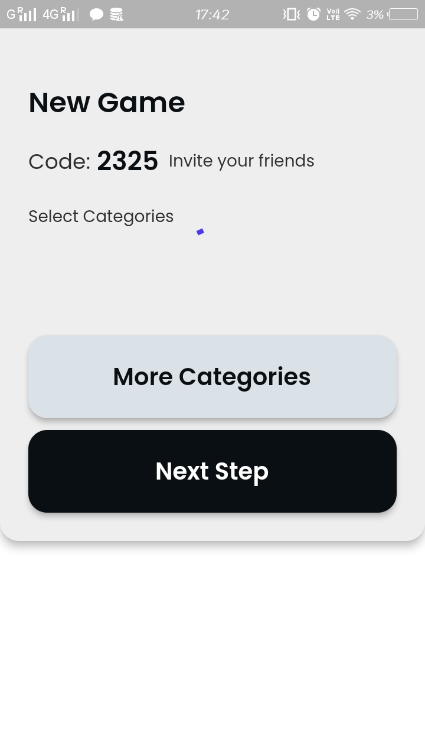
MOCK UI(Continued…)
(3) Game Hosting and Joining
(4) Forgot Password Page

Slide 9
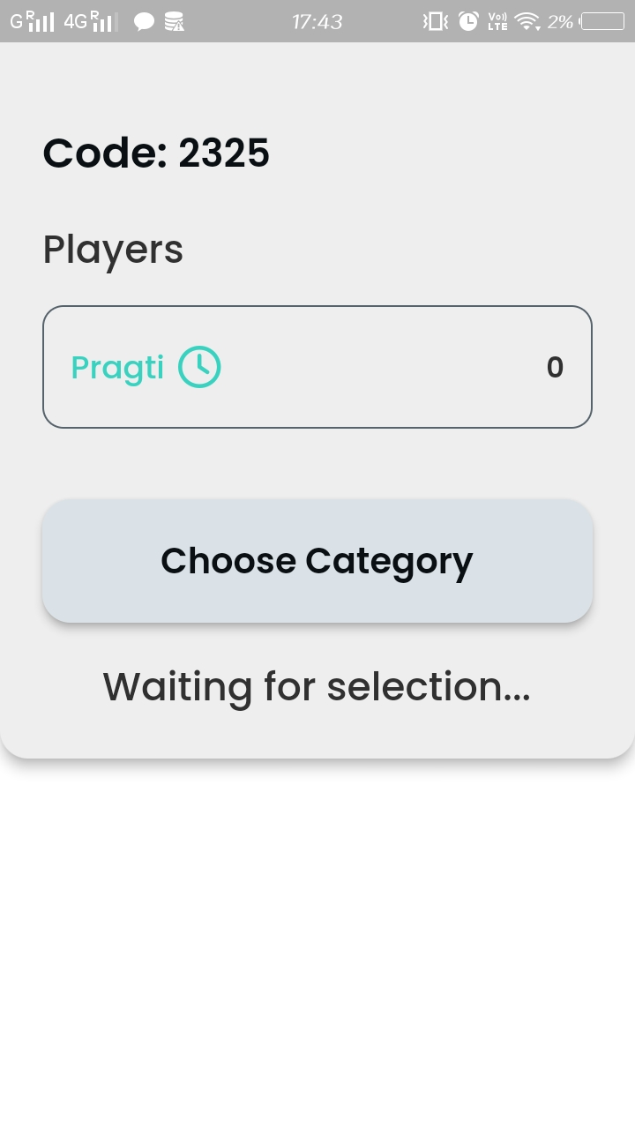
MOCK UI(Continued…)
(5)Authentication Page

Slide 10
THANK YOU

