Slide 1
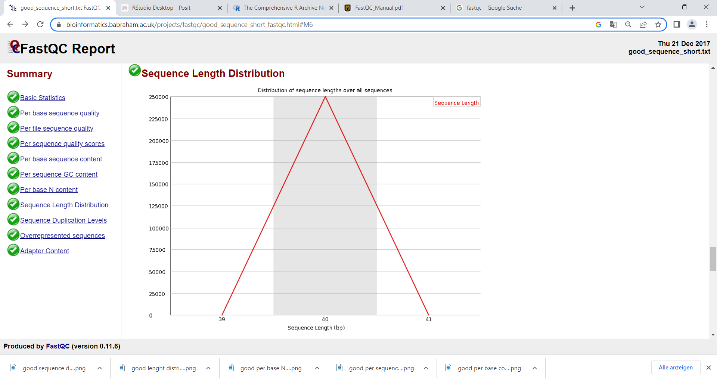
FastQC
(Babraham Bioinformatics - FastQC A Quality Control tool for High Throughput Sequence Data, o. D.)

Slide 2
Basics
Simple quality control checks for raw data from a high throughput sequencer
For problems or biases in the data
Spot problems originate from the sequencer or the starting library material
Two modes : offline or interactive application
https://dnacore.missouri.edu/PDF/FastQC_Manual.pdf

Slide 3
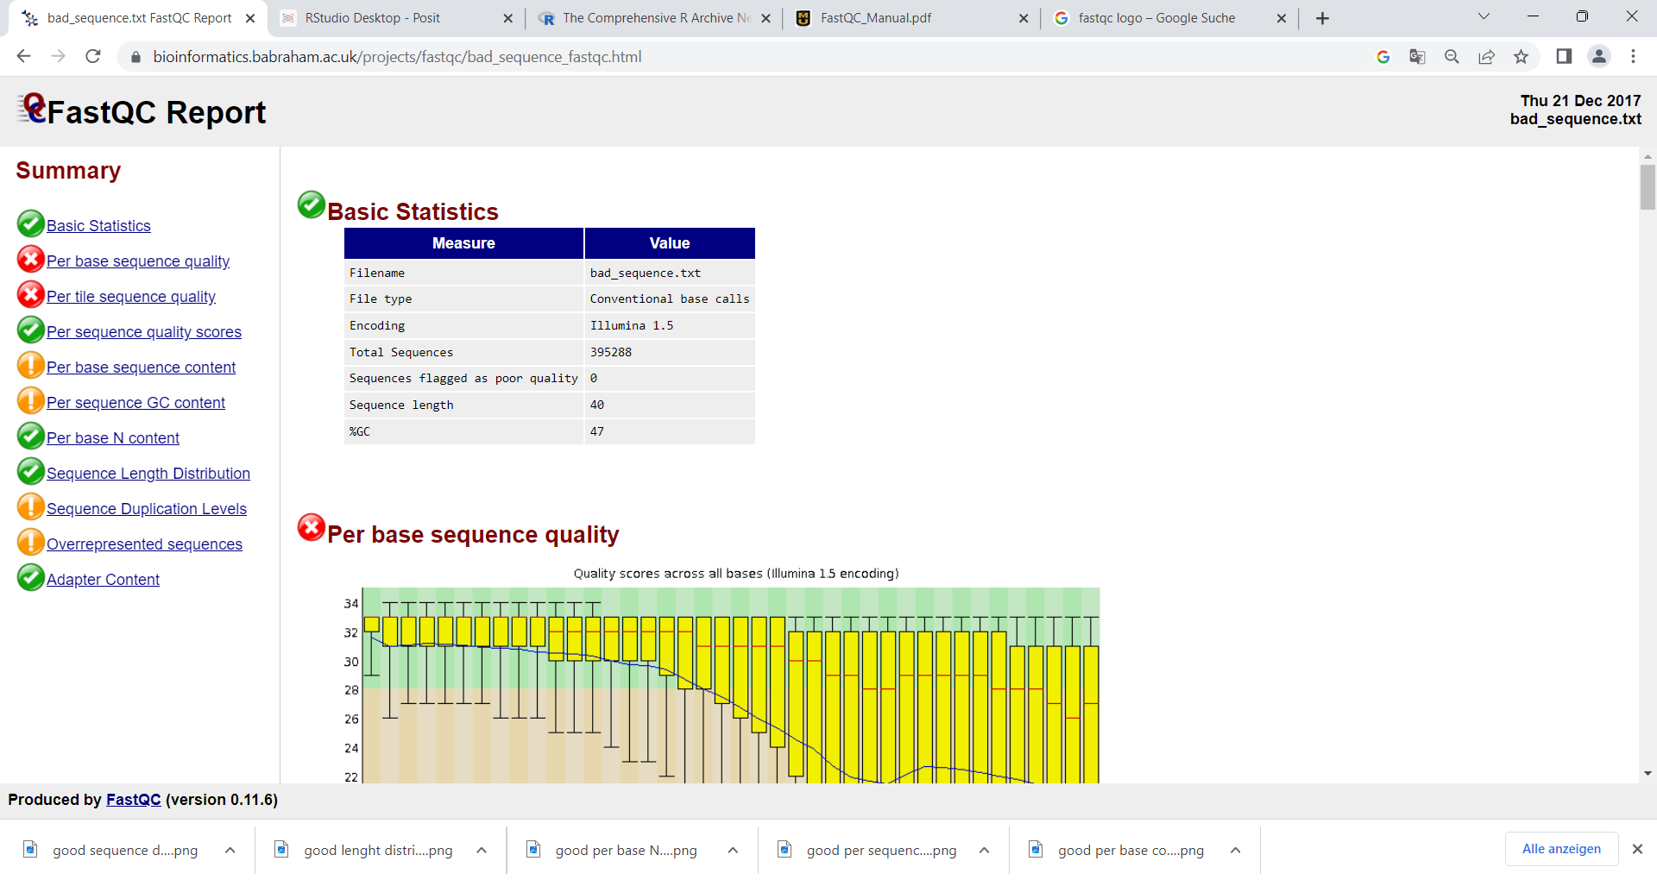
Modules
Different modules are run:
Green tick: seems normal
Orange !: slightly abnormal
Red cross: very unusual
(Babraham Bioinformatics - FastQC A Quality Control tool for High Throughput Sequence Data, o. D.)

Slide 4
Basic statistics
(Babraham Bioinformatics - FastQC A Quality Control tool for High Throughput Sequence Data, o. D.)

Slide 5
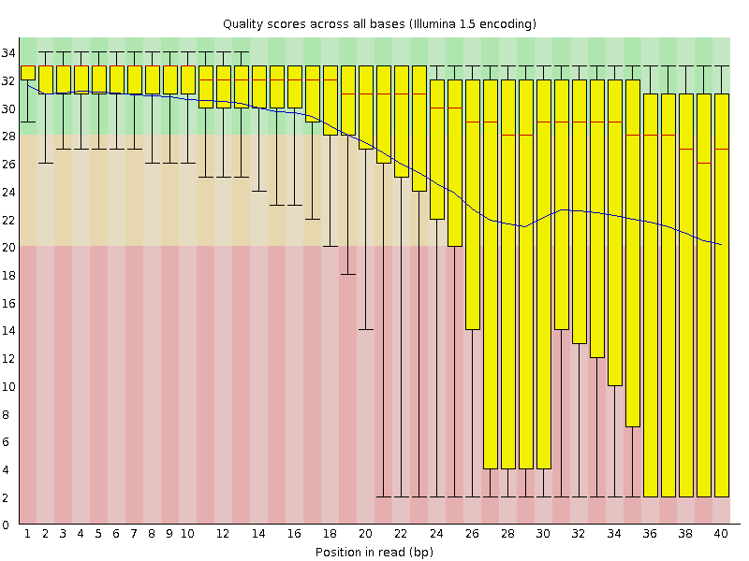
Per base sequence quality
Overview of the range of qualitiy values
Across all bases at each position
Solution: trim the data
good
bad
(Babraham Bioinformatics - FastQC A Quality Control tool for High Throughput Sequence Data, o. D.)

Slide 6
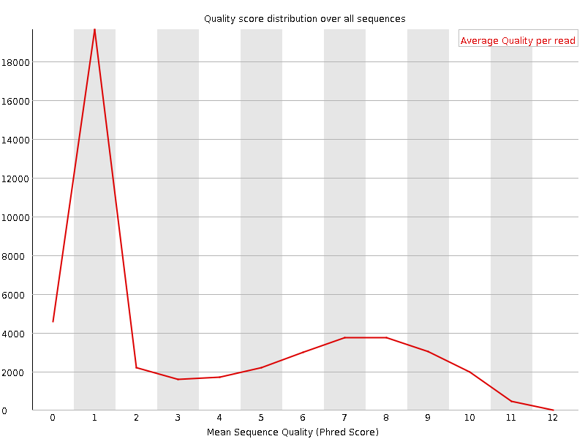
Per sequence quality scores
Control if a subset of sequences has universally low values
Solution: Filtering the set – remove set with lower quality
good
bad
(Babraham Bioinformatics - FastQC A Quality Control tool for High Throughput Sequence Data, o. D.)

Slide 7
Per base sequence content
Plots the proportion of each base positon
good
bad
(Babraham Bioinformatics - FastQC A Quality Control tool for High Throughput Sequence Data, o. D.)

Slide 8
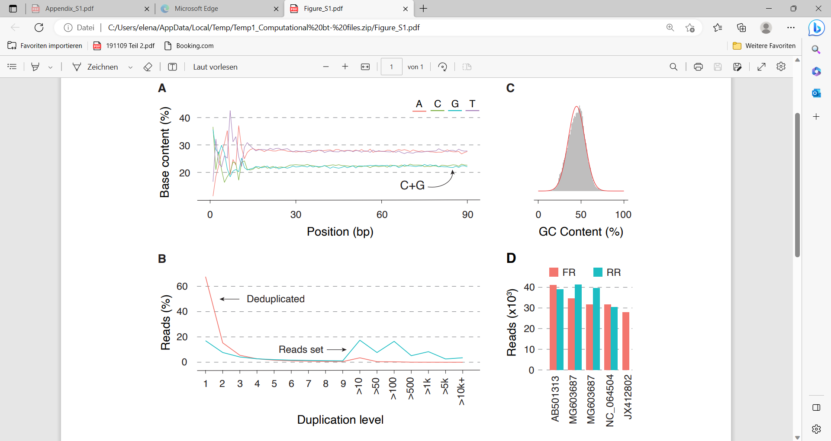

Slide 9
Per sequence GC content
GC content across the whole lenght of each sequence
Compared to the normal distribution of GC content
good
bad
(Babraham Bioinformatics - FastQC A Quality Control tool for High Throughput Sequence Data, o. D.)

Slide 11
Per base N content
Plots if there is any uncalled base in the library
(Babraham Bioinformatics - FastQC A Quality Control tool for High Throughput Sequence Data, o. D.)

Slide 12
Sequence lenght distribution
Distribution of fragment sizes in the file
(Babraham Bioinformatics - FastQC A Quality Control tool for High Throughput Sequence Data, o. D.)

Slide 13
Sequence duplicate levels
How unique are the sequences within the library
good
bad
(Babraham Bioinformatics - FastQC A Quality Control tool for High Throughput Sequence Data, o. D.)

Slide 15
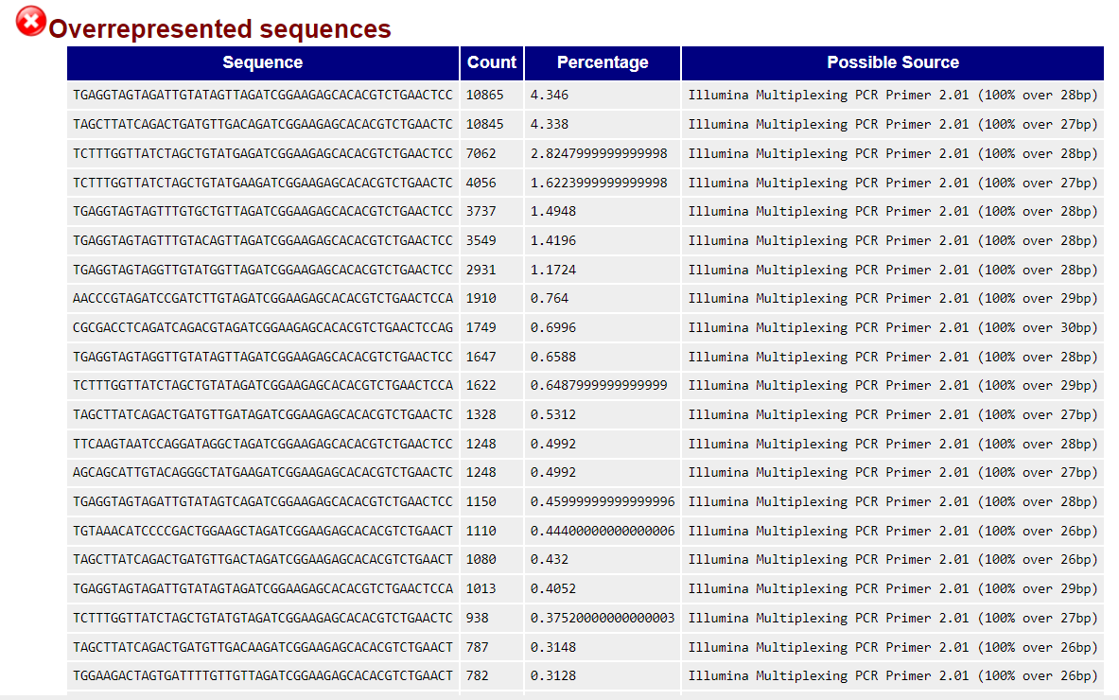
Overrepresented sequences
Individual sequences which are overrepresented within the set
(Babraham Bioinformatics - FastQC A Quality Control tool for High Throughput Sequence Data, o. D.)

