Slide 1


BLASTp: Protein-Protein Basic Local Alignment Search Tool
Alexandra Grebe (11825155)
MOL.981 Computational Biotechnology,
University of Technology Graz
Stephen F. Altschul, Thomas L. Madden, Alejandro A. Schäffer, Jinghui Zhang, Zheng Zhang, Webb Miller, and David J. Lipman (1997), "Gapped BLAST and PSI-BLAST: a new generation of protein database search programs", Nucleic Acids Res. 25:3389-3402 & Stephen F. Altschul, John C. Wootton, E. Michael Gertz, Richa Agarwala, Aleksandr Morgulis, Alejandro A. Schäffer, and Yi-Kuo Yu (2005) "Protein database searches using compositionally adjusted substitution matrices", FEBS J. 272:5101-5109.

Slide 2
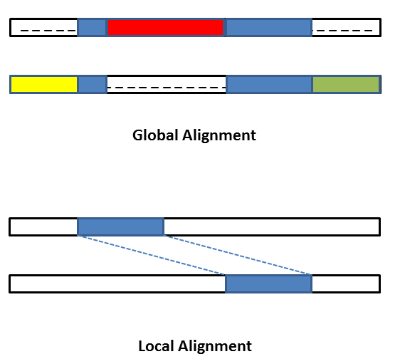
BLASTp Compares a Protein Query Sequence to a Database of Protein Sequences
Sequence is broken into „words“
Short conserved regions are found
Heuristic approach: approximate best match

Slide 3

BLASTp Enables Two Steps in our Transcriptome Study
Reads quality assessment & trimming
Transcriptome de novo assembly
Transcriptome assembly evaluation
Identification of protein-coding sequences
Removal of biological contamination
Protein homology prediction
FastQC,
Fastp
Trinity
Busco,
Transrate
Transcoder,
Seqkit
BLASTp,
Taxonomizr
BLASTp

Slide 4
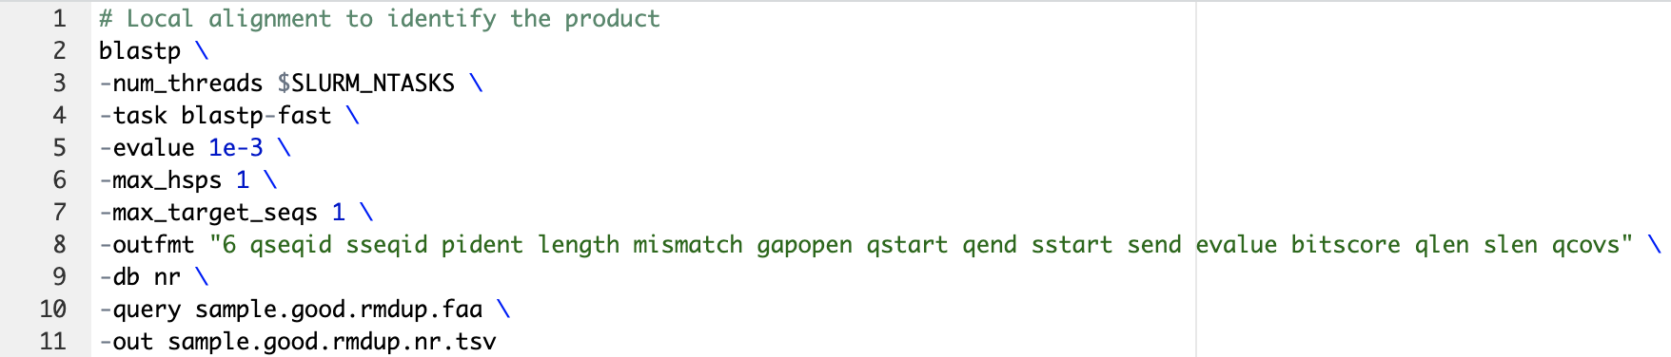
The Code is in Riddles…?

Slide 5
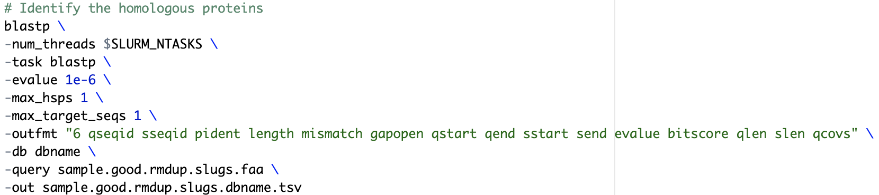
The Code is in Riddles…?

Slide 6
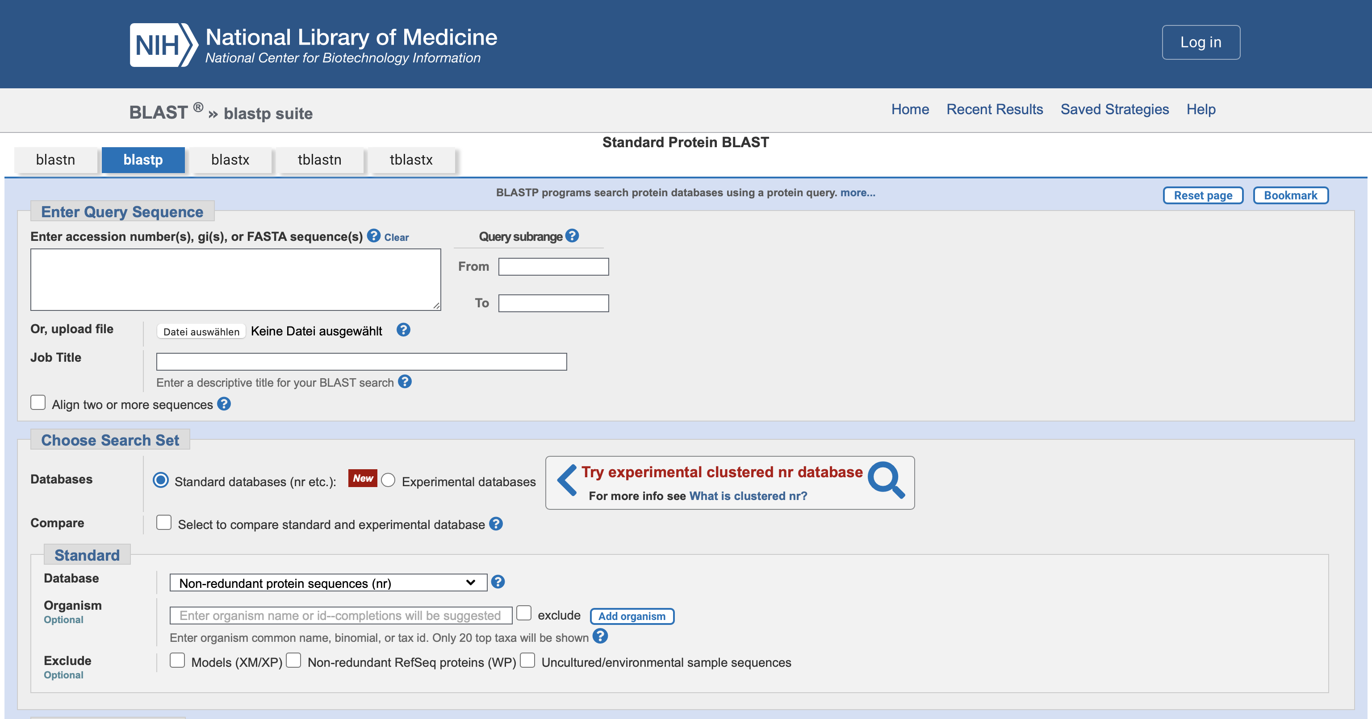
BLASTp Webtool Gives a Reference

Slide 7
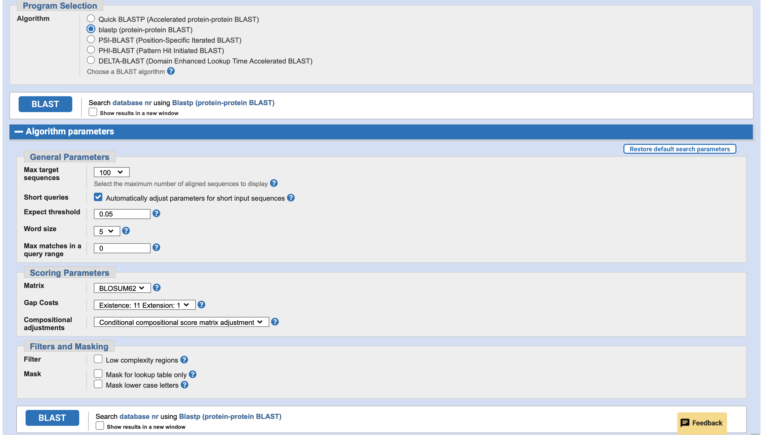
BLASTp Webtool Gives a Reference

Slide 8
The Code Defines the Search Parameters
Number of threads (CPUs to use in blast search)
Blastp-fast is a faster version
Expect value (E) for saving hits
Maximum number of HSPs (alignments) to keep for any single query-subject pair
Number of aligned sequences to keep
Output format
?
Db (database): nr (non-redundant)
Input file with query sequence
Name of output file

Slide 9
This Gibberish Defines the Output Format
qseqid: query or source (gene) sequence ID sseqid: suject or target (reference genome) sequence ID
pident: percentage of identical positions
length: alignment length (sequence overlap)
mismatch: number of mismatches
gapopen: number of gap openings
qstart: start of alignment in query
qend: end of alignment in query
sstart: start of alignment in subject
send: end of alignment in subject
evalue: expect value
bitscore: bit score
qlen: query sequence length
slen: subject sequence length
qcovs: query coverage per subject

Slide 10
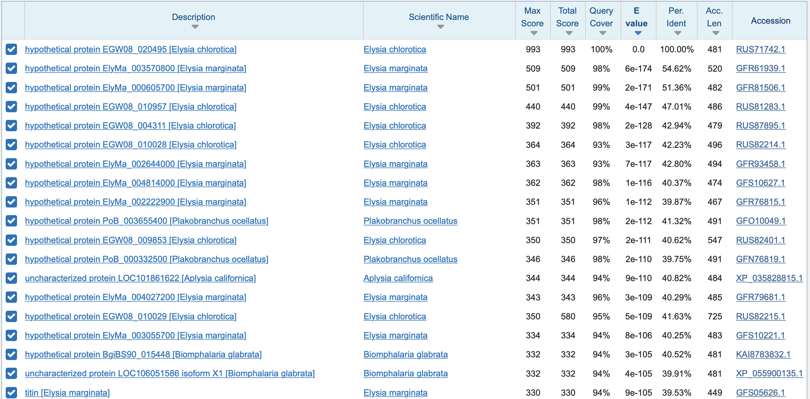
Common BLASTp Result Parameters Are Included

Slide 11
BLASTp Enables Two Steps in our Transcriptome Study
Reads quality assessment & trimming
Transcriptome de novo assembly
Transcriptome assembly evaluation
Identification of protein-coding sequences
Removal of biological contamination
Protein homology prediction
FastQC,
Fastp
Trinity
Busco,
Transrate
TransDecoder,
Seqkit
BLASTp,
Taxonomizr
BLASTp

Slide 12
Removal of Biological Contamination via BLASTp
Transcriptome translated to proteins was aligned to the NCBI nr database
Only transcripts matching against a Tectipleura protein were kept
Taxonomic information of the matches was extracted via Taxonomizr

Slide 13
BLASTp Enables Two Steps in our Transcriptome Study
Reads quality assessment & trimming
Transcriptome de novo assembly
Transcriptome assembly evaluation
Identification of protein-coding sequences
Removal of biological contamination
Protein homology prediction
FastQC,
Fastp
Trinity
Busco,
Transrate
TransDecoder,
Seqkit
BLASTp,
Taxonomizr
BLASTp

Slide 14
Protein Homology Prediction via BLASTp
The assembled reference transcriptome „ELVIRA“ (Elysia Viridis Reference Assembly) was annotated using BLASTp and HMMER:
Protein homology prediction via BLASTp
Protein domain identification via HMMER

Slide 15
BLASTp allows the removal of biological contamination.
BLASTp enables protein homology prediction.
The use of BLASTp is determined by you, or rather your input and code.

Slide 16
References
TU Graz Logo (Slide 1, Master slides): https://de.wikipedia.org/wiki/Datei:TU_Graz.svg (last accessed 19.05.2023)
BLASTp cover picture (Slide 1): https://blast.ncbi.nlm.nih.gov/Blast.cgi (last accessed 19.05.2023)
Local vs. global alignment (Slide 2): Issa, Mohamed & Hassanien, Aboul Ella & Helmi, Ahmed & Ziedan, Ibrahim & Alzohairy, Ahmed. (2018). Pairwise Global Sequence Alignment Using Sine-Cosine Optimization Algorithm. 10.1007/978-3-319-74690-6_11.

