Slide 1
Deadlock and Starvation
CSSE 332
Operating Systems
Rose-Hulman Institute of Technology
Notes:
Hand out Deadlock and starvation Quiz.
1

Slide 2
The deadlock problem
A set of blocked processes each holding a resource and waiting to acquire a resource held by another process in the set
Example
System has 2 disk drives
P1 and P2 each holds one disk drive and each needs another one
Notes:
Write this example on the board.
P0 P1
wait (A); wait(B)
wait (B); wait(A)
Discuss it with students.
2

Slide 3
System model – reusable resources
Resource types R1, R2, . . ., Rm
CPU cycles, memory space, I/O devices
Each resource type Ri has Wi instances.
Each process utilizes a resource as follows:
request
use
release
Notes:
3
These are examples of reusable resources – used by one process at a time and not depleted with use
Other examples of reusable resources:
printer
tape
disk
Semaphores

Slide 4
Necessary conditions for deadlock
Deadlock can arise if 4 conditions hold simultaneously
Mutual exclusion
Only one process may use a resource at a time
Hold-and-wait
A process holding at least one resource is waiting to acquire additional resources held by other processes
No preemption
a resource can be released only voluntarily by the process holding it, after that process has completed its task

Slide 5
Necessary conditions for deadlock (2)
Circular wait
there exists a set {P1, P2, …, Pn} of waiting processes such that P1 is waiting for a resource that is held by P2,
P2 is waiting for a resource that is held by P3,
…, Pn–1 is waiting for a resource that is held by
Pn, and Pn is waiting for a resource that is held by P1.
Notes:
Draw a figure on the board using n = 4.
5

Slide 6
Resource-Allocation Graph (RAG)
A set of Vertices V and a set of Edges E
V is partitioned into two types:
P = {P1, P2, …, Pn}, the set consisting of all the processes in the system.
R = {R1, R2, …, Rm}, the set consisting of all resource types in the system.
request edge – directed edge Pi → Rj
assignment edge – directed edge Rj→ Pi
Notes:
Deadlocks can be described more precisely using a directed graph called a system resource-allocation graph. This graph consists of a set of vertices and a set of edges---a total of three sets P, R, and E.
6

Slide 7
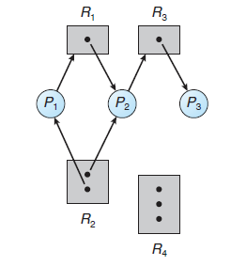
RAG
A line from a resource (dot) to a process indicates an assignment.
A line from a process to a resource (rectangle) indicates a request.
Notes:
7
Have students describe this RAG

Slide 8
Let’s do an example. Let‘s use Readers/Writers problem. In this case, we have 4 threads R1 R2 W1 W2. There are two semaphores, WriterSem and ReaderCountSem.
In the current situation, W1 is currently in the critical section and has acquired WriterSem. W2 has requested WriterSem. R1 has acquired ReaderCountSem and has requested WriterSem. R2 has requested ReaderCountSem.

Slide 9
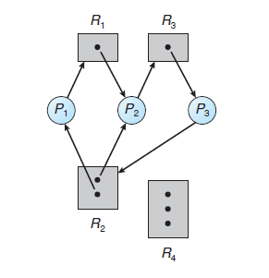
RAG example with a deadlock
Notes:
Q1 Do 1.a with class
9

Slide 10
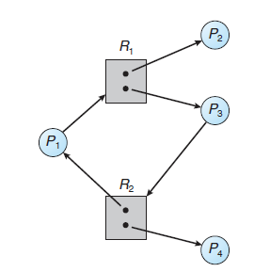
RAG with cycle but no deadlock

Slide 11
Basic facts
If graph contains no cycles
no deadlock.
If graph contains a cycle
if only one instance of each resource type, then deadlock.
if several instances per resource type, possibility of deadlock.
Notes:
Have students answer question 2
11

Slide 12
Approaches to deadlock handling
Ignore Deadlock (Ostrich approach)
If infrequent enough and result is not serious
Used by most operating systems, including UNIX
Deadlock Prevention
Prevent one of the necessary/sufficient conditions
Deadlock Avoidance
Allow the 3 necessary conditions
Dynamically make choices to avoid deadlock
decide based on knowledge of future requests
i.e., find a safe path

Slide 13
Approaches to deadlock handling
Deadlock Detection
Periodically run algorithm to detect circular waiting
After detecting deadlock,
run a recovery algorithm to remove deadlock

Slide 14
Deadlock prevention
Restrain ways a request can be made
Direct method: prevent circular wait from occurring
Indirect method: prevent any one of the three necessary conditions from occurring
Mutual Exclusion
Hold and Wait
No preemption

Slide 15
Deadlock prevention: indirect method
Mutual Exclusion
Not required for sharable resources
Must hold for non-sharable resources
Hold and Wait
Must guarantee that whenever a process requests a resource, it does not hold any other resources.
Require process to request and be allocated all its resources before it begins execution, or allow process to request resources only when the process has none.
Low resource utilization; starvation possible.
Notes:
Prevent one of these conditions from occurring.
Example of sharable resources (e.g., read only file)
Any number of processes can access that resource simultaneously
Non-sharable resources include (printer, CPU)
Only one process can use this resource at a time.
15

Slide 16
Deadlock prevention: indirect method
No Preemption
If a process that is holding some resources requests another resource that cannot be immediately allocated to it, then all resources currently being held are released.
Preempted resources are added to the list of resources for which the process is waiting.
Process will be restarted only when it can regain its old resources, as well as the new ones that it is requesting.

Slide 17
Deadlock prevention: direct method
Prevent Circular Wait
impose a total ordering of all resource types
require that each process requests resources in an increasing order of enumeration
Notes:
If time is available, illustrate this with an example.
e.g., F:R → N
F(optical drive) = 1
F(disk drive) = 5
F(printer) = 12
17

