Slide 1
File System Implementation
CSSE 332
Operating Systems
Rose-Hulman Institute of Technology
Notes:
Print packet for Homework on File System.

Slide 2
File-system structure
File structure
Logical storage unit
Collection of related information
File system resides on secondary storage (disks)
File system organized into layers
File control block – storage structure consisting of information about a file

Slide 3
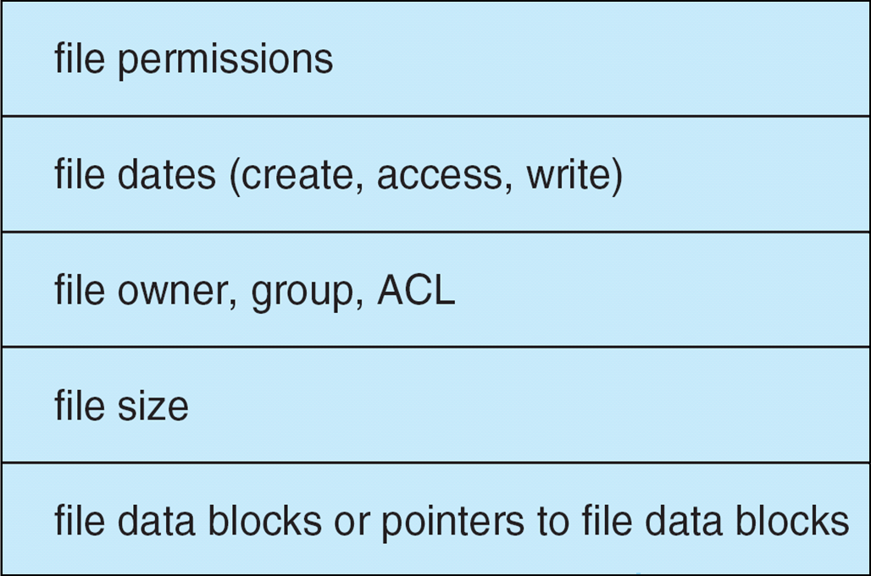
Typical file control block
Notes:
A per-file FCB contains many details about a file.
It has a unique identifier number to allow association with a directory entry. The directory entry contains the name of the fine and the inode number on a LINUX system. On other systems, file block information is included. It also contains file type information.
In NTFS, this is stored in the master file table. In UNIX, this is the same as the inode.

Slide 4
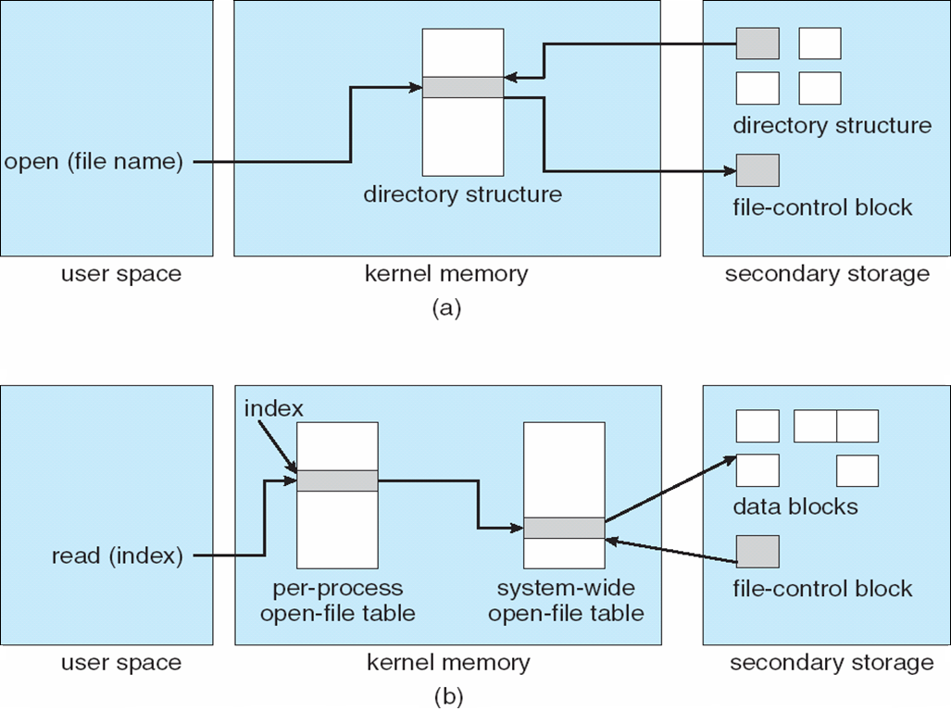
In-memory file system structures
Notes:
Each process has an open-file table that contains a pointer to the appropriate entry in the system-wide open –file table.

Slide 5
Virtual file systems
Virtual File Systems (VFS) provide an object-oriented way of implementing file systems.
VFS allows the same system call interface (the API) to be used for different types of file systems.
The API is to the VFS interface, rather than any specific type of file system.
Notes:
So how do we plug in a file system?
Most OS’es including UNIX offers a VFS that interfaces with any file system that we wish to add.

Slide 6
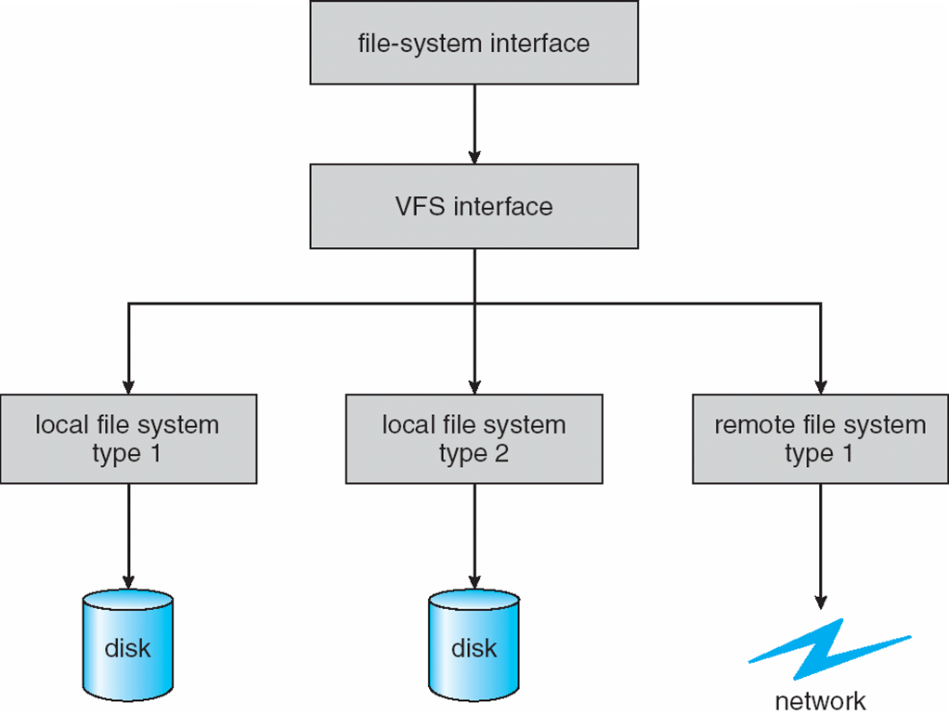
Schematic of virtual file system
Notes:
But on these disks, files are stored in directories. How should directories be implemented so they can be searched efficiently?

Slide 7
Directory implementation
Linear list of file names with pointer to the data blocks.
simple to program
time-consuming to execute
Hash Table – linear list with hash data structure.
decreases directory search time
collisions – situations where two file names hash to the same location
fixed size
Notes:
O(n) vs O(1 + n/k) where k → number of slots or buckets for values.

Slide 8
Allocation methods
An allocation method refers to how disk blocks are allocated to files:
Contiguous allocation
Linked allocation
Indexed allocation
Notes:
How do we actually organize the data component of files on disk?

Slide 9
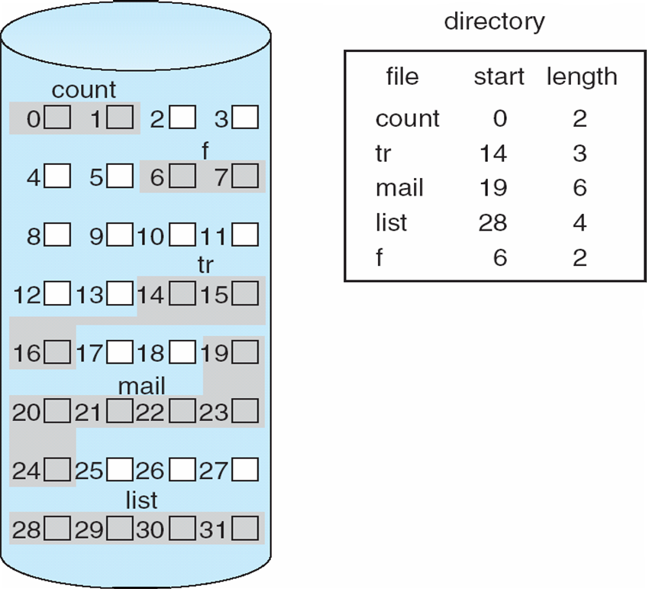
Contiguous allocation of disk space
Notes:
Each file has a simple directory entry

Slide 10
Contiguous allocation
Each file occupies a set of contiguous blocks on the disk
Simple directory entry
only starting location (block #) and
length (number of blocks) are required
Random access
Wasteful of space
dynamic storage-allocation problem
Files cannot grow

Slide 11
Linked allocation
Each file is a linked list of disk blocks: blocks may be scattered anywhere on the disk.
block =
pointer

Slide 12
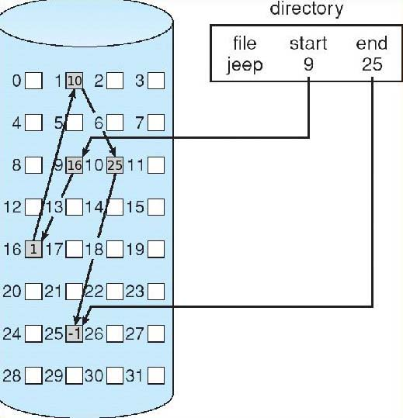
Linked allocation (2)
Notes:
For the directory entry, ONLY the starting address of the file is really needed. The end address is not needed; the file ends when the next block pointer points to NULL.

Slide 13
Linked allocation (Cont.)
Simple – need only starting address
Free-space management system – no waste of space
No random access
Mapping
Q
LA/511
R
Block to be accessed is the Qth block in the linked chain of blocks representing the file.
Displacement into block = R + 1
File-allocation table (FAT) – disk-space allocation used by MS-DOS and OS/2.
Notes:
Assume block is of size 512 words and pointer occupies 1 one. A word may be 4 or 8 bytes long.
Displacement is R + 1 because first word holds the pointer.
FAT is a simple variation of the Linked allocation method.
In FAT, a section of the disk, at the beginning of each volume is set aside to contain the table.
Table has one entry for each block & is indexed by block number.
Unused block is indicated by a value of 0. To find a block, find the index of the first block with a value of 0.

Slide 14
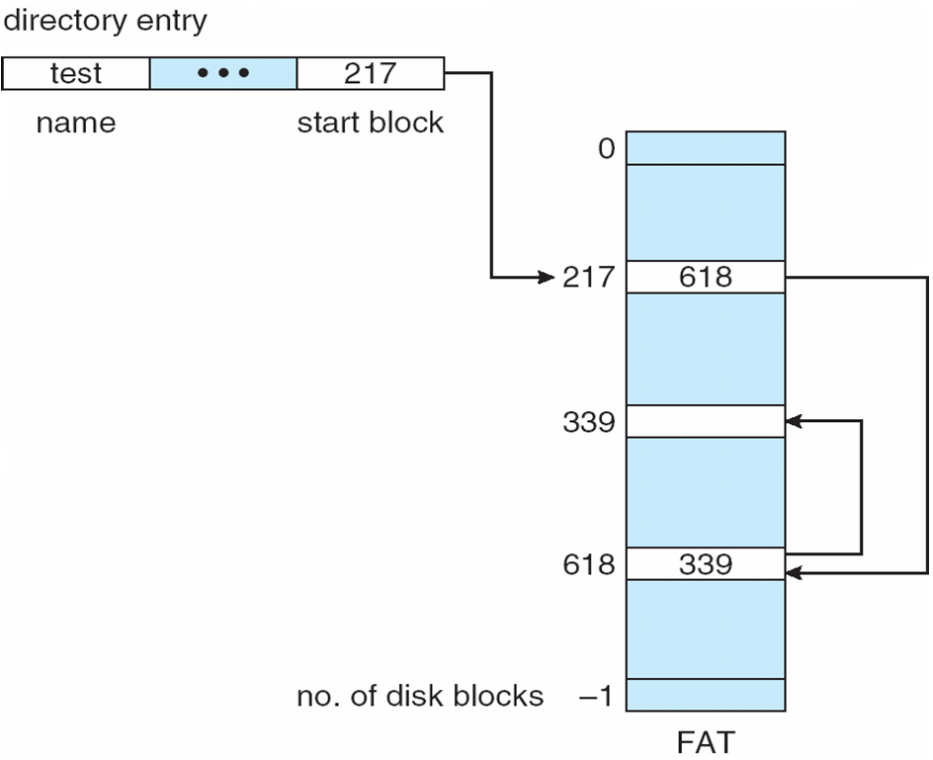
File-allocation table

Slide 15
Indexed allocation
Brings all pointers together into the index block.
Logical view.
index table

Slide 16
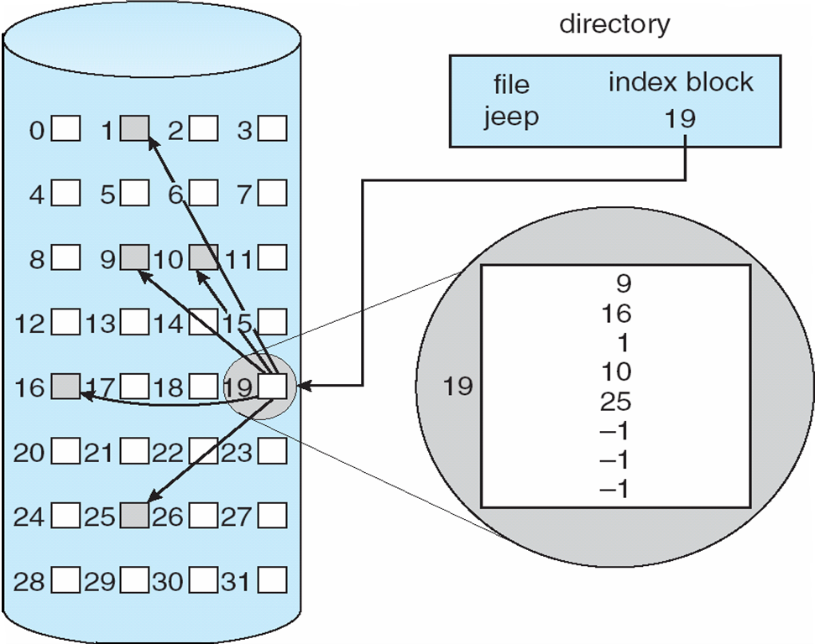
Example of indexed allocation

Slide 17
Indexed allocation (Cont.)
Need index table
Random access
Dynamic access without external fragmentation, but have overhead of index block.
Mapping from logical to physical in a file of maximum size of 256K words and block size of 512 words. We need only 1 block for index table.
Q
LA/512
R
Q = displacement into index table
R = displacement into block

Slide 18
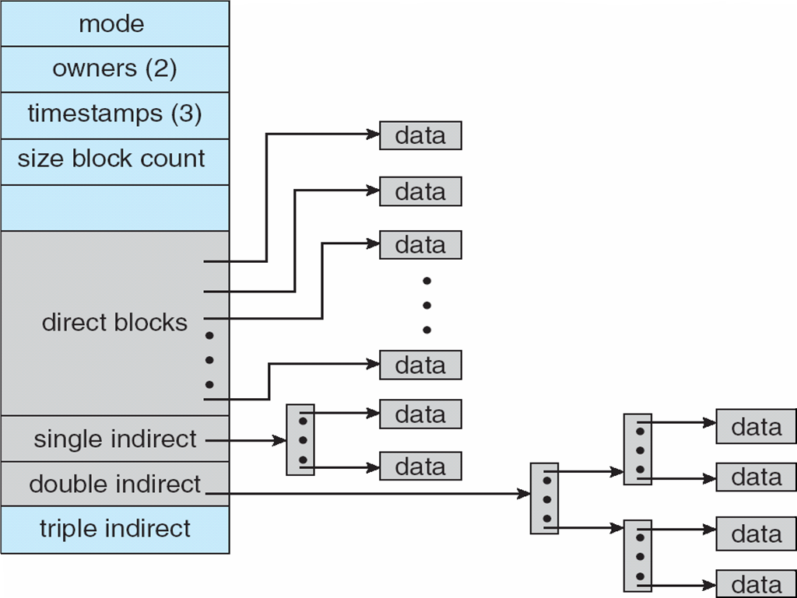
Combined Scheme: UNIX inode (4K bytes per block)
Notes:
Data that would otherwise be in the File control block is stored in the inode.

Slide 19
Inode
128 bytes (64 bytes in older systems) each
Statically allocated
Root inode (inode 2) is the root (/) of the filesystem
Notes:
(inode 0 marks unused directory slots and inode 1 is reserved for future use)

Slide 20
i-node:
Notes:
Each directory entry contains an i-node number and a file name.
The i-node number is used to index into the i-node table or the i-list. Each i-node contains the attributes of a single file.

Slide 21
Free space management
Bit vector (n blocks)
0
1
2
n-1
…
0 ⇒ block[i] free
1 ⇒ block[i] occupied
bit[i] =


Slide 22
Free space management
Bit map requires extra space. Example: block size = 2¹² bytes (4096 Bytes) disk size = 2³⁴ bytes (16 GByte) n = 2³⁴/2¹² = 2²² bits (4Mbits=512 KBytes)
Linked list (free blocks)
Cannot get contiguous space easily
No waste of space
Grouping
Notes:
Grouping
- A free block contains n pointers to free blocks
- The last pointer among n pointers points to another block that contains another n free block pointers.
Example
Suppose that the size of a disk block and the size
of a pointer are 4KB and 4 bytes, respectively. Suppose that the system implements the grouped linked list for free-space list.
What is the number of disk IO to obtain 10,000 blocks?

Slide 23
Free space management
Need to protect:
Pointer to free list
Bit map
Must be kept on disk
Problem: Copy in memory and disk may differ.
Cannot allow for block[i] to have a situation where bit[i] = 1 in memory and bit[i] = 0 on disk.
Solution:
Set bit[i] = 1 in disk.
Allocate block[i]
Set bit[i] = 1 in memory
Notes:
Disk is non volatile

Slide 24
Free space management
Every block is assigned an ID in sequential order
In a reserved part of the disk, a list of the IDs of free blocks is maintained
The ID size depends on the number of blocks on disk
The number of blocks required to hold the IDs depends on how many blocks are free

