Slide 1
Process Synchronization
CSSE 332
Operating Systems
Rose-Hulman Institute of Technology
Notes:
1

Slide 2
Background
Concurrent access to shared data may result in data inconsistency
Maintaining data consistency requires mechanisms to ensure the orderly execution of cooperating processes
Notes:
2
Cooperating processes can either directly share a logical address space (both code and data through threads) OR be allowed to share data only through files or messages.
Suppose that we wanted to provide a solution to the consumer-producer problem that fills all the buffers. We can do so by having an integer count that keeps track of the number of full buffers. Initially, count is set to 0. It is incremented by the producer after it produces a new buffer and is decremented by the consumer after it consumes a buffer.

Slide 3
Producer
while (true) {
/* produce an item and put in nextProduced */
while (count == BUFFER_SIZE)
; // do nothing
buffer [in] = nextProduced;
in = (in + 1) % BUFFER_SIZE;
count++;
}
Notes:
3
Does it appear that there is any issue with the producer code?
This code is correct if this is run separately from the consumer code, that is, by itself.

Slide 4
Consumer
while (true) {
while (count == 0)
; // do nothing
nextConsumed = buffer[out];
out = (out + 1) % BUFFER_SIZE;
count--;
/* consume the item in nextConsumed */
}
Notes:
4
This code is also correct if it runs by itself.

Slide 5
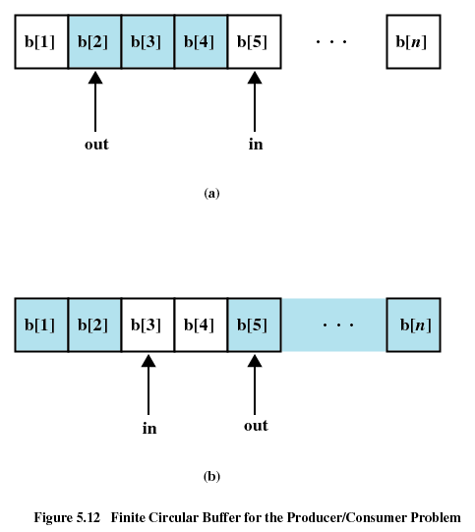
Producer-Consumer problem
Notes:
5

Slide 6
Race Condition
count++ could be implemented as
register1 = count
register1 = register1 + 1
count = register1
count-- could be implemented as
register2 = count
register2 = register2 - 1
count = register2
Consider this execution interleaving with “count = 5” initially:
S0: producer execute register1 = count {register1 = 5}
S1: producer execute register1 = register1 + 1 {register1 = 6}
S2: consumer execute register2 = count {register2 = 5}
S3: consumer execute register2 = register2 - 1 {register2 = 4}
S4: producer execute count = register1 {count = 6 }
S5: consumer execute count = register2 {count = 4}
Notes:
6
However, if the producer and the consumer code (processes) run concurrently, they may not function correctly. Why?
Because they share the count variable.
Producer process increments count while consumer process decrements count.
On a typical machine, the count++ instruction is implemented as 3 machine language instructions.
Since the resulting value of count depends on the order in which the processes execute, we have a race condition.

Slide 7
Race Condition
A condition where two or more threads/processes modify a shared resource and the final result depends on the relative timing of their execution.
Notes:
We do not want race conditions so we need to think of ways to avoid them.
How do we avoid this?
By ensuring that only one process manipulates the count variable at a time.
This requires that the processes be synchronized in some way.
Situations such as the one just described occur frequently in OSes because different parts of the OSes manipulate resources.
The advent of multicores puts pressure on programmers to develop multithreaded applications, which are quite possibly sharing data and running in parallel on different CPU cores.
7

Slide 8
How to prevent the problem?
Restricted access to shared variables and resources
Implementing critical section
Requiring mutual execution
Q2
Notes:
A critical section is a section of code in each process that may be changing a common variable, updating a shared table, writing a file, and so on.
When one process is executing in its critical section, no other process should be executing in its critical section.
No 2 processes should be executing in their critical sections at the same time.
The critical-section problem is to design a protocol that the process can use to cooperate.
8

Slide 9
Structure of a typical process
do {
entry section
critical section
exit section
remainder section
} while (TRUE);
Notes:
9
Protocol description:
Each process must request permission to enter its critical section (code in which this request is made --- entry section)
Critical section code may be followed by an exit section.
The remaining code is called the remainder section.
Entry section and remainder section are highlighted.

Slide 10
Critical-section problem solution
Mutual Exclusion - If process Pi is executing in its critical section, then no other processes can be executing in their critical sections
Progress - If no process is executing in its critical section and there exist some processes that wish to enter their critical section, then the selection of the processes that will enter the critical section next cannot be postponed indefinitely
Bounded Waiting - A bound must exist on the number of times that other processes are allowed to enter their critical sections after a process has made a request to enter its critical section and before that request is granted
Assume that each process executes at a nonzero speed
No assumption concerning relative speed of the N processes
Notes:
10
A solution to the critical-section problem must satisfy the following three requirements:

Slide 11
Peterson’s Solution
Two process solution
Assume that the LOAD and STORE instructions are atomic; that is, cannot be interrupted.
The two processes share two variables:
int turn;
Boolean flag[2]
The variable turn indicates whose turn it is to enter the critical section.
The flag array is used to indicate if a process is ready to enter the critical section.
flag[i] = true implies that process is ready!
Notes:
11
This is a software-based solution.
load To load a value from memory, you copy the data from memory into a register.
store To store a value to memory, you copy the data from a register to memory.

Slide 12
Algorithm for Process
do {
flag[i] = TRUE;
turn = j;
while (flag[j] && turn == j);
critical section
flag[i] = FALSE;
remainder section
} while (TRUE);
Notes:
12
Entry section and remainder section are highlighted.
Because of the way that most modern computers implement the basic LOAD and STORE machine instructions, there is no guarantee that this will work.
But this presents a good algorithmic description of solving the critical section problem.
It also exposes the complexities of writing software that addresses the requirements of mutual exclusion, progress, and bounded wait.
Pi and Pj alternate entry into their critical sections and their remainder sections.

Slide 13
Synchronization Hardware
Many systems provide hardware support for critical section code
Uniprocessors – could disable interrupts
Currently running code would execute without preemption
Generally too inefficient on multiprocessor systems
Operating systems using this not broadly scalable
Modern machines provide special atomic hardware instructions
Atomic = non-interruptable
Either test memory word and set value
Or swap contents of two memory words
Notes:
13
Would need to disable interrupts on every processor core at the same time for this approach to work.
Another approach is to use atomic hardware instructions.
Both of these approaches require simple locks. Race conditions are prevented by requiring that critical sections be protected by locks.
Processes must acquire a lock to enter its critical section and release the lock when it exits its critical section.

Slide 14
Solutions using locks
do {
acquire lock
critical section
release lock
remainder section
} while (TRUE);

Slide 15
TestAndndSet Instruction
Definition:
boolean TestAndSet (boolean *target){
boolean rv = *target;
*target = TRUE;
return rv:
}
Notes:
15
An atomic instruction

Slide 16
Solution using TestAndSet
Shared boolean variable lock., initialized to false.
Solution:
do {
while ( TestAndSet (&lock ) == TRUE)
; // do nothing
// critical section
lock = FALSE;
// remainder section
} while (TRUE);
Notes:
16

Slide 17
Swap Instruction
Definition:
void Swap (boolean *a, boolean *b){
boolean temp = *a;
*a = *b;
*b = temp:
}
Notes:
17
Another atomic instruction

Slide 18
Solution using Swap
Shared Boolean variable lock initialized to FALSE; Each process has a local Boolean variable key
Solution:
do {
key = TRUE;
while ( key == TRUE)
Swap (&lock, &key );
// critical section
lock = FALSE;
// remainder section
} while (TRUE);
Notes:
18

Slide 19
Better TestandSet() solution
do {
waiting[i] = TRUE;
key = TRUE;
while (waiting[i] && key)
key = TestAndSet(&lock);
waiting[i] = FALSE;
// critical section
j = (i + 1) % n;
while ((j != i) && !waiting[j])
j = (j + 1) % n;
if (j == i)
lock = FALSE;
else
waiting[j] = FALSE;
// remainder section
} while (TRUE);
Notes:
Bounded-waiting mutual exclusion that shows progress
A process can only enter its critical section when waiting[i] == false or when key = false.
Key only changes to false in testAndSet().
19

