Slide 1
CSSE 332 Filesystem(II)
Tuesday, January 8, 2019
Adapted from ND CSE 30341 Operating System Principles (Fall 2017)

Slide 2
Outline
Directory implementation
Filesystem overview
A non-Unix approach: FAT

Slide 3
Directories
Directories are special files that typically contain data in a certain format to describe their directory entries (dentries):
inumber | name
5 | .
2 | ..
12 | foo
13 | bar
24 | foobar
Creating a file will add an entry in its directory.
Deleting a file just need to set a reverse inode number (i.e., -1) on that file in its directory.
Notes:
Linear scan
Hash Table of Tree!

Slide 4
Example: Read a file
open a file (e.g., /foo/bar), read it. For this simple example, let’s assume the file is just 12KB in size (i.e., 3 blocks).
Disk location
 | root inode | foo Inode | bar inode | root data | foo data | bar data[0] | bar data[1] | bar data[2]
open(bar) | read
 |  |  |  | read
 |  | read
 |  |  |  |  | read
 |  |  | read
read() |  |  | read
 |  |  |  |  |  | read
 |  |  |  |  |  |  | read
 |  |  |  |  |  |  |  | read
Time

Slide 5
Directory practice
Block_0 (inode block): | Block_1 (inode block): | Block_2:
Block_3: | Block_4: | Block_5:
direct pointers | file size
2 | 72B
3 | 72B
4 | 72B
direct pointers | file size
2 | 72B
5 | 72B
2 | 72B
name (20B) | inode number (4B)
.. | -1
. | 0
bar | 1
root0 | 4
0
1
2
3
4
5
name (20B) | inode number (4B)
.. | 0
. | 1
foo | 2
Given the storage data above, let assume we know the root directory is associated with inode 0, please list the absolute path of the file(s)

Slide 6
Motivation
Which data block is available?
Which inode is available?
Where are the inodes on storage?
Inode | Inode

Slide 7
File System: Overview
We need to use data structures to organize the data on disk:
Use portion of disk to store metadata
Use another portion to store allocation structures
Use final portion to store filesystem information
Data Region

Slide 8
File System: Organization
Superblock: Keeps track of file system information such as number of blocks and inodes
Inodes: Keeps meta-data about individual files and directories
S
ib
db
Inodes
Data
Inode Bitmap: Keeps track of status of inode
Data Bitmap: Keeps track of status of data block
Data: Holds data corresponding to files and directories

Slide 9
File System: Work Sheet
Consider a multi-indexed file system with a 32-bit block address, 4KB block size, and an inode structure with 4 direct pointers and one indirect pointer:
What is the largest disk this file system can use?
What is the largest file that this file system could store?
Assuming a disk of 128GB, how big is the free block bitmap?
2³² * 4KB = 2³² * 2¹² = 2⁴⁴ = 16TB
direct = 4 * 4KB = 2² * 2¹² = 2¹⁴ = 16KB indirect = 4KB / 4bytes * 4KB = 2¹² / 2² * 2¹² = 2²² = 4MB
128GB / 4KB / 8 = 2³⁷ / 2¹² / 2³ = 2²² = 4MB

Slide 10
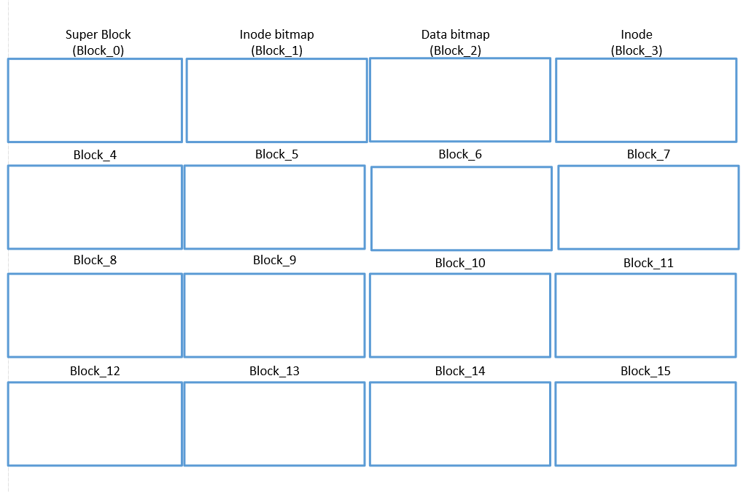
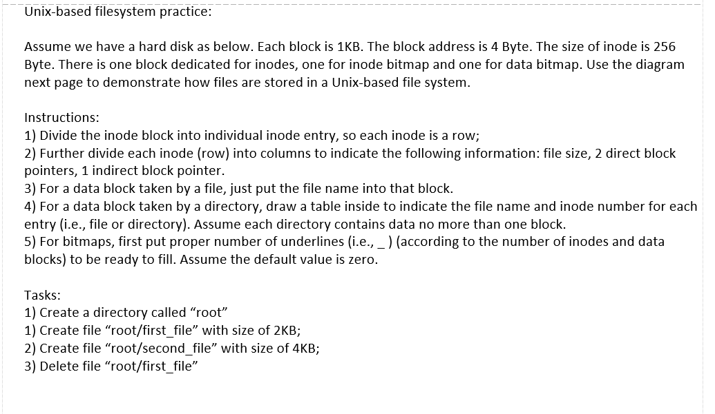
Filesystem practice
Check the handout for activity.

Slide 11
Free space management
Bitmaps
Used by our VSFS
free lists
A single pointer in the super block was kept to point to the first free block; inside that block the next free pointer was kept, thus forming a list through the free blocks of the system.
B-tree
Modern method
But not cover in this course

Slide 12
Optional materials from this point
Introduce various filesystems
FAT
FFS
LFS

Slide 13
FAT
Disk is divided into clusters.
A File Allocation Table (FAT) is created on this disk, to map the next cluster (in a file) of a given cluster, like a linked list.
Each cluster in the disk has an entry in FAT.
For a existing file, we only need to indicate the starting cluster of the file.

Slide 14
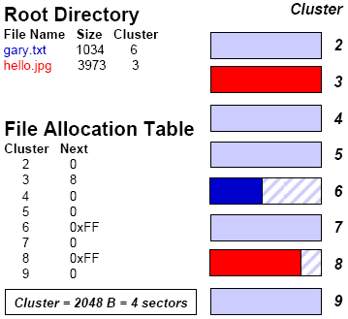
FAT example
In FAT:
0 indicates unallocated
0xFF indicates the end of file.

Slide 15
Pros and Cons of FAT
Advantages:
Simple to use
Cross-platform compatible
Disadvantages:
No random access
Upper-capped file size: 4GB (because it uses 32-bit to denote file size)
Security

Slide 16
FFS: Fast File System
Problem
A hard drive is not like random access memory; seeking is an expensive operation:
Data blocks can be far from inodes
Data would be spread all over disk leading to fragmentation
Solution
Make file system disk aware by organizing the disk into block groups!
Aggregate consecutive blocks into blocks.
Group 0
Group 1
Group 2

Slide 17
FFS: Block Groups
Superblock
Each block group contains all necessary file system structures
Multiple copies of the superblock allow for more reliability
Per-group inode and data bitmaps keep track of which inodes and data blocks are available
Most of the group consists of data blocks
Inode Bitmap
Data Bitmap
Inode Table
Data

Slide 18
FFS: Policies
To take advantage of this new organization, the file system utilizes the following heuristics:
Directories: Use group with low number of directories and lots of free inodes
Files: Allocate data blocks in same group as inode and place files from same directory in same group (for large files, only use up to a threshold within a group before moving to another group)
Keep related stuff together!

Slide 19
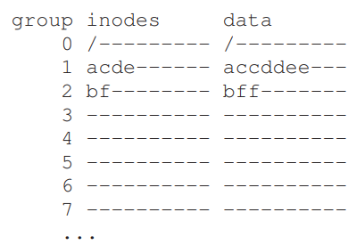
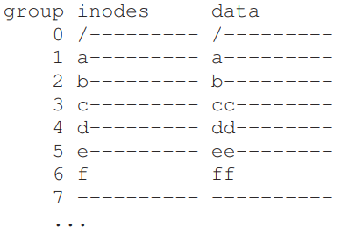
FFS: example
In the example, assume that there are only 10 inodes and 10 data blocks in each group.
3 directories (the root directory /, /a, and /b) and 4 files (/a/c, /a/d, /a/e, /b/f) are placed within them per the FFS policies.
FFS Policy
Non-FFS Policy

Slide 20
LFS: Log-structured File System
Problem
File systems do not take advantage of evolution in hardware resources nor do they consider common workloads
Larger main memory
Sequential I/O better than random I/O

Slide 21
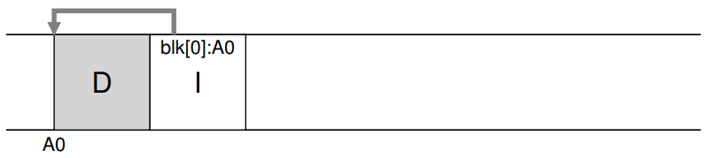
LFS: Motivation
When a user writes a data block, it is not only data that gets written to disk; there is also other metadata that needs to be updated.
In order to write a new data block D, we also need to update the corresponding inode I.
Disk writing tasks

Slide 22
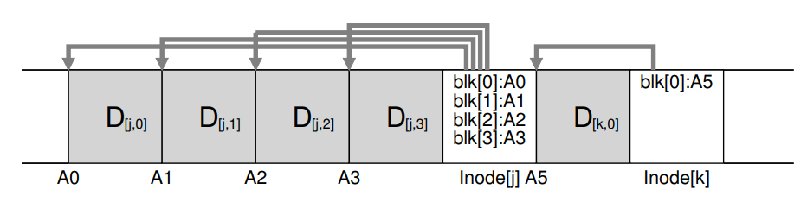
LFS: Solution
Buffer updates into a memory segment and then write segment to free location when full
Aggregates update into a single efficient write
Never overwrite data (always create new blocks)

Slide 23
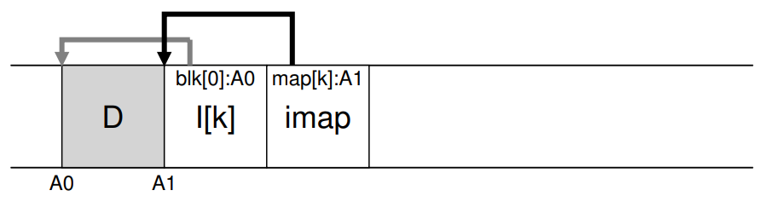
LFS: Where to find inodes?
Solution Through Indirection: The Inode Map (imap)
Imap keeps tracking where is the newest version inode.
But where to find imap?

Slide 24
LFS: Checkpoint Region
Checkpoint Region (CR): keep track of these inode maps, we have fixed regions of disk to store it. Since CR can be fairly small, we can consistently cache CR into memeory and update it to disk occationally (periodically).
CR
D
I[K]
IMAP

Slide 25
LFS: Garbage Collection
Never overwriting existing data leads to the problem of dealing with garbage (old blocks):
Periodically read old segments
Determine which blocks are live
Write these live blocks to new segments
0
1
2
3
4
5
6
7
Compact
0
3
5
6
7

Slide 26
LFS: Legacy
Innovations
Heavy emphasis on write buffering
Uses copy-on-write
Can use older versions as snapshots
Although LFS was an implementation failure, the ideas live on in new file systems:
ZFS
Btrfs
F2FS

