Slide 1
CPU Scheduling
CSSE 332
Operating Systems
Rose-Hulman Institute of Technology
Notes:
1

Slide 2
Basic concepts
CPU scheduling is the basis for multiprogrammed operating systems
Need to maximum CPU utilization obtained with multiprogramming
Various CPU-scheduling algorithms allow us to work toward that
Notes:
2
Otherwise, a system would run a process until it terminates or blocks and the CPU would be idle while the process is blocked waiting for I/O completion or for some other event to occur.
All this idle time would be wasted with no useful work being accomplished.
With multiprogramming, we try to use this time productively.
Almost all computer resources are scheduled before use. The CPU is an example of such resources. Its scheduling is central to OS design.

Slide 3
Processes execute in cycles
Success of CPU scheduling based on observed property of processes:
Executions consists of cycles of CPU execution and I/O wait
Processes alternate between these two states
Execution begins with CPU burst
That is followed by I/O burst, and so on
Final CPU burst ends with system call to terminate process
Notes:
3
Duration of CPU burst has been studied. Varies from process to process and from computer to computer.
They tend to have a frequency distribution as shown on next slide.

Slide 4
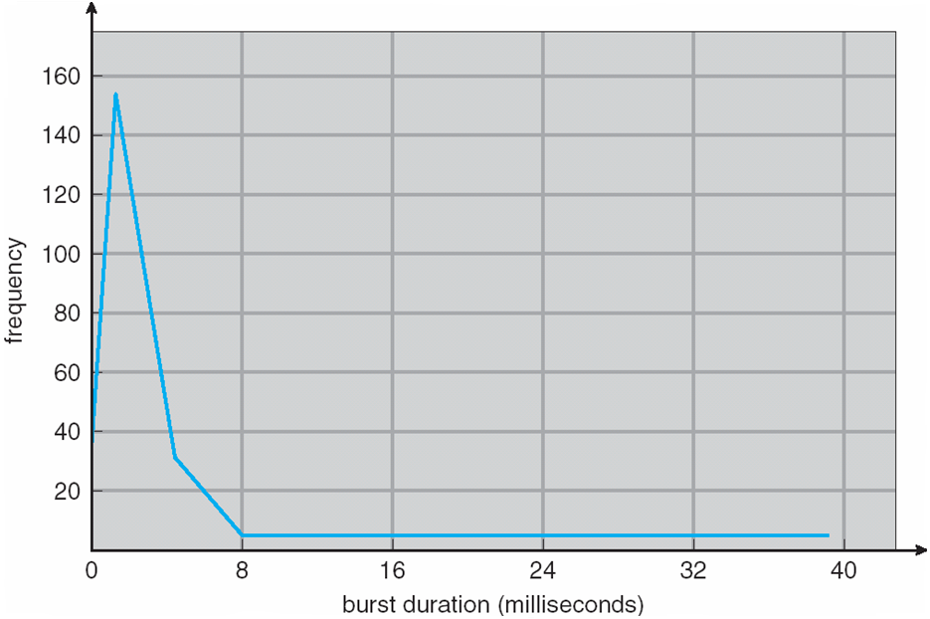
Histogram of CPU-burst times
Notes:
4
Curve described as exponential or hyperexponential.
Large number of short CPU bursts and small number of long CPU bursts.
I/O bound process has many short CPU bursts.
CPU bound process has few long CPU bursts.
Distribution may be important in the selection of an appropriate CPU-scheduling algorithm.

Slide 5
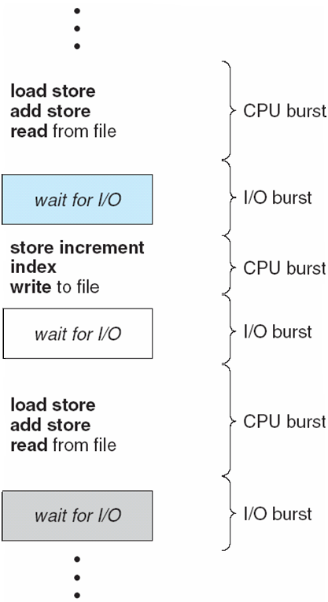
Alternating sequence of CPU and I/O bursts
Notes:
5

Slide 6
CPU scheduler
Selects from among the processes in memory that are ready to execute, and allocates the CPU to one of them
CPU scheduling decisions may take place when a process:
1. Switches from running to waiting state
2. Switches from running to ready state
3. Switches from waiting to ready
4. Terminates
Scheduling under 1 and 4 is nonpreemptive
All other scheduling is preemptive
Notes:
6
CPU scheduler is the short term scheduler.
Its job is to do what’s in the first bullet.
The scheduling decision may take place under any of the following four circumstances.
Under nonpreemptive scheduling (aka cooperative) , once the CPU has been allocated to a process, the process keeps it until it releases it by terminating or by switching to the waiting state.
This is the type of scheduling that was used in Windows 3.x From Windows 95 onward, Microsoft switched to preemptive scheduling.
Mac OS X uses preemptive scheduling. Earlier version of the Mac OS used nonpreemptive scheduling.
Some hardware platforms use only nonpreemptive scheduling because they do not have timers or other specialized hardware to do preemptive scheduling.

Slide 7
Dispatcher
Dispatcher module gives control of the CPU to the process selected by the short-term scheduler; this involves:
switching context
switching to user mode
jumping to the proper location in the user program to restart that program
Dispatch latency – time it takes for the dispatcher to stop one process and start another running
Notes:
7
Silberschatz, Galvin, and Gagne differentiate between the Dispatcher and the short term scheduler.
Other authors treat them as the same thing.

Slide 8
Scheduling criteria
CPU utilization – keep the CPU as busy as possible
Throughput – # of processes that complete their execution per time unit
Turnaround time – amount of time to execute a particular process (this includes stuff like wait queue time, CPU execution time, doing I/O time)
Waiting time – amount of time a process has been waiting in the ready queue
Response time – amount of time it takes from when a request was submitted until the first response is produced, not output (for time-sharing environment)
Notes:
8
Different scheduling algorithms favor different processes because they have different properties.
In choosing which algorithm to use in a particular situation, we must consider properties of the various scheduling algorithms.
Many criteria have been suggested for comparing CPU-scheduling algorithms. The best algorithm for a particular situation depends on the characteristics used in the comparisons.
The criteria include the following:

Slide 9
Scheduling algorithm optimization criteria
Max CPU utilization
Max throughput
Min turnaround time
Min waiting time
Min response time
Notes:
9
It is desirable to maximize CPU utilization and throughput, and to minimize turnaround time, waiting time, and response time.
In most cases we want to optimize the average measure, but there may be times when we bound or minimize the maximum response time, for example.
For the algorithms we consider, our measure of comparison will be the average waiting time.

Slide 10
First-Come, First-Served (FCFS) scheduling
Process Burst Time
P1 24
P2 3
P3 3
Suppose the processes arrive in order: P1 , P2 , P3
The Gantt Chart for the schedule is:
Waiting time for P1 = 0; P2 = 24; P3 = 27
Average waiting time: (0 + 24 + 27)/3 = 17
P1
P2
P3
0
24
27
30
Notes:
10
CPU scheduling deals with the problem of deciding which of the processes in the ready queue is to be allocated the CPU.
There are many CPU scheduling algorithms. We will describe several of them.
Burst time here → CPU burst time.
Write table on board.

Slide 11
FCFS scheduling continues
Suppose the processes arrive in order P2 , P3 , P1
The Gantt chart for the schedule is:
Waiting time for P1 = 6; P2 = 0; P3 = 3
Average waiting time: (6 + 0 + 3)/3 = 3
Much better than previous case
Convoy effect short process behind long process
P2
P3
P1
0
3
6
30
Notes:
11
Note that this is a nonpreemptive scheduling algorithm.
Observation: Average waiting time under FCFS is not minimal and varies substantially if the processes CPU burst times vary greatly.
Convoy effect: I/O bound processes wait in ready queue for a long time while CPU burst process hug the CPU (so I/O devices are idle). Then, CPU bound process does quick I/O, which allows I/O bound processes to do the short CPU burst then their I/O burst.
In general, a convoy effect happens when a set of processes need to use a resource for a short time, and one process holds the resource for a long time, blocking all of the other processes. Causes poor utilization of the other resources in the system.

Slide 12
Shortest-Job-First (SJF) scheduling
Associate with each process the length of its next CPU burst. Use these lengths to schedule the process with the shortest time
SJF is optimal – gives minimum average waiting time for a given set of processes
The difficulty is knowing the length of the next CPU request
Notes:
12
This is provably optimal: → moving a short process ahead of a long process decreases the waiting time of the short process more than it increases the waiting time of the long process.
This has the effect of avoiding the convoy effect, which can be experienced with FCFS scheduling.

Slide 13
SJF example
Process Burst Time
P1 6
P2 8
P3 7
P4 3
SJF scheduling Gantt chart
Average waiting time = (3 + 16 + 9 + 0) / 4 = 7
P4
P1
P3
P2
0
3
9
16
24
Notes:
13
This represents a nonpremptive version of SJF. SJF can be either preemptive or nonpreemptive. The preemptive version of the SJF is sometimes called shortest-remaining-time-first scheduling.
This assumes that all processes are admitted at the same time.

Slide 14
Determine length of next CPU burst
Can only estimate the length
Can be done by using the length of previous CPU bursts, using exponential averaging
Notes:
14
The parameter alpha controls the relative weight of recent and past history in our prediction.
Alpha ➔ 0, recent history has no effect.
Alpha ➔ 1, then past history has no effect and only the most recent CPU burst matters.

Slide 15
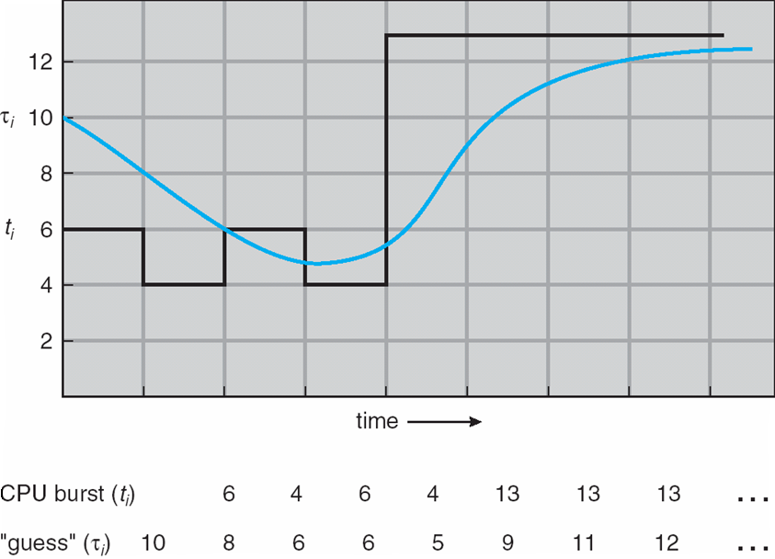
Prediction of length of next CPU burst
Notes:
15
Predict length of next CPU burst using alpha = ½ and Tau{0} = 10.

Slide 16
Examples of Exponential Averaging
α =0
τn+1 = τn
Recent history does not count
α =1
τn+1 = α tn
Only the actual last CPU burst counts
If we expand the formula, we get:
τn+1 = α tn+(1 - α)α tn -1 + …
+(1 - α )j α tn -j + …
+(1 - α )n +1 τ0
Since both α and (1 - α) are less than or equal to 1, each successive term has less weight than its predecessor
Notes:
16
Have students produce Gantt chart for these processes using nonpreemptive SJF and calculate average waiting time:
Process Arrival Time Burst Time
P1 0.0 6
P2 2.0 8
P3 4.0 7
P4 5.0 3
0 p1 6 p4 9 p3 16 p2 24
Waiting times: (0 – 0) + (16 – 2) + (9 – 4) + (6 – 5) = 6 + 14 + 5 + 1 = 20
Average waiting time = 20/4 = 5

