Slide 1
CPU Scheduling Algorithms
CSSE 332
Operating Systems
Rose-Hulman Institute of Technology
Notes:
Print Homework 13 and take to class.
1

Slide 2
Scheduling criteria
CPU utilization – keep the CPU as busy as possible
Throughput – # of processes that complete their execution per time unit
Turnaround time – amount of time to execute a particular process
Waiting time – amount of time a process has been waiting in the ready queue
Response time – amount of time it takes from when a request was submitted until the first response is produced, not output (for time-sharing environment)
Notes:
2
Different scheduling algorithms favor different processes because they have different properties.
In choosing which algorithm to use in a particular situation, we must consider properties of the various scheduling algorithms.
Many criteria have been suggested for comparing CPU-scheduling algorithms. The best algorithm for a particular situation depends on the characteristics used in the comparisons.
The criteria include the following:

Slide 3
Shortest-Job-First (SJF)
Associate with each process the length of its next CPU burst. Use these lengths to schedule the process with the shortest time
SJF is optimal – gives minimum average waiting time for a given set of processes
The difficulty is knowing the length of the next CPU request
Notes:
3
This is provably optimal: → moving a short process ahead of a long process decreases the waiting time of the short process more than it increases the waiting time of the long process.

Slide 4
Length of next CPU burst
Can only estimate the length
Can be done by using the length of previous CPU bursts, using exponential averaging
Notes:
4
The parameter alpha controls the relative weight of recent and past history in our prediction.
Alpha ➔ 0, recent history has no effect.
Alpha ➔ 1, then past history has no effect and only the most recent CPU burst matters.

Slide 5
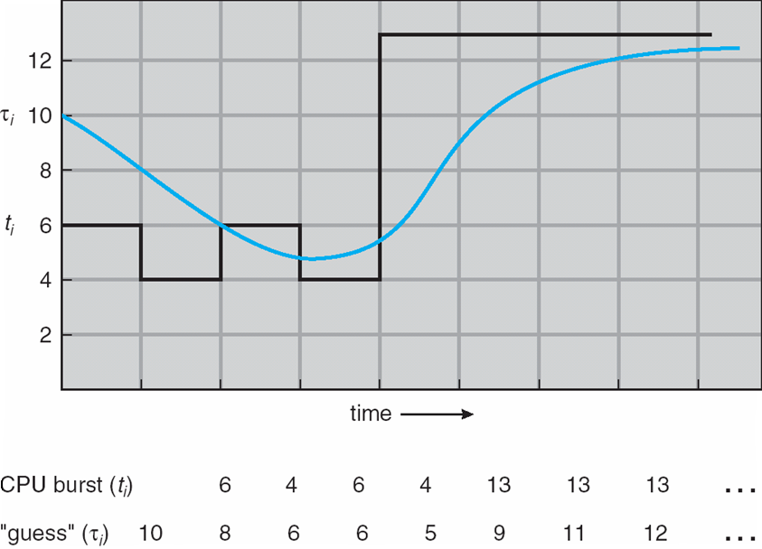
Prediction next CPU burst
Notes:
5
Predict length of next CPU burst using alpha = ½ and Tau{0} = 10.
Over time, the actual and the predicted next CPU burst converge.

Slide 6
Exponential averaging examples
α =0
τn+1 = τn
Recent history does not count
α =1
τn+1 = α tn
Only the actual last CPU burst counts
If we expand the formula, we get:
τn+1 = α tn+(1 - α)α tn -1 + …
+(1 - α )j α tn -j + …
+(1 - α )n +1 τ0
Since both α and (1 - α) are less than or equal to 1, each successive term has less weight than its predecessor
Notes:
6
Have students produce Gantt chart for these processes using nonpreemptive SJF and calculate average waiting time:
Process Arrival Time Burst Time
P1 0.0 6
P2 2.0 8
P3 4.0 7
P4 5.0 3
0 p1 6 p4 9 p3 16 p2 24
Waiting times: (0 – 0) + (16 – 2) + (9 – 4) + (6 – 5) = 6 + 14 + 5 + 1 = 20
Average waiting time = 20/4 = 5

Slide 7
Priority scheduling
A priority number (integer) is associated with each process
The CPU is allocated to the process with the highest priority (smallest integer ≡ highest priority)
Preemptive
nonpreemptive
SJF is a priority scheduling where priority is the predicted next CPU burst time
Problem ≡ Starvation – low priority processes may never execute
Solution ≡ Aging – as time progresses increase the priority of the process
Notes:
7

Slide 8
Round Robin (RR)
Each process gets a small unit of CPU time (time quantum), usually 10-100 milliseconds. After this time has elapsed, the process is preempted and added to the end of the ready queue.
If there are n processes in the ready queue and the time quantum is q, then each process gets 1/n of the CPU time in chunks of at most q time units at once. No process waits more than (n-1)q time units.
Performance
q large ⇒ FIFO
q small ⇒ q must be large with respect to context switch, otherwise overhead is too high
Notes:
8

Slide 9
RR example: quantum = 4
Process Burst Time
P1 24
P2 3
P3 3
The Gantt chart is:
Typically, higher average turnaround than SJF, but better response
P1
P2
P3
P1
P1
P1
P1
P1
0
4
7
10
14
18
22
26
30
Notes:
9
Have students do the calculation in pairs.
Waiting time: (6 + 4 + 7) = 17
Average waiting time = 5 2/3

Slide 10
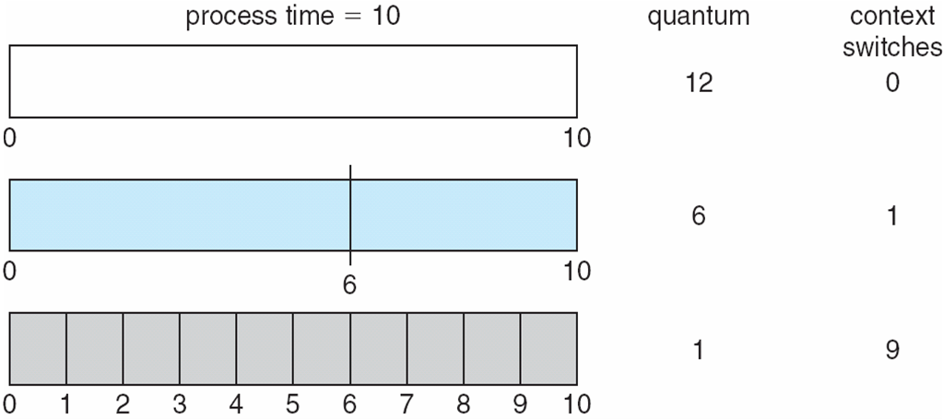
Quantum & context switches
Notes:
10
This figure shows that a smaller time quantum increases context switches.
Should desire that short processes are able to complete within a time quantum.

Slide 11
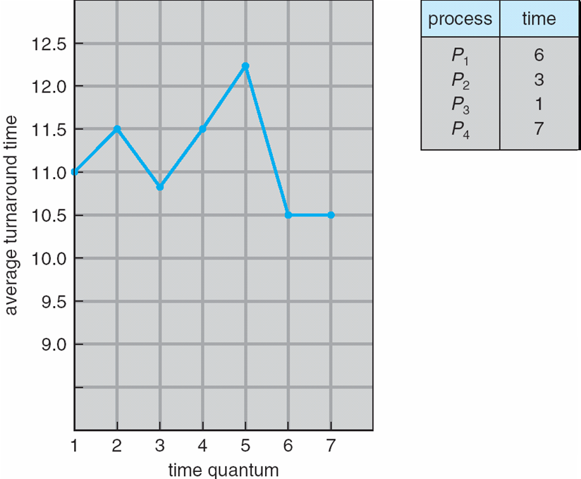
Turnaround time vs Quantum
Notes:
11
The average turnaround time for a set of processes does not necessarily improve as the time quantum increases.
In general, the average turnaround time can be improved if most processes finish their next CPU burst within a single time quantum.

Slide 12
Multilevel Queue
Ready queue is partitioned into separate queues: E.g.,
foreground (interactive)
background (batch)
Each queue has its own scheduling algorithm
foreground – RR
background – FCFS
Notes:
12
Example, can use RR for foreground processes and FCFS for background processes.

Slide 13
Multilevel Queue (continues)
Scheduling must be done between the queues
Fixed priority scheduling: (i.e., serve all from foreground then from background).
Possibility of starvation.
Time slice – each queue gets a certain amount of CPU time that it can schedule amongst its processes: i.e.,
80% to foreground in RR
20% to background in FCFS
Notes:
13
Scheduling among the queues can be done in different ways.
One option is Fixed priority scheduling. Another option is time slicing.

Slide 14
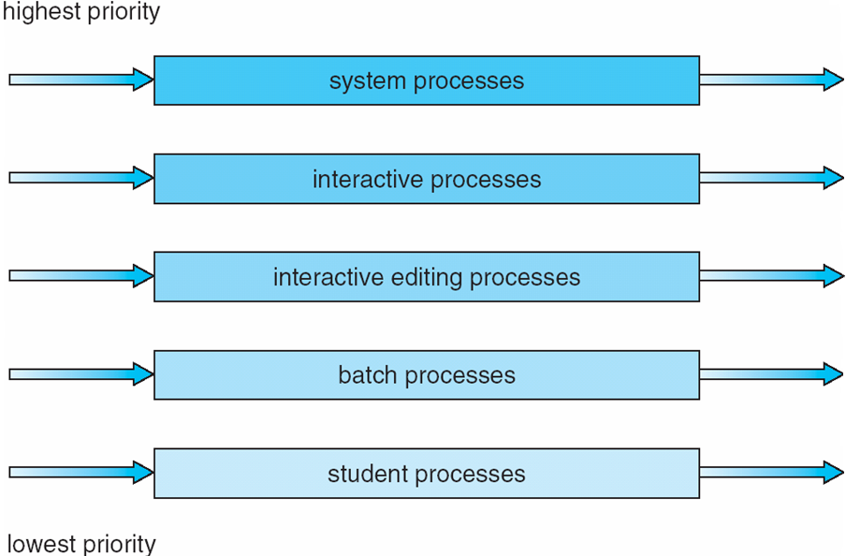
Multilevel Queue Scheduling
Notes:
14

Slide 15
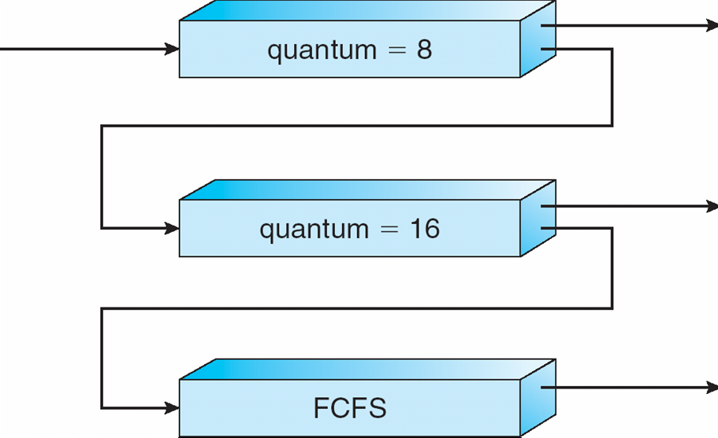
Multilevel Feedback Queues
Notes:
15

Slide 16
Multilevel Feedback Queue example
Three queues:
Q0 – RR with time quantum 8 milliseconds
Q1 – RR time quantum 16 milliseconds
Q2 – FCFS
Scheduling
A new job enters queue Q0, which is served FCFS. When it gains CPU, job receives 8 milliseconds. If it does not finish in 8 milliseconds, job is moved to queue Q1.
At Q1 job is again served FCFS and receives 16 additional milliseconds. If it still does not complete, it is preempted and moved to queue Q2.
Notes:
16

Slide 17
Multilevel Feedback Queue
A process can move between the various queues; aging can be implemented this way
Multilevel-feedback-queue scheduler defined by the following parameters:
number of queues
scheduling algorithms for each queue
method used to determine when to upgrade a process
method used to determine when to demote a process
method used to determine which queue a process will enter when that process needs service
Notes:
17
MLFQ is the most general CPU-scheduling algorithm.
It can be configured to match a specific system under design.
It is also the most complex algorithm, need to select best value for each parameter.

