Slide 1
File System Interface
CSSE 332
Operating Systems
Rose-Hulman Institute of Technology
Notes:
1

Slide 2
Why a file system
There is a general need for long-term and shared data storage:
need to store large amount of information
persistent storage (outlives process and system reboots)
concurrent sharing of information
Files meet these requirements
The file manager or file system within the OS
Set of system software proving services to users and applications in use of files
Files are accessed through file management system
Notes:
2

Slide 3
Concept of a file
A named collection of related data stored on secondary storage
File extension may encode the file type
in UNIX and Windows
Abstraction presented to the user
An ADT that specifies a minimal set of operations
Common examples of File types
Regular files, directories
Executable files
special files (block and character)
Archives
Notes:
Files can store program or data:
numeric data
character data
binary data
3

Slide 4
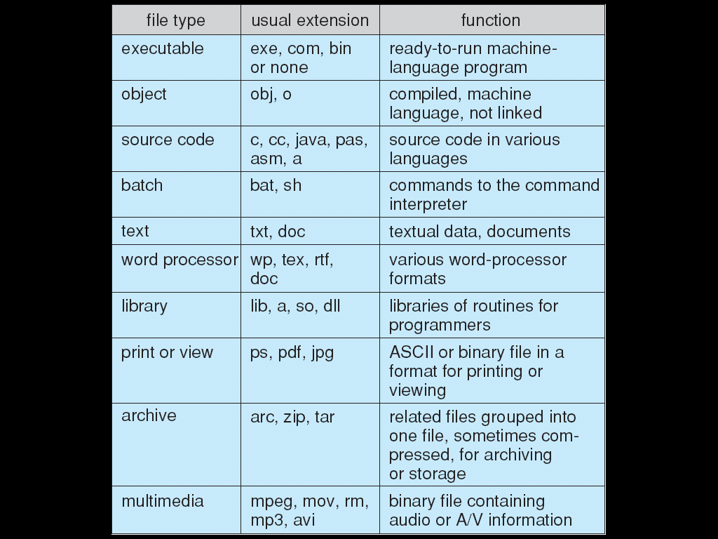
Examples of file types
Notes:
4
What other file types have you used that are not on this list?

Slide 5
File structure (logical)
None - sequence of words, bytes
Simple record structure
Lines, Fixed length, Variable length
Complex Structures
Formatted document, multi-media documents
Who decides:
Operating system
Application
DBMS
Notes:
5

Slide 6
File Attributes
Name – only information kept in human-readable form
Identifier – unique tag (number) identifies file within file system
Type – needed for systems that support different types
Location – pointer to file location on device
Size – current file size
Protection – controls who can do reading, writing, executing
Time, date, and user identification – data for protection, security, and usage monitoring
Information about files are kept in the directory structure, which is maintained on the disk
Notes:
6
https://linux.die.net/man/2/stat
e.g., stat 18-FileSystemInterface.pptx

Slide 7
File Operations
File is an abstract data type
Create
Write
Read
Reposition within file
Delete
Truncate
Open(Fi) – search the directory structure on disk for entry Fi, and move the content of entry to memory
Close (Fi) – move the content of entry Fi in memory to directory structure on disk
Notes:
7
Opening a file moves the content of the file to a buffer in memory.
Closing a file moves the buffered content of the file from memory to disk.
How is truncating a file different from writing a file? Writing a file resets the file pointer to the start of the file, but truncating a file allows the user to specify the new size of the file.

Slide 8
Open Files
Several pieces of data are needed to manage open files:
File pointer: pointer to last read/write location, per process that has the file open
File-open count: counter of number of times a file is open – to allow removal of data from open-file table when last processes closes it
Disk location of the file: cache of data access information
Access rights: per-process access mode information
Notes:
8
How is opening a file for reading different from opening a file for writing? – for writing, the content of the file is cleared and the file pointer points to the beginning of the file.

Slide 9
Access Methods
Sequential Access
read next
write next
reset
no read after last write
(rewrite)
Direct Access
read n
write n
position to n
read next
write next
rewrite n
n = relative block number
Notes:
9
Examples of direct access files are directories, pricing tables, schedules, and name lists.

Slide 10
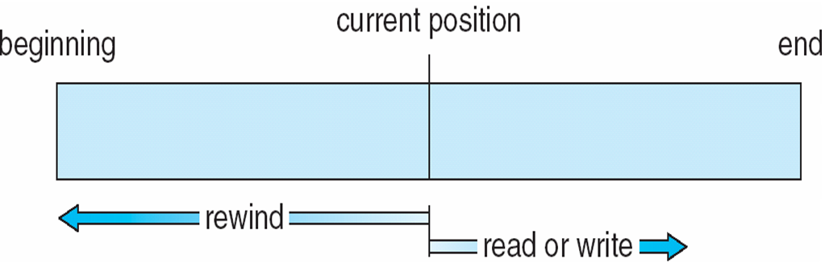
Sequential-access File
Notes:
10

Slide 11
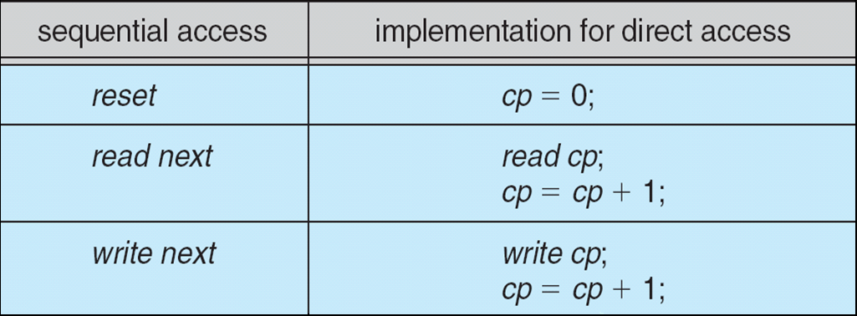
Simulation of Sequential Access on Direct-access File
Notes:
11

Slide 12
Directory structure
Directory contains a collection of nodes containing information about all files
Both the directory structure and the files reside on disk
Backups of these two structures were kept on tapes
Directory
Files
F 1
F 2
F 3
F 4
F n
Notes:
Both the directory and the files are stored on disks. Of course, these can be backed up for reliability (to keep the disks safe from physical damage).
12

Slide 13
Disk Structure
Disk can be subdivided into partitions
Disks or partitions can be RAID protected against failure
Disk or partition can be used raw – without a file system, or formatted with a file system
Partitions also known as minidisks, slices
Entity containing file system known as a volume
Each volume containing file system also tracks that file system’s info in device directory or volume table of contents
As well as general-purpose file systems there are many special-purpose file systems, frequently all within the same operating system or computer
Notes:
RAID (redundant array of independent disks) is a way of storing the same data in different places (thus, redundantly) on multiple hard disks.
13

Slide 14
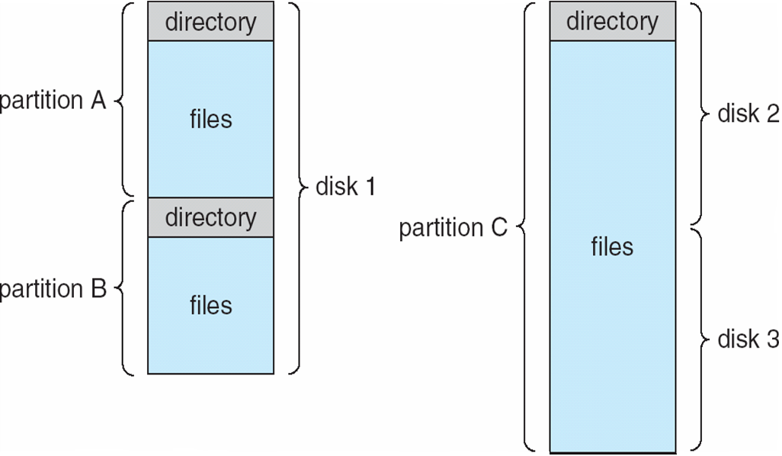
A Typical File-system Organization
Notes:
14
My brother likes to burn and store music. He has 2 internal hard drives on his system.

Slide 15
Directory operations
Search for a file
Create a file
Delete a file
List a directory
Rename a file
Traverse the file system
Notes:
Directory operations in LINUX
find ~/ -name '.svn’ -print
Typically use a program to crate a file
Delete a file with rm
Use ls to list a directory
Use mv to rename a file
Use cd to traverse a file system
15

Slide 16
Information per file in a directory
Name
Type
Address
Current length
Maximum length
Date last accessed (for archival)
Date last updated (for dump)
Owner ID (who pays)
Protection information (discuss later)
Notes:
All of this information is stored in a node per file
stat <filename>
16

Slide 17
Organize the directory (logically)
Efficiency – locating a file quickly.
Naming – convenient to users.
Two users can have same name for different files.
The same file can have several different names.
Grouping – logical grouping of files by properties, (e.g., all Java programs, all games, …)
Notes:
17

Slide 18
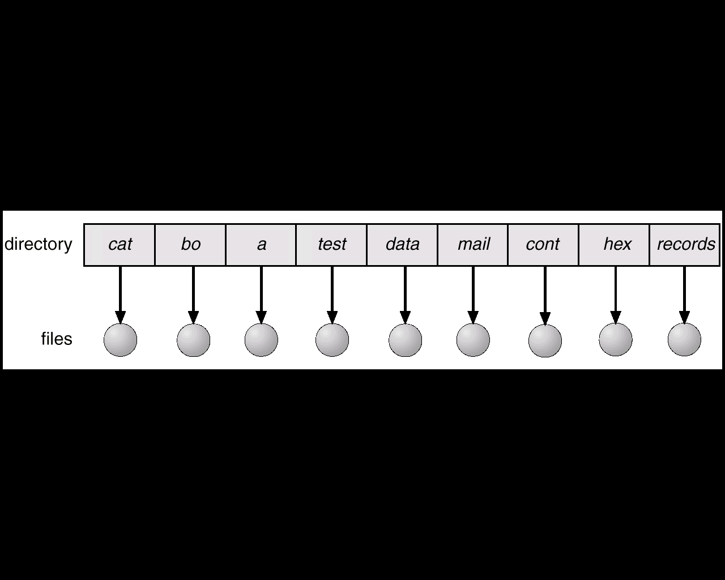
Single-level directory
A single directory for all users.
Naming problem
Grouping problem
Notes:
Naming problem: two users (or even one user) cannot have files of the same name.
Grouping problem: cannot group all OS files together in a sub-directory.
18

Slide 19
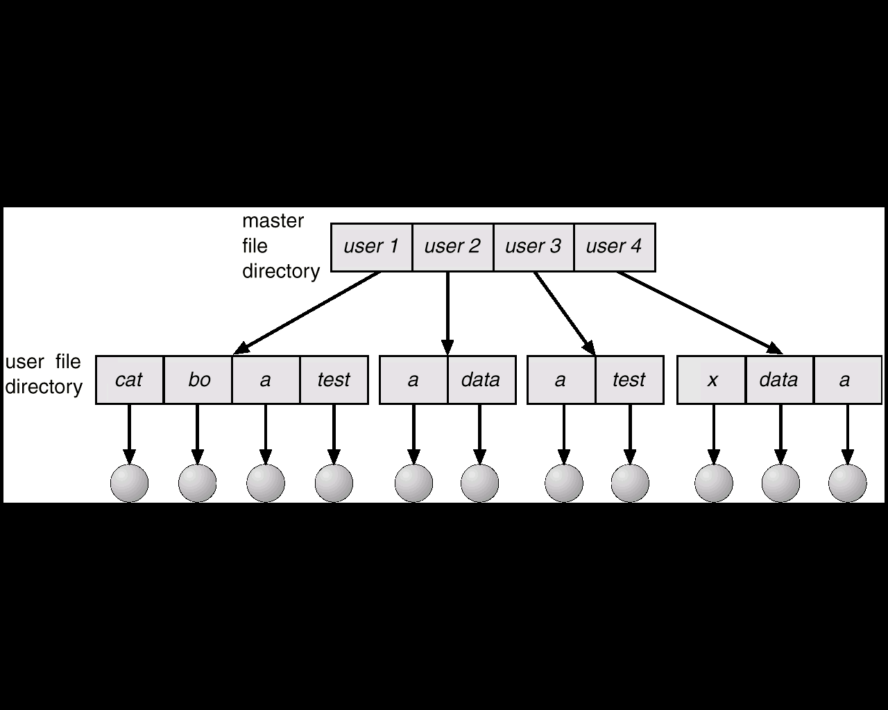
Two-level directory
Separate directory for each user.
Path name
Can have the same file name for different user
Efficient searching
No grouping capability
Notes:
Each user has a directory, but all his/her files are stored in that one directory.
A user cannot group files in directories.
19

Slide 20
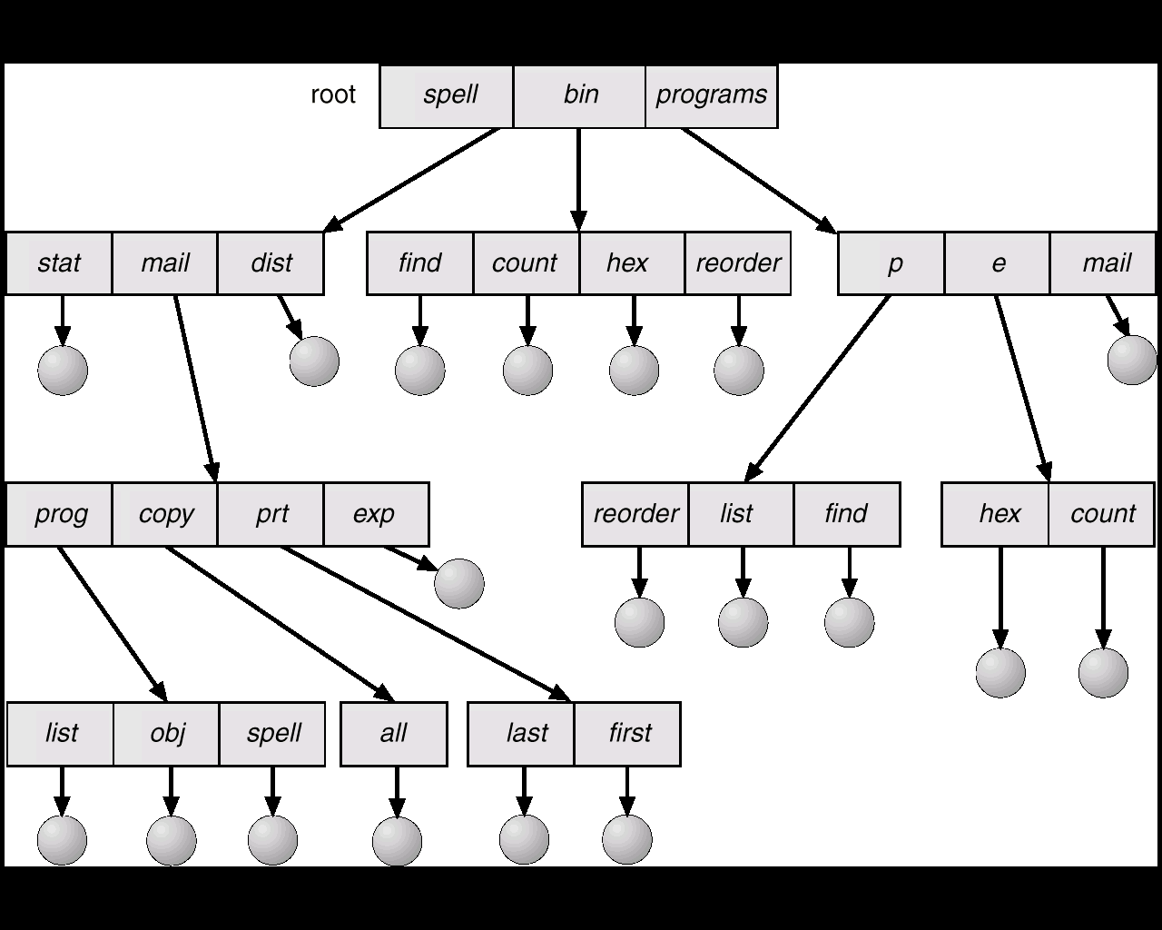
Tree-structured directories
Notes:
This is a directory-tree structure.
Each directory entry points to a file or another directory. This is what LINUX and WINDOWS use.
20

Slide 21
Tree-structured directories (2)
Efficient searching
Grouping Capability
Absolute or relative path name
Current directory (working directory)
cd /Users/faculty/defoe/Public/
Creating a new file is done in current directory
Creating a new subdirectory is done in current directory
Notes:
21

Slide 22
Tree-structured directories (3)
Absolute or relative path name
Creating a new file is done in current directory
Delete a file
rm <file-name>
Creating a new subdirectory is done in current directory
mkdir <dir-name>
Example: if in current directory /mail
mkdir count
mail
prog
copy
prt
exp
count
Deleting mail ⇒ deletes the entire subtree rooted by mail
Notes:
22
Your text discusses other directory structures (acyclic graph, general graph) but we will not discuss these in class
Mounting file systems and File sharing are also important concepts, but we will not have time to discuss them in class.

Slide 23
Protection
File owner/creator should be able to control:
what can be done
by whom
Types of access
Read
Write
Execute
Append
Delete
List
Notes:
23

Slide 24
Access lists and groups
Mode of access: read, write, execute
Three classes of users
RWX
a) owner access 7 ⇒ 1 1 1
RWX
b) groups access 6 ⇒ 1 1 0
RWX
c) public access 1 ⇒ 0 0 1
Ask manager to create a group (unique name), say G, and add some users to the group.
For particular file or subdirectory, define an appropriate access.
owner
group
public
chmod
761
game
Attach a group to a file or directory
chgrp G game
Notes:
game is a subdirectory.
G is a group.
24

Slide 25
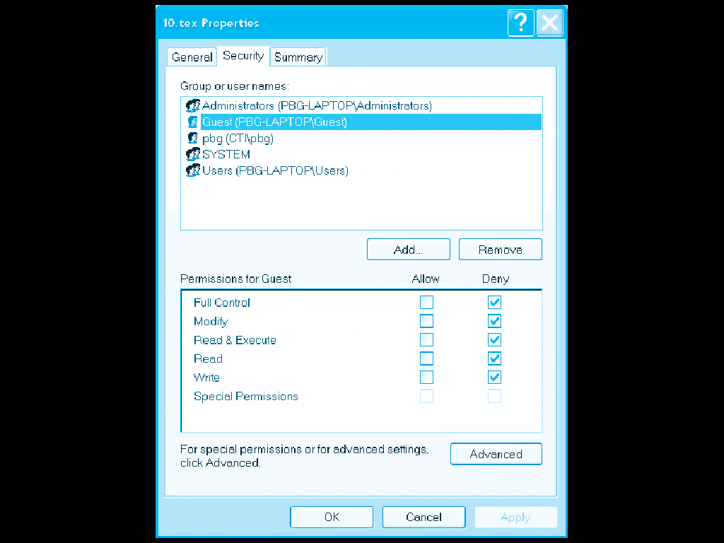
Windows XP Access-control List Management
Notes:
25

Slide 26
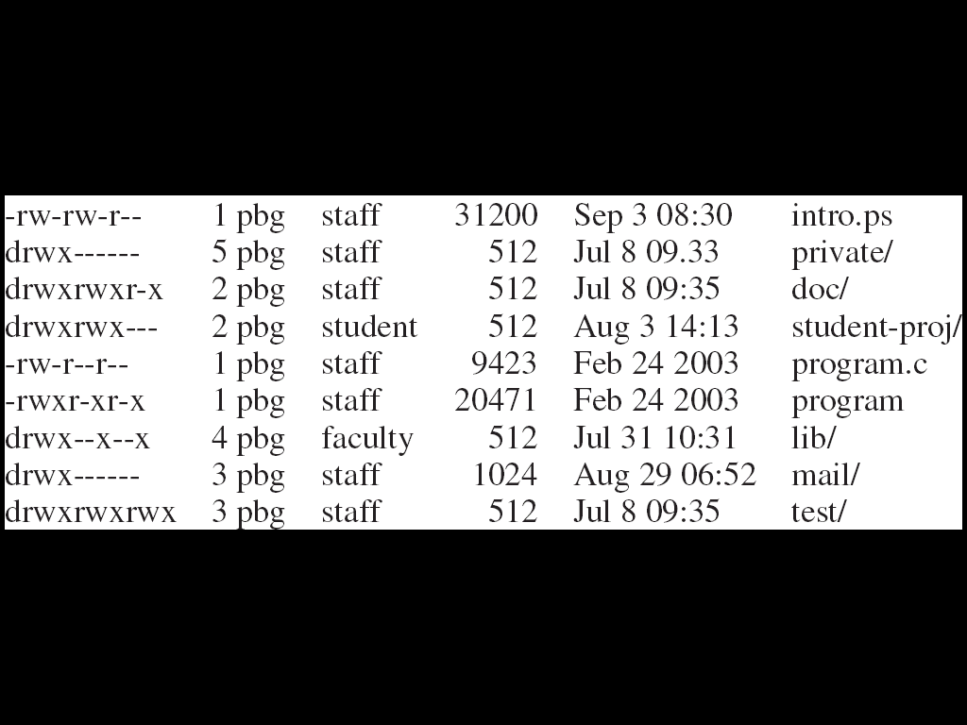
A Sample UNIX Directory Listing
Notes:
26
If first char is a d, then it’s the listing for a subdirectory.
As shown (from left to right):
Owner, group, universe permissions
Number of links to the file
The owner’s name
The group’s name
The size of the file in bytes
The date of last modification
File name

