Slide 1
Process operation
CSSE 332
Operating Systems
Rose-Hulman Institute of Technology
Notes:
1

Slide 2
Process schedulers
Long term scheduler: job scheduler
selects which processes should be brought into the ready queue.
invoked infrequently (seconds, minutes)
controls the degree of multiprogramming
Medium term scheduler:
allocates memory for process.
invoked periodically or as needed.
Short term scheduler:
selects which process should be executed next and allocates CPU.
invoked frequently (ms)
Notes:
A process migrates among the various scheduling queues throughout its lifetime.
The OS must select, for scheduling purposes, processes from among these queues in some fashion.
The selection process is carried out by the appropriate scheduler.
2

Slide 3
Long-term scheduling
Different schedulers run with different frequencies.
Long-term scheduler runs on the order of minutes
Controls degree of multi-programming
Degree is stable when avg rate of process creation = avg departure rate of processes leaving system
May need to be invoked only when a process leaves the system
Notes:
Degree of multi-programming: number of processes in memory
Long-term scheduler should be careful about deciding which type of process to select.
There are at least two types: I/O bound or CPU bound processes.
3

Slide 4
Long-term scheduling: process mix
I/O bound process:
Spends more of its time doing I/O than it spends doing computation
CPU bound process:
Generates I/O requests infrequently
Uses more of its time doing computation
Long term scheduler should select a good mix of processes
Notes:
4

Slide 5
Right mix of processes (2)
All processes should not be I/O bound. Why?
All processes should not be CPU bound. Why?
System with best performance is one with a mix of I/O bound and CPU bound processes
Notes:
If all processes are I/O bound processes: ready queue would be practically empty and the short term scheduler would have little to do.
If all processes are CPU bound processes: the I/O waiting queues will almost always be empty and devices will go unused and the system will be unbalanced.
5

Slide 6
Another scheduler
On some systems, the long-term schedule may be absent or minimal
E.g., time-sharing systems like UNIX and Windows put all new processes in memory for the short term scheduler
Some time-sharing systems may introduce an additional, intermediate level of scheduling called medium-term scheduling
Notes:
6

Slide 7
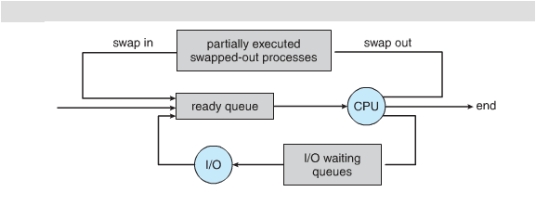
Medium-term scheduling
Q3
Notes:
Some times it can be advantageous to remove processes from memory and thus reduce the degree of multiprogramming.
Those processes are removed from actively contending for the CPU.
Later, those processes can be reintroduced into memory and execution can continue from where they left off.
This is called swapping.
Swapping can help improve the process mix and can free up overcommitted memory.
7

Slide 8
Short-term scheduling
Selects the next process from the ready queue to run and allocates the CPU to it
The context of the current process must be saved in its PCB
The context of the new process must be restored from its PCB
Notes:
The saving and restoring of the process contexts is done by the kernel. This is what context switching or process switching is all about.
Context-switch time is purely overhead because the system does no useful work while switching.
Context-switching time varies by system. It depends on number of registers, memory speed, and the existence of special instructions to load and store all registers at once.
Typical speed is a few milliseconds.
8

Slide 9
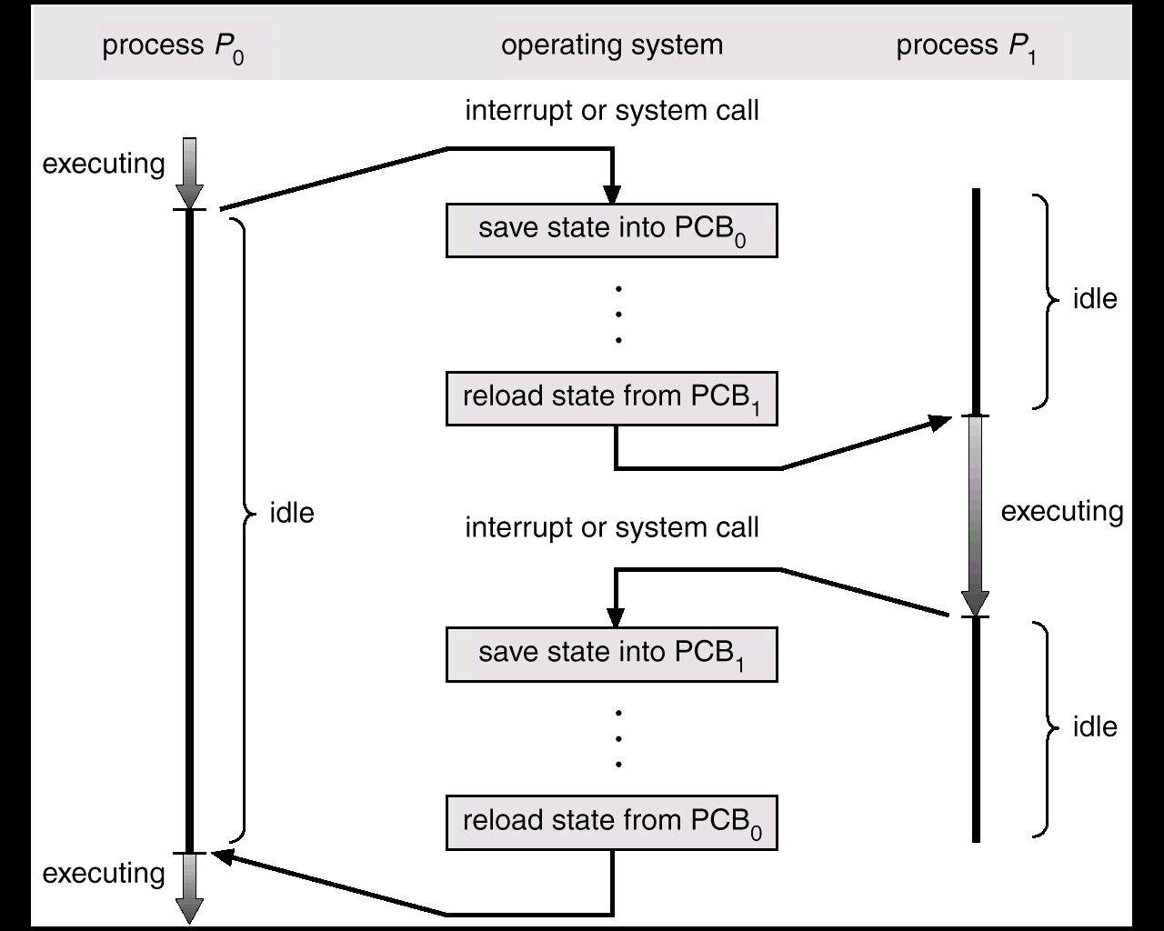
Context switching recap
Notes:
Recall this example from last class
9

Slide 10
Context switching overhead
If the short term scheduler executes at least once every 100 ms and takes about 10 ms to execute, what percent of the CPU time is used simply to schedule work?
Notes:
If the short term scheduler executes at least once every 100 ms and takes about 10 ms to execute, what percent of the CPU time is used simply to schedule work?
10/(100 + 10) ~ 9%.
10

Slide 11
Operations on processes
Processes on most systems can execute concurrently
Processes are created and deleted dynamically
System must provide mechanism for creating and deleting processes
A parent process may create child processes, forming process tree
Notes:
11

Slide 12
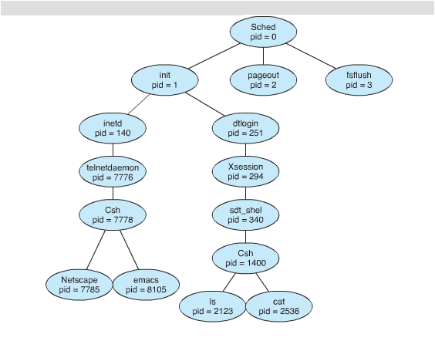
Example process tree
Notes:
On a UNIX system, ps –el will list complete information for all processes currently active in the system.
pstree displays the information in a nice readable format.
12

Slide 13
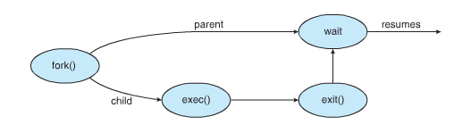
Process creation in LINUX
Notes:
Code FIGURE 3.34 together, on page 152.
Explain the use of fork and wait.
13

Slide 14
Semantics of fork system call
int fork_pid = fork(); // can fail, fork_pid < 0
Called once, but returns twice
Once in the parent (if fork_pid > 0)
Once in the child (if fork_pid == 0)
Child is a duplicate of its parent
Both processes continue executing from the statement after fork()
Notes:
14

Slide 15
Child can defer from parent
Can make child do something different from its parent by using an if-statement to verify that you are in the child.
Let’s study the Fork Example code together
Complete the In-class Coding Activity
Avoid fork bomb. What’s this?
Notes:
15

