Slide 1
Interprocess communication
CSSE 332
Operating Systems
Rose-Hulman Institute of Technology
Notes:
Populate Students’ repos with examples/InterProcessCommunication project
1

Slide 2
Independent vs cooperating processes
A process is independent if it cannot affect or be affected by other processes
Does not share data with other processes
A process is cooperating if it can affect or be affected by other processes
A process that shares data with other processes is a cooperating process
Notes:
Processes executing concurrently in the OS may be either independent processes or cooperating processes.
2

Slide 3
Reasons why processes cooperate
Information sharing
Computation speedup
Modularity
Convenience
Notes:
Several users may be interested in sharing information (e.g., file data)
Break up a task that we want to run faster in several sub-tasks
Design system so that different functions are performed by different processes or threads
An individual user may work on several tasks at the same time (editing, printing, compiling in parallel)
3

Slide 4
IPC mechanism
Cooperating processes require an IPC mechanism that will allow them to exchange data
Two fundamental approaches to IPC
Shared memory
Message passing
Notes:
The processes should be able to exchange both data and information
4

Slide 5
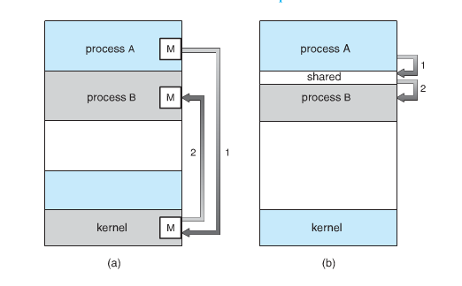
Communication models
Notes:
Message Passing
Shared Memory
5

Slide 6
Shared memory
Communicating processes must establish a region of shared memory
Resides in the address space of process creating region
Other process must attach to it
OS cannot prevent either process from accessing the shared region (has no control)
Both processes can read or write data in shared memory region
Notes:
The form and location of shared memory region must be determined by cooperating processes.
Cooperating processes must also coordinate access to shared memory region.
Producer-Consumer problem can be solved by using shared memory. We will discuss this problem at a later time.
6

Slide 7
Ways to do shared memory
Study code in InterProcessCommunication project in examples directory.
client.c and server.c explicitly create and use a shared memory region
shared_simple.c uses mmap to allocate a shared memory space
Notes:
Walk students through the code in the InterProcessCommunication project.
7

Slide 8
Ways to do shared memory
Study code in InterProcessCommunication project in examples directory.
pipes_simple.c uses pipes to send and receive data
Try completing factoring.c on your own
Notes:
Walk students through the code in the InterProcessCommunication project.
8

Slide 9
Message Passing
Allows processes to communicate and to synchronize their activities without having to share the same address space
E.g., IM, chat programs, etc.
send (destination, message)
receive (source, message)
Notes:
A message passing facility provides at least two operations (primitives): send and receive
The send and receive primitives are system calls because the message passing facility is provided by the OS
Send: sends a message to a given destination
Receive: receives a message from a given source or from ANY source if the receiver does not care.
If no message is available the receiver can block until one arrives.
Messages can have fixed sizes or variable sizes.
9

Slide 10
Communication link
If processes A and B want to communicate
A communication link must exist between them. Physical implementation e.g.,
Shared memory
Hardware bus
Network
Logical implementation of link is our primary concern

Slide 11
Logical implementation of link
Direct or indirect communication
Synchronous or asynchronous communication
Automatic or explicit buffering of messages
11
Notes:
There are several methods for logical implementation of a link and the send()/receive() operations.
A link can be implemented to provide: (Highlight the bullets).
11

Slide 12
Addressing or naming processes
Direct addressing
Send primitive includes a specific identifier of the destination process
Receive primitive could know ahead of time from which process a message is expected
Receive primitive could use source parameter to return an ack when the receive operation has been performed
send (destination, message)
receive (source, message)
Notes:
Processes that wish to communicate must have a way to refer to each other. They can use either direct or indirect communication.
Each process that wants to communicate using direct communication must explicitly name the recipient or sender of the communication.
The specific ID of the destination process can be a unique address. (e.g. IP address and port number)
The return value could be an ack message.
12

Slide 13
Addressing or naming processes (2)
Indirect addressing
Messages are sent to a shared data structure consisting of queues
Queues are called mailboxes
One process sends a message to the mailbox and the other process picks up the message from the mailbox
Notes:
Technically speaking, a mailbox is a place for a certain number of messages. If a process is trying to send a message to a full mailbox, it is blocked until a message is retrieved from the mailbox.
In this case the address parameter in the send and receive primitives is a mailbox instead of a process. In the Mach OS, a mailbox is called a port.
For the producer-consumer problem both the producer and consumer creates a mailbox. Producer sends full message to consumer’s mailbox and consumer sends empty messages to the producer’s mailbox.
13

Slide 14
Synchronization
Sender and receiver may or may not be blocking (waiting for message)
Blocking send, blocking receive
Both sender and receiver are blocked until message is delivered
Called a rendezvous
Synchronous communication
Notes:
Synchronization: Situation in which two or more processes coordinate their activities base on a condition
There are different options for implementing the send() and receive() primitives. Message passing may be either blocking (synchronous) or non-blocking (asynchronous).
In a rendezvous, no buffering of messages is involved. If the sending is done first, the sender is blocked until the receive happens. If the receiving is done first, the receiver is blocked until a send happens.
In this scenario the receiver and sender run in lockstep. There is no flexibility.
14

Slide 15
Synchronization
Non-blocking send, blocking receive
Sender continues on
Receiver is blocked until the requested message arrives
Non-blocking send, non-blocking receive
Neither party is required to wait
Notes:
1st major bullet, Asynchronous sender, synchronous receiver
2nd major bullet, asynchronous communication
15

Slide 16
Notes:
Relationship between sender and receiver:
Here a port is given as a mailbox that is owned by the receiver.
1 to 1: Allow private communication link to be set up between processes
M to 1: useful for client/server interaction; one process provides service to a number of other processes. Mailbox is referred to as a port. Clients send service requests to the server. The port is typically owned and created by the receiving process (server).
1 to M: useful for applications where a message is to be broadcast to a set of processes
M to M: allows multiple server processes to provide concurrent service to multiple clients
16

Slide 17
Buffering
Zero capacity queue:
Queue has a maximum length of zero
Bounded capacity queue:
Queue has a finite length n
Unbounded capacity queue:
Queue’s length is potentially infinite
Notes:
Whether direct or indirect communication is used, messages exchanged by communicating processes reside in temporary queues.
These queues are implemented in three ways:
Zero capacity queue has a blocking sender since the link cannot have any messages waiting in it.
Bounded capacity queue: At most n messages can reside in the link. Sender blocks only when the queue is full.
Unbounded capacity queue: any number of messages can wait in the link. Sender never blocks.
17

Slide 18
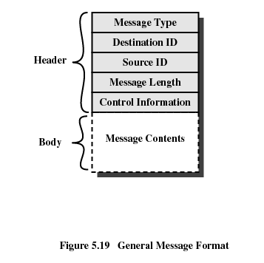
Message Format
Notes:
Content part of the message can be of fixed length or variable length.
Variable length messages allow for flexibility.
18

