Slide 1
Intro to Processes
CSSE 332
Operating Systems
Rose-Hulman Institute of Technology
Notes:
Administer quiz/csse332_quiz_06 during this session
1

Slide 2
Processes
A process is a program in execution
A process requires resources, which are managed by the operating system
The OS interleaves the execution of several processes to maximize processor utilization
OS supports Inter-Process Communication (IPC) and user creation of processes
Notes:
Process requires hardware resources (CPU, memory, HDD, devices)
The CPU is multiplexed among OS processes and user processes
2

Slide 3
Process in memory
max
Stack
Heap
Data
Text
0
Notes:
This figure represents the structure of a process in memory.
Recall that a process is more than the program code. Program code is just the text section (stores list of instructions on disk in a file called an executable file) of a process. It is a passive entity.
A process is an active entity with a program counter that holds address on next instruction and a set of associated resources.
DATA Section: stores global variables
How does the stack differ from the heap?
STACK: contains temporary data (function parameters, local variables, return addresses)
HEAP: Memory that is dynamically allocated
3

Slide 4
Process state
As a process executes, it changes state
New: The process is being created.
Ready: The process is waiting to be assigned to a processor.
Running: Instructions are being executed.
Waiting or blocked: The process is waiting for some event to occur.
Terminate or Exit: The process has finished execution.
Notes:
As a process executes, it changes state. The state of a process is defined partly by the current activity of the process
Each process may be in one of the following states:
4

Slide 5
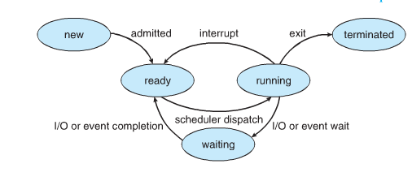
Diagram of process state
Notes:
The scheduler that dispatches processes is called the CPU scheduler, short term scheduler, dispatcher.
It runs on the order of milliseconds (e.g., every 100 milliseconds).
From which state must a process be before it can be dispatched?
Exactly how many processes can execute on each CPU?
5

Slide 6
Process representation in OS
Each process is represented as a process control block PCB or task control block
PCB contains many pieces of information associated with a specific process
Process state
Program counter
CPU registers
CPU scheduling information
Memory management information
I/O status information
Accounting information
Notes:
Process state (new, ready, running, waiting, etc.)
Registers include accumulators, index registers, stack pointers, general-purpose registers, etc. These vary in number and type based on the computer architecture.
Scheduling info includes process priorities, pointers to scheduling queues, and so on.
Memory management info depends on memory management system being used.
I/O status info includes list of I/O devices allocated to the process, list of open files, and so on.
Accounting (amount of CPU and real-time used; time limits, account numbers, process numbers, etc.)
6

Slide 7
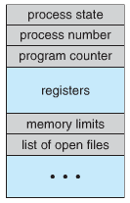
Process Control Block
*multiple sets of registers and stacks in the multithreaded world
Notes:
7

Slide 8
Support for multiple threads
In single threaded model, only one thread of execution
Only one thing can be done at a time
In word processor, cannot type and spell check at the same time
Many modern OS’s expanded process concept to support multiple threads
Multiple tasks can be performed at once
PCB is expanded to include info for each thread

Slide 9
Process scheduling
Objective of multiprogramming:
Have some process running at all time
Keep CPU(s) busy
Objective of time sharing:
Switch CPU(s) among processes frequently
Allow user to interact with each running process
To meet these objectives process scheduler selects an available process for execution on the CPU
Notes:
Only one process can run on a CPU at a time.
9

Slide 10
Process switch
The process scheduler typically runs:
when a new process is admitted
When a process terminates
When a process is blocked
When a timer interrupt occurs
A process switch occurs when the scheduler runs
Notes:
10

Slide 11
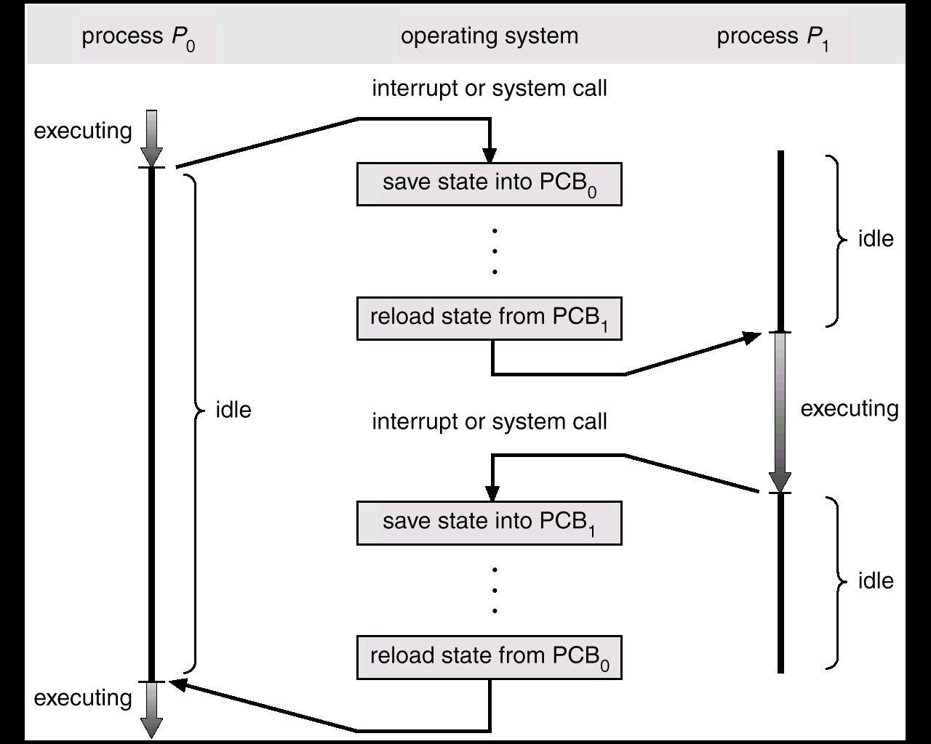
CPU Process Switch
Notes:
CPU receives an interrupt or P0 issues a system call.
OS needs to respond to and handle the interrupt or execute a system call on behalf of P0. The machine must first save the state of P0 before the kernel does so.
1. The machine then transfers control to the kernel.
Set kernel mode and set PC := handler.
2. Kernel handler examines registers and saved machine state.
What happened? What was the machine doing when it happened? How should the kernel respond?
3. Kernel responds to the condition.
Execute kernel service, device control code, fault handlers, etc., modify machine state as needed.
4. Kernel restores saved context (registers) and resumes activity or in this case switches to process P1 to allow it to execute.
5. Specific events and mechanisms for saving, examining, or restoring context are machine-dependent.
11

Slide 12
Process switch summary
Interrupts cause the OS to switch the CPU from its current task to run kernel code
These CPU switches happen frequently
The system needs to save the current context of the process running on the CPU
How is the context of the running process represented?
The state of the CPU is saved also and is restored when the processes context is restored
Process switching is therefore called context switching
Notes:
12

Slide 13
Process switch vs mode switch
CPU executes user pace code when a user process is running
When user process makes a system call or an interrupt occurs, the CPU executes OS code.
The CPU has a mode bit that indicates whether it is executing in user mode or kernel mode
The mode bit value changes depending on what code the CPU is executing
Notes:
13

Slide 14
Process Scheduling Queues
Job queue – set of all processes in the system.
Ready queue – set of all processes residing in main memory, ready and waiting to execute.
Device queues – set of processes waiting for an I/O device.
Process migration between the various queues.
Notes:
As processes enter the system they are put into a job queue, which consists of all the processes in the system.
Processes that are resident in memory and ready and waiting to execute are kept on a list called the ready queue.
There are several other queues that processes can be on.
What really is put on the queue?
The PCBs (or pointers to the PCBs)
14

Slide 15
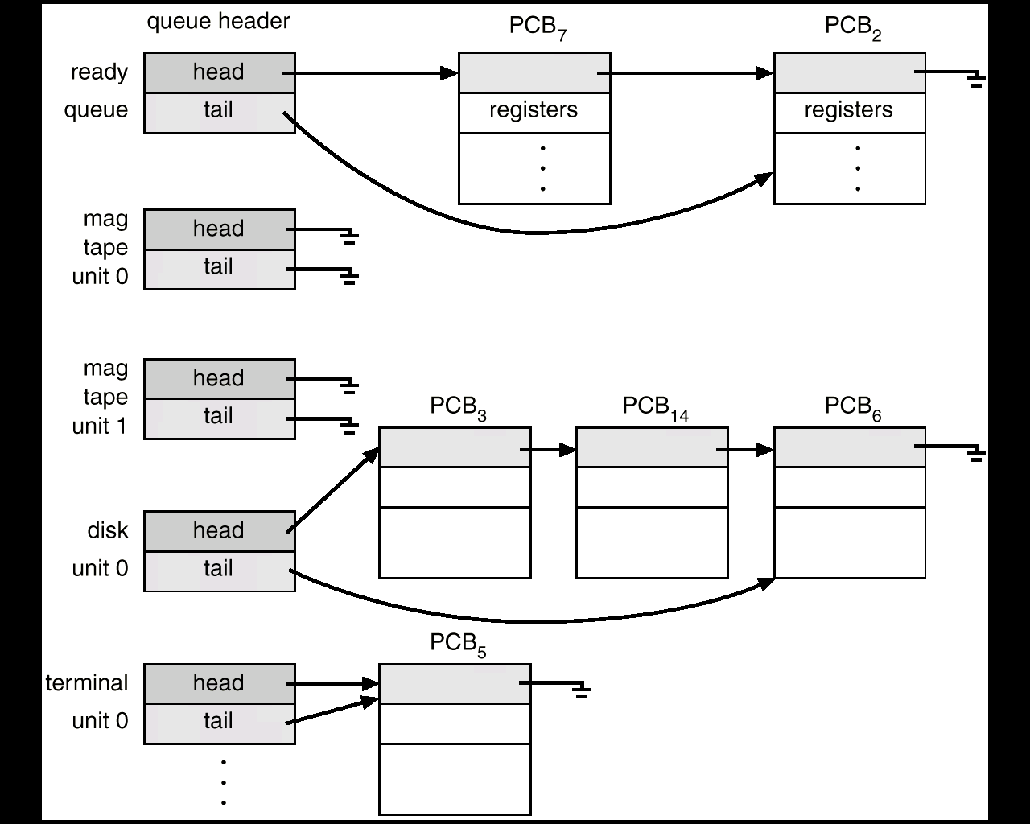
Ready Queue, I/O Device Queues
Notes:
Each device has its own device queue. Queues are represented as lined lists.
15

Slide 16
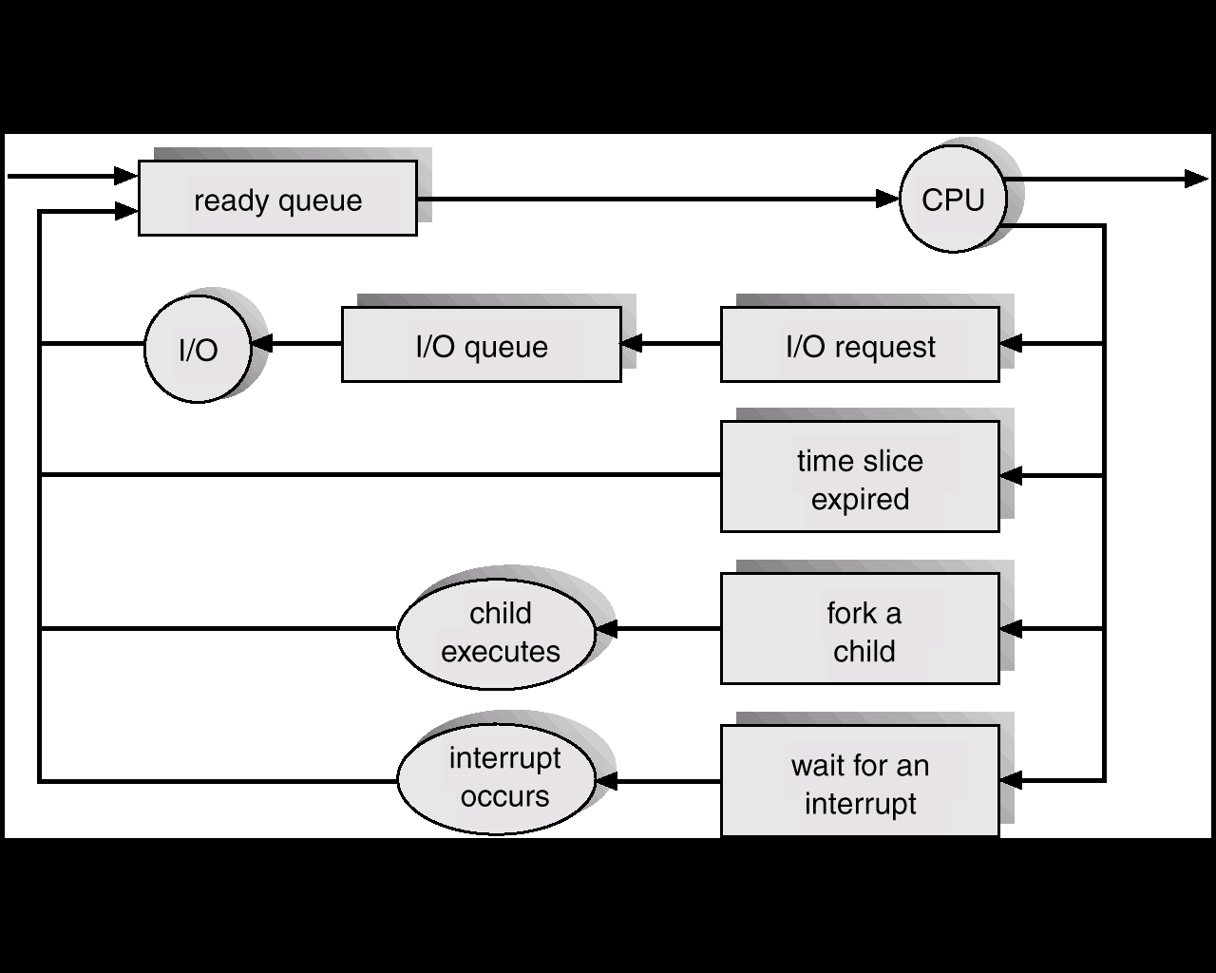
Process Scheduling diagram
Notes:
A common representation of process scheduling is a queuing diagram.
Each rectangular box represents a queue.
The circles represent the resources that serve the queues.
The arrows represent the flow of processes in the system.
16

Slide 17
Do Now
Complete the quiz on process state transition, process switch, and mode switch
Notes:
17

Slide 18
Next class
Process scheduling
Operating on processes
Notes:
18

