Slide 1
Kernel-space & User-space threads
CSSE 332
Operating Systems
Rose-Hulman Institute of Technology
Notes:
1

Slide 2
Problems with User-space Threads (from last time)
What can't they do? (critical issues only)
They can't run simultaneously on multiple CPUs if my system has multiple CPUs
If one user space thread does something that causes a wait (e.g. requests something from memory, disk, the network) the OS will de-schedule all the user space threads
They have to manually yield – they can't be preempted (moved off the CPU involuntary)
So what if we let the Operating System know about threads?

Slide 3
Thread overview
A basic unit of CPU utilization
Comprises
A thread ID
A program counter
A register set
A stack
Shares with other threads of the same process
Code section
Data section
Other OS resources (open files, signals, etc)
Notes:
A traditional process has a single thread of control.
If a process has more than one threads of control, it can perform multiple tasks at a time.
3

Slide 4
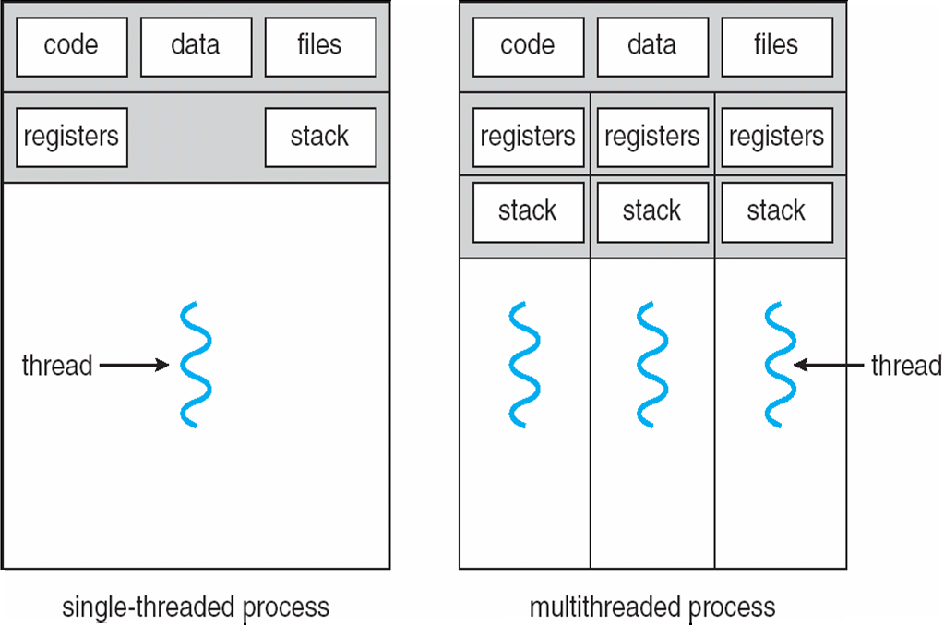
Single and multithreaded processes
* Think how similar the picture on the right is to your user space thread design.
Notes:
4

Slide 5
Have we solved our problems?
Multithreading
The OS knows about each thread, and can schedule them independently and on different CPUs
Waiting
The OS knows about each thread, and can have one wait while others complete for the CPU
Preemption
Individuals threads can be preempted like individual processes (i.e., move off the CPU involuntarily)

Slide 6
Programming threads is not easy
Multicore systems put pressure on programmers
Challenges include
Dividing activities
Balance
Data splitting
Data dependency
Testing and debugging
Notes:
Do think-pair-share on why these are challenges
Examining app to find areas that can be divided into separate, concurrent tasks that can run on individual cores
Ensuring that tasks do equal work of equal value
Data accessed and manipulated by tasks must be divided to run on separate cores
Does one task depend on data from another task? The tasks must be synchronized in this case
Different execution paths --- testing and debugging inherently more difficult.
6

Slide 7
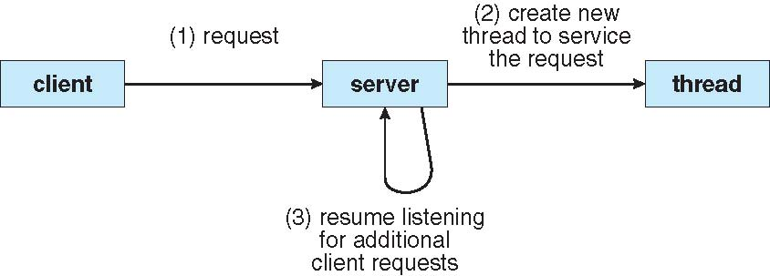
Multithreaded server architecture
Notes:
The main thread waits for requests from clients, creates thread to service request, and resumes waiting for requests.

Slide 8
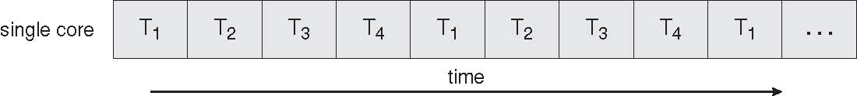
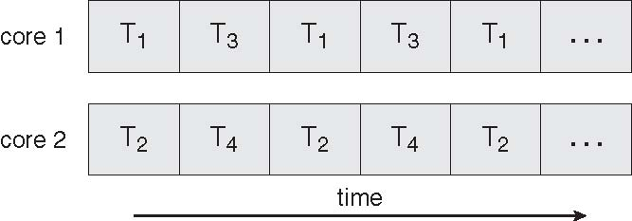
Concurrent execution on single-core system
Parallel execution on multi-core system

Slide 9
OS support for threads
All modern OSes support threads
Supported by the Kernel
Examples
Windows XP/2000/7/8/10
Solaris
Linux
Mac OS X
Notes:
9
Threading model supported by the kernel. Needed for true parallelism on multiple CPUs.

Slide 10
Multithreading Models
Many-to-One
One-to-One
Many-to-Many
Notes:
10
Multithreading models answer the question of how do we map user threads to kernel threads in order to experience parallelism

Slide 11
Many-to-One
Many user-level threads mapped to single kernel thread
Examples:
Your user-space thread library
Solaris Green Threads
GNU Portable Threads
Notes:
11
Thread management is done by thread library in user space. Efficient thread management but no parallelism. If thread blocks, process blocks.

Slide 12
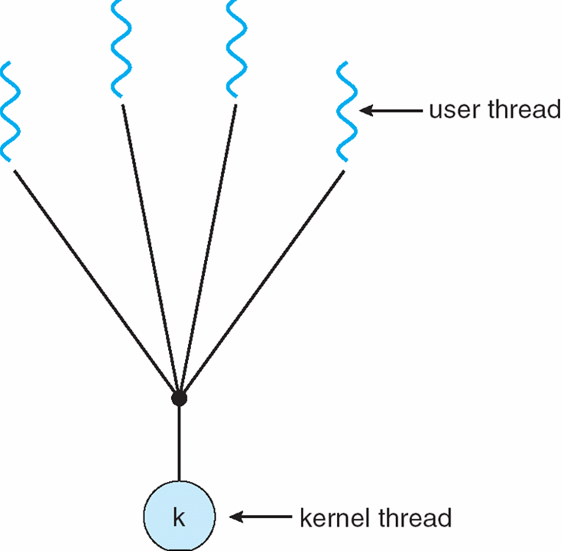
Many-to-One Model
Notes:
12
Thread management is done by thread library in user space.

Slide 13
One-to-One
Each user-level thread maps to kernel thread
Examples
Windows NT/XP/2000
Linux
Solaris 9 and later
Notes:
13
Each user thread is mapped to a kernel thread
True parallelism
LINUX threads are not the same as POSIX threads

Slide 14
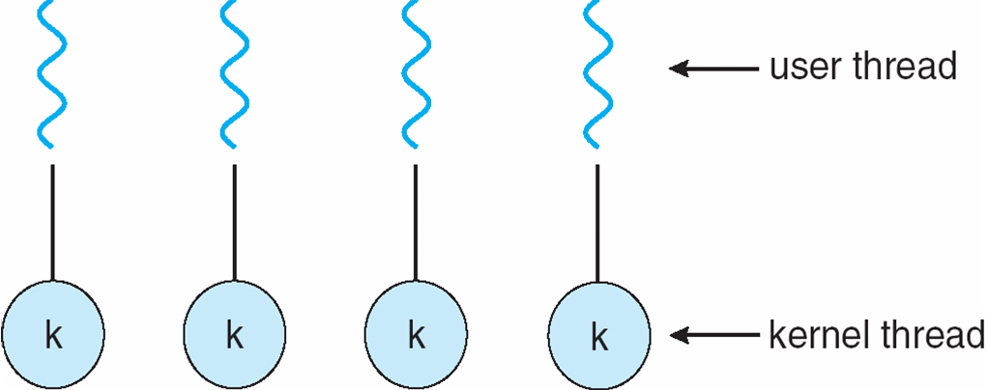
One-to-one Model
Notes:
14
Only drawback: creating a user thread requires the overhead of creating a kernel thread

Slide 15
Many-to-Many
Allows many user level threads to be mapped to many kernel threads
Allows the operating system to create a sufficient number of kernel threads
Solaris prior to version 9
Windows NT/2000 with the ThreadFiber package
Notes:
15

Slide 16
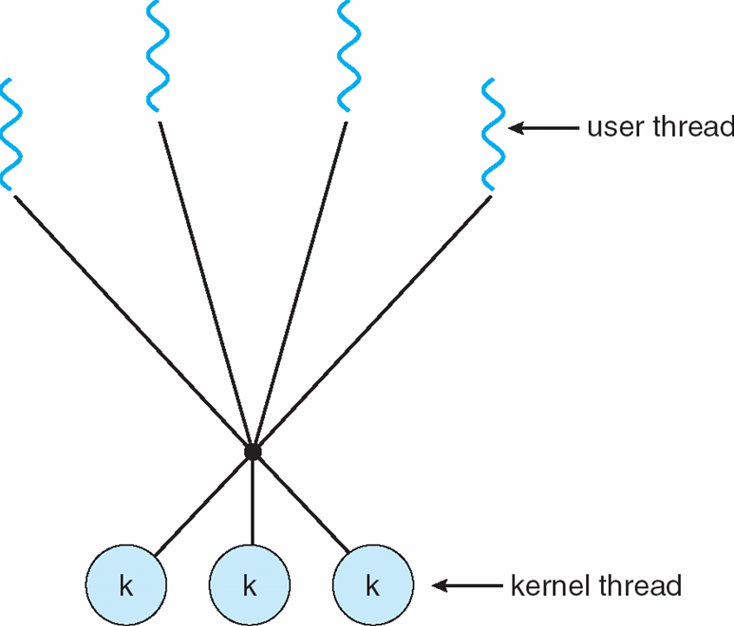
Many-to-Many Model
Notes:
16

Slide 17
Two-level Model
Similar to M:M, except that it allows a user thread to be bound to kernel thread
Examples
IRIX
HP-UX
Tru64 UNIX
Solaris 8 and earlier
Notes:
17

Slide 18
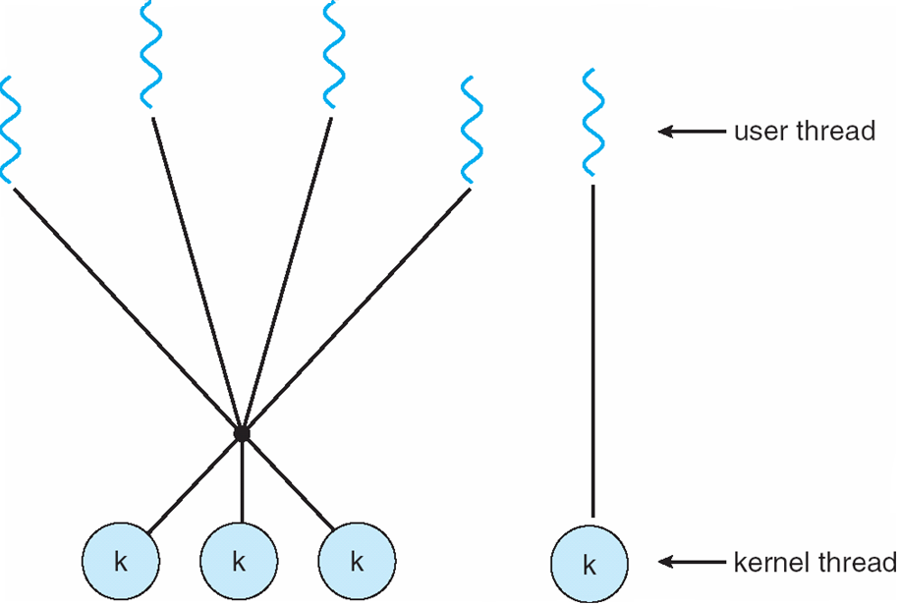
Two-level Model
Notes:
18

