Slide 1
Bare metal OS project
CSSE 332
Operating Systems
Rose-Hulman Institute of Technology
Notes:
1

Slide 2
Building an OS from scratch
A project for an introductory OS course
Designed by Michael Black at American University
http://www.michaeldblack.org
Notes:
2

Slide 3
Building an OS from scratch
Operating Systems Course Should Have an Operating Systems Project
Notes:
3

Slide 4
Bare metal system
No simulator
No underlying system
No prewritten code
Notes:
4

Slide 5
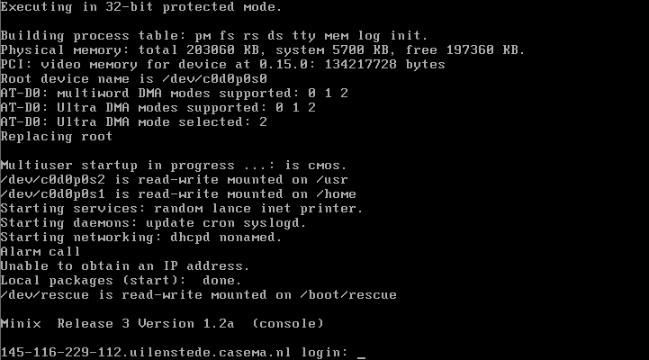
Existing Bare-Metal Systems
Minix
GeekOS
Good for upper-level or graduate courses
Need a simpler project

Slide 6
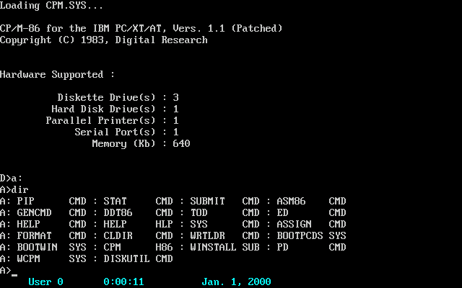
Want vs Need
Functionality of CP/M
Teach/review essential concepts
Accessible to sophomore students
Notes:
Control Program for Microcomputers
was a mass-market operating system created for Intel 8080/85 based microcomputers by Gary Kildall of Digital Research, Inc (Originally incorporated as "Intergalactic Digital Research") . Initially confined to single-tasking on 8-bit processors and no more than 64 kilobytes of memory, later versions of CP/M added multi-user variations, and were migrated to 16-bit processors (Wikipedia).
6

Slide 7
Key Characteristics
Be bare metal:
boot loading, disk drivers, console drivers
Be "real":
program execution, interrupts, processes
file system, shell
Would be nice:
GUI, virtual memory

Slide 8
Finished OS Characteristics
Has all functionality of older OS like CP/M
Can execute a program from a file
Command-line shell with necessary commands:
Directory listing, type, copy, delete, execute
Multiprocessing and basic memory management

Slide 9
Goals
Minimize total lines of code
Minimal pre-written assembly code
Students write own kernel and all C functions
3 components - bootloader, kernel, shell
Run on Qemu simulator to develop and debug, also bootable from floppy disk
Qemu is an x86 hardware platform simulator

Slide 10
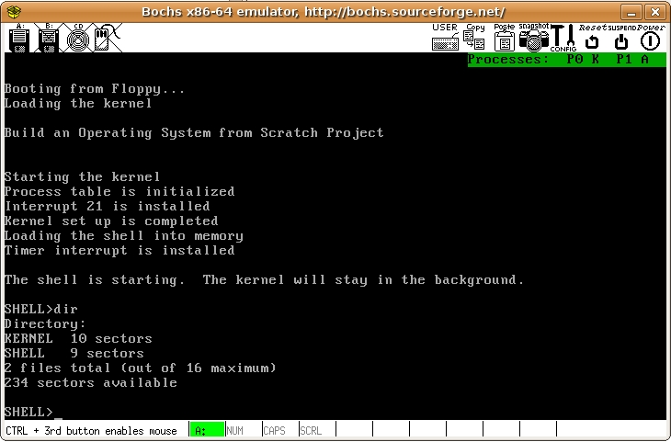
Notes:
10

Slide 11
Skills needed
Skills that you need to complete the project
x86 Segmentation
UNIX Commands
C Programming Language Basics

Slide 12
Project outline
5 mini projects
~ 1 week each, progressively more difficult
Tested on
Qemu - https://www.qemu.org/
Standard Linux tools:
16-bit tools: bcc compiler, as86 assembler
dd command for floppy image
hexedit for binary files

Slide 13
Project A – Hello World
Two assembly files provided:
bootloader assembly file
kernel assembly file that writes to memory
Students write a simple kernel in C
Printed Hello World by writing to video memory

Slide 14
Project B - Kernel Interrupts
Three assembly routines provided:
Make interrupt call
Modify Interrupt Vector Table for Interrupt 21
Call students' C functions
Students write:
Print String to console
Read string from keyboard
Read sector to buffer
Result: Print a text file from disk to the screen

Slide 15
Project C - Read, Execute, Kill
Read a file from disk to a buffer, using a directory sector
Execute a program: Read file, copy to 0x2000 memory block, call LaunchProgram (provided)‏
Shell: prompt user, print text files, execute program files
Terminate program system call: reloads the shell when programs finish

Slide 16
Project D - Single-Process OS
Write - create new file, copy buffer to new file
Delete - remove file
Add commands to shell:
copy,
delete,
create a text file,
print directory

Slide 17
Project E - Multi-Processing
Assembly functions provided:
initialize system timer,
receive timer interrupts,
call user routine,
set up stack
Students write round-robin scheduler, runs on timer interrupts
Additional shell commands: execute as a background process, kill processes

Slide 18
Success Factors
Provide detailed step-by-step instructions
Minimize prewritten assembly code
Give clear instructions on calling functions
Keep it simple - approximate DOS, not UNIX
Use BIOS calls, not device drivers
No advanced data structures, binary math, stack handling, or extra assembly

