Slide 1
Bare metal OS project
CSSE 332
Operating Systems
Rose-Hulman Institute of Technology
Notes:
1

Slide 2
Building an OS from scratch
5 week project for an introductory OS course
Designed by Michael Black at American University
http://www.michaeldblack.org
Notes:
2

Slide 3
We need to form teams & make project repos
I'm going to ask you to form teams right here in class
All teams must be 2-3...I recommend 2
No working alone, no 4 person teams, no cross-section teams
Form your teams and enter your members on the google doc linked from the schedule page
Then construct/test a git repo following the instructions on the schedule page

Slide 4
Bare metal system
No simulator
No underlying system
No prewritten code
Notes:
4

Slide 5
Key Characteristics
Be bare metal:
boot loading, disk drivers, console drivers
Be "real":
program execution, interrupts, processes
file system, shell
Would be nice:
GUI, virtual memory

Slide 6
Finished OS Characteristics
Has all functionality of older OS like CP/M
Can execute a program from a file
Command-line shell with necessary commands:
Directory listing, type, copy, delete, execute
Multiprocessing and basic memory management

Slide 7
Goals
Minimize total lines of code
Minimal pre-written assembly code
Students write own kernel and all C functions
3 components - bootloader, kernel, shell
Run on Qemu simulator to develop and debug, also bootable from floppy disk
Qemu is an x86 hardware platform simulator

Slide 8
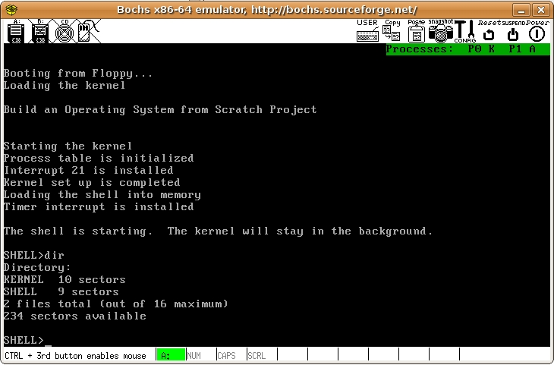
Notes:
8

Slide 9
Skills needed
Skills that you need to complete the project
x86 Segmentation
UNIX Commands
C Programming Language Basics

Slide 10
General advice
Code in person, as a group, rather than attempting to divide tasks
Inform me of group problems *before* they become major issues
When weird stuff is happening get visibility into the problem
Work ahead of the milestone deadlines

Slide 11
Project outline
5 mini projects
~ 1 week each, progressively more difficult
Tested on
Qemu - https://www.qemu.org/
Standard Linux tools:
16-bit tools: bcc compiler, as86 assembler
dd command for floppy image
hexedit for binary files

Slide 12
M1 – Hello World
Write a simple kernel in C that prints Hello World by writing to video memory
Really more about getting everything setup than a tough assignment in its own right
This is due soon after Exam 1 and we don't give you any class time to do it

Slide 13
M2 - Kernel Interrupts
Write:
Print String to console
Read string from keyboard
Read sector to buffer
Also easy, though we will have a little class time for folks who have problems

Slide 14
M3 - Read, Execute, Kill
Read a file from disk to a buffer, using a directory sector
Execute a program: Read file, copy to 0x2000 memory block, call LaunchProgram (provided)‏
Shell: prompt user, print text files, execute program files
Terminate program system call: reloads the shell when programs finish

Slide 15
M4 - Single-Process OS
Write - create new file, copy buffer to new file
Delete - remove file
Add commands to shell:
copy,
delete,
create a text file
print directory

Slide 16
M5 - Multi-Processing
Assembly functions provided:
initialize system timer,
receive timer interrupts,
call user routine,
set up stack
Students write round-robin scheduler, runs on timer interrupts
Additional shell commands: execute as a background process, kill processes
Probably don't want to do all this in the final week

