Slide 1
CSSE 332 Thread (II.)
Thursday, December 13, 2018

Slide 2
Agenda
Parallel computing with pthread.
(+) Performance improvement
(-) Concurrency issues – mutual exclusion

Slide 3
Intro to pthreads
May be provided either as user-level or kernel-level
A POSIX standard (IEEE 1003.1c) API for thread creation and synchronization
API specifies behavior of the thread library, implementation is up to development of the library
Common in UNIX operating systems (Solaris, Linux, Mac OS X; in the kernel)

Slide 4
Similar effort: Java threads
Java threads are managed by the JVM
Typically implemented using the threads model provided by underlying OS
Java threads may be created by:
Extending Thread class
Implementing the Runnable interface

Slide 5
PThreads: Compiling
To compile a program that uses POSIX Threads, we need to include the pthreads header in our source code:
#include <pthreads.h>
And pass the -pthread flag to the compiler:
$ gcc -o program program.c -pthread
Adapted from Peter Bui@ND

Slide 6
PThreads: Creating
When our program starts, we have one main thread. To create another one, we can use the pthread_create function:
void *function(void *arg) { // Thread function
int tid = *((int*) arg);
printf("thread %d\n", tid);
return NULL;
}
pthread_t thread; // Thread structure
int i = 7;
pthread_create(&thread, NULL, function, &i); // Create thread
What if function needs more input arguments?
Adapted from Peter Bui@ND

Slide 7

PThreads: Waiting
To wait for a thread to complete, we can use the pthread_wait function:
int* result;
pthread_join(thread, (void **)&result);
A thread can return a value either by doing return or pthread_exit:
pthread_exit(NULL);
Adapted from Peter Bui@ND

Slide 8
Let's use pthreads
Look at the threadSpeedTest code, play just a bit with adjusting the size
Then modify it so it makes more threads according to the THREAD_COUNT variable. BTW if you finish early you can also make the fork section respect that variable.

Slide 9
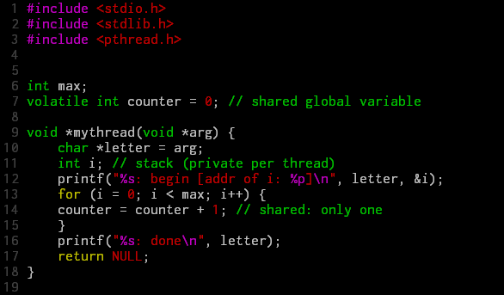
Problem illustration with example
* volatile means the variable may change.

Slide 10
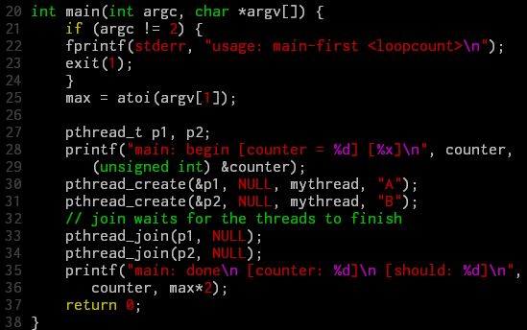
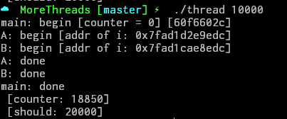


Problem illustration with example (cont.)

Slide 11
Problem investigation
mov 0x8049a1c, %eax //1. load count
add $0x1, %eax //2. add one
mov %eax, 0x8049a1c //3. store new value
count = count + 1 →
If ..
Thread 1
Thread 2
mov 0x8049a1c, %eax
add $0x1, %eax
mov %eax, 0x8049a1c
mov 0x8049a1c, %eax
add $0x1, %eax
mov %eax, 0x8049a1c

Slide 12
Solution: The Wish For Atomicity
Goal: finish code in a critical section as a unit – no interrupt.
Correctness
Performance

Slide 13


Approach #1
Disable/enable alarm
1 void lock() {
2 DisableInterrupts();
3 }
4 void unlock() {
5 EnableInterrupts();
6 }
But dangerous that any program may monopolize the CPU.
Correct
Performance

Slide 14

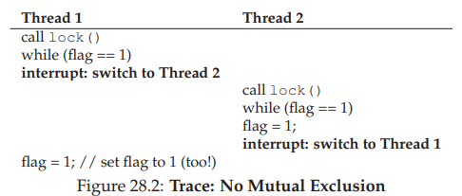
Approach #2
Correct
Performance
Use a global flag
1 typedef struct __lock_t { int flag; } lock_t;
2
3 void init(lock_t *mutex) {
4 // 0 -> lock is available, 1 -> held
5 mutex->flag = 0;
6 }
7
8 void lock(lock_t *mutex) {
9 while (mutex->flag == 1) // TEST the flag
10 ; // spin-wait (do nothing)
11 mutex->flag = 1; // now SET it!
12 }
13
14 void unlock(lock_t *mutex) {
15 mutex->flag = 0;
16 }

Slide 15
Solution: Mutual exclusion
We'll talk about actual working solutions in future classes

Slide 16
Approach #3
Use atomic function which is supported by hardware
1 int TestAndSet(int *old_ptr, int new) {
2 int old = *old_ptr; // fetch old value at old_ptr
3 *old_ptr = new; // store ’new’ into old_ptr
4 return old; // return the old value
5 }
Get the old value and set the new value.

Slide 17
Approach #3 (cont.)
Correct
Performance
1 typedef struct __lock_t {
2 int flag;
3 } lock_t;
4
5 void init(lock_t *lock) {
6 // 0 indicates that lock is available, 1 that it is held
7 lock->flag = 0;
8 }
9
10 void lock(lock_t *lock) {
11 while (TestAndSet(&lock->flag, 1) == 1)
12 ; // spin-wait (do nothing)
13 }
14
15 void unlock(lock_t *lock) {
16 lock->flag = 0;
17 }

Slide 18
Approach #4
Atomic with park()

