Slide 1
CSSE 332 Deadlock Avoidance
Sunday, January 20, 2019

Slide 2
Outline
How to detect deadlock?
RAG algorithm
Banker algorithm
How to recover from deadlock?
https://en.wikipedia.org/wiki/Banker%27s_algorithm

Slide 3
Detecting deadlock – RAG algorithm
If one resource only has one instance, we can apply RAG algorithm to detect circular wait.
Maintain wait-for graph
Nodes are processes
Pi -> Pj if Pi is waiting for Pj
Periodically invoke an algorithm that searches for a cycle in the graph. If there is a cycle, there exists a deadlock!
Detecting a cycle in a graph requires an order of n² operations, where n is the number of vertices in the graph

Slide 4
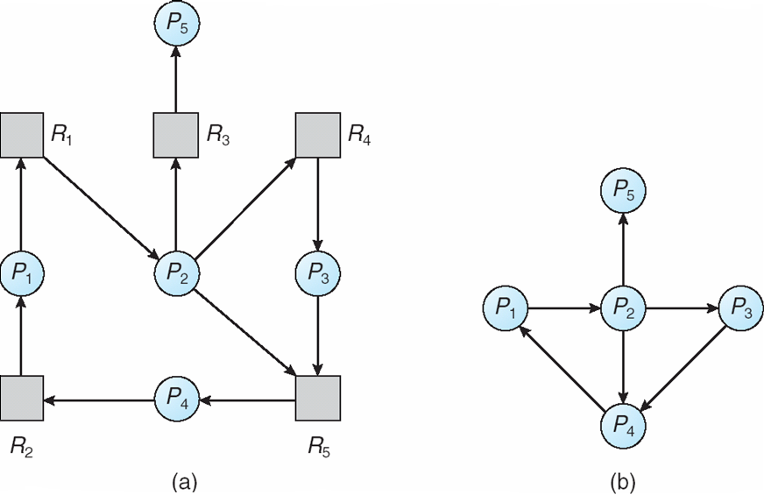
Wait-for Graph
“One resource has only one instances” is too good to be true.
If one resource has multiple instances, we need Banker Algorithm.

Slide 5
Detection algorithm – Banker algorithm
First, the algorithm Require system has a priori information
How much of each resource each process could possibly Max
How much of each resource each process is currently Allocation
How much of each resource the system currently has Available

Slide 6
Data structures for Banker Algorithm
Let n = number of processes, and m = number of resource types.
Available: Vector of length m. If Available[j] = k, there are k instances of resource type R_{j} available
Max: n x m matrix. If Max[i,j] = k, then process P_{i} may request at most k instances of resource type R_{j}
Allocation: n x m matrix. If Allocation[i,j] = k, then P_{i} is currently allocated k instances of R_{j}
Need: n x m matrix. If Need[i,j] = k, then P_{i} may need k more instances of R_{j} to complete its task
Need [i,j] = Max[i,j] – Allocation [i,j]

Slide 7
Banker Algorithm (cont.)
1. Let Finish be a vector of length n. Initialize: Finish [i] = false for i = 0,1,...,n 2. Find an i such that both: (a) Finish [i] = false (b) Need[i] < Available If no such i exists, go to step 4 3. Available = Available + Allocation[i] Finish[i] = true go to step 2 4. If Finish [i] == true for all i, then the system is in a safe state; Otherwise, Pi is deadlocked if Finished[i] == false;

Slide 8
Banker Algorithm (cont.)
Processes (maximum resources):
A B C D
P1 3 3 2 2
P2 1 2 3 4
P3 1 3 5 0
Total system resources are:
A B C D
6 5 7 6
Processes (currently allocated resources):
A B C D
P1 1 2 2 1
P2 1 0 3 3
P3 1 2 1 0
Need = maximum resources - currently allocated resources
Processes (possibly needed resources):
A B C D
P1 2 1 0 1
P2 0 2 0 1
P3 0 1 4 0
Available system resources are:
A B C D
3 1 1 2

Slide 9
Another example
5 processes P0 through P4;
3 resource types
A (7 instances), B (2 instances), and C (6 instances)
Snapshot at time T0:
Allocation Request Available
A B C A B C A B C
P0 0 1 0 0 0 0 0 0 0
P1 2 0 0 2 0 2
P2 3 0 3 0 0 0
P3 2 1 1 1 0 0
P4 0 0 2 0 0 2
Is the system in a deadlock state?
What about P2 requesting 0 0 1?

Slide 10
Banker Algorithm discussion
It needs to know how much of each resource a process could possibly request. In most systems, this information is unavailable, making it impossible to implement the Banker's algorithm.
Also, it is unrealistic to assume that the number of processes is static since in most systems the number of processes varies dynamically.
If detection algorithm is invoked arbitrarily, there may be many cycles in the resource graph and so we would not be able to tell which of the many deadlocked processes “caused” the deadlock

Slide 11
Recovery: process Termination
Abort all deadlocked processes
Abort one process at a time until no deadlock
In which order should we choose to abort?
Priority of the process.
How long process has computed, and how much longer to completion.
Resources the process has used.
Resources process needs to complete.
How many processes will need to be terminated?
Is process interactive or batch?

Slide 12
Recovery: Resource Preemption
Selecting a victim – minimize cost
Rollback – return to some safe state, restart process from that state
Starvation – same process may always be picked as victim
include number of rollback in cost factor

