Slide 1
CSSE 332 Memory: Segmentation
Sunday, January 27, 2019

Slide 2
Questions
What is an address space?
What is virtual memory?
How do we allocate memory?
Base and Bound
Segmentation

Slide 3
Address Space
Stack
High address
Each process takes a certain size of the physical memory as its own space.
It uses certain address to retrieve data.
Direction of Growth
Heap
Data
Code
Low address
Region | Data
Stack | Automatic memory, local variables
Heap | Dynamic memory
Data | Static data, Global variables
Code | Program instruction

Slide 4
Motivation
Operating System (code, data, etc.)
Operating System (code, data, etc.)
Current Program (code, data, etc.)
Process A (code, data, etc.)
Process B (code, data, etc.)
With the development of multiprogramming and timesharing, we needed a way to protect programs from each other and to effectively switch between them.

Slide 5
Address Translation: Overview
Goals
Transparency Invisible to application.
Efficiency As efficient as possible.
Protection Protect processes from each other.
Each address in our program is actually a virtual address that must be translated to a physical address.
This virtualization allows us to relocate a process to any location in memory.

Slide 6
Address Translation: Base & Bounds
One simple method of hardware-based translation is the base and bounds method:
The CPU has a base register which holds the starting point in physical memory, and a bounds register which holds the ending point in physical memory
A physical address can be generated with the following:
Physical Address = Base + Virtual Address

Slide 7
Address Translation: Example
Suppose we had an address space of 8KB (bound) that has been loaded at address 32KB (base):
Virtual Address | Physical Address
0 KB | 32 KB
1 KB | 33 KB
5000 | 37768
9000 | Fault (Out of Bounds)

Slide 8
Base and Bounds: Problems
Base and Bounds has two main problems:
It is wasteful since there is a lot of unused space between the stack and heap.
Operating System
(free)
Stack
(free)
Heap
Data
Code

Slide 9
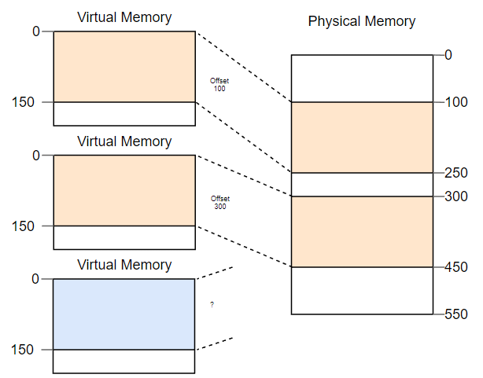
Base and Bounds: Problems (cont.)
Base and Bounds has two main problems:
2. External Fragmentation: Total memory space is enough to satisfy a request or to reside a process in it, but it is not contiguous so it can not be used.

Slide 10
Segmentation: Overview
Segmentation is a generalized form of base and bounds:
Each component in the address space is considered a separate segment
Each segment has its own base and bounds registers
Operating System
(free)
Code
Data
(free)
Stack
Heap

Slide 11
Segmentation: Hardware Information
To support segmentation, the hardware (Memory Management Unit) now needs to store the following information:
Operating system must track this information for every process and save and restore it on each context switch.
Segment | Base | Size | Grows Positive? | Protection
Code | 32K | 2K | 1 | Read-Execute
Heap | 36K | 2K | 1 | Read-Write
Stack | 28K | 2K | 0 | Read-Write

Slide 12
Segmentation: example
Segment | Base | Size | Grows Positive?
Code | 32K | 2K | 1
Heap | 36K | 2K | 1
Stack | 28K | 2K | 0
Assume the heap’s virtual address starts from 4096(4K). Given the virtual address 4200, the physical address should be the segment base 36K + (4200 - 4096) = 34920.
Let’s try stack where its virtual address starts from 16KB to grow backward to 14KB. Given a virtual address 15KB, what should be the physical address?

Slide 13
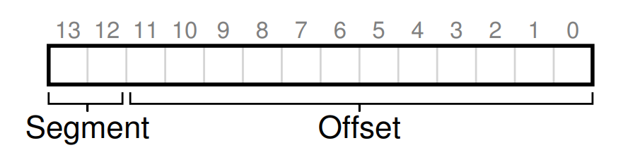
Which Segment Are We Referring To?
Chop up the address space into segments based on the top few bits of the virtual address
For example, we can use the top two bits of our 14-bit virtual address to select the segment, our virtual address looks like this

Slide 14
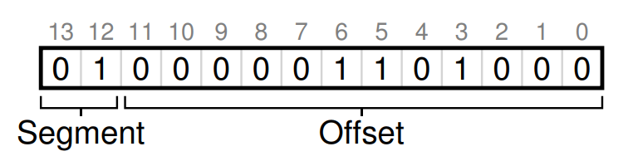
Which Segment Are We Referring To? (cont.)
Take our example heap virtual address from above (4200) and translate it
Segment | number
Code | 00
Heap | 01
Stack | 10

Slide 15
Segmentation: Addressing
Given the following 16-bit virtual address:
1000 0010 0000 1010
Segment Offset
What is the largest possible segment size?
What is the maximum possible offset value?
Which segment is this virtual address located in?
What is the physical address of this virtual address?

