Slide 1
Address Space 0
Physical Memory
Kernel
Reserved
App0
Physical
Address
App0
Data
[1]Access Memory
App1
Data
[2]Address Translation
Virtual
Address
App0
Data
App2
Data
MMU
App0 Token

Slide 2




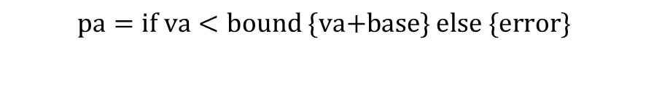


Physical Memory
Address Space of App0
Kernel
Reserved
$$\text{bound}$$
Stack
Slot0
Bound(Const)=Address Space
Size Limit
Internal
Fragment
Heap
$$\text{base}+\text{bound}$$
Slot1
MMU
App0 Token
$$\text{va}$$
$$\text{pa}$$
Data
$$\text{base}$$
Code
Slot2
$$\text{0}\text{x}\text{0}$$
$$\text{pa}=\text{if} \text{va}<\text{bound}\text{ \{}\text{va}\text{+}\text{base}\text{\} }\text{else}\text{ \{}\text{error}\text{\} }$$

Slide 3




Physical Memory
Kernel
Reserved
Address Space of App0
$$\text{MAXVA}$$
App0Stack
App0Stack
OtherApps
External
Fragments
App0Code
App0Heap
App0Data
MMU
$$\text{pa}$$
App0Data
$$\text{va}$$
App0Data Token
App0Heap
App0Code
$$\text{0}\text{x}\text{0}$$
OtherApps

Slide 4






Physical Memory
Kernel
Reserved
Address Space of App0
$$\text{MAXVA}$$
Page7
MMU
Frame0
Page6
PageTable of App0
Frame1
Page5
PageNumber
FrameNumber
Protection
Frame2
Page4
0
5
r-x
$$\text{pa}$$
Frame3
Page3
$$\text{vpn}$$
$$\text{ppn}$$
$$\text{va}$$
1
2
rw-
Frame4
Page2
2
3
rw-
Frame5
Page1
7
8
rw-
Frame6
Page0
$$\text{0}\text{x}\text{0}$$
Frame7
Frame8
Frame9

Slide 5








Virtual Address (39bits)
$$38$$
$$12$$
$$11$$
$$0$$
Virtual Page Number
Page Offset
Physical Address (56bits)
$$55$$
$$12$$
$$11$$
$$0$$
Physical Page Number
Page Offset

Slide 6








Physical Memory
High Address
. . .
$$\text{VPN}i \text{PTE}$$
$$\text{base}\text{_}\text{addr}\text{+8}i$$
. . .
A Page Table
$$\text{VPN}\text{2 }\text{PTE}$$
$$\text{base}\text{_}\text{addr}\text{+16}$$
$$\text{VPN}\text{1 }\text{PTE}$$
$$\text{base}\text{_}\text{addr}\text{+8}$$
$$\text{VPN}\text{0 }\text{PTE}$$
$$\text{base}\text{_}\text{addr}$$
Low Address

Slide 7
root
a
b
c
a
b
c
a
b
c
a
b
c
a
b
c
aa
ab
ac
ba
bb
bc
ca
cb
cc
a
b
c
a
b
c
a
b
c
a
b
c
a
b
c
a
b
c
a
b
c
a
b
c
a
b
c
C(aac)
C(aab)
C(aaa)
C(abc)
C(abb)
C(aba)
C(acc)
C(acb)
C(aca)
C(bac)
C(bab)
C(baa)
C(bbc)
C(bbb)
C(bba)
C(bcc)
C(bcb)
C(bca)
C(cac)
C(cab)
C(caa)
C(cbc)
C(cbb)
C(cba)
C(ccc)
C(ccb)
C(cca)

Slide 8
root
a
a
c
root
Insert “acb”
ac
a
b
c
C(acc)=0
C(acb)=1
C(aca)=0

Slide 9






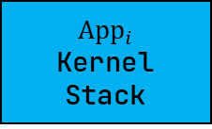
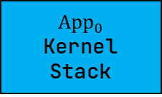



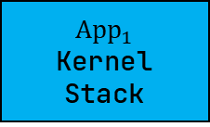

Kernel Address Space (High)
$$2^{64}\text{B}$$
Trampoline
$$4\text{KiB}$$
Linear,-r-x
$$2^{64}\text{B}−4\text{KiB}$$
$${\text{App}}_{0}$$
Kernel
Stack
$$\text{KERNEL}\text{_}\text{STACK}\text{_}\text{SIZE}$$
Framed,-rw-
Guard Page
$$4\text{KiB}$$
$${\text{App}}_{1}$$
Kernel
Stack
$$\text{KERNEL}\text{_}\text{STACK}\text{_}\text{SIZE}$$
Framed,-rw-
Guard Page
$$4\text{KiB}$$
. . .
Guard Page
$$4\text{KiB}$$
$$2^{64}\text{B}−\left(4\text{KiB}\text{+}\text{KERNEL}\text{_}\text{STACK}\text{_}\text{SIZE}\right)×i$$
$${\text{App}}_{i}$$
Kernel
Stack
$$\text{KERNEL}\text{_}\text{STACK}\text{_}\text{SIZE}$$
Framed,-rw-
$$2^{64}\text{B}−256\text{GiB}$$

Slide 10




Kernel Address Space (Low)
$$256\text{GiB}$$
$$\text{MEMORY}\text{_}\text{END}$$
Available
Physical
Frames
-rw-
.bss
-rw-
Identical
.data
-rw-
.rodata
-r--
.text
-r-x
$$\text{BASE}\text{_}\text{ADDRESS}$$
$$0$$

Slide 11








Application Address Space (Low)
Application Address Space (High)
$$256\text{GiB}$$
$$2^{64}\text{B}$$
$$4\text{KiB}$$
Trampoline
Linear,-r-x
TrapContext
$$4\text{KiB}$$
Framed,-rw-
User
Stack
$$\text{USER}\text{_}\text{STACK}\text{_}\text{SIZE}$$
Framed,urw-
Guard Page
$$4\text{KiB}$$
.bss
urw-
.data
urw-
Framed
.rodata
ur--
.text
ur-x
$$\text{0}\text{x}\text{0}$$
$$2^{64}\text{B}−256\text{GiB}$$

