Slide 1
वाणी सेतु · a bridge of voice
VaaniSetu
An AI-powered multilingual document reader built on AWS
Amazon Bedrock · Amazon Polly · Amazon Rekognition · AWS Lambda · API Gateway · S3 · DynamoDB · Amplify
Presented by: Student Name1 (App ID) · Student Name2 (App ID) · Student Name3 (App ID)
Supervisor: Dr. Kunal Meher (Assistant Professor)
Cloud Application Development (CAP 303) · TY B.Tech Sem V · uGDX School of Technology · AY 2026-27
Notes:
Introduce the team and the project. VaaniSetu means 'bridge of voice'. It turns a photo of any document into a spoken explanation in the listener's own language, built entirely on serverless AWS services.

Slide 2



The problem
Everyday life runs on paper, but not everyone can read it comfortably
Low vision & elderly
Limited literacy
Language barrier
Small print on prescriptions and bills is hard to read, and mistakes with doses or due dates have real consequences.
Official notices and forms use formal, technical language that is hard to understand even when it can be read.
Migrants and students often receive documents in a language they do not read, such as a Hindi bill for a non-Hindi reader.
VaaniSetu · CAP 303 Mini-Project · 2
Notes:
Three groups struggle with printed documents: people with low vision or the elderly, people with limited literacy, and people facing a language barrier. The cost of misunderstanding is high: a missed bill deadline or a wrong dosage.

Slide 3
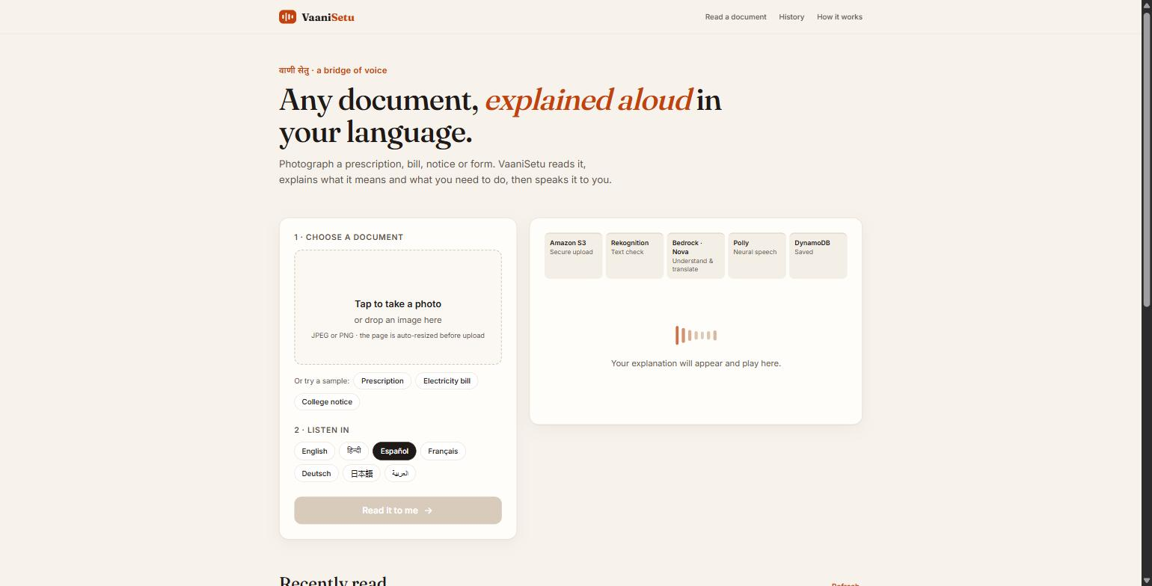



Our solution: VaaniSetu
Photograph a document and hear it explained in your language in about 10 seconds
Snap
Take a photo of a prescription, bill, notice or form
Understand
AI reads it and explains what it means and what to do
Listen
A natural neural voice reads the explanation aloud
7 output languages · any input language · key points & action items · history
VaaniSetu · CAP 303 Mini-Project · 3
Notes:
The user experience is three steps: snap, understand, listen. The output includes a plain-language summary, key facts and action items with deadlines. Seven output languages are supported: English, Hindi, Spanish, French, German, Japanese and Arabic.

Slide 4
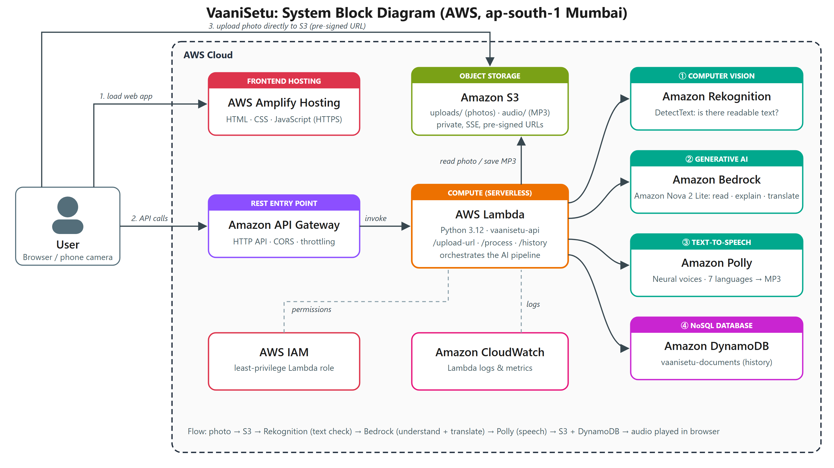
Block diagram
VaaniSetu · CAP 303 Mini-Project · 4
Notes:
Everything runs in the Mumbai region, ap-south-1. The frontend is on Amplify Hosting. The browser talks to API Gateway, which invokes a single Lambda function. Lambda orchestrates Rekognition, Bedrock, Polly, S3 and DynamoDB. IAM restricts permissions and CloudWatch collects logs.

Slide 5
How a request flows
One photo, five AWS services, about 10 seconds
1
2
3
4
5
S3
Rekognition
Bedrock
Polly
DynamoDB
Pre-signed upload
Text check
Understand
Speak
Remember
Browser uploads the photo directly to a private bucket
DetectText rejects photos with no readable text
Nova 2 Lite transcribes, explains and translates
Neural voice produces an MP3, saved to S3
Result stored and shown in history
API Gateway (HTTP API) → AWS Lambda orchestrates every step · IAM least-privilege role · CloudWatch logs
VaaniSetu · CAP 303 Mini-Project · 5
Notes:
Walk through a single request. The photo never passes through the API: it goes straight to S3 with a pre-signed URL, which avoids API payload limits. Rekognition is a cheap gate so we do not pay for an AI call on a blank photo. Bedrock does the heavy lifting in one multimodal call. Polly speaks it, and DynamoDB stores the record.

Slide 6









Cloud services used
8 core AWS services plus IAM and CloudWatch, all serverless or fully managed
Amazon S3
AWS Lambda
API Gateway
Amazon Bedrock
Rekognition
Photos & MP3 audio, private + encrypted
Python 3.12 backend orchestrating the AI pipeline
HTTP API: /upload-url, /process, /history
Amazon Nova 2 Lite reads, explains, translates
DetectText gate before the AI model runs
Amazon Polly
DynamoDB
Amplify Hosting
AWS IAM
CloudWatch
Neural voices in 7 languages
On-demand table for document history
HTTPS hosting + CDN for the web app
Least-privilege Lambda execution role
Logs & metrics for every request
VaaniSetu · CAP 303 Mini-Project · 6
Notes:
The rubric asks for at least three cloud services; VaaniSetu uses eight core AWS services plus IAM and CloudWatch, and no Azure services. Every service is serverless or fully managed, so there is nothing to patch and no idle cost.

Slide 7







Development technologies
Python 3.12 + Boto3
AWS CLI + Bash
Lambda backend calling S3, Rekognition, Bedrock Converse API, Polly and DynamoDB
One repeatable script provisions every resource
HTML5
Git + GitHub
Semantic, accessible page structure with a skip link and ARIA roles
Version control with small, atomic commits
CSS3
JSON
Responsive grid, design tokens, animated pipeline tracker, reduced-motion support
API payloads, structured AI output and IAM policies
JavaScript (ES2020)
Camera / drag-and-drop upload, Canvas resizing, Fetch API, audio playback
VaaniSetu · CAP 303 Mini-Project · 7
Notes:
The backend is Python on Lambda using Boto3. The frontend is plain HTML, CSS and JavaScript with no framework, which keeps it fast. Deployment is automated with the AWS CLI, and the code is on GitHub.

Slide 8
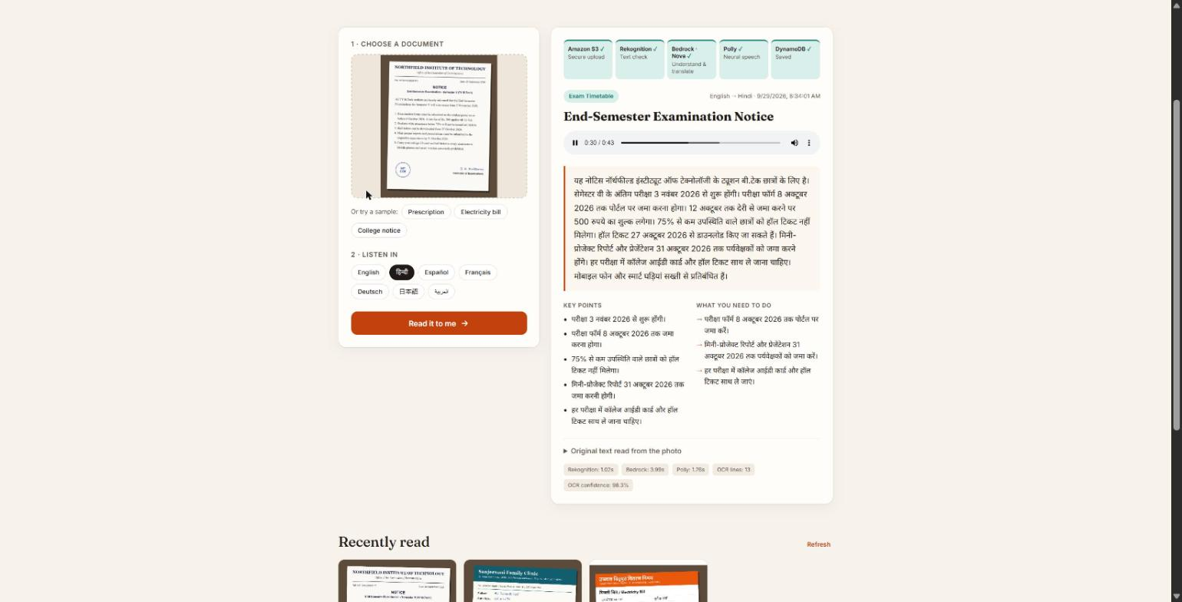
Demo: English notice → Hindi speech
Document type detected: exam notice
Summary written and spoken in Hindi by Polly (Kajal, neural)
Key points and action items with deadlines
All five pipeline stages complete
OCR confidence 98.3%
VaaniSetu · CAP 303 Mini-Project · 8
Notes:
Live demo: choose the college notice sample, select Hindi and click 'Read it to me'. The tracker lights up S3, Rekognition, Bedrock, Polly and DynamoDB, and the Hindi audio plays automatically.

Slide 9
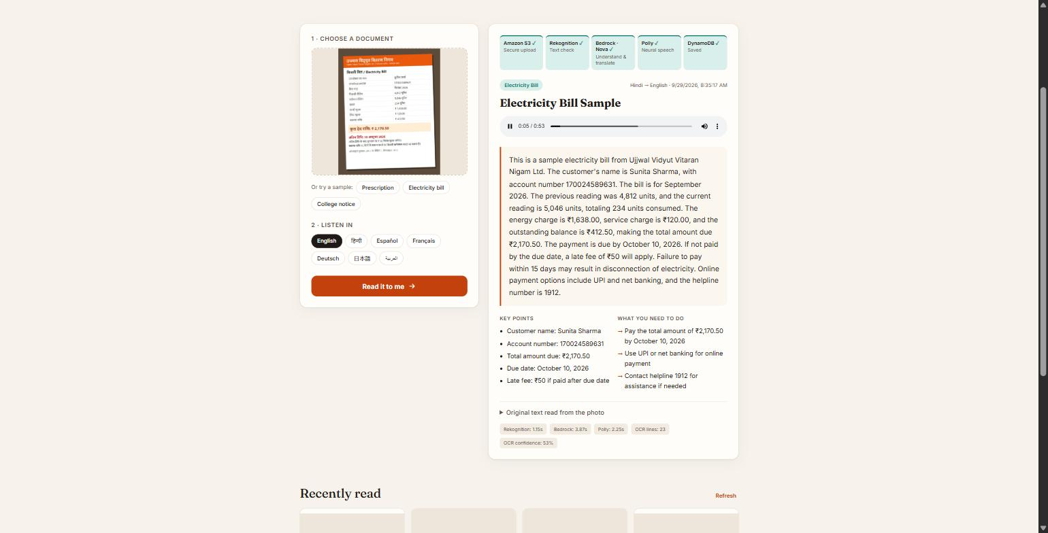
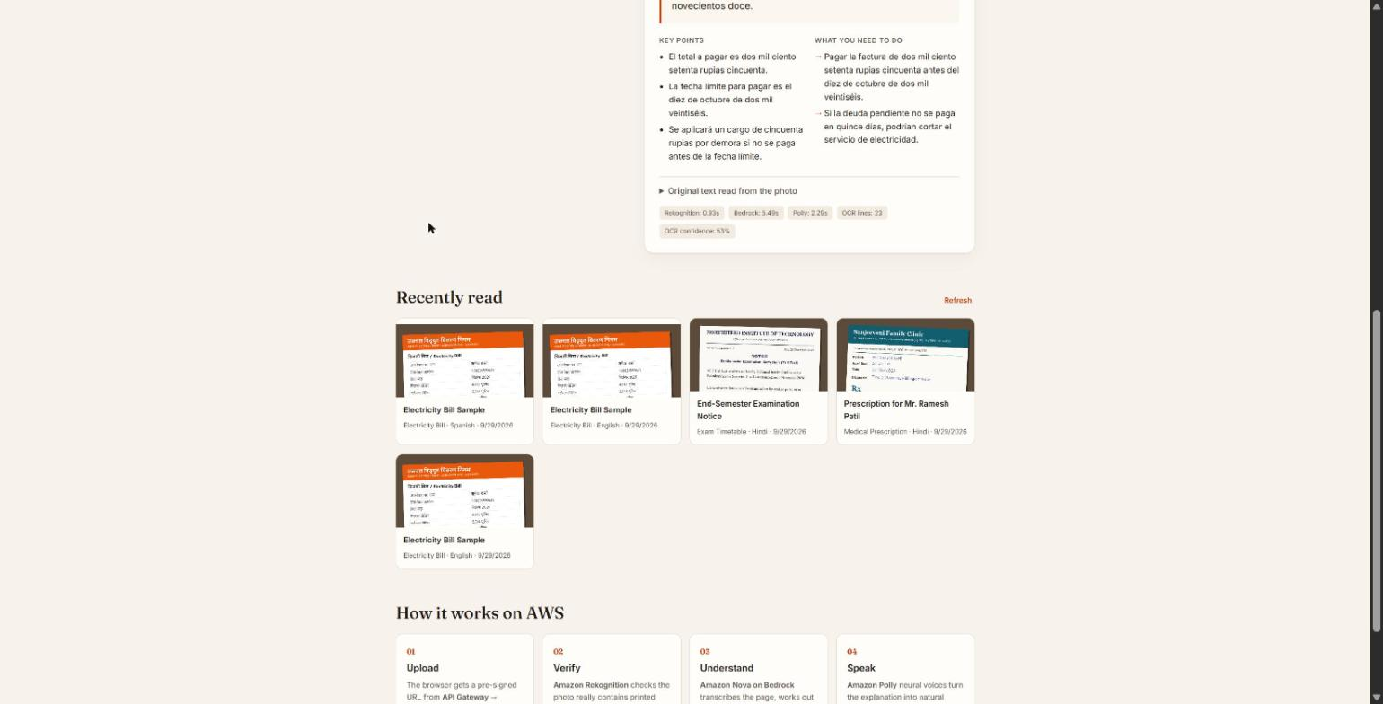
Demo: Hindi bill → English, and history
A bill printed in Hindi is explained in English: amount due ₹2,170.50, due date 10 October 2026, late fee ₹50.
Every result is saved in DynamoDB. Tapping a card replays the explanation and audio.
VaaniSetu · CAP 303 Mini-Project · 9
Notes:
This shows cross-language understanding: the input is Hindi and the output is English. Rekognition cannot read Devanagari, so its confidence is low here, but the Bedrock model reads Hindi correctly. That is exactly why Rekognition is used only as a gate.

Slide 10
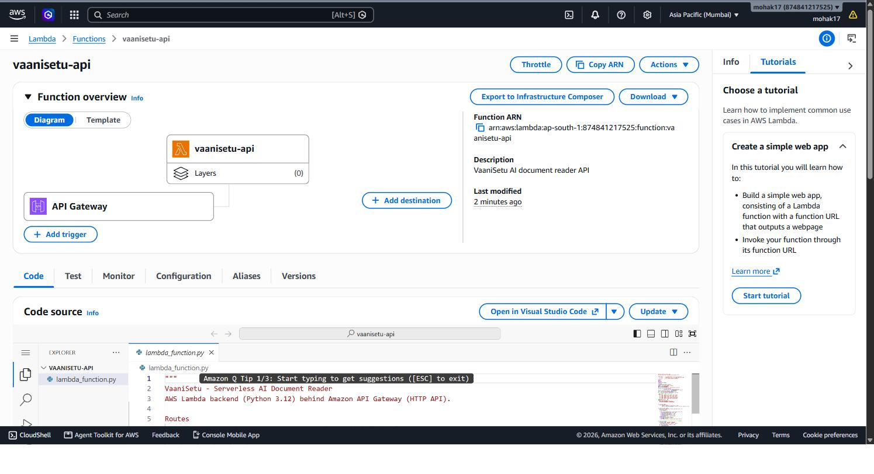
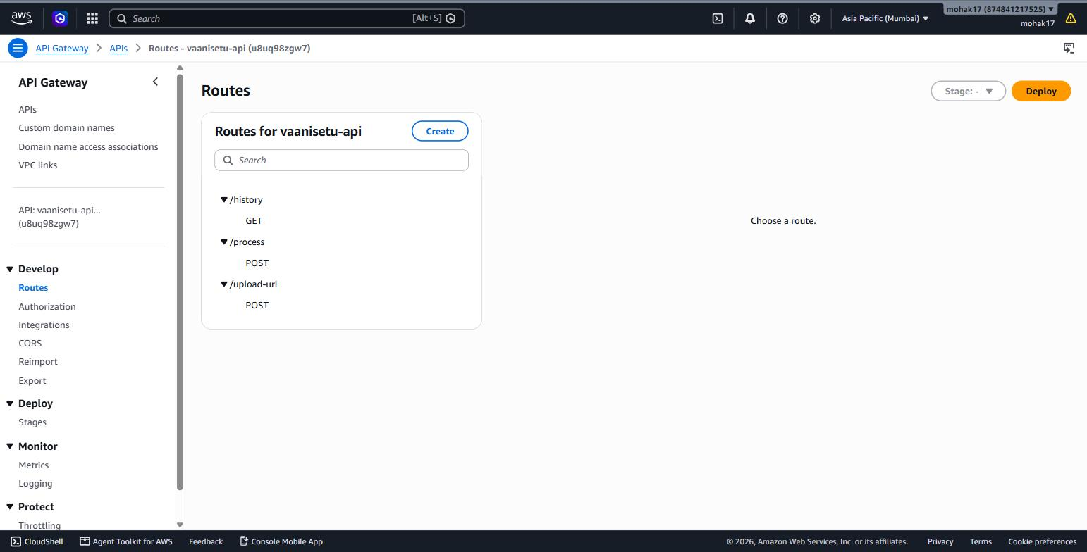
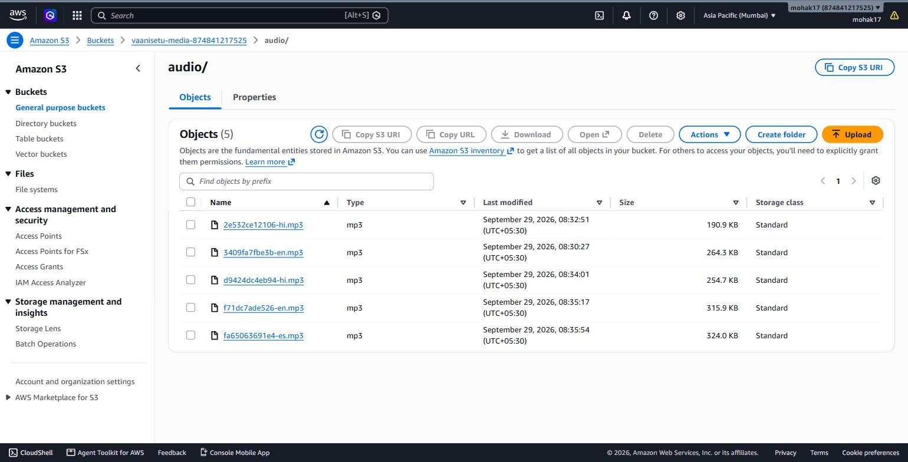
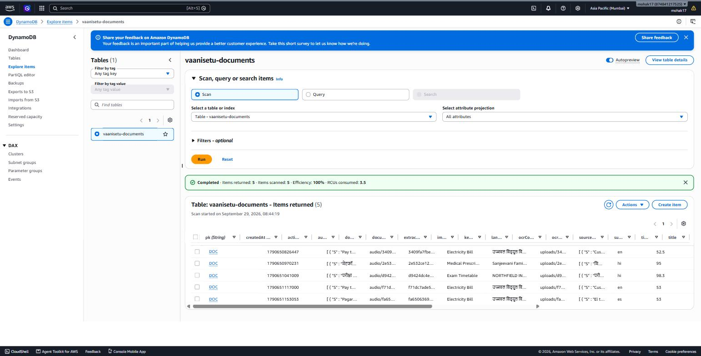
Deployed on AWS (ap-south-1)
Lambda: vaanisetu-api
API Gateway routes
S3: Polly MP3 files
DynamoDB items
VaaniSetu · CAP 303 Mini-Project · 10
Notes:
These are AWS Console screenshots of the real deployment: the Lambda function with its API Gateway trigger, the three HTTP routes, the audio files Polly generated in S3, and the stored records in DynamoDB.

Slide 11
Performance at a glance
Measured per document during testing
~1 s
~4 s
~2 s
~10 s
Rekognition text check
Bedrock understanding
Polly neural speech
Photo to speech, end to end
7
output languages
10
AWS services
₹0
cost while idle
VaaniSetu · CAP 303 Mini-Project · 11
Notes:
Timings come from the Lambda's own measurements, which are shown in the app under each result. The whole pipeline fits comfortably inside API Gateway's 29-second limit. Because everything is pay-per-use, the app costs nothing when nobody is using it.

Slide 12






Security & cost by design
Private storage
Pre-signed URLs
S3 public access blocked, SSE-S3 encryption at rest, uploads expire after 30 days
Browser gets 5-minute upload and 1-hour download links, never AWS keys
Least privilege
Throttling
Lambda role may only use one bucket, one table, and the exact AI actions
API Gateway limits 10 req/s (burst 20) to protect the budget
Cost gate
Serverless
Rekognition blocks non-document photos before any AI charge
No servers to patch; pay only per request
VaaniSetu · CAP 303 Mini-Project · 12
Notes:
Security was a design goal from the start. The browser never holds AWS credentials; it only receives short-lived pre-signed URLs. The IAM policy is scoped to specific resources. Throttling and the Rekognition gate protect the budget.

Slide 13
Challenges we solved
Challenge
How we solved it
Textract, Translate & Comprehend blocked on the AWS Free plan
One multimodal Bedrock model reads, translates and summarises in a single call
CloudFront needs account verification for new accounts
Hosted the frontend on AWS Amplify Hosting (HTTPS + CDN)
Rekognition reads Latin script only
Used as a fast "is there text?" gate; Bedrock handles Hindi and other scripts
API Gateway's 29-second limit
Direct-to-S3 uploads and a pipeline that finishes in about 10 seconds
VaaniSetu · CAP 303 Mini-Project · 13
Notes:
Real-world constraints shaped the design. The original plan used Textract, Translate and Comprehend, but the Free-plan account blocks them, so we used a multimodal Bedrock model instead. It turned out simpler and handles more languages.

Slide 14
Conclusion & future scope
What we achieved
What comes next
A working, deployed serverless app that turns any document photo into spoken guidance
8 core AWS services + IAM and CloudWatch, integrated end to end
Secure, cheap to run, and deployed with one script
Multi-page PDFs with SQS / Step Functions
More Indian-language voices and a spoken Q&A mode
Private per-user history with Amazon Cognito
WhatsApp / IVR channel for feature phones
Live: main.dubqxztshiysh.amplifyapp.com · Code: github.com/17mohak/vaanisetu
Notes:
Summarise the achievement and the roadmap, then offer the live URL for anyone who wants to try it.

Slide 15
Thank you
Questions? · प्रश्न?
Notes:
Invite questions. Likely viva topics: why serverless, pre-signed URLs, how IAM least privilege works, why Rekognition runs before Bedrock, and what happens if Bedrock returns malformed JSON.

