Slide 1
Internet Systems Programming Project
A client management system by Matthew Dray, Trevor LaBoe, and John Jeffery
Notes:
Make a five-minute presentation and demo of your project during the week of Monday, November 23, 2020. (5% of the total score). Your PPT needs only about five pages: title of your project with the names of group members, diagrams of system design, implementation tools, issues encountered and conclusions.

Slide 2
Client Management
Contains information in regards to project management, including tables for each project, the clients that commissioned the projects, contacts, and various other details to assist in project development.
Utilizes the following languages in the tech stack:
PHP backend
MySQL databasing
HTML web page
CSS web page styling
JS frontend

Slide 3

System Design
The back end utilizes the MVC architecture with PHP and MySQL. The MVC model divides the back end into three components: Model, View, and Controller.
The front end utilizes html, css, and js

Slide 4
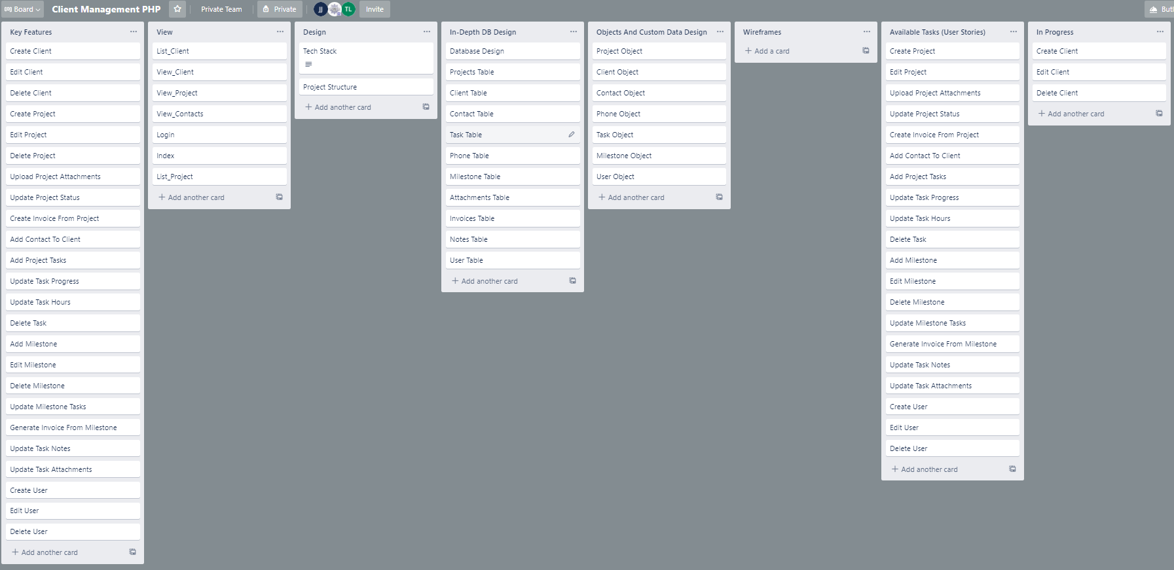
Implementation Tools
Features and user stories for the project were first determined using the website Trello
The backend was constructed with php mvc design
The front end was implemented with various js libraries and utilities such as Node.js, React, Bootstrap, etc
The entire program is compiled and ran using Yarn

Slide 5
Issues & Conclusions
Some issues encountered were installation of modules and software, and some bugs that were patched with the databases, css modals, and javascript events.
Overall, while some features were cut due to complexity or time constraints, the project functions as intended and demonstrates the fundamentals of internet systems programming.

