Slide 1
Parallel Dual Population Genetic Algorithm for solving 0/1 Knapsack Problem
Proposed By:-
Shashank Jaiswal - 171IT239
Akshay Khatri - 171IT206

Slide 2
Abstract:
Dual Population Genetic Algorithm is an effective optimization algorithm that provides additional diversity to the main population. It deals with the premature convergence problem as well as the diversity problem associated with Genetic Algorithm. But dual population introduces additional search space that increases time required to find an optimal solution. This large scale search space problem can be easily solved efficiently using all available cores of current age multi-core processors using Parallel Environment. Results of Sequential DPGA and Parallel DPGA are compared for the 0/1 Knapsack problem on the basis of accuracy and run time.

Slide 3
Motivation:
0/1 Knapsack Problem is an NP-complete problem for which solution doesn’t exists in polynomial time.
Using Genetic Algorithm, the optimal solution for the same can be obtained in polynomial time.
DPG algorithm can be used for better convergence.
But it will increase the search space , and thus more computations are required which will increase both time and memory space.
This hurdle can be eliminated using parallel environment, which will decrease computation time and provide better convergence and more effective utilisation of resources.

Slide 4
Implementation Details:
First we will write sequential 0/1 Knapsack problem using Genetic Algorithm.
Then we will identify parallelism in above algorithm.
We will use parallel environment constructs for task and data sharing.
As Fitness Evaluation of each individual is an independent step , it can be executed in parallel. Parallel environment directives will be used to create multiple threads. These threads will evaluate each individual’s fitness separately.
Better convergence to the optimal solution of the problem is achieved using DPG algorithm.

Slide 5
Implementation Strategy
Genetic Algorithm:
[Start] Generate random population of n chromosomes (suitable solutions for the problem)
[Fitness] Evaluate the fitness f(x) of each chromosome x in the population
[New population] Create a new population by repeating following steps until the new population is complete
[Selection] Select two parent chromosomes from a population according to their fitness (the better fitness, the bigger chance to be selected)
[Crossover] With a crossover probability cross over the parents to form a new offspring (children). If no crossover was performed, offspring is an exact copy of parents
[Mutation] With a mutation probability mutate new offspring at each locus (position in chromosome)
[Accepting] Place new offspring in a new population
[Replace] Use new generated population for a further run of algorithm
[Test] If the end condition is satisfied, stop, and return the best solution in current population
[Loop] Go to step 2

Slide 6
Dual Population Genetic Algorithm:
The working is same as Genetic Algorithm.
Here, we have initialized two population, namely general population and reserve population.
Reserve population also follows the same procedure as followed by general population in Genetic Algorithm.
Reserve population is used for crossbreeding with general population.
In crossbreeding, best chromosomes from both the populations are taken and merged to form a new population.
Rest all steps are same as Genetic Algorithm.

Slide 7
Parallelisation of Dual Population Genetic Algorithm:
This code is implemented in Python.
concurrent.futures library has been used for parallelising the code.
Parallelising components:-
General Population and Reserve population can be initialized and updated parallely.
General Population fitness and Reserve population fitness can be initialised and updated parallely.
Data Sharing:-
Reserver fitness and normal fitness
Reserve population and normal population

Slide 8
RESULTS
DPGA has better convergence to optimal solution than the Genetic Algorithm.
The parallel DPGA algorithm takes lesser time than the serial version and offers the same convergence.
Proposed Parallel Algorithm would give a solution of problem close to the optimal solution obtained as a result of sequential algorithm.

Slide 9
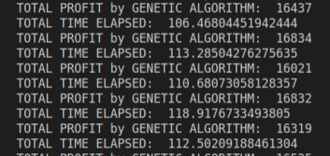
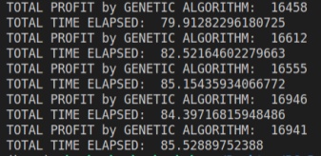
Outputs Screenshots:-
Output as given by DPGA Output as given by Parallel DPGA

Slide 10
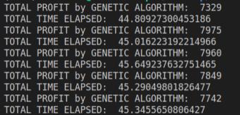
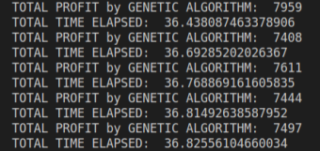
Output as given by DPGA Output as given by Parallel DPGA

Slide 11


Output as given by GA Output as given by Parallel DPGA

Slide 12
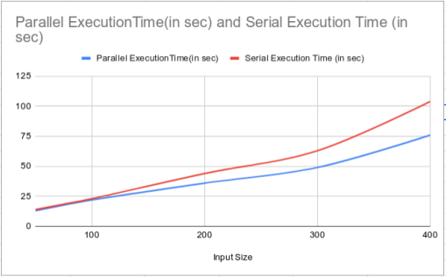
Graphs
Keeping Population size fixed at 300

Slide 13
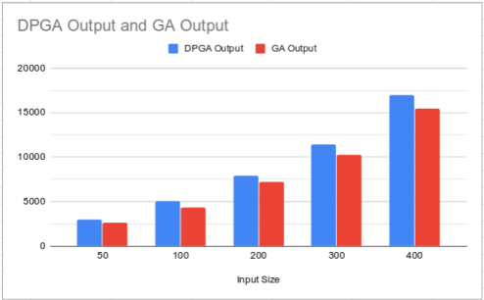
Max Weight of Sack for each input : { 1000, 1500, 2000, 3500, 5000 }

Slide 14
Team Load Distribution
Team Member 1:-
Genetic Algorithm
Writing Serial code of above problem
Finding Concurrency in above problem
Team Member 2:-
DPG Algorithm
Task Parallelism in fitness evaluation of individuals
Writing Parallel Code for above problem

Slide 15
REFERENCES
https://ieeexplore.ieee.org/document/6013975
https://ieeexplore.ieee.org/document/6047101
https://www.researchgate.net/figure/Speed-up-and-efficiency-achieved-by-OpenMP-DPGA_tbl4_273310889

