Slide 1

Roza mubarak ☺
FOSE

Slide 2
Software Quality Engineering Road Map
Quality Engineering at every SDLC phase:
Quality Engineering
Requirement Analysis
Design
Code
Testing
QA
Deployment
QC

Slide 3
What is an Error?
Error is usually refer to some syntax mistake by developer.
Refer to both Syntax and semantic error.
Syntax error are usually fixed by developer.
Semantic error give rise to unusual output.

Slide 4
What is Defect?
Defect is deviation from customer requirement.
Mostly defects are found in the software after software is shipped to the customer at production site.
Example:
In online shopping, the option of searching a debit card for making payment is missing.

Slide 5
What is Bug?
Error found before the software is shipped into production.
“Defects” accepted by developers are bugs.

Slide 6
What is Fault?
Fault is a result of error.
Fault is an incorrect step or process due to which unanticipated result arises.

Slide 7
What is Failure?
Failure is a result of faults.
Failure is inability of the program to behave as expected within given performance requirement.

Slide 8
Testing
According to ANSI/IEEE 1059 standard, Testing can be defined as - A process of analyzing a software item to detect the differences between existing and required conditions (that is defects/errors/bugs) and to evaluate the features of the software item.

Slide 9
Who does Testing?
It depends on the process and the associated stakeholders of the project(s). In the IT industry, large companies have a team with responsibilities to evaluate the developed software in context of the given requirements. Moreover, developers also conduct testing which is called Unit Testing. In most cases, the following professionals are involved in testing a system within their respective capacities:
Software Tester
Software Developer
Project Lead/Manager
End User (how…………… ?)
Notes:
User Acceptance Testing (UAT), involves testing the software from a user's perspective or by end users.
9

Slide 10
When to Start Testing?
Testing is done in different forms at every phase of SDLC:
During the requirement gathering phase, the analysis and verification of requirements are also considered as testing.
Reviewing the design in the design phase with the intent to improve the design is also considered as testing.
Testing performed by a developer on completion of the code is also categorized as testing.
Notes:
An early start to testing reduces the cost and time to rework and produce error-free software that is delivered to the client. However in Software Development Life Cycle (SDLC), testing can be started from the Requirements Gathering phase and continued till the deployment of the software. It also depends on the development model that is being used. For example, in the Waterfall model, formal testing is conducted in the testing phase; but in the incremental model, testing is performed at the end of every increment/iteration and the whole application is tested at the end.
10

Slide 11
When to Stop Testing?
It is difficult to determine when to stop testing, as testing is a never-ending process and no one can claim that a software is 100% tested. The following aspects are to be considered for stopping the testing process:
Testing Deadlines
Completion of test case execution
Completion of functional and code coverage to a certain point
Bug rate falls below a certain level and no high-priority bugs are identified
Management decision

Slide 12
Functional coverage refers to the extent to which the software has been tested to ensure that it meets its intended functionality or requirements.
Code coverage, on the other hand, refers to the percentage of code that has been tested through automated testing or other methods.
It's important to note that achieving complete functional and code coverage is often difficult or even impossible, particularly for large or complex software projects. Instead, testing efforts typically focus on testing the most critical and high-risk parts of the code, while acknowledging that some areas may remain untested or under-tested.

Slide 13
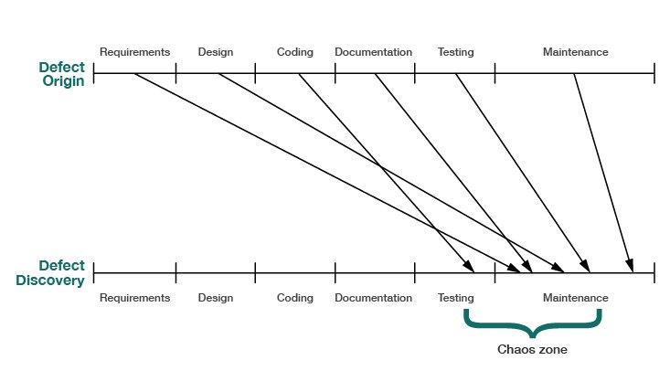

Slide 14
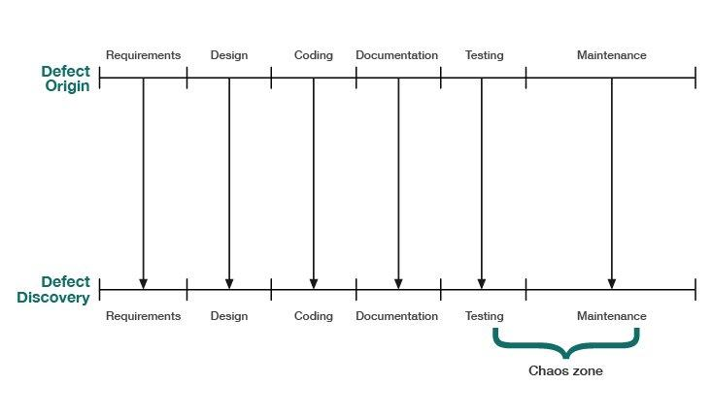

Slide 15
Our objective with Inspections is to reduce the Cost of Quality by finding and removing defects earlier and at a lower cost.

Slide 16
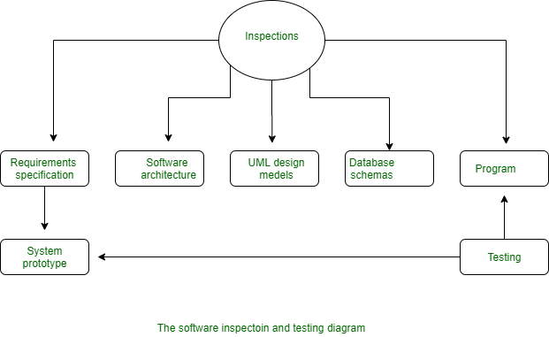

Slide 17
Requirements, architecture, design documents………
Cannot “execute” these as a test

Slide 18
Verification | Validation
Verification addresses the concern: "Are you building it right?" | Validation addresses the concern: "Are you building the right thing?"
Ensures that the software system meets all the functionality. | Ensures that the functionalities meet the intended behavior.
Verification takes place first and includes the checking for documentation, code, etc. | Validation occurs after verification and mainly involves the checking of the overall product.
Done by developers. | Done by testers.
It has static activities, as it includes collecting reviews, walkthroughs, and inspections to verify a software. | It has dynamic activities, as it includes executing the software against the requirements.

Slide 19
QA vs QC vs Testing
QA , QC already discussed
QC vs Testing ?
They can be considered as same activities, but there exist distinguishing points that set them apart.
QC | Testing
It is a corrective process. | It is a preventive process.
QC can be considered as the subset of Quality Assurance. | Testing is the subset of Quality Control.
Notes:
Testing can be considered a preventive approach in quality control when it is integrated into the early stages of the production or development process.
By testing early in the process, potential defects or issues can be identified before they become major problems. This allows for corrective actions to be taken promptly, preventing further complications down the line

Slide 20
Software testing strategies (basic level)
■ To test the software in its entirety, once the completed package is available; otherwise known as “big bang testing”.
■ To test the software piecemeal, in modules, as they are completed (unit tests); then to test groups of tested modules integrated with newly completed modules (integration tests). This process continues until all the package modules have been tested. Once this phase is completed, the entire package is tested as a whole (system test). This testing strategy is usually termed “incremental testing”

Slide 21
Bottom-up and top-down
Incremental testing is also performed according to two basic strategies: bottom-up and top-down. Both incremental testing strategies assume that the software package is constructed of a hierarchy of software modules.
In top-down testing, the first module tested is the main module, the highest level module in the software structure; the last modules to be tested are the lowest level modules.
In bottom-up testing, the order of testing is reversed: the lowest level modules are tested first, with the main module tested last.

Slide 22
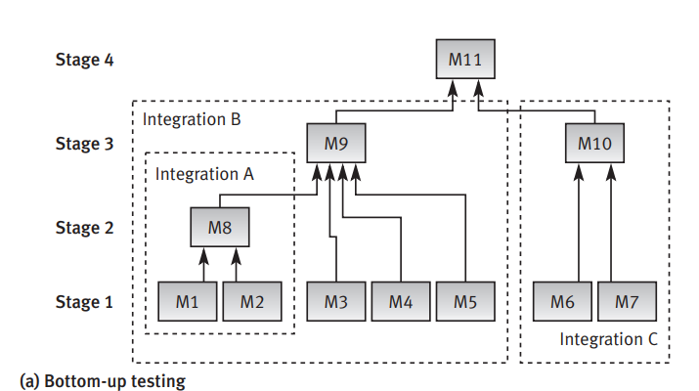

Slide 23
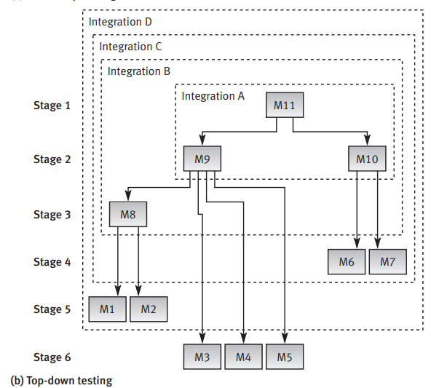

Slide 24
Another way to classify
Breadth first testing: This testing strategy involves testing all the features of a system at a high level, then going back and testing each feature in more detail. This means that all the features of the system are tested at a similar level of depth before moving on to the next feature.
The main advantage of this approach is that it ensures that all the features of the system are tested, and any major issues are caught early on.

Slide 25
Depth first testing: In this approach, one feature or component of the system is tested in detail before moving on to the next one. This means that the tester spends more time testing a particular feature or component, and moves on to the next one only after they are satisfied that the current feature is working as expected.
The main advantage of this approach is that it allows the tester to focus on the details of each feature, and uncover any subtle issues that might be missed in a higher-level test.

Slide 26
Classification according to testing concept
■ Black box (functionality) testing. Identifies bugs only according to software malfunctioning as they are revealed in its erroneous outputs. In cases that the outputs are found to be correct, black box testing disregards the internal path of calculations and processing performed.
■ White box (structural) testing. Examines internal calculation paths in order to identify bugs. Although the term “white” is meant to emphasize the contrast between this method and black box testing, the method’s other name – “glass box testing” – better expresses its basic characteristic, that of investigating the correctness of code structure

