Slide 2



Welcome to
Fundamentals of Software Engineering
Taught by :
Muhammad Umer Haroon
You can follow me at
www.linkedin.com/in/engrmuh/
السلام
عليكم

Slide 3




ENGR. MUHAMMAD UMER HAROON
SOFTWARE ENGINEERING

Slide 4
Testing
According to ANSI/IEEE 1059 standard, Testing can be defined as - A process of analyzing a software item to detect the differences between existing and required conditions (that is defects/errors/bugs) and to evaluate the features of the software item.

Slide 5
Who does Testing?
It depends on the process and the associated stakeholders of the project(s). In the IT industry, large companies have a team with responsibilities to evaluate the developed software in context of the given requirements. Moreover, developers also conduct testing which is called Unit Testing. In most cases, the following professionals are involved in testing a system within their respective capacities:
Software Tester
Software Developer
Project Lead/Manager
End User (how…………… ?)

Slide 6
When to Start Testing?
Testing is done in different forms at every phase of SDLC:
During the requirement gathering phase, the analysis and verification of requirements are also considered as testing.
Reviewing the design in the design phase with the intent to improve the design is also considered as testing.
Testing performed by a developer on completion of the code is also categorized as testing.

Slide 7
When to Stop Testing?
It is difficult to determine when to stop testing, as testing is a never-ending process and no one can claim that a software is 100% tested. The following aspects are to be considered for stopping the testing process:
Testing Deadlines
Completion of test case execution
Completion of functional and code coverage to a certain point
Bug rate falls below a certain level and no high-priority bugs are identified
Management decision

Slide 8
Functional coverage refers to the extent to which the software has been tested to ensure that it meets its intended functionality or requirements.
Code coverage, on the other hand, refers to the percentage of code that has been tested through automated testing or other methods.
It's important to note that achieving complete functional and code coverage is often difficult or even impossible, particularly for large or complex software projects. Instead, testing efforts typically focus on testing the most critical and high-risk parts of the code, while acknowledging that some areas may remain untested or under-tested.

Slide 9
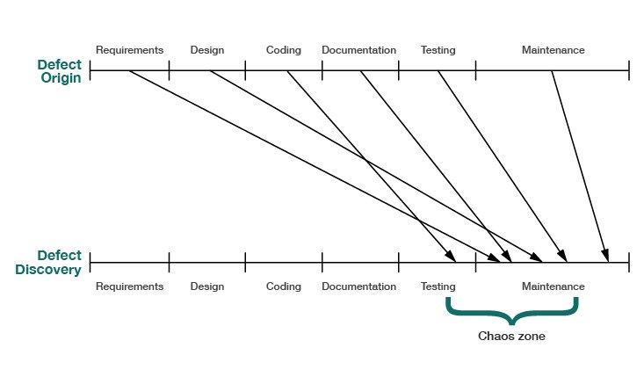

Slide 10
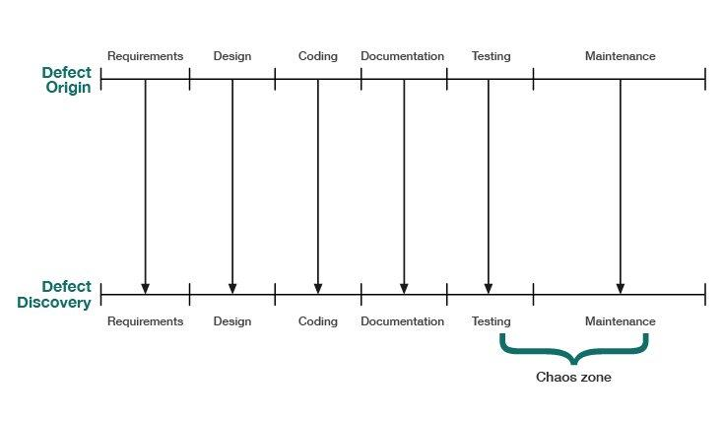
Our objective with Inspections is to reduce the Cost of Quality by finding and removing defects earlier and at a lower cost.

Slide 11
Types of black box testing
Functional testing
System testing
End-to-end testing
Sanity testing
Regression testing
Acceptance testing
Load testing
Stress testing
Install/uninstall testing
Recovery testing
Compatibility testing
Comparison testing
Alpha testing
Beta testing
Mutation testing

Slide 12
Checking login functionality
Functional testing is a type of software testing that verifies that each function of the software application operates in conformance with the requirement specification. It focuses on what the software does .
Functional testing
Black box type testing geared to functional requirements of an application.
System testing
Black box type testing that is based on overall requirements specifications; covering all combined parts of the system.
End-to-end testing
Similar to system testing; involves testing of a complete application environment in a situation that mimics real-world use.
End to End testing is testing the application from start to finish. I.e. a complete flow that a user would be expected to do.
Integration testing is testing a group of components together as a single item.
System testing is testing the system as a whole against the requirements.
Testing the entire process of booking a flight ticket online
End-to-end testing is performed after system testing and before acceptance testing.
Notes:
System testing is performed on a complete system while integration testing is performed on a subset of the system
System testing checks the behaviors of the system as a whole while integration testing checks the data transferring among multiple modules of the system
It is the level of testing where the complete integrated application is tested as a whole.
It aims at determining if the application conforms to its business requirements.
System testing is carried out in an environment that is very similar to the production environment.
Integration testing can be both black box and white box
12

Slide 13
Sanity testing
Initial effort to determine if a new software version is performing well enough to accept it for a major testing effort.
Regression testing
Re-testing after fixes or modifications of the software or its environment.
Acceptance testing
Final testing based on specifications of the end-user or customer.
Sanity Testing is a type of software testing that is performed after receiving a software build. The goal is to determine that the proposed functionality works approximately as expected.
Regression testing is a software testing practice that ensures an application still functions as expected after any code changes, updates, or improvements. Regression testing is responsible for the overall stability and functionality of the existing features
Notes:
Sanity testing ensures that the software is ready for the next level of testing.
13

Slide 14
Load testing
Testing an application under heavy loads.
Eg. Testing of a web site under a range of loads to determine, when the system response time degraded or fails.
Stress Testing
Testing under unusually heavy loads, heavy repetition of certain actions or inputs, input of large numerical values, large complex queries to a database etc.
Term often used interchangeably with ‘load’ and ‘performance’ testing.
Performance testing
Testing how well an application complies to performance requirements
Testing the app with maximum number of user and input is defined as load testing. While testing the app with more than maximum number of user and input is defined as stress testing.
Load is beyond the expected threshold.
Notes:
Performance testing is a type of software testing that is used to test the speed, response time, stability, reliability, scalability, and resource usage of a software application under a particular workload. The main purpose of performance testing is to identify and eliminate the performance bottlenecks in the software application
14

Slide 15
Install/uninstall testing
Testing of full, partial or upgrade install/uninstall process.
Recovery testing
Testing how well a system recovers from crashes, HW failures or other problems.
Compatibility testing
Testing how well software performs in a particular HW/SW/OS/NW environment.
Comparison testing
Comparing SW strengths and weakness to competing products.
Recovery testing is a type of system testing which aims at testing whether a system can recover from failures or not. The technique involves failing the system and then verifying that the system recovery is performed properly. Recovery testing is important to perform to ensure that a system is fault-tolerant and can recover well from failures
Printing software ….

Slide 16
Alpha testing
Testing done when development is nearing completion; minor design changes may still be made as a result of such testing.
Beta-testing
Testing when development and testing are essentially completed and final bugs and problems need to be found before release.
Mutation testing
To determining if a set of test data or test cases is useful, by deliberately introducing various bugs.
Re-testing with the original test data/cases to determine if the bugs are detected.
. Beta testing is performed by a group of external users who are not part of the development team and who use the software in a real-world environment. The main goal of beta testing is to identify any remaining defects or issues with the software that were not discovered during the internal testing phase. The feedback obtained from the beta testers can be used to make any necessary changes or improvements to the software before its final release.
Mutation testing is a type of software testing technique that is used to evaluate the effectiveness of a software testing process. It involves introducing small, deliberate changes (known as "mutations") into the code to see if the existing tests can detect these changes. The main goal of mutation testing is to identify weaknesses in the test suite by evaluating how well it can detect these changes.

Slide 18
Test Case
A test case is a specific set of inputs, expected results, and execution conditions designed to test a particular aspect of a software application. It is the smallest unit of testing.(not unit testing).

Slide 19
Components of a Test Case
Test Case ID: Unique identifier for the test case.
Objective: Clearly states what is being tested.
Preconditions: Conditions that must be met before executing the test.
Steps: Detailed actions to perform during the test.
Expected Results: What should happen if the test passes

Slide 20
Example , steps missing
Test Case ID | TC04
Use Case Ref. | UC04
Test Date | Dec 01, 2021
Objective | To test the process of updating marriage status and broadcasting the update.
Environment | Web-based Application
Assumptions | System displaying current marriage status on the screen.
Pre-Requisite | User is at marriage status page.
Test Procedure | Steps to Perform | Input Data | Expected Result | Actual Result
 | Click on the update status button. | N/A | Change in marriage status has been verified. Marriage status is updated successfully and the update is broadcasted across the network. | Same as expected.
Status | Pass
Marriage Certificate Blockchain Application
Qaiser Iqbal
Umar Iqbal
Soban Nazir
Supervised By
Engr. Muhammad Umer Haroon

Slide 21
Mapping of Test Case with Use Case
Use cases describe how users interact with the system to achieve specific goals. Mapping test cases to use cases ensures that all user interactions are thoroughly tested.

