Slide 1

Northwind Traders Analysis
Team D: Makenzie Howard, Vidhi Arun Sharma, Willie Watts, Alissa Yang

Slide 2
Objective
Scope
Strategic Impact
Northwind Traders Analysis
Introduction
Extract meaningful insights from the Northwind database
Support strategic business decision-making
Employee Performance Monthly Sales Trends
Product Sales Rankings Customer Purchase Behavior
Identify opportunities to improve profit margins
Optimize resource allocation
Enhance sales strategy with data-driven insights

Slide 3
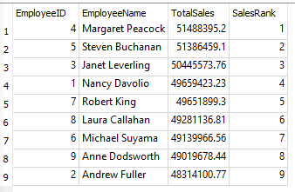
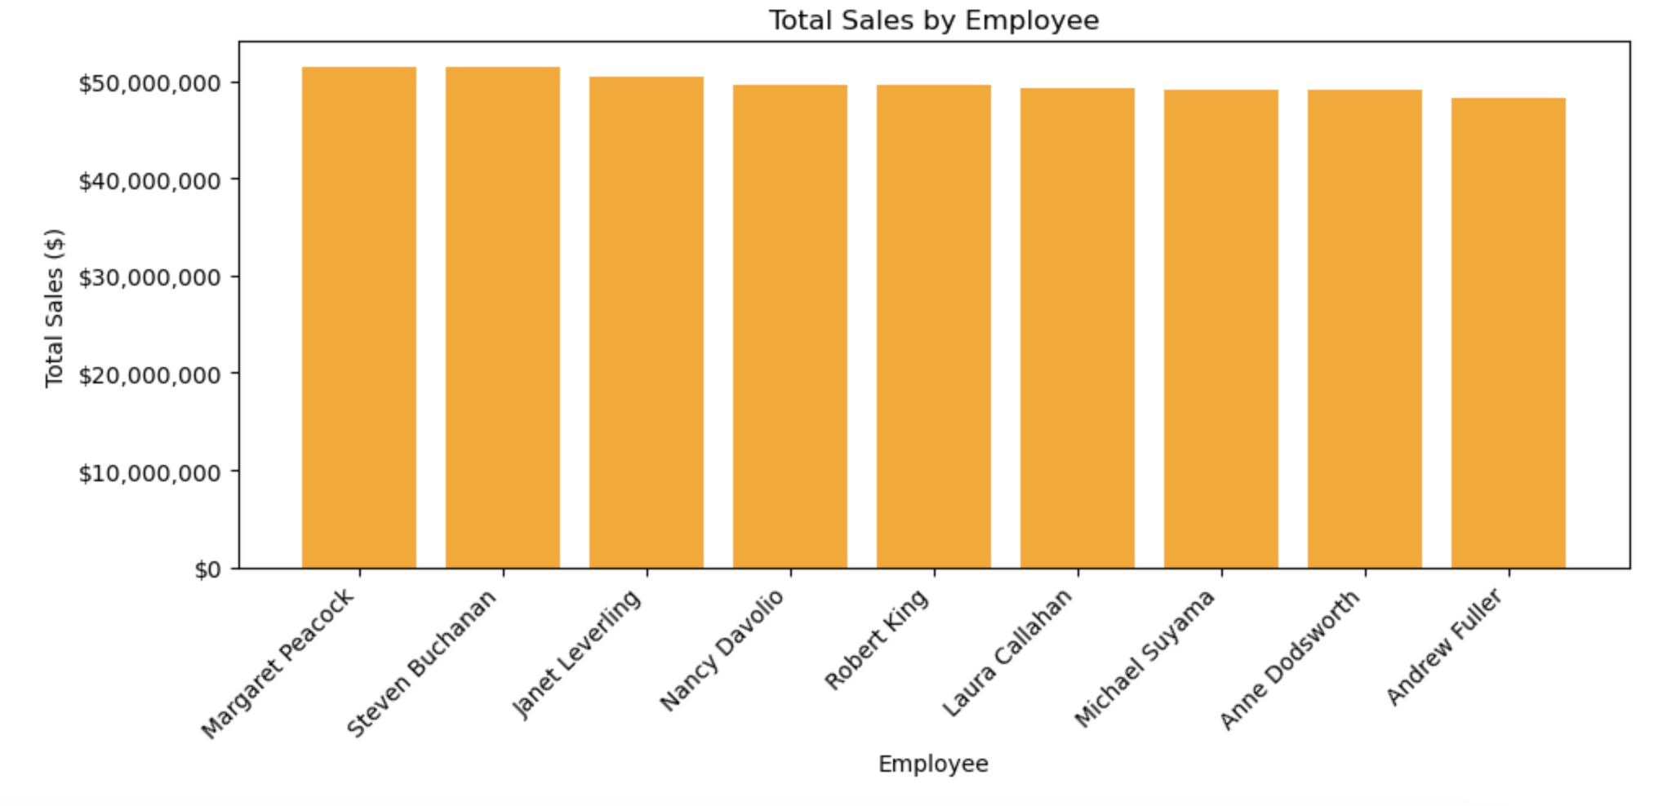
Employee Performance
Key Insights:
Sales distribution is relatively close — no extreme underperformance.
Top 2 performers are nearly tied, suggesting similar effectiveness or territory potential.
The bottom performers are not drastically behind, but small differences add up in total revenue.
No advantage or disadvantage in territory/clients/products, so slight underperformance is most likely attributed to differing sales tactics
MH

Slide 4
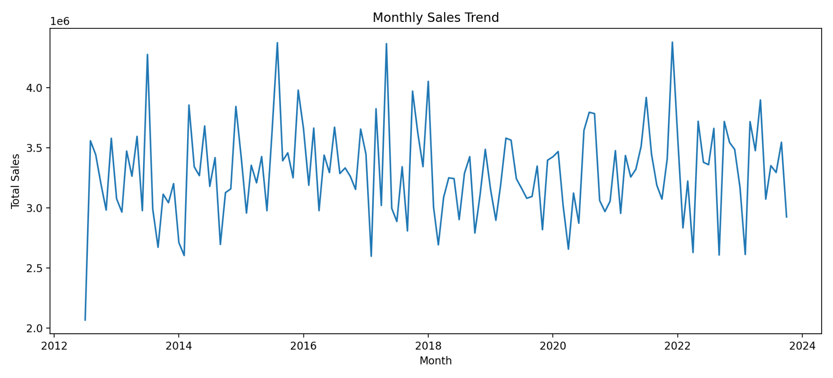
Monthly Sales Trend Analysis (SQL + Python)
Key Findings
Seasonal peaks in March, May, July, October,
November, December
MoM growth during peaks often 21%–48%
Sharp post-peak declines of 21%–31%
Recommendations
Plan inventory and staffing ahead of peak months
Launch marketing and promotions 4–6 weeks
before peaks
Use slower months for clearance sales and cross-sell
campaigns.
VS

Slide 5
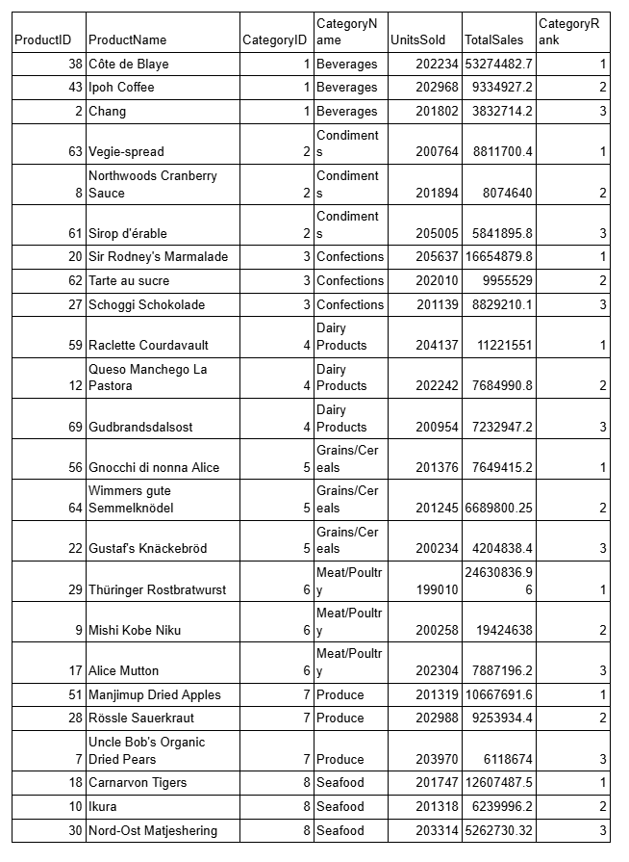
Product Sales Analysis
Objective: Identify top-selling products in each category.
Method
Calculated Total Sales per product, ranked products using RANK() in SQL.
Grouped by category and ranked with RANK() to find Top 3 products in each category.
Insights
High-priced products often lead in revenue despite lower unit sales (Premium beverages & condiments)
Pricing strategy is as critical as volume for profitability.
AY

Slide 6
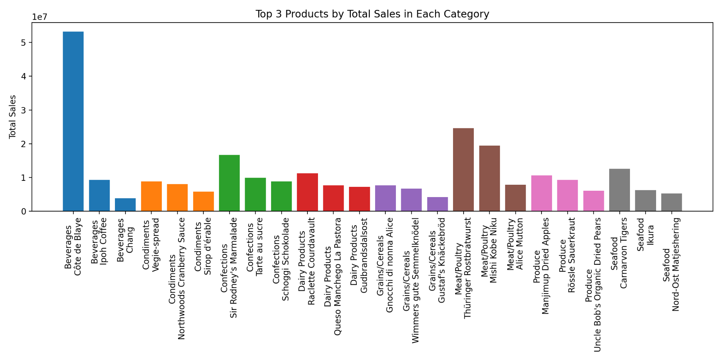
Product Sales Ranking by Category
Key Findings
High-priced items dominate
revenue despite lower unit sales
This pattern appears in most
Categories
Highlights importance of margin,
not just volume
Recommendations
Prioritise high-margin items in
promotions and marketing
Ensure adequate stock of these
products during peak months
Bundle premium products to boost
total order value
VS

Slide 7
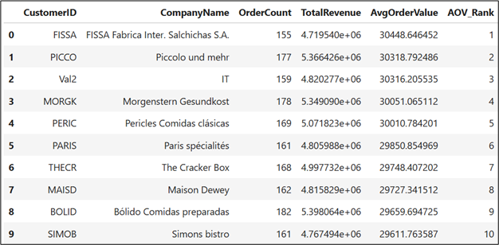
Objective: Rank customers with the highest average order value
Key Takeaway: FISSA leads in Average Order Value (AOV) but is absent from top-ten rankings for total revenue and order count
Customer Purchase Behavior Analysis
WW

Slide 8
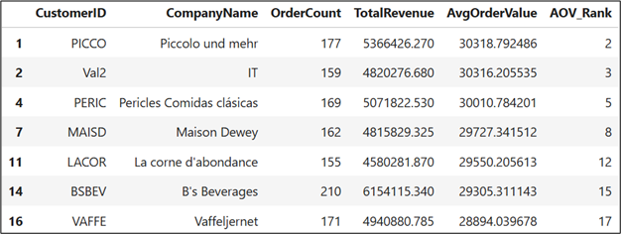
Objective: Show the customers with Ranks 2, 3, 5, 8, 12, 15, and 17
Key Takeaways: All of these customers have higher revenue and more total orders than the AOV leader, with one exception - La corne d’abondance (same total order count)
Customer Purchase Behavior Analysis
WW

Slide 9
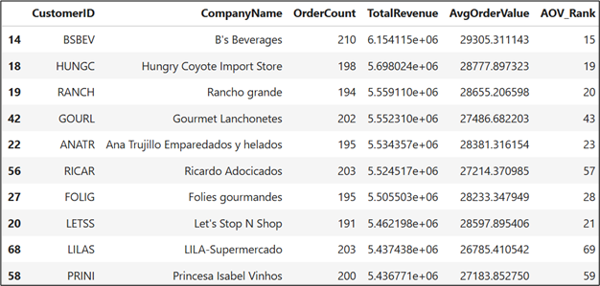
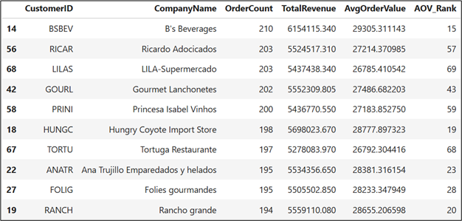
Objective: Identify Top 10 customers by revenue and order count
Key Takeaways: B’s Beverages ranks #1 in both total revenue and order count but not in Top 10 for AOV
2 distinct value segments identified - high average order value customers
2 distinct value segments identified - high revenue/high volume customers
Customer Purchase Behavior Analysis
WW

Slide 10
Actionable Takeaways
Employee Sales Performance:
Replicate top performer tactics
Incentive performance gains
Monthly Sales Trends:
Front-load marketing before peak months
Inventory planning
Smoothing post-peak slumps
Product Profitability
Prioritize high-margin items
Refine pricing strategy
Seasonal product focus
Customer Purchase Behavior
Segmented engagement strategies
Monitor segments regularly
MH

Slide 11
Conclusion/Q+A
Seasonal peaks are predictable and can be leveraged for proactive planning.
Profitability relies on both sales volume and product margin.
Customer segmentation allows precise, high-impact marketing.
Data-driven alignment of operations with demand patterns supports sustainable growth.
Thank you!
MH

